Slide 1
Wholesome Packaging Restage

Slide 2
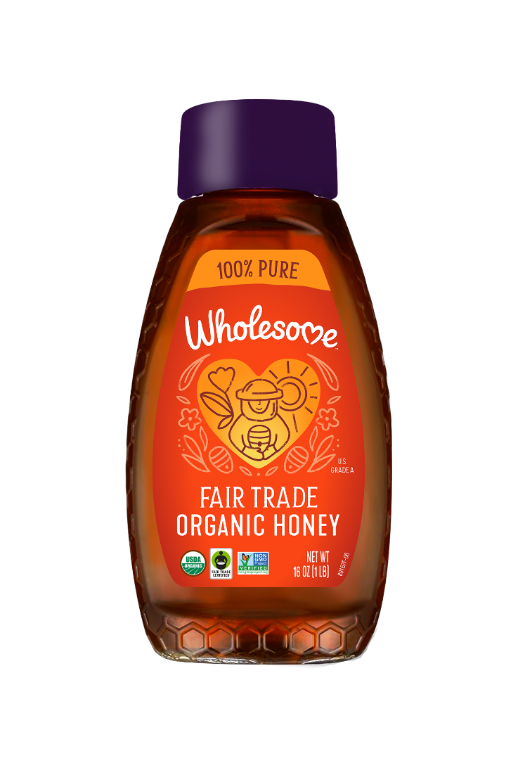
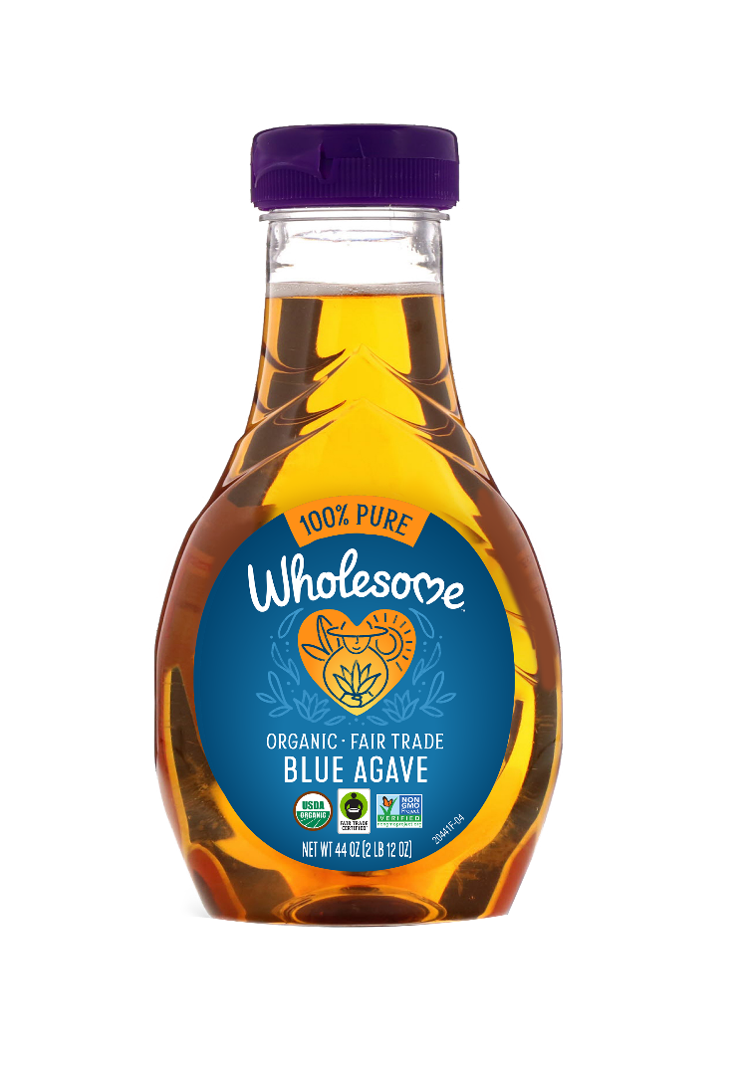
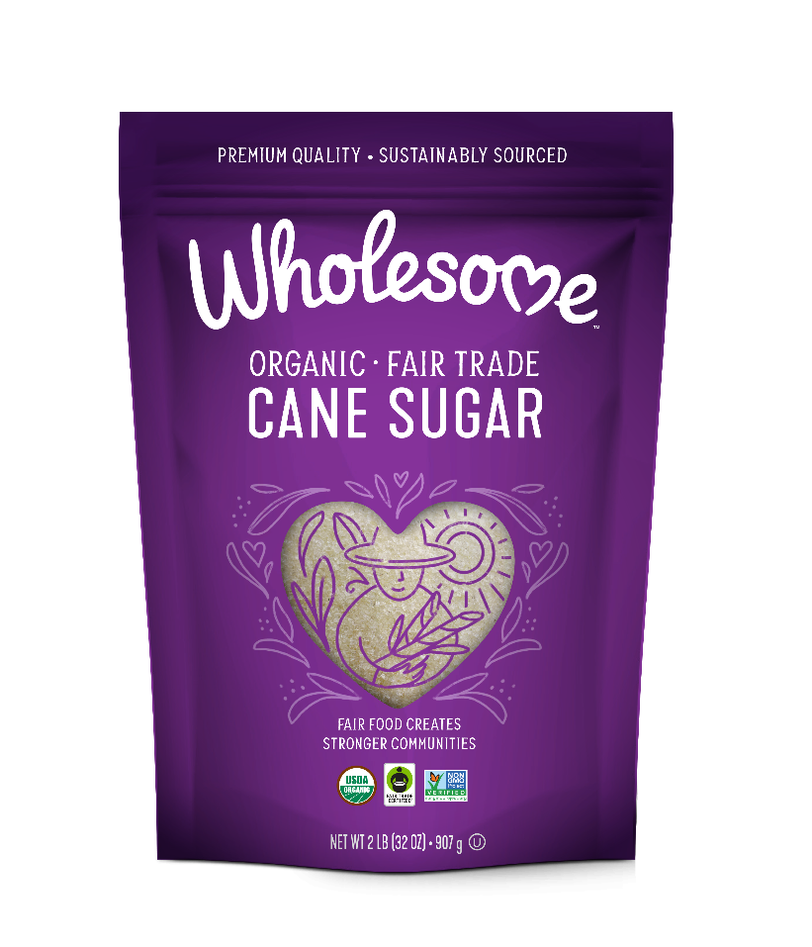
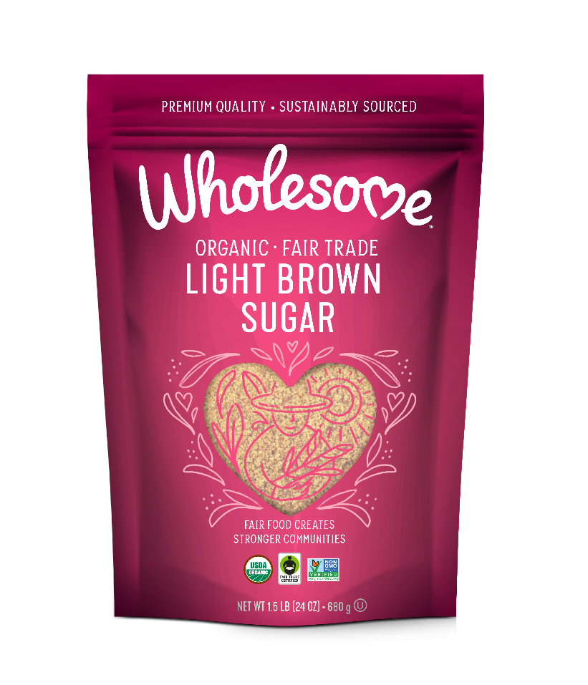
Wholesome launching new look to better reflect the brand’s premium quality and mission to positively impact farming communities
Coming Summer 2021!

Slide 3
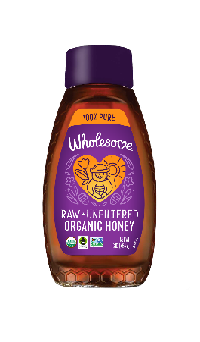
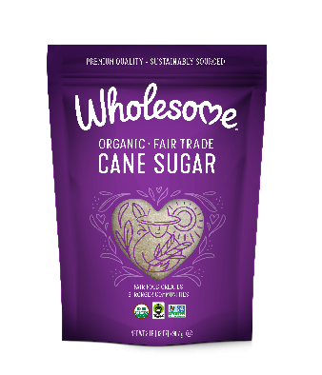
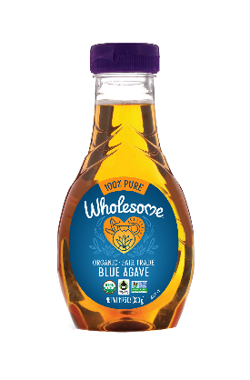
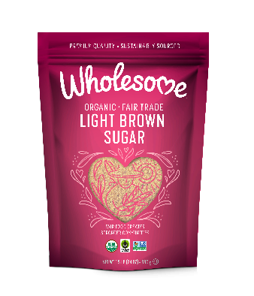
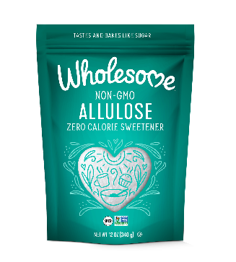
Wholesome Packaging Rollout Timeline
On Shelf Timing (Approximate)
Packaging Phase | 1st Ship | Jun | Jul | Aug | Sep | Oct | Nov | Dec | Notes
Honey | June |  |  |  |  |  |  |  | On-shelf July/Aug depending on retailer inventory levels
Agave | June |  |  |  |  |  |  |  | On-shelf July/Aug depending on retailer inventory levels
Granulated Sugar | Sep
Zero Calorie | August
Club | October
Syrups | November
Bulk | TBD
Canada | TBD
NOTE: packaging rollout is a “soft transition” (use up old prior to transition to new); Thus expect shelf to potentially have mix of old and new design for first 1-3 months

Slide 4
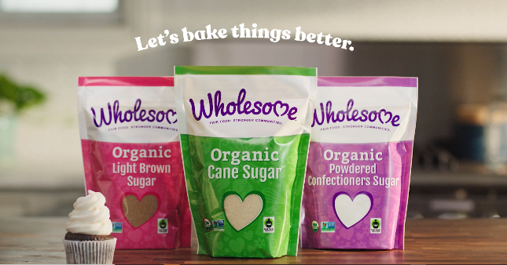
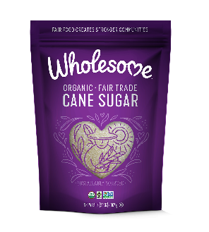
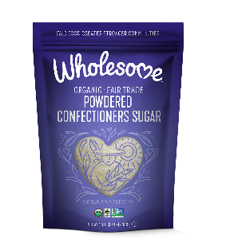

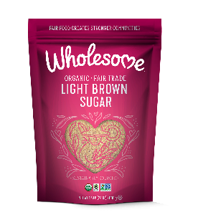

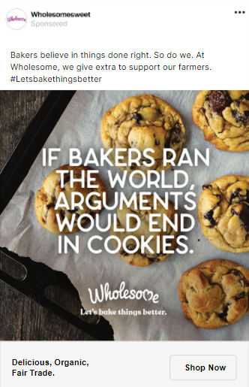
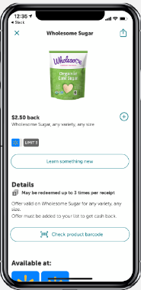
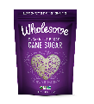
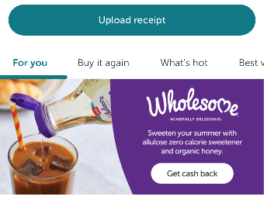
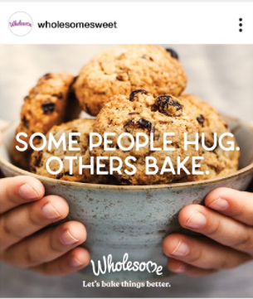

Comprehensive marketing support plan with digital and in-store communication will build awareness and help shoppers transition to new brand look and feel
Digital Awareness Campaign
National In-Store Support

Slide 5
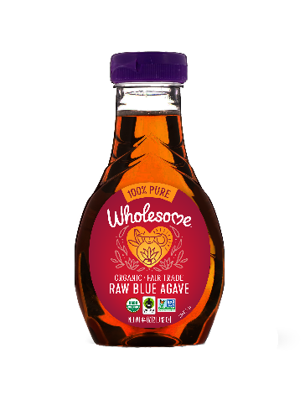

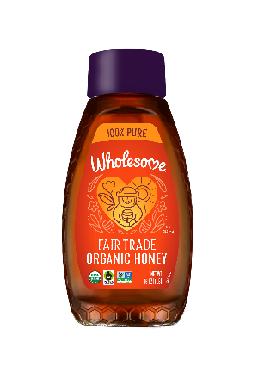
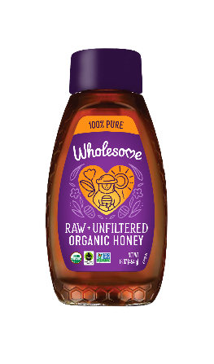
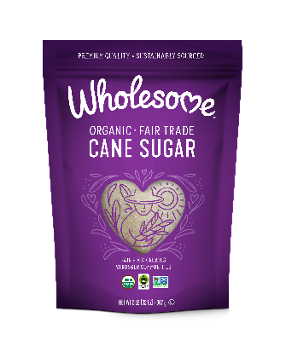
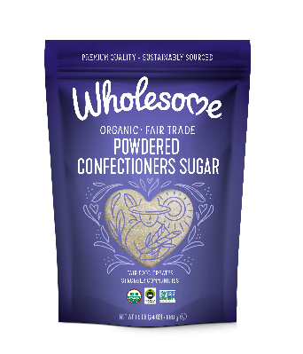
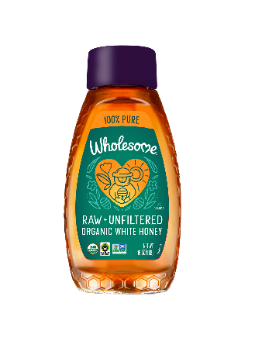
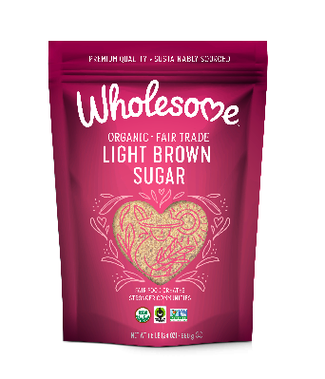
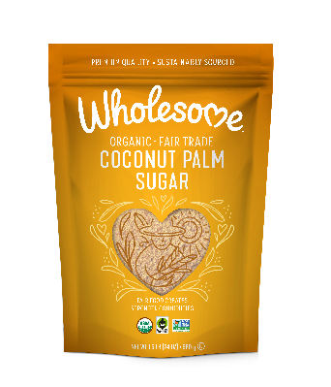
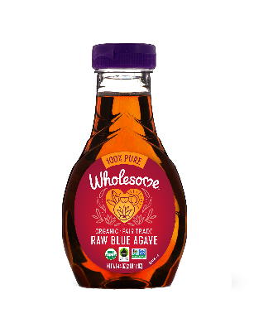

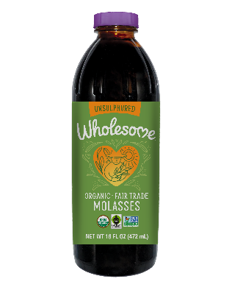
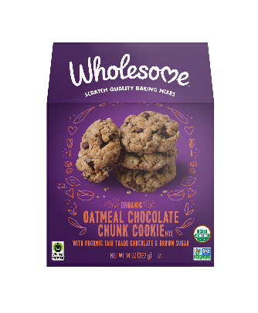
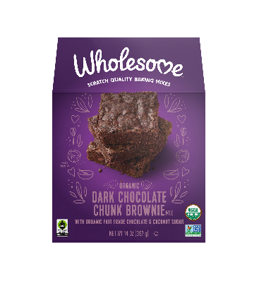

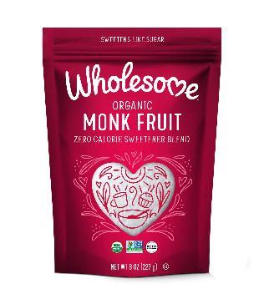
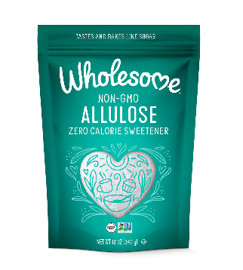
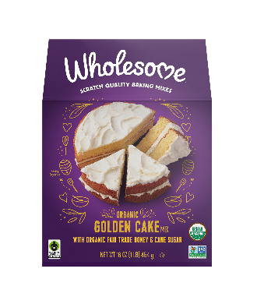
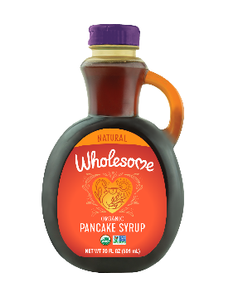
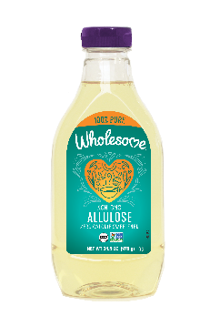
Wholesome Sweeteners Portfolio
Organic & Raw Cane Sugars
Organic Agaves
Organic Honeys
Molasses & Syrups
Zero Calorie
Baking Mixes

Slide 6
APPENDIX

Slide 7
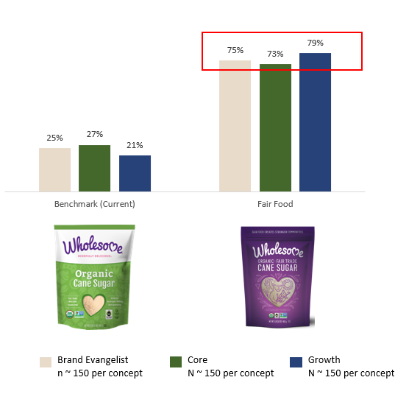
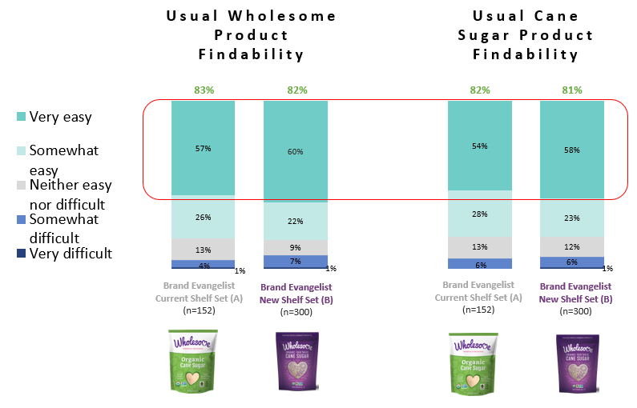
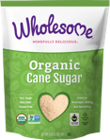
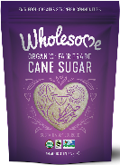
When tested amongst Wholesome consumers, new packaging outperforms old and hits on core brand equities of Quality, Togetherness and Impact
New packaging preferred at almost a 3 to 1 ratio across all consumer groups
New look and feel does not impact product findability on shelf
When tested against old packaging, new packaging better delivers Quality, Togetherness and Impact.
Quality 26%
Togetherness 12%
Impact 16%
Quality 74%
Togetherness 89%
Impact 84%
Source: iBotta Packaging Quant Study January 2021

