Slide 1
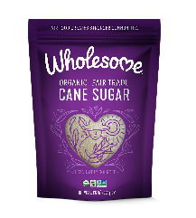
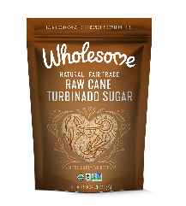
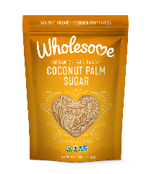
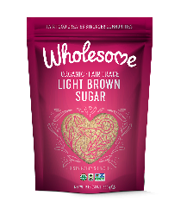
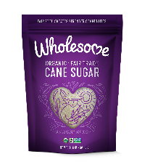
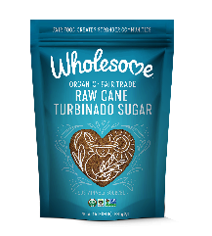
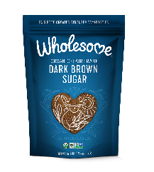
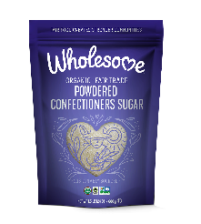
MUST STOCK LIST: ORGANIC & FAIR TRADE SUGARS
US Food Must-Stock List
1
2
3
4
5
6
7
8
Wholesome Organic Cane Sugar 2lb | Wholesome Fair Trade Raw Cane Turbinado 1.5lb | Wholesome Organic Coconut Sugar 1lb | Wholesome Organic Light Brown Sugar 1.5lb | Wholesome Organic Cane Sugar 1lb | Wholesome Organic Raw Cane Turbinado 1.5lb | Wholesome Organic Dark Brown Sugar 1.5lb | Wholesome Organic Powdered Sugar 1lb
Natural Channel Must-Stock List
1
2
3
4
5
6
7
8
Wholesome Organic Cane Sugar 2lb | Wholesome Organic Light Brown Sugar 1.5lb | Wholesome Organic Dark Brown Sugar 1.5lb | Wholesome Organic Powdered Sugar 1lb | Wholesome Organic Cane Sugar 1lb | Wholesome Organic Coconut Sugar 1lb | Wholesome Organic Raw Cane Turbinado 1.5lb | Wholesome Fair Trade Raw Cane Turbinado 1.5lb

Slide 2
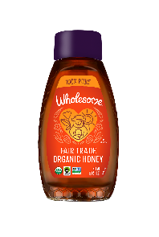
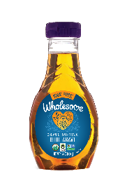
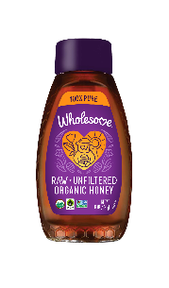
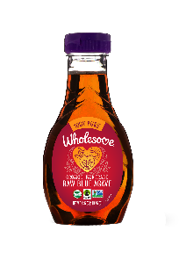
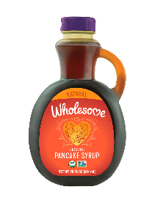
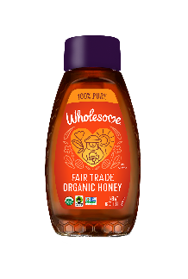
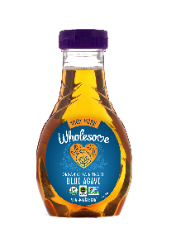
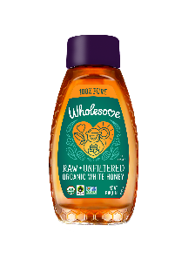
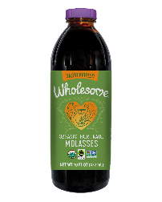
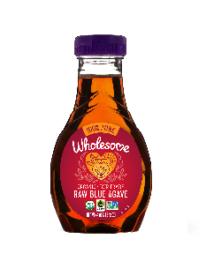
MUST STOCK LIST: ORGANIC & FAIR TRADE LIQUIDS
US Food Must-Stock List
1
2
3
4
5
6
7
8
9
Wholesome Organic Honey Bottle 16oz | Wholesome Organic Blue Agave 23.5oz | Wholesome Organic Raw & Unfiltrd Honey Bottle 16oz | Wholesome Organic Raw Blue Agave 23.5oz | Wholesome Organic Molasses 16oz | Wholesome Organic Pancake Syrup 20oz | Wholesome Organic Honey Bottle 24oz | Wholesome Organic Blue Agave 44oz | Wholesome Organic Raw & Unfiltrd White Honey Bottle 16oz
Natural Channel Must-Stock List
1
2
3
4
5
6
7
8
9
Wholesome Organic Blue Agave 44oz | Wholesome Organic Raw Blue Agave 44oz | Wholesome Organic Raw & Unfiltered Honey Bottle 16oz | Wholesome Organic Honey Bottle 24oz | Wholesome Organic Molasses 16oz | Wholesome Organic Pancake Syrup 20oz | Wholesome Organic Honey Bottle 16oz | Wholesome Organic Blue Agave 23.5oz | Wholesome Organic Raw & Unfiltered White Honey Bottle 16oz

