Slide 1

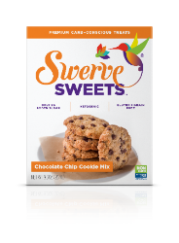

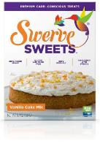




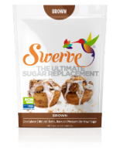



Swerve® Portfolio
Granular
Confectioners
Brown Swerve
Chocolate Chip Cookie Mix
Chocolate Cake Mix
Yellow Cake Mix
Brownie Mix
Pancake & Waffle Mix
Granular, Confectioners, and Brown Displays
Bake Mix Displays

