Slide 1


P-nuff crunch
Crunchy Peanut Puff
“Under 5 Calories per bite for your delight”
Under 5 Calories Per Bite for your Delight
Perfect life nutrition
Mark Cuban Companies

Slide 2

…are made to taste great without regard for nutrition.
That’s why Dr. Salinas created P-nuff Crunch! a snack
that’s both delicious and made from truly nutrient-packed ingredients, so your customers can stay in
shape, even when the cravings hit.
Cravings for Crunchy, Salty, Sweet Treats Are Real
  About 70% of men and almost 100% of women get cravings, and these cravings intensify when our bodies are lacking certain nutrients or go too long without eating.*
*Statistics sourced from a study by Monell Chemical Senses Center and the University of Pennsylvania School of Medicine

Slide 3

At P-nuff Crunch we understand your customer feels to want to get in shape and feel their very best.
To make this happen they have to exercise regularly and eat a healthy, balanced diet.
The problem is that cravings for junk food are real and oftentimes irresistible. Sometimes these cravings turn into binges that cause us to gain weight and overindulge on foods that make us feel physically and emotionally crappy. Life is too short to be on a diet and feel deprived, to not be able to enjoy delicious foods, go to bed hungry, track every calorie or feel the need to measure & weigh food and be perfect. We believe reaching your fitness goals should be fun and fulfilling.
That’s why Dr. Juan Salinas created P-nuff Crunch! As a Ph D in Food Science and Certified Sports
Nutritionist who also competed as a professional Natural Bodybuilder, he struggled with the same
issues. So, he decided to create a product that would not only satisfy his salty or sweet
craving but that would also provide the ingredients and nutrients his body needed to
stay in shape.

Slide 4
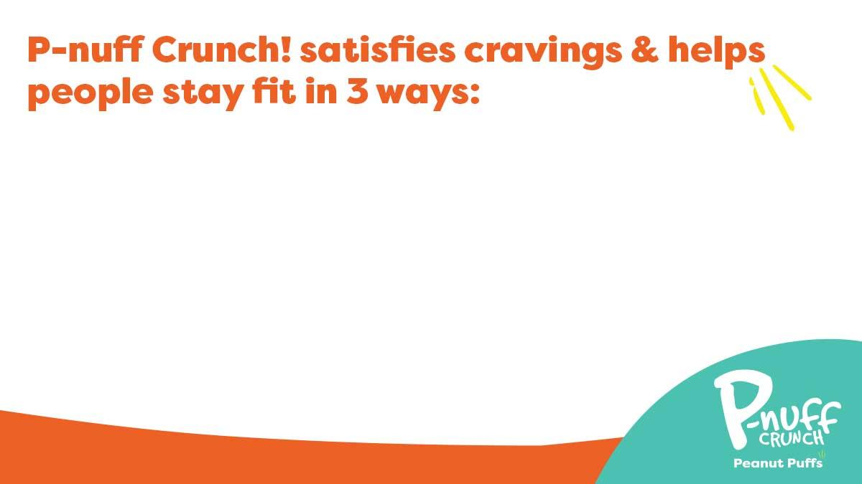
Crunchy and delicious salty & sweet peanut butter flavor with only 130 calories per serving (28 pieces)
Complete plant protein (20g per bag) to build muscle and stay in shape
Low GI carbs and fiber (3g per serving) to help feel full and have longer lasting energy
Provide your customers P-nuff Crunch! today so they can stop worrying about their diet and start enjoying every craving moment on their journey to a fit life!

Slide 5
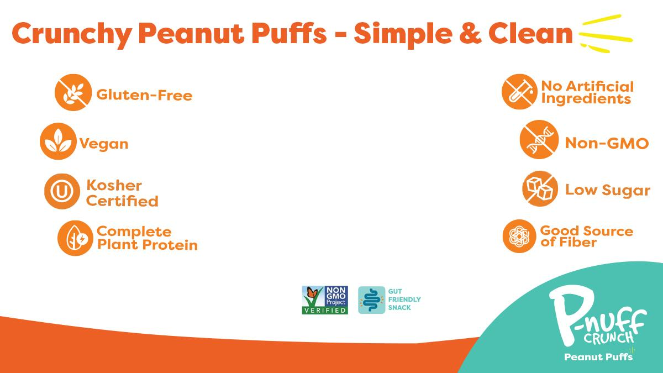
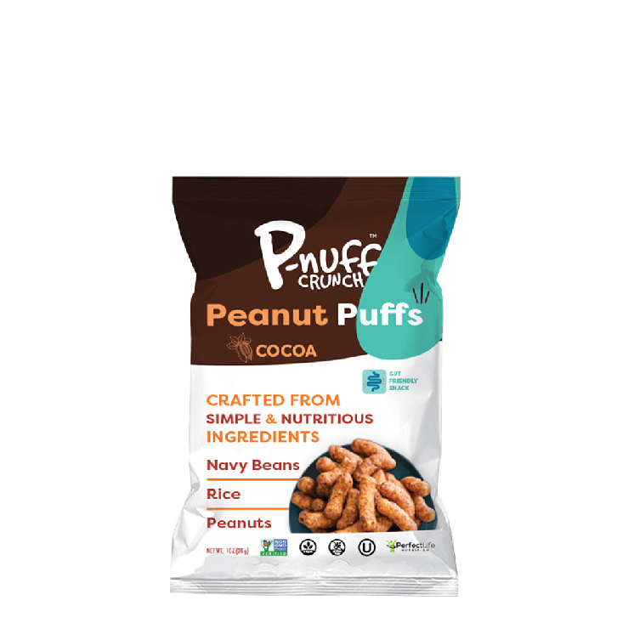
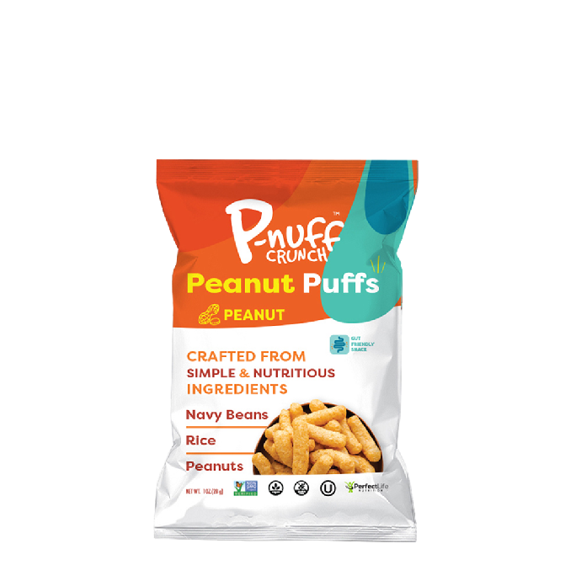
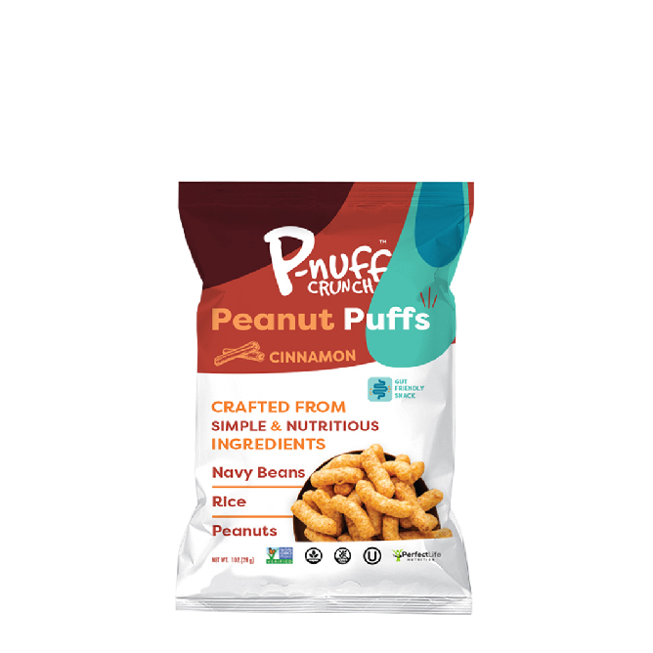

Slide 6















Active Lifestyle Support
Complete Protein*
Yes | 5gm
No | 5gm
No | 5gm
Yes | 10gm
No | 5gm
No | 2gm
No | 1gm
No | 5gm
No | 3gm
Primary Ingredients
Navy Beans,
Peanuts, Rice
Corn
Corn
Pea, Brown Rice, Navy Beans
Corn
Sorghum
Rice, Peanuts
Corn
Rice, Sweet Potatoes
Claims
Gut Friendly
Yes
No
No
No
No
No
No
No
No
Vegan
Yes
Yes
Yes
No
Yes
Yes
No
Yes
Yes
Good Source of Fiber
Yes
No
No
Yes
No
No
No
No
No
Gluten Free
Yes
Yes
Yes
Yes
Yes
Non GMO
Yes
Yes
Yes
Yes
USDA Organic
No
No
No
No
No
No
Dairy Free
Yes
No
No
No
Yes
Yes
No
Yes
No
Kosher
Yes
No
Yes
No
No
Yes

Slide 7
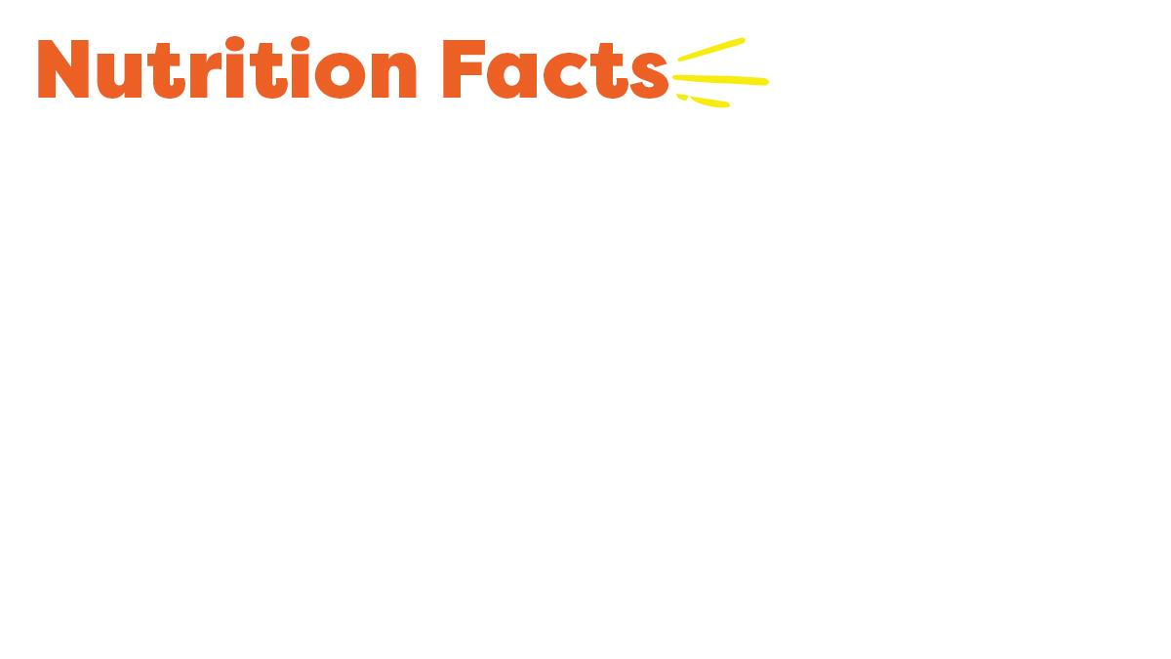
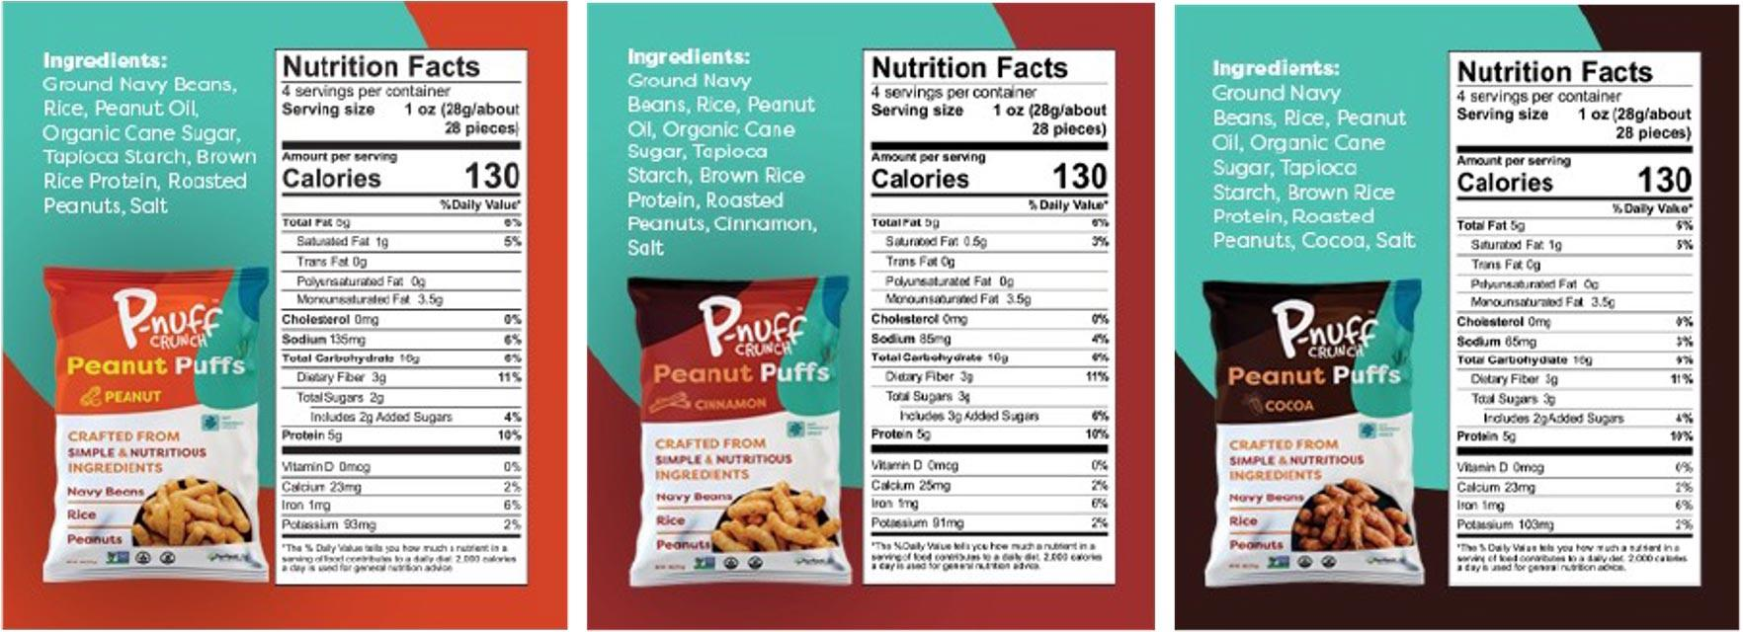
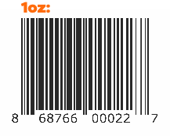
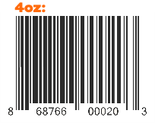
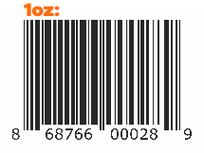
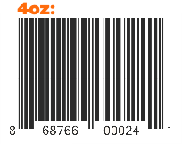
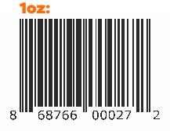
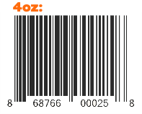

Slide 8

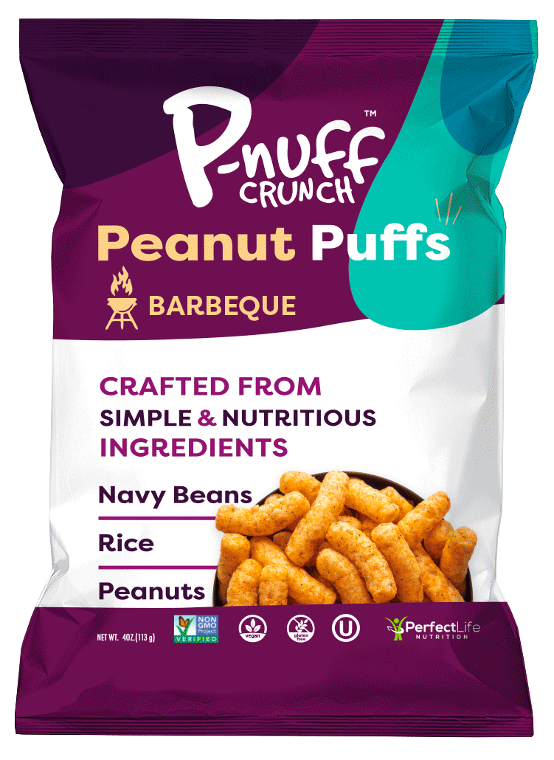
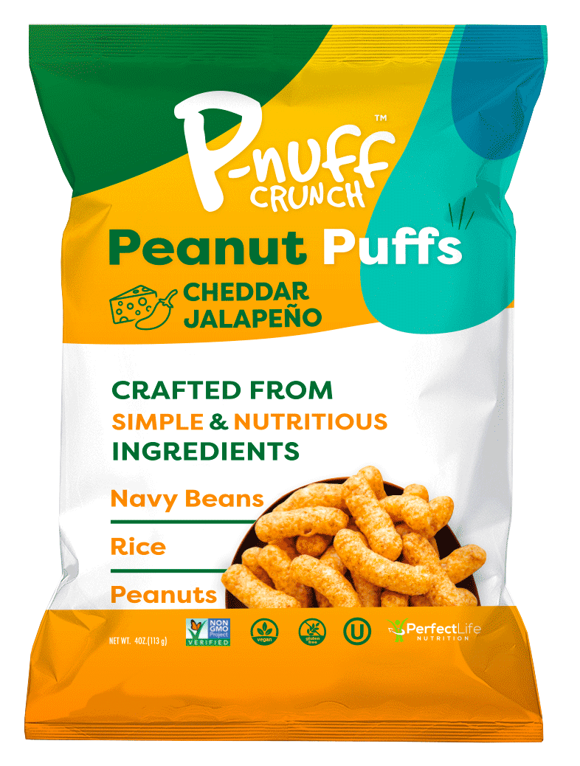
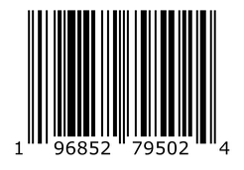

Q1 2023

Slide 9

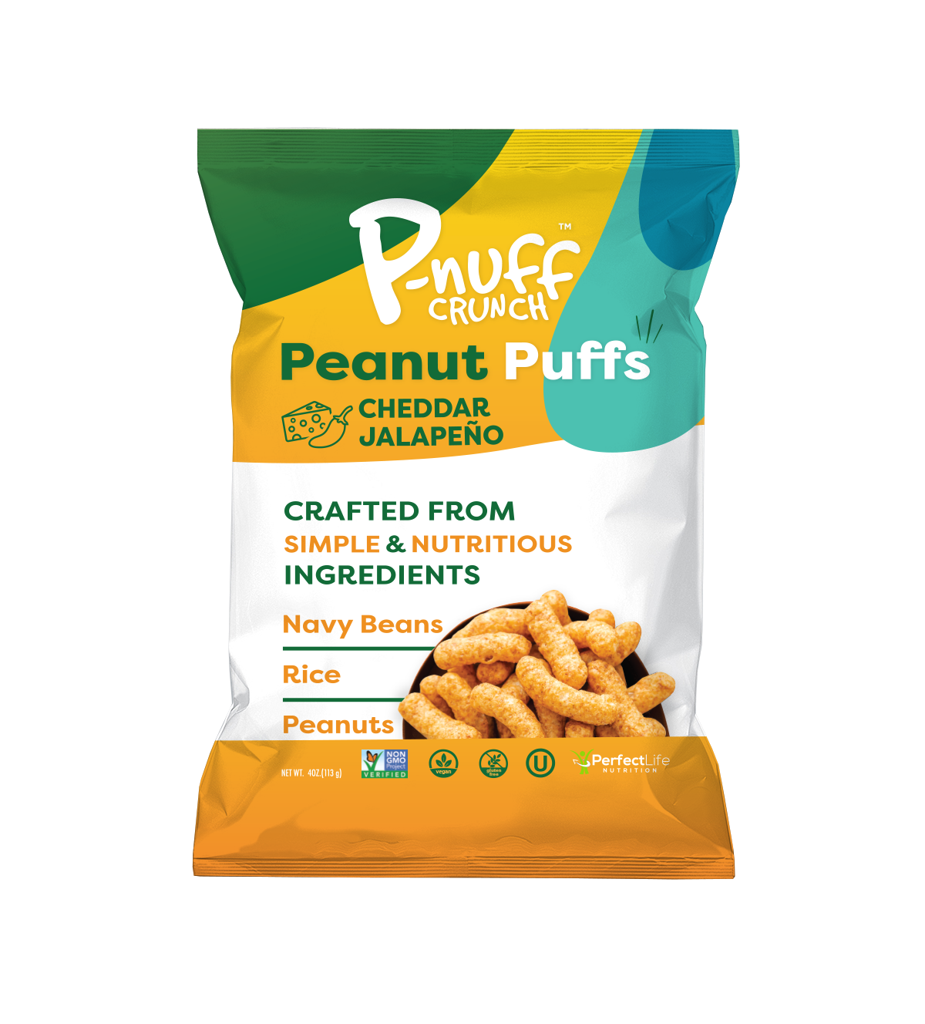
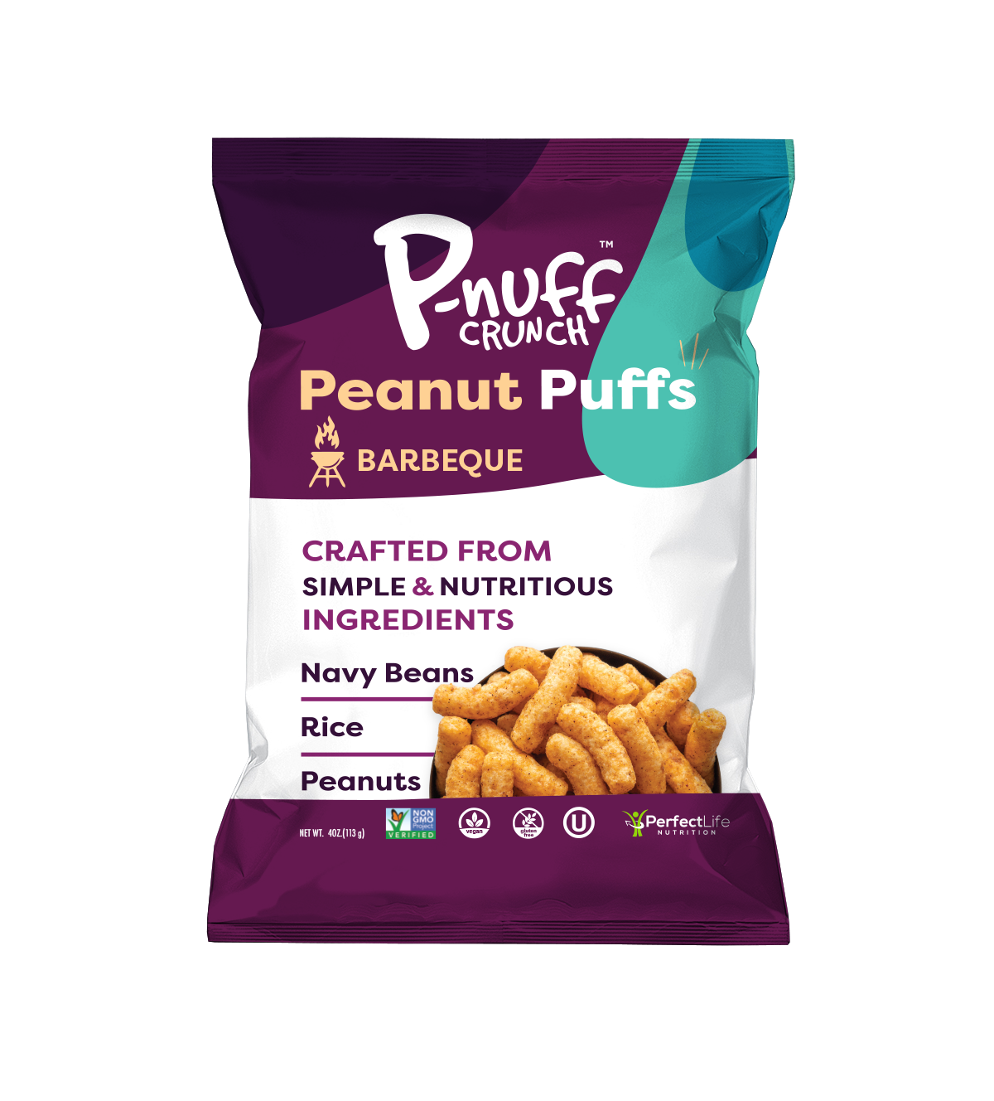
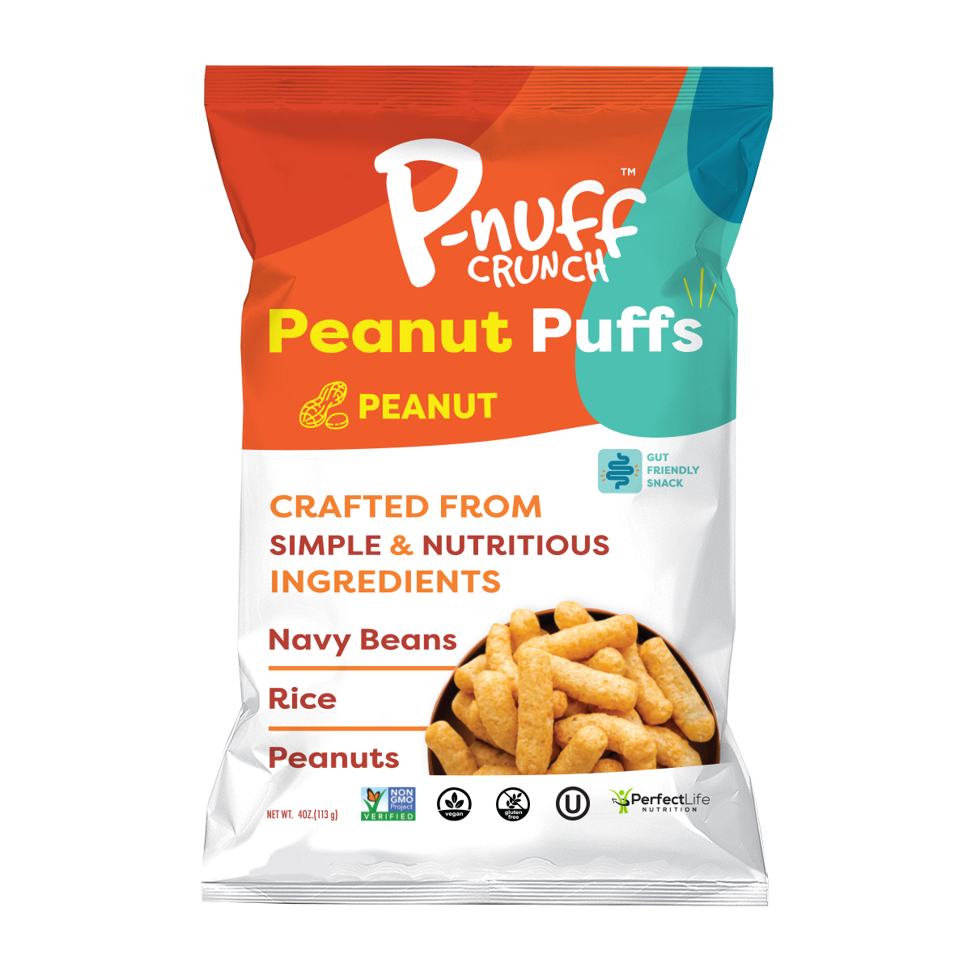
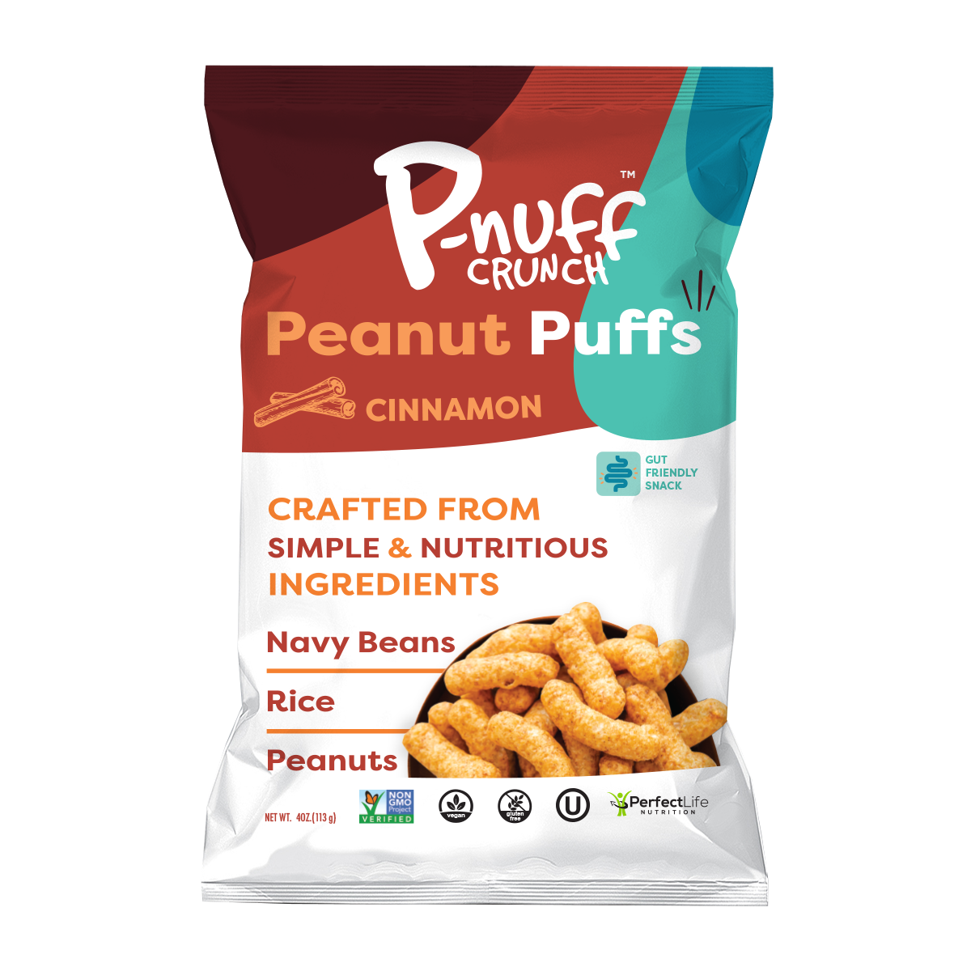
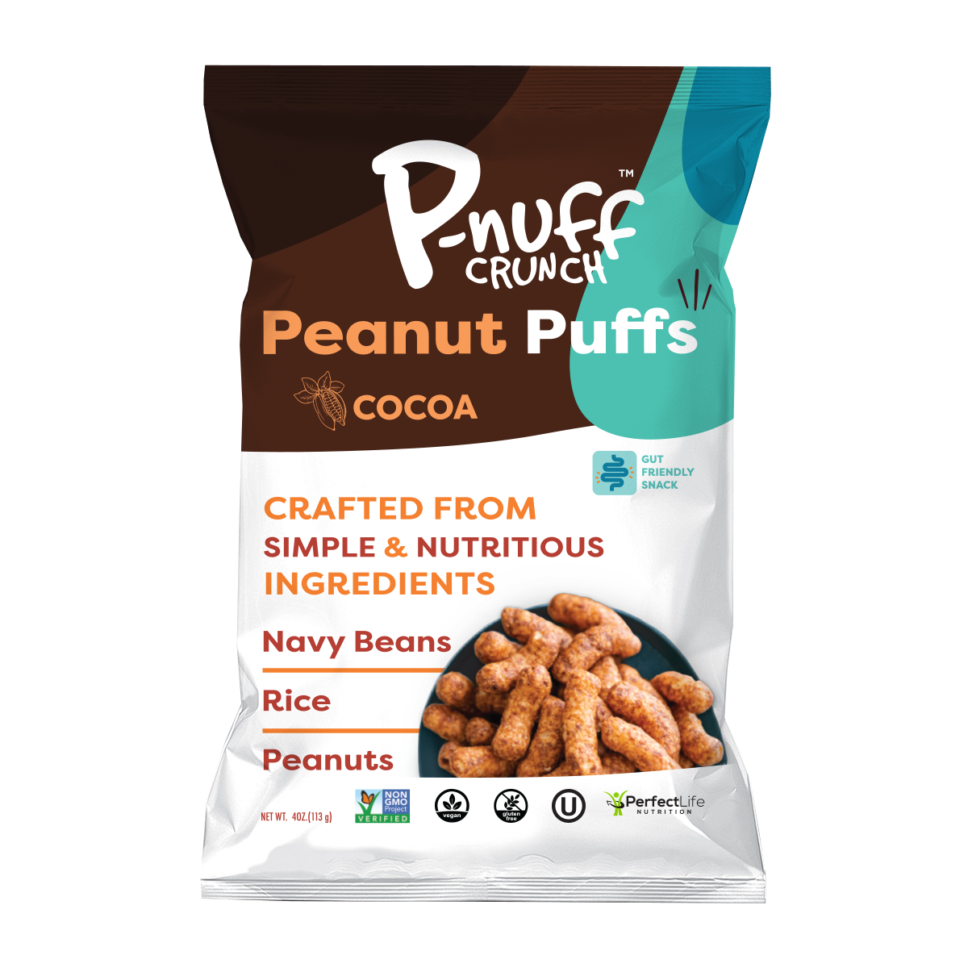
(anticipated)
Ranking #2
(anticipated)
Ranking #3
Ranking #1
Ranking #4
Ranking #5
Peanut
1oz: 868766000227
4oz: 868766000203
Cheddar Jalapeno
1oz: 196852253807
4oz: 196852371488
Barbecue
1oz: 196852754496
4oz: 196852795024
Cinnamon
1oz: 868766000289
4oz: 868766000241
Cocoa
1oz: 868766000272
4oz: 868766000258
Unit
Weight
Bag
Dimension (in)
Case
Case
Dimensions (in)
(L x W/D x H)
Case
Weight (lbs)
Shelf Life
Suggested
Retail price
(U.S. Mainland)
FOB Price
Per Case*
(U.S. Dollars)
4oz (113g)
1oz (28g)
10.75 x 7.25 x 2.5
5.62 x 7.75 x 2.5
6 units
6 units
12 x 8 x 8
9 x 5.75 x 6.75
2.10
.75
12
12
$10.56
$5.40
$3.99
$1.99

Slide 10

Our target consumer: The “Empty Nester”
  Age: 40-55
  Gender: Even 50/50 Male to Female
  Income: Middle to upper class
  Education: College Graduates
“I eat them as a snack when watching tv at night after dinner instead of eating junk food.”
- Damian D.
“I love peanut butter and these peanut butter puffs are the best! I can eat a whole bag and not feel guilty about enjoying the fabulous flavor of peanut butter!”
- Wilma T.
“Love this crunchy treat! Helps me keep my weight down...great healthy snack.”
- Connie H.

Slide 11




Perfect Life Nutrition LLC
380 Saint Cloud Avenue
West Orange, NJ 07052
937-980-2298
www.pnuff.com
Dr. Juan Salinas
juan@pnuff.com
Bryan Bootka
bryan@pnuff.com

