Slide 1


P-nuff crunch
Crunchy Peanut Puff
“Under 5 Calories per bite for your delight”
Under 5 Calories Per Bite for your Delight
Perfect life nutrition
Mark Cuban Companies

Slide 2

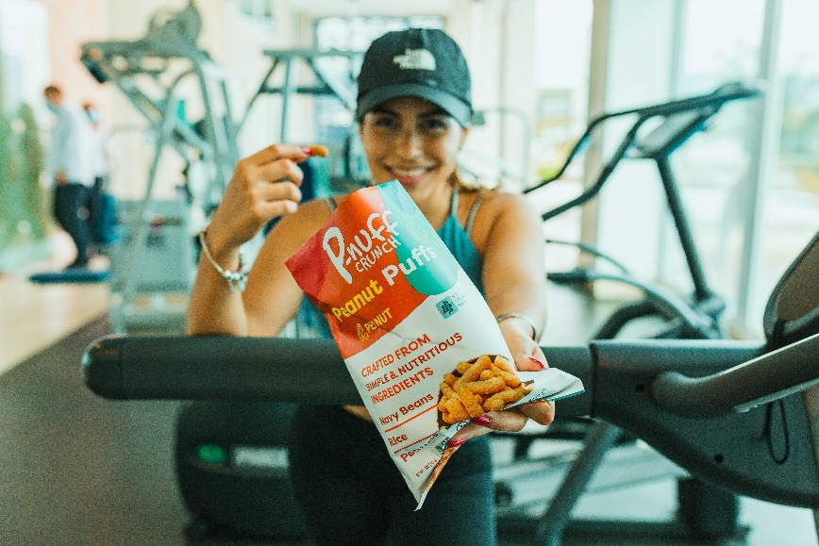
…are made to taste great without regard for nutrition.
That’s why Dr. Salinas created P-nuff Crunch!
A snack that’s both delicious and made from truly nutrient-packed ingredients
So your customers can stay in shape, even when the cravings hit.

Slide 3



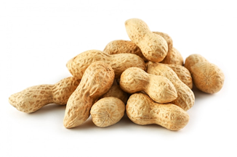
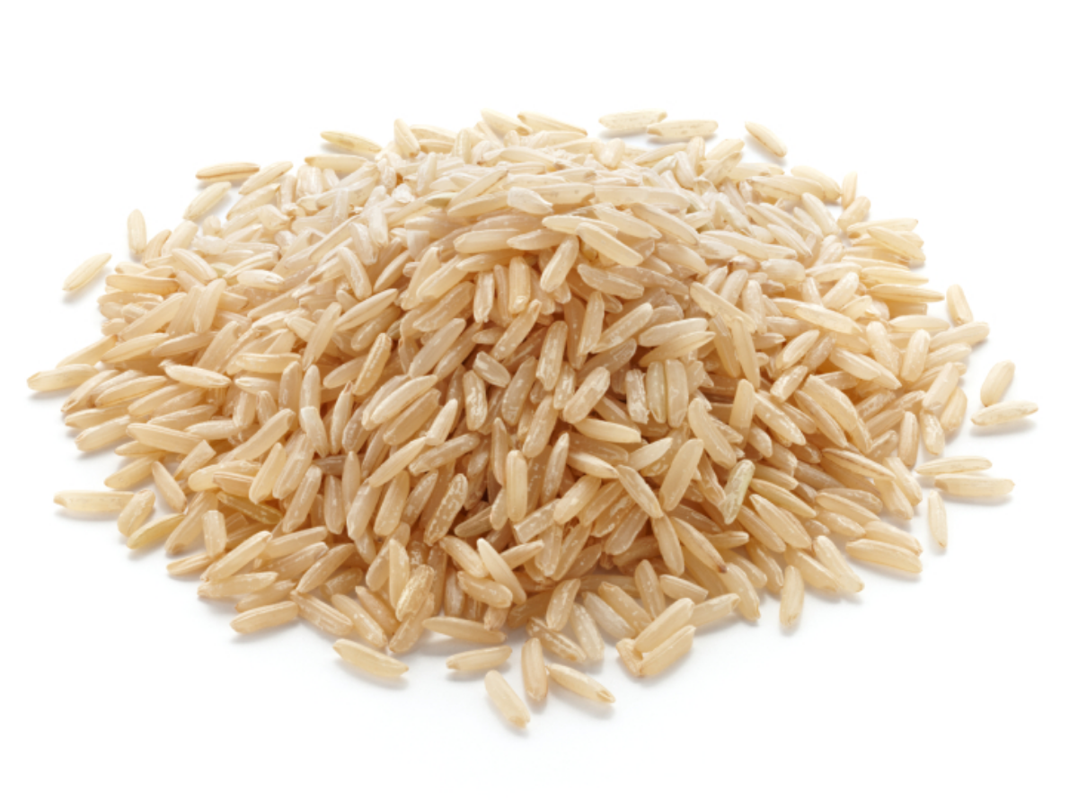
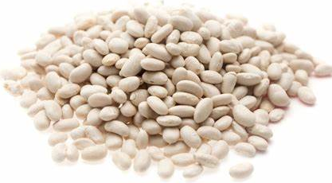
We believe reaching your fitness goals should be fun and fulfilling.
As a Ph D in Food Science & Sports Nutrition, and Natural Bodybuilder, Dr Juan, struggled with finding snacks that were nutritious and tasty. So, he decided to create a product that would not only satisfy his midday craving but also provide the ingredients and nutrients his body needed to stay in shape.

Slide 4

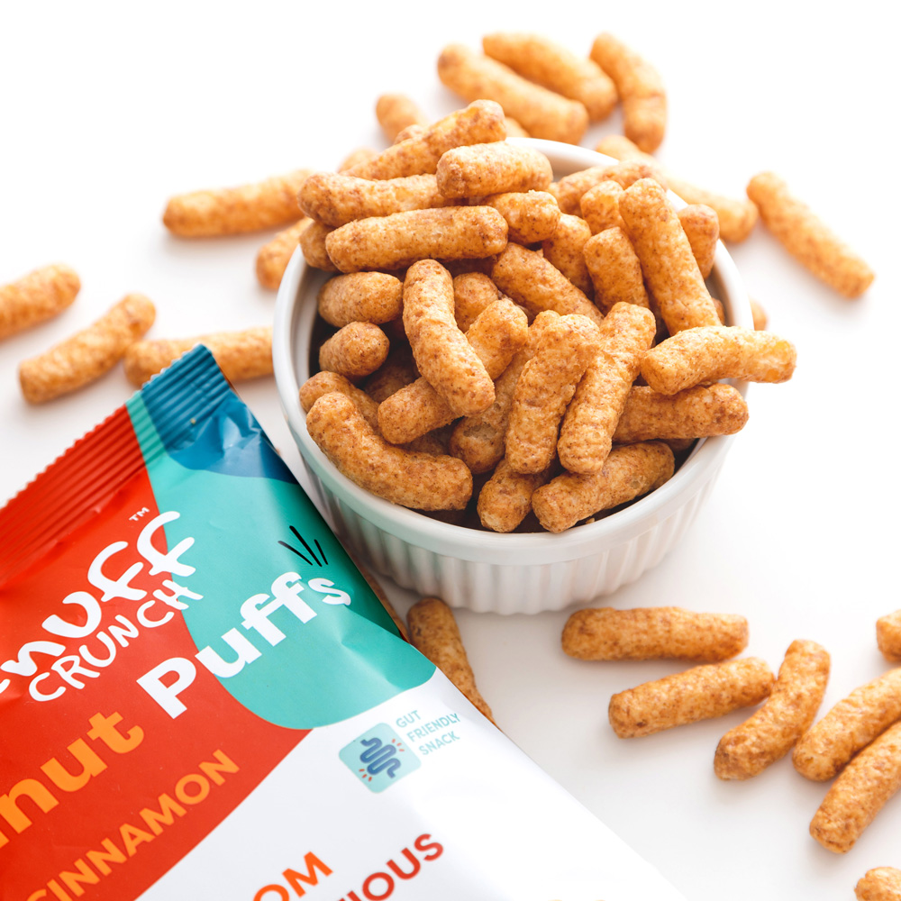
Crunchy and delicious: salty & sweet peanut butter flavor with only 130 calories per serving (28 pieces)
Complete plant protein (20g per bag): to build muscle and stay in shape
Low sugar and GI carbs (1-3 g per serving), and good source of fiber (3g per serving): for longer lasting energy and feeling fully satisfied

Slide 5

Clean Plant- Based “Complete” proteins from Navy Beans, Peanuts and Brown Rice
Vegan and Gluten-free diets
Gut-Friendly – Naturally Prebiotic and low FODMAP
Reduced Sugar – 2-3g per serving

Slide 6
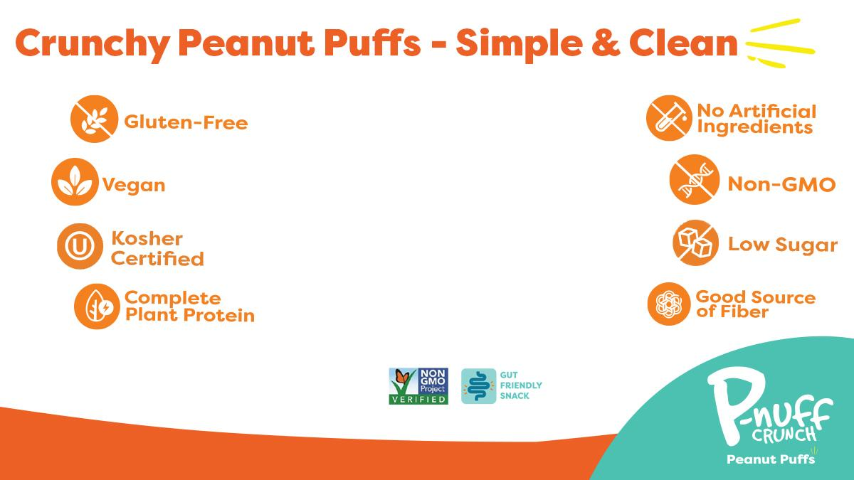
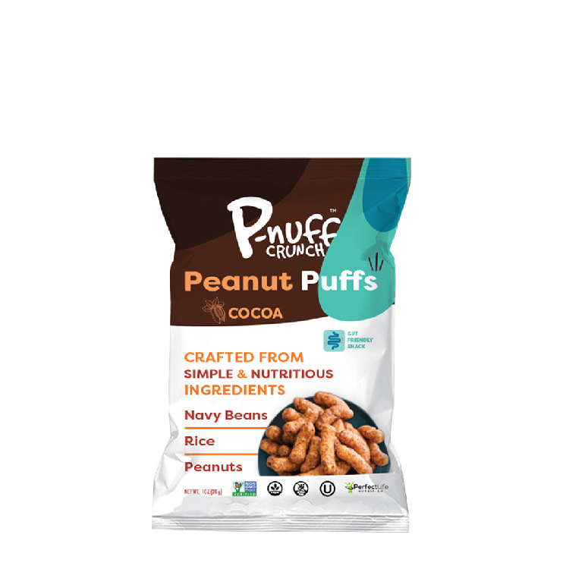
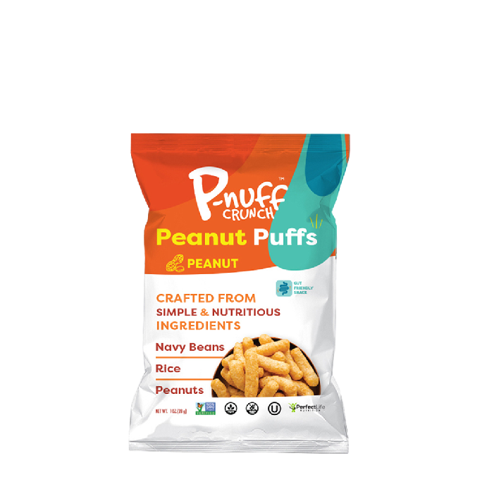
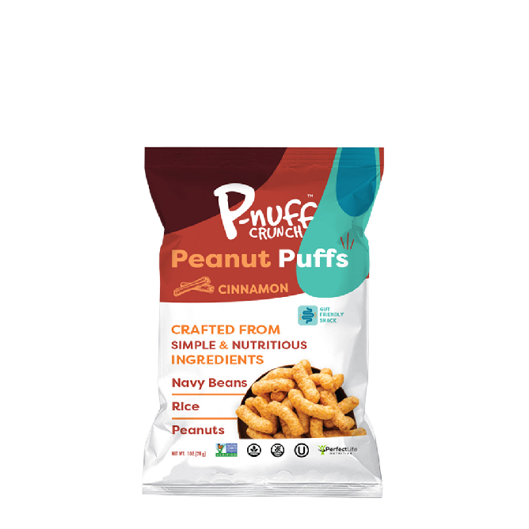

Slide 7












Active Lifestyle Support
Complete Protein* Grams per Oz
Yes | 5 gm
No | 4 gm
No | 5 gm
Yes | 6 gm
No | 2 gm
No | 3gm
Primary Ingredients
Navy Beans,
Peanuts, Rice
Chickpeas, Rice, Tapioca. Yellow Peas
Cassava flour, Pea Protein
Pea, Brown Rice, Navy Beans
Sorghum
Rice, Sweet Potatoes
Flavor Varieties
Peanut, Cocoa, Cinnamon,
BBQ, Vegan Cheddar Jalapeno
Vegan white Cheddar, Nacho, Siracha
Spicy salsa, sour cream and onion, Himalayan pink salt, fiery hot, vegan cheese
Cheddar cheese, red pepper, cameralized onion
Beet, Brussel Sprout, Cheddar, Cauliflower, Dragon
Cheddar, Cinnamon Churro, Sour cream and onion
Gut Friendly
Yes
No
No
No
No
No
Vegan
Yes
Yes
No
Yes
Yes
Good Source of Fiber
Yes
Yes
No
Yes
No
No
Gluten Free
Yes
Yes
Yes
Non GMO
Yes
No
Dairy Free
Yes
Yes
Yes
No
Yes
No
Kosher
No
Yes
No
Yes

Slide 8

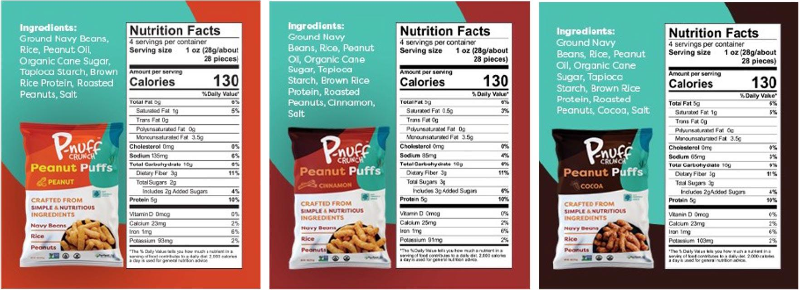







Slide 9

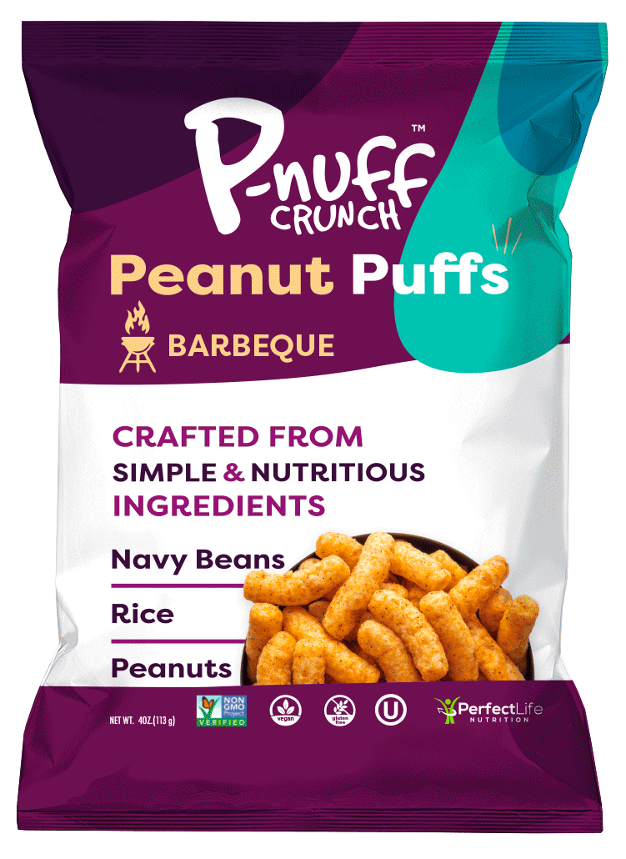
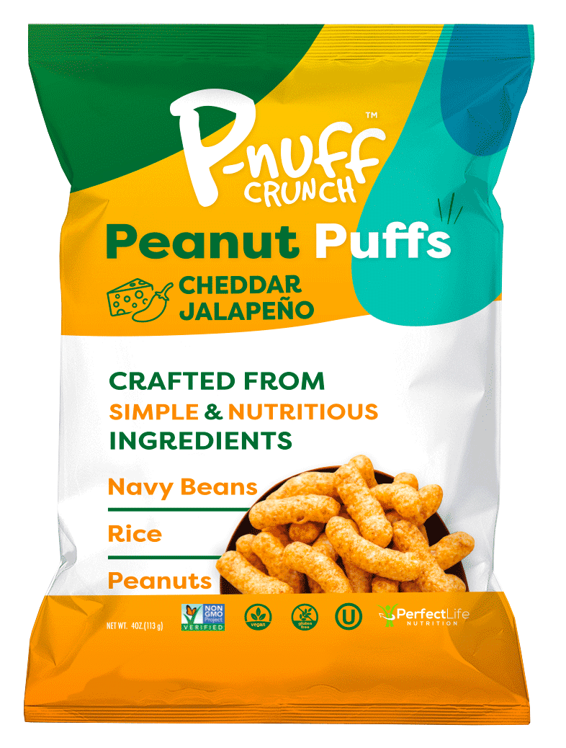



Slide 10
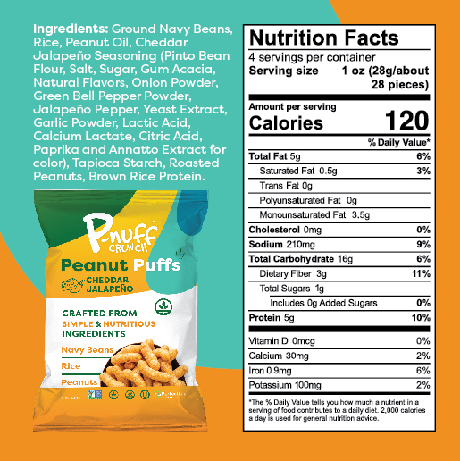
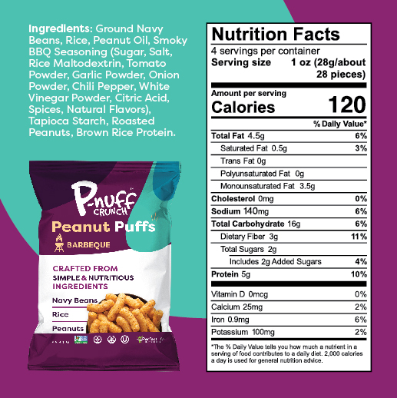
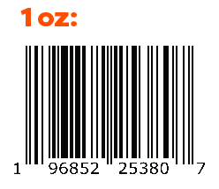
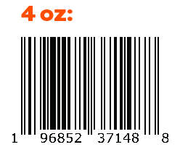
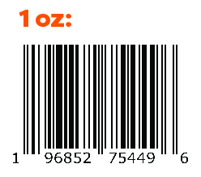
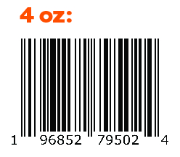

Slide 11

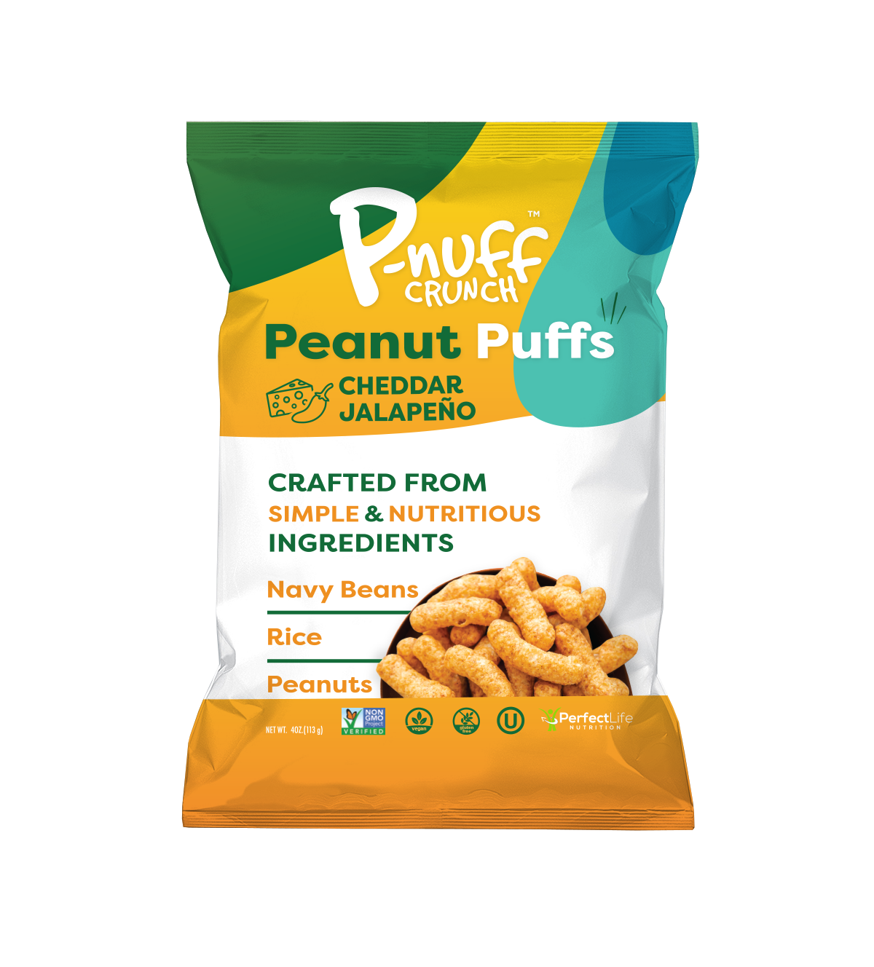
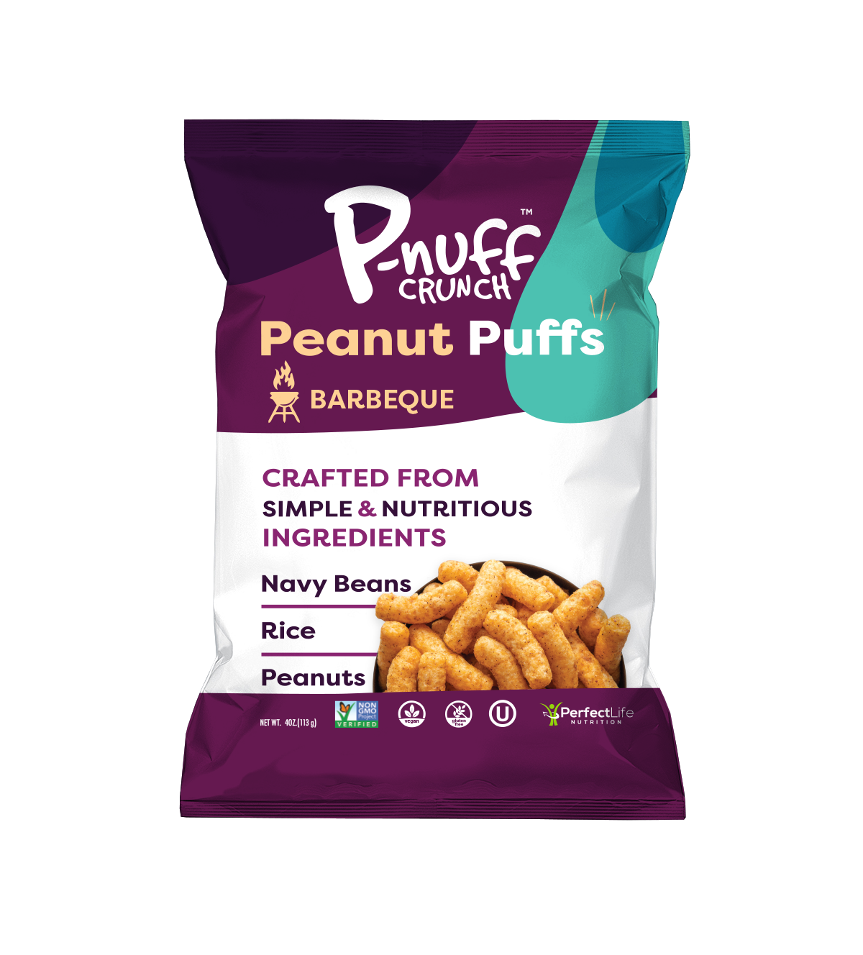
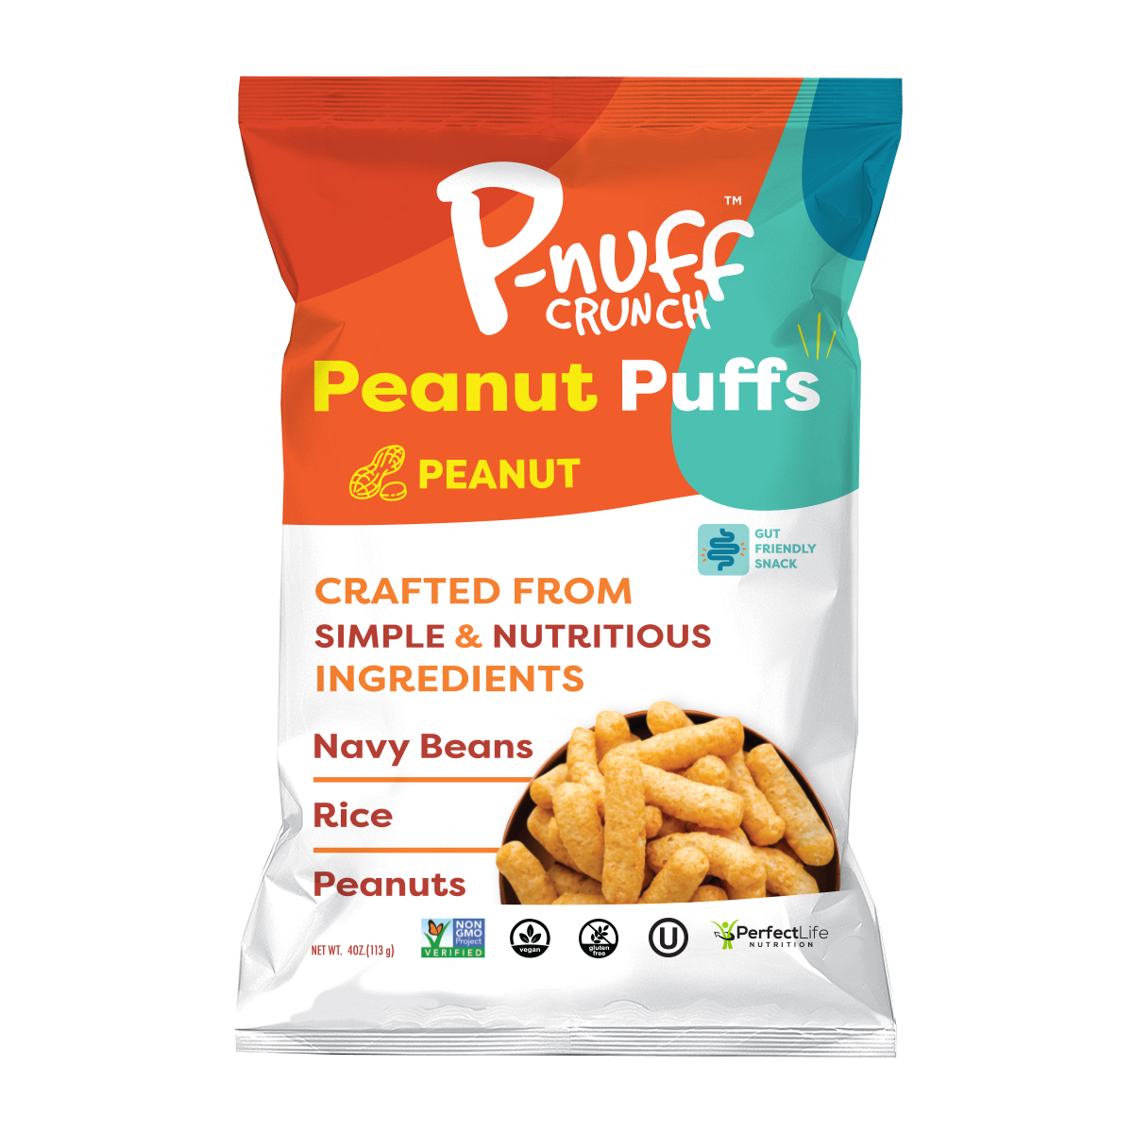
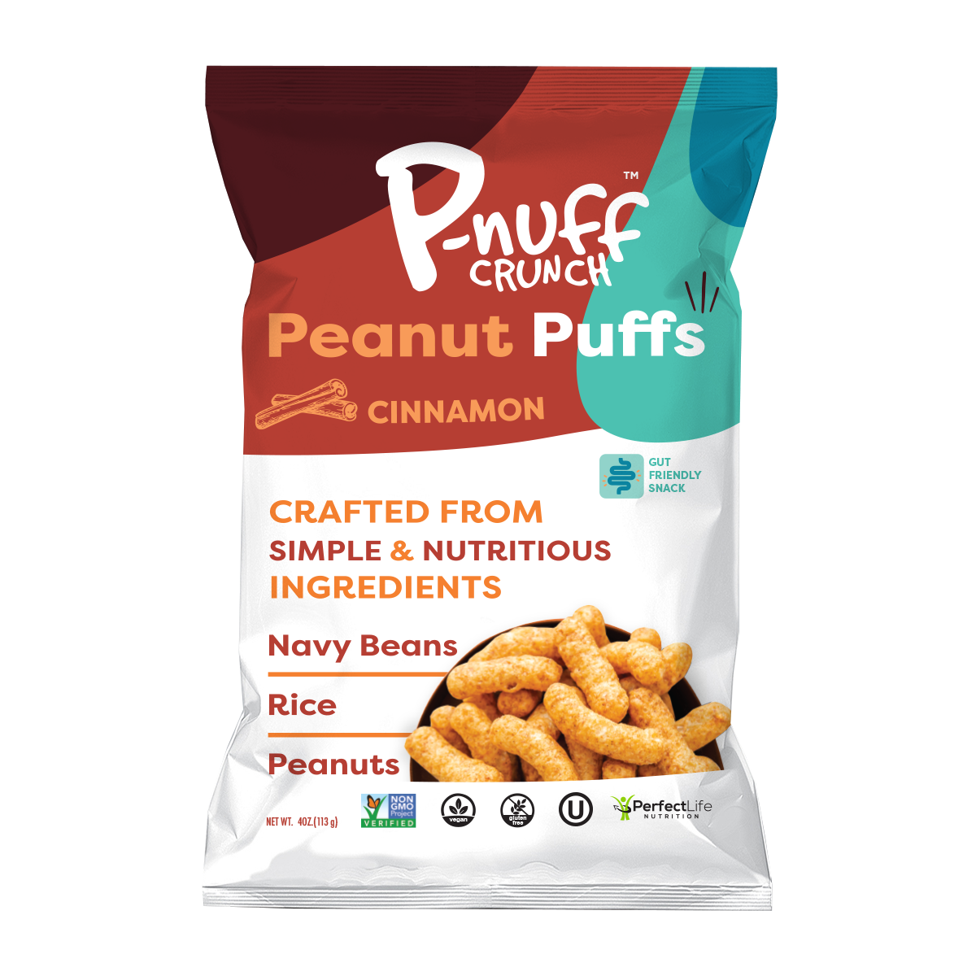
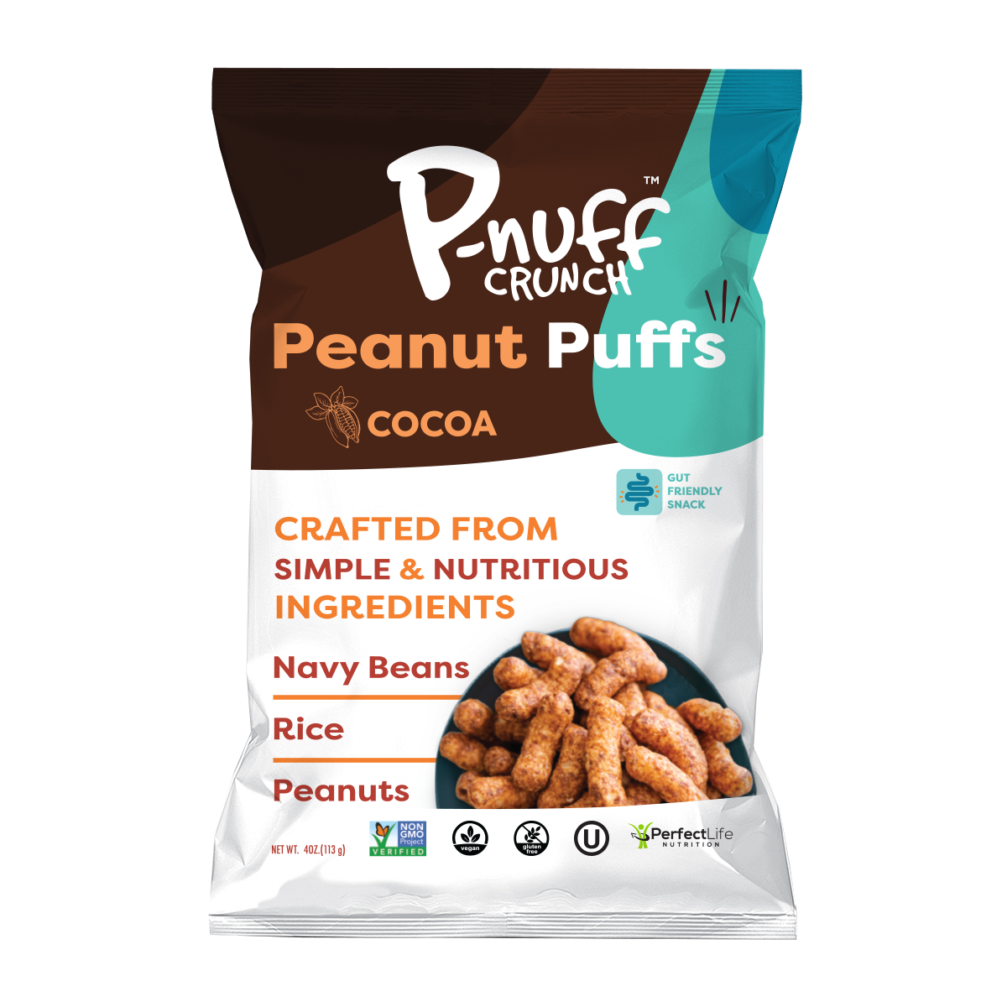
(anticipated)
Ranking #2
(anticipated)
Ranking #3
Ranking #1
Ranking #4
Ranking #5
Peanut
1oz: 868766000227
4oz: 868766000203
Cheddar Jalapeno
1oz: 196852253807
4oz: 196852371488
Barbecue
1oz: 196852754496
4oz: 196852795024
Cinnamon
1oz: 868766000289
4oz: 868766000241
Cocoa
1oz: 868766000272
4oz: 868766000258
Unit
Weight
Bag
Dimension (in)
Case
Dimensions (in)
(L x W/D x H)
Case
Weight (lbs)
Shelf Life
Suggested
Retail price
(supermarkets)
Case
4oz (113g)
1oz (28g)
10.75 x 7.25 x 2.5
5.62 x 7.75 x 2.5
6 units
6 units
12 x 8 x 8
9 x 5.75 x 6.75
2.0
.75
12
12
$3.99
$1.99

Slide 12

Primary target consumer: The “Empty Nester”
  ACTIVE, 40-55 years old, 50/50 Male to Female
  Middle to upper class, College Graduates
Secondary target consumer: All family
ACTIVE, 27-42, with/without kids
“I eat them as a snack when watching tv at night after dinner instead of eating junk food.”
- Damian D.
“I love peanut butter and these peanut butter puffs are the best! I can eat a whole bag and not feel guilty about enjoying the fabulous flavor of peanut butter!”
- Wilma T.
“Love this crunchy treat! Helps me keep my weight down...great healthy snack.”
- Connie H.

Slide 13




Perfect Life Nutrition LLC
380 Saint Cloud Avenue
West Orange, NJ 07052
937-980-2298
www.pnuff.com
Dr. Juan Salinas
juan@pnuff.com
Bryan Bootka
bryan@pnuff.com

