Slide 1

Ancient Harvest & Pamela’s Brand Introduction

Slide 2
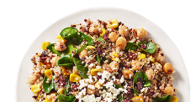
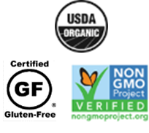
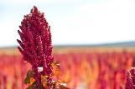

Ancient Harvest - Who We Are…
Our Mission:
Return natural, plant-based nutrition to American diets
Plant-based nutrition company and natural food pioneer since 1983
Products are Gluten-Free and Non-GMO Project Verified with many being USDA organic
First company to bring quinoa to the US over 35 years ago – and still #1 brand today!
Recent rebrand has invigorated growth by modernizing our look & appealing to a younger shopper
Our Approach:
Incorporate the nutritional benefits of ancient grains into today’s modern diets & lifestyles
Transform existing food categories with a unique approach to ingredients & recipe formulation
Build trust with consumers by using clean, recognizable ingredients

Slide 3
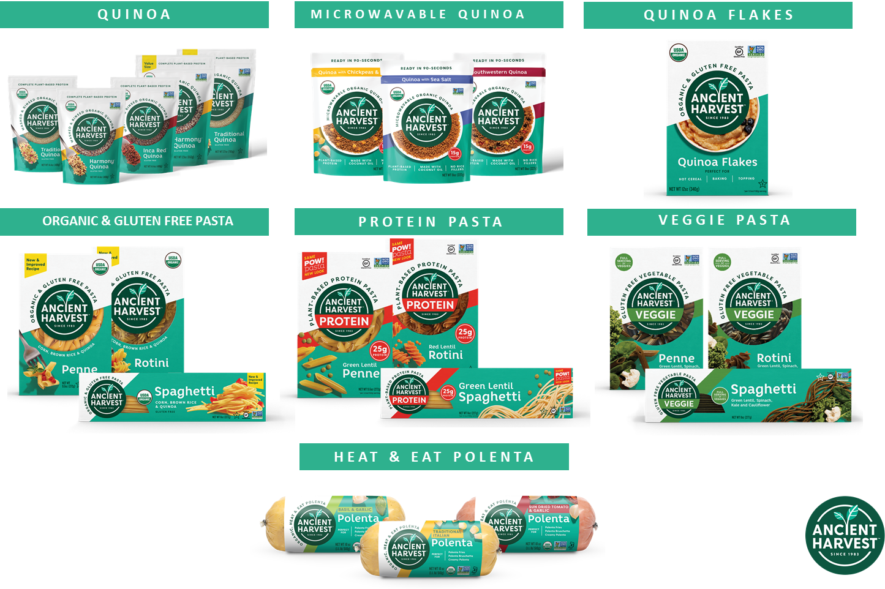
Ancient Harvest Product Portfolio

Slide 4
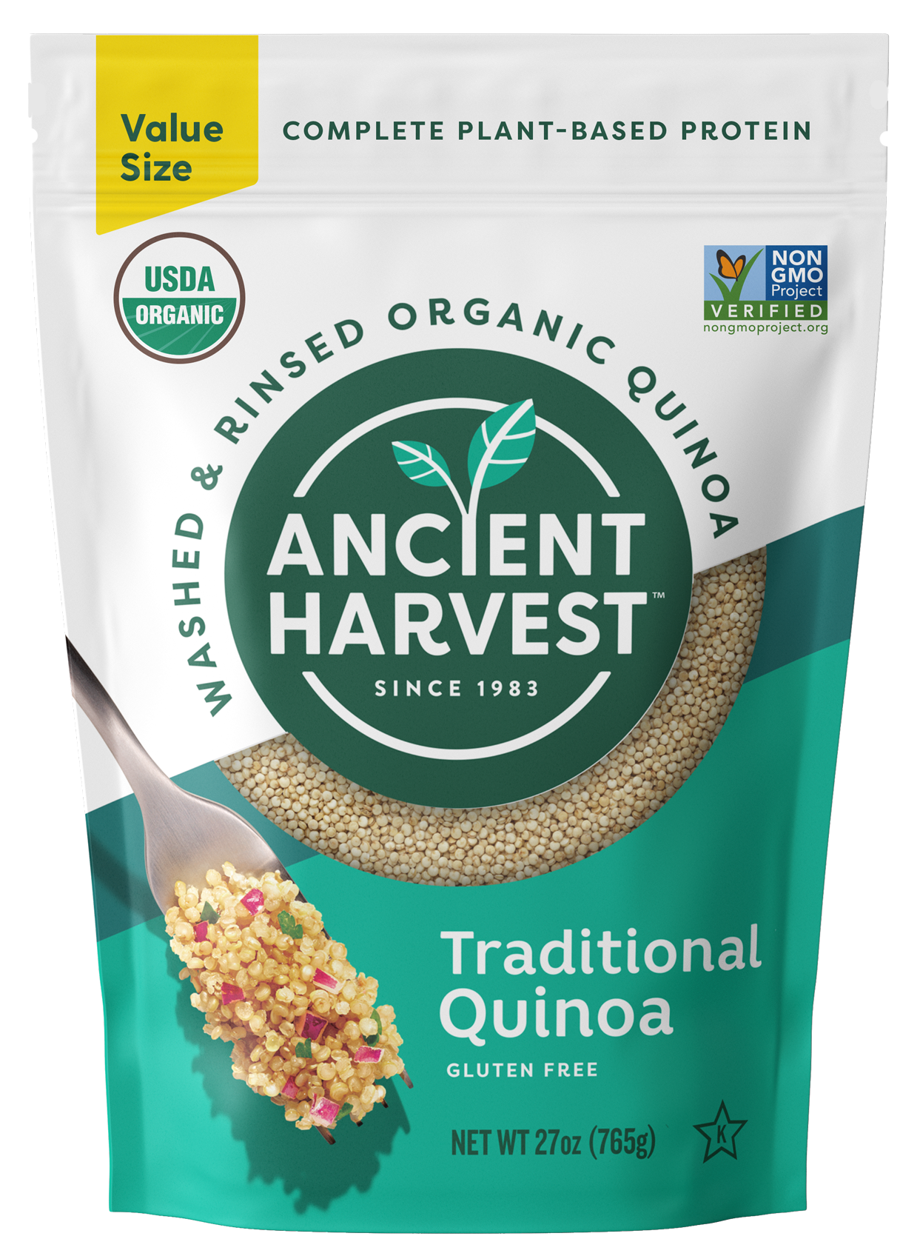
Ancient Harvest Quinoa
Benefits:
Quinoa category grew +32% in 2020
Ancient Harvest is #1 branded Quinoa in U.S.
100% Royal Bolivian Quinoa
  Delivers superior taste & texture
Pre-washed & ready-to-cook
Certified Organic & Non-GMO Project Verified
Gluten Free
Great source of complete plant-based protein
  2X the protein & 3X the fiber of white rice!
Product Details:
Varieties:
  Traditional (White) Quinoa (27oz Value Size)
Published Cost: $5.12 per unit FOB (pick-up)
27oz resealable pouch / 6 count case

Slide 5
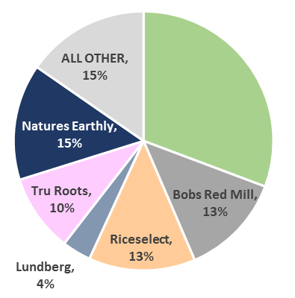
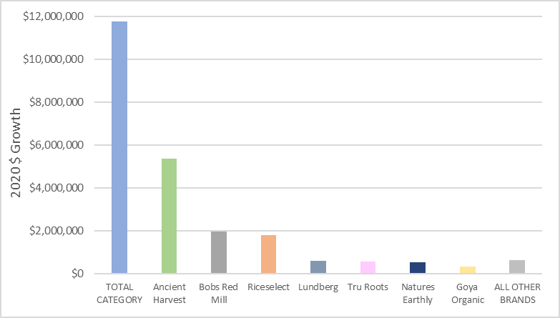
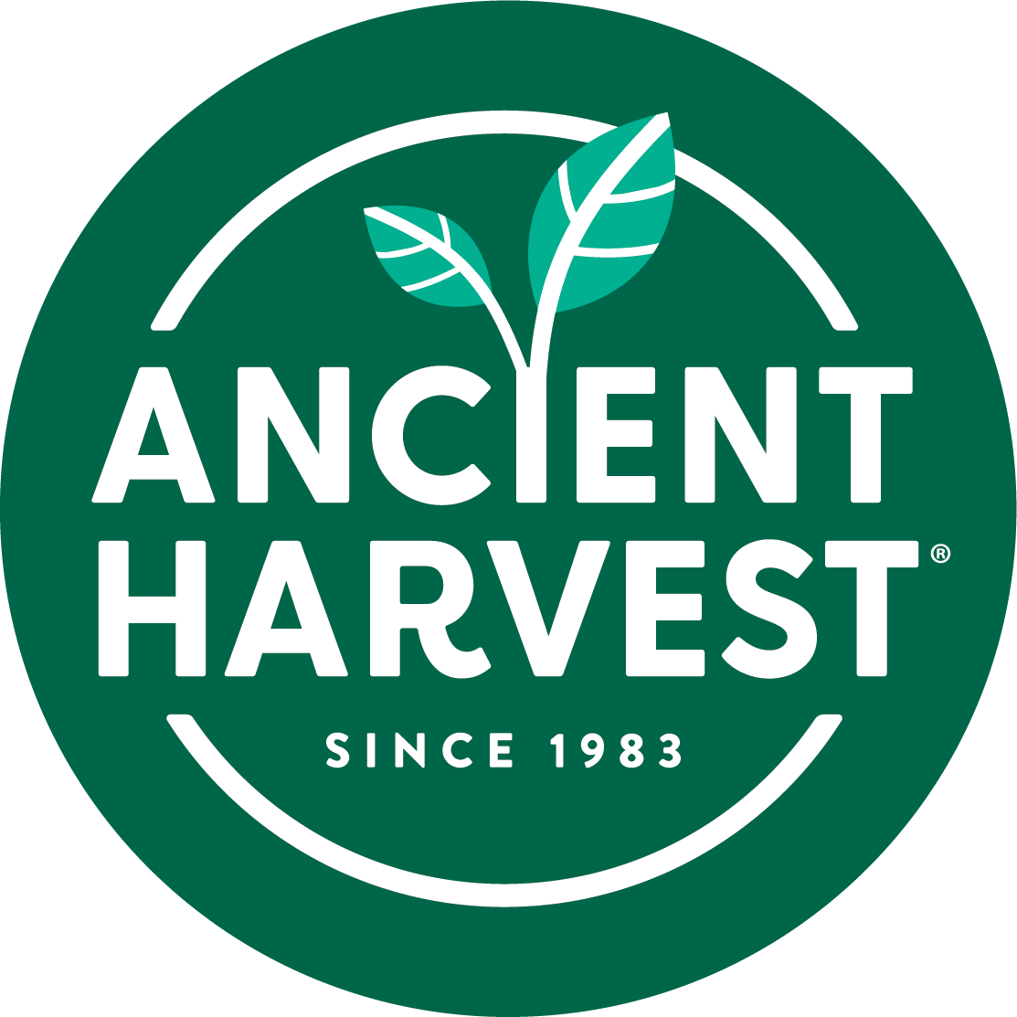
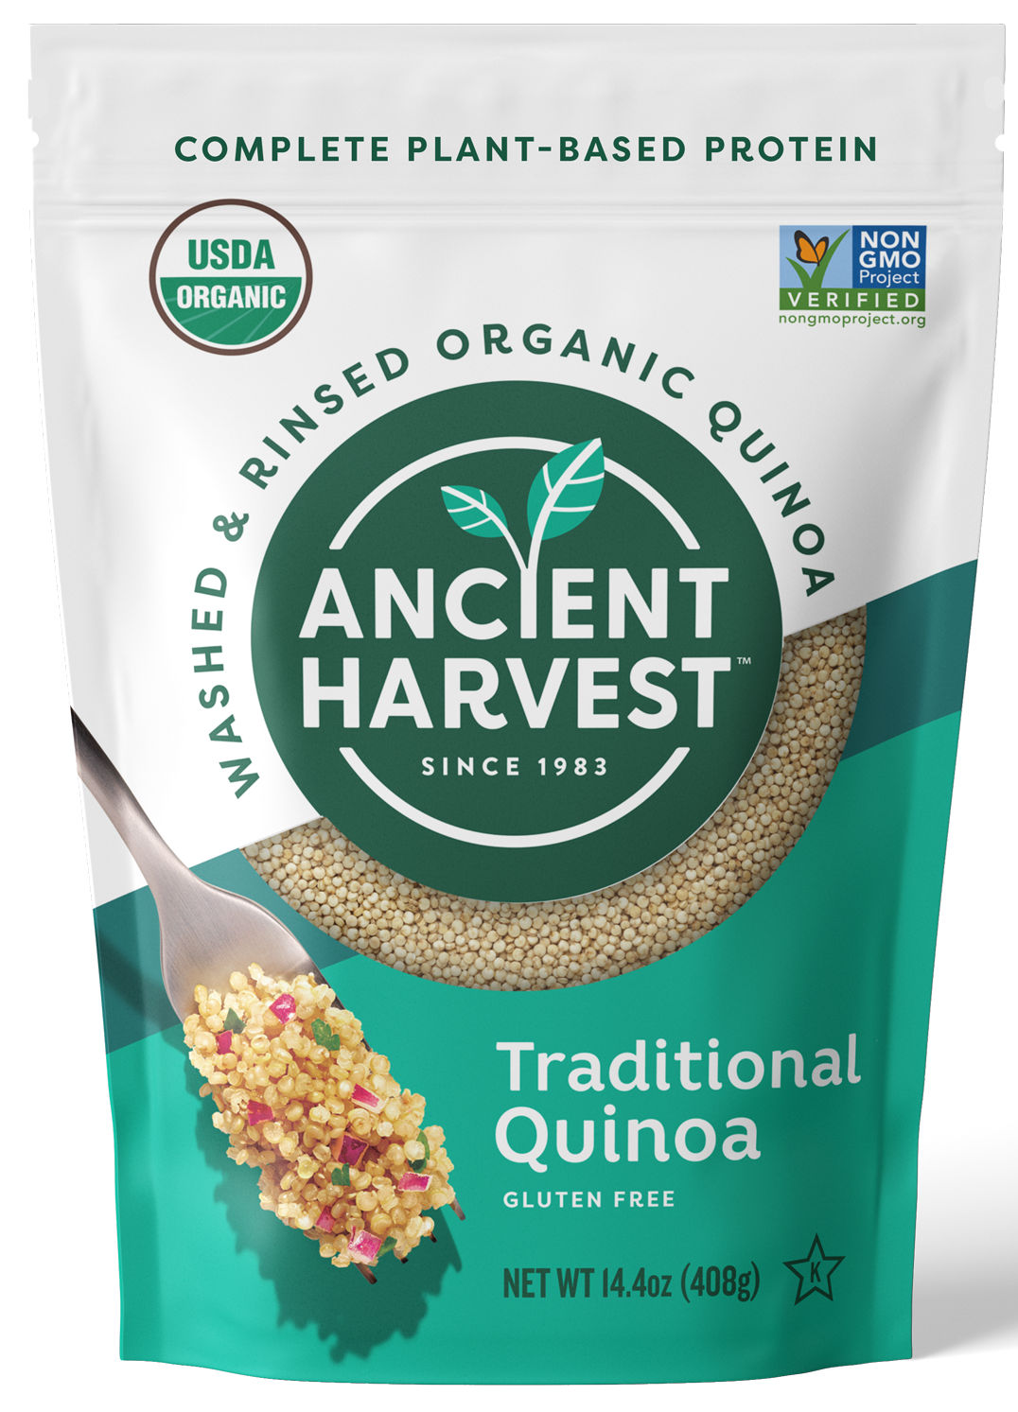
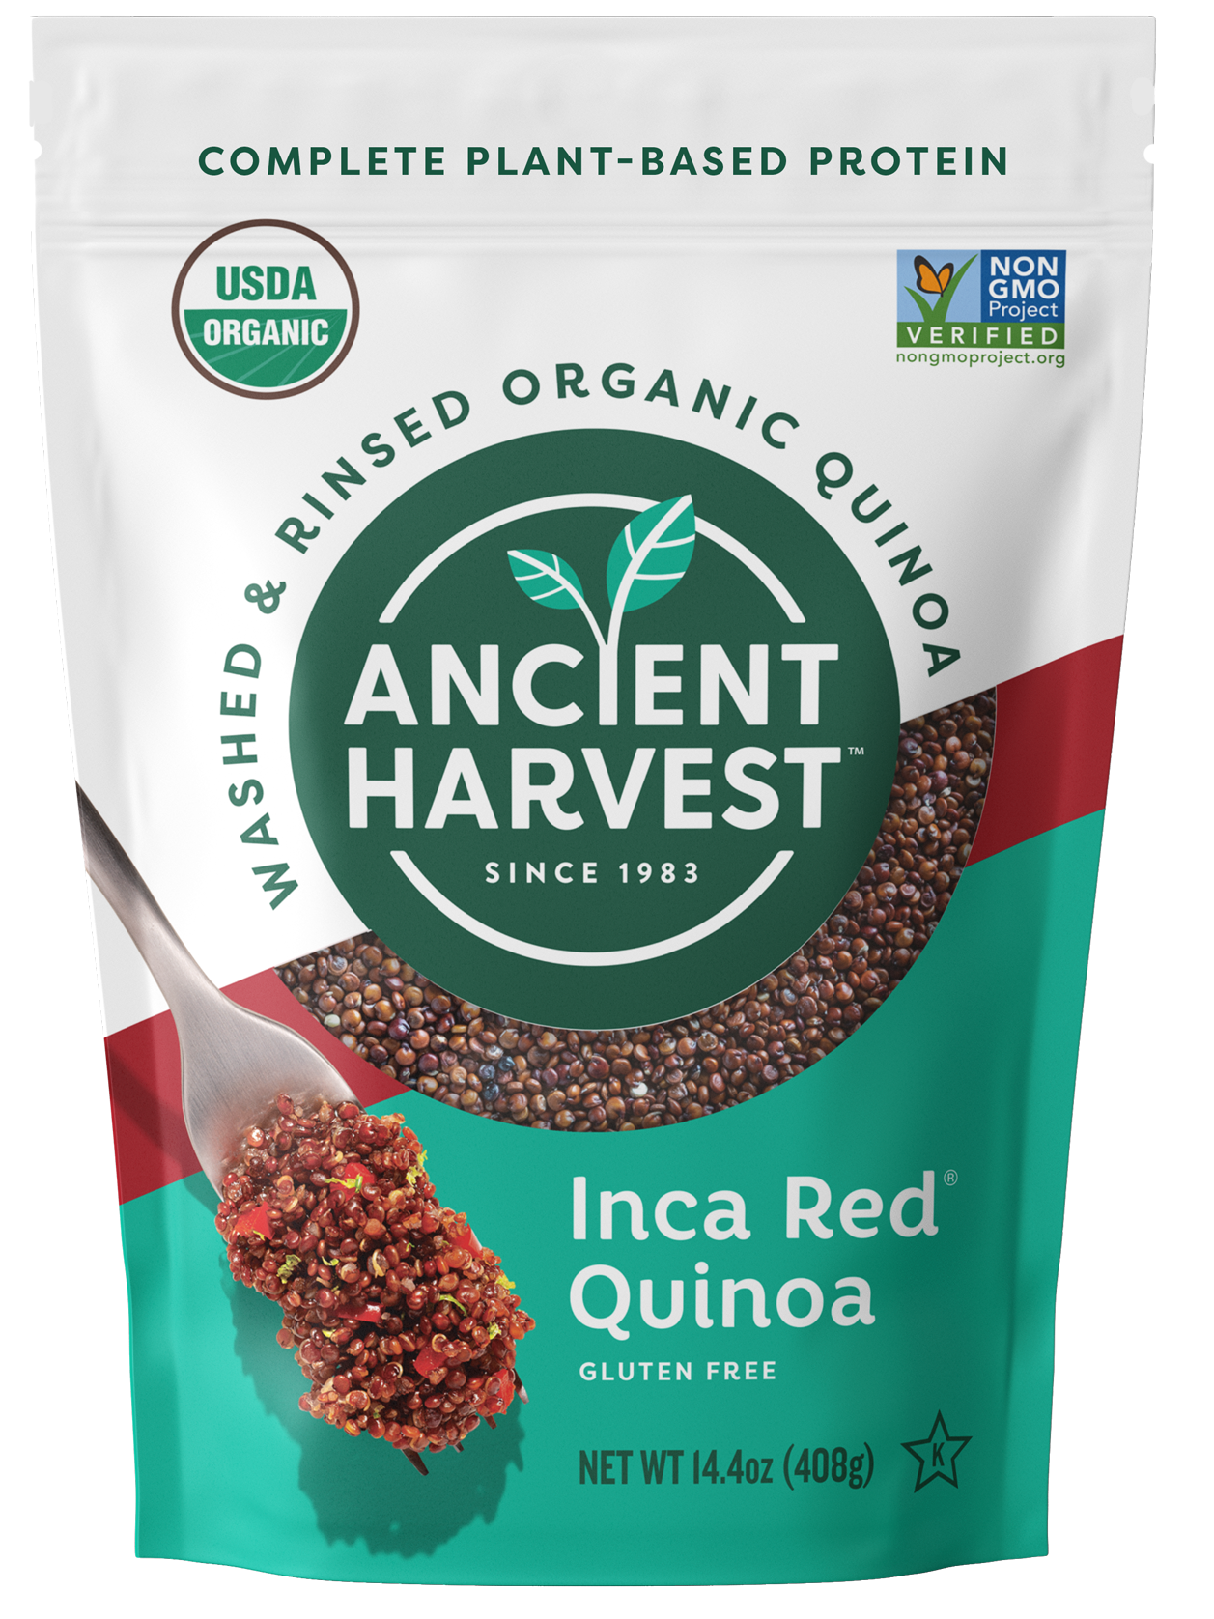
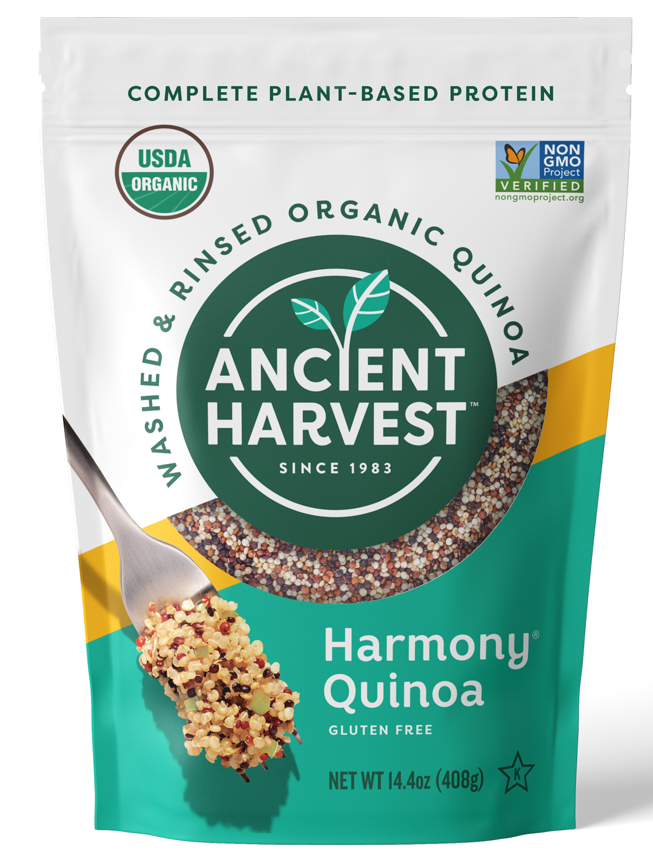
Ancient Harvest Quinoa
Let The #1 Brand Drive Your Category Growth!
Quinoa Category $ Share in 2020
Quinoa Category Branded $ Growth 2020
31%
Ancient Harvest is the #1 brand in the US & is driving nearly 50% of the branded $ growth in the category
Ancient Harvest has a stable supply of quinoa with 3 primary suppliers working directly with farmers in North & South America
Source: SPINS – US MULO + US Natural Enhanced Channels – Quinoa Category (excl. Private Label) – Past 52 Wks ending 12.27.20

Slide 6
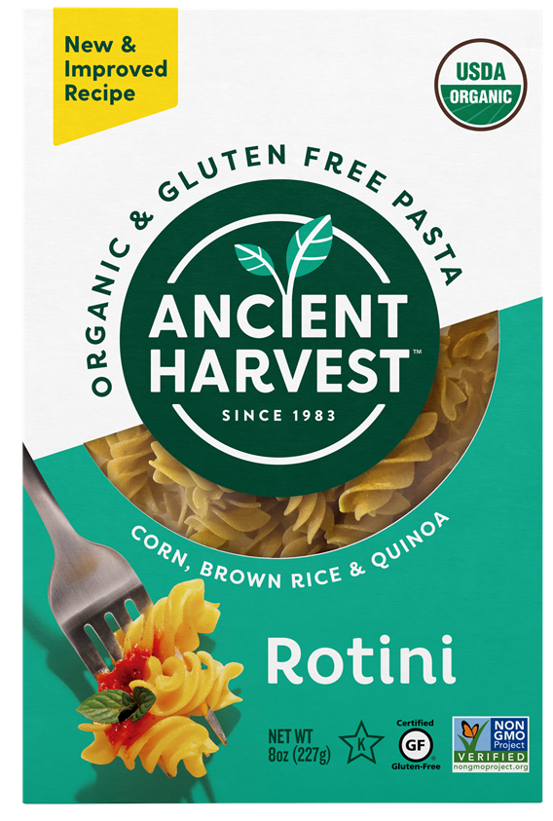

Ancient Harvest Organic Gluten Free Pasta
Benefits:
Gluten Free pasta category grew +40% in 2020
Ancient Harvest was one of the 1st Gluten Free pastas in the US (1984)
Corn, brown rice & quinoa blend
  New recipe delivers superior taste, texture & cook timing vs. other GF pasta options
Certified USDA Organic
Certified Gluten Free
Non-GMO Project Verified
Kosher
Product Details:
Varieties:
  Rotini – one of our top selling forms
Published Cost: $1.75 per unit FOB (pick-up)
8oz boxes / 12 count case

Slide 7
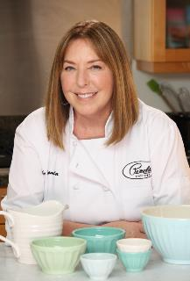


Pamela’s – Who We Are…
In 1988, Pamela (a 3rd generation baker) took her knowledge of the natural and gluten-free consumer to create Pamela’s Products. For 30+ years the brand has focused on delivering delicious, alternative ingredient foods to a fiercely loyal and growing consumer base.
In January 2020, Pamela’s Products was purchased by Ancient Harvest, joining 2 of the great heritage natural & gluten-free brands
Under new ownership, there is a strong commitment to invest and partner with key retailers to return this brand to growth
Our mission: Live by the principles Pamela instilled in this brand to delight consumers with great-tasting products & continue to innovate with alternative, premium ingredients to ensure everyone in the family can enjoy our products - no matter their dietary preference or need
What continues to make us different:
  Trusted natural brand with 30+ year track record of delicious products
  Innovative recipes that allow consumers to avoid certain ingredients while
  not compromising on taste or quality
  Always Certified Gluten-Free
  Prioritizing organic, whole grain & Non-GMO ingredients

Slide 8
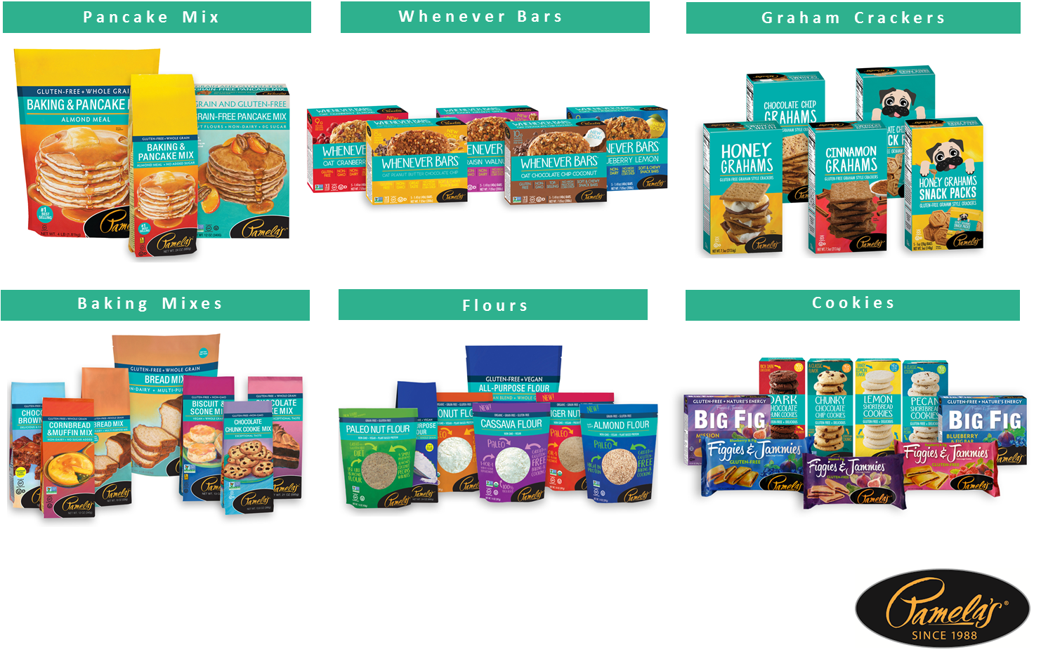
Pamela’s Product Portfolio

Slide 9
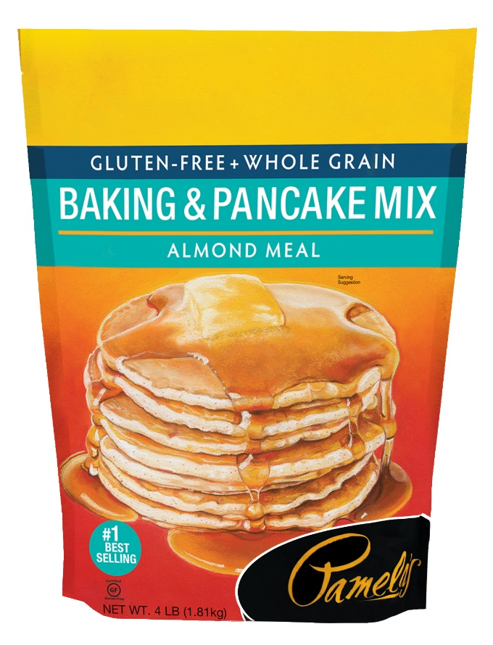
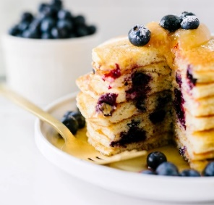
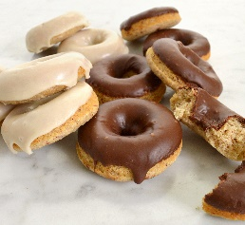
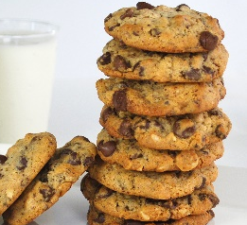
Pamela’s Baking & Pancake Mix
Benefits:
Gluten Free Certified
Whole Grains
No Added Sugar
Made with Almond Meal
  Good source of plant-based protein (4g / serving)
No Artificial Colors or Preservatives
Multi-Use Baking Occasions
  Cookies, breads, pancakes, waffles, donuts, and more!
Product Details:
64 oz (4.0lb)
$8.26 / unit FOB (pick-up)
3 units / case

Slide 10
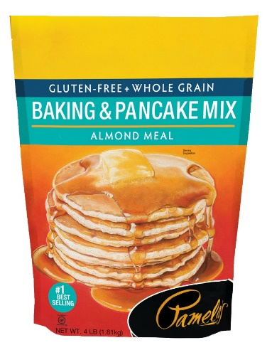
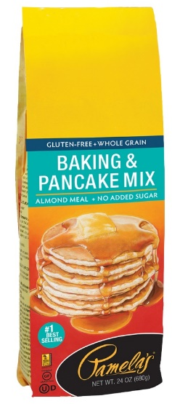
Pamela’s Pancake Sales & Productivity Performance
#1 most productive and Top 4 in $ sales ‘better-for-you’ pancake brand in Food & Natural channels
source: SPINS IRI - NPI Brands - US Natural Enhanced Channels – 24 weeks ending 12/27/2020 - SS Pancake & Waffle Mixes
Nielsen NPI brands- US FOOD Channel- 24 weeks ending in 12/26/2020- Pancake Mix, & All Purpose Baking Mix (Pamela’s 24 oz pancake mix)

Slide 11
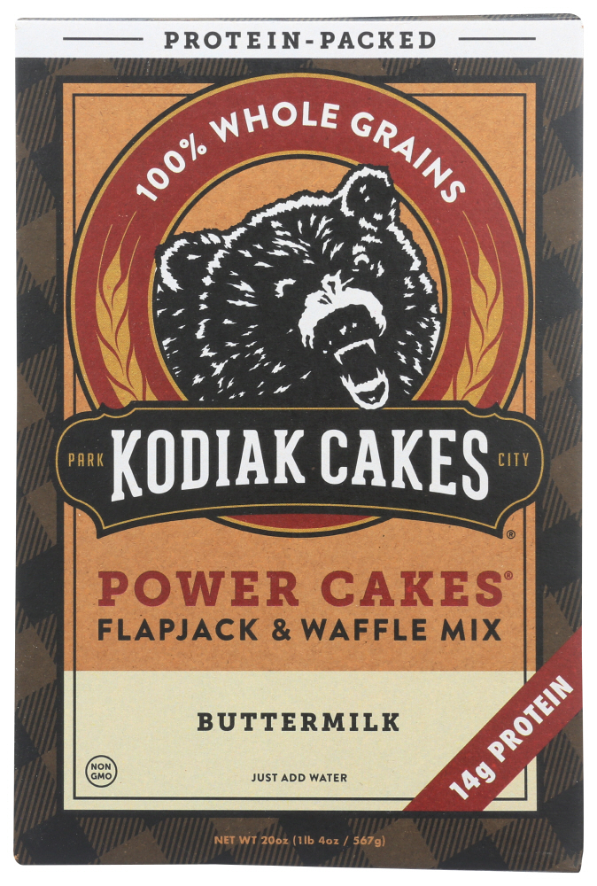
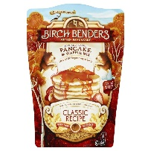
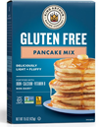
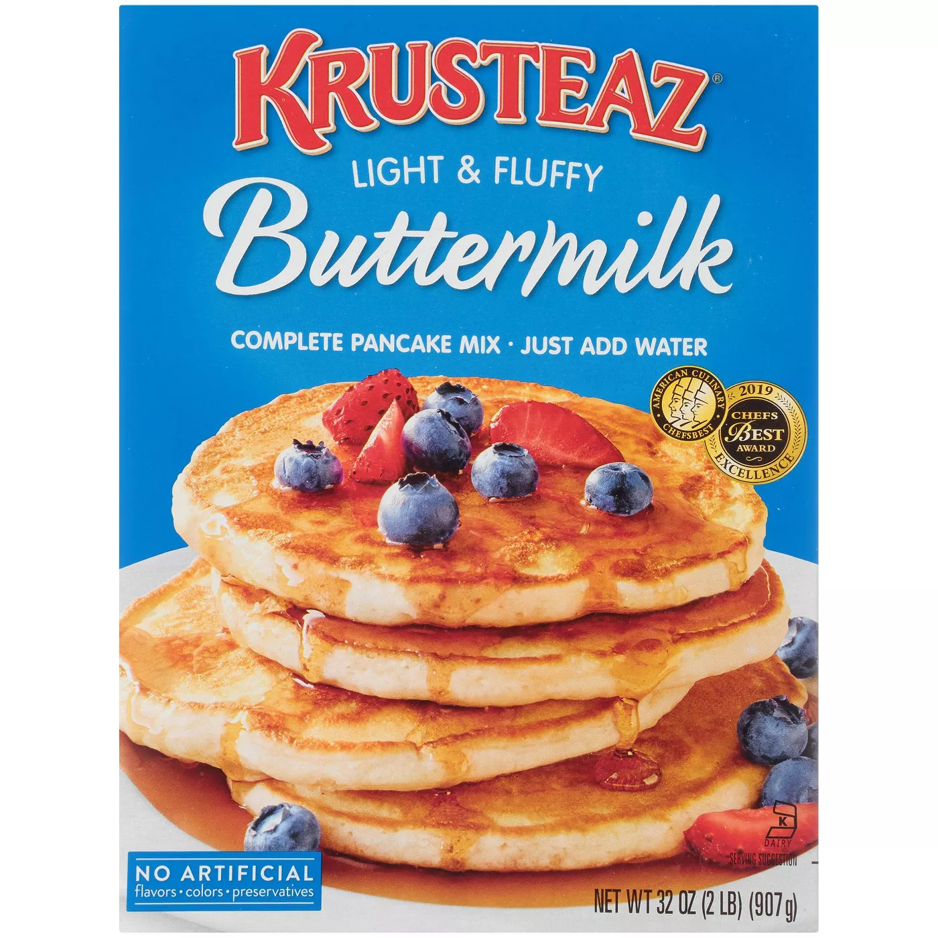
Pamela’s Pancakes are Superior to Competitive ‘Better-For-You’ Brands in Benefits Consumers Care About
Brand & Product | Gluten-Free | Added Sugars* | Whole Grain | Protein* | Carbs*
Pamela’s Baking & Pancake Mix | YES | NO | YES | 4g | 25g
Kodiak Cakes Power Cakes Buttermilk | NO | YES, 3g | YES | 14g | 30g
Birch Benders Classic Recipe | NO | YES, 6g | NO | 4g | 25g
King Arthur Gluten Free Pancake Mix | YES | YES, 4g | YES | 2g | 41g
Krusteaz Light & Fluffy | NO | YES, 10 g | NO | 4g | 45g
*based on 1 serving size dry mix as designated by brand

