Slide 1
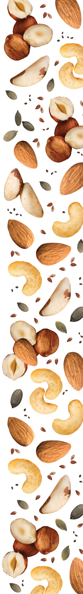


Slide 2

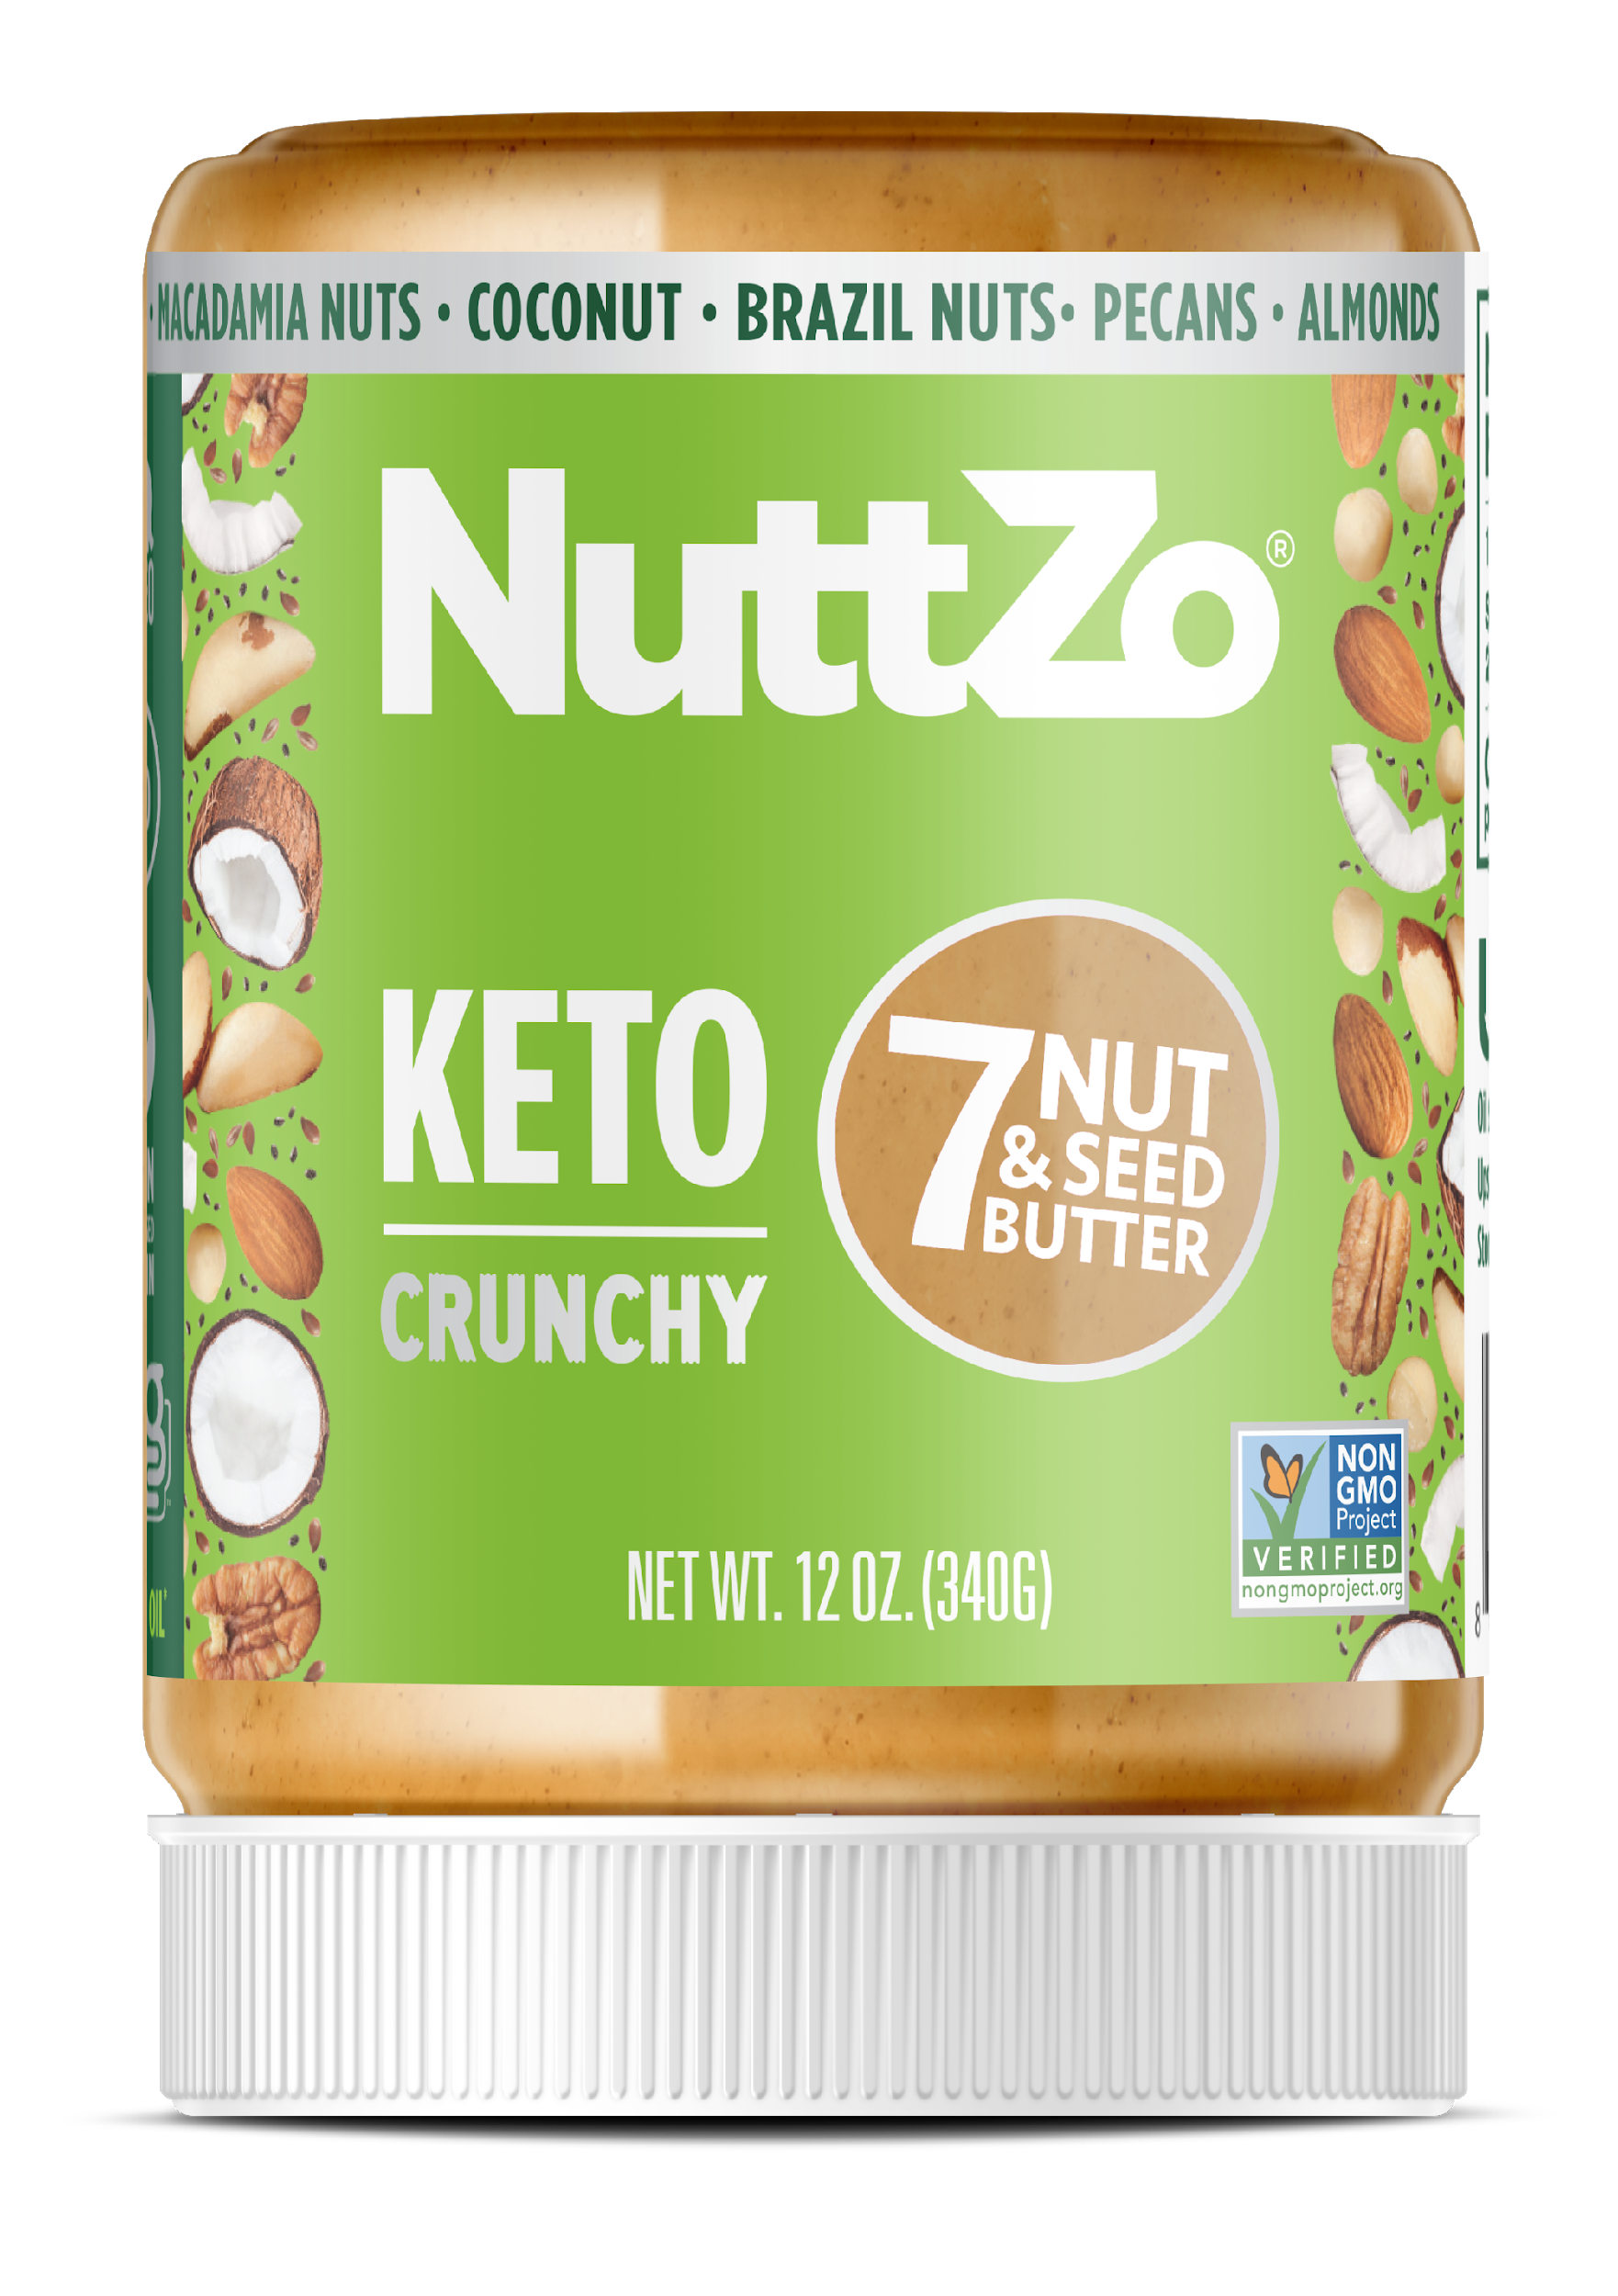
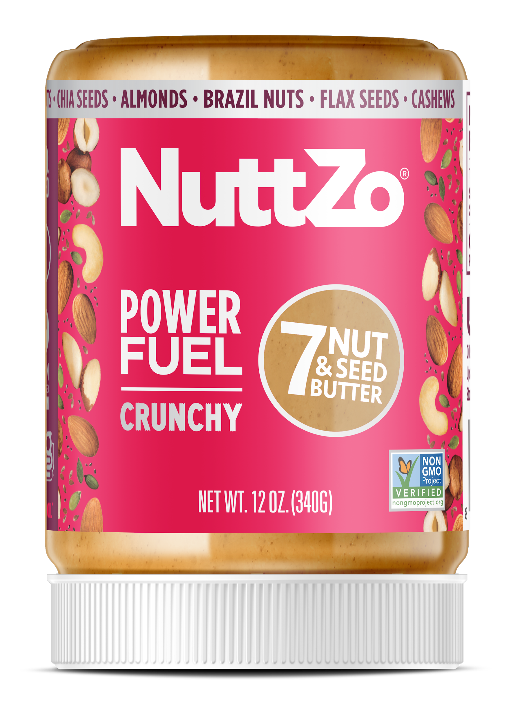
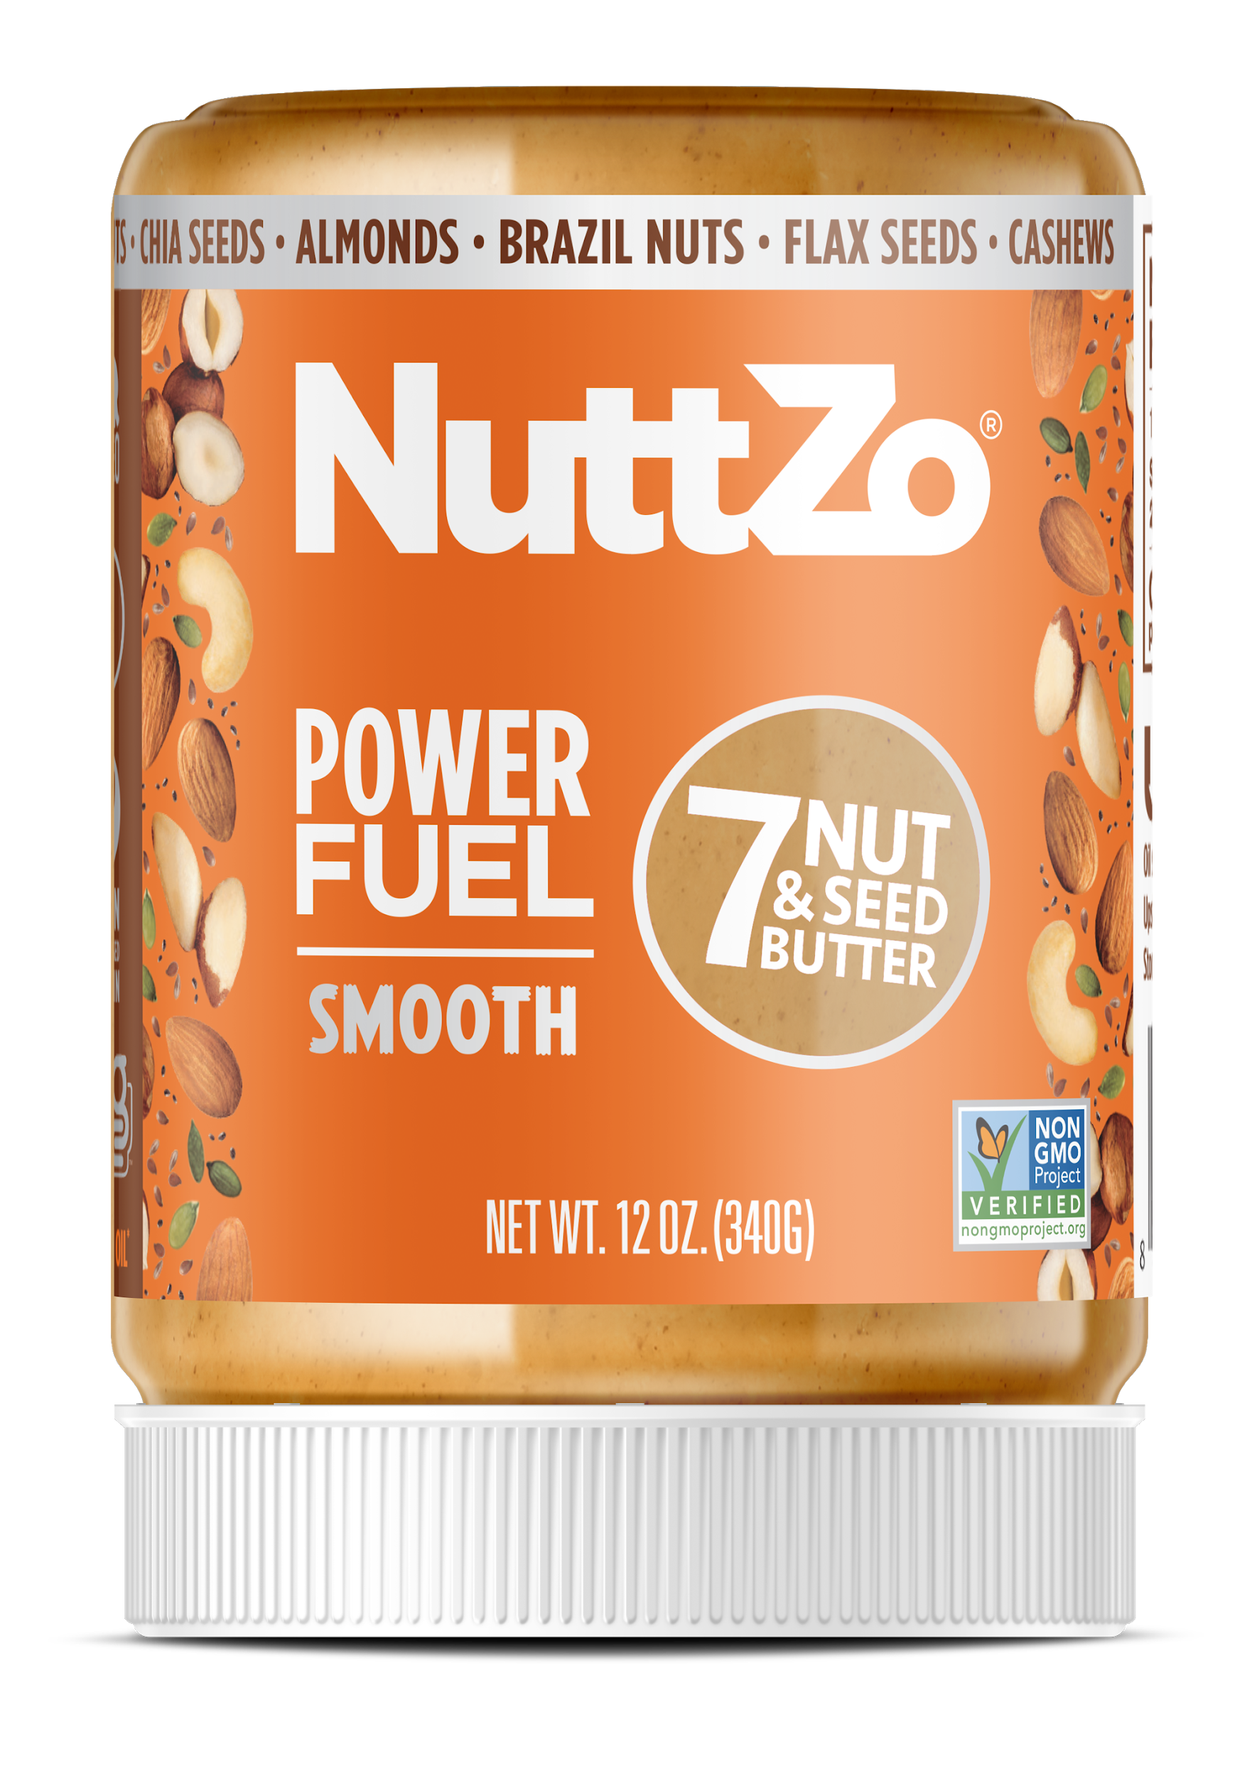
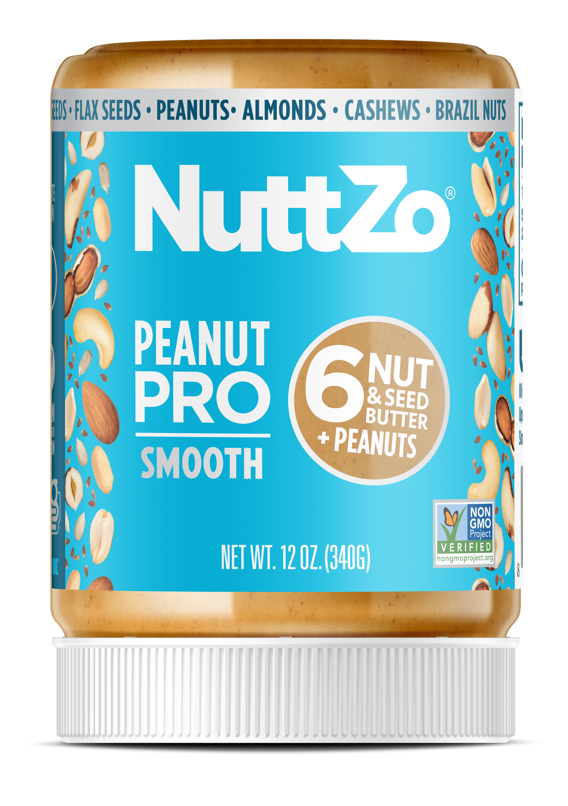
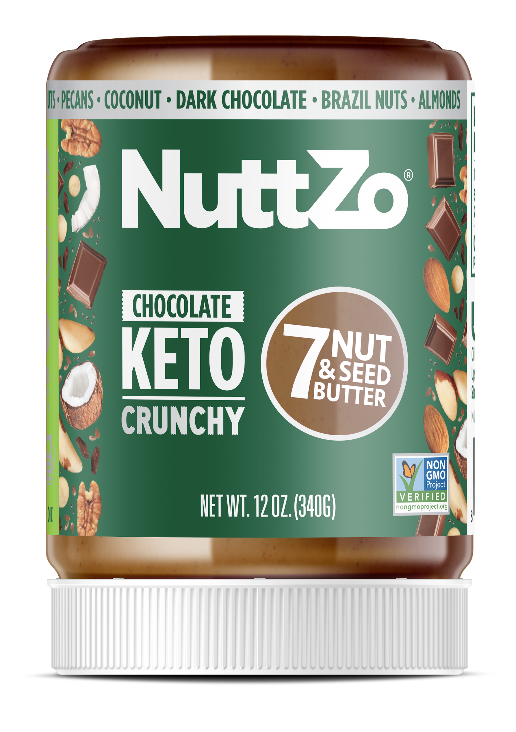
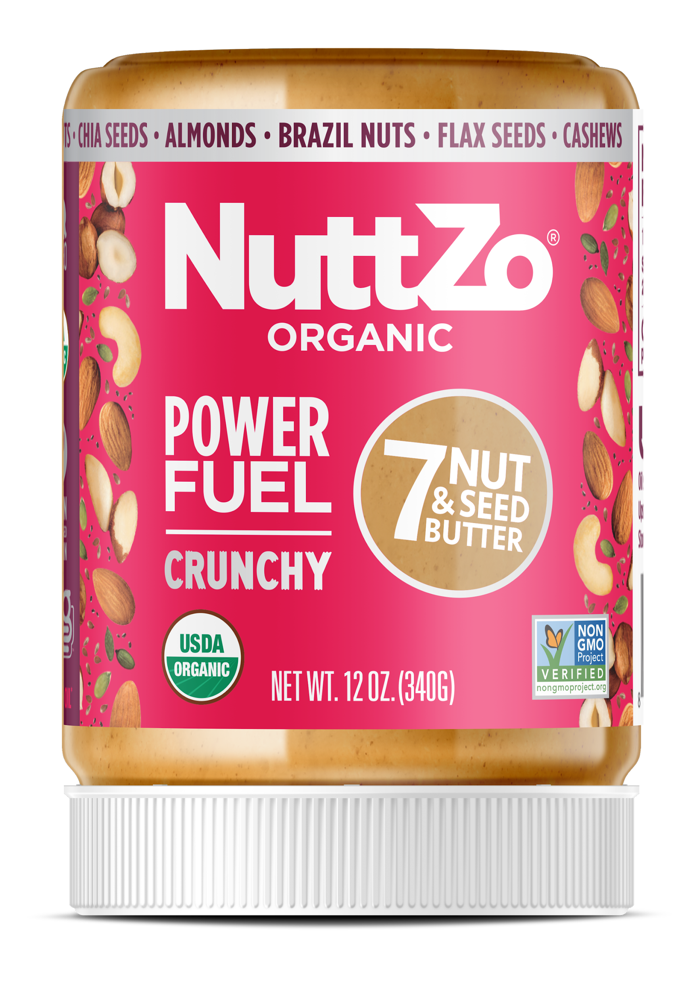
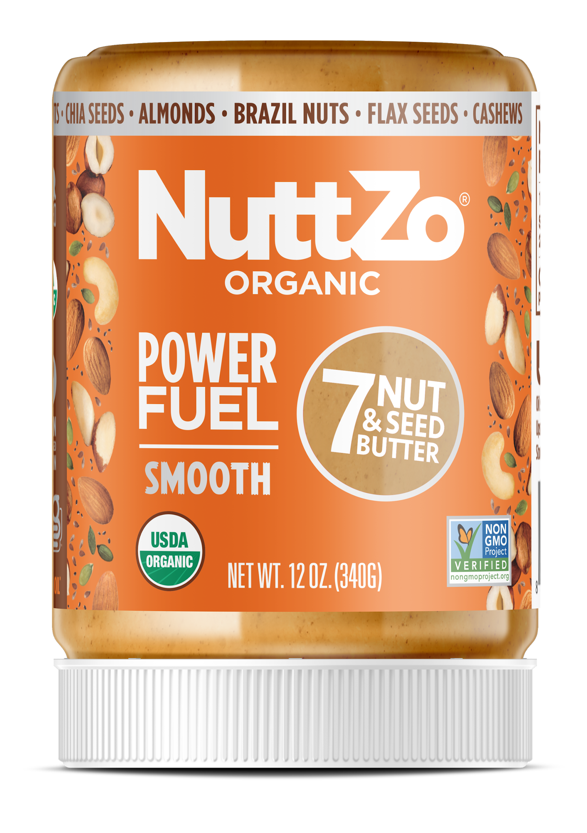
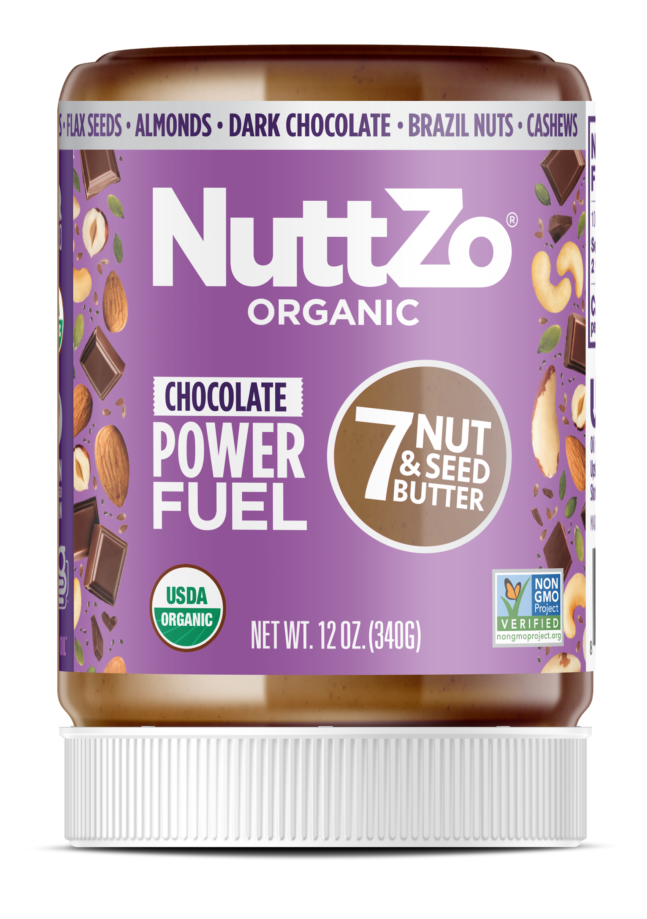
Product Line
Natural/Non-GMO 12oz Jars, 6pk
#1
#2
#3
#4
New!
Keto
Crunchy
Power Fuel
Crunchy
Power Fuel
Smooth
Peanut Pro
Smooth
Chocolate
Keto
UPC: 894697002788
UPC: 894697002306
UPC: 894697002290
UPC: 894697002276
UPC: 894697002894
Organic 12oz Jars, 6pk
#1
#2
#3
Power Fuel
Crunchy
Power Fuel
Smooth
Chocolate Power Fuel
UPC: 894697002375
UPC: 894697002382
UPC: 894697002412

Slide 3


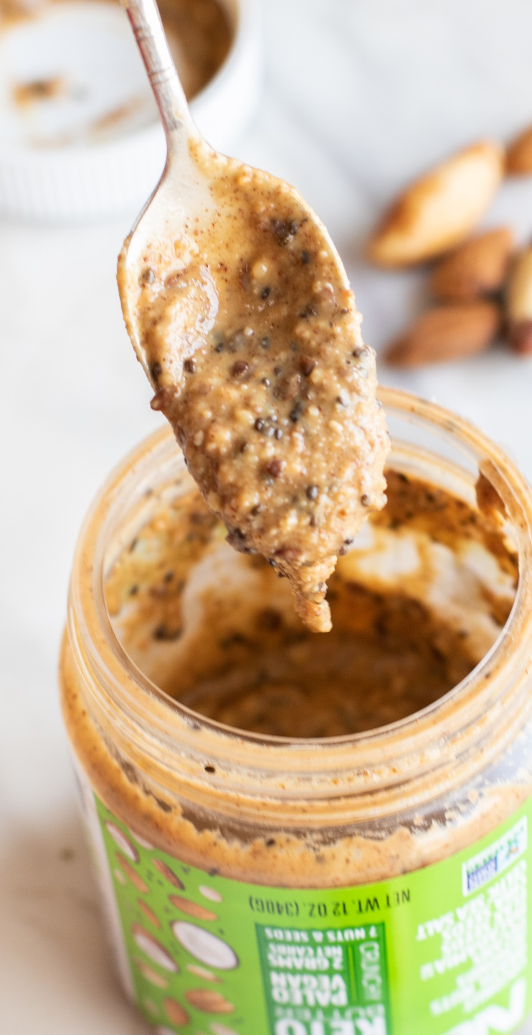

2
1
+
=
Adopted nutrient-
deficient boys
Mom on
a mission

Slide 4
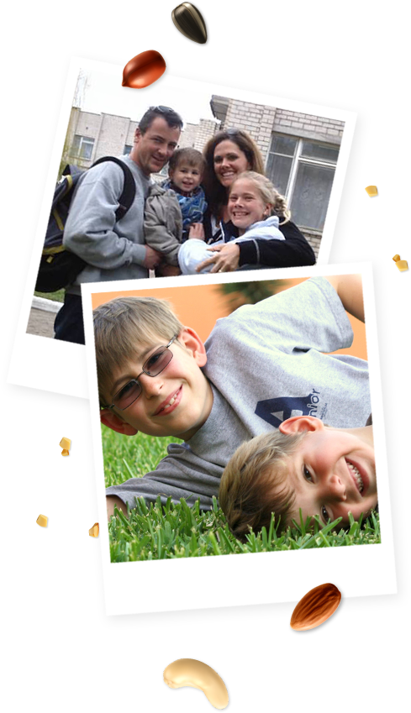






Sometimes life’s unexpected twists and turns lead you to your best life. When I adopted my sons internationally in 2002 and 2005, they were both extremely nutrient-deficient. In desperation, I took to the kitchen and blended a variety of nuts and seeds to make a delicious protein source for them.
Voilà, the nut and seed butter brand ‘NuttZo’ was born!
At the heart of NuttZo is our mission to spread health and happiness all over the world. While launching NuttZo, we created a non-profit that remains core to who we are today. Making a real difference is what motivates us most. Every sale of NuttZo supports Project Left Behind, helping orphaned and underprivileged children in Peru and India.

Slide 5
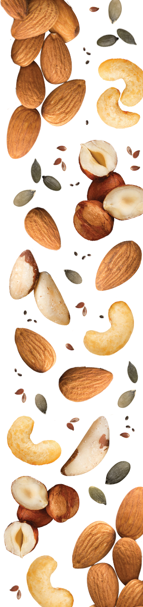

NuttZo is committed to revolutionizing the natural peanut and nut butter category by producing mega-nutritious “superfoods” that taste out of this world.
NuttZo is dedicated to helping transform the plight of orphaned and disadvantaged children in India and Peru through our 501(c)(3) non-profit, Project Left Behind.

Slide 6
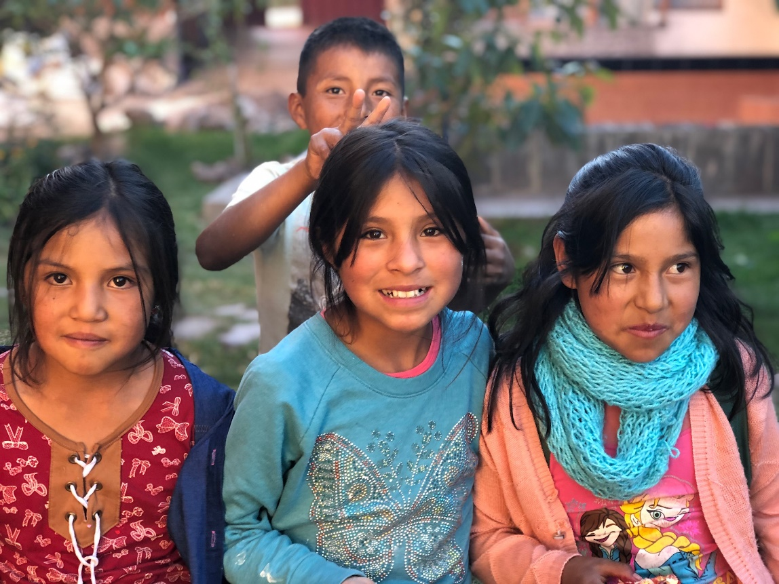

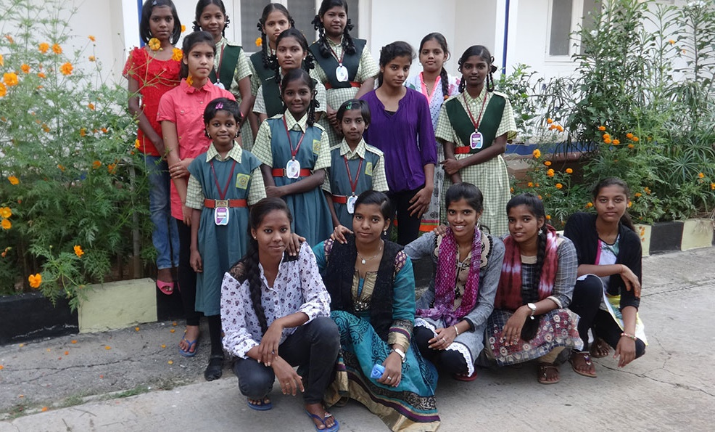
^{22 Children Providing:}
Food, vital staff, education, utilities, household supplies, and healthcare
^{17 Young Women and Girls} ^{Providing:}
Education, living expenses, food and water, building maintenance, and safe transportation to and from school to combat human-trafficking
^{10 Higher Education Grants:}
Providing full scholarships to trade schools and universities for children who would never otherwise have had the opportunity to further their education.
Hogar Semillas de Jesus
Urubamba, Peru
Tender Loving Care Orphanage
Hyderabad, India
Since 2011, NuttZo has contributed $100,000 as well as covers all overhead expenses so that 100% of donations go to the children.
PLB has raised over $500,000.
Annual PLB Voluntour trips to Peru - NuttZo leads a team of 10-15 people to Peru every year to help maintain the children's home.
Visit the PLB Website:
projectleftbehind.org

Slide 7
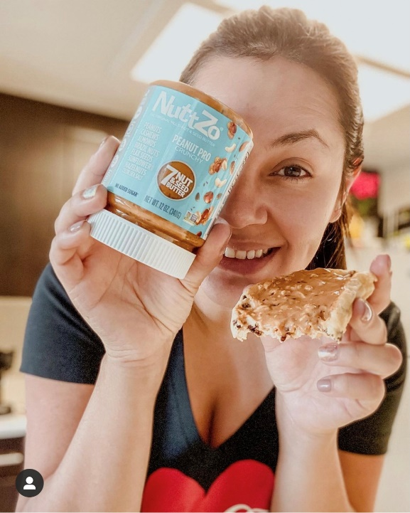
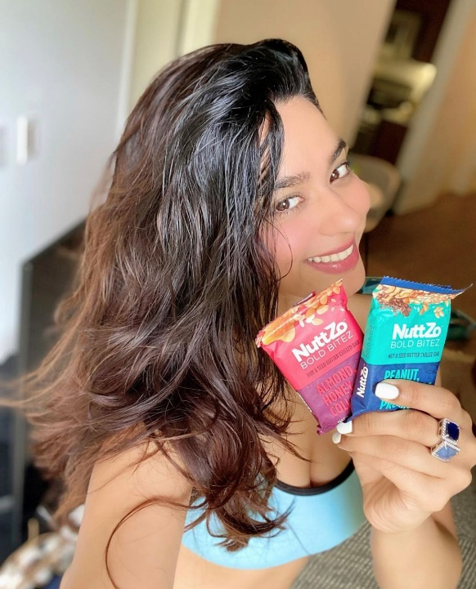

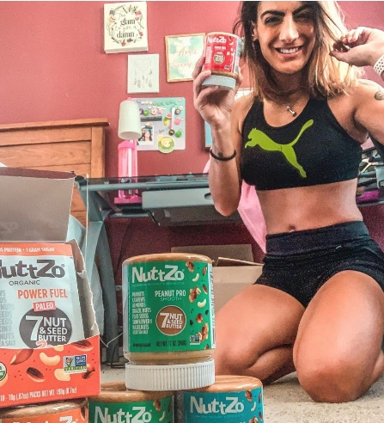
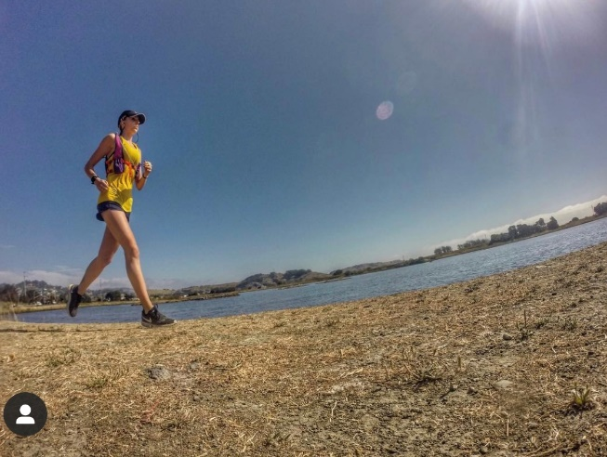
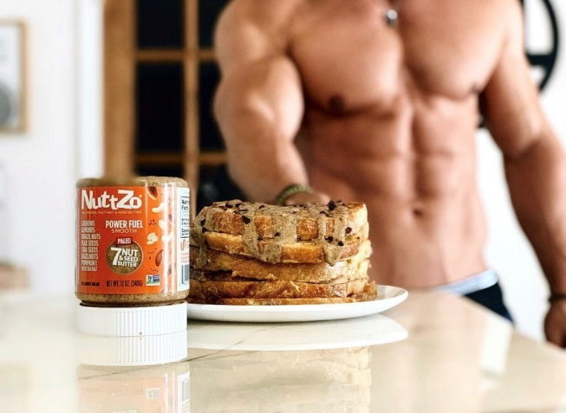
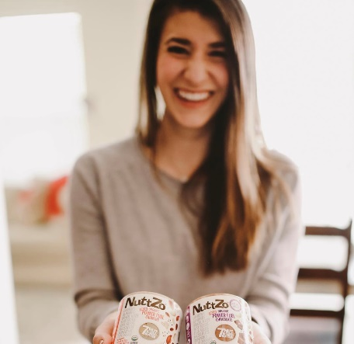
We are the nut-butter for all! We are the original mixed nut and seed butter with a
cult following of 22-45 year-old active,
health-conscious consumers concerned
with clean eating.
THIS INCLUDES:
Millennial moms
Healthy snackers and foodies
Outdoors enthusiasts +
adventure seekers
Athletes and exercisers
Vegan, Paleo, Gluten-Free, Vegetarian + Keto communities
NuttZo Fanatics love to fuel their bodies with NuttZo’s mixed nut and seed butter because it’s high in protein and healthy fats - and low in sugar.

Slide 8

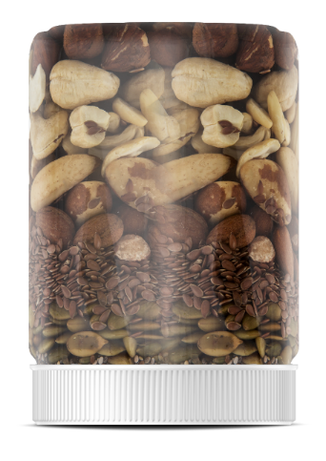





The original mixed nut & seed butter, brought to market in 2009
No added sugar*,
oils, or natural flavors
Supports Project Left Behind - a 501c3 non-profit organization
The only 7 nut & seed butter on the market
One-of-a-kind,
no-mess packaging
Unique blend of high quality ingredients to provide a variety of vitamins and minerals
NATURAL
All Natural, Vegan, Gluten Free, Non GMO, Kosher
*Coconut sugar is included in the chocolate in Chocolate Power Fuel

Slide 9



EASIER TO STIR
NO EMULSIFIERS
NO PALM OIL
NuttZo’s label is on upside down not just because we think it’s eye-catching but because we want it stored on its lid while sitting on the store shelves. The natural oils separate to the bottom of the jar which is really the top. This makes for NO mess when the customer finally opens the jar at home and stirs in all that nutty goodness.

Slide 10





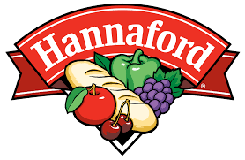


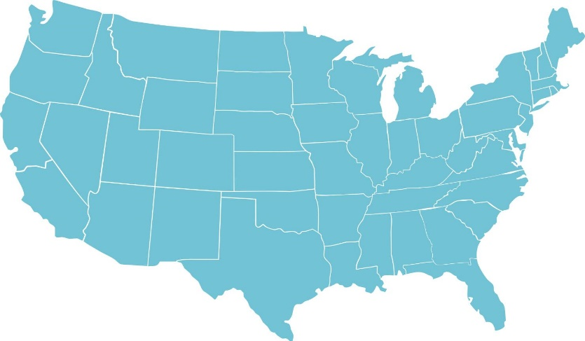








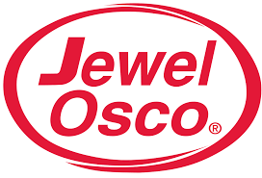

















Sold in over 10,000 stores nationwide and in Canada
National Accounts:

Slide 11








NuttZo vs.
Other Nut
Butters
No Sugar Added
Donates to Non-Profit
7 Nuts & Seeds
Woman Owned
Brazil Nuts
Flax Seeds
Pumpkin Seeds
Almonds
Hazelnuts
Non-GMO
Complete Protein
Chia Seeds
Cashews
Vegan
No Palm Oil

Slide 12
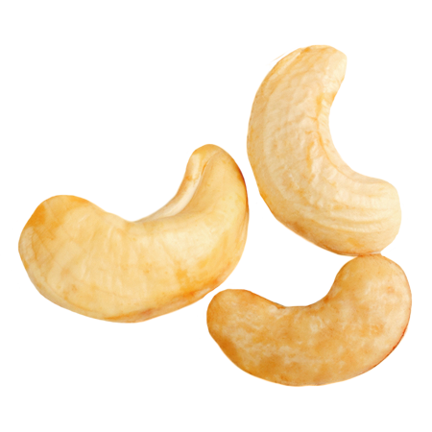
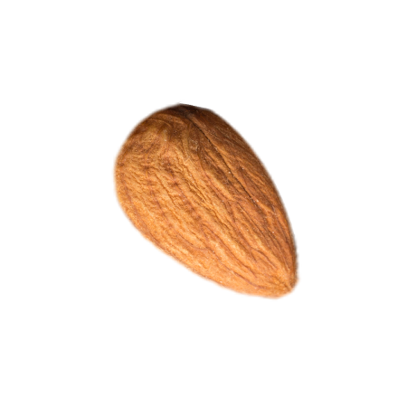
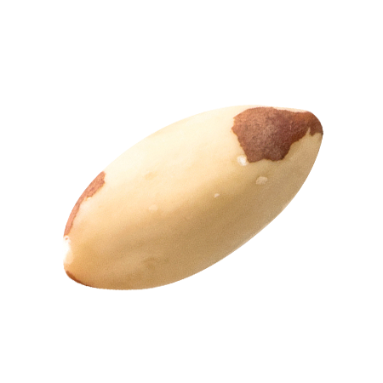
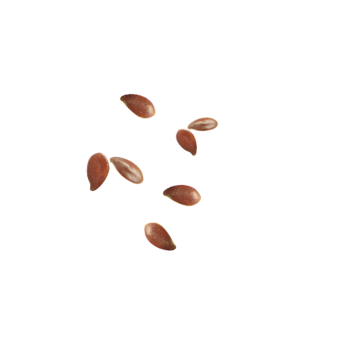
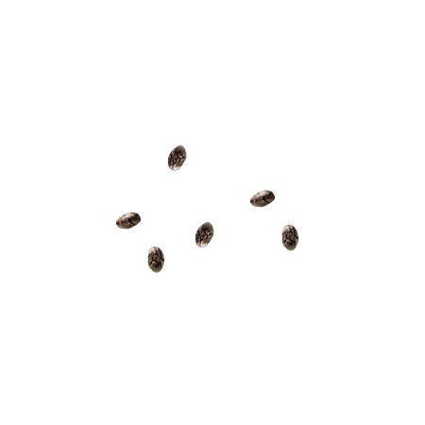
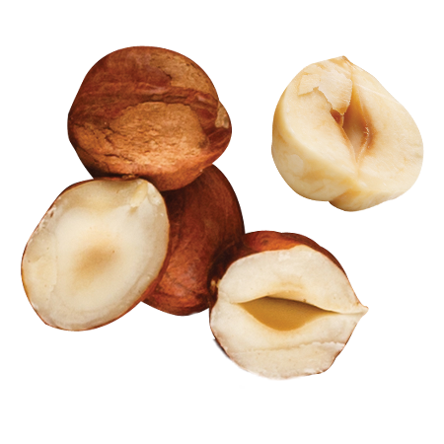
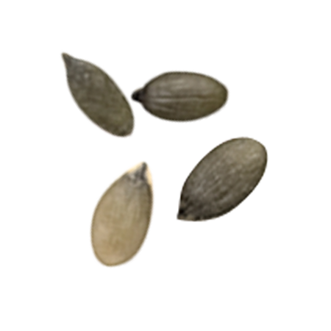
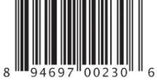
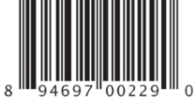
Nuts & Seeds In Every Jar
7
Unlike a mono-nut butter, NuttZo has 7 nuts & seeds in every jar
Unique blend of high- quality ingredients to provide a variety of vitamins and minerals
VEGAN (no honey or egg whites included)
All natural, Gluten Free, Non GMO, Kosher
Supports Project Left Behind - a 501c3 non-profit organization
One-of-a-kind,
no-mess packaging
CASHEWS
ALMONDS
BRAZIL NUTS
FLAX SEEDS
CHIA SEEDS
HAZELNUTS
PUMPKIN SEEDS

Slide 13
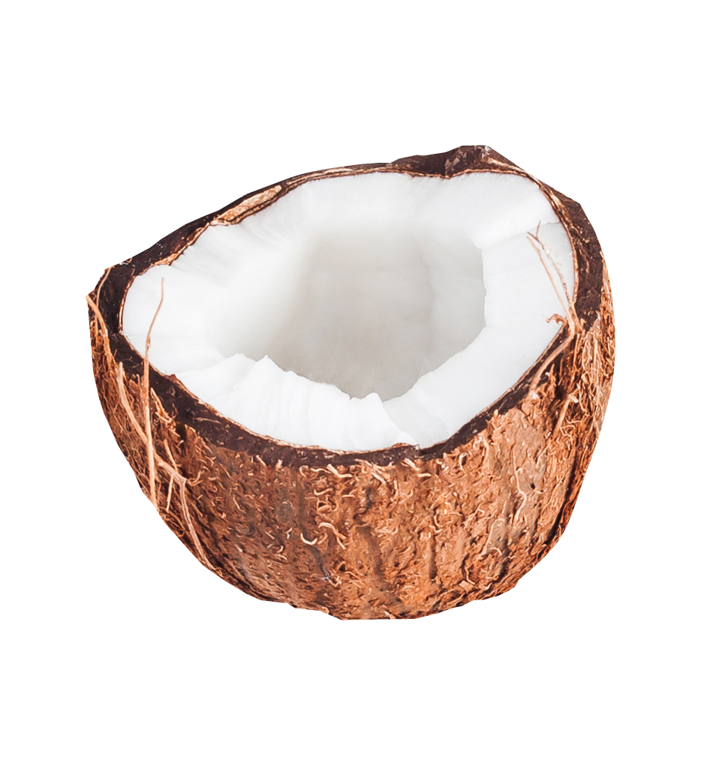
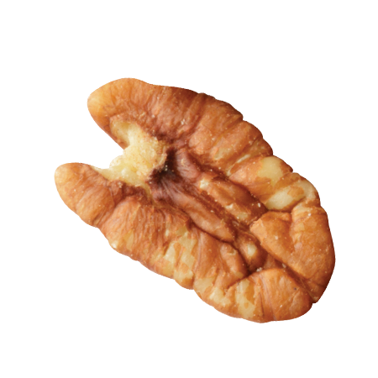
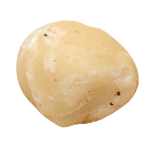
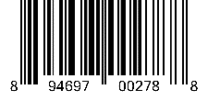

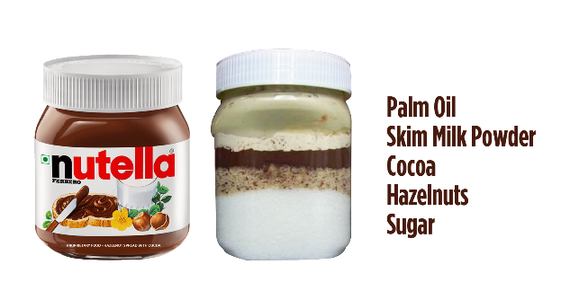
and satiating the health-conscious consumer appetite!
Keto
Keto Diet Trending: Our Keto Butter sales are UP +31.8%**
Only 2 net grams carbs
Paleo, Vegan, Non-GMO Project Verified
Gluten-Free, Peanut-Free, Soy-Free, Dairy-Free, Whey-Free
Chocolate Keto
Trending: Decadence!
Nutella dollar sales are UP +9.6%*
Only 4 net grams carbs
1 gram of sugar (No added sugar)
Nutella has 21 grams sugar
No added Palm Oil
Nutella adds palm oil
Made with Organic 100%
Dark Chocolate
ALMONDS
COCONUT
BRAZIL NUTS
PECANS
MACADAMIA NUTS
FLAX SEEDS
CHIA SEEDS
*SPINS MULO 4 wks, 7/11/2021 | **SPINS Natural Channel 24 Weeks 07/11/2021 | ***Coconut sugar is included in the chocolate in Chocolate Keto.

Slide 14
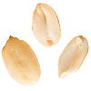
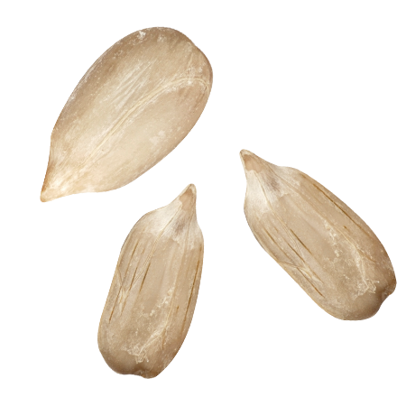
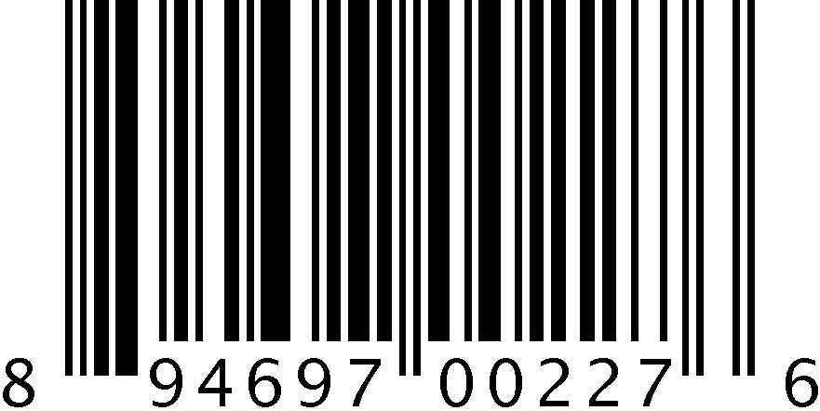
Nuts & Seeds In Every Jar
7
Unlike a mono-nut butter, NuttZo has 7 nuts & seeds in every jar
Unique blend of high- quality ingredients to provide a variety of vitamins and minerals
VEGAN (no honey or egg whites included)
All natural, Gluten Free, Non GMO, Kosher
Supports Project Left Behind - a 501c3 non-profit organization
One-of-a-kind,
no-mess packaging
PEANUTS
CASHEWS
ALMONDS
BRAZIL NUTS
FLAX SEEDS
SUNFLOWER
SEEDS
HAZELNUTS

