Slide 1
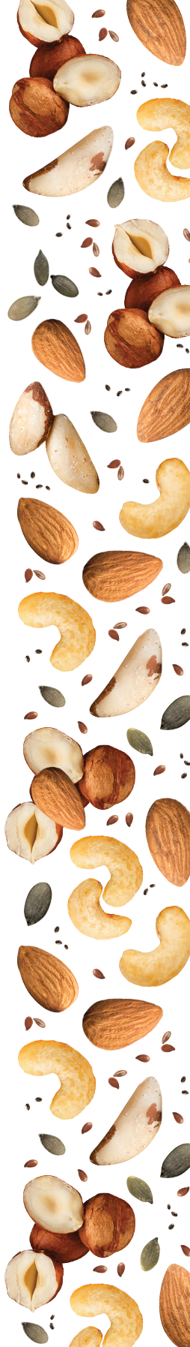


Slide 2


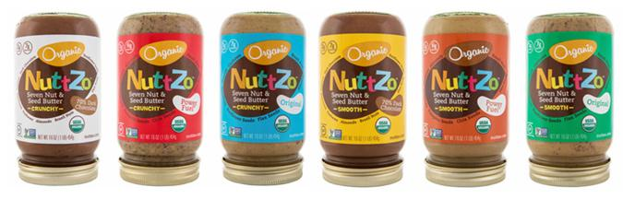
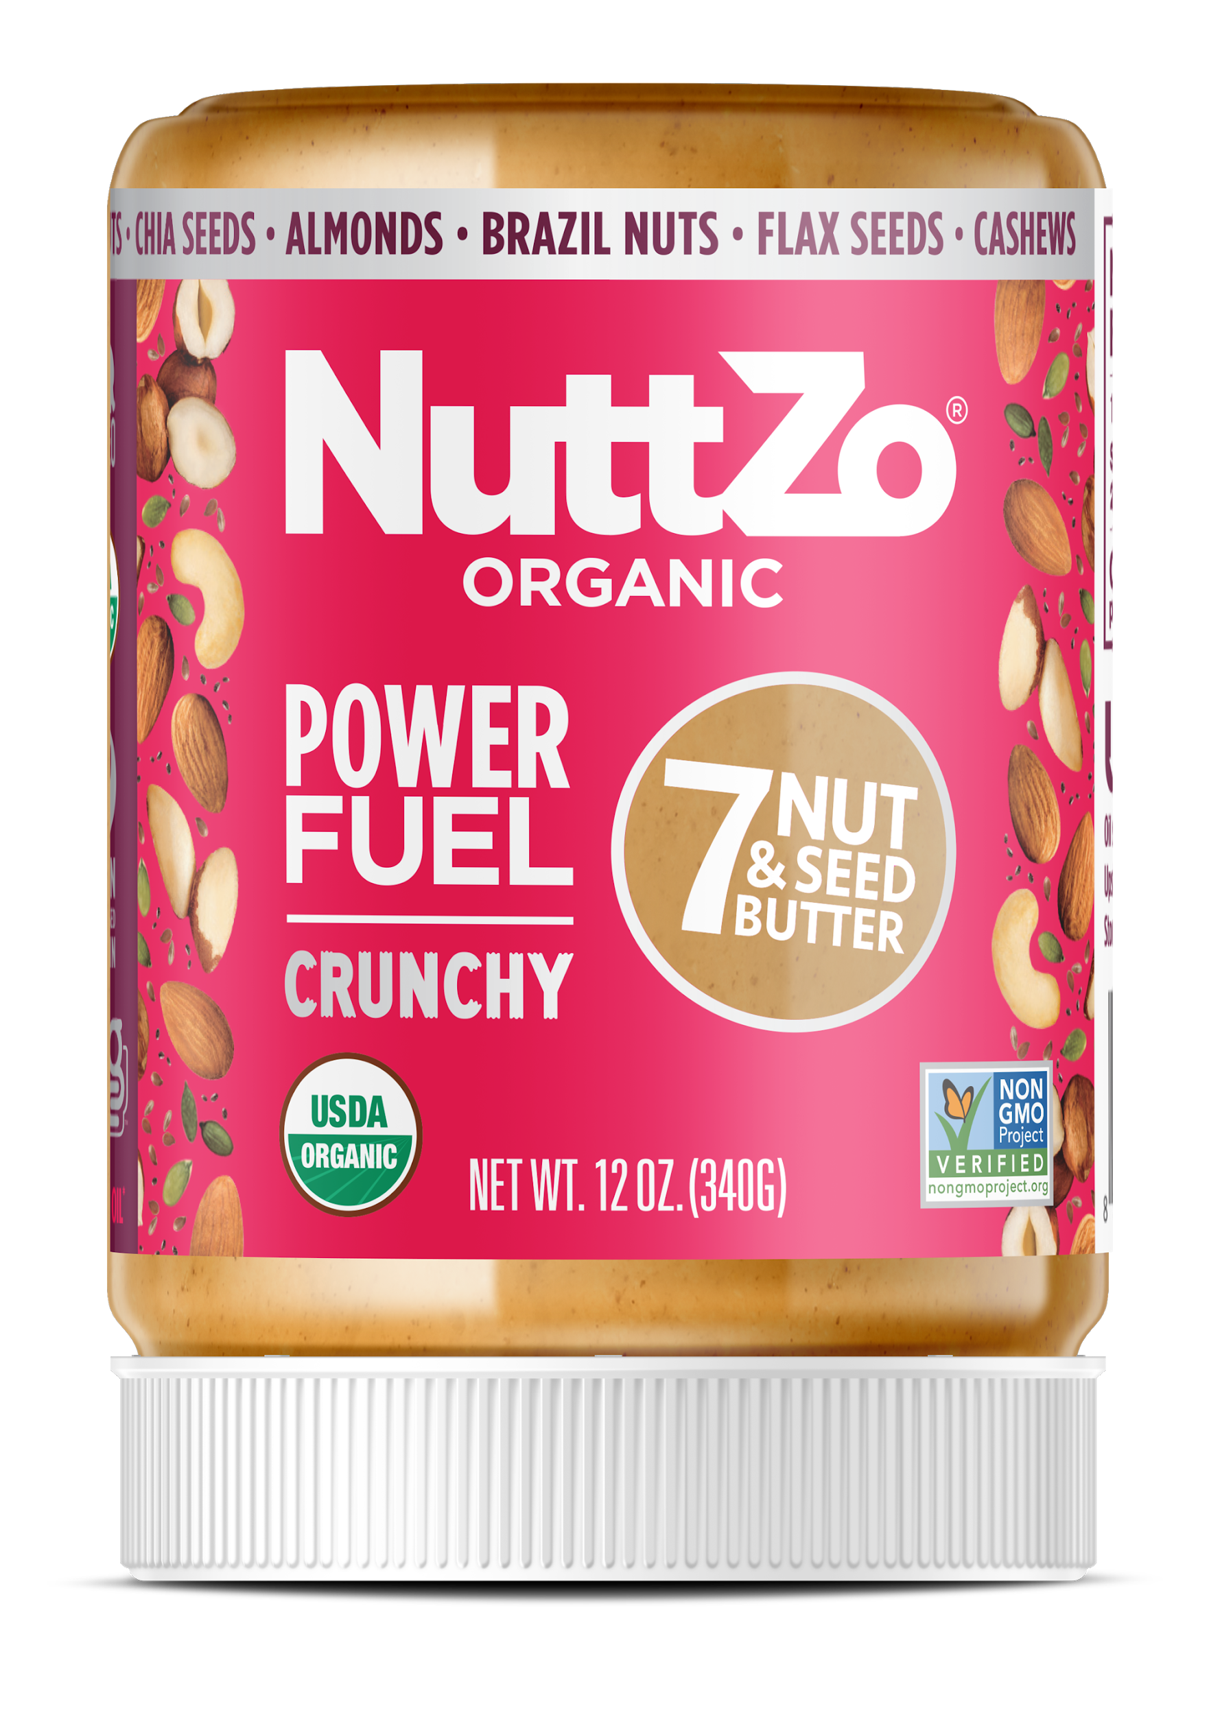
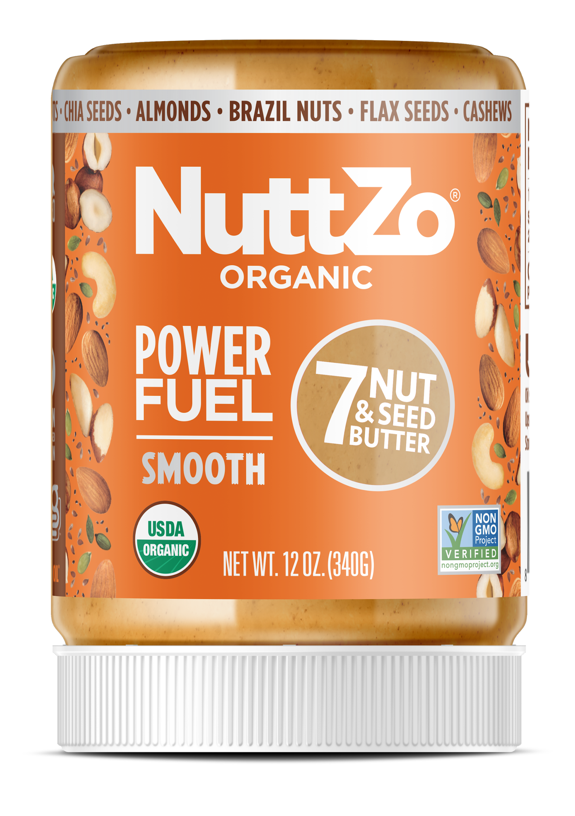
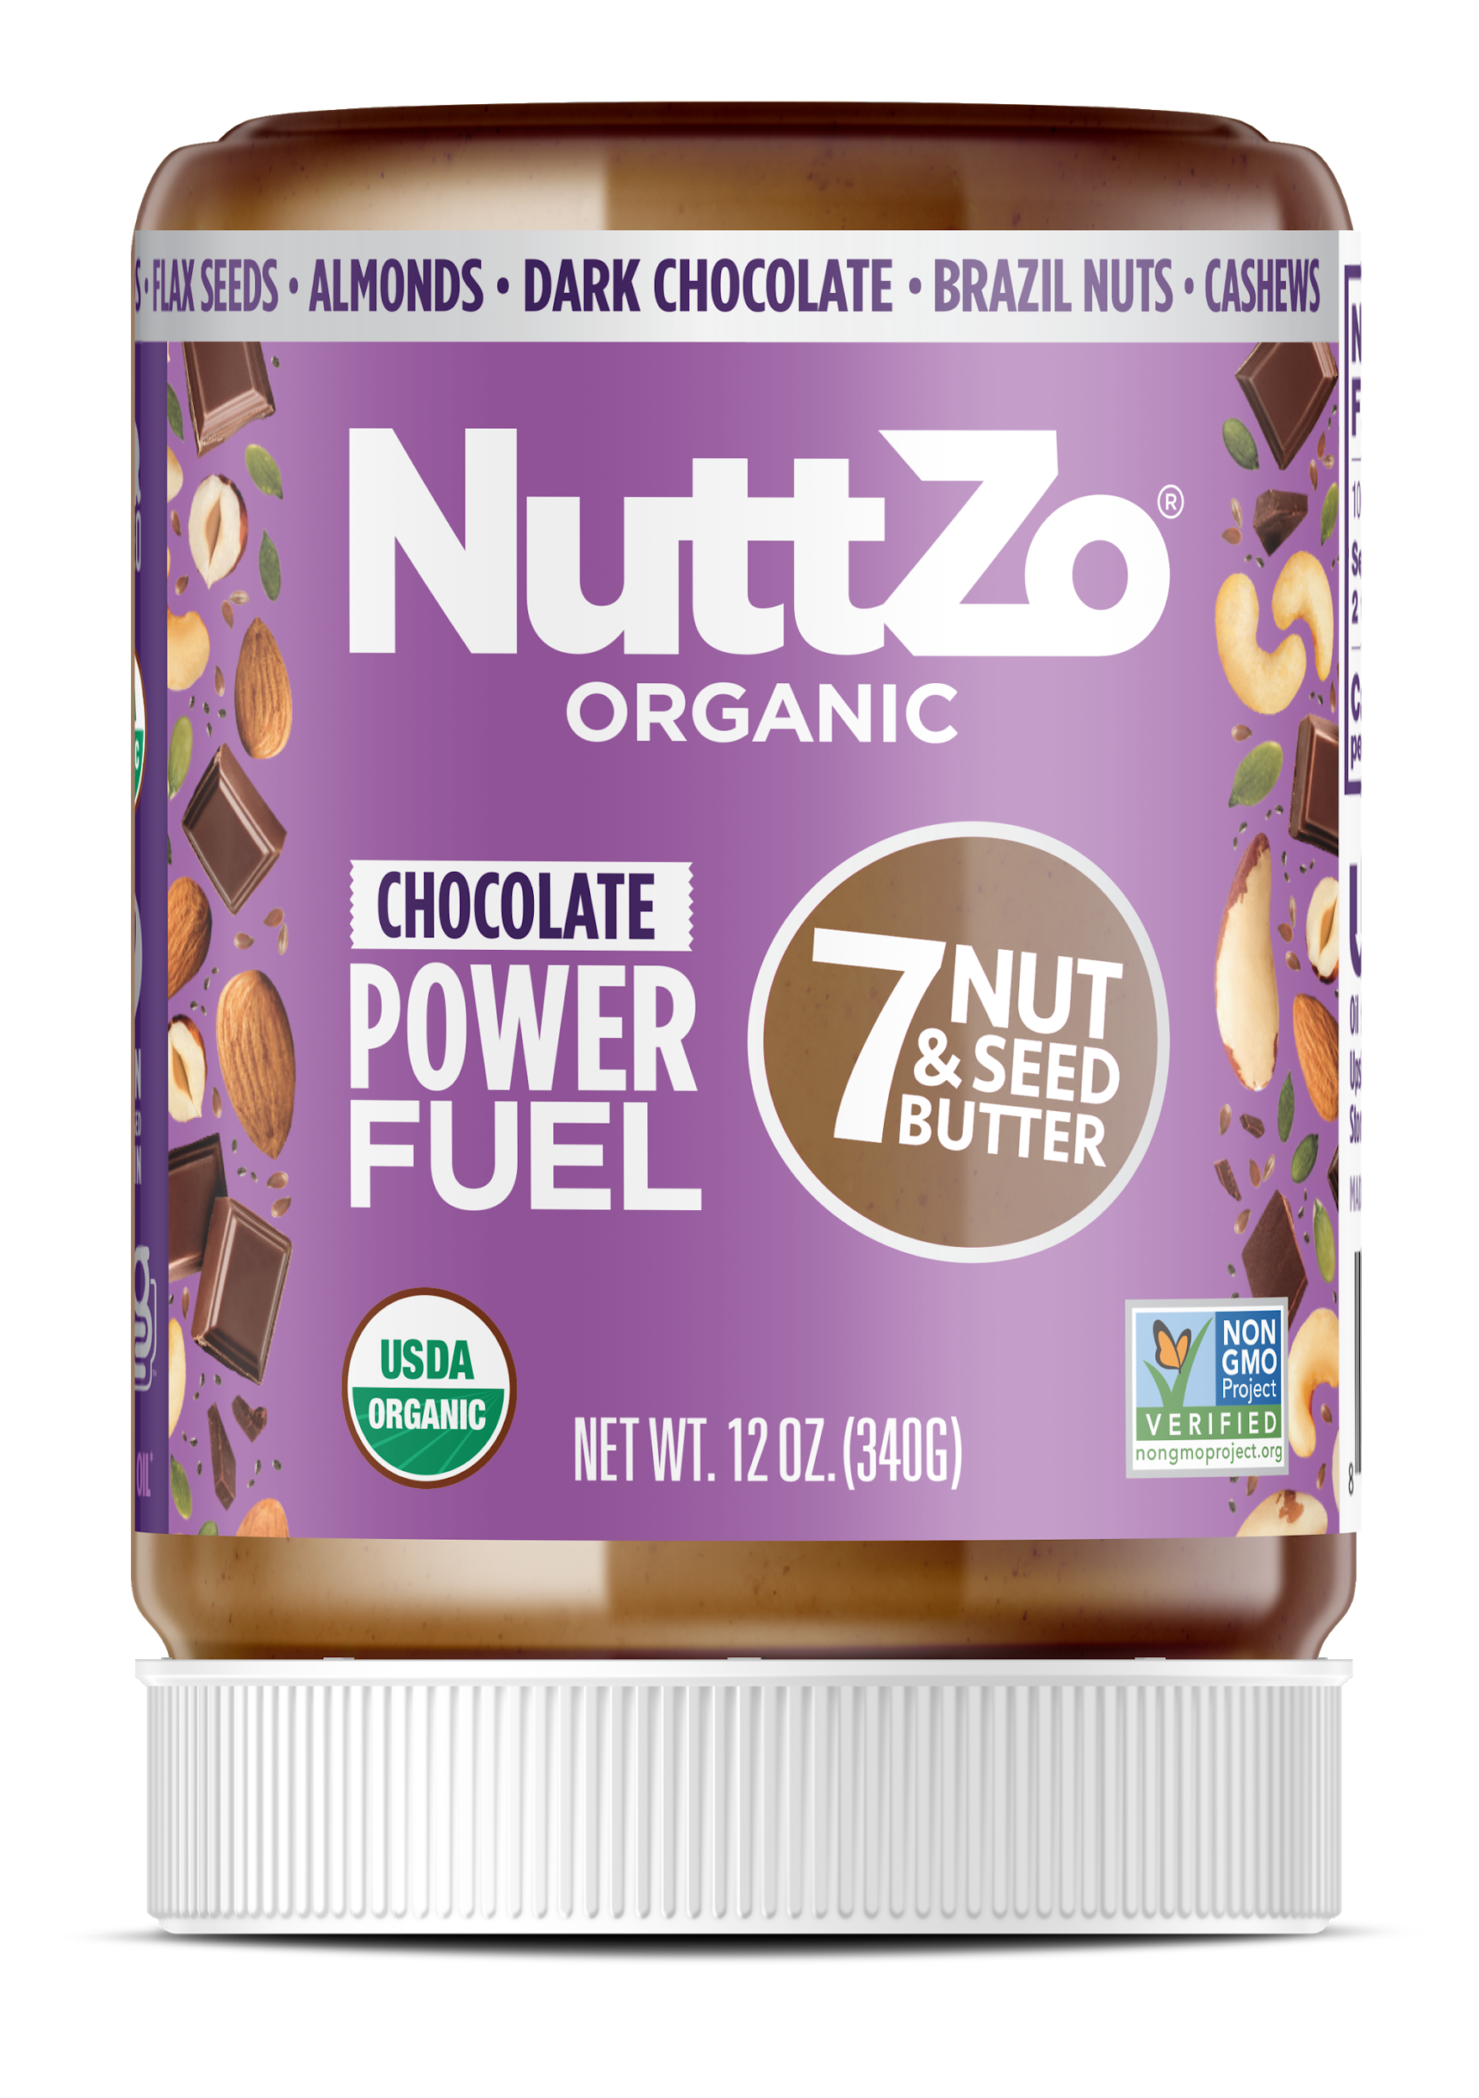
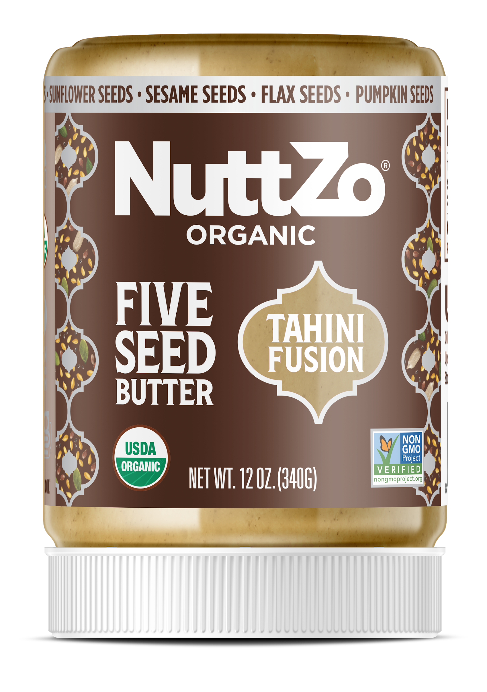
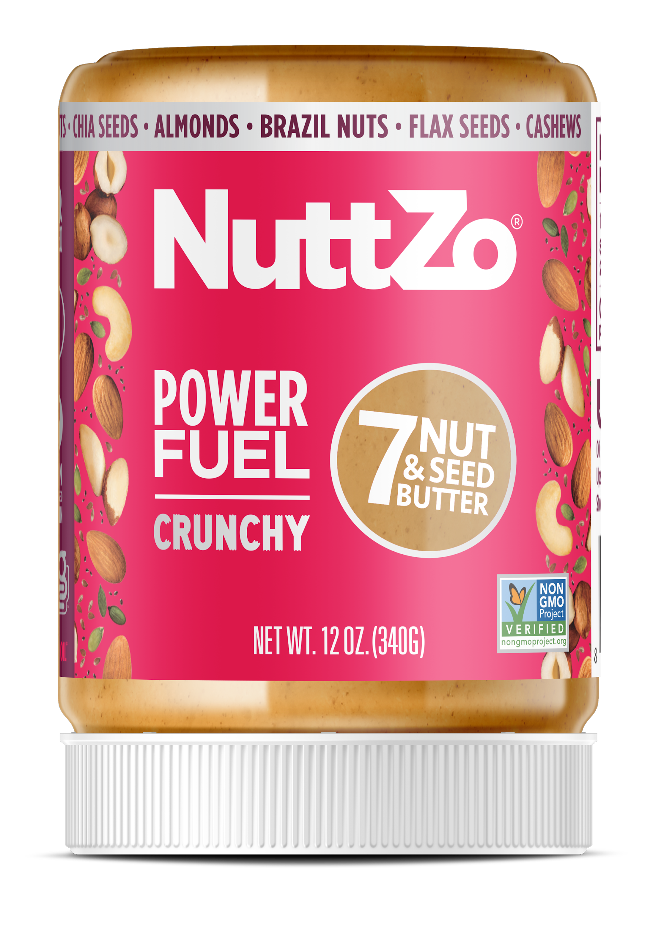
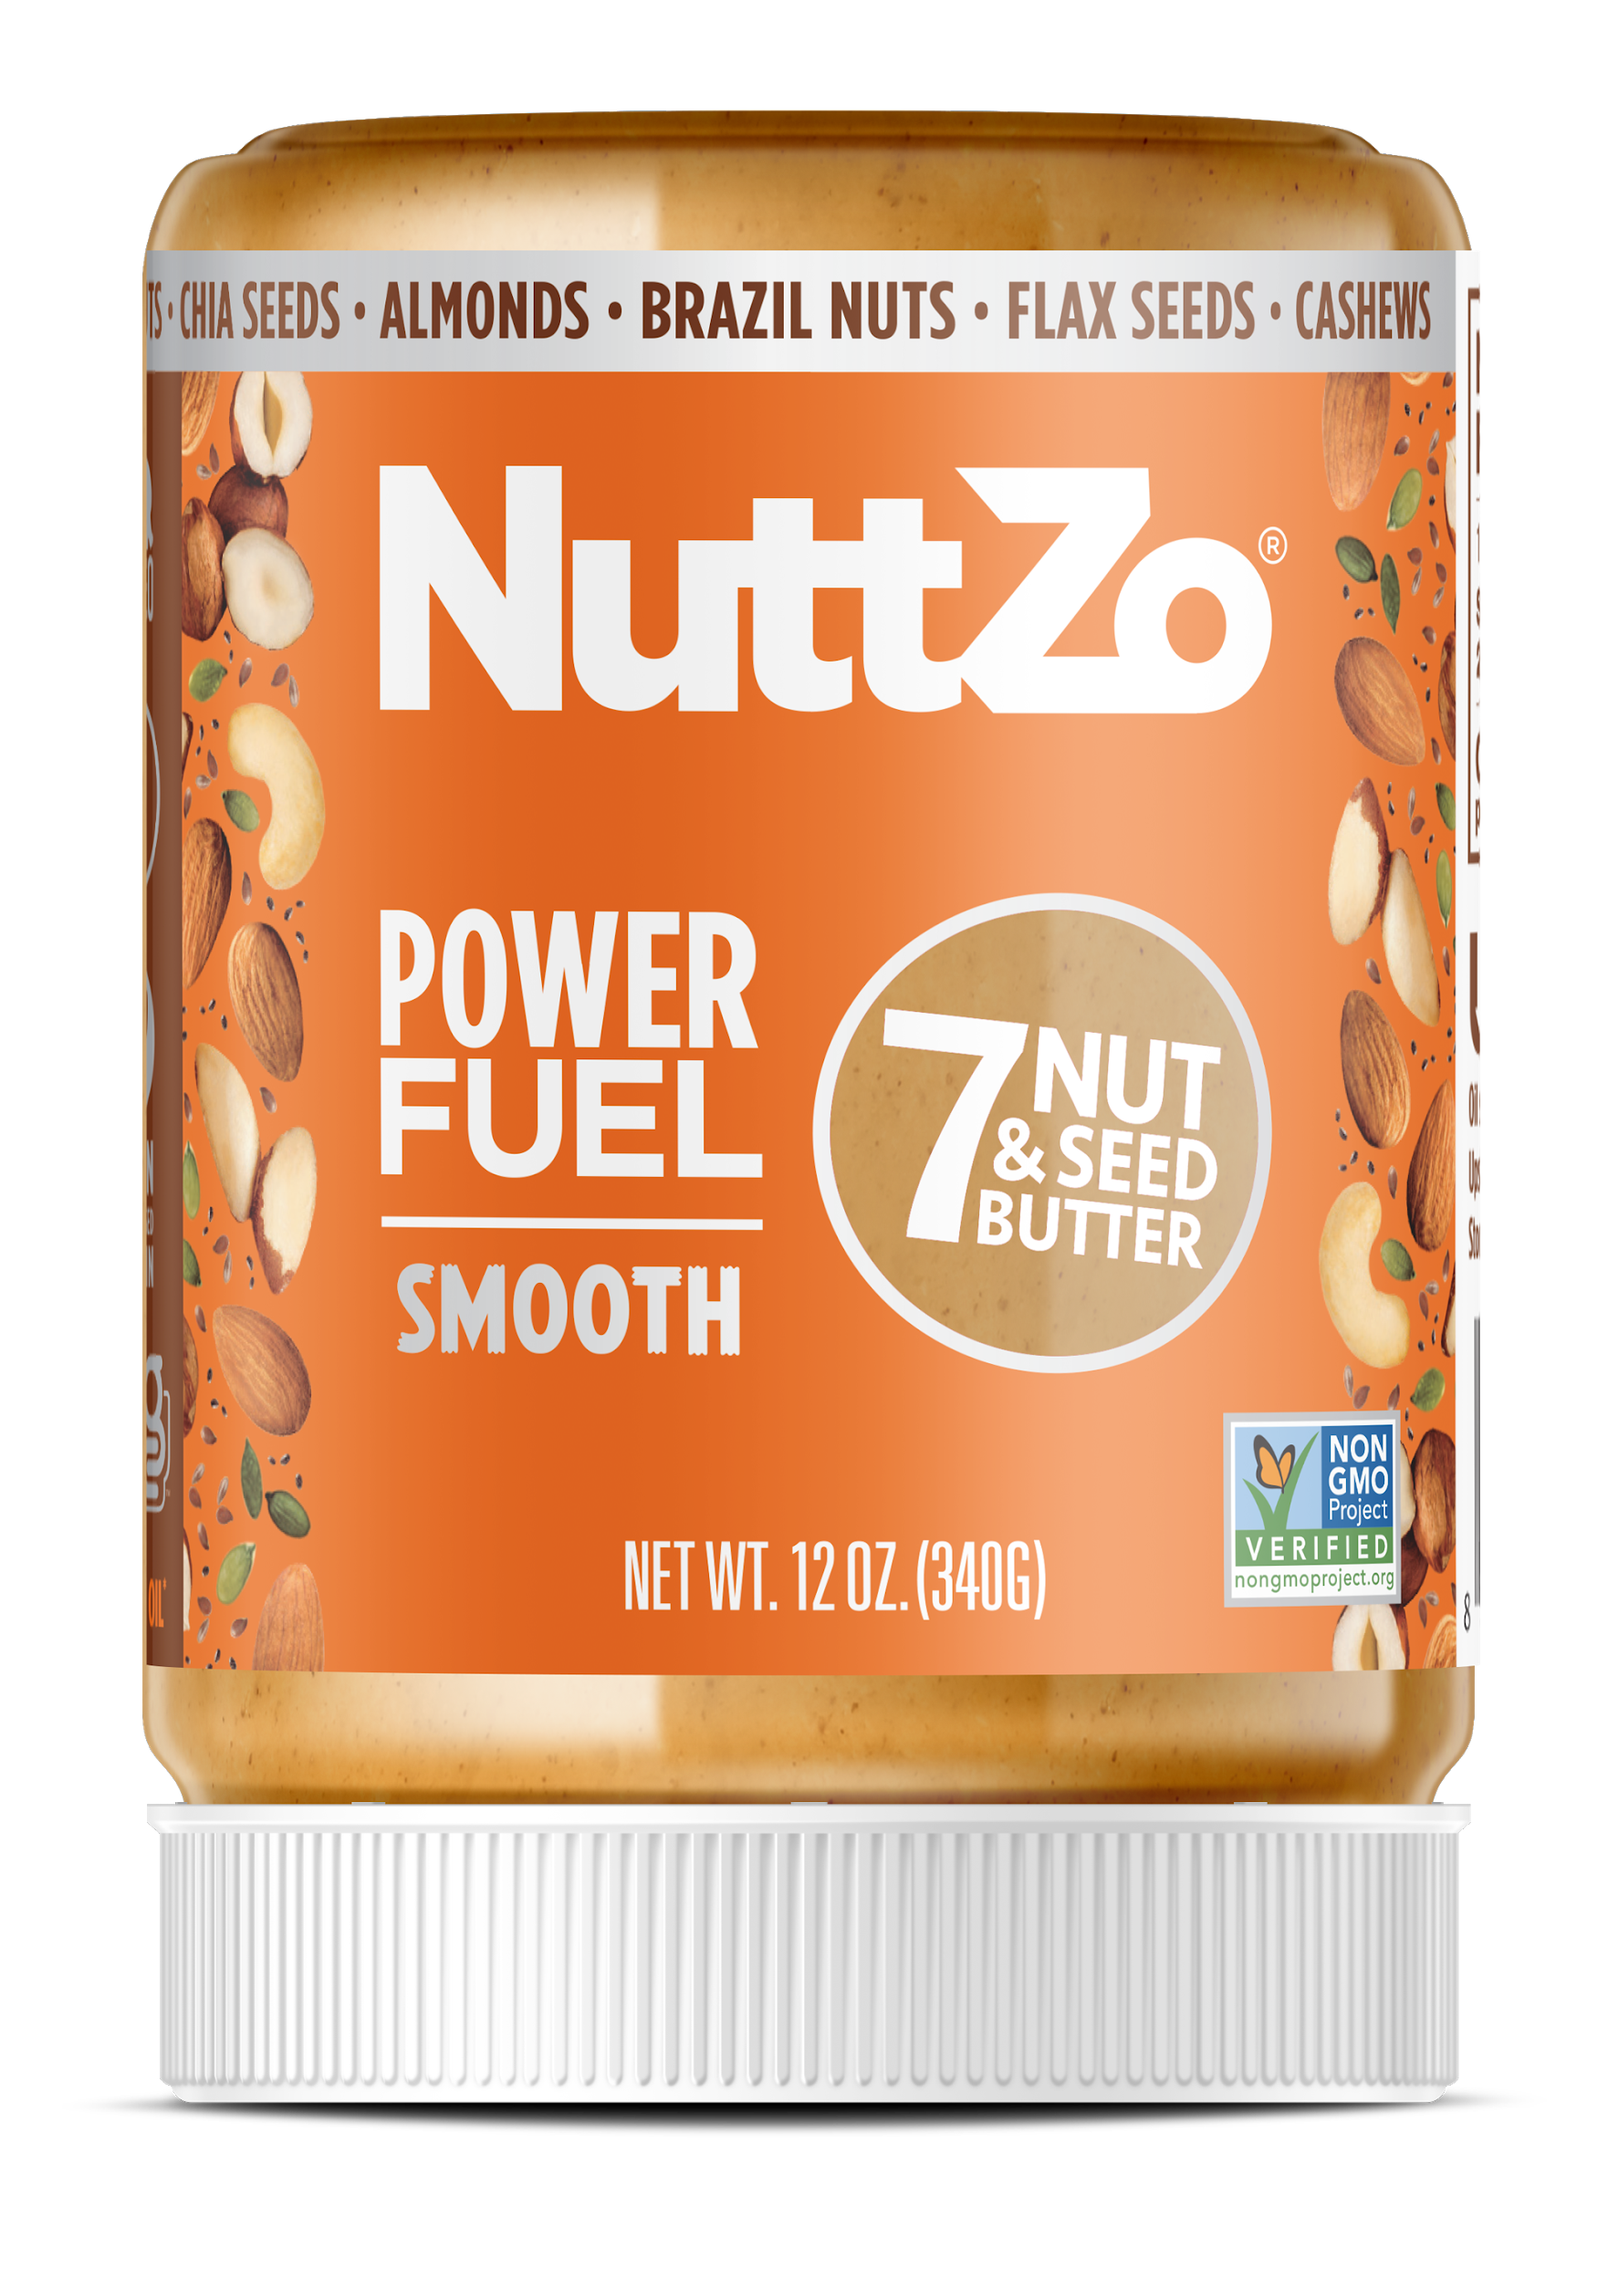
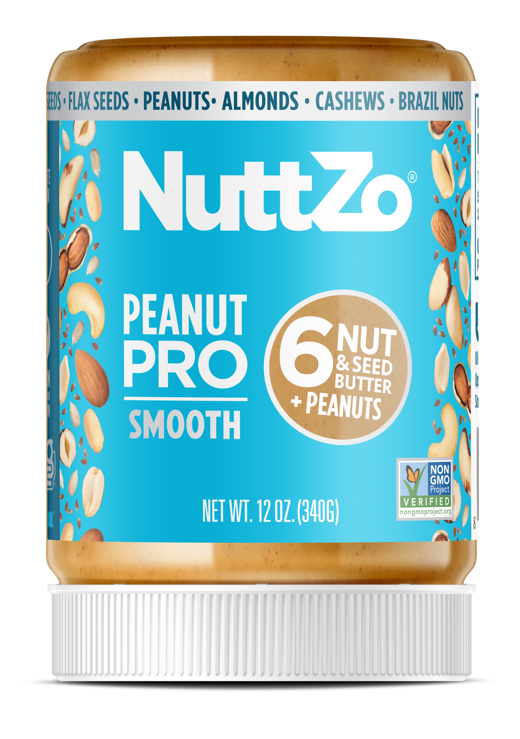
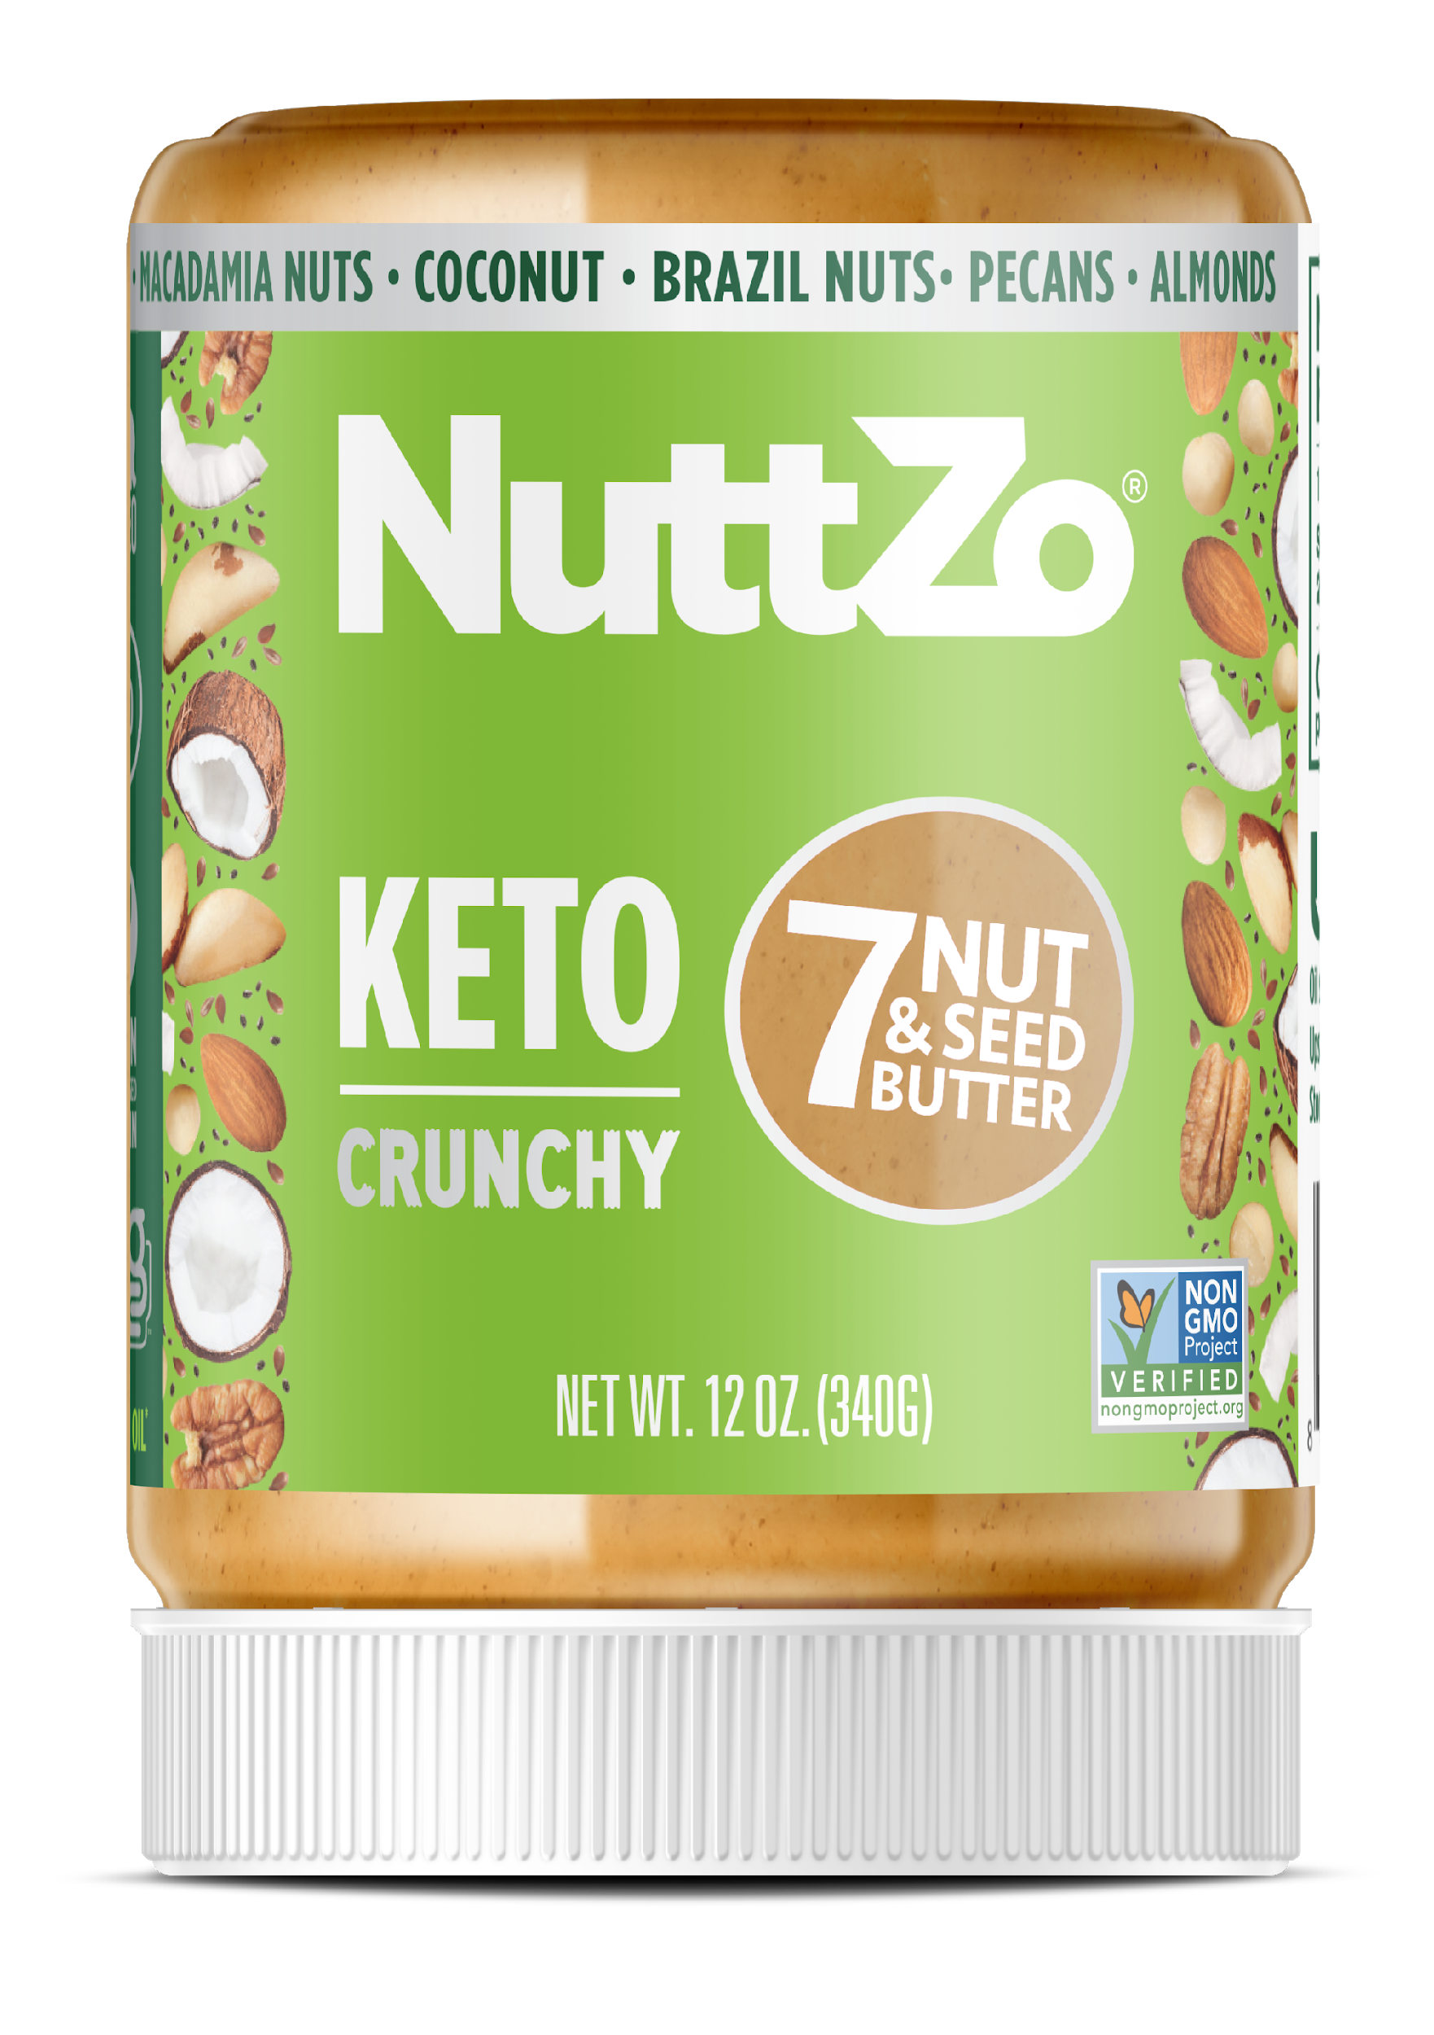
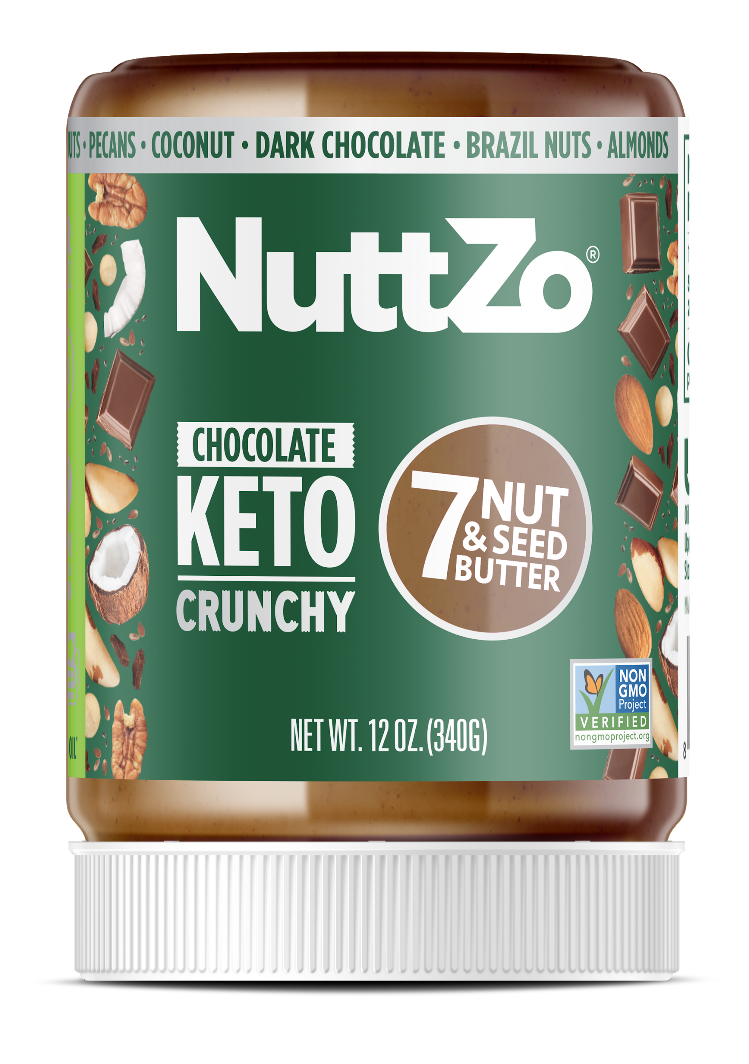
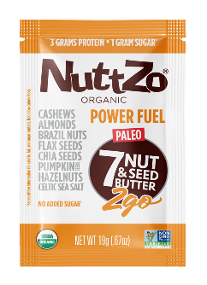
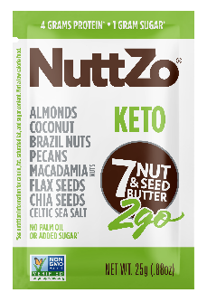
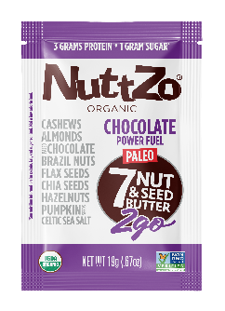
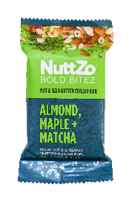
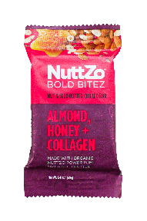
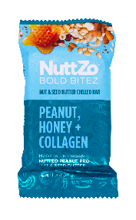
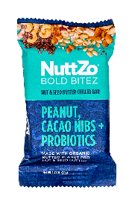
OUR BRAND EVOLUTION
A Nut Butter for All
When consumers talk, we listen. We started out as a line of organic nut butters and have built a brand portfolio to better fit the lives of healthy, on-the-go consumers. Along with our portfolio, we’ve updated our look to be modern but approachable and drive shelf appeal.

Slide 3


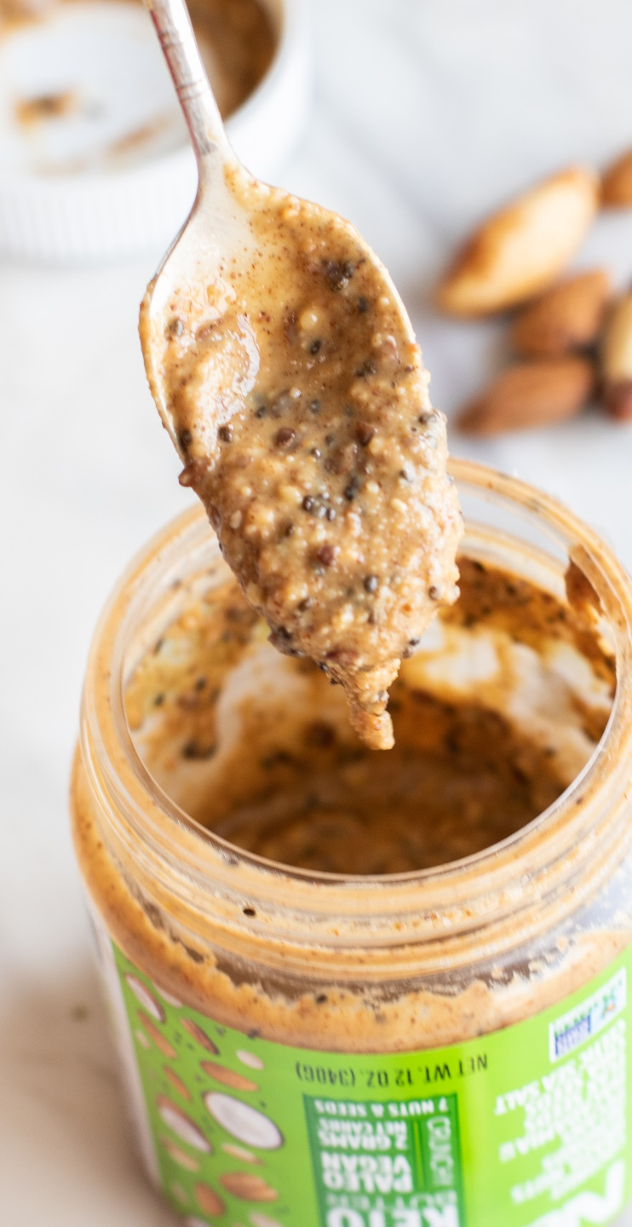

2
1
+
=
Adopted nutrient-
deficient boys
Mom on
a mission

Slide 4
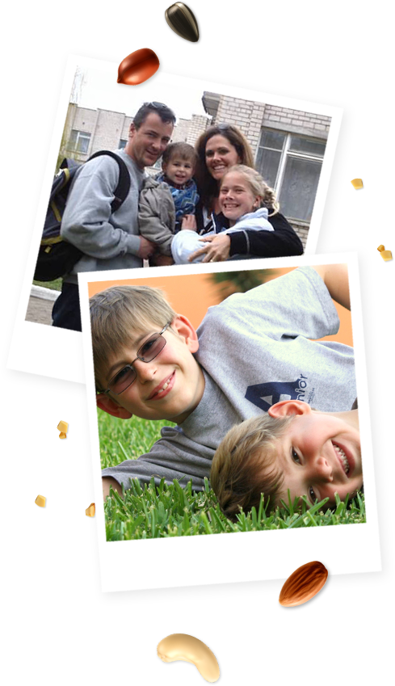






Sometimes life’s unexpected twists and turns lead you to your best life. When I adopted my sons internationally in 2002 and 2005, they were both extremely nutrient-deficient. In desperation, I took to the kitchen and blended a variety of nuts and seeds to make a delicious protein source for them.
Voilà, the nut and seed butter brand ‘NuttZo’ was born!
At the heart of NuttZo is our mission to spread health and happiness all over the world. While launching NuttZo, we created a non-profit that remains core to who we are today. Making a real difference is what motivates us most. Every sale of NuttZo supports Project Left Behind, helping orphaned and underprivileged children in Peru and India.

Slide 5
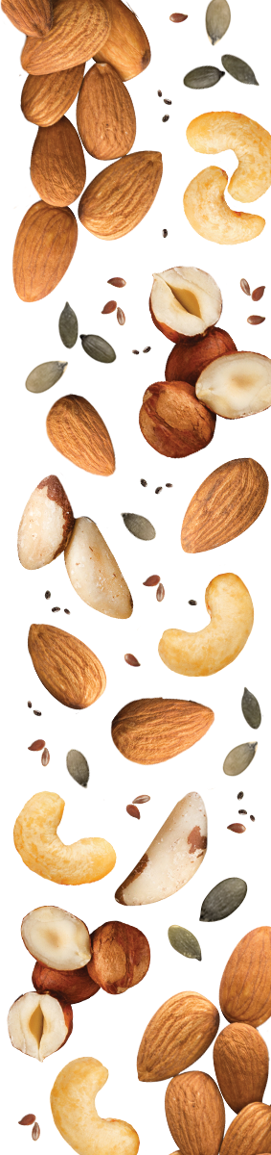

NuttZo is committed to revolutionizing the natural peanut and nut butter category by producing mega-nutritious “superfoods” that taste out of this world.
NuttZo is dedicated to helping transform the plight of orphaned and disadvantaged children in India and Peru through our 501(c)(3) non-profit, Project Left Behind.

Slide 6


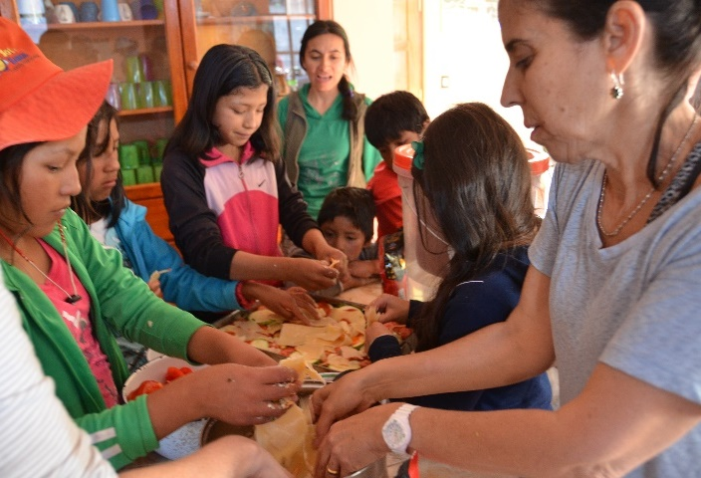






Slide 7


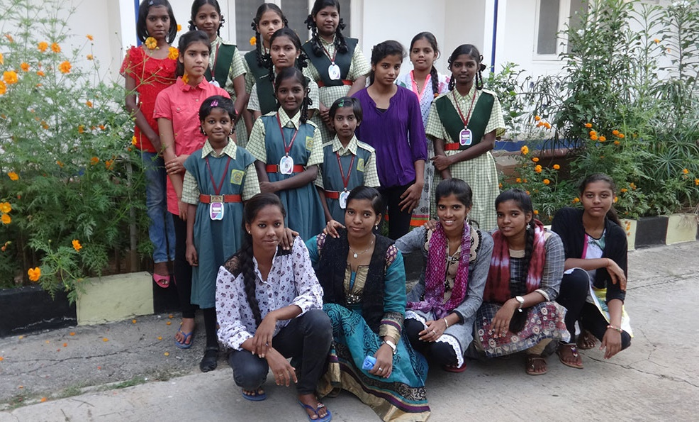
^{22 Children Providing:}
Food, vital staff, education, utilities, household supplies, and healthcare
^{17 Young Women and Girls} ^{Providing:}
Education, living expenses, food and water, building maintenance, and safe transportation to and from school to combat human-trafficking
^{10 Higher Education Grants:}
Providing full scholarships to trade schools and universities for children who would never otherwise have had the opportunity to further their education.
Hogar Semillas de Jesus
Urubamba, Peru
Tender Loving Care Orphanage
Hyderabad, India
Since 2011, NuttZo has contributed $100,000 as well as covers all overhead expenses so that 100% of donations go to the children.
PLB has raised over $500,000.
Annual PLB Voluntour trips to Peru - NuttZo leads a team of 10-15 people to Peru every year to help maintain the children's home.
Visit the PLB Website:
projectleftbehind.org

Slide 8
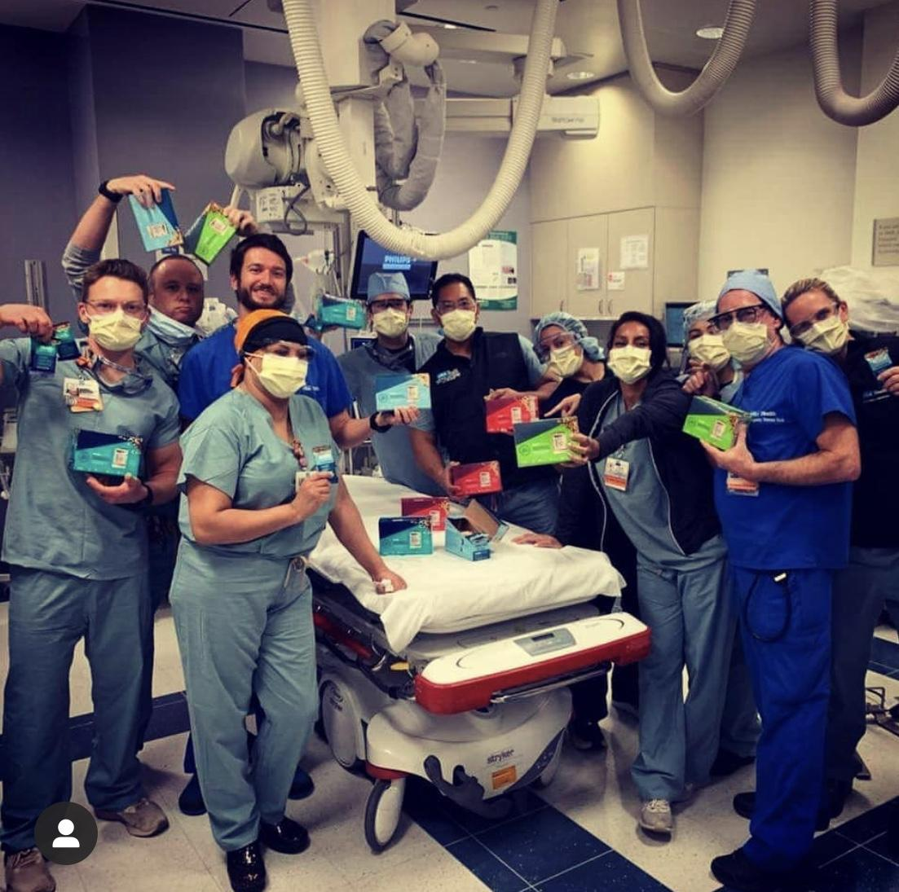
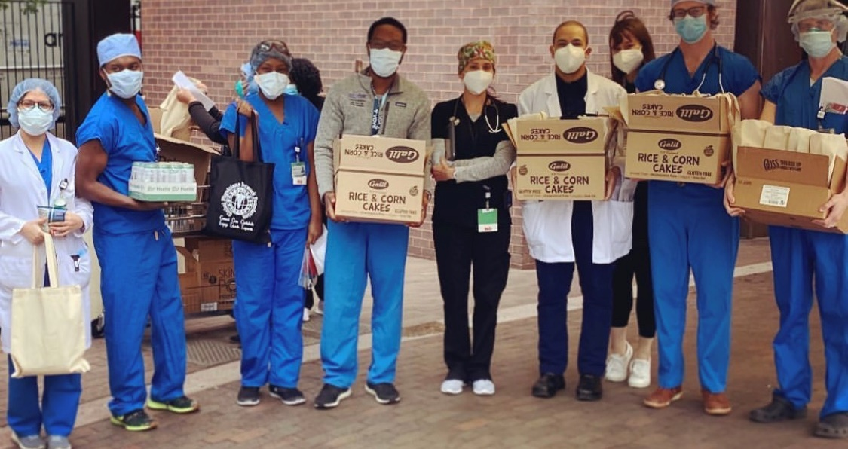
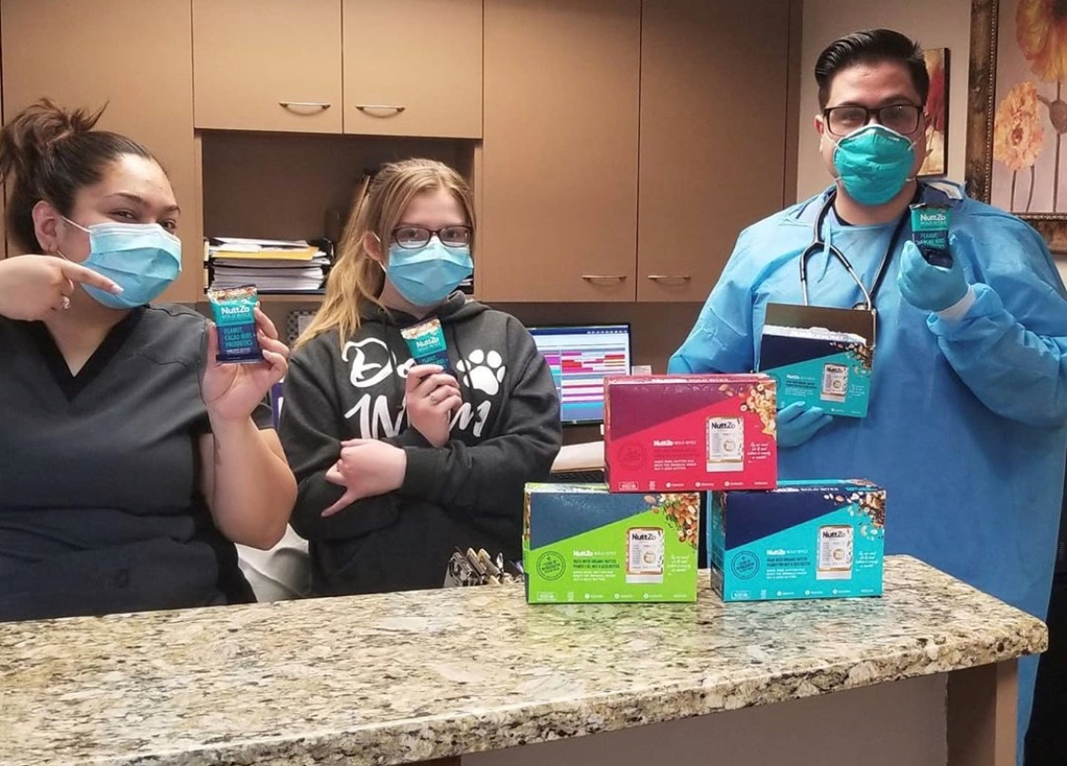

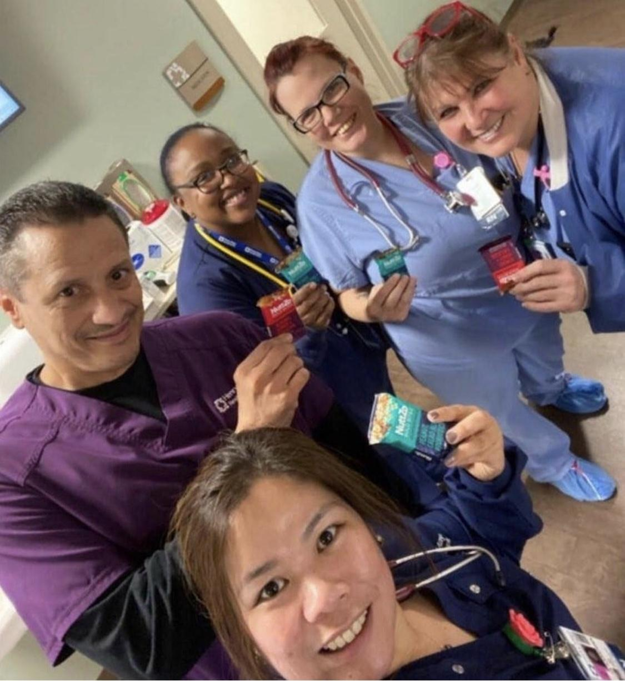

We are proud and humbled
to be doing our part to support essential workers and those on the front-line of the current COVID-19 crisis.
35K Bold BiteZ snack bars
Over 85 front-line facilities

Slide 9
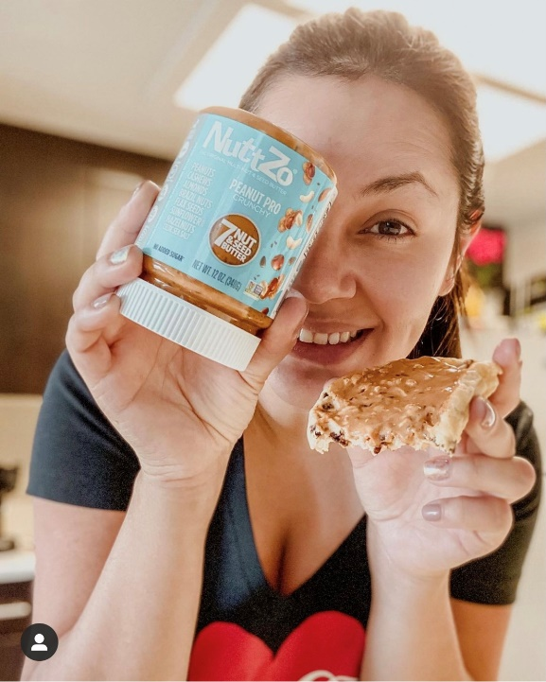
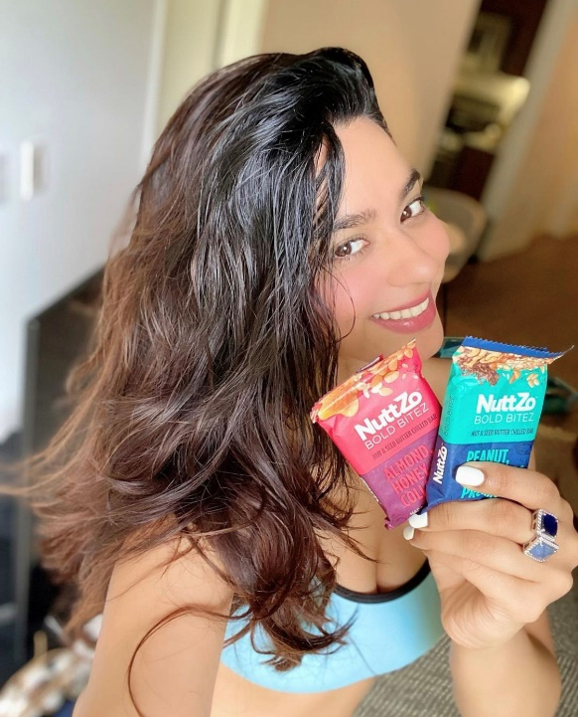

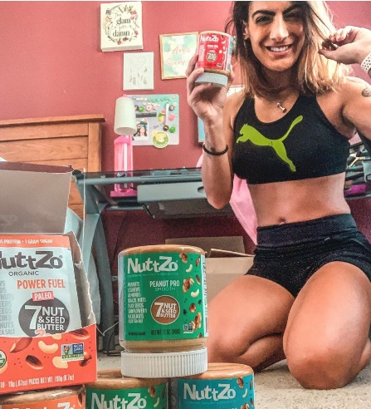
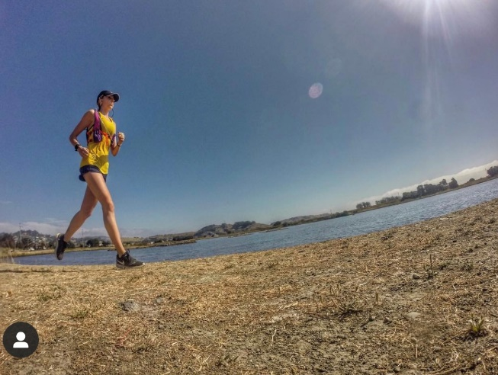
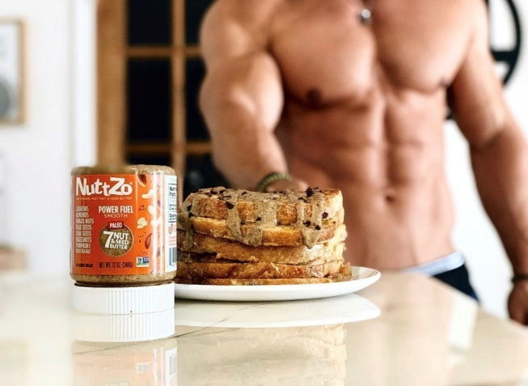
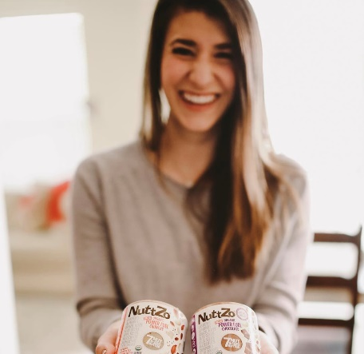
We are the nut-butter for all! We are the original mixed nut and seed butter with a
cult following of 22-45 year-old active,
health-conscious consumers concerned
with clean eating.
THIS INCLUDES:
Millennial moms
Healthy snackers and foodies
Outdoors enthusiasts +
adventure seekers
Athletes and exercisers
Vegan, Paleo, Gluten-Free, Vegetarian + Keto communities
NuttZo Fanatics love to fuel their bodies with NuttZo’s mixed nut and seed butter because it’s high in protein and healthy fats - and low in sugar.

Slide 10

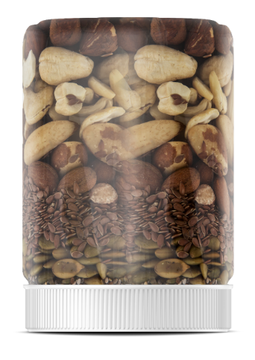




The original mixed nut & seed butter, brought to market in 2009
No added sugar*,
oils, or natural flavors
Supports Project Left Behind - a 501c3 non-profit organization
The only 7 nut & seed butter on the market
One-of-a-kind,
no-mess packaging
Unique blend of high quality ingredients to provide a variety of vitamins and minerals
NATURAL
All Natural, Vegan, Gluten Free, Non GMO, Kosher
*Coconut sugar is included in the chocolate in Chocolate Power Fuel

Slide 11



EASIER TO STIR
NO EMULSIFIERS
NO PALM OIL
NuttZo’s label is on upside down not just because we think it’s eye-catching but because we want it stored on its lid while sitting on the store shelves. The natural oils separate to the bottom of the jar which is really the top. This makes for NO mess when the customer finally opens the jar at home and stirs in all that nutty goodness.

Slide 12








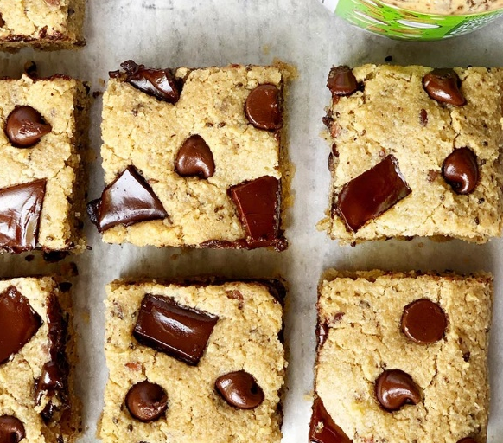
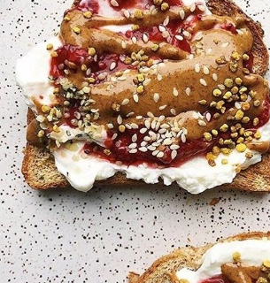
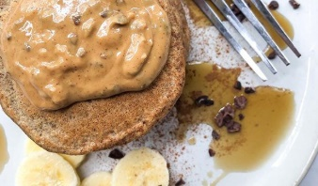
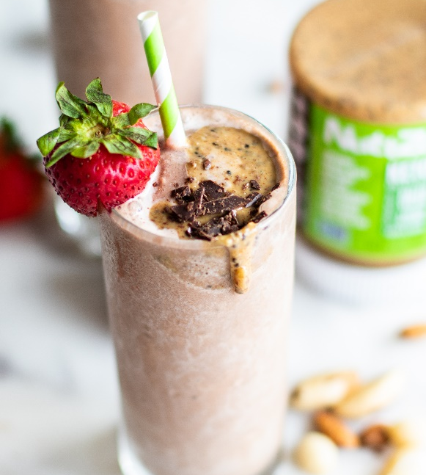
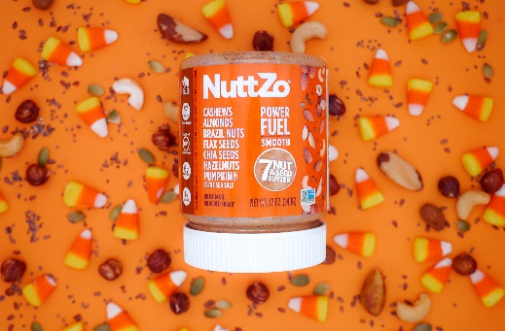
Data – NuttZo Shows Positive Growth in all Channels
Natural Channel Brand $ Growth, YoY
NuttZo is taking customers away from the top brands because customers want the benefits of a mixed nut and seed butter.*
NuttZo Channel Growth ($)
NuttZo is trending positively.**
 | 12 wk | 24 wk | 52 wk
Food | 9.7% | 10.1% | 6.0%
Natural Channel | 3.2% | 6.4% | 4.1%
Organic Retailer | 59.1% | 26.7% | 17.0%
+6.4%
-26.8%
-19.7%
-22.7%
-14.3%
-13.2%
-11.4%
*Source: SPINS Ending 07/11/21, 24 wk, Natural Channel
** Source: SPINS Ending 07/11/21, Og Retailer Ending 07/11/21

Slide 13
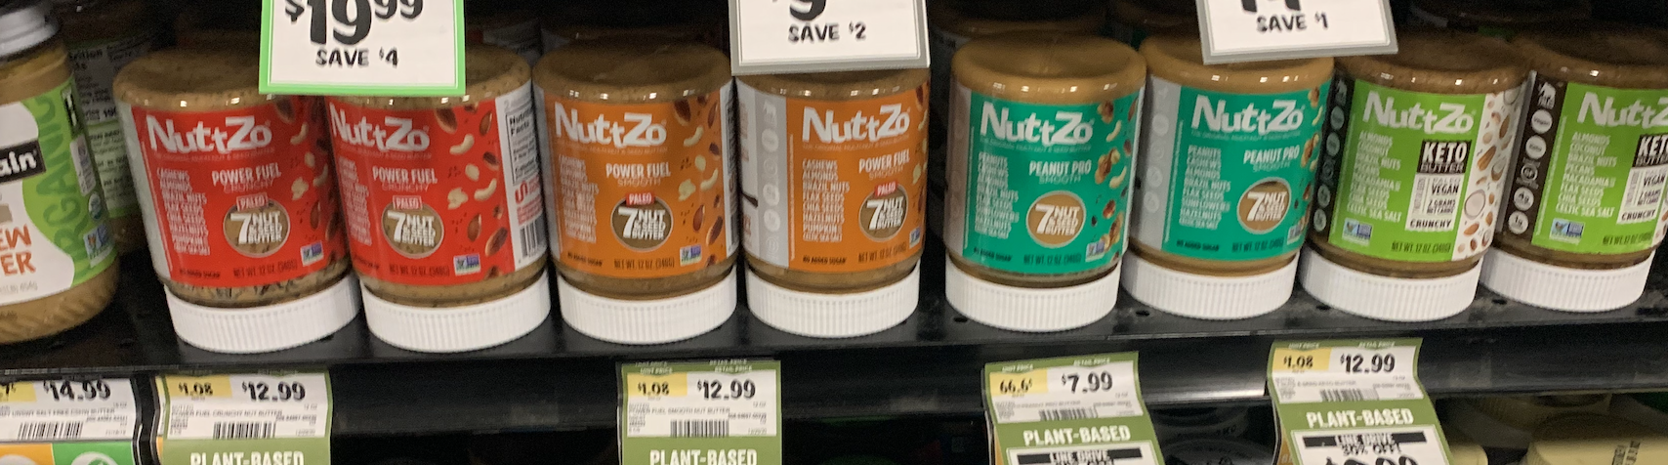
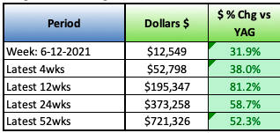
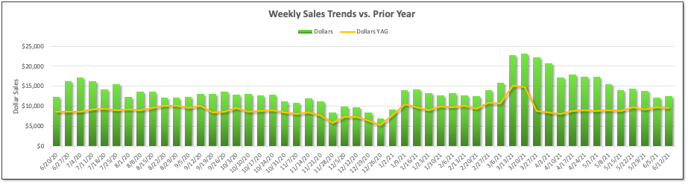
NuttZo Retailer Successes
Retailer | 52 wk $ Sales | % Growth YoY
Leading National Conventional (K) | $695,832 | +38.1%
Leading National Natural (S) | $669,791 | +14.8%
East Coast Conventional Retailer (T) | $92,240 | +42.6%
Leading National Natural Retailer
Dollar Sales +14.8% (52wk sales, 7/11/2021)
Solid NuttZo brand block, mid-shelf placement
Keto outperforming other jars (1.1 v 0.9 u/st/wk) and added incremental sales
Competitive retails at $9.99 & $7.99
Source: SPINS Ending 7/11/2021, Leading National Conv. (K) ending 7/11/2021
Leading National Conventional Retailer
Dollar Sales +52.3% (52wk sales, 6/12/2021)
Keto Butter swapped in, in July 2020 and added incremental sales lift.

Slide 14







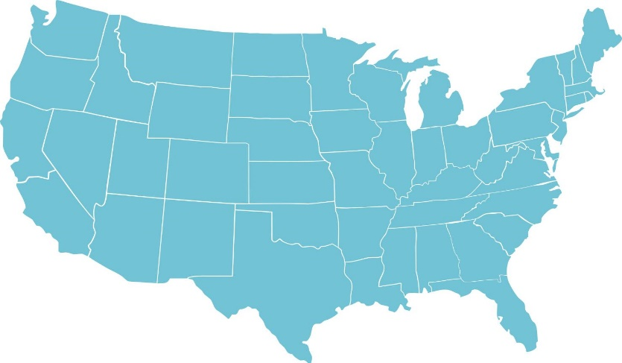



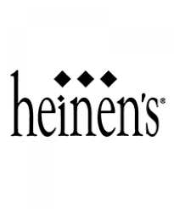





















Sold in over 10,000 stores nationwide and in Canada
National Accounts:

Slide 15








NuttZo vs.
Other Nut
Butters
No Sugar Added
Donates to Non-Profit
7 Nuts & Seeds
Woman Owned
Brazil Nuts
Flax Seeds
Pumpkin Seeds
Almonds
Hazelnuts
Non-GMO
Complete Protein
Chia Seeds
Cashews
Vegan
No Palm Oil

Slide 16
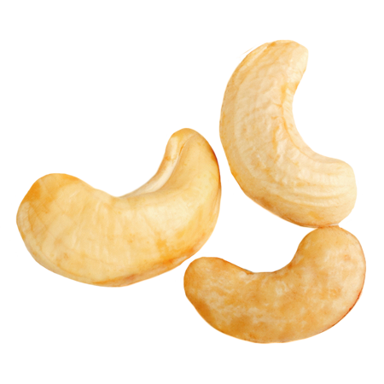
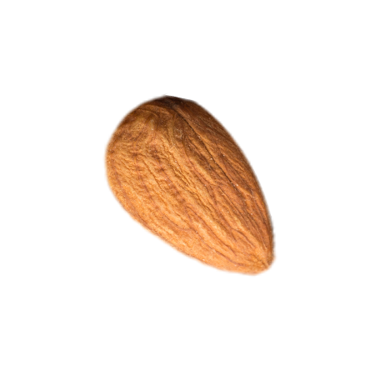
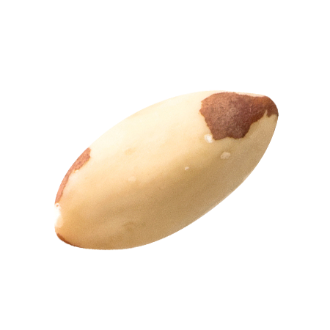
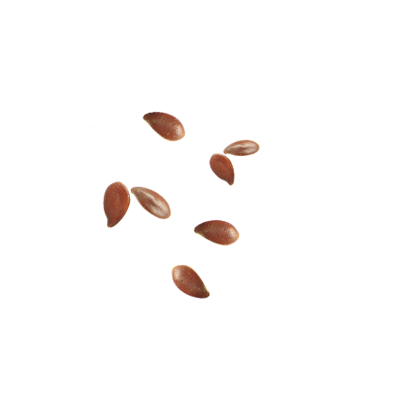
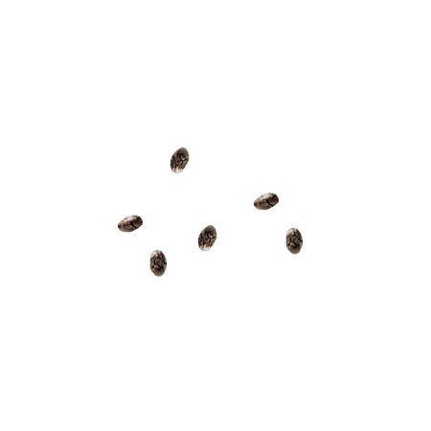
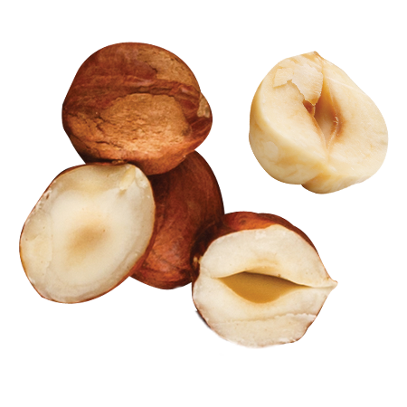



Nuts & Seeds In Every Jar
7
Unlike a mono-nut butter, NuttZo has 7 nuts & seeds in every jar
Unique blend of high- quality ingredients to provide a variety of vitamins and minerals
VEGAN (no honey or egg whites included)
All natural, Gluten Free, Non GMO, Kosher
Supports Project Left Behind - a 501c3 non-profit organization
One-of-a-kind,
no-mess packaging
CASHEWS
ALMONDS
BRAZIL NUTS
FLAX SEEDS
CHIA SEEDS
HAZELNUTS
PUMPKIN SEEDS
SRP $12.99

Slide 17






and satiating the health-conscious consumer appetite!
Keto
Keto Diet Trending: Our Keto Butter sales are UP +31.8%**
Only 2 net grams carbs
Paleo, Vegan, Non-GMO Project Verified
Gluten-Free, Peanut-Free, Soy-Free, Dairy-Free, Whey-Free
Chocolate Keto
Trending: Decadence!
Nutella dollar sales are UP +9.6%*
Only 4 net grams carbs
1 gram of sugar (No added sugar)
Nutella has 21 grams sugar
No added Palm Oil
Nutella adds palm oil
Made with Organic 100%
Dark Chocolate
ALMONDS
COCONUT
BRAZIL NUTS
PECANS
MACADAMIA NUTS
FLAX SEEDS
CHIA SEEDS
SRP $12.99
*SPINS MULO 4 wks, 7/11/2021 | **SPINS Natural Channel 24 Weeks 07/11/2021 | ***Coconut sugar is included in the chocolate in Chocolate Keto.

Slide 18



Nuts & Seeds In Every Jar
7
Unlike a mono-nut butter, NuttZo has 7 nuts & seeds in every jar
Unique blend of high- quality ingredients to provide a variety of vitamins and minerals
VEGAN (no honey or egg whites included)
All natural, Gluten Free, Non GMO, Kosher
Supports Project Left Behind - a 501c3 non-profit organization
One-of-a-kind,
no-mess packaging
PEANUTS
CASHEWS
ALMONDS
BRAZIL NUTS
FLAX SEEDS
SUNFLOWER
SEEDS
HAZELNUTS
SRP $7.99

Slide 19






FIVE-SEED TAHINI FUSION: UNIQUE & NUTRITIOUS
For the DIY consumer, adding a boost of nutrition and flavor intrigue.
Tahini sales are
on the rise!
The Pandemic has led to healthy, DIY eating!
SPINS Tahini Sales:
NuttZo introduces the
1st multi-seed Tahini!
5 Seeds in Every Jar:
Sesame, Flax, Pumpkin, Sunflower
& Chia Seeds
Simple ingredients, no salt or palm oil added
Organic Certified, Non-GMO Project Verified
$12.1M
+40%*
$2.9M
+34%*
SESAME
SEEDS
FLAX
SEEDS
PUMPKIN
SEEDS
SUNFLOWER
SEEDS
CHIA
SEEDS
MULO
Natural
Uses of Tahini:
Salad dressings, dip for veggies & falafel, use in hummus, spread on toast, mix into soup…
SRP $7.99
*SPINS 24 wks, 06/11/2021 vs 2YA

Slide 20




 | Brand | SRP | Size | $/oz | Ingredients | GF | Kosher | Organic | Non-GMO
 | NuttZo | $7.99 | 12oz | $0.67 | Sesame seeds, Flax, Pumpkin, Sunflower, Chia Seeds
 | Once Again | $9.69 | 16oz | $0.61 | Sesame Seeds
 | Artisana | $10.99 | 14oz | $0.79 | Sesame Seeds
 | Joyva | $6.58 | 15oz | $0.44 | Sesame Seeds
NuttZo – Kari Janapareddi – Kari@NuttZo.com - 408-909-8760

Slide 21






Upgrade your nut butter!
KETO Butter
Crunchy
Power Fuel Paleo
Crunchy
Power Fuel Paleo
Smooth
Power Fuel/ Keto Unit Cost (Dist) $7.10
SRP: $12.99-$13.49
Gross Margin: 40%
Peanut Pro Unit Cost (Dist) $4.35
SRP: $7.49-$7.99
Gross Margin: 40%
Product Type: Grocery – Nut Butters
Promotional Support:
Channel Strategy: Natural & Conventional
Manufacturer Launch Date: Available Now
Case Pack: 6, 12oz jars
The original mixed nut & seed butter
The only 7 nut & seed butter on the market
Unique blend of high-quality ingredients to provide a variety of vitamins and minerals
No added sugar* or oils
Supports Project Left Behind - a 501c3 non-profit organization
One-of-a-kind, no-mess packaging
#1
#2
#3
#4
NEW!
Peanut Pro
Smooth
Chocolate
Keto
Crunchy
NuttZo – Kari Janapareddi – Kari@NuttZo.com - 408-909-8760
(*Monk Fruit is included in the chocolate in Chocolate Keto)

Slide 22




Upgrade your nut butter!
#1
#2
Unit Cost (Dist) $7.85
SRP: $13.99-$14.49
Gross Margin: 40%
Product Type: Grocery – Nut Butters
Promotional Support:
Channel Strategy: Natural & Conventional
Manufacturer Launch Date: Available Now
Case Pack: 6, 12oz jars
The original mixed nut & seed butter
The only 7 nut & seed butter on the market
Unique blend of high-quality ingredients to provide a variety of vitamins and minerals
No added sugar*, oils or natural flavors
Supports Project Left Behind –
a 501c3 non-profit organization
One-of-a-kind, no-mess packaging
Power Fuel
Paleo
Crunchy
Power Fuel
Paleo
Smooth
#3
Power Fuel
Chocolate
Paleo
NuttZo – Kari Janapareddi – Kari@NuttZo.com - 408-909-8760
(*Coconut sugar is included in the chocolate in Chocolate Power Fuel)

Slide 23
Distributor Delivered Unit Cost: $7.10
Suggested Retail Price : $12.99-$13.49
Gross Margin 40%
Product Type: Grocery – Nut Butters
Promotional Support Program:
Channel Strategy of Item: Natural & Select Conventional Manufacturer Launch Date: Available June 2021
Case Pack: 6, 12oz Jars
NuttZo’s Chocolate Keto Butter is specifically designed for the high fat, low net carb Keto diet.
Simple nutritious ingredients; Almonds, shredded coconut, organic chocolate liquor (organic cocoa beans) , brazil nuts, pecans, monk fruit (Erythritol, Monk Fruit Extract), Macadamia Nuts, Flax Seeds, Chia Seeds, Celtic Sea Salt
Only 4g net carbs
Keto, Paleo, Vegan, Non-GMO Project Verified
Gluten-Free, Peanut-Free, Soy-Free, Dairy-Free, Whey-Free
Enjoy with fruit, yogurt, as a spread or by the spoonful
Supports Project Left Behind – a 501c3 non-profit organization
NuttZo – Kari Janapareddi – Kari@NuttZo.com - 408-909-8760

Slide 24


Upgrade your tahini!
Distributor Landed Cost: $4.40/unit
Suggested Retail Price: $7.99-$8.49
Gross Margin: 40%
Product Type: Grocery
Promotional Support Program: Quarterly Promotions
Channel Strategy of Item: Natural & Conventional
Manufacturer Launch Date: Jan 2021
Case Pack: 6, 12oz jars
The 1st 5 seed Tahini Butter!
Upgrade your tahini spread with 5 seeds in every jar: Sesame, Flax, Pumpkin, Sunflower & Chia Seeds
All Organic, Non-GMO Project Verified
Simple ingredients, no palm oil or sugar added
Enjoy on toast, over salad or roasted vegetables, in your soup recipe & upgrade your hummus!
Supports Project Left Behind – a 501c3 non-profit organization
SESAME
SEEDS
FLAX
SEEDS
PUMPKIN
SEEDS
SUNFLOWER
SEEDS
CHIA
SEEDS
NuttZo – Kari Janapareddi – Kari@NuttZo.com - 408-909-8760
Notes:
Need high quality screenshots of the Insights How-to Guide

Slide 25
Marketing/Promotional Support
Pricing
TPRs: # weeks of TPRs
Digital Couponing
Sample Promo Calendar
May/June | Jul | Aug | Nov | Jan | Feb | Mar
Nut Butter RESET

Slide 26


NuttZo Jar | Rank | SRP | Flavor Profile
Keto | #1 | $12.99 | Rich Coconut & Almond; Keto-Diet Friendly
Power Fuel Crunchy | #2 | $12.99 | Upgrade your Almond Butter *Crunchy*
Power Fuel Smooth | #3 | $12.99 | Upgrade your Almond Butter *Smooth*
Chocolate Keto | #4 | $12.99 | Decadent Dark Chocolate, & Coconut; Keto-diet Friendly
Peanut Pro Smooth | #5 | $7.99 | Upgrade your Peanut Butter
Five-Seed Tahini Fusion | #6 | $7.99 | Healthy, Organic nutritious 5 seed Tahini Fusion!
Priorities:
3+ Jar Brand Block
Midlevel placement for best sell-through
Marketing Promotional Support:
TPRs
Digital

Slide 27


Slide 28





NuttZo is ranked #4 in both Natural & MULO Channels^^
Market Leading Growth in Natural Channels
FOOD Channels
NuttZo is taking customers away from the top brands because customers want the benefits of
a mixed nut and seed butter.^
NuttZo is driving category growth with 24.5% Dollar growth YoY and ranked #4 in the “OTHER NUT BUTTER CATEGORY”. ^^
+6.4%
-26.8%
-19.7%
-22.7%
-14.3%
-13.2%
-11.4%
NuttZo is #4
65.3 ACV
+24.5%
NuttZo
-8.2%
Once Again
-13.3%
Maranatha
^ Source: SPINS Ending 07/11/21, 24 wk, Natural Channel
^^ 24 wk SPINS Ending 07/11/21, “Other Nut Butter” Category Food Channels
Notes:
This doesn’t include CLUB and WFM

Slide 29




INSTAGRAM
FACEBOOK
73,000
FOLLOWERS*
57,000
FOLLOWERS*
TWITTER
PINTEREST
4,420
FOLLOWERS*
3,371
FOLLOWERS*
*Updated as of 11.12.20

Slide 30



First to market collagen oatmeal, sourced
from grass-fed collagen.
Incorporating a packet of NuttZo, the premium multi nut and seed butter, into the oatmeal topper for incredible taste appeal.
Bringing innovation to the dated oatmeal category with the leading dietary trend of collagen.
Consumers looking to add this beneficial protein to their diet in more than just beverage.
2 delicious flavors; Blueberry Walnut &
Vanilla Pecan.
Base of oatmeal made with; oats, quinoa, amaranth, flax and chia.
11g Protein, 7g Fiber
$2.99, line priced with other oat cups
Certified Non-GMO,
Gluten Free, Made with Organic

Slide 31




Online couponing
Social media Influencers
Brand collaborations
Trade show presence
National event sampling
National PR Outreach:
The New York Times
Good Housekeeping
Hers Magazine
SHAPE
Huffington Post
Pregnancy & Newborn Magazine
… and more!

Slide 32













Spreading the #NuttZoLove. PR & Collaborations:
HUNGRY FOR MORE? > READ THE LATEST NUTTZO NEWS

