Slide 1
Kemps LLC Presentation
2022

Slide 2


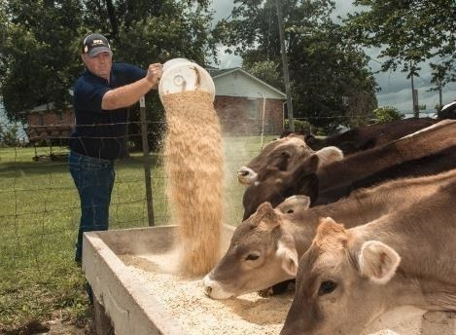

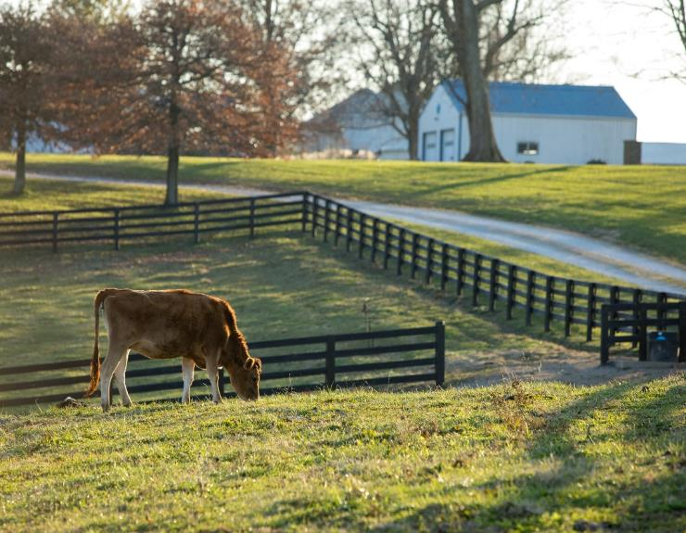
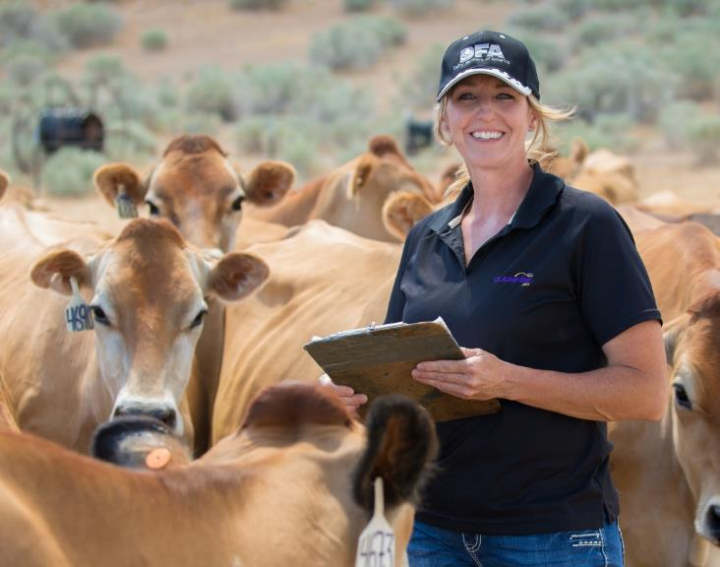
MORE THAN 14,000 FARMER-OWNERS
GRASSROOTS
DFA is owned & governed by our members

Slide 3
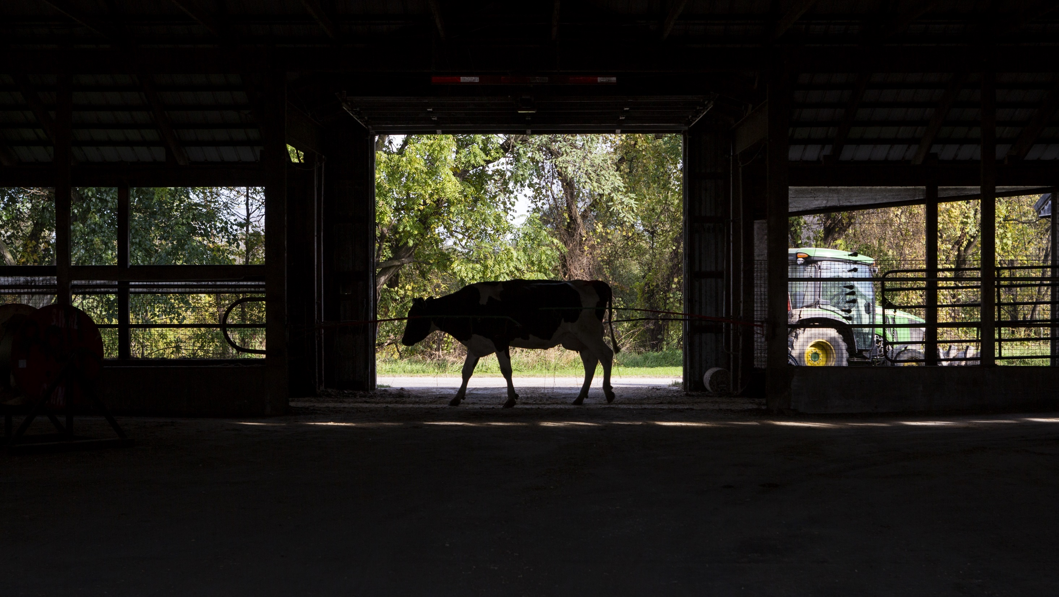
IT ALL STARTS WITH MILK …
DFA IS THE LARGEST SUPPLIER OF FLUID MILK IN THE WORLD
This allows our customers access to…
A national network of family farms
Cross-country manufacturing capabilities to meet all dairy needs
Dairy industry expertise
Sustainability initiatives across all areas of the organization

Slide 4

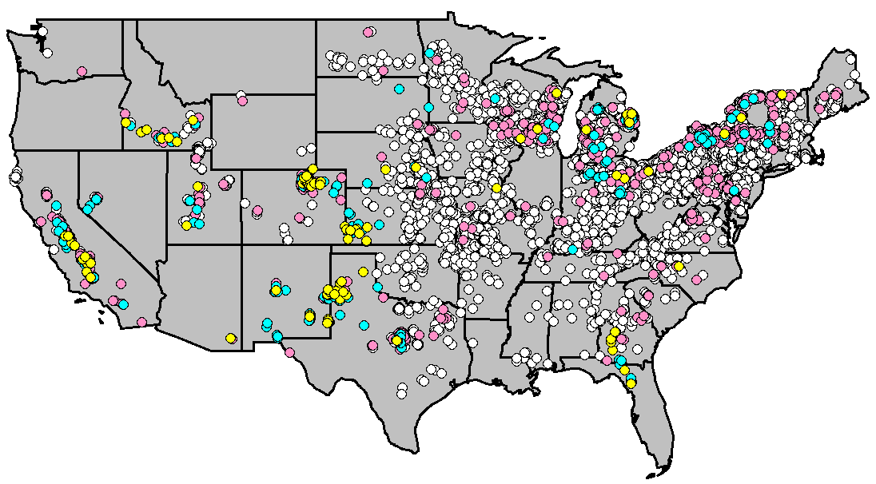

A COAST–TO–COAST NETWORK OF
FAMILY FARMS
Our members farms are diverse
Note: Based off January 2020 member milk production

Slide 5
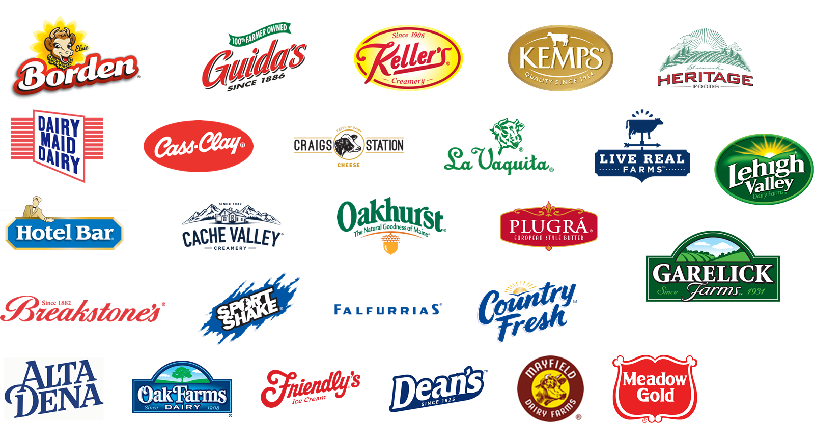






A STRONG PORTFOLIO OF
REGIONAL BRANDS
With unwavering dedication, our family farmer owners work tirelessly to produce pure, quality dairy in regional brands that families love.

Slide 6
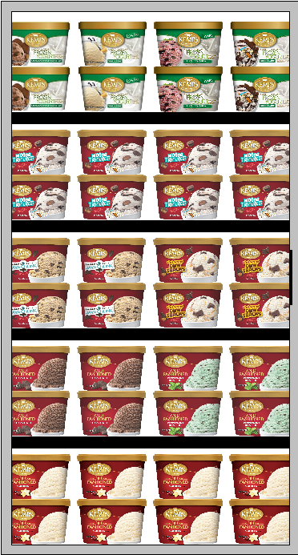
Kemps Scrounds
Ice cream and Frozen Yogurt

Slide 7
Flavors of Scrounds
 | KEMPS ICE CREAM - 48 oz (Scrounds)
KEMPS | APPLE CRISP | 3 - | - | 48oz
KEMPS | BEAR CREEK CARAMEL | 3 - | - | 48oz
KEMPS | CANDY CANE | 3 - | - | 48oz
KEMPS | CARAMEL COW TRACKS | 3 - | - | 48oz
KEMPS | CARAMEL FUDGE COW TRACKS | 3 - | - | 48oz
KEMPS | CARAMEL BROWNIE MOOSE TRACKS | 3 - | - | 48oz
KEMPS | CARIBOU JAVA CHUNK | 3 - | - | 48oz
KEMPS | CHERRY FUDGE CHUNK | 3 - | - | 48oz
KEMPS | CHOCOLATE CHIP COOKIE DOUGH | 3 - | - | 48oz
KEMPS | CHOCOLATE PEANUT BUTTER CUP | 3 - | - | 48oz
KEMPS | CINNAMON | 3 - | - | 48oz
KEMPS | COOKIE DOUGH MOOSE TRACKS | 3 - | - | 48oz
KEMPS | DOUBLE CARAMEL COOKIE CRUNCH | 3 - | - | 48oz
KEMPS | DOUBLE FUDGE MOOSE TRACKS | 3 - | - | 48oz
KEMPS | EGG NOG | 3 - | - | 48oz
KEMPS | LT VANILLA | 3 - | - | 48oz
KEMPS | MALT SHOP CHOCOLATE | 3 - | - | 48oz
KEMPS | MINT COW TRACKS | 3 - | - | 48oz
KEMPS | MINT PATTIE | 3 - | - | 48oz
KEMPS | MOOSE TRACKS | 3 - | - | 48oz
KEMPS | NEAPOLITAN | 3 - | - | 48oz
KEMPS | NUT GOODIE | 3 - | - | 48oz
KEMPS | OLD FASHIONED BUTTER PECAN | 3 - | - | 48oz
KEMPS | OLD FASHIONED CHOC CHIP | 3 - | - | 48oz
KEMPS | OLD FASHIONED CHOCOLATE | 3 - | - | 48oz
KEMPS | OLD FASHIONED COOK N CREAM | 3 - | - | 48oz
KEMPS | OLD FASHIONED FRENCH VANILLA | 3 - | - | 48oz
KEMPS | OLD FASHIONED HOMEMADE VANILLA | 3 - | - | 48oz
KEMPS | OLD FASHIONED MAPLE NUT | 3 - | - | 48oz
KEMPS | OLD FASHIONED NATURAL VANILLA | 3 - | - | 48oz
KEMPS | OLD FASHIONED NEW YORK VANILLA | 3 - | - | 48oz
KEMPS | OLD FASHIONED PEPPERMINT BON BON | 3 - | - | 48oz
KEMPS | OLD FASHIONED STRAWBERRIES N CREAM | 3 - | - | 48oz
KEMPS | OLD FASHIONED TOASTED ALMOND FUDGE | 3 - | - | 48oz
KEMPS | OLD FASHIONED VANILLA CUSTARD | 3 - | - | 48oz
KEMPS | OLD FASHIONED VANILLA | 3 - | - | 48oz
KEMPS | PECAN TURTLE TRAIL | 3 - | - | 48oz
KEMPS | SALTED CARAMEL & VANILLA | 3 - | - | 48oz
KEMPS | SALTED NUT ROLL | 3 - | - | 48oz
KEMPS | TRW GOO GOO CLUSTER | 3 - | - | 48oz
KEMPS | UNDER THE STARS | 3 - | - | 48oz
KEMPS | VANILLA BEAN CARAMEL CRUNCH | 3 - | - | 48oz
 | KEMPS ICE CREAM MASH UPS - 48 oz (Scrounds)
KEMPS | BROWNIES & COOKIE DOUGH | 3 - | - | 48oz
KEMPS | BROWNIES & BLONDIES | 3 - | - | 48oz
KEMPS | PEANUT BUTTER & BROWNIES | 3 - | - | 48oz
KEMPS | PEANUT BUTTER & COOKIES N CREAM | 3 - | - | 48oz
 | KEMPS ICE CREAM - SIMPLY CRAFTED
KEMPS | SIMPLY CRAFTED BROWNIE COOKIE DOUGH DELIGHT | 3 - | - | 48oz
KEMPS | SIMPLY CRAFTED BUTTER PECAN | 3 - | - | 48oz
KEMPS | SIMPLY CRAFTED CARAMEL SHORTBREAD COOKIE | 3 - | - | 48oz
KEMPS | SIMPLY CRAFTED CHOCOLATE | 3 - | - | 48oz
KEMPS | SIMPLY CRAFTED CHOCOLATE CHIP | 3 - | - | 48oz
KEMPS | SIMPLY CRAFTED CHOCOLATE CHIP COOKIE DOUGH | 3 - | - | 48oz
KEMPS | SIMPLY CRAFTED CHOCOLATE PEANUT BUTTER | 3 - | - | 48oz
KEMPS | SIMPLY CRAFTED COOKIES N'CREAM | 3 - | - | 48oz
KEMPS | SIMPLY CRAFTED FUDGE 'N PEANUT BUTTER CUPS | 3 - | - | 48oz
KEMPS | SIMPLY CRAFTED MAPLE NUT | 3 - | - | 48oz
KEMPS | SIMPLY CRAFTED MINT CHOCOLATE CHIP | 3 - | - | 48oz
KEMPS | SIMPLY CRAFTED MUDSLIDE | 3 - | - | 48oz
KEMPS | SIMPLY CRAFTED SALTED CARAMEL | 3 - | - | 48oz
KEMPS | SIMPLY CRAFTED SALTED CARAMEL BROWNIE | 3 - | - | 48oz
KEMPS | SIMPLY CRAFTED SCOTCHAROO | 3 - | - | 48oz
KEMPS | SIMPLY CRAFTED STRAWBERRY | 3 - | - | 48oz
KEMPS | SIMPLY CRAFTED STRAWBERRY RHUBARB COBBLER | 3 - | - | 48oz
KEMPS | SIMPLY CRAFTED VANILLA | 3 - | - | 48oz
KEMPS | SIMPLY CRAFTED VANILLA BEAN | 3 - | - | 48oz
KEMPS | SIMPLY CRAFTED WHITE CHOCOLATE RASPBERRY | 3 - | - | 48oz
 | KEMPS ICE CREAM - NO SUGAR ADDED
KEMPS | BUTTER PECAN | 3 - | - | 48oz
KEMPS | CHOCOLATE | 3 - | - | 48oz
KEMPS | FROZEN YOGURT FAT FREE VANILLA | 3 - | - | 48oz
KEMPS | STRAWBERRY | 3 - | - | 48oz
KEMPS | VANILLA | 3 - | - | 48oz

Slide 8
Frozen Yogurts
 |  | KEMPS FROZEN YOGURT
47251 | KEMPS | BUTTER PECAN | 3 - | - | 48oz
45160 | KEMPS | CARAMEL BROWNIE MOOSE TRACKS | 3 - | - | 48oz
52370 | KEMPS | CARAMEL COOKIE CRUNCH | 3 - | - | 48oz
47719 | KEMPS | CARAMEL PRALINE | 3 - | - | 48oz
47436 | KEMPS | CHOCOLATE CARAMEL BROWNIE | 3 - | - | 48oz
47262 | KEMPS | CHOCOLATE CHIP | 3 - | - | 48oz
47264 | KEMPS | CHOCOLATE CHIP COOKIE DOUGH | 3 - | - | 48oz
52375 | KEMPS | CHOCOLATE PEANUT BUTTER CUP | 3 - | - | 48oz
45161 | KEMPS | COOKIE DOUGH MOOSE TRACKS | 3 - | - | 48oz
47433 | KEMPS | DARK CHOCOLATE ALMOND | 3 - | - | 48oz
47437 | KEMPS | MOOSE TRACKS | 3 - | - | 48oz
47395 | KEMPS | NEAPOLITAN | 3 - | - | 48oz
52374 | KEMPS | ROCKY ROAD | 3 - | - | 48oz
47252 | KEMPS | SEA SALT CARAMEL FUDGE TRUFFLE | 3 - | - | 48oz
47439 | KEMPS | STRAWBERRY | 3 - | - | 48oz
47396 | KEMPS | TRIPLE CHOCOLATE | 3 - | - | 48oz
52393 | KEMPS | TWISTED DOUGH | 3 - | - | 48oz
 |  | KEMPS FROZEN YOGURT - TRIPLE CREAM
52369 | KEMPS | TRIPLE CREAM COCONUT FUDGE | 3 - |  | 48oz
52366 | KEMPS | TRIPLE CREAM HONEY VANILLA | 3 - |  | 48oz
52367 | KEMPS | TRIPLE CREAM SALTED CARAMEL | 3 - |  | 48oz
52368 | KEMPS | TRIPLE CREAM SUMMER STRAWBERRY | 3 - |  | 48oz
 |  | KEMPS FROZEN YOGURT - LOW FAT
47434 | KEMPS | BLACK JACK CHERRY | 3 - | - | 48oz
47540 | KEMPS | CHOCOLATE | 3 - | - | 48oz
47542 | KEMPS | COOKIES N CREAM | 3 - | - | 48oz
47541 | KEMPS | MINT CHOCOLATE CHIP | 3 - | - | 48oz
52372 | KEMPS | VANILLA BEAN | 3 - | - | 48oz
 |  | KEMPS FROZEN YOGURT - FAT FREE
47432 | KEMPS | BLACK RASPBERRY SWIRL | 3 - | - | 48oz
47450 | KEMPS | CHOCOLATE | 3 - | - | 48oz
47442 | KEMPS | STRAWBERRY | 3 - | - | 48oz
47451 | KEMPS | VANILLA | 3 - | - | 48oz

Slide 9
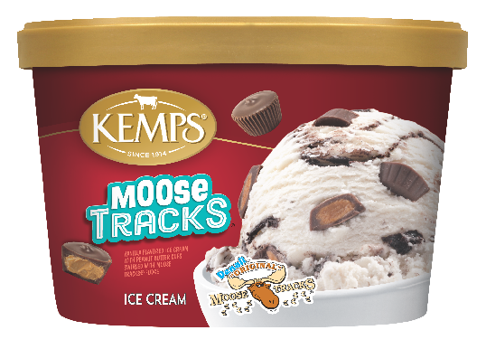
Driving Sales with Kemps Premium Scrounds
Kemps is the scround leader in MN
Kemps has top dollar share and top turning scrounds
Kemps contributes the highest dollars per point distribution (shelf space)
Kemps turns / sells quicker than other brand on promotion (merch)
Dollar Share
Dollars Per Point of Distribution
Avg Weekly $ per $ACV/MM – Any Merch
Source: IRI MN/WI, Scround/Round Pack Type, L52 WE 12/27/20

Slide 10
Novelties and ITTI Bitz
Little Bitz of Ice Cream Fun

Slide 11
ITTI Bitz and Novelties
 |  | KEMPS ICE CREAM - ITTI BITZ
60727 | KEMPS | BANANA SPLIT | 12 - | - | 2.9oz
60704 | KEMPS | BIRTHDAY CAKE | 12 - | - | 2.9oz
60726 | KEMPS | CHOCOLATE CHIP COOKIE DOUGH | 12 - | - | 2.9oz
60725 | KEMPS | COOKIES N CREAM | 12 - | - | 2.9oz
60719 | KEMPS | COTTON CANDY | 12 - | - | 2.9oz
60728 | KEMPS | MINT CHIP | 12 - | - | 2.9oz
60887 | KEMPS | RED WHITE & POP | 12 - | - | 2.9oz
60749 | KEMPS | SUPER POWER | 12 - | - | 2.9oz
60757 | KEMPS | UNICORN SWIRL | 12 - | - | 2.9oz
 |  | KEMPS ICE CREAM - CUP
53350 | KEMPS | SINGLES BIRTHDAY CAKE | 12 - | - | 6oz
53032 | KEMPS | SINGLES CARAMEL COW TRAX | 12 - | - | 6oz
53049 | KEMPS | SINGLES FUDGE CRUNCH | 12 - | - | 6oz
53031 | KEMPS | SINGLES MINT FUDGE CRUNCH | 12 - | - | 6oz
53033 | KEMPS | SINGLES MOOSE TRACKS | 12 - | - | 6oz
53035 | KEMPS | SINGLES PECAN TURTLE TRAIL | 12 - | - | 6oz
53351 | KEMPS | SINGLES UNICORN SWIRL | 12 - | - | 6oz
60161 | KEMPS | VANILLA SHAKE CUP | 24 - | - | 20oz
 |  | KEMPS ICE CREAM - BAR
62937 | KEMPS | ORANGE CREAM BAR | 8 - | 12ct | 1.7oz
62867 | KEMPS | FUDGE BAR | 8 - | 12ct | 3oz
62868 | KEMPS | KEMPS ICE CREAM BAR | 8 - | 12ct | -
62866 | KEMPS | POPSICLE FLOAT BAR | 8 - | 12ct | 1.7oz
60210 | KEMPS | SIMPLY CRAFTED CHOCOLATE CHIP COOKIE DOUGH BAR | 8 - | 4ct | 3.25oz
60208 | KEMPS | SIMPLY CRAFTED MINT CHIP BAR | 8 - | 4ct | 3.25oz
60209 | KEMPS | SIMPLY CRAFTED SALTY CARAMEL SWIRL BAR | 8 - | 4ct | 3.25oz
60207 | KEMPS | SIMPLY CRAFTED STRAWBERRY RHUBARB COBBLER BAR | 8 - | 4ct | 3.25oz
 |  | KEMPS ICE CREAM - CONE
60409 | KEMPS | CHOCOLATE OVERLOAD SUNDAE CONE | 6 - | 4 ct | -
60407 | KEMPS | VANILLA SUNDAE CONE | 6 - | 4 ct | -
60410 | KEMPS | VANILLA FUDGE SUNDAE CONE | 6 - | 4 ct | -
60408 | KEMPS | VANILLA CARAMEL SUNDAE CONE | 6 - | 4 ct | -
 |  | KEMPS FROZEN - POP
62863 | KEMPS | ALL-AMERICAN POPSICLE | 9 - | 12ct | 1.75oz
62862 | KEMPS | POPS JR POPSICLE | 9 - | 12ct | 1.75oz
62864 | KEMPS | POPS JR NSA POPSICLE | 9 - | 12ct | 1.75oz
62865 | KEMPS | TROPICAL POPS JR POPSICLE | 9 - | 12ct | 1.75oz
 |  | KEMPS FROZEN - SANDWICH
60305 | KEMPS | KEMPSWICH | 12 - | 4ct | -
61997 | KEMPS | SIMPLY CRAFTED SANDWICH HEAVENLY VANILLA | 9 - | 8 ct | -
61998 | KEMPS | SIMPLY CRAFTED SANDWICH SALTED CARAMEL BLONDIE | 9 - | 8 ct | -
62398 | KEMPS | SANDWICH CHOCOLATE CHIP COOKIE DOUGH | 9 - | 12ct | -
62988 | KEMPS | SANDWICH CHOCOLATE CHIP | 9 - | 12ct
62300 | KEMPS | SANDWICH MINI VANILLA | 6 - | 16ct | -
62998 | KEMPS | SANDWICH MINT CHOCOLATE CHIP | 9 - | 12ct | -
62986 | KEMPS | SANDWICH N.S.A. VANILLA | 9 - | 12ct | -
62397 | KEMPS | SANDWICH SALT CARAMEL | 9 - | 12ct | -
63338 | KEMPS | SANDWICH STRAWBERRY | 9 - | 12ct | -
63348 | KEMPS | SANDWICH VANILLA | 9 - | 12ct | -
61783 | KEMPS | SANDWICH VANILLA | 12 - | 6ct | -
 |  | NOVELTY - OTHER
44236 | COUNTRY FRESH | ORANGE PUSHUPS | 6 - | 12ct | 3oz

Slide 12
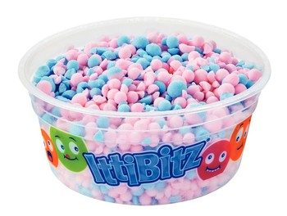
ITTI BITZ
Little Bitz of Ice Cream Fun

Slide 13
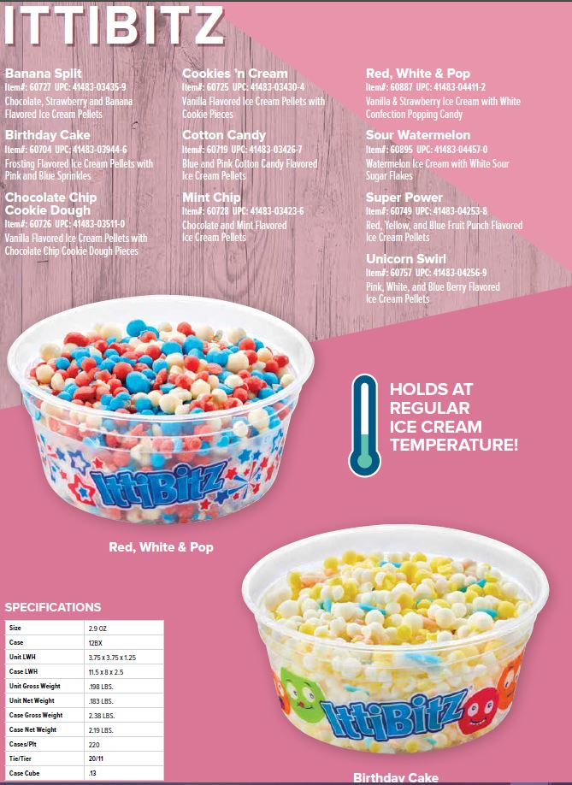
Introducing IttiBitz!
Introducing a fun and easy way to add excitement to your impulse snack sales! IttiBitz is a new pelletized ice cream product available from Kemps, the ice cream experts.
IttiBitz is real ice cream delivered in a fun and family pleasing frozen pellet form.
IttiBitz is unique from other pellet products in the market because you can serve, store, and ship it like regular ice cream. Unlike other pelletized ice creams which require special handling in order to maintain product integrity at -40, IttiBitz maintains product integrity up to zero Fahrenheit, just like other ice cream. There is no special handling required!

Slide 14
Novelties are a growing category; IttiBitz out-pacing growth
Novelties continue to become a larger portion of the frozen category
3YR CAGR: 11% Novelties vs. 5% IC
IttiBitz is 10.2% of the single serve cup segment; +2.3 share points vs. YA
IttiBitz growth rate +30%; significantly out-pacing the category and cup segment
Source: IRI, Total US, L52 Weeks Ending 7.11.21

Slide 15

Kemps IttiBitz are Growing Nationwide
 | Geography | 4YR CAGR | ACV | ACV Chg vs. YA
 | Total US | 25% | 47.0 | 6.4
 | California | 15% | 26.4 | 3.5
 | Great Lakes | 23% | 66.0 | 6.5
 | Mid-South | 34% | 39.7 | 8.6
 | Northeast | 59% | 16.3 | 2.2
 | Plains | 13% | 65.1 | 9.9
 | S. Central | 21% | 65.8 | 22.5
 | Southeast | 54% | 55.0 | -7.2
 | West | 18% | 50.9 | 10.6
More than doubled the distribution!
Source: IRI, Total US, L52 Weeks Ending 7.11.21

Slide 16
Q&A

