Slide 1
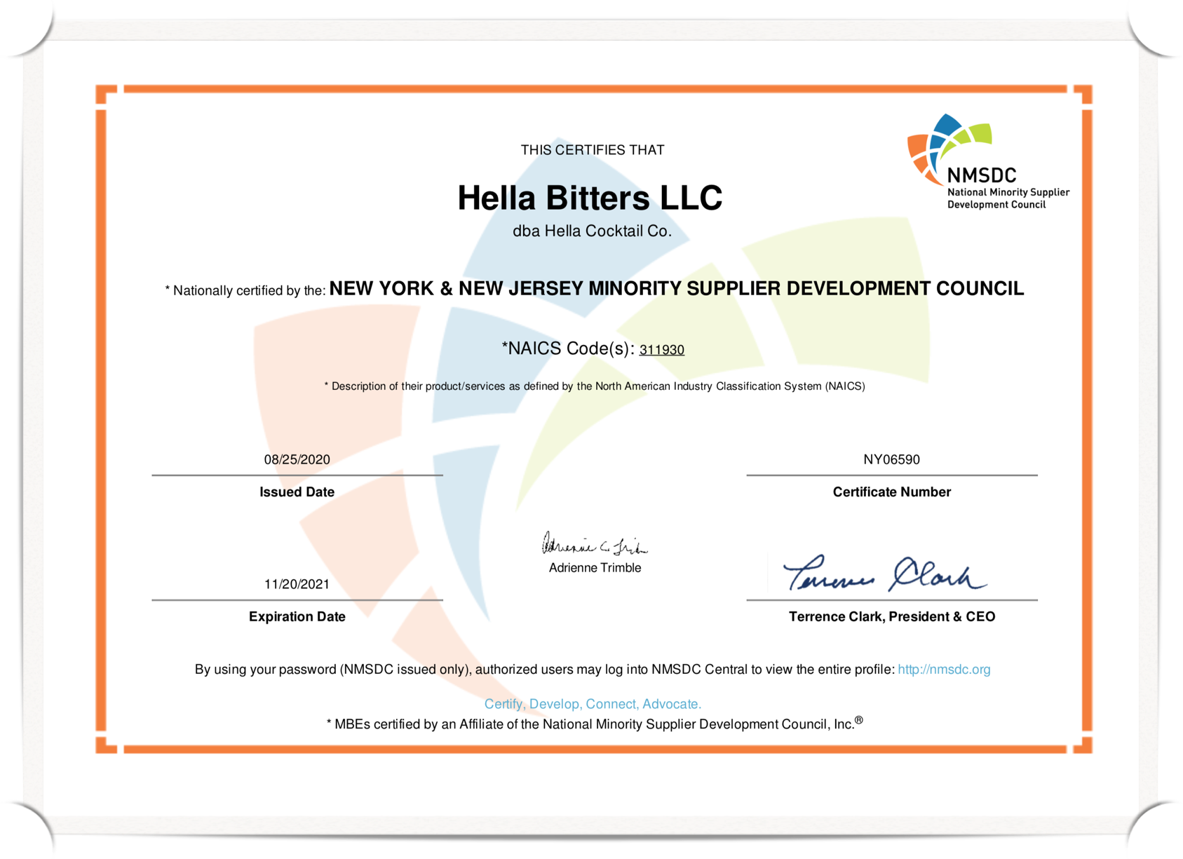
Hella is a Proud Minority-Led Business
Hella Cocktail Co is a MSDC Certified Minority-Owned mixology company that sits at the intersection between the better-for-you movement and the cocktail culture. The company’s goal is to create an all-natural cocktail experience to anyone along the continuum of adult drinking - booze optional. Hella Cocktail makes a full line of bitters, mixers and most recently launched a Bitters and Soda ready-to-drink line.
OUR CORE VALUES
Celebration
We believe cocktailing is inherently about celebrations, large and small. At Hella Cocktail Company, we celebrate a great drink but also good health, the pursuit of happiness, and good fortune.
Roots
Just as we as a company are of a place, so are our ingredients. At Hella Cocktail Company, we have deep respect and reverence for culture, heritage, and where we’ve been inspires where we can go.
Diversity
We believe life is best when we shake things up and explore new worlds and perspectives. We welcome diversity of people, places, and recipes. We know variety is the spice of life - and makes for a great journey in mixology too.
Giving
We believe in a spirit of hospitality and generosity. From these roots, we live to discover and give those discoveries to the world, be it a good cocktail or a good story. Similarly, we build bridges with like-minded organizations who share our vision for hospitality and giving.

