Slide 1
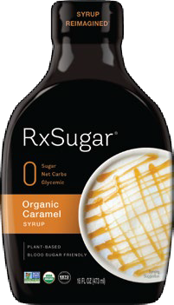
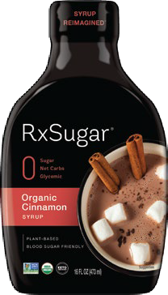
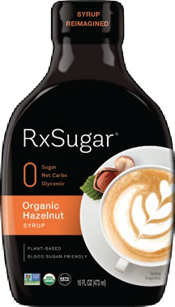
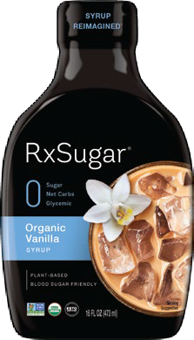
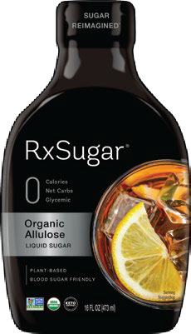
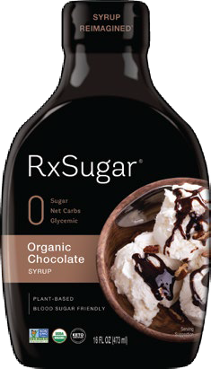
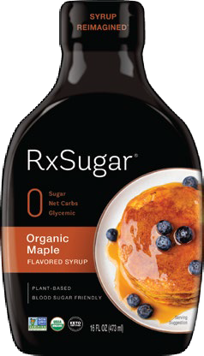
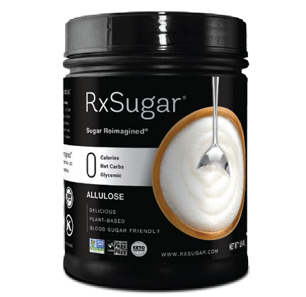
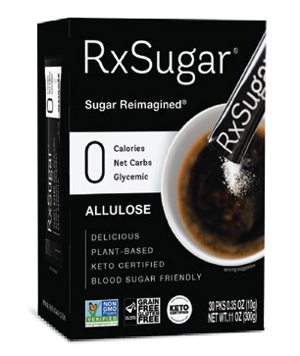
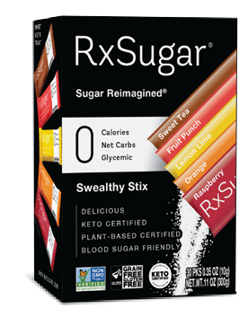

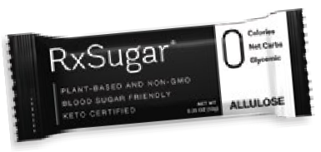
®
Grovara Deck 2023
www.RxSugar.com
@RxSugar

Slide 2
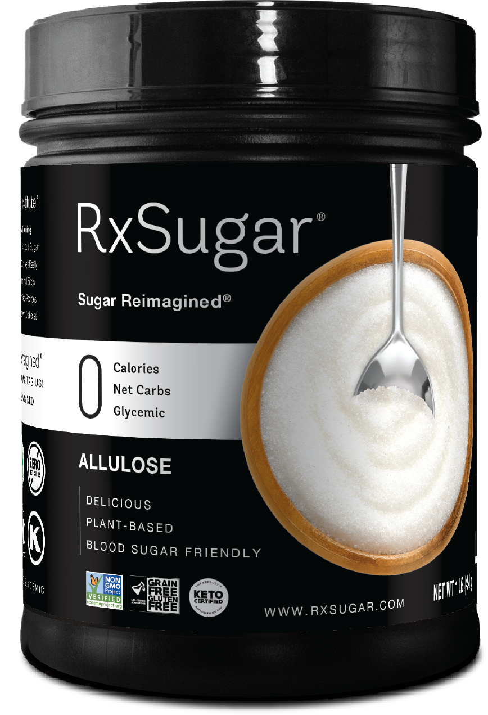


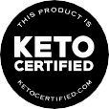



RxSugar® One Pound Canister
The World’s Best Tasting, Keto Certified, Non-GMO, Plant-based Sugar & Syrup
Functional & Convenient
A Sweet Treat for Everyday Use Ideal for Coffee/Tea, Water, Shakes Perfect for Baking & Cooking
Use on Cereal, Granola, Yogurt
No artificial flavors, colors or preservatives Dissolves easily
Caramelizes and browns
Zero Aftertaste & Perfect Mouthfee
Delicious & Sweet
Tastes Better Than Sugar!
Keto Certified, Paleo & Primal friendly Non-GMO Project Verified Gluten/Grain Free Certified
Vegan, FODMAP Friendly Certified Zero Net Carbs, Zero Glycemic Blood Sugar Friendly
Suitable for People with Diabetes
Nutrition Facts 45 servings per container Serving Size 2.5 Tsp. (10g)
Calories | 0
 | % Daily Value*
Total Fat 0g | 0%
Sodium 0mg | 0%
Total Carbohydrate 10g | 3%
Total Sugars 0g Includes 0g Added Sugars 0% Protein 0g Not a significant source of saturated fat, trans fat, cholesterol, dietary fiber, vitamin D, calcium, iron and potassium. %DV = % Daily Value
Amount per serving
INGREDIENT: ALLULOSE
MANUFACTURED FOR NUTRISHUS BRANDS INC. ATLANTA, GA 30309
Total Carbs/Serving 10g
Less: Allulose Carbs (10g)
Total Net Carbs 0g
Allulose is a plant-based sugar and, per the FDA, is different from other sugars in that it is not metabolized by the human body in the same way as table sugar. It produces only a negligible increase in blood glucose or insulin levels.
UPC
CASE PACK
UNIT WEIGHT
CASE WEIGHT
UNIT DIMENSIONS CASE DIMENSIONS
SHELF LIFE
8-50009-17304-1 | 6 | 16 oz | 6.60 lb | 3.75 x 3.75 x 6 in | 11.38 x 7.5 x 6 in | 2 Years
Here at RxSugar®, We are on a Mission to Make the World Sweet & Healthy, or as we call it: SWEALTHY™!
www.RxSugar.com

Slide 3
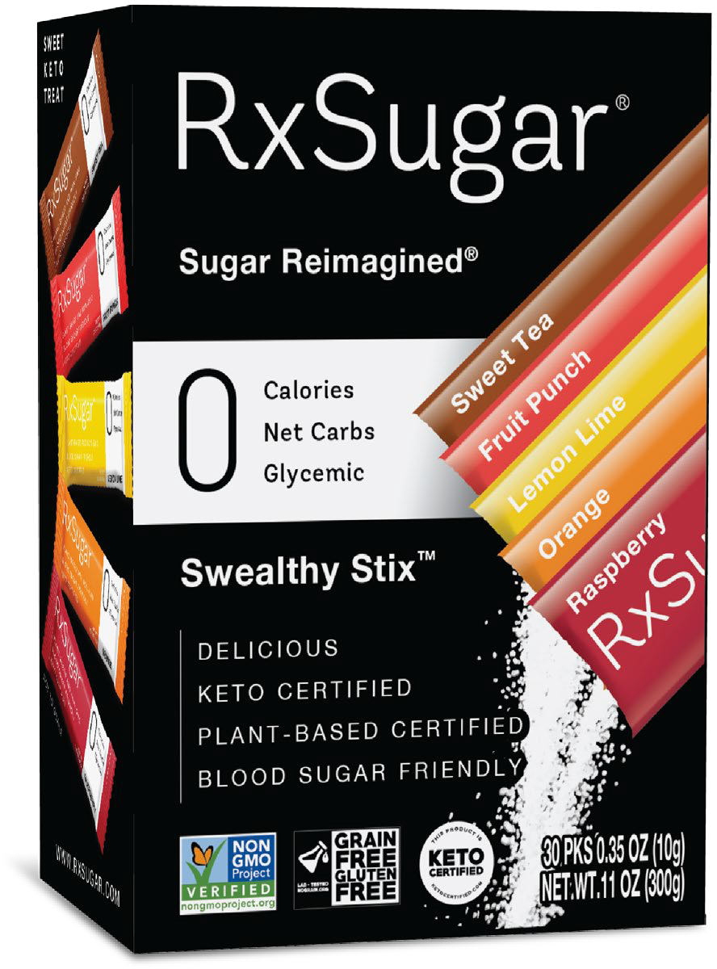
RxSugar® Swealthy Stix Carton
The World’s Best Tasting, Keto Certified, Non-GMO, Plant-based Sugar & Syrup
Delicious & Sweet
Tastes Better Than Sugar!
Keto Certified, Paleo & Primal Friendly Non-GMO Project Verified Gluten/Grain Free Certified
Vegan, FODMAP Friendly Certified Zero Net Carbs, Zero Glycemic Blood Sugar Friendly
Suitable for People with Diabetes
Functional & Convenient
Consume Direct to Mouth or with 3-5 oz of Water No Artificial Flavors, Colors or Preservatives Dissolves Easily
Zero Aftertaste Perfect Mouthfeel
A Sweet Keto Treat!
Nutrition Facts 30 servings per container Serving Size 1 Packet (10g)
Calories | 0
 | % Daily Value*
Total Fat 0g | 0%
Sodium 0mg | 0%
Total Carbohydrate 10g | 3%
Total Sugars 0g Includes 0g Added Sugars 0% Protein 0g * Not a significant source of saturated fat, trans fat, cholesterol, dietary fiber, vitamin D, calcium, iron and potassium. * %DV = % Daily Value
Amount per serving
INGREDIENT: ALLULOSE, NATURAL FLAVOR, MALIC ACID, CITRIC ACID
MANUFACTURED FOR NUTRISHUS BRANDS INC. ATLANTA, GA 30309
Total Carbs/Serving 10g
Less: Allulose Carbs (10g)
Total Net Carbs 0g
Allulose is a plant-based sugar and, per the FDA, is different from other sugars in that it is not metabolized by the human body in the same way as table sugar. It produces only a negligible increase in blood glucose or insulin levels.
UPC
CASE PACK
UNIT WEIGHT
CASE WEIGHT
UNIT DIMENSIONS CASE DIMENSIONS
SHELF LIFE
8-50009-17303-4 | 6 | 11 oz | 4.7 lb | 2.75 x 4 x 5.75 in | 8.875 x 3.75 x 6 in | 2 Years
Here at RxSugar®, We are on a Mission to Make the World Sweet & Healthy, or as we call it: SWEALTHY™!
www.RxSugar.com

Slide 4
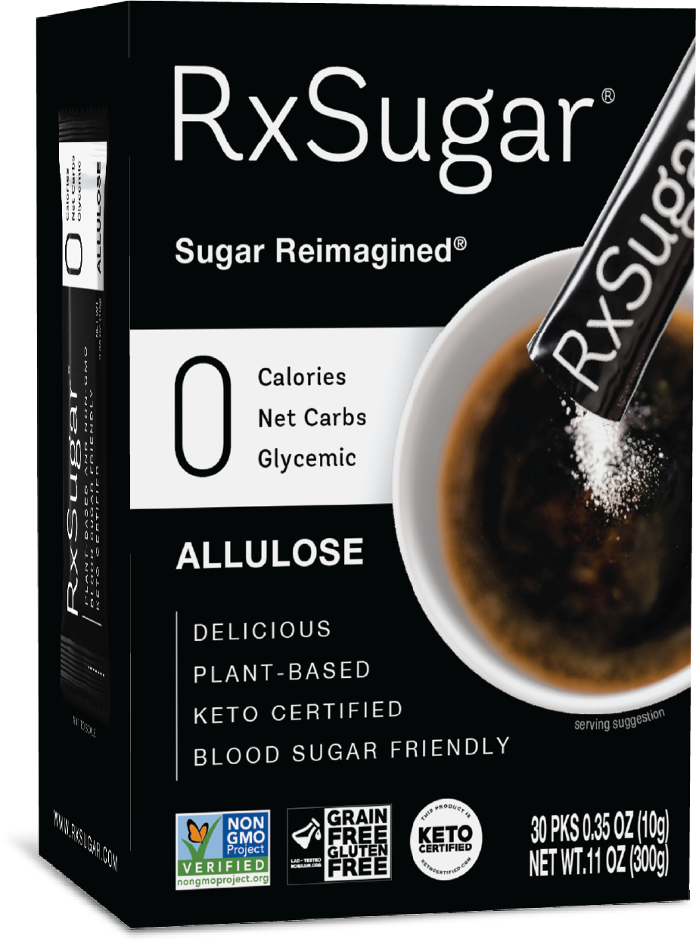
RxSugar® 30 Stick Pack Carton
The World’s Best Tasting, Keto Certified, Non-GMO, Plant-based Sugar & Syrup
Delicious & Sweet
Tastes Better Than Sugar!
Keto Certified, Paleo & Primal friendly Non-GMO Project Verified Gluten/Grain Free Certified
Vegan, FODMAP Friendly Certified Zero Net Carbs, Zero Glycemic Blood Sugar Friendly
Suitable for People with Diabetes
Functional & Convenient
A Sweet Treat for Everyday Use Ideal for Coffee/Tea, Water, Shakes Perfect for Baking & Cooking
Use on Cereal, Granola, Yogurt
No artificial flavors, colors or preservatives Dissolves easily
Caramelizes and browns
Zero Aftertaste & Perfect Mouthfee
Nutrition Facts 30 servings per container Serving Size 1 Packet (10g)
Calories | 0
 | % Daily Value*
Total Fat 0g | 0%
Sodium 0mg | 0%
Total Carbohydrate 10g | 3%
Total Sugars 0g Includes 0g Added Sugars 0% Protein 0g * Not a significant source of saturated fat, trans fat, cholesterol, dietary fiber, vitamin D, calcium, iron and potassium. * %DV = % Daily Value
Amount per serving
INGREDIENT: ALLULOSE
MANUFACTURED FOR NUTRISHUS BRANDS INC. ATLANTA, GA 30309
Total Carbs/Serving 10g
Less: Allulose Carbs (10g)
Total Net Carbs 0g
Allulose is a plant-based sugar and, per the FDA, is different from other sugars in that it is not metabolized by the human body in the same way as table sugar. It produces only a negligible increase in blood glucose or insulin levels.
UPC
CASE PACK
UNIT WEIGHT
CASE WEIGHT
UNIT DIMENSIONS CASE DIMENSIONS
SHELF LIFE
8-50009-17305-8 | 6 | 11 oz | 4.7 lb | 2.75 x 4 x 5.75 in | 8.875 x 3.75 x 6 in | 2 Years
Here at RxSugar®, We are on a Mission to Make the World Sweet & Healthy, or as we call it: SWEALTHY™!
www.RxSugar.com

Slide 5
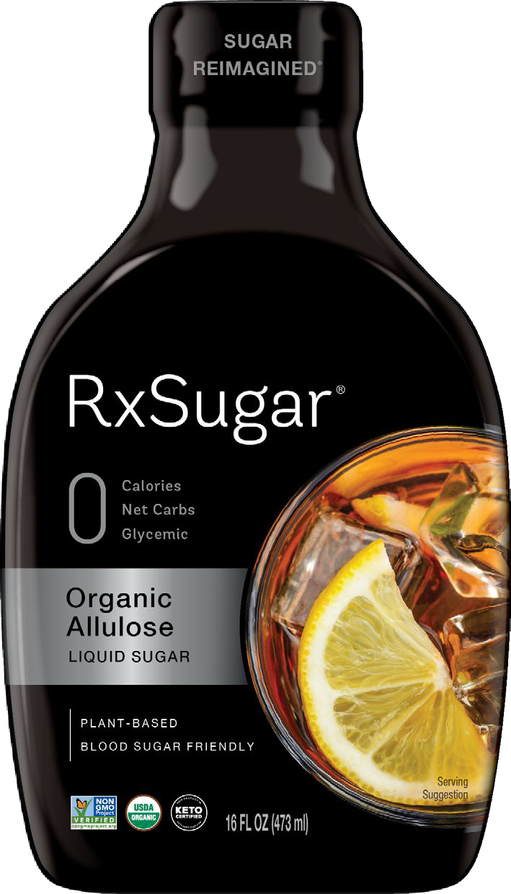
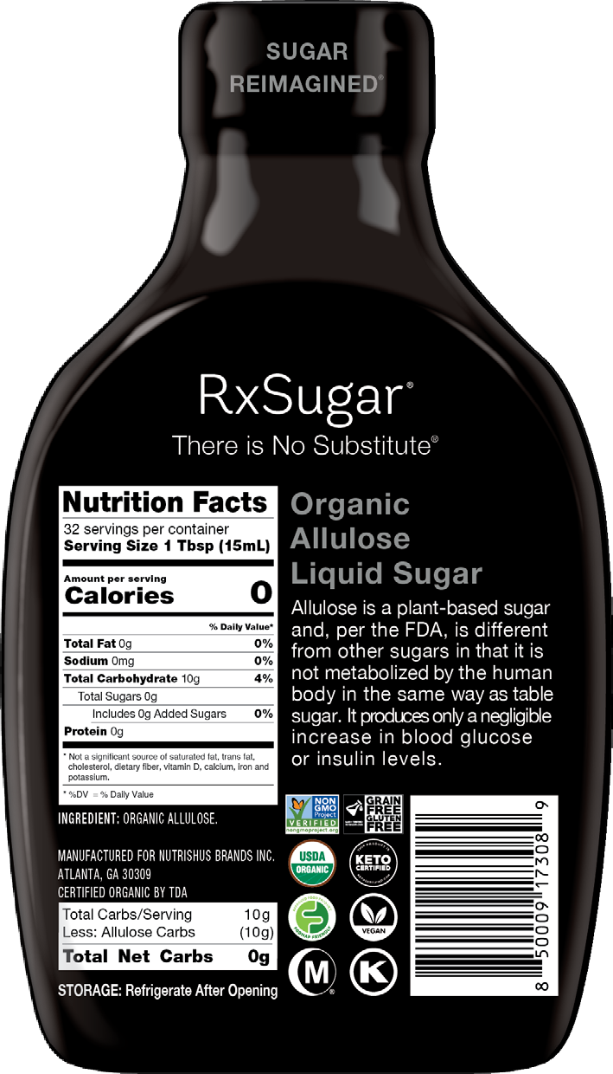
RxSugar® Organic Liquid Sugar
The World’s Best Tasting, Keto Certified, Non-GMO, Plant-based Sugar & Syrup
Delicious & Sweet
Tastes Better Than Sugar!
Keto Certified, Paleo & Primal friendly Non-GMO Project Verified Gluten/Grain Free Certified
Vegan, FODMAP Friendly Certified Zero Net Carbs, Zero Glycemic Blood Sugar Friendly
Suitable for People with Diabetes
Functional & Convenient
A Sweet Treat for Everyday Use Ideal for Coffee/Tea, Water, Shakes Perfect for Baking & Cooking
Use on Cereal, Granola, Yogurt
No artificial flavors, colors or preservatives Dissolves easily
Caramelizes and browns
Zero Aftertaste & Perfect Mouthfee
UPC
CASE PACK
UNIT WEIGHT
CASE WEIGHT
UNIT DIMENSIONS CASE DIMENSIONS
SHELF LIFE
8-50009-17308-9 | 6 | 16 oz | 9.30 lb | 3.82 x 2.5 x 6.5 in | 7.5 x 7.75 x 7 in | 2 Years
Here at RxSugar®, We are on a Mission to Make the World Sweet & Healthy, or as we call it: SWEALTHY™!
www.RxSugar.com

Slide 6
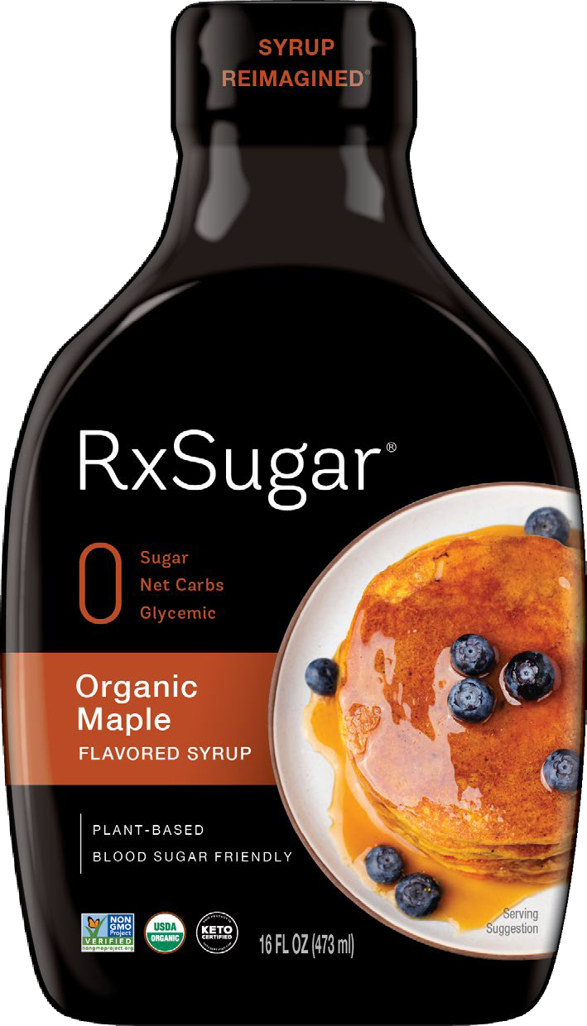
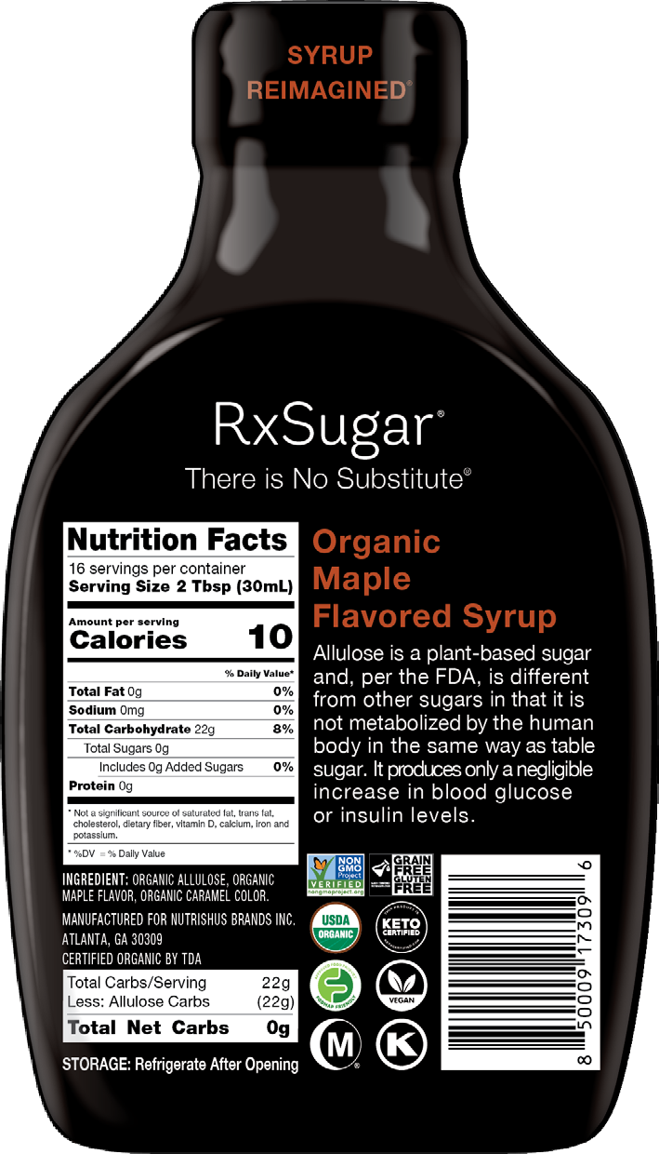
RxSugar® Organic Pancake Syrup
The World’s Best Tasting, Keto Certified, Non-GMO, Plant-based Sugar & Syrup
Delicious & Sweet
Tastes Better Than Sugar!
Keto Certified, Paleo & Primal friendly Non-GMO Project Verified Gluten/Grain Free Certified
Vegan, FODMAP Friendly Certified Zero Net Carbs, Zero Glycemic Blood Sugar Friendly
Suitable for People with Diabetes
Functional & Convenient
A Sweet Treat for Everyday Use Ideal for Coffee/Tea, Water, Shakes Perfect for Baking & Cooking
Use on Cereal, Granola, Yogurt
No artificial flavors, colors or preservatives Dissolves easily
Caramelizes and browns
Zero Aftertaste & Perfect Mouthfee
UPC
CASE PACK
UNIT WEIGHT
CASE WEIGHT
UNIT DIMENSIONS CASE DIMENSIONS
SHELF LIFE
8-50009-17309-6 | 6 | 16 oz | 9.30 lb | 3.82 x 2.5 x 6.5 in | 7.5 x 7.75 x 7 in | 2 Years
Here at RxSugar®, We are on a Mission to Make the World Sweet & Healthy, or as we call it: SWEALTHY™!
www.RxSugar.com

Slide 7
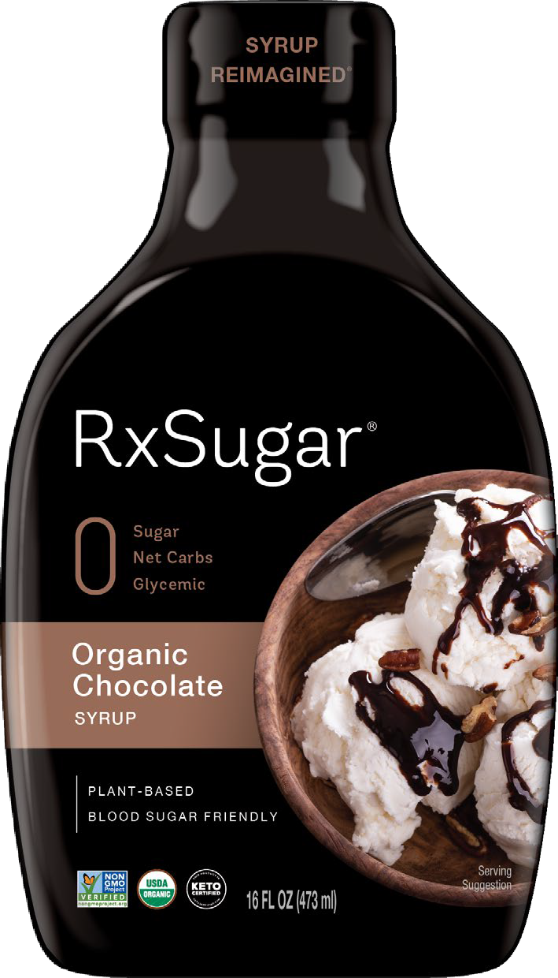
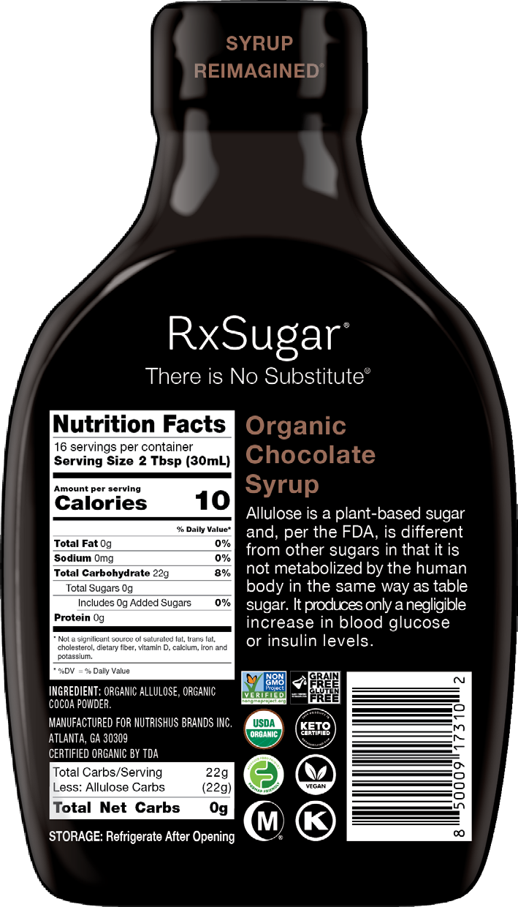
RxSugar® Organic Chocolate Syrup
The World’s Best Tasting, Keto Certified, Non-GMO, Plant-based Sugar & Syrup
Delicious & Sweet
Tastes Better Than Sugar!
Keto Certified, Paleo & Primal friendly Non-GMO Project Verified Gluten/Grain Free Certified
Vegan, FODMAP Friendly Certified Zero Net Carbs, Zero Glycemic Blood Sugar Friendly
Suitable for People with Diabetes
Functional & Convenient
A Sweet Treat for Everyday Use Ideal for Coffee/Tea, Water, Shakes Perfect for Baking & Cooking
Use on Cereal, Granola, Yogurt
No artificial flavors, colors or preservatives Dissolves easily
Caramelizes and browns
Zero Aftertaste & Perfect Mouthfee
UPC
CASE PACK
UNIT WEIGHT
CASE WEIGHT
UNIT DIMENSIONS CASE DIMENSIONS
SHELF LIFE
8-50009-17310-2 | 6 | 16 oz | 9.30 lb | 3.82 x 2.5 x 6.5 in | 7.5 x 7.75 x 7 in | 2 Years
Here at RxSugar®, We are on a Mission to Make the World Sweet & Healthy, or as we call it: SWEALTHY™!
www.RxSugar.com

Slide 8
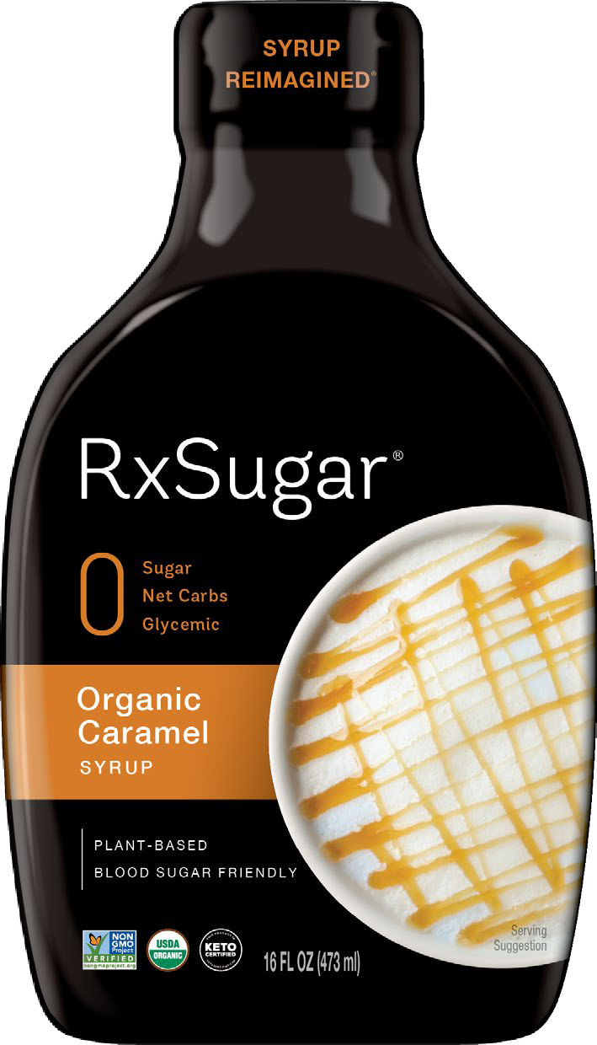
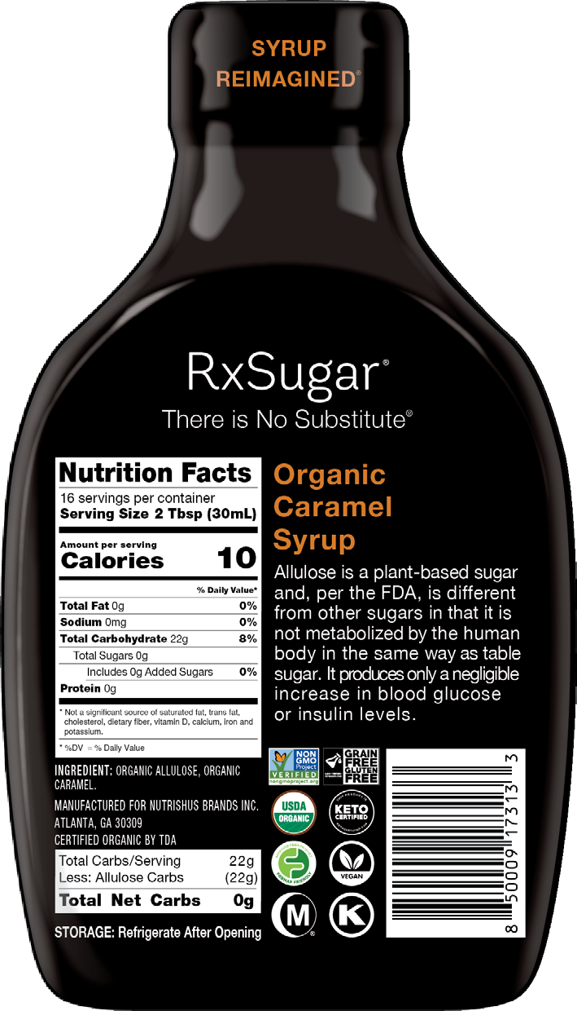
RxSugar® Organic Caramel Syrup
The World’s Best Tasting, Keto Certified, Non-GMO, Plant-based Sugar & Syrup
Delicious & Sweet
Tastes Better Than Sugar!
Keto Certified, Paleo & Primal friendly Non-GMO Project Verified Gluten/Grain Free Certified
Vegan, FODMAP Friendly Certified Zero Net Carbs, Zero Glycemic Blood Sugar Friendly
Suitable for People with Diabetes
Functional & Convenient
A Sweet Treat for Everyday Use Ideal for Coffee/Tea, Water, Shakes Perfect for Baking & Cooking
Use on Cereal, Granola, Yogurt
No artificial flavors, colors or preservatives Dissolves easily
Caramelizes and browns
Zero Aftertaste & Perfect Mouthfee
UPC
CASE PACK
UNIT WEIGHT
CASE WEIGHT
UNIT DIMENSIONS CASE DIMENSIONS
SHELF LIFE
8-50009-17313-3 | 6 | 16 oz | 9.30 lb | 3.82 x 2.5 x 6.5 in | 7.5 x 7.75 x 7 in | 2 Years
Here at RxSugar®, We are on a Mission to Make the World Sweet & Healthy, or as we call it: SWEALTHY™!
www.RxSugar.com

Slide 9
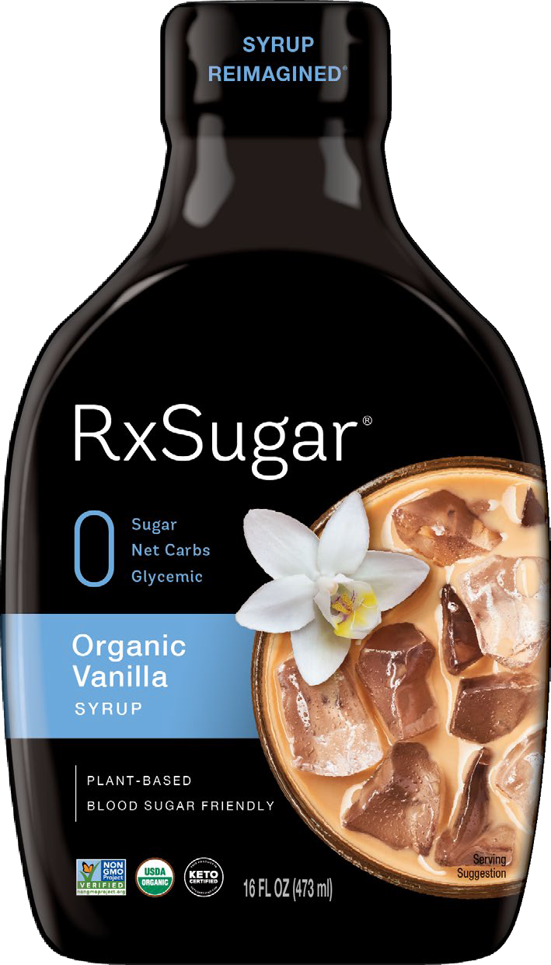
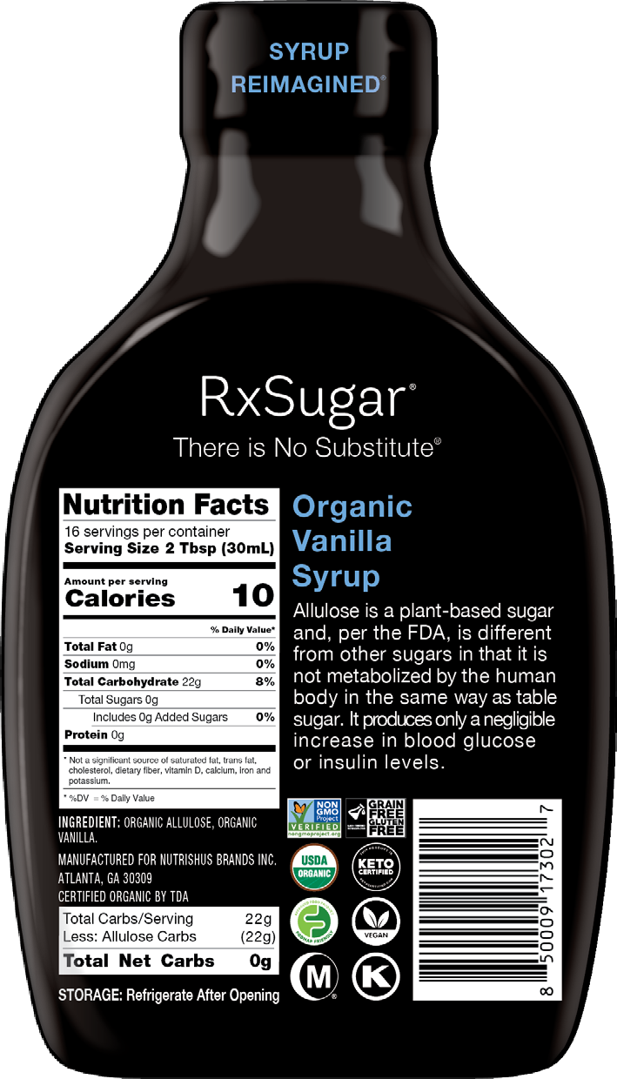
RxSugar® Organic Vanilla Syrup
The World’s Best Tasting, Keto Certified, Non-GMO, Plant-based Sugar & Syrup
Delicious & Sweet
Tastes Better Than Sugar!
Keto Certified, Paleo & Primal friendly Non-GMO Project Verified Gluten/Grain Free Certified
Vegan, FODMAP Friendly Certified Zero Net Carbs, Zero Glycemic Blood Sugar Friendly
Suitable for People with Diabetes
Functional & Convenient
A Sweet Treat for Everyday Use Ideal for Coffee/Tea, Water, Shakes Perfect for Baking & Cooking
Use on Cereal, Granola, Yogurt
No artificial flavors, colors or preservatives Dissolves easily
Caramelizes and browns
Zero Aftertaste & Perfect Mouthfee
UPC
CASE PACK
UNIT WEIGHT
CASE WEIGHT
UNIT DIMENSIONS CASE DIMENSIONS
SHELF LIFE
8-50009-17302-7 | 6 | 16 oz | 9.30 lb | 3.82 x 2.5 x 6.5 in | 7.5 x 7.75 x 7 in | 2 Years
Here at RxSugar®, We are on a Mission to Make the World Sweet & Healthy, or as we call it: SWEALTHY™!
www.RxSugar.com

Slide 10
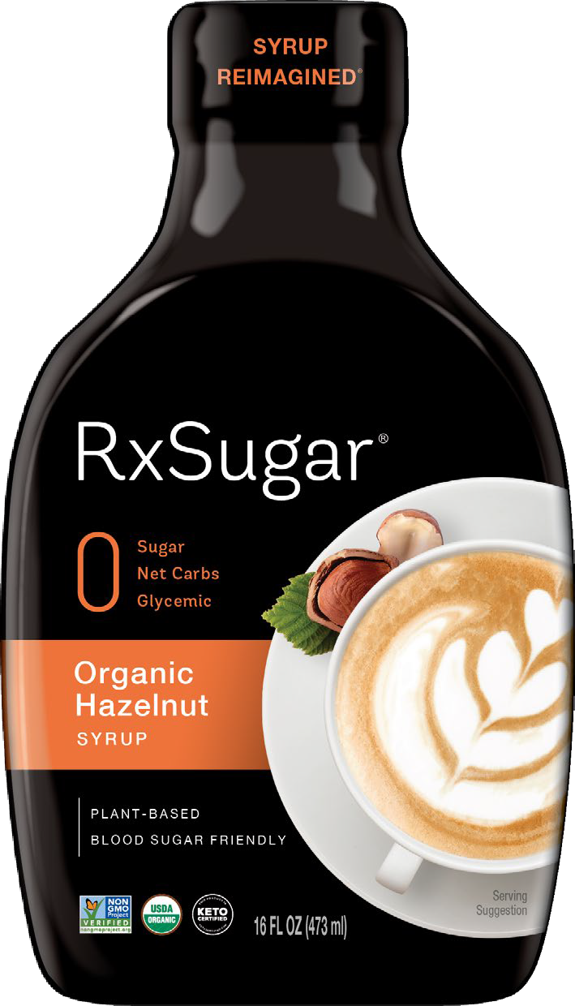

RxSugar® Organic Hazelnut Syrup
The World’s Best Tasting, Keto Certified, Non-GMO, Plant-based Sugar & Syrup
Delicious & Sweet
Tastes Better Than Sugar!
Keto Certified, Paleo & Primal friendly Non-GMO Project Verified Gluten/Grain Free Certified
Vegan, FODMAP Friendly Certified Zero Net Carbs, Zero Glycemic Blood Sugar Friendly
Suitable for People with Diabetes
Functional & Convenient
A Sweet Treat for Everyday Use Ideal for Coffee/Tea, Water, Shakes Perfect for Baking & Cooking
Use on Cereal, Granola, Yogurt
No artificial flavors, colors or preservatives Dissolves easily
Caramelizes and browns
Zero Aftertaste & Perfect Mouthfee
UPC
CASE PACK
UNIT WEIGHT
CASE WEIGHT
UNIT DIMENSIONS CASE DIMENSIONS
SHELF LIFE
8-50009-17314-0 | 6 | 16 oz | 9.30 lb | 3.82 x 2.5 x 6.5 in | 7.5 x 7.75 x 7 in | 2 Years
Here at RxSugar®, We are on a Mission to Make the World Sweet & Healthy, or as we call it: SWEALTHY™!
www.RxSugar.com

Slide 11
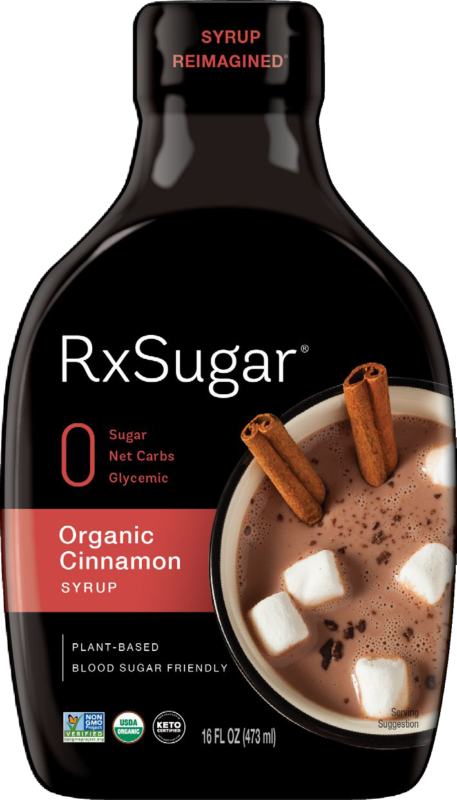

RxSugar® Organic Cinnamon Syrup
The World’s Best Tasting, Keto Certified, Non-GMO, Plant-based Sugar & Syrup
Delicious & Sweet
Tastes Better Than Sugar!
Keto Certified, Paleo & Primal friendly Non-GMO Project Verified Gluten/Grain Free Certified
Vegan, FODMAP Friendly Certified Zero Net Carbs, Zero Glycemic Blood Sugar Friendly
Suitable for People with Diabetes
Functional & Convenient
A Sweet Treat for Everyday Use Ideal for Coffee/Tea, Water, Shakes Perfect for Baking & Cooking
Use on Cereal, Granola, Yogurt
No artificial flavors, colors or preservatives Dissolves easily
Caramelizes and browns
Zero Aftertaste & Perfect Mouthfee
UPC
CASE PACK
UNIT WEIGHT
CASE WEIGHT
UNIT DIMENSIONS CASE DIMENSIONS
SHELF LIFE
8-50009-17312-6 | 6 | 16 oz | 9.30 lb | 3.82 x 2.5 x 6.5 in | 7.5 x 7.75 x 7 in | 2 Years
Here at RxSugar®, We are on a Mission to Make the World Sweet & Healthy, or as we call it: SWEALTHY™!
www.RxSugar.com

Slide 12
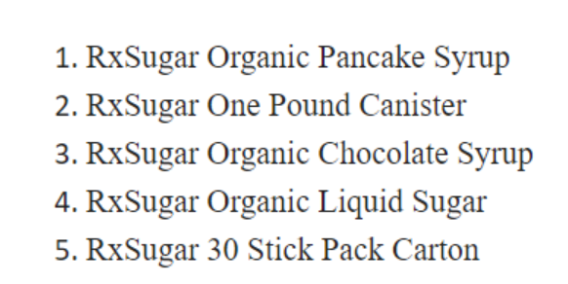
Top 5 Best Sellers:

Slide 13
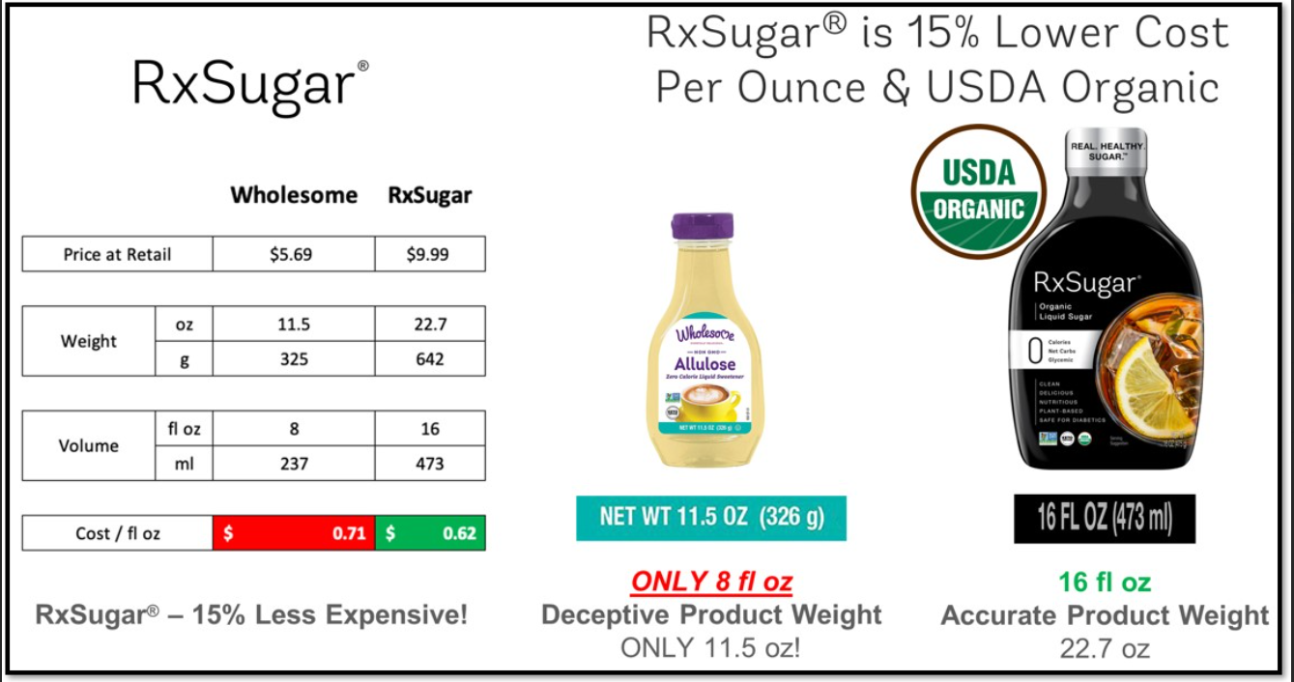
Allulose Pricing Compared to Main Competitor: Wholesome Sweeteners

Slide 14
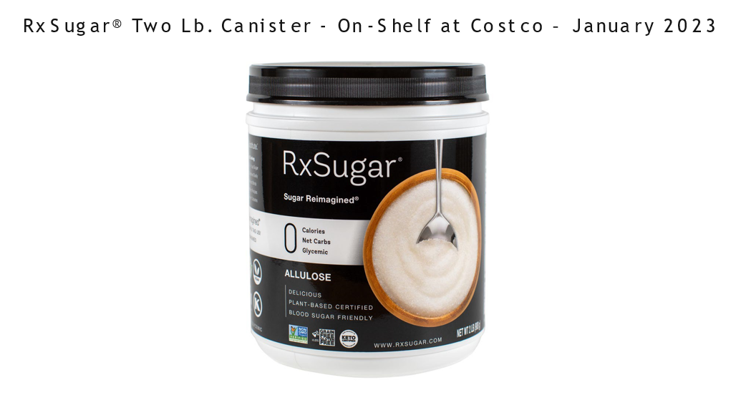

Slide 15
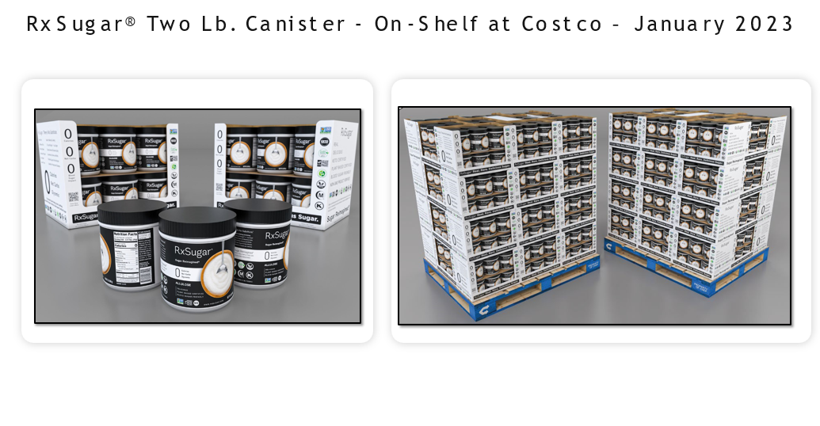

Slide 16
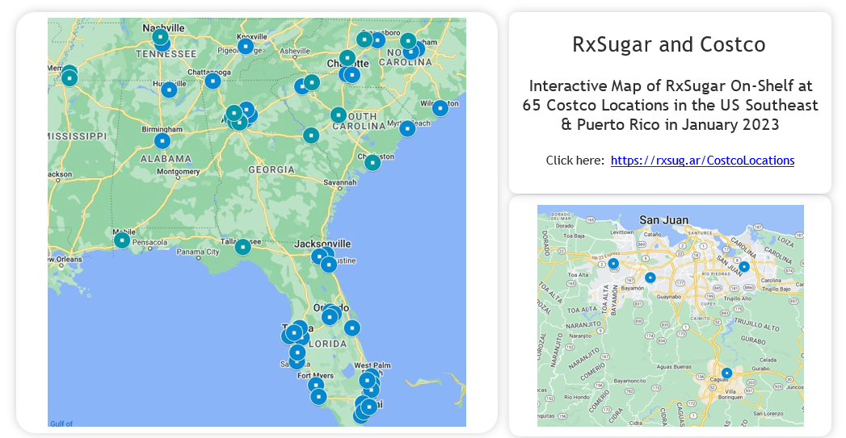

Slide 17
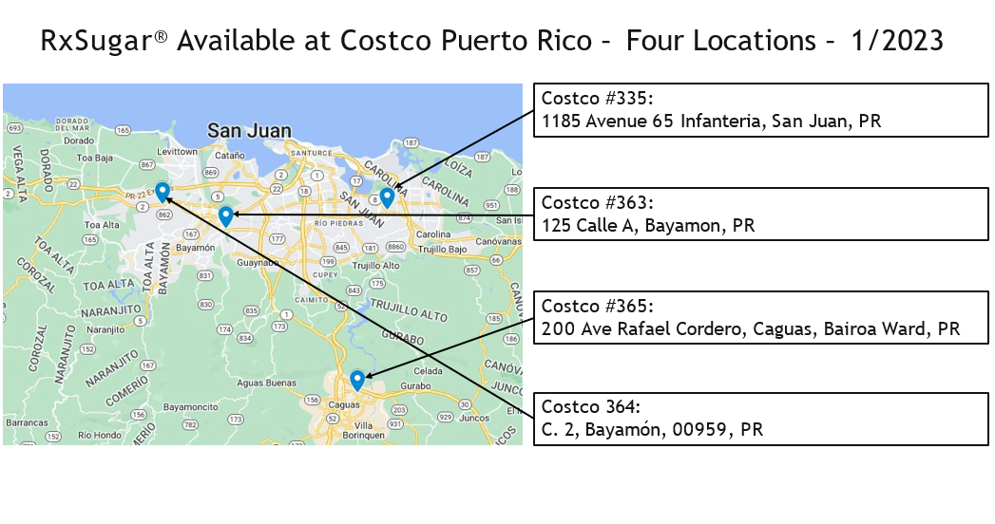

Slide 18
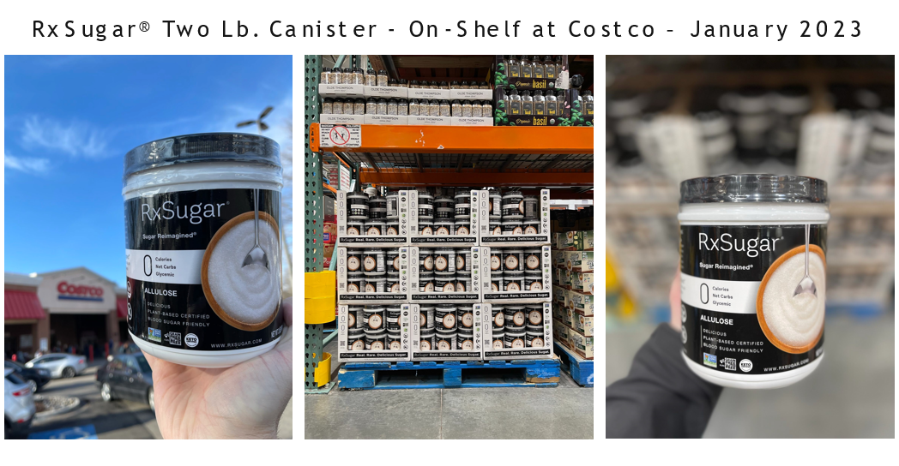

Slide 19
