Slide 1
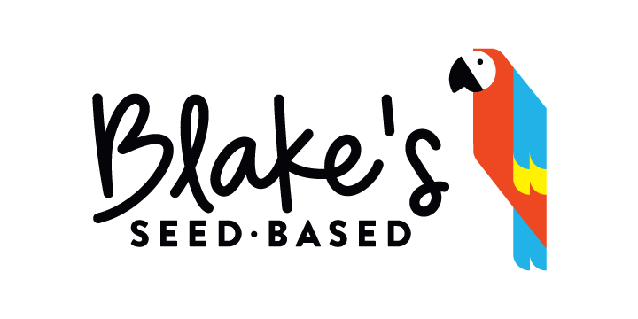
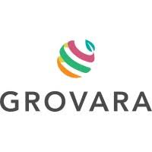

TOM KLOSS, DIRECTOR OF SALES
TOM@BLAKESSEEDBASED.COM | 847-370-8927
WWW.BLAKESSEEDBASED.COM
© 2021 Blake’s Seed Based. All Rights Reserved
Notes:
-Good

Slide 2
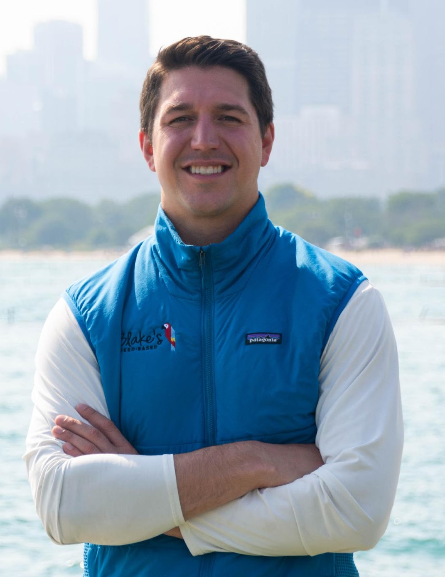

BLAKE’S SEED BASED STORY
The company was started in 2018 when Blake Sorensen was an MBA student at Indiana University.
Growing up as an athlete with a deathly nut allergy, he was frustrated with the lack of snacks available.
He started making snacks in his kitchen using seeds instead of nuts and quickly realized that people with and without food allergies loved them.
BLAKE@BLAKESSEEDBASED.COM | 952.913.8698
© 2021 Blake’s Seed Based. All Rights Reserved
Notes:
-Changed bold some

Slide 3

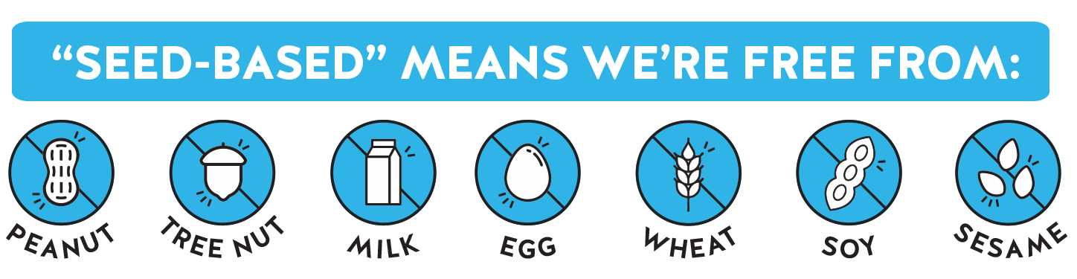
FOOD ALLERGEN MARKET
$19B Annually
100MM+
INDIRECTLY AFFECTED
__________________
  Households
  Schools
  Airlines
  Offices
UNITED STATES
32MM
PEOPLE HAVE
FOOD ALLERGIES
1 in 4 Americans (85 million people) spend $19 billion annually to avoid purchasing products with the top nine allergens.
Annual growth rate for the allergy-friendly food segment is 27% (Food Dive).
Peanuts, Tree Nuts, Wheat, Soy, Milk, Eggs, Sesame, Fish, Shellfish account for 90% of food allergies.
Top 9 Food Allergens
Sources:
https://www.fooddive.com/news/food-allergies-affect-1-in-4-consumers-study-says/580211/
https://www.foodallergy.org/
© 2021 Blake’s Seed Based. All Rights Reserved
3

Slide 4
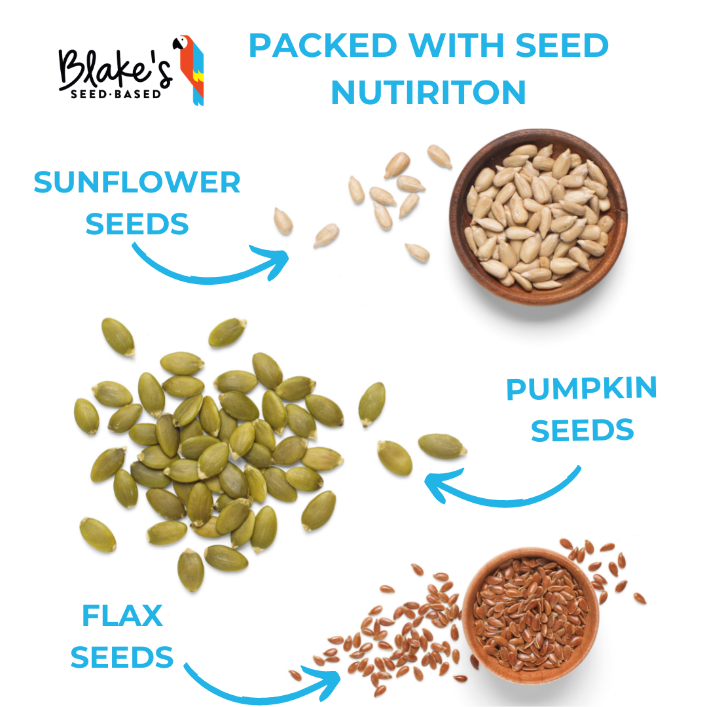
SNACKS FULED BY SEEDS
“We use Seeds because they are truly superfoods. They are loaded with quality protein, healthy fats, essential vitamins and rich minerals that all help fuel our consumers adventures ”
- Blake
Packed with Vitamin E, B6, and Antioxidants
TOP ATTRIBUTES CONSUMERS LIKE ABOUT BLAKE’S SEED BASED
Packed with Iron, Zinc and Magnesium
Packed with Fiber, Omega 3’s, and Protein
Source: Social Nature Campaign – Survey Aug 2021
© 2021 Blake’s Seed Based. All Rights Reserved

Slide 5
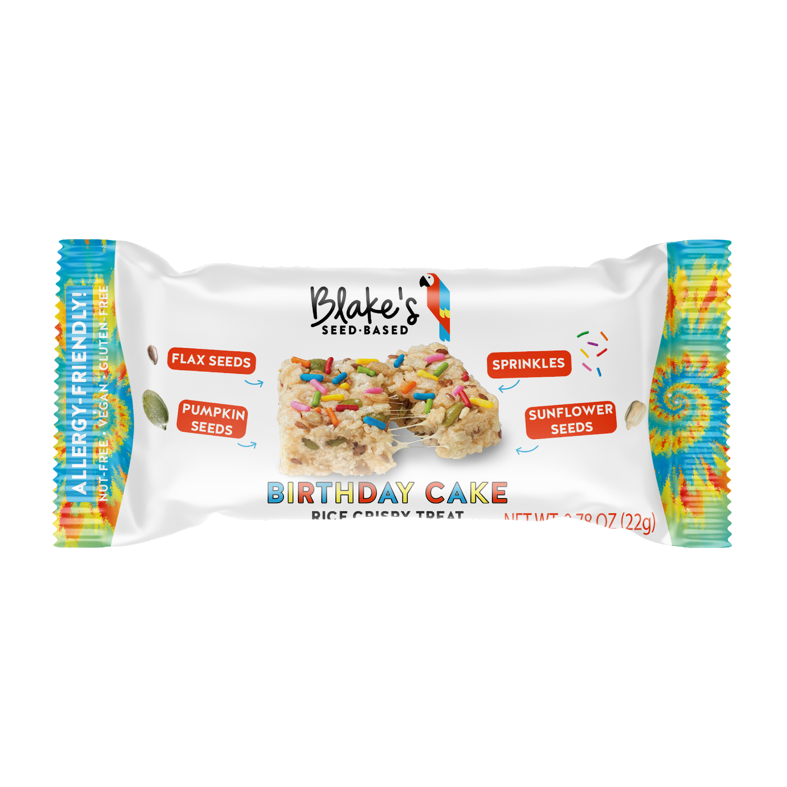
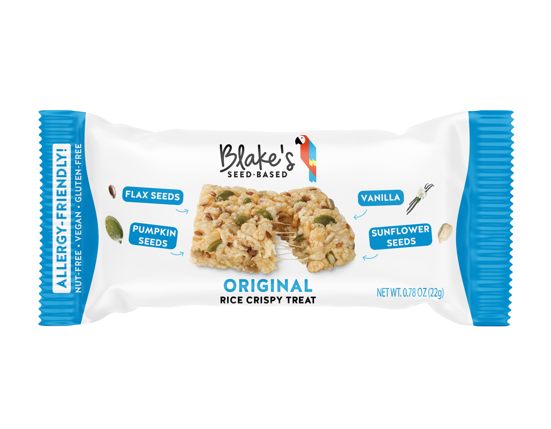
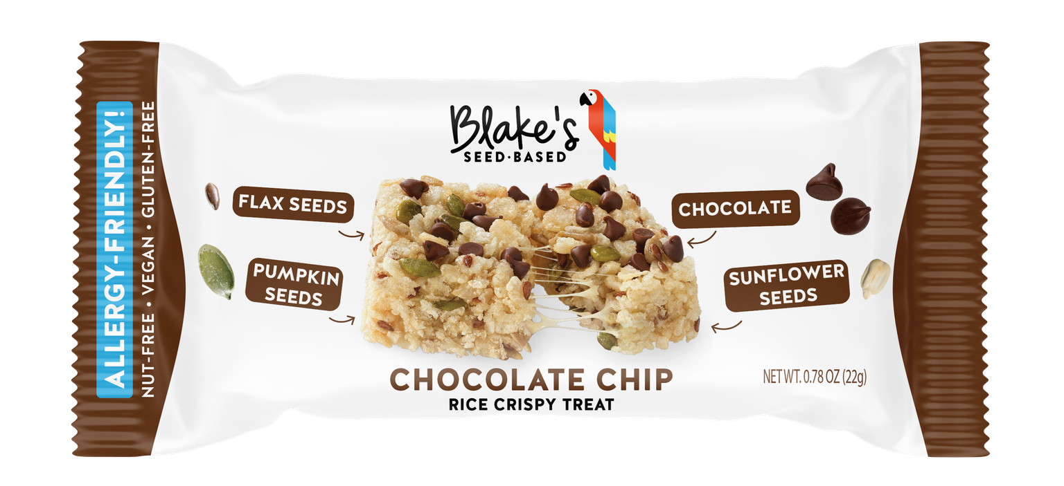
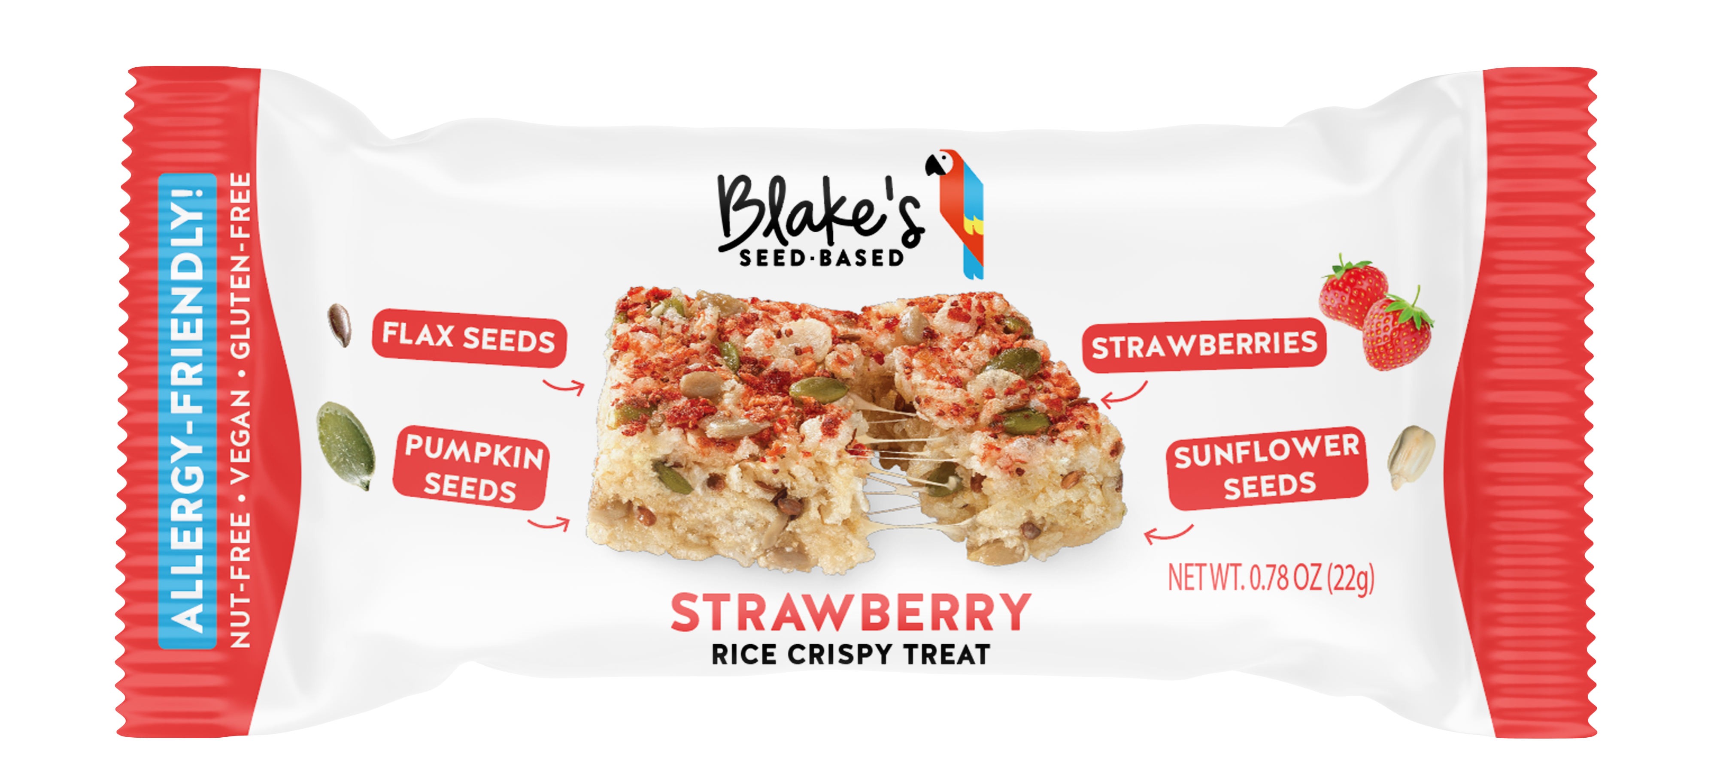
WHY BLAKE’S SEED BASED
Insights & Opportunities
Rice Crispy Treats
100MM people directly/indirectly impacted by food allergies allergies.
Lack of snacking options for these individuals.
Blake’s Seed Based makes healthy, great tasting snacks that everyone can eat because they’re Allergy Friendly.
IN ORDER OF RANK
1) Original
2) Birthday Cake
Consumer Benefits
Rice Crispy Treats made from Crispy Rice, Vegan marshmallow, Seeds and Fruit or Chocolate
Only 90 calories, low sugar
One of first Vegan Rice Crispy Treats on the market
Vegan, Non-GMO and Top 8 Allergen-Free. (free from: peanuts, tree nuts, milk, eggs, soy, wheat, fish, shellfish)
Certified Nut-Free and Gluten-Free facility
3) Chocolate Chip
4) Strawberry
Launch Details
Size: 6 Pack (multicount)
Brand New: New to the market in 2021
“I have tried many rice crispy treat alternatives – Annies, Made Good, Smash Crispy, and Blake’s. Blake’s is BY FAR the best. It is so delicious. And it is dairy free and gelatin free. -Emily from Michigan
© 2021 Blake’s Seed Based. All Rights Reserved

Slide 6
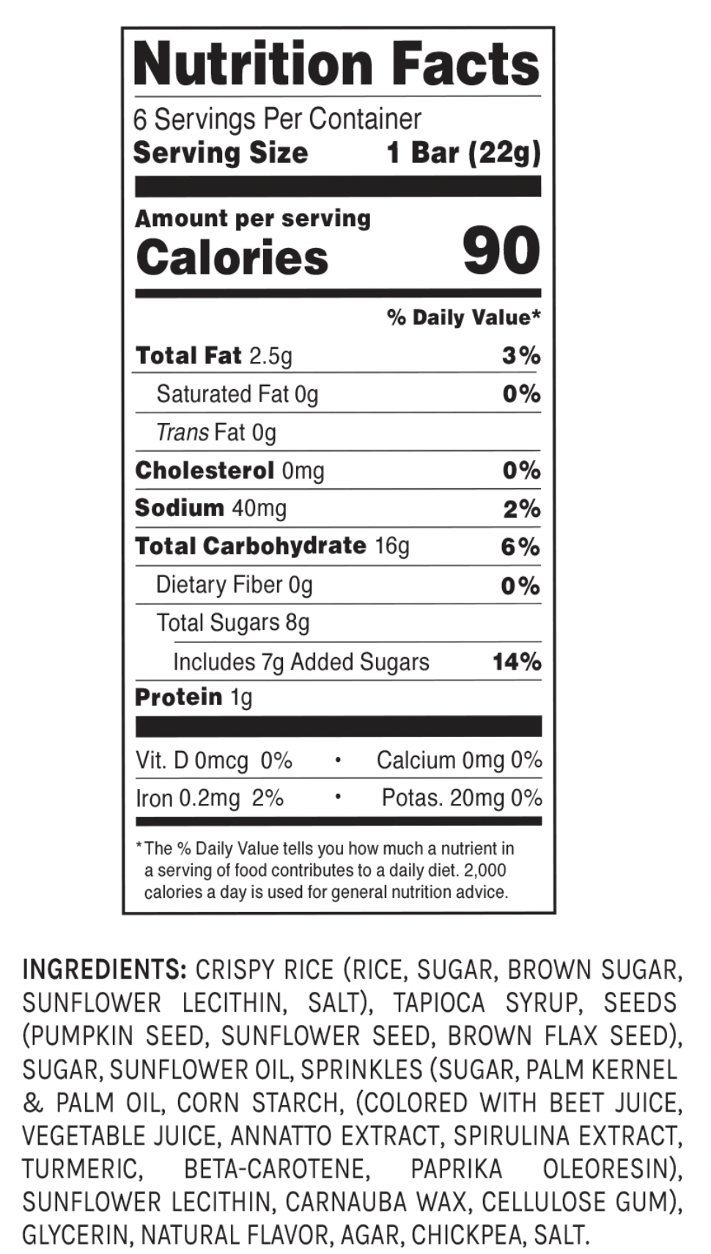
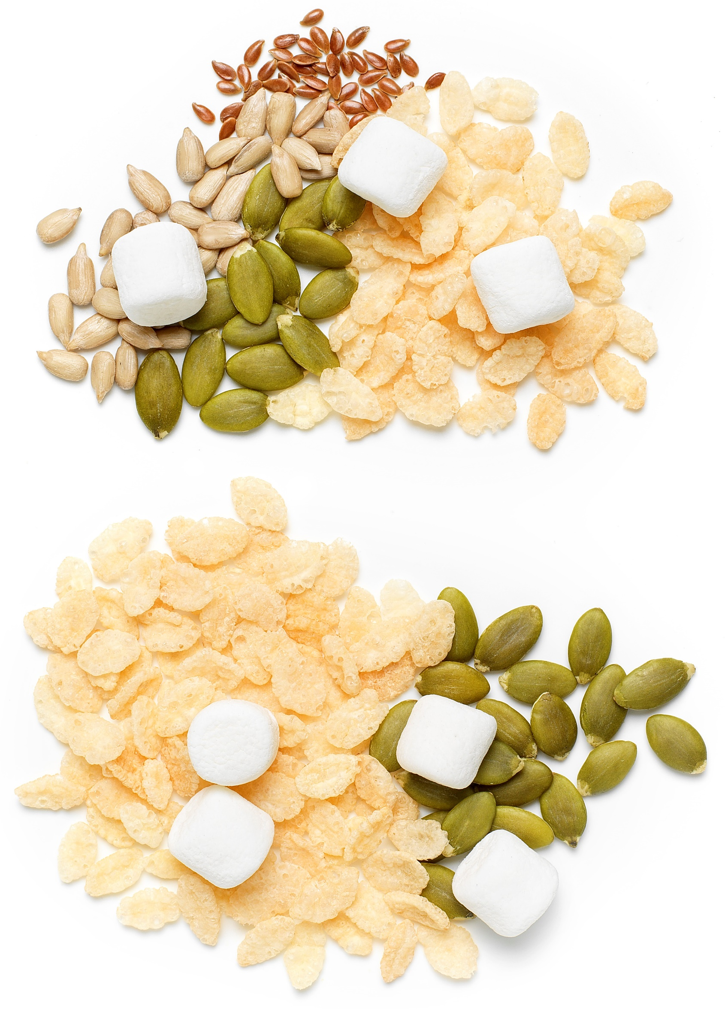
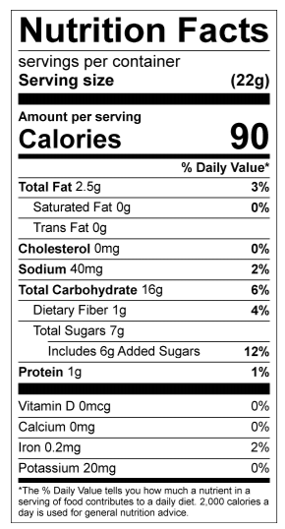
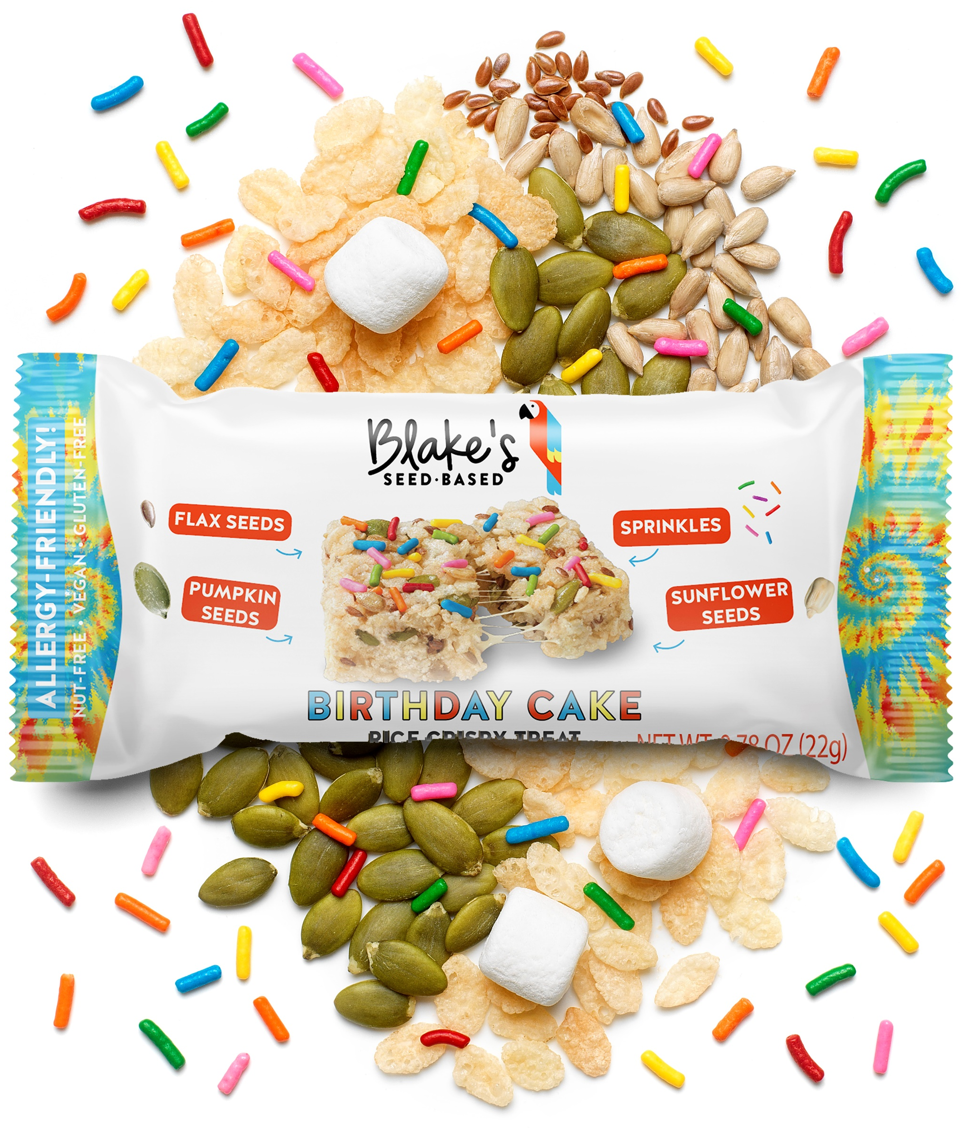
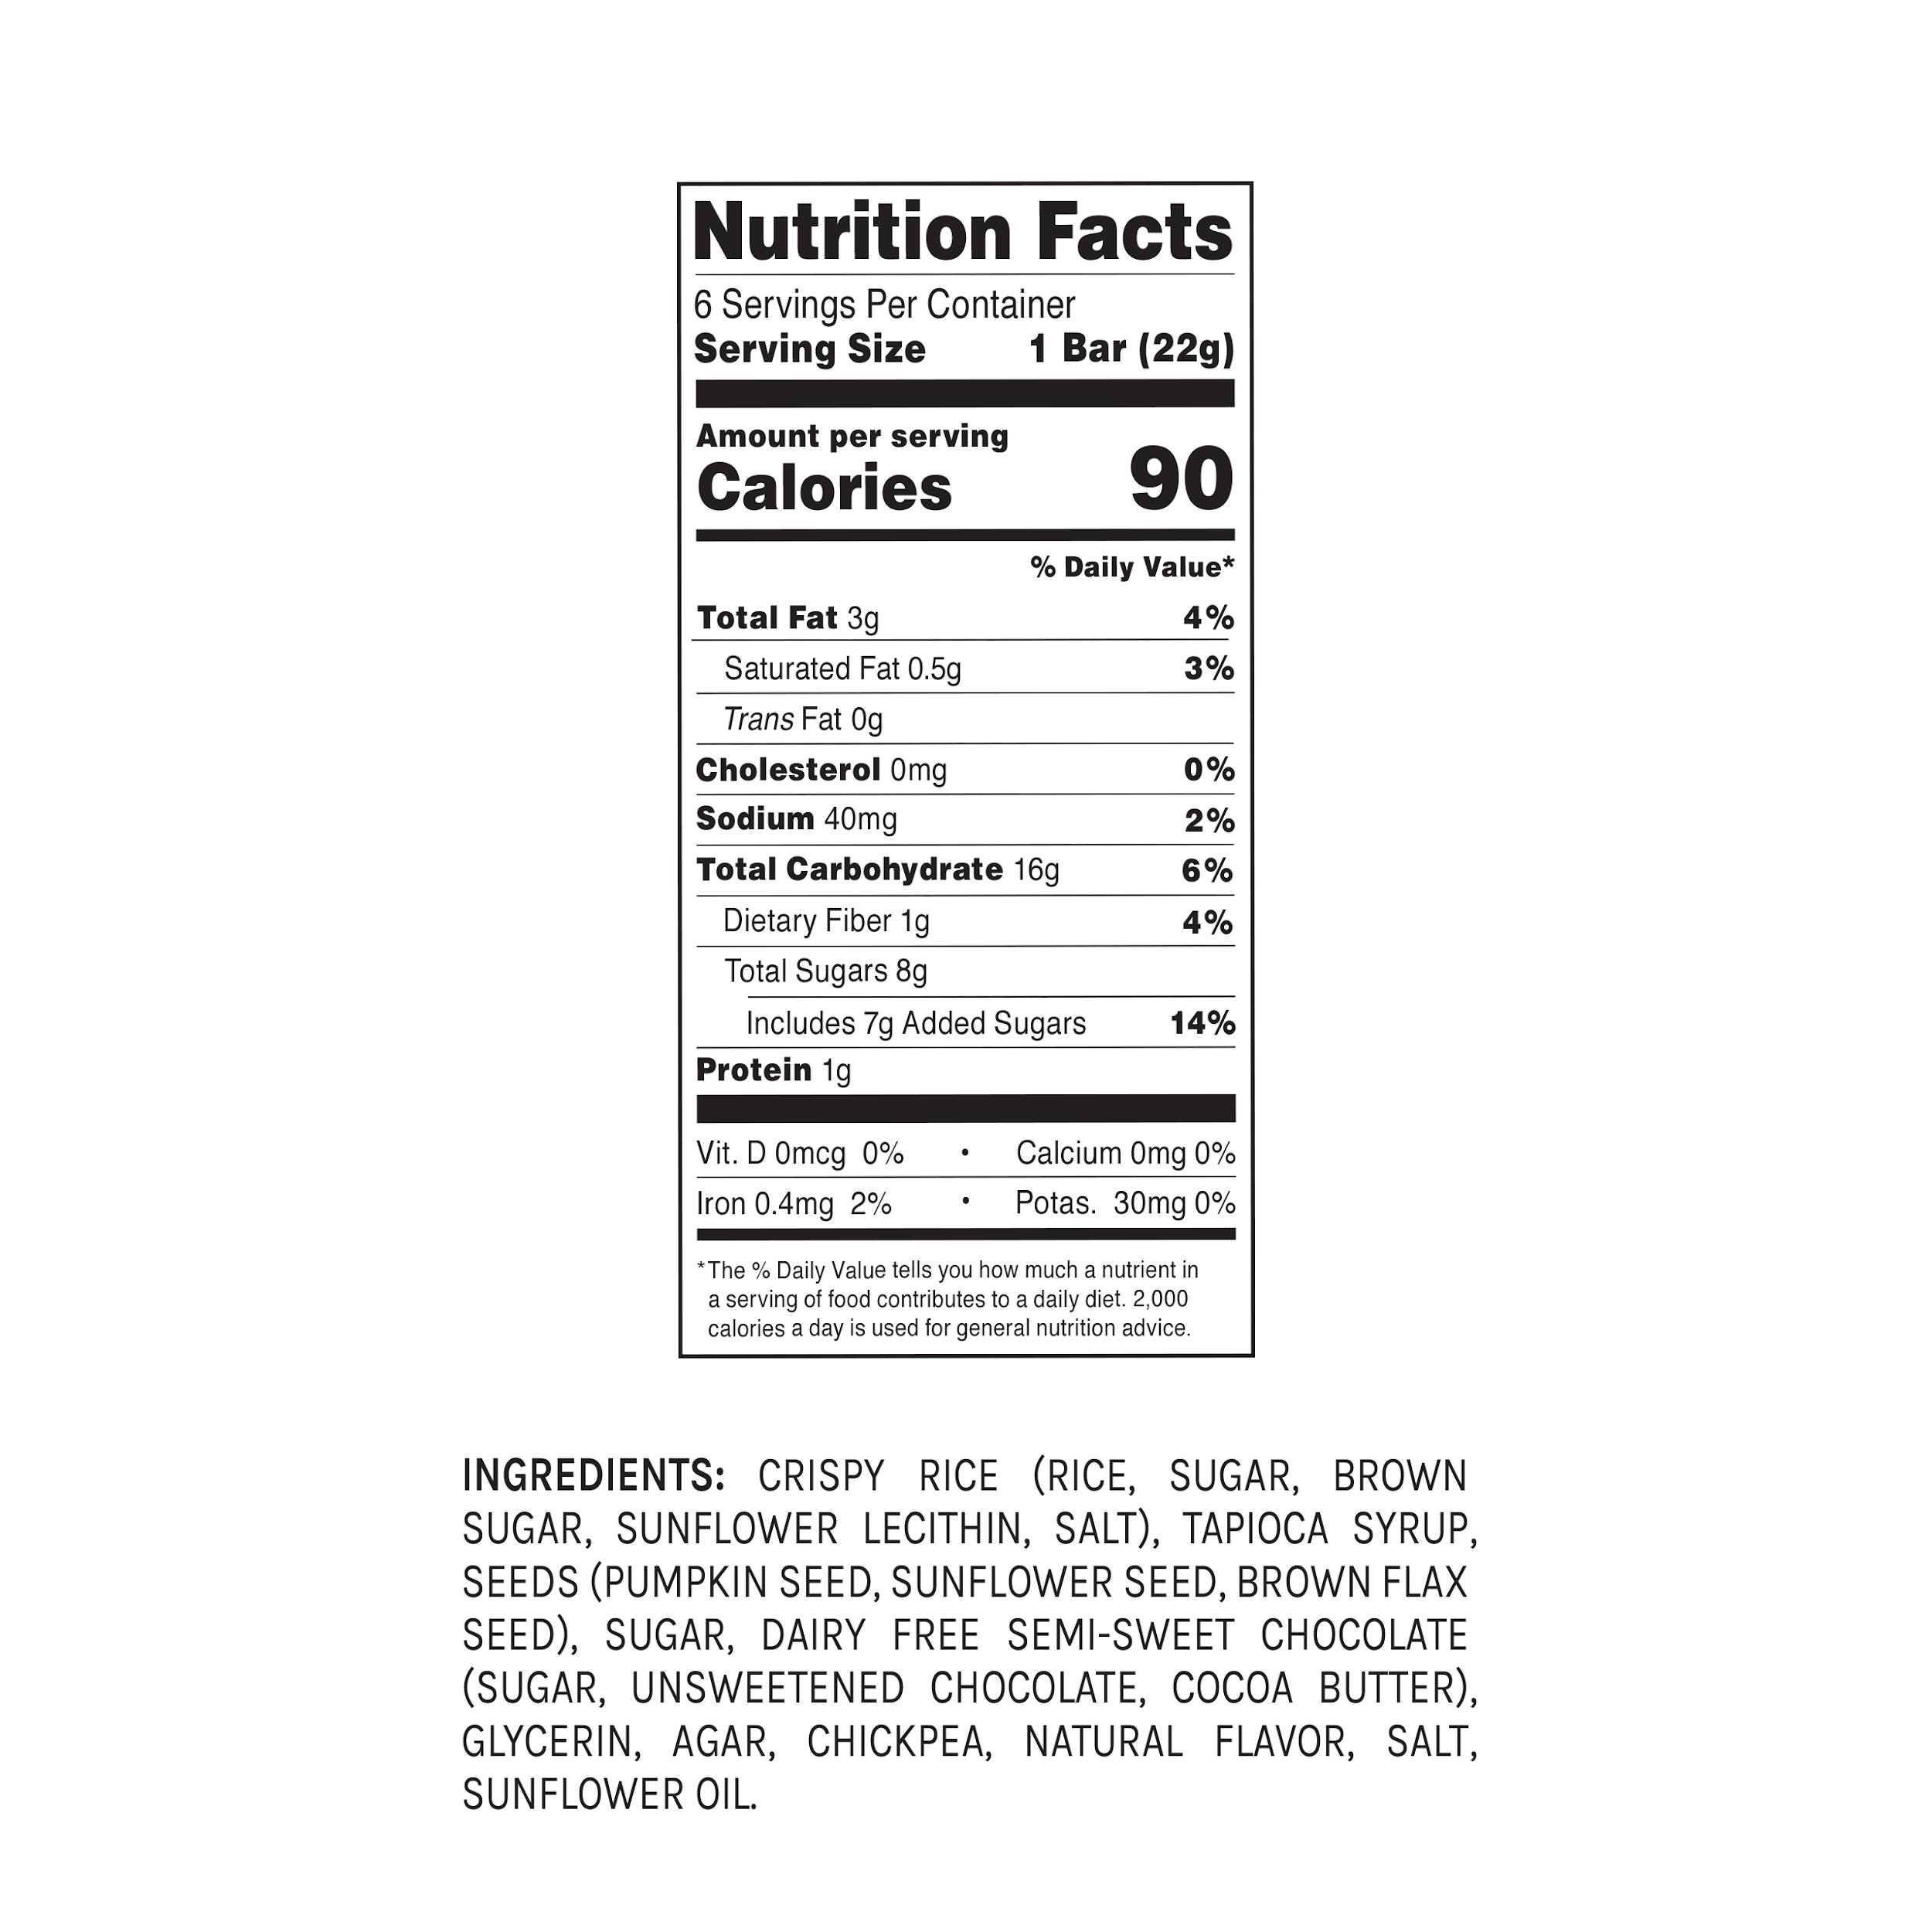
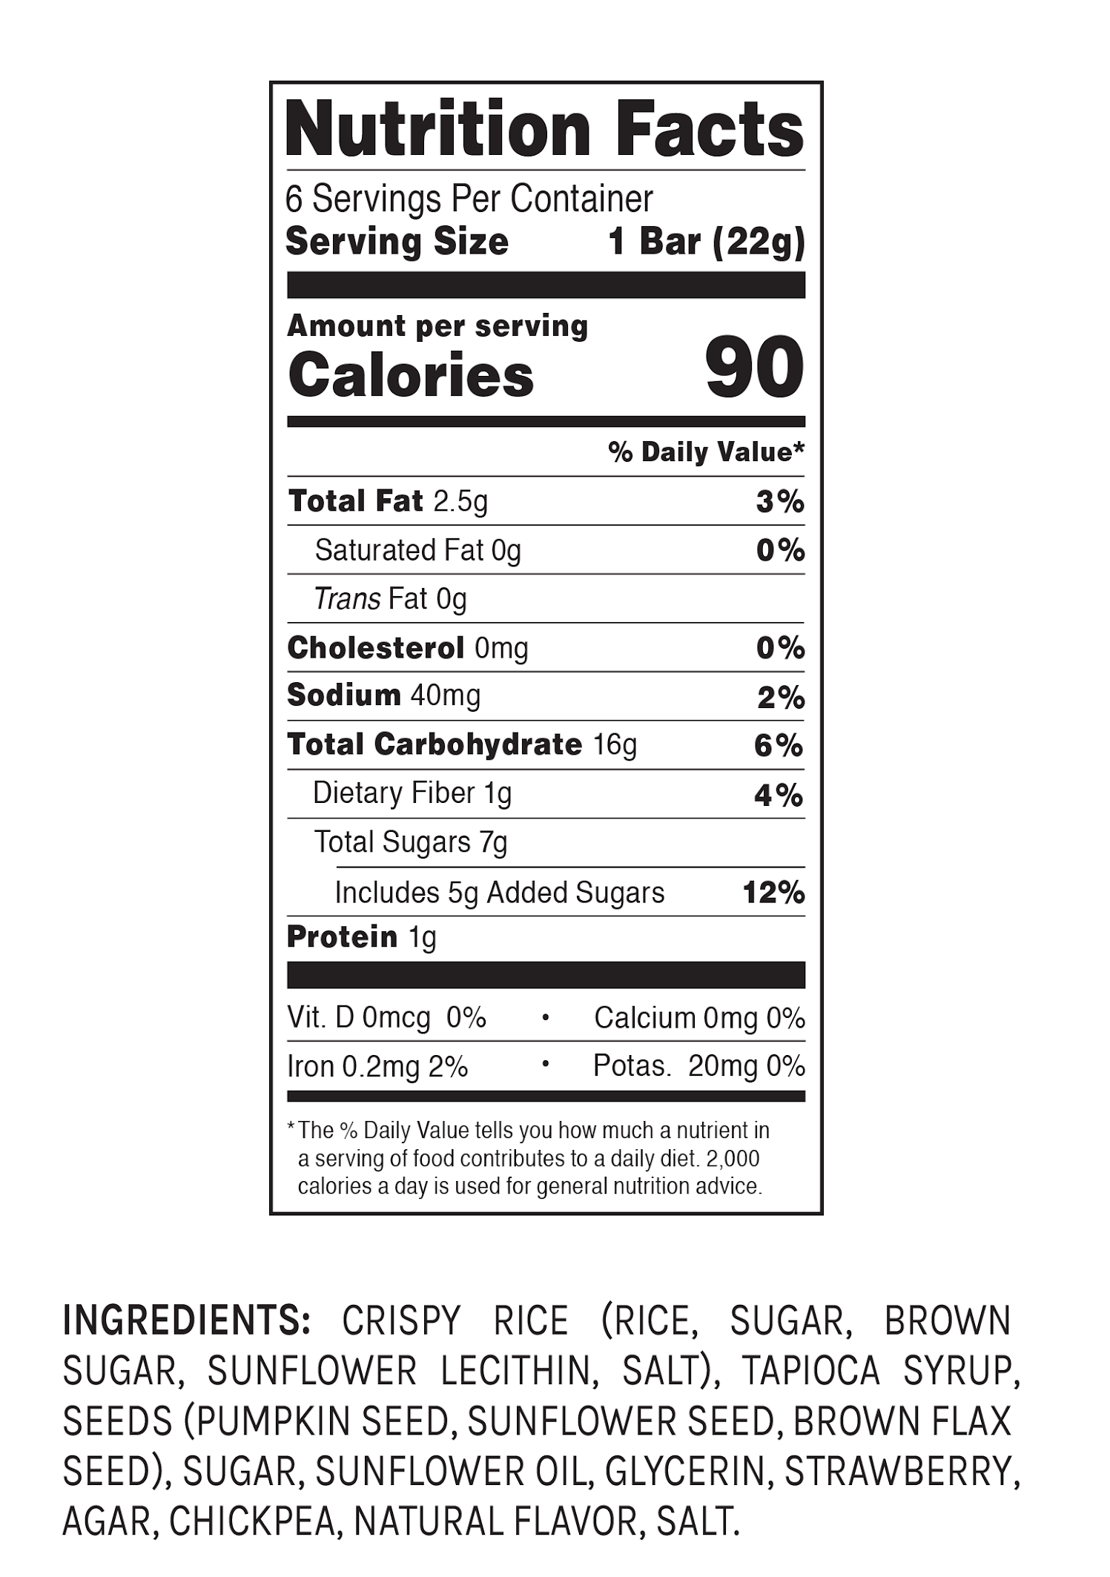
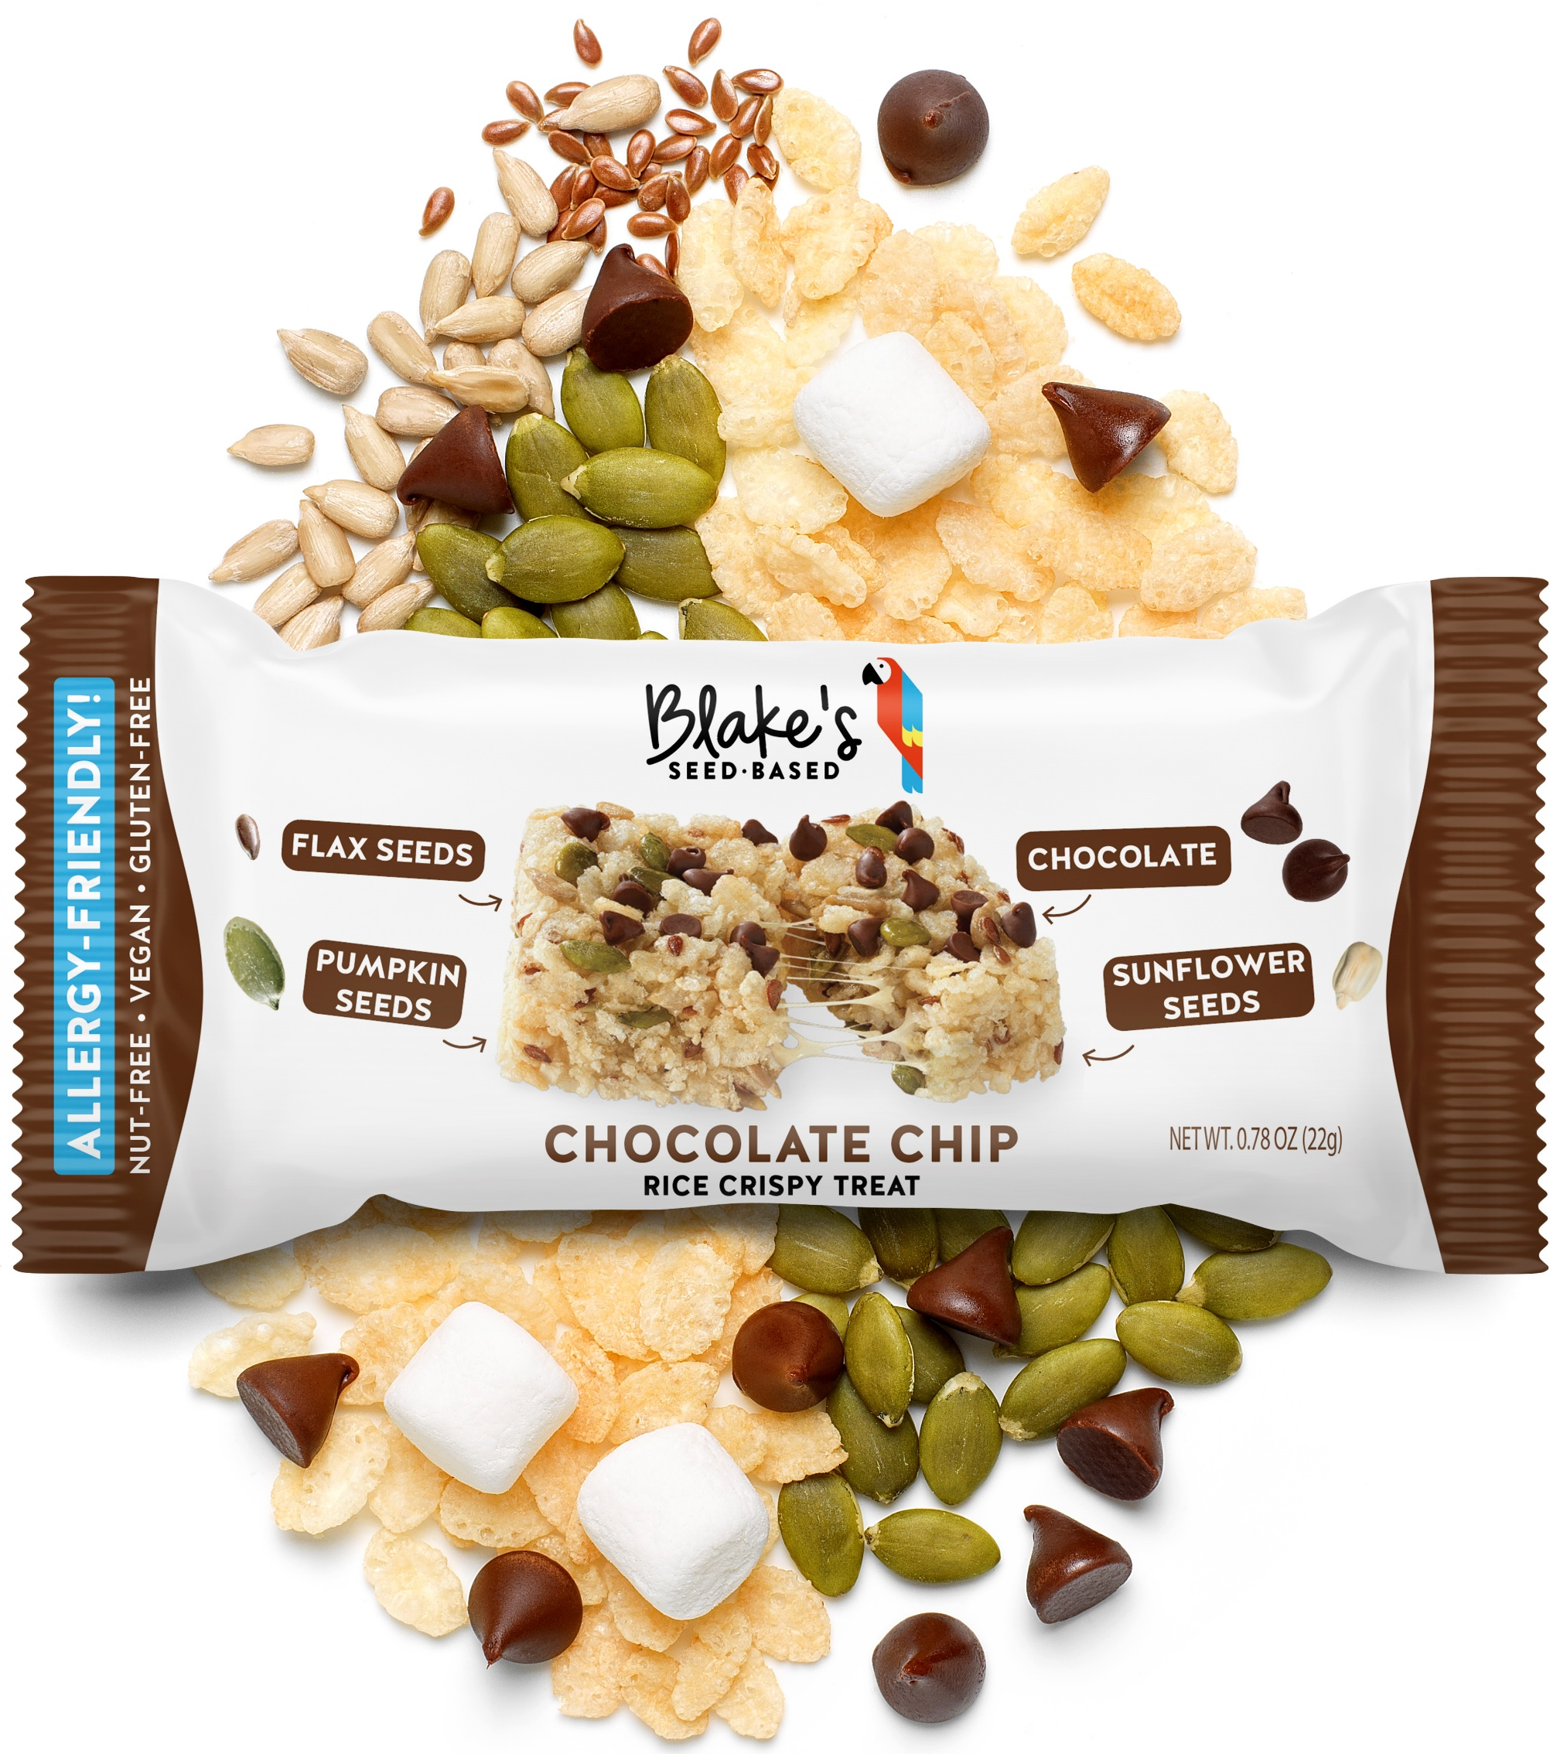
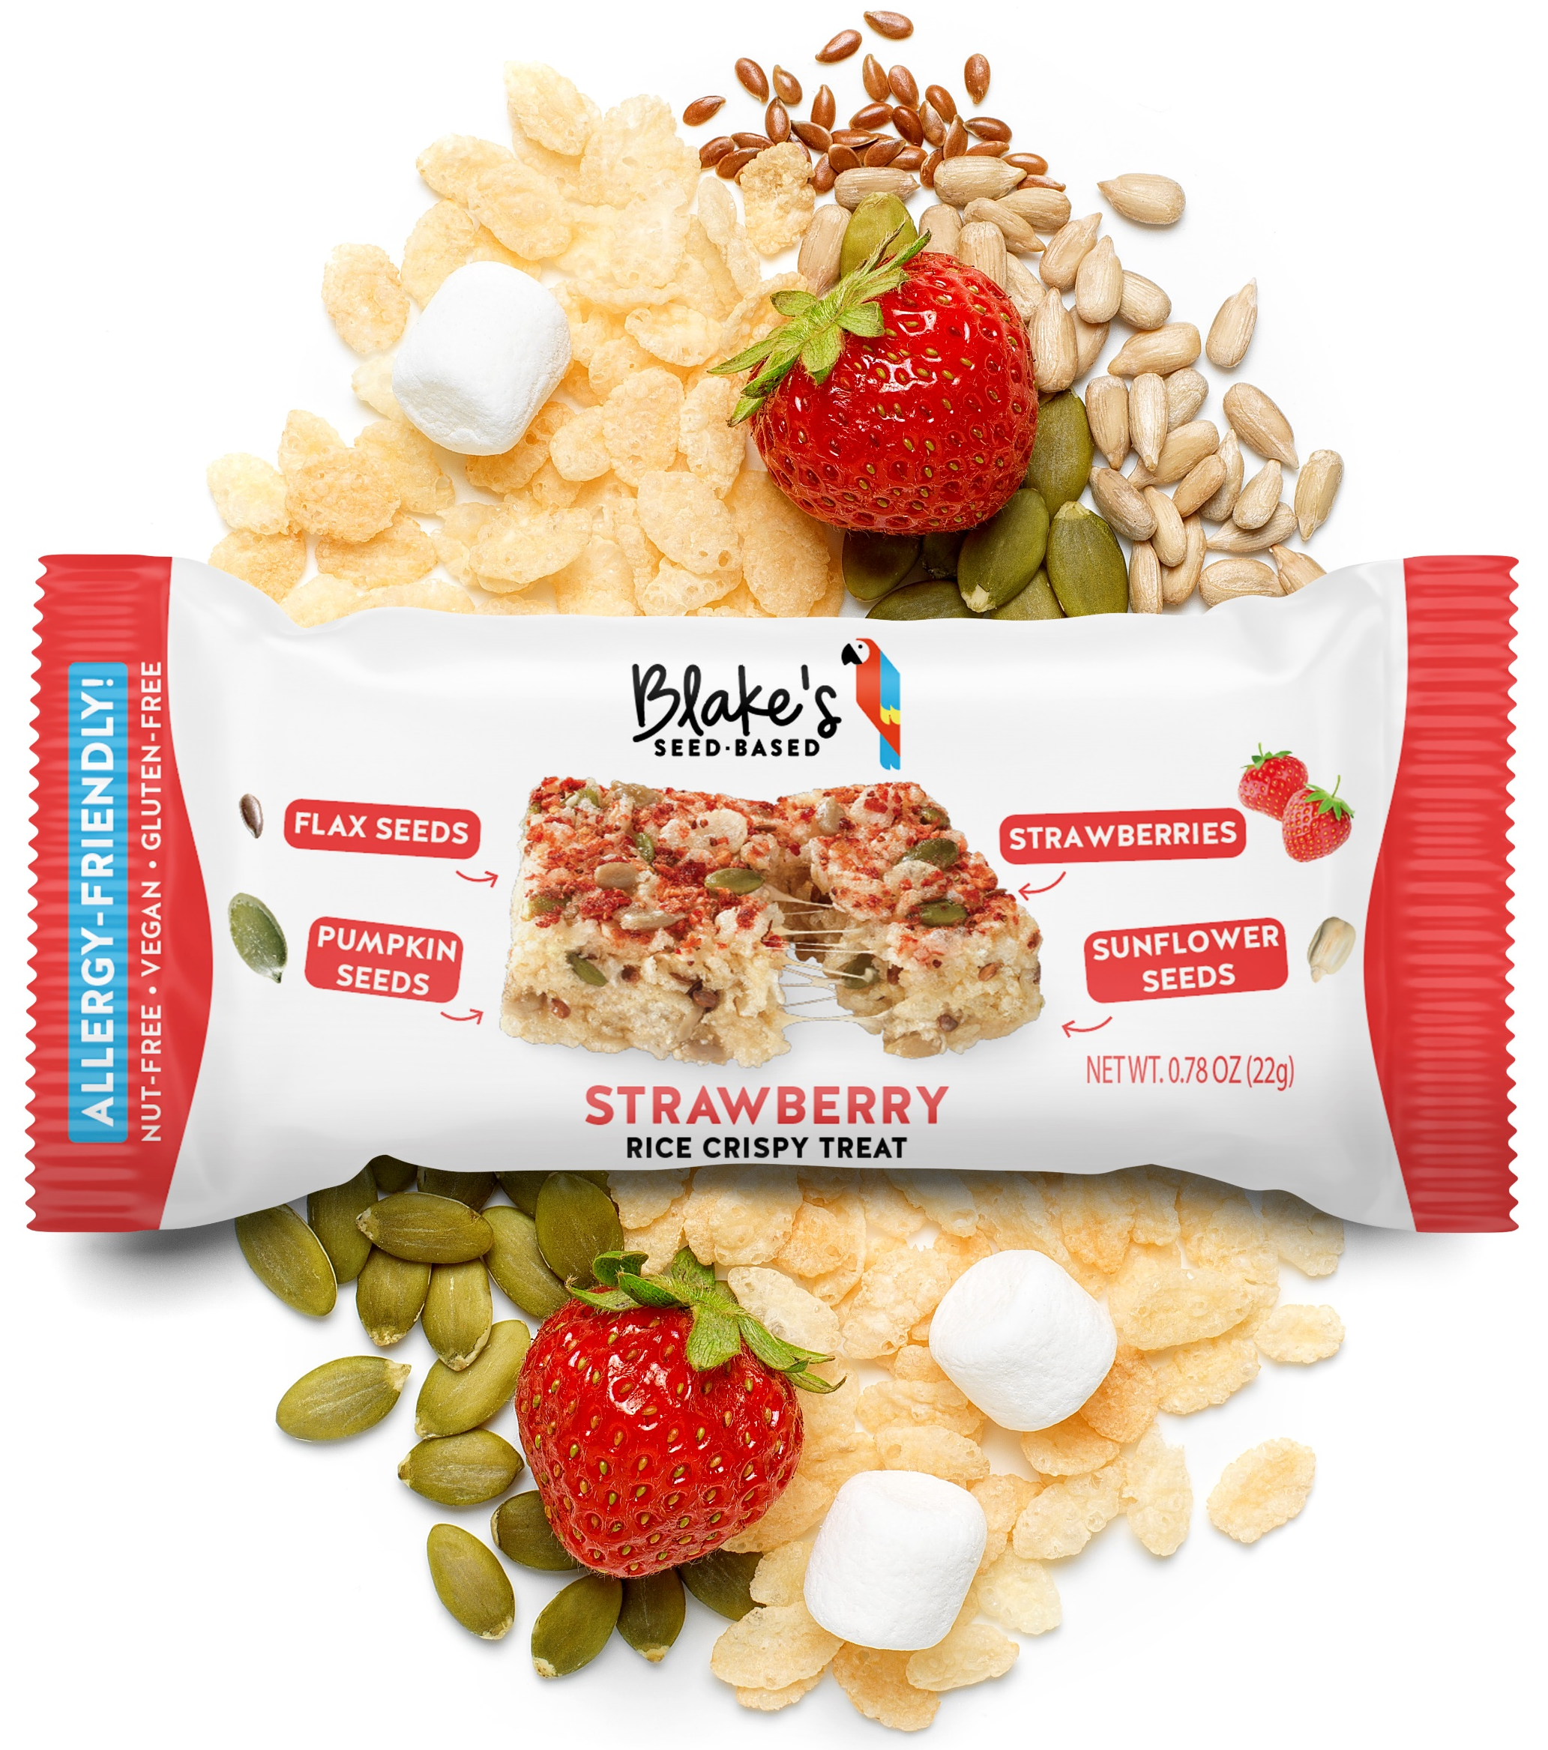
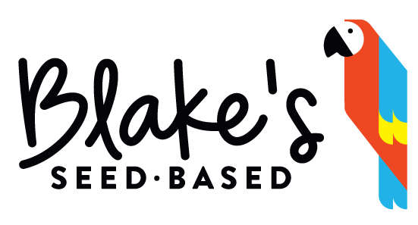
RICE CRISPY TREAT FLAVORS: INGREDIENTS AND NUTRITION
BIRTHDAY CAKE RICE CRISPY TREAT
ORIGINAL RICE CRISPY TREAT
INGREDIENTS: CRISPY RICE (RICE, SUGAR, BROWN SUGAR, SUNFLOWER LECITHIN, SALT), TAPIOCA SYRUP, SEEDS (PUMPKIN SEED, SUNFLOWER SEED, BROWN FLAXSEED), SUGAR, WATER, SUNFLOWER OIL, GLYCERIN, AGAR, CHICKPEA, NATURAL FLAVOR, SALT.
CHOCOLATE CHIP RICE CRISPY TREAT
STRAWBERRY RICE CRISPY TREAT
© 2021 Blake’s Seed Based. All Rights Reserved

Slide 7
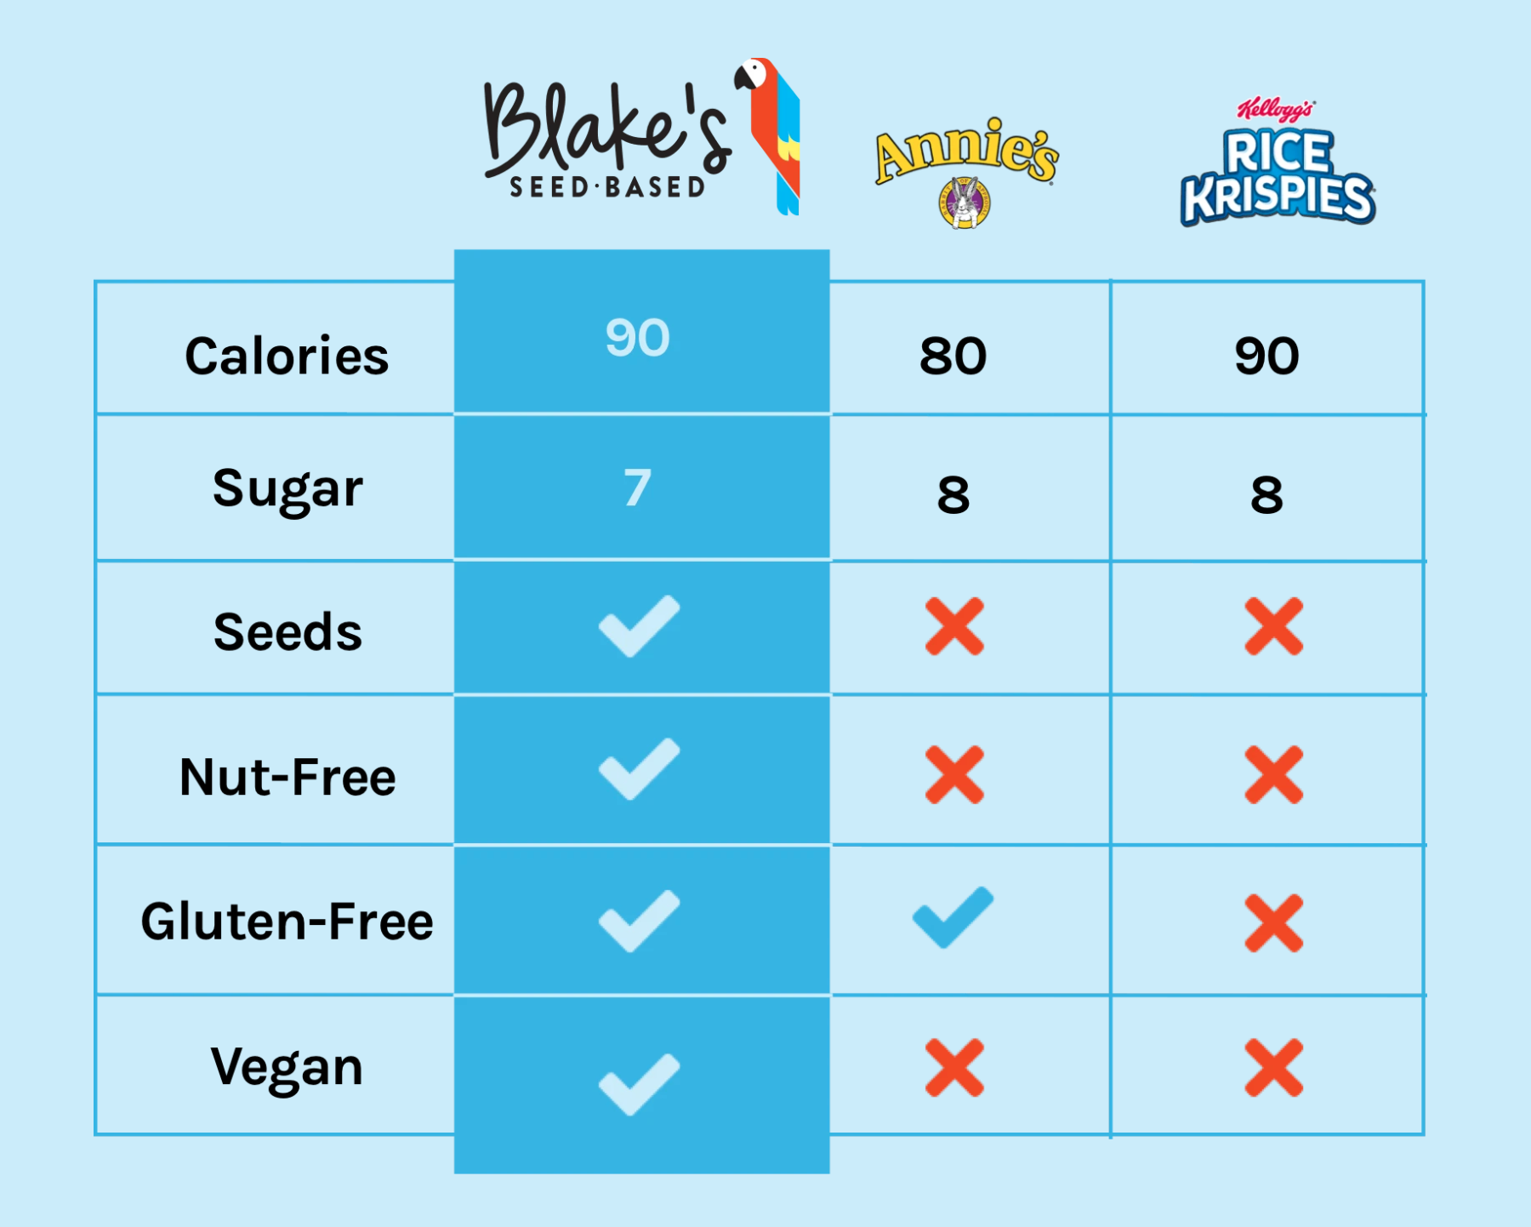
RICE CRISPY TREAT COMPETITION
© 2021 Blake’s Seed Based. All Rights Reserved

Slide 8





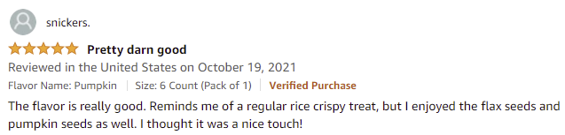
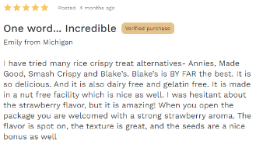

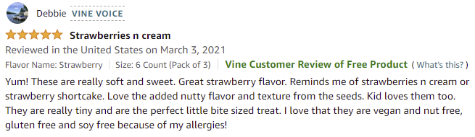
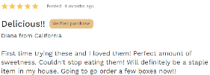
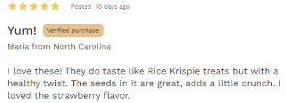
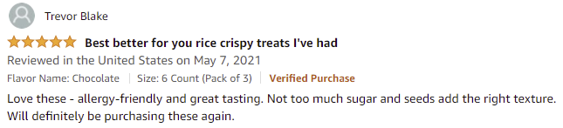
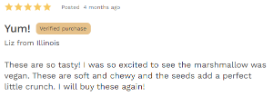

STRONG CONSUMER RATING AND RESPONSE TO NEW RICE CRISPY TREATS
4.4 out of 5 stars
4.5 out of 5 stars
(407 ratings)
(94 ratings)
© 2021 Blake’s Seed Based. All Rights Reserved

Slide 9
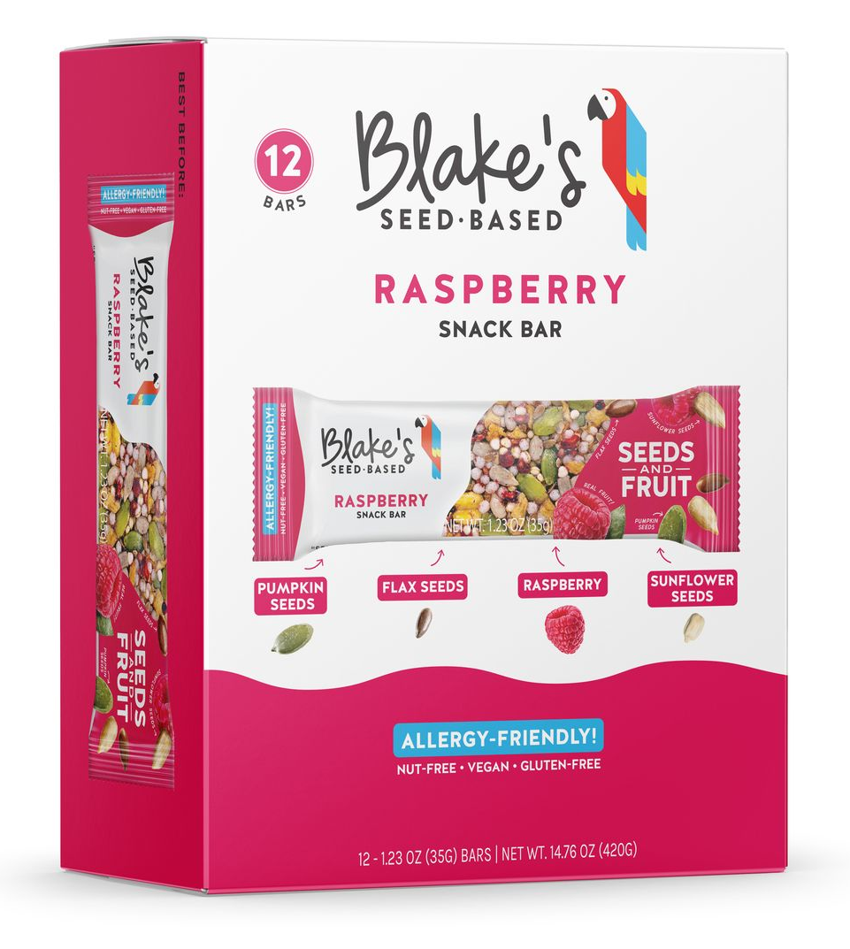
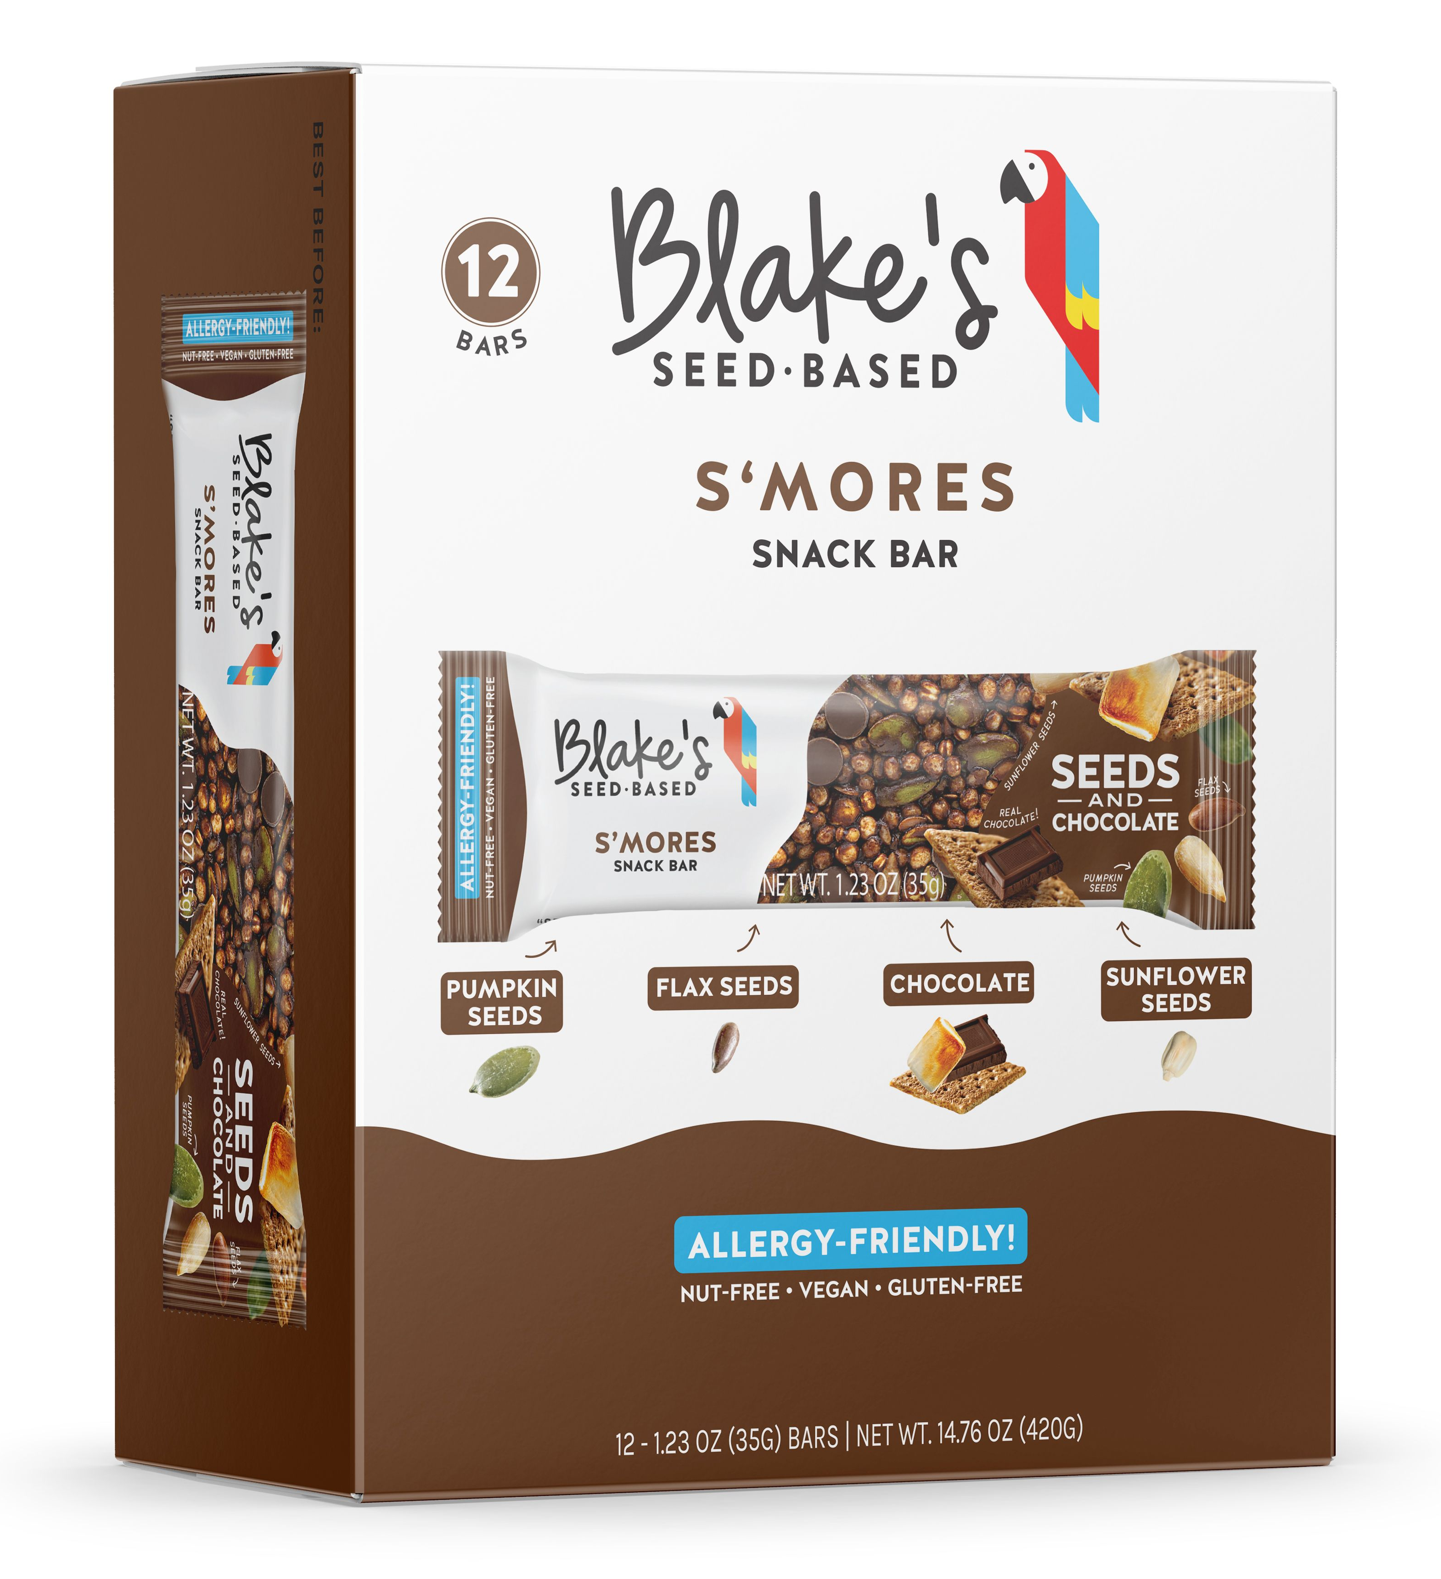
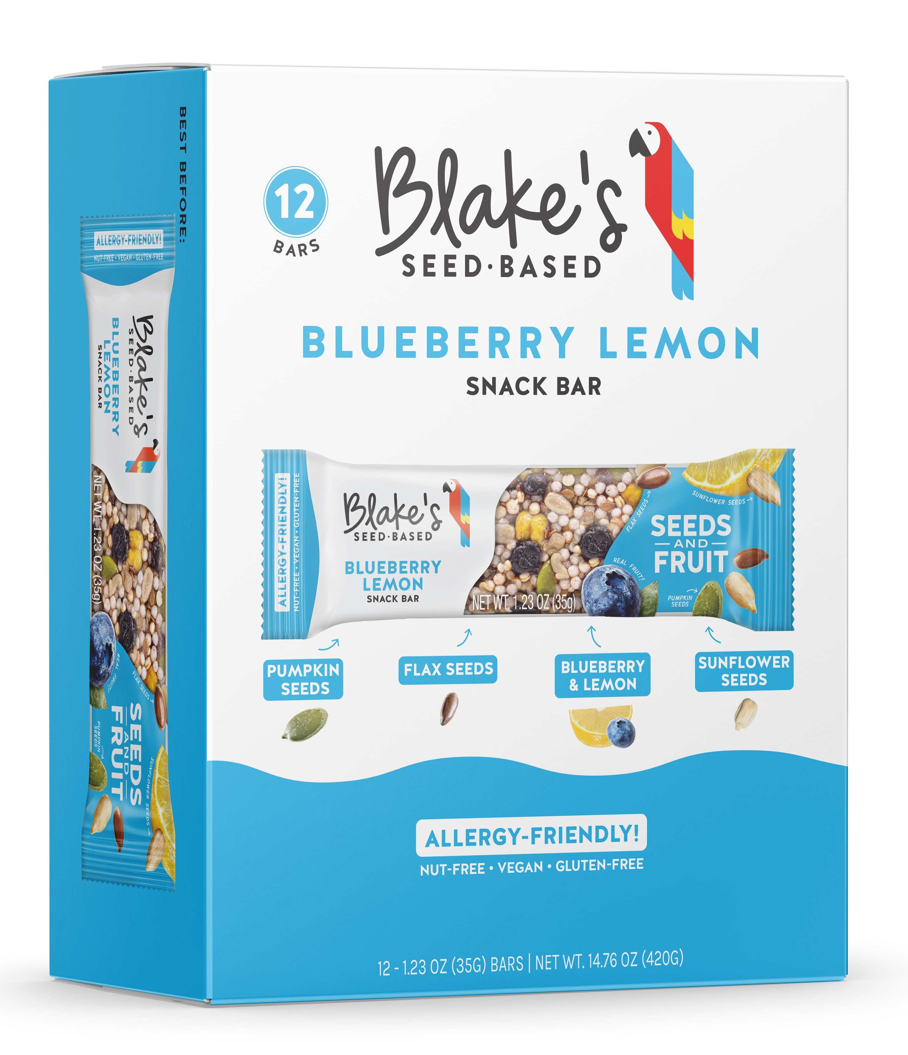
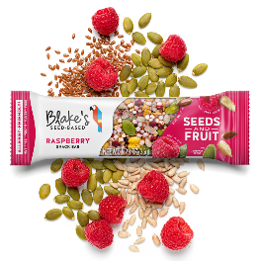
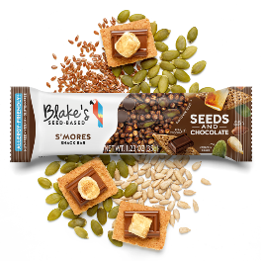
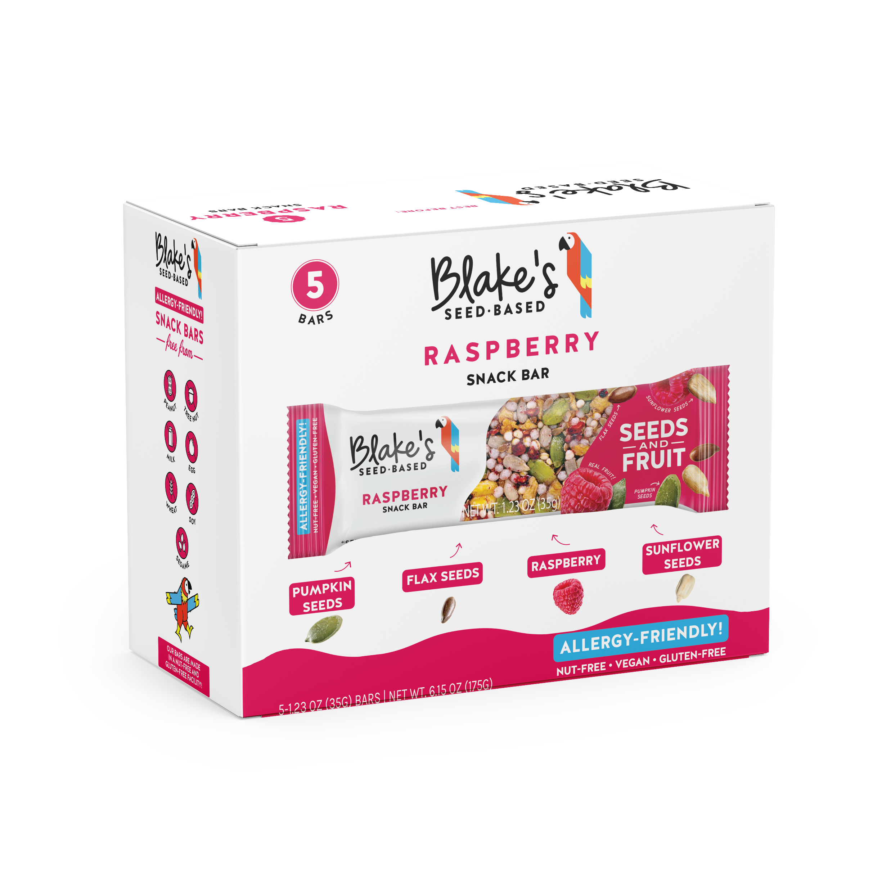
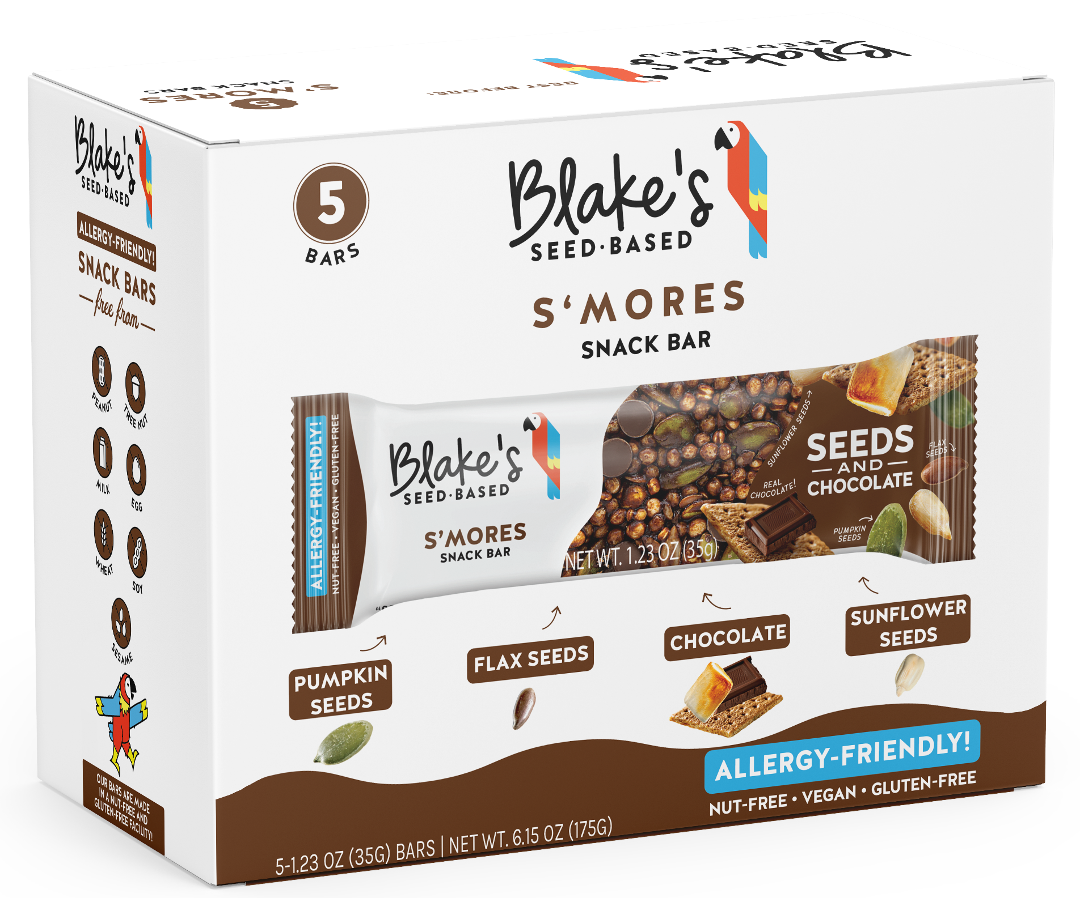
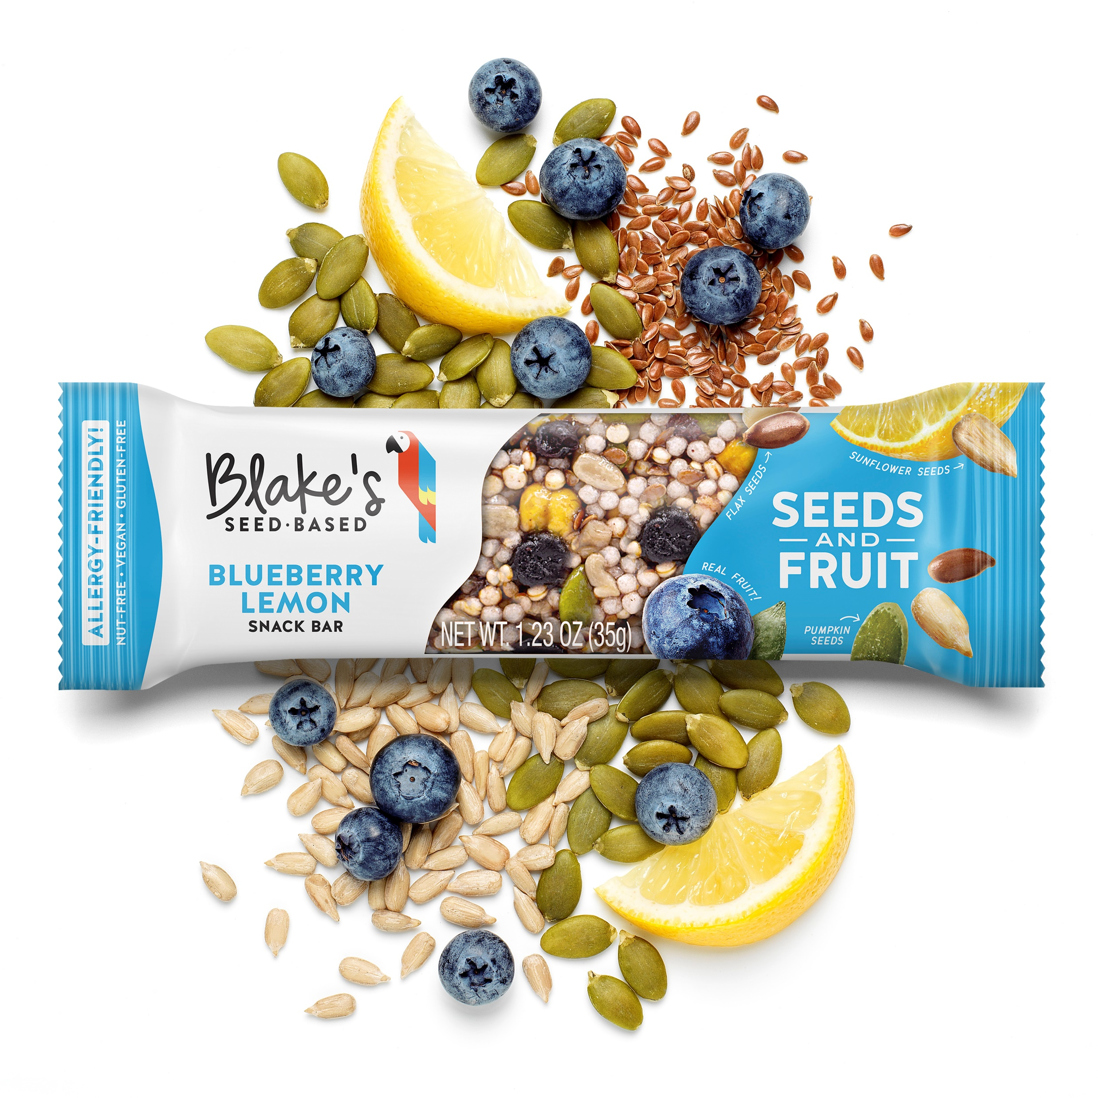
SNACK BAR LINEUP
12Ct Packaging
12 Ct. Singles
IN ORDER OF RANK
1) RASPBERRY
5Ct
IN ORDER OF RANK
2) S’MORES
3) BLUEBERRY LEMON
RASPBERRY
S’MORES
© 2021 Blake’s Seed Based. All Rights Reserved

Slide 10
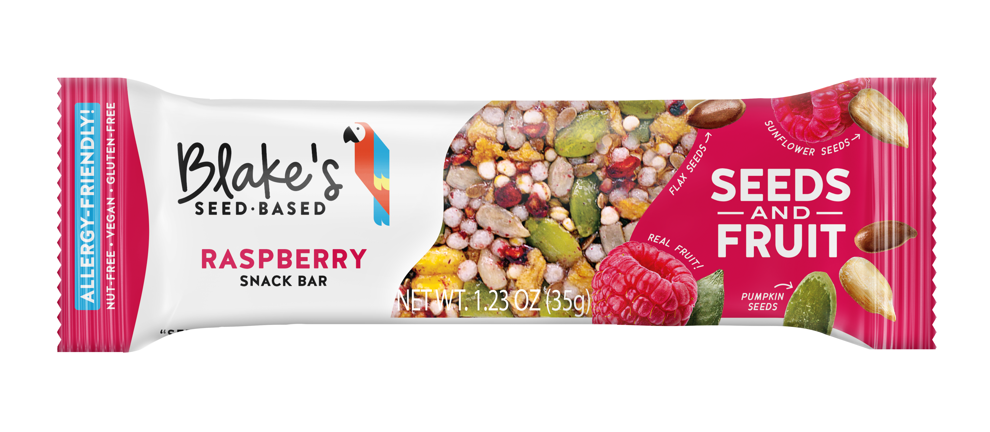
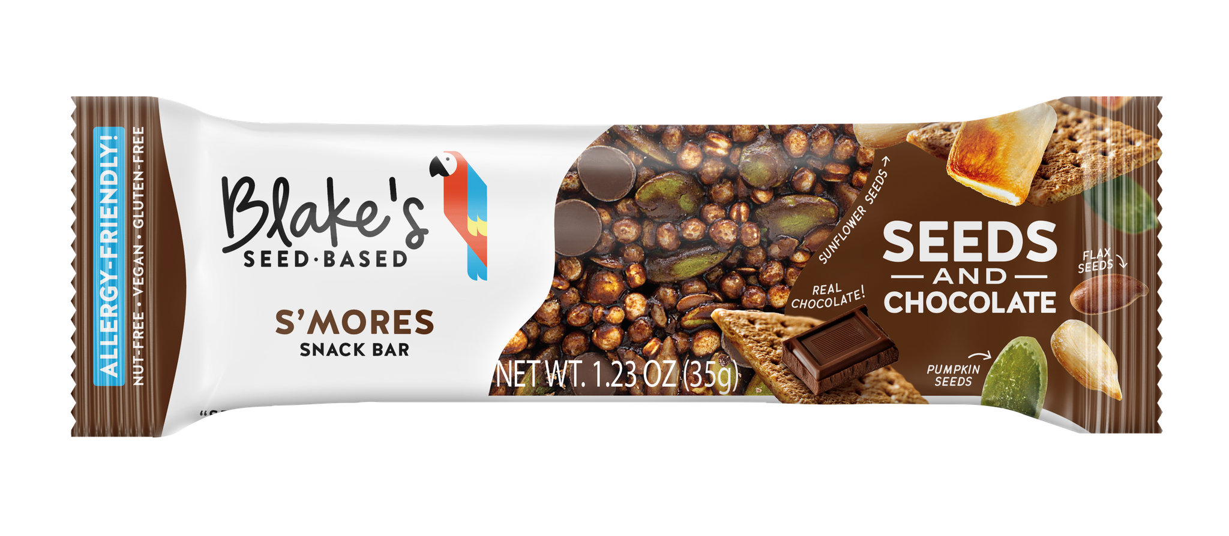
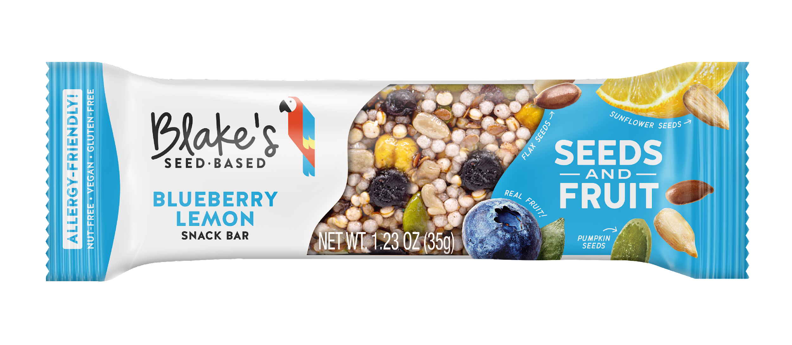
WHY BLAKE’S SEED BASED
Snack Bars
IN ORDER OF RANK
Insights & Opportunities
100MM people directly/indirectly impacted
by food allergies.
Lack of snacking options for these individuals.
Blake’s Seed Based makes healthy, great tasting snacks that everyone can eat because they’re Allergy Friendly.
1) RASPBERRY
Consumer Benefits
Snack Bars made from Seeds, Fruit + Chocolate
Vegan, Non-GMO and Top 8 Allergen-Free. (free from: peanuts, tree nuts, milk, eggs, soy, wheat, fish, shellfish)
Certified Nut-Free and Gluten-Free facility
2) S’MORES
Launch Details
Size: 12 Pack (Individual bars) or 5 Pack (multicount)
SRP: $1.99 Per Bar or $7.99 for 5 Pack.
Shelving: Nutrition and Health Bars
3) BLUEBERRY
LEMON
© 2021 Blake’s Seed Based. All Rights Reserved

Slide 11
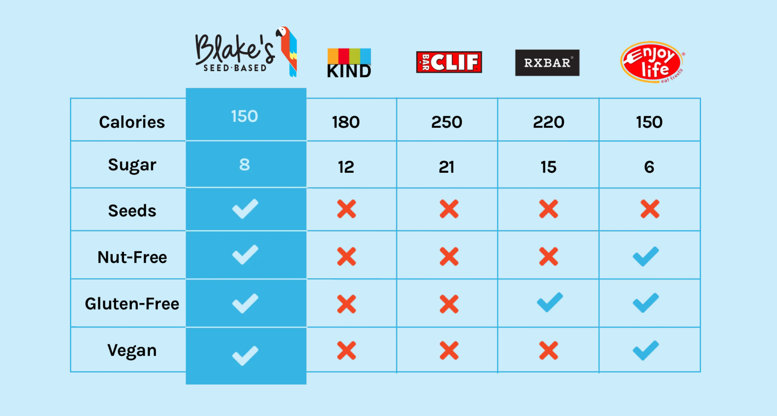
SNACK BAR COMPETITION
© 2021 Blake’s Seed Based. All Rights Reserved

Slide 12
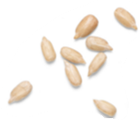
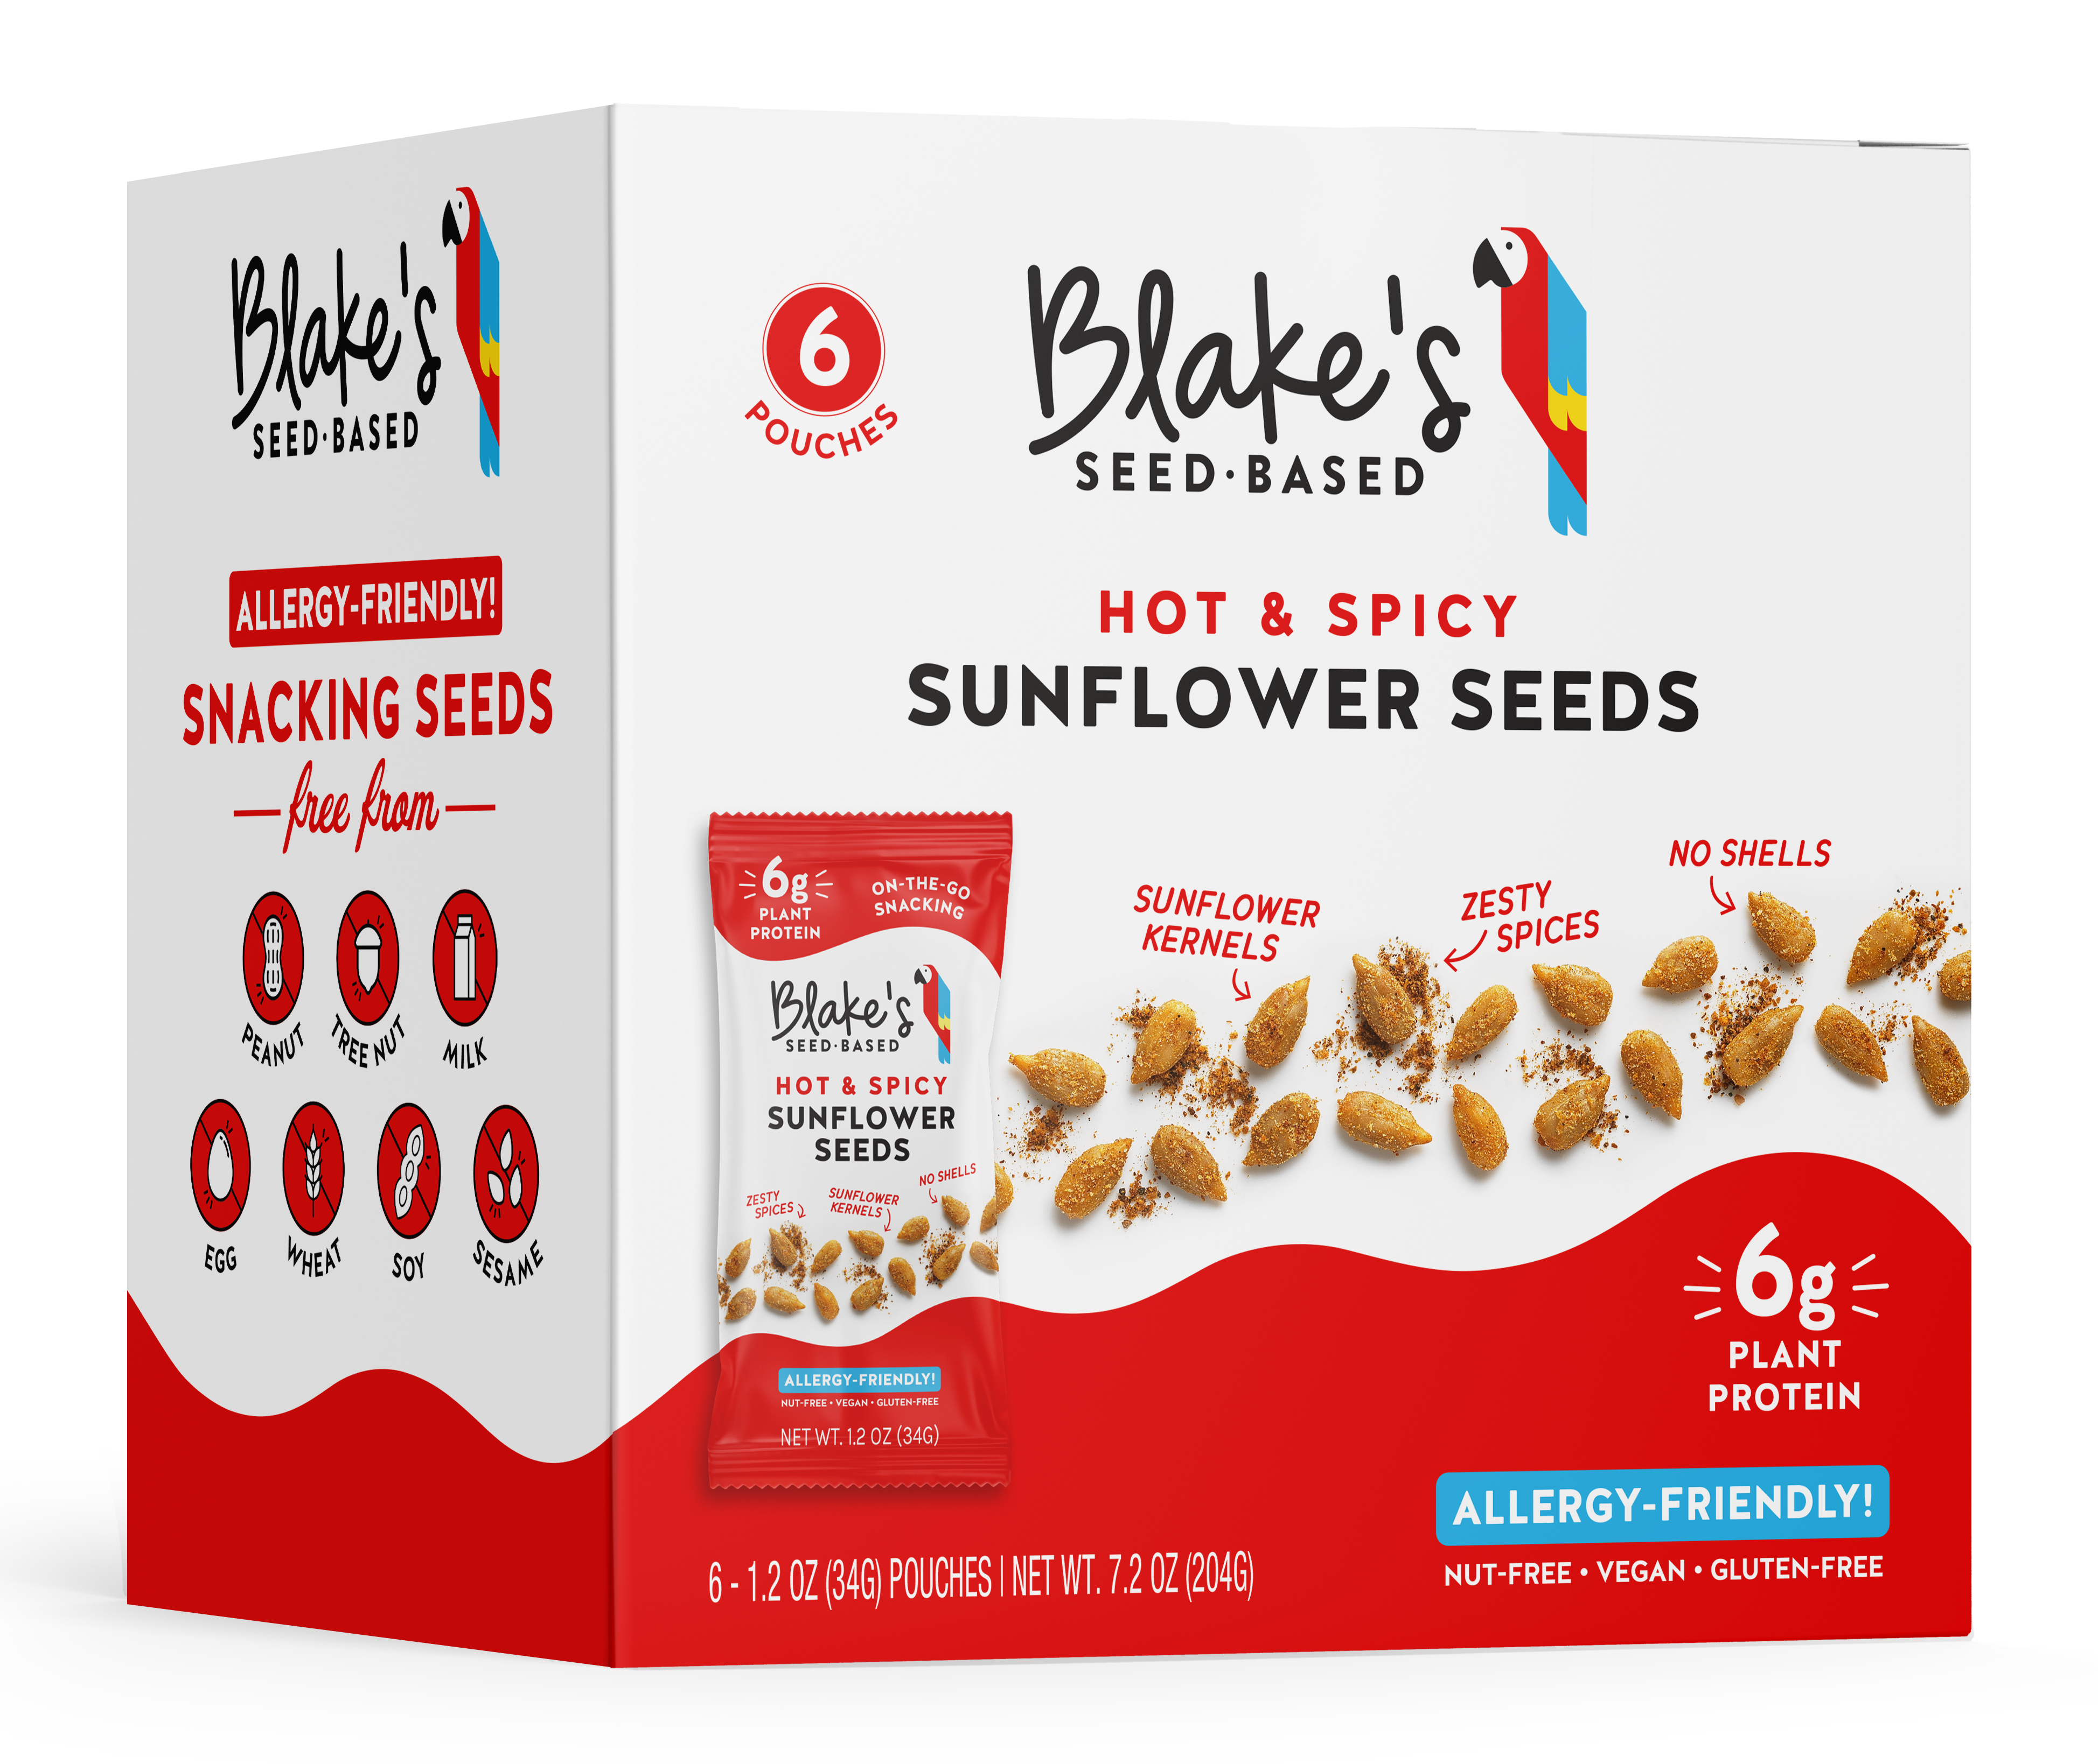
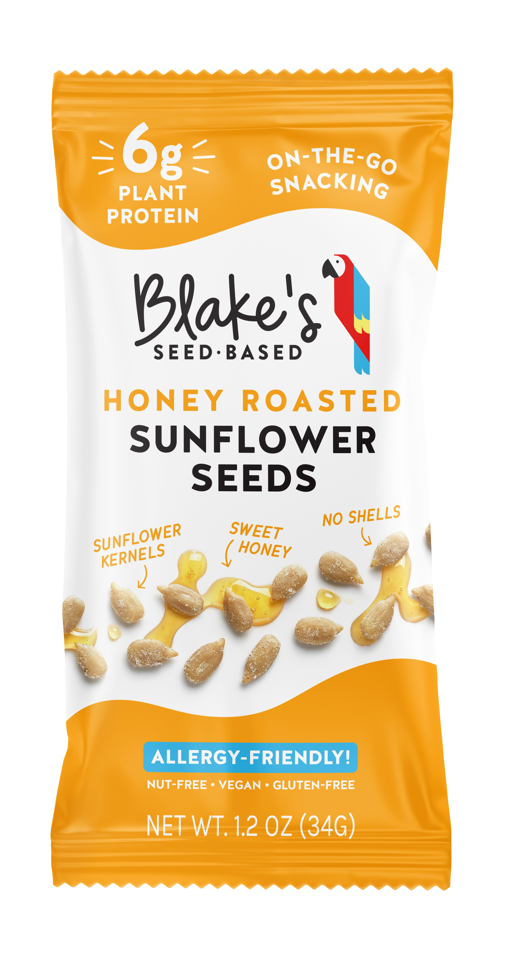
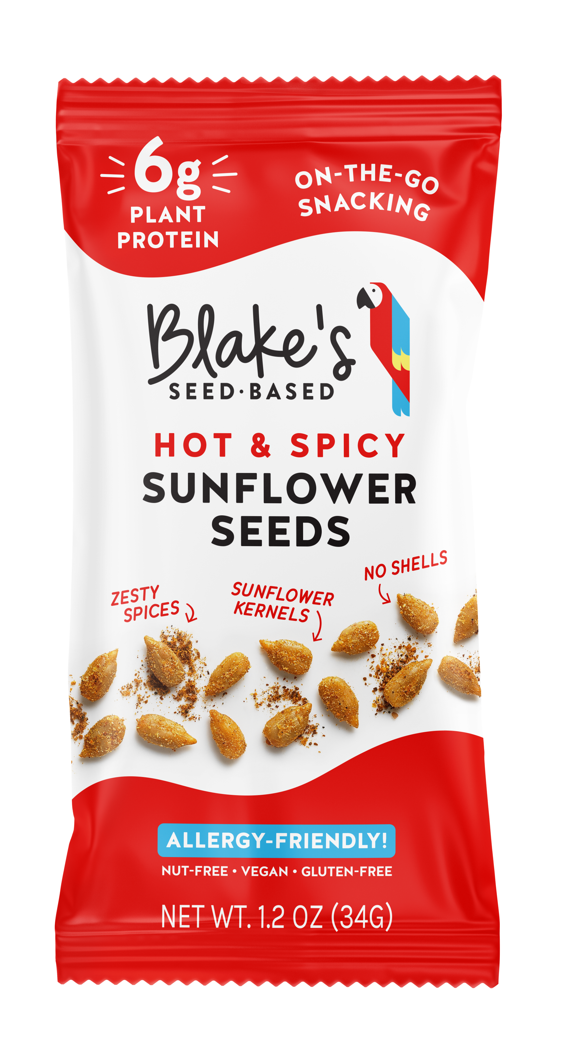
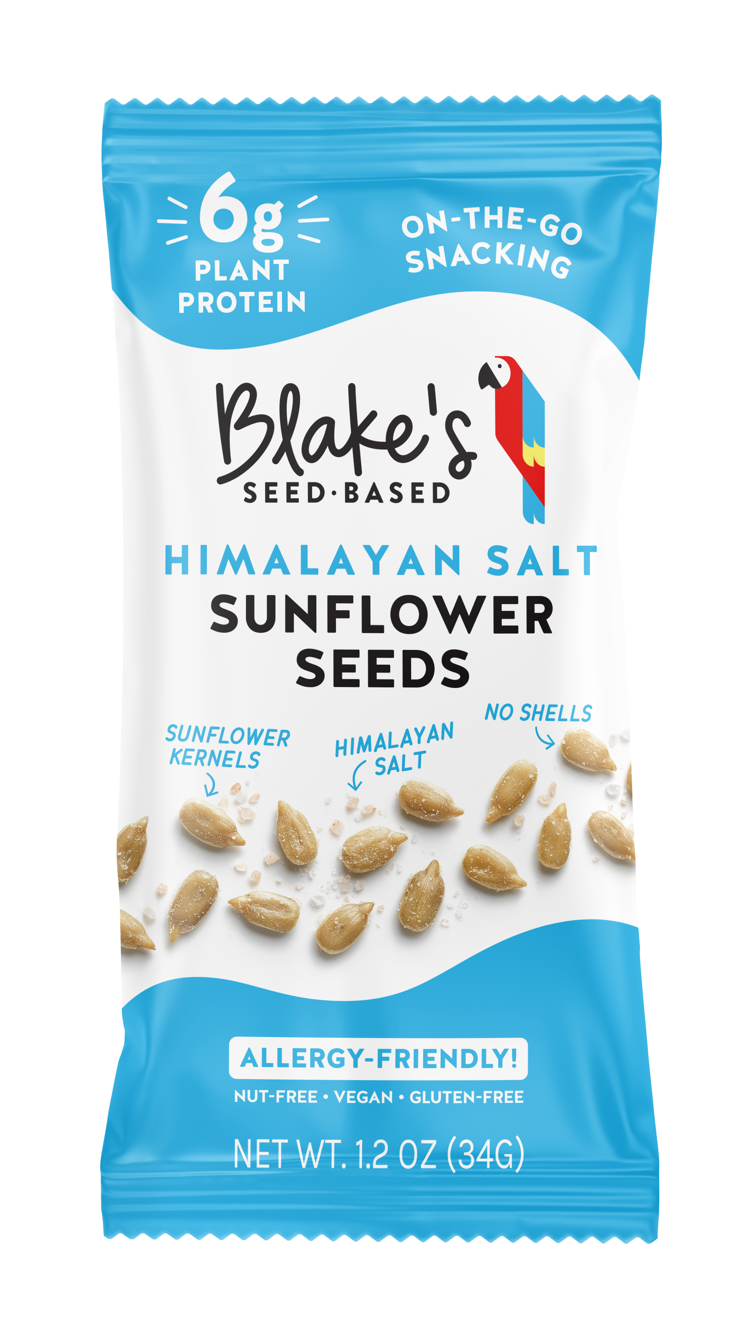
2022 NEW ITEM LAUNCH- ROASTED SEEDS
Product Launch Details
Product: Roasted Sunflower Seeds
Flavors:
2022 Q1 Launch: HIMALAYAN SEA SALT + HONEY ROASTED + SPICY
2022 Q2 Launch: BBQ + CHOCOLATE
Pack Size: 1.2oz seed pouches - 6ct and 12ct box
Timing: December 2021 Production
“Our consumers live an active lifestyle, and we see a clear need for a healthy, great tasting snack that can be tossed in a backpack or in your pocket that will provide clean fuel and protein for our consumers adventures. Out came roasted sunflower seed pouches.” – Blake
Why Sunflower Seeds?
Global packaged sunflower seed market was 1.1 Billion USD in 2020¹
Packages sunflower seed marketing is expected to grow at a compound annual growth rate of 6.9% from 2020 to 2027 to reach USD 1.76 Billion¹
The growing trend of a healthy diet and increasing awareness about the product's health benefits are expected to boost the market growth in the upcoming years¹
Why Blakes Roasted Sunflower Seeds?
We are currently positioned in the market as a better for you/healthy snack company that leverages the nutrition of seeds
All of our snacks are certified vegan, gluten free, and nut Free
Top 9 allergy-friendly
Strong demand for our current on-the-go ready to eat healthy snacks
Meets the need of our explorer consumers
The perfect on the go size!
© 2021 Blake’s Seed Based. All Rights Reserved
1. https://www.grandviewresearch.com/industry-analysis/packaged-sunflower-seeds-market
Notes:
Packaged sunflower seeds are beneficial in promoting heart health, reducing inflammation, treating diabetes, slowing down the aging process, preventing cancer, and decreasing cholesterol. The vitamin E content of the seeds helps in reducing the risk of developing osteoarthritis and atherosclerosis. Furthermore, these seeds contain magnesium, which helps prevent migraines and headaches, reduce hypertension, relax nerves, and avoid muscle spasm. Additionally, vitamin B1 and electrolytes present in the product help in boosting energy. The growing trend of a healthy diet and increasing awareness about the product's health benefits are expected to boost the market growth in the upcoming years.

Slide 13





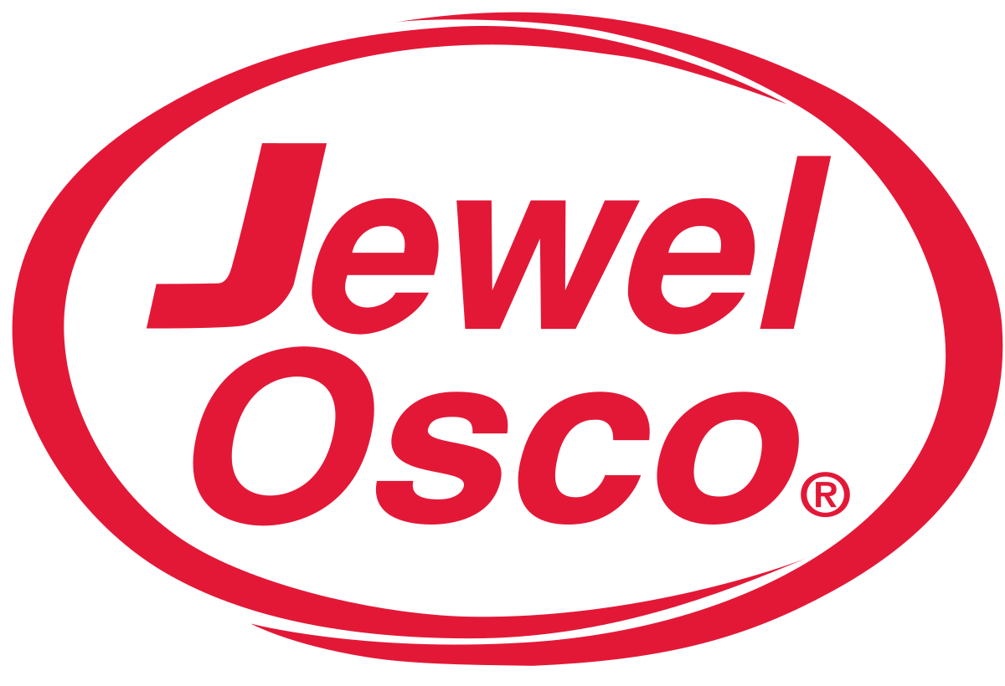


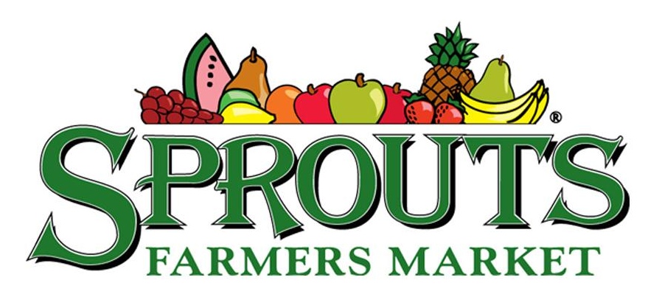







DISTRIBUTION
© 2021 Blake’s Seed Based. All Rights Reserved
Notes:
150+ Locations
(9/18 Launch)

Slide 14
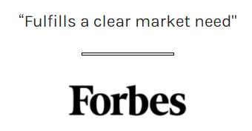
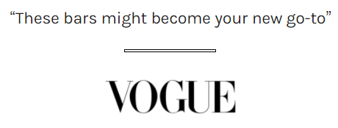
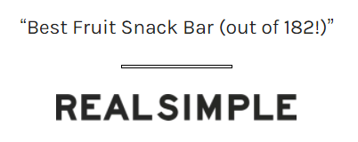








PRESS
© 2021 Blake’s Seed Based. All Rights Reserved

Slide 15
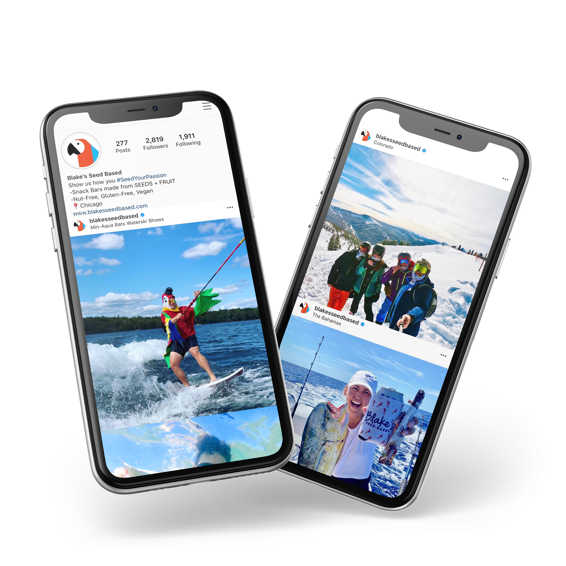



CHECK OUT HOW OUR CONSUMERS
#SEEDYOURPASSION
Check us out on social!
#SeedYourPassion
@BlakesSeedBased
THANK YOU!
© 2021 Blake’s Seed Based. All Rights Reserved
Notes:
-Good

