Slide 1
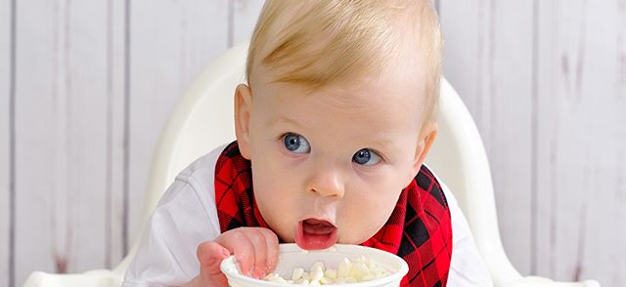
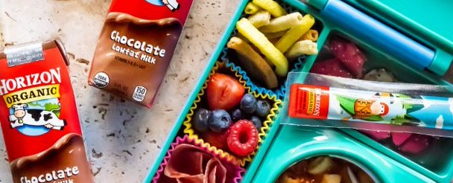

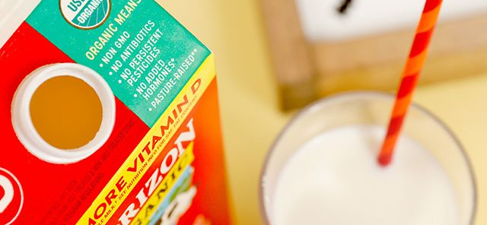
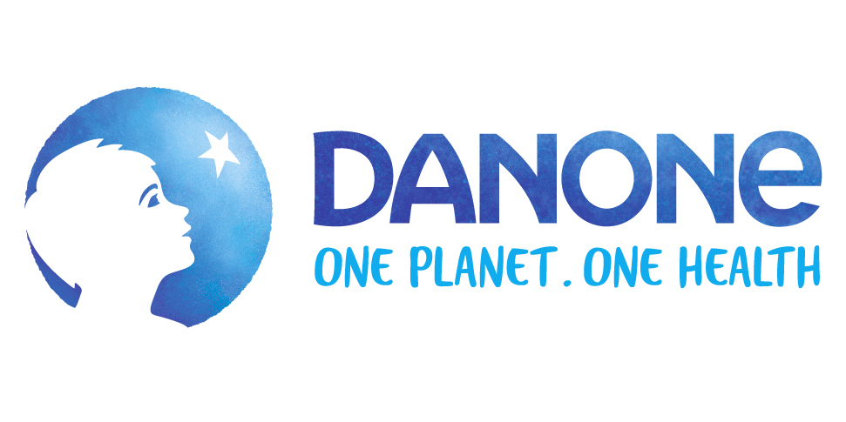
Why Horizon Organic

Slide 2

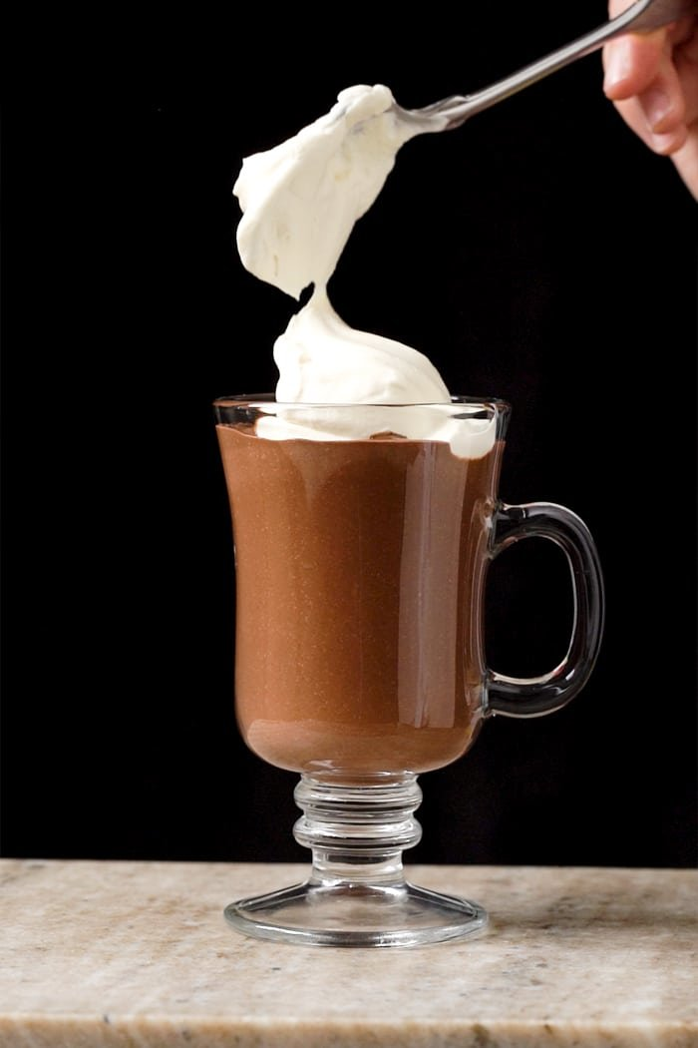
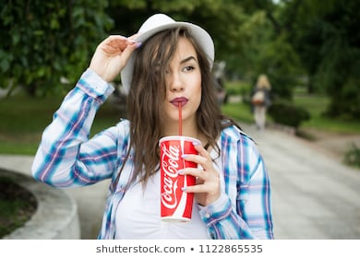

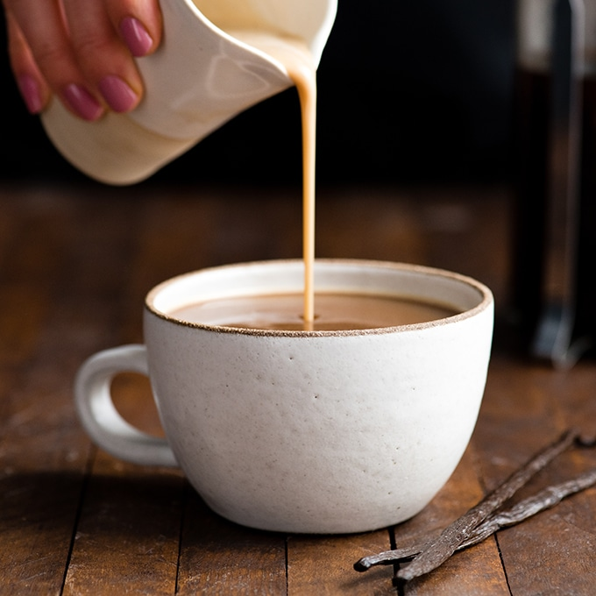

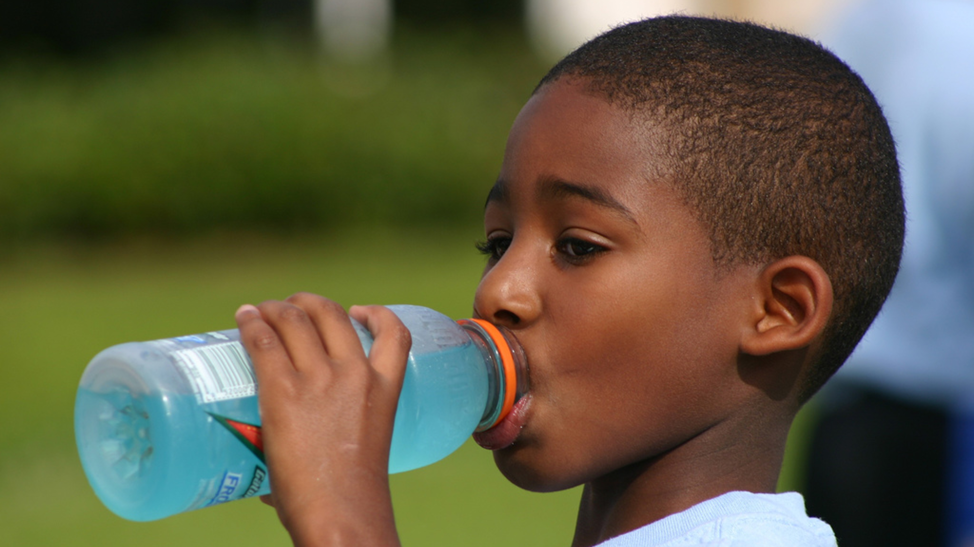
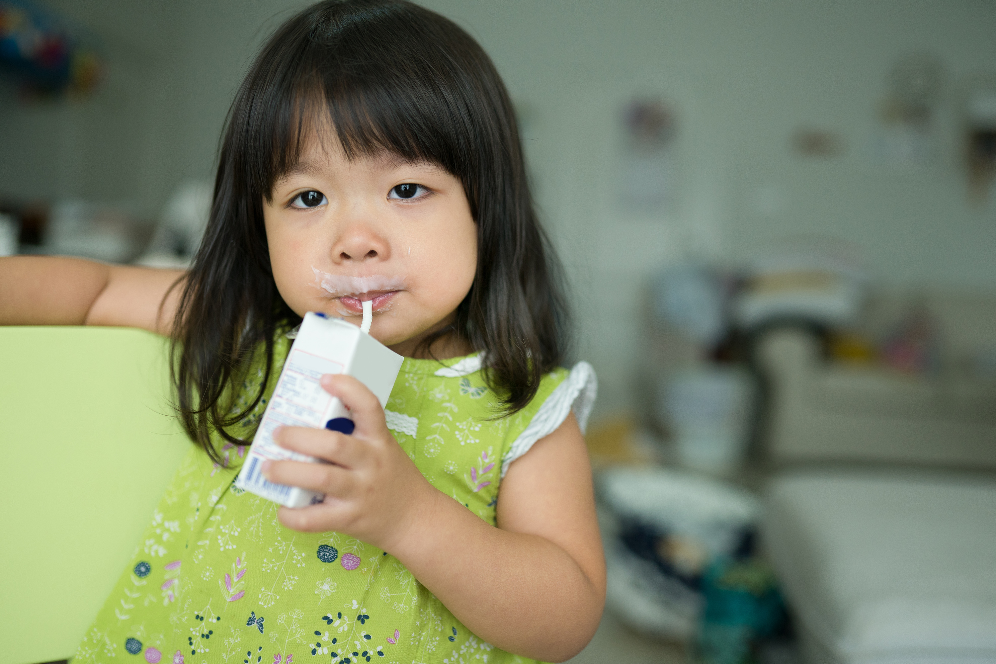
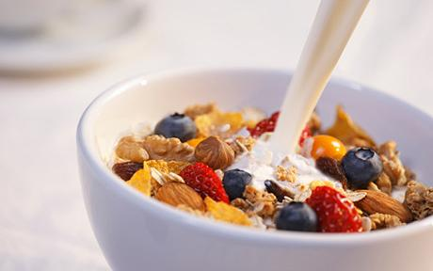
American’s LOVE to Drink!
FOR FUN | FOR HEALTH BENEFITS | FOR ‘SNACKS’ & ‘ON-THE-GO’ | FOR FLAVOR / ADDITIONS
Source: https://www.huffpost.com/entry/americans-soda-beer_n_885340

Slide 3


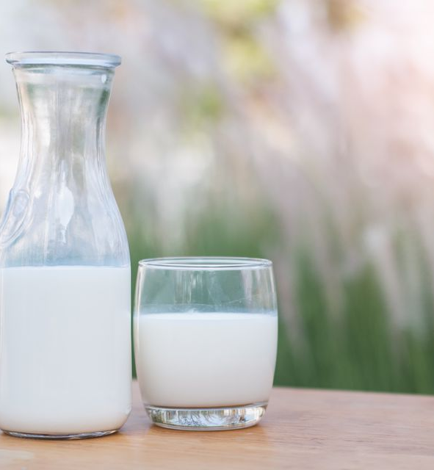



Dairy and Dairy Alternatives are a HUGE and IMPORTANT Category
Milk is the #4 Gallons per capita category
High HHP and Appeals to the Whole Family
>90% HHP with 28 annual Trips per HH
+42% in HH with children/teens, appeal across Income Levels
Dairy & Dairy Alts are Valuable for Retailers
>$15B Category
>$70 Basket per Trip!
Source: https://www.huffpost.com/entry/americans-soda-beer_n_885340

Slide 4

Unfortunately, growth has stagnated in commoditized conventional milk
However pockets of growth within the massive category offer sustainable upside
Rfg Milk
$15.1B (-0.7%)
Conventional
$10.7B (71%, -3.0%)
Value Added
$4.4B (29%, +5.5%)
White
$9.09B (61%, -3.5%)
PBB
$1.69B (11%, +6.1%)
Organic
$1.43B (10%, 0%)
Lactose Free $887M (6%, +5.8%)
CVAM
$441M (3%, +24%)
Flav/ Nog/ AO
$1.5B (10%, +0.3%)
Projection:
-4.2% 3YR CAGR
Projection:
+5.0% 3YR CAGR
Prioritizing Organic Milk can help restore Category Growth
Source: IRI Scan – Total US – MULO + Conv, L52WE 10/27/19

Slide 5



Why Organic?
Organic food & beverages are a source of growth & trust
GROWTH acceleration
Continues thru q3 & q4
a trusted source in times of uncertainty
poised for growth in
2021 and beyond
Organic Growth contribution from New & Existing Buyers
Top 3 Attributes that Organic Shoppers Desire more today
Established & Emerging Organic Segments are driving Growth
#1
Priced Fairly
+$1.9B
#2
In Stock
#3
Carry Brands I Trust
15%
6%
Lowest Importance:
Product on Sale
Product priced lowest
79%

Slide 6

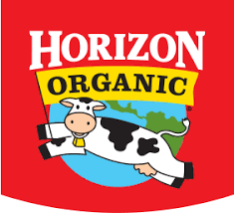
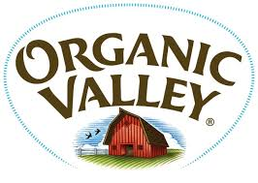


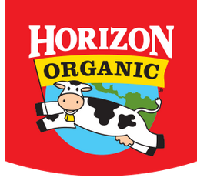
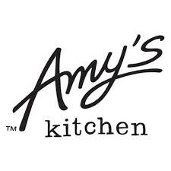



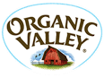

Why Danone?
Danone is the right partner to take organic to the Next Frontier
Danone is the #1 Organic
CPG in the Store (ex PL)
Danone captures more Organic Buyers than any other CPG in the Store (ex PL)
$3.6B
70%
of Horizon Organic Buyers have Repeated over the last year (#1 ex PL)
>
Horizon has nearly 3X more Buyers than the leading Branded Competitor in Dairy
Source 1: IRI Scan, Total MULO+C , L52 We 9/27/20
Source 2: IRI Panel, Total Outlets

Slide 7
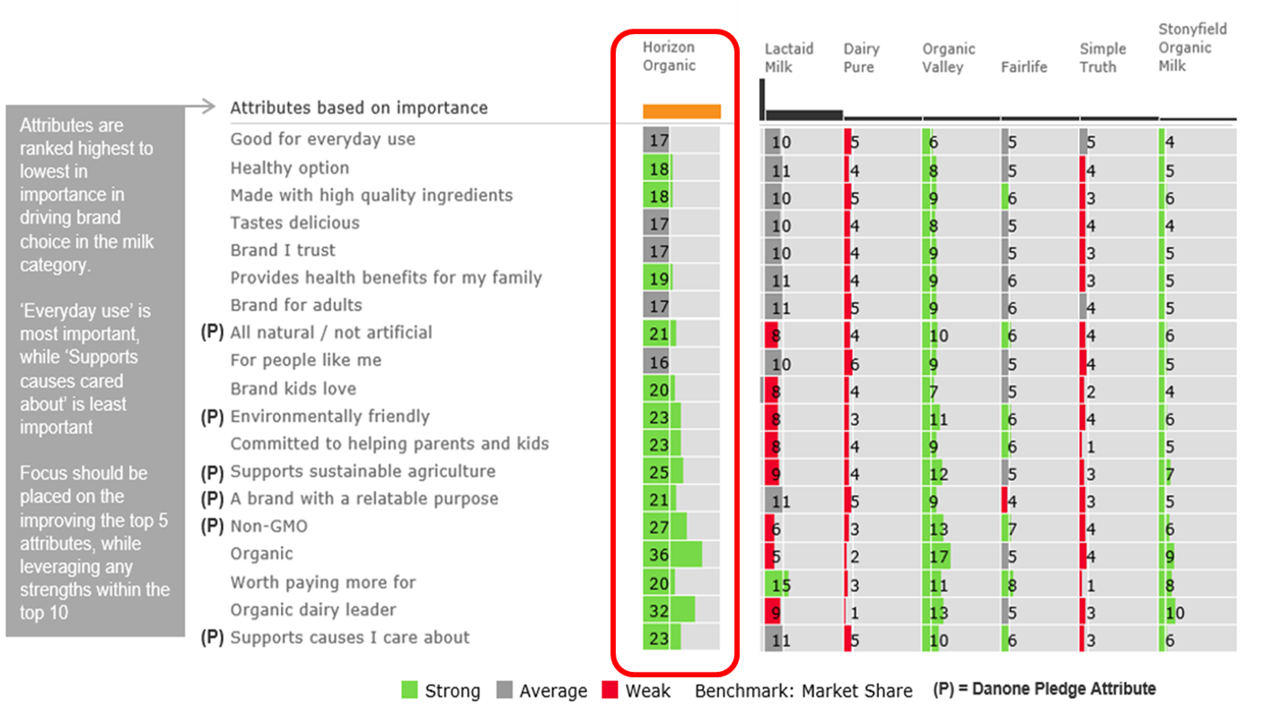
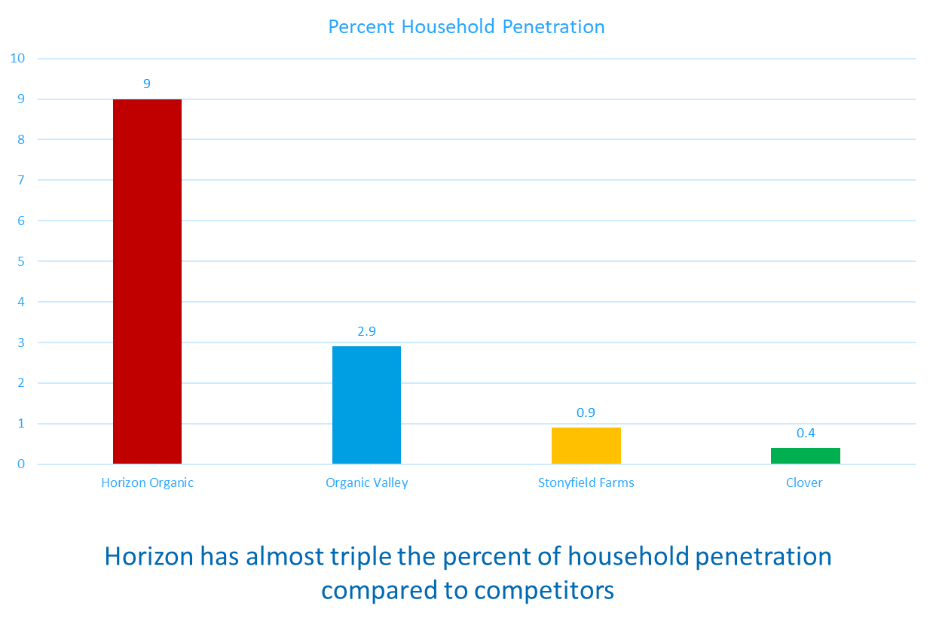
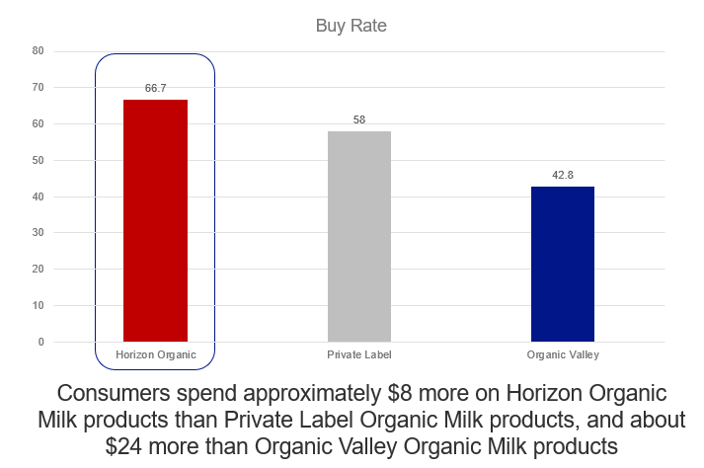
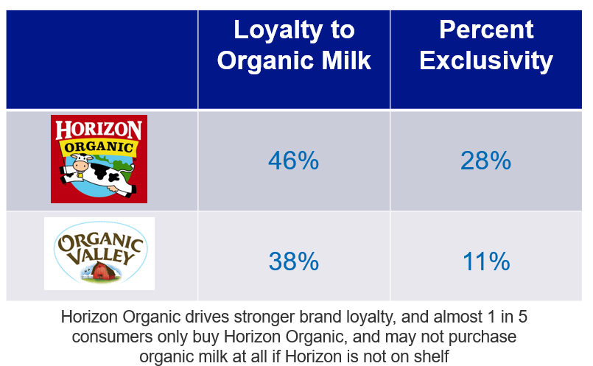
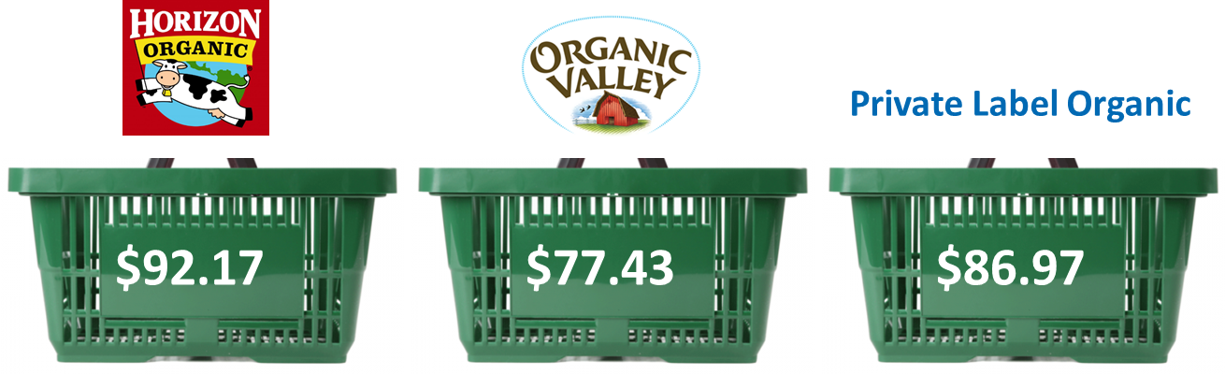
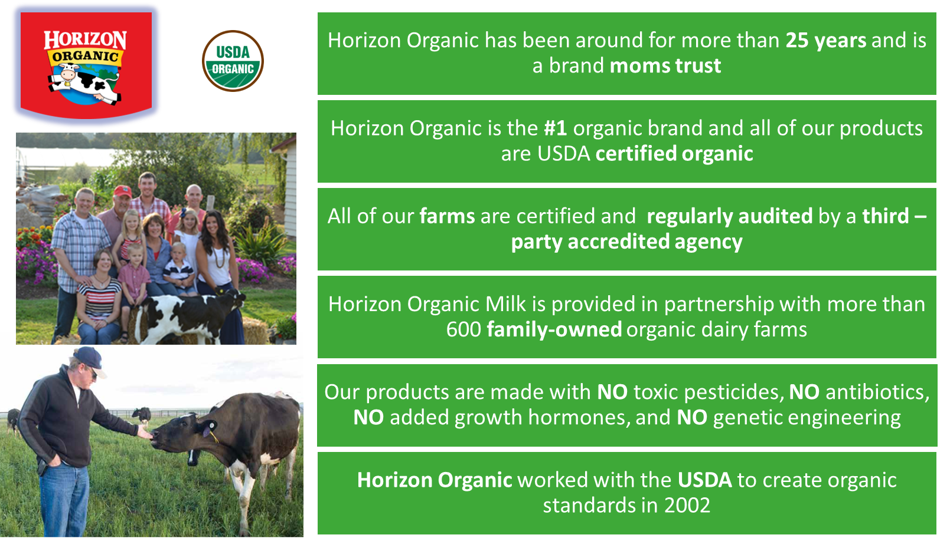
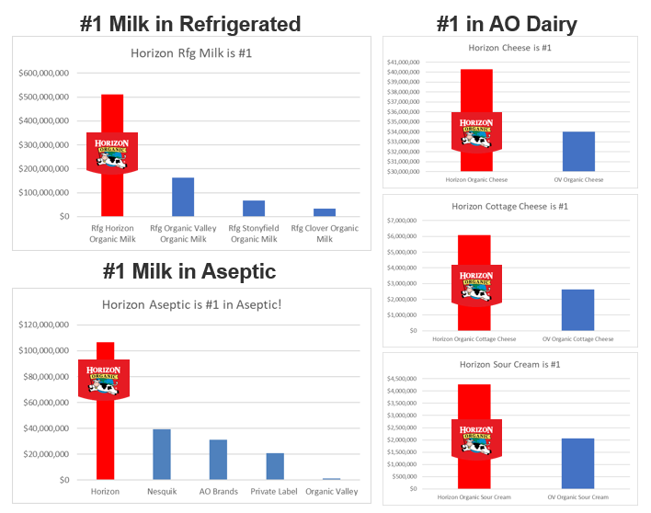
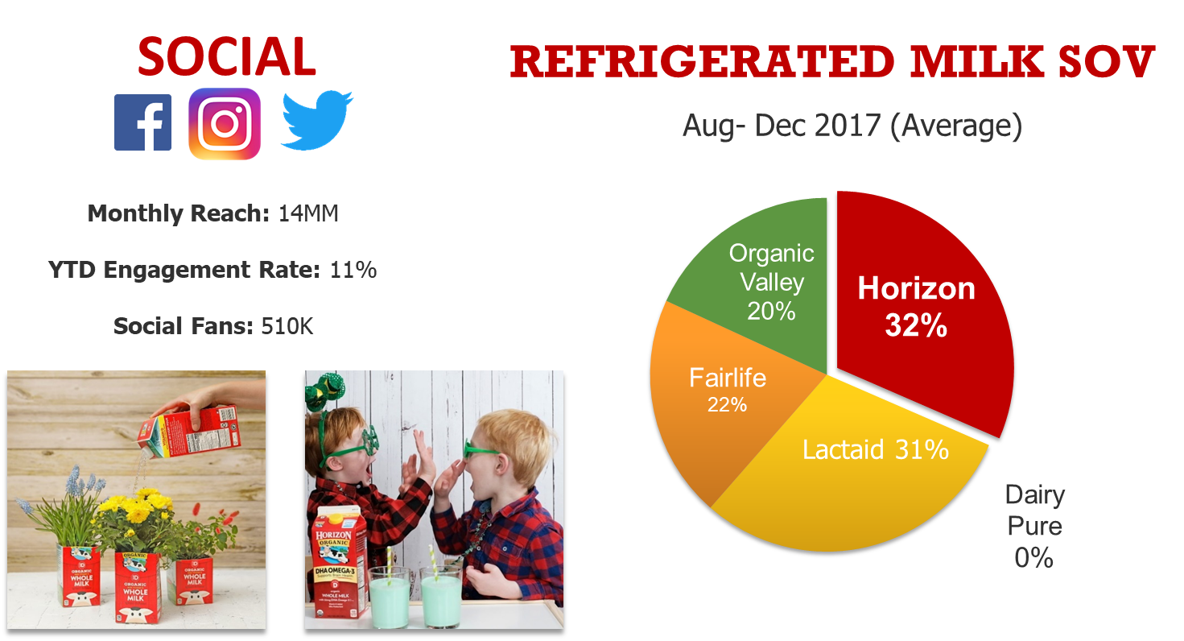
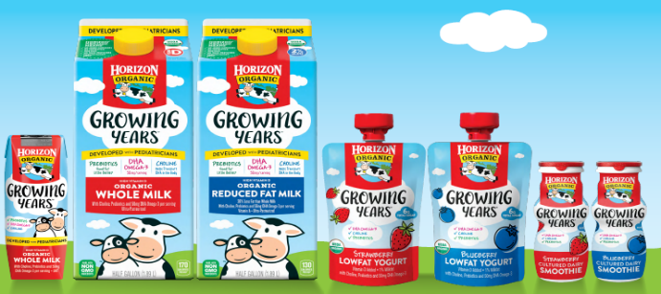
Horizon is the Organic Dairy Partner that can help lead Category Growth
Why Horizon?
1
2
3
4
5
STRONGEST EQUITY SCORES in Value Added Milk | HIGHEST HHP in the Organic Milk Category 3X higher than next brand | LARGEST BASKET SIZE in the Organic Milk Category >$6 more per trip | HIGHEST BUY RATE in the Organic Milk Category >15% higher | MOST LOYAL Organic Milk Shopper 2X higher than OV
HIGHEST SHARE OF VOICE (online, Digital) and a large digital following | INNOVATION LEADER in Organic Milk | #1 BRAND across Organic RFG + SS Milk & Cheese | Horizon PIONEERED Organic Dairy Standards …and we’re not done yet
6
7
8
9
Source: IRI Panel All Outlets Latest 52W W/E 02/23/2020
Source: DataRank Social Analytics
Source: Nielsen GroC+SC, week ending 4/8/17 through 3/31/18

Slide 8
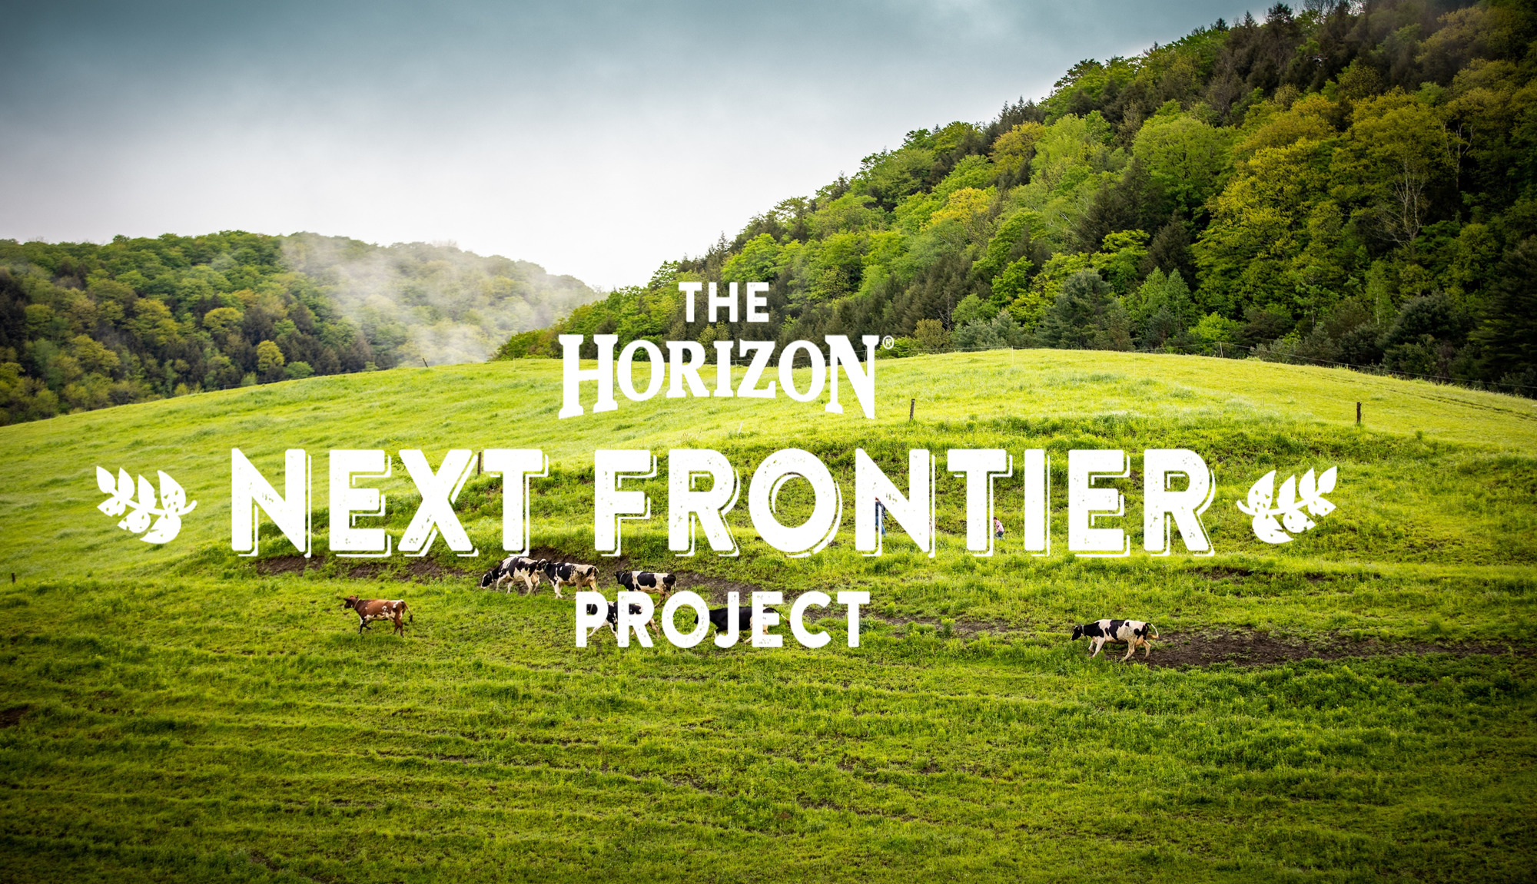
And Horizon is committed to making milk better… for the whole world
Why Horizon?
10
And Horizon CONTINUES TO PIONEER Organic Dairy Standards

Slide 9
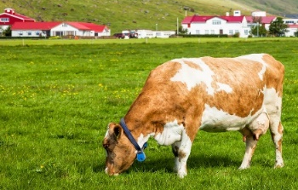
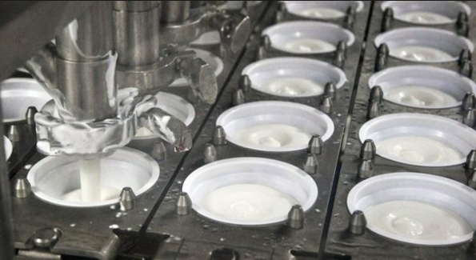
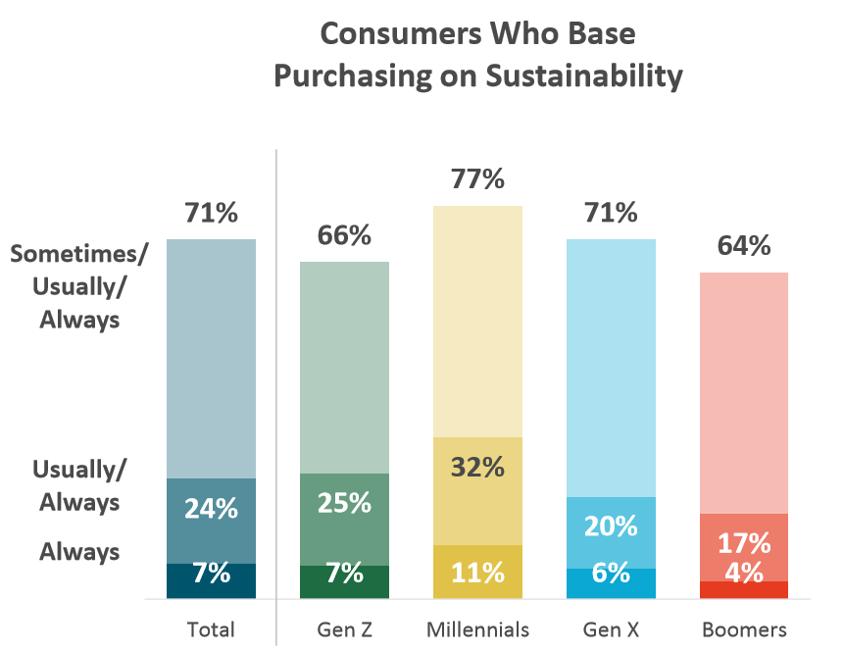
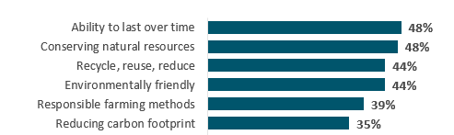

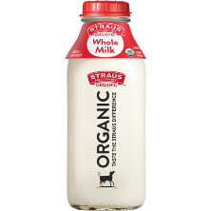
Consumers are increasingly focused on the Environmental Impact of their Food Choices, Including Dairy
Why Sustainability?
Majority of consumers base purchasing decisions on sustainability
Sustainability is closely tied to responsible farming and land management, up from 2013
Consumers seek dairy that has been naturally raised and authentically processed
Consumer Definitions of Sustainability
How is it raised?
How is it processed?
+7 pp
+11 pp
+8 pp
Who made it?
How is it packaged?
The Hartman Group, Sustainability 2019

Slide 10
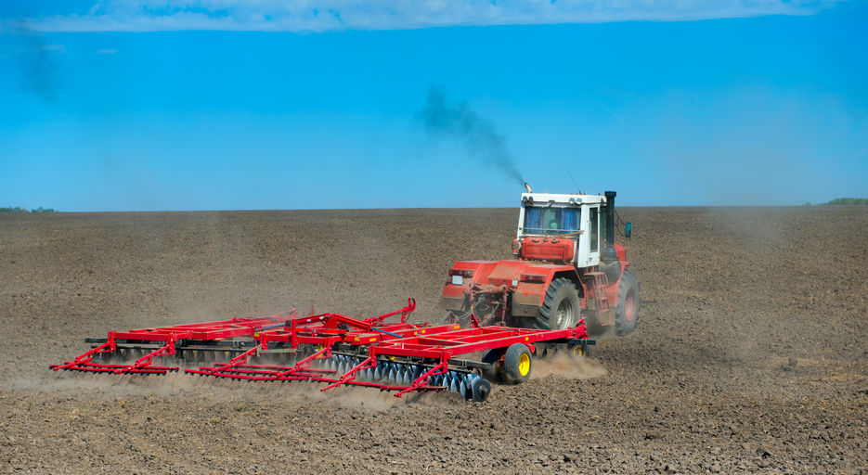
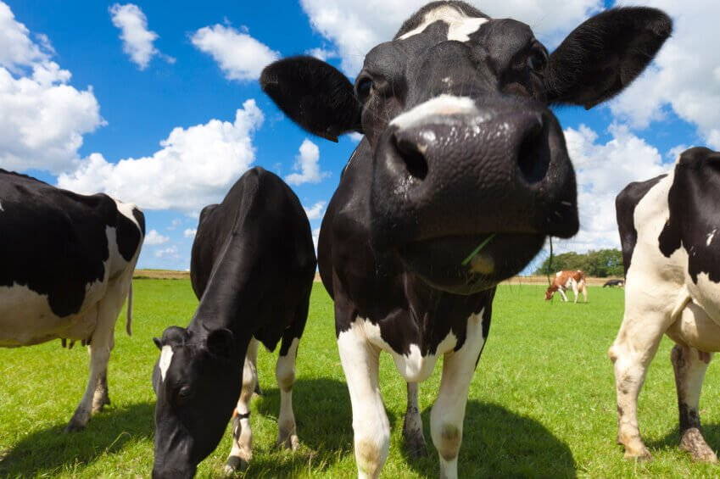
Agriculture’s Contribution to Carbon Emissions creates an opportunity for HORIZON - as the #1 Organic Milk Brand - to Lead the Moment for Change
Why Sustainability?
Agriculture is responsible for up to 10% of the US Greenhouse Gas Emissions
4% from the Dairy Industry
The Hartman Group, Sustainability 2019
https://www.epa.gov/ghgemissions/sources-greenhouse-gas-emissions

Slide 11
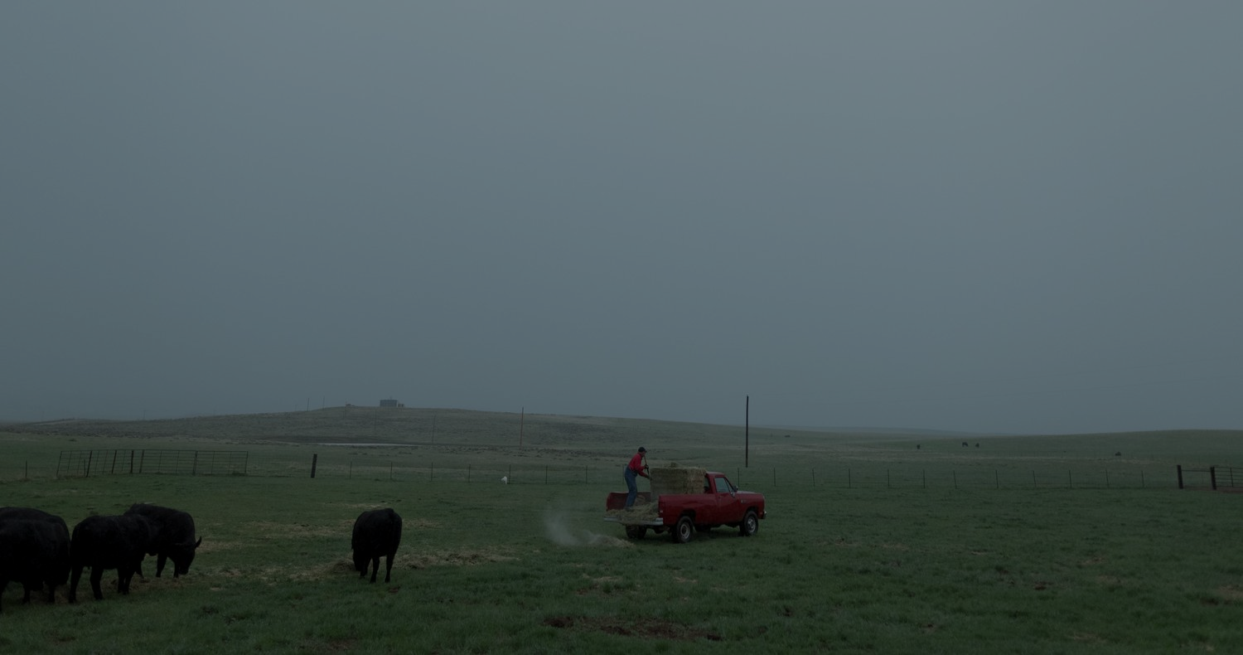
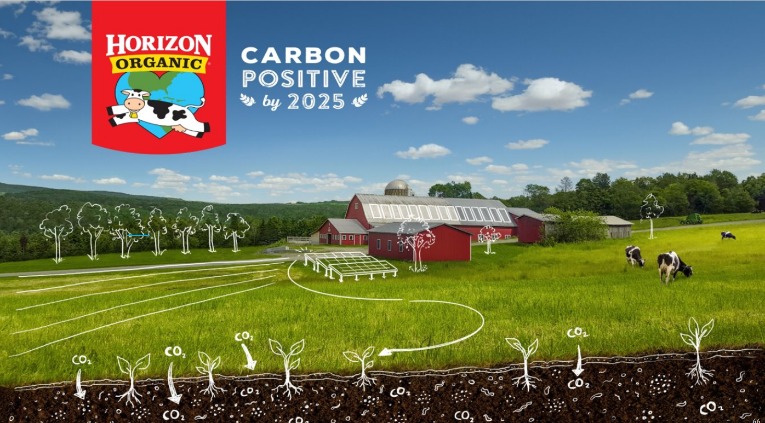
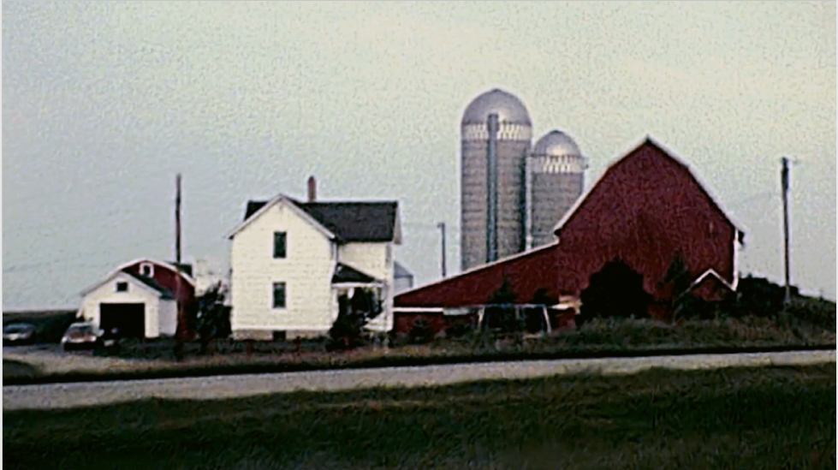
Horizon’s Promise:
The Horizon Commitment
The Creative Idea
ONE HORIZON
Video coming soon
Notes:
Horizon Organic is the first major dairy brand to commit to carbon positivity across the full supply chain: From seed through the consumer usage
The campaign idea is one shared horizon. We have milk that is good for today, but not necessarily good for tomorrow. Good for today, good for tomorrow.
We can make a change one glass at a time
This idea has been tested with consumers, and it tested overwhelmingly positive. We’re so excited to bring this to life.

Slide 12
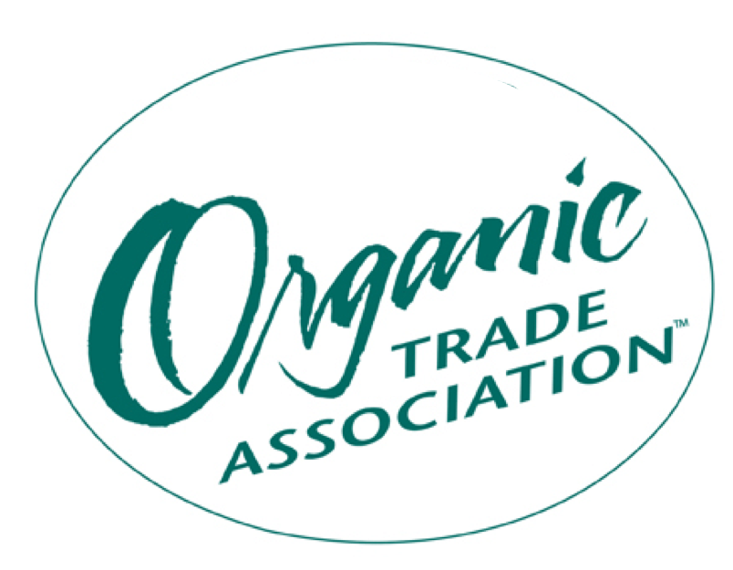

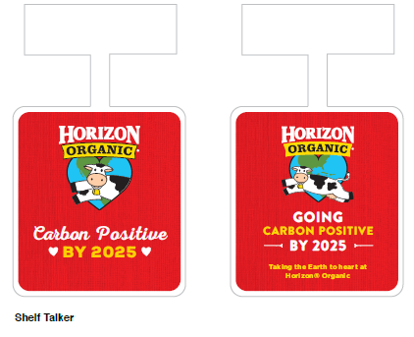

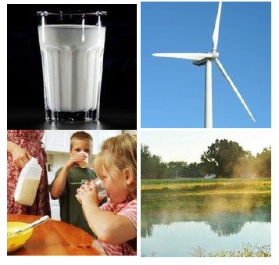



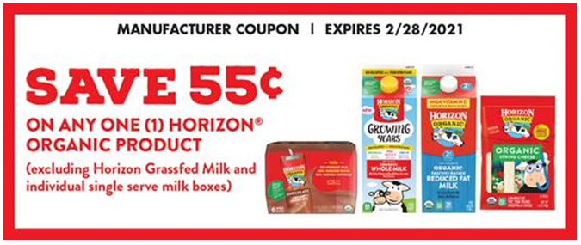
How will Horizon Drive Awareness?
We will leverage multiple touchpoints to Drive Awareness of our Carbon Positive Commitment
New Ad
Campaign
Sustainability
Focused Activations
Industry
Partnerships
Instore
Shopper Promotions
“One Glass for the World”
Highlighting our Pledge to go Carbon Positive by 2025
Shopper
Tactics
OLV/Social Media
Media Content Partnerships
PR/Earned Media

Slide 13
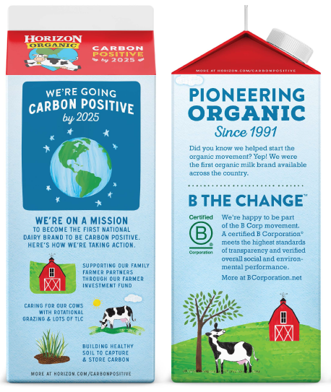
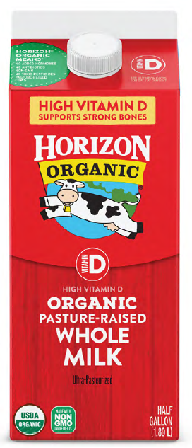

We’re updating the Base HG packaging to call out our commitment to go Carbon Positive by 2025
How will Horizon Drive Awareness?
New Base HG packaging will drive awareness around the three pillars of the Next Frontier Project:
  Farmer Care
  Cow Care
  Soil Care
In market April 2021, to celebrate Earth Day activations!

Slide 14
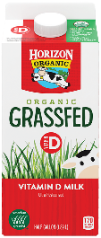

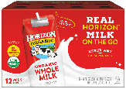
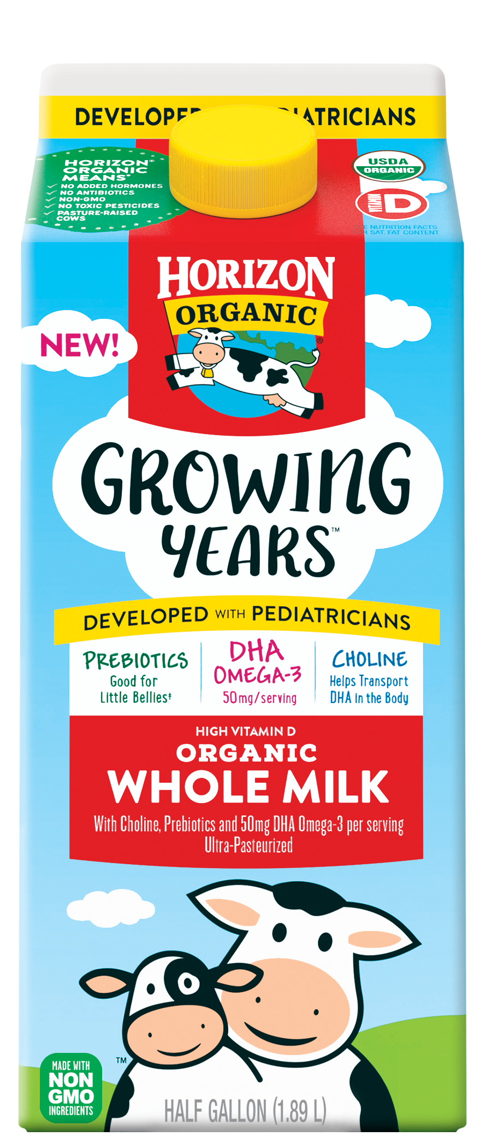
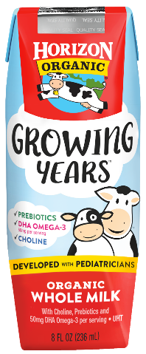
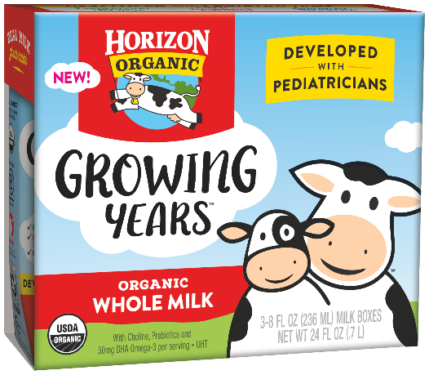
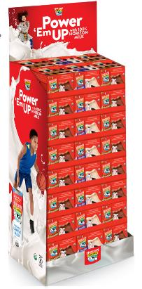
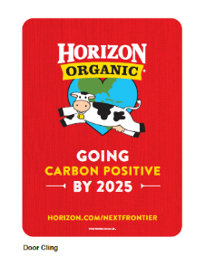
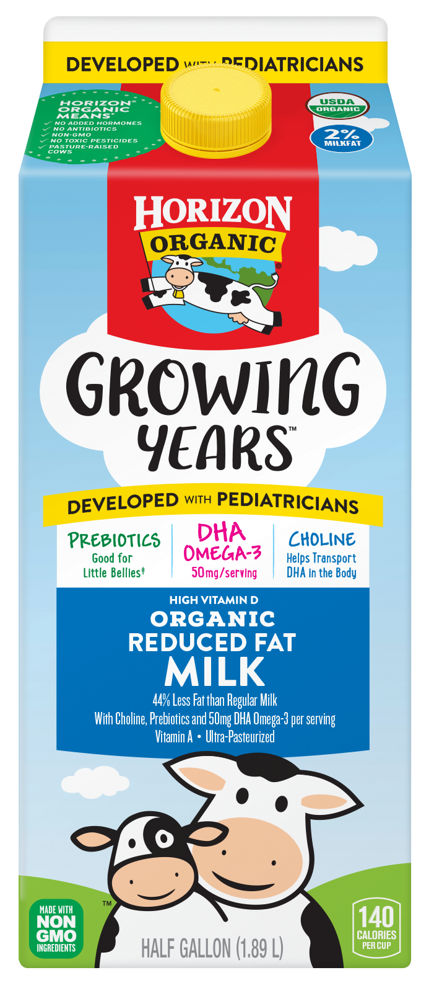



How to Partner with Horizon Organic and Grow Total Organic Milk
How to Partner?
INVEST IN THE SHELF
Win Shopper First Moment of Truth
MAINTAIN A HEALTHY CORE
Leverage the Portfolio to Drive Topline and Bottom Line
Easy to Find
Organic Share of Shelf ≥ $ Sales Organic Blocked Together Signage to ID Organic location
Easy to Choose
Brands blocked Horizontal Flow by Fat Level Vertical Flow for Functional Benefits
Drivers
Drive Vol with Large Sizes & PL Drive Topline with Value Adds and multiples Drive Bottomline w/ smart promos & penny profit
Drags
Deep discounting on list items Creating ‘lost price swapping’ situation Too many brands, not enough benefit or size variety
Insert HO POG example
ACCELERATE INNOVATION
Grow Category Trade In, Trade Up & Trade Across
CREATE THE FUTURE
Increase HHP with Shopper Marketing
Trade In (new $)
Prioritize consumer-benefit innovation vs. new base brands
Trade Up (higher $/oz)
Leverage Innovation to premiumize the category
Trade Across (more $/trip)
Drive master brands and multiproduct use
Drive Awareness
Feature & Merch to disrupt Educate shoppers RE PODs through shelf and digital communication
Drive Trial
Incent trial and repeat to bring in new HHs Leverage high HHP categories to increase reach

Slide 15
Next Steps
Teams Customize
INVEST IN THE SHELF
Win Shopper First Moment of Truth
MAINTAIN A HEALTHY CORE
Leverage the Portfolio to Drive Topline and Bottom Line
Shelf Reco
Distribution & Merch Reco
ACCELERATE INNOVATION
Grow Category Trade In, Trade Up & Trade Across
CREATE THE FUTURE
Increase HHP with Shopper Marketing
New Item Acceptance and Support
Shopper Plan

