Slide 1
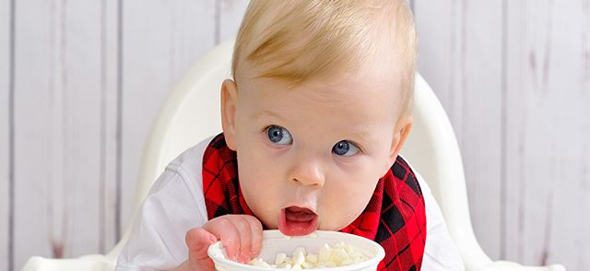
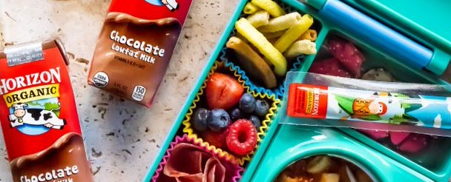

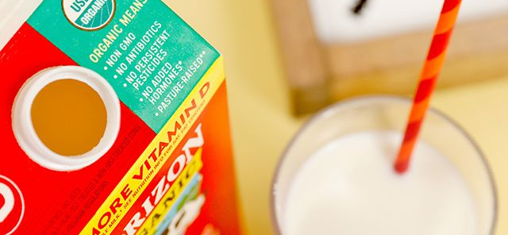
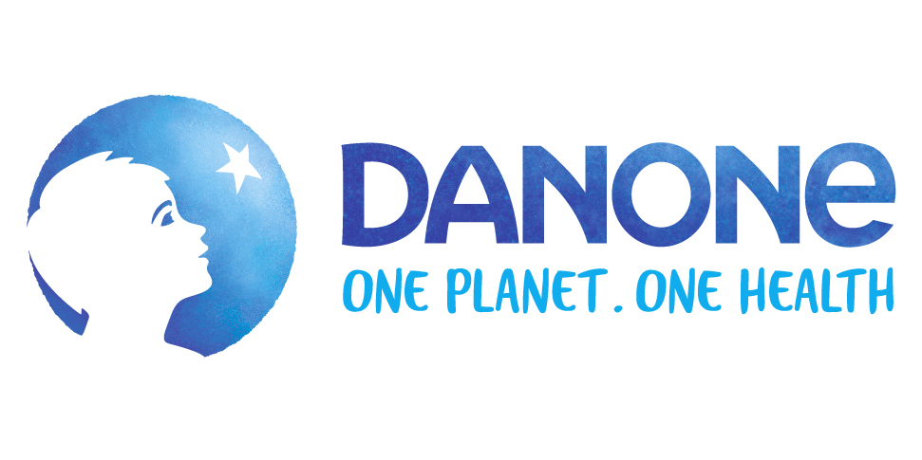
Why Horizon Organic?

Slide 2
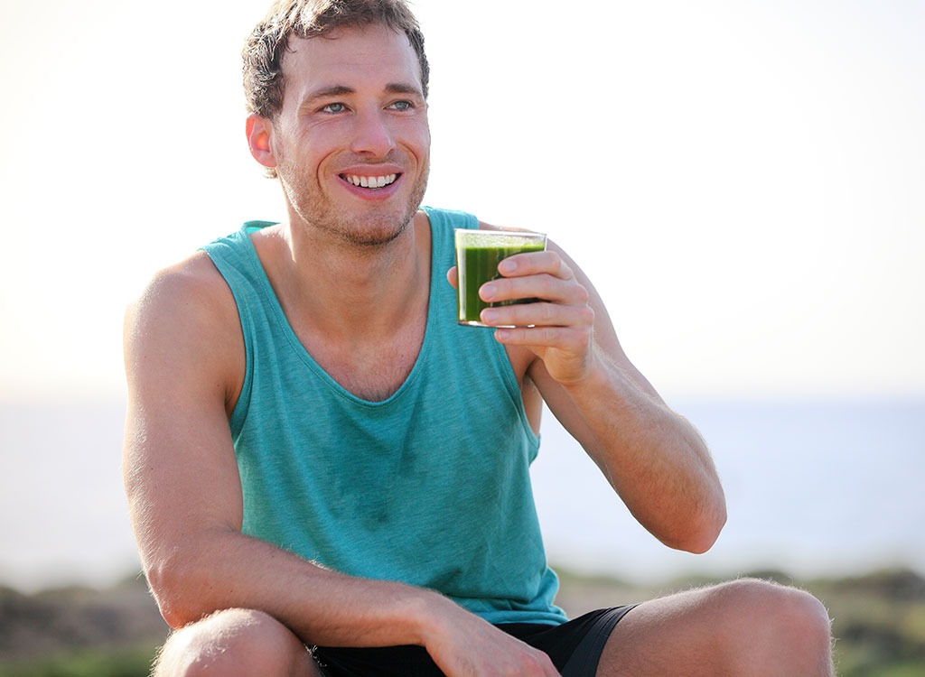
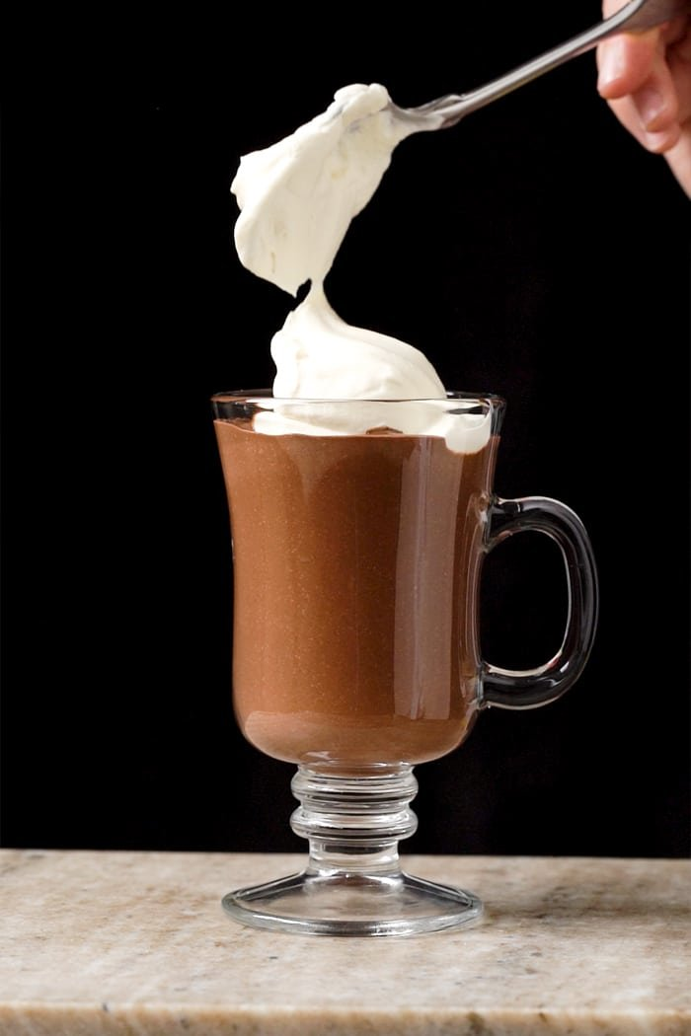
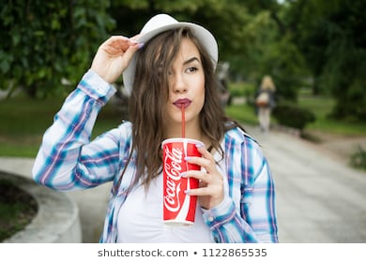

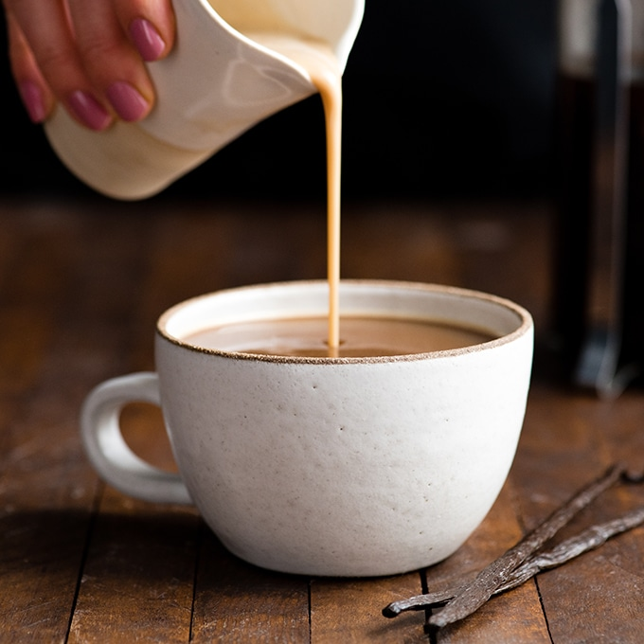
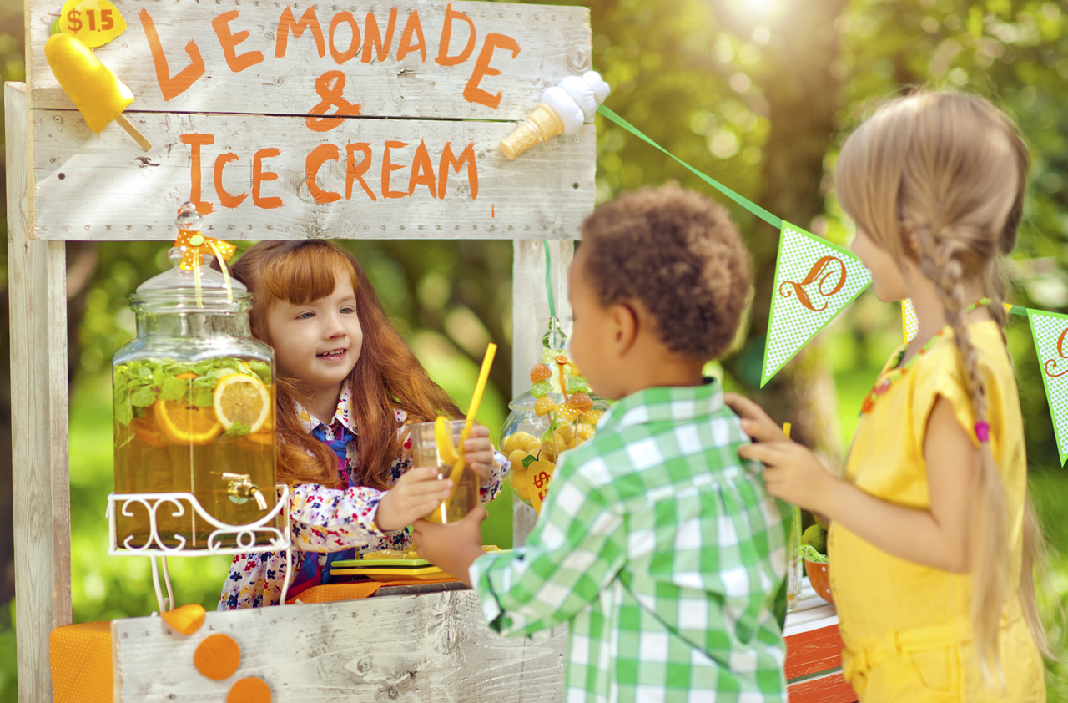
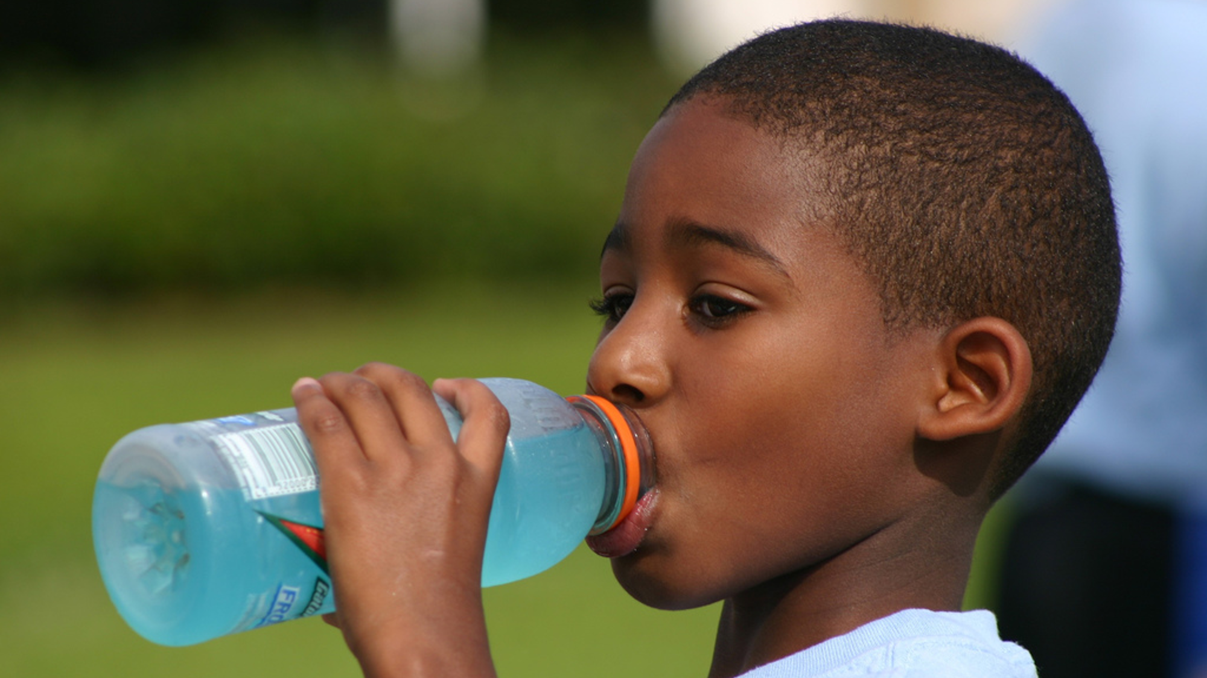
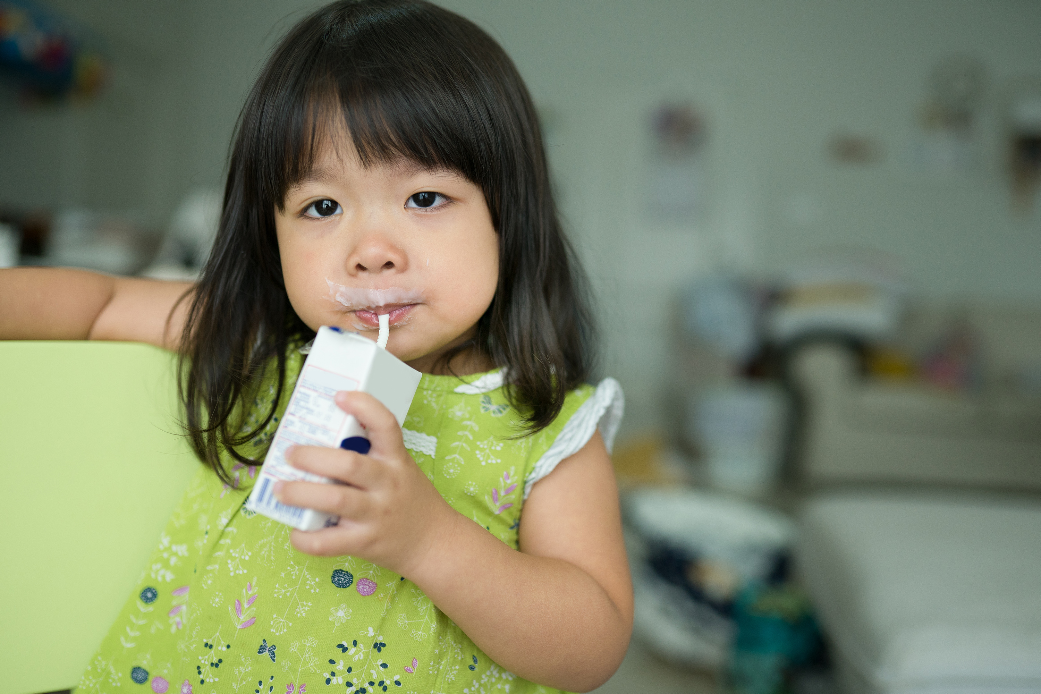
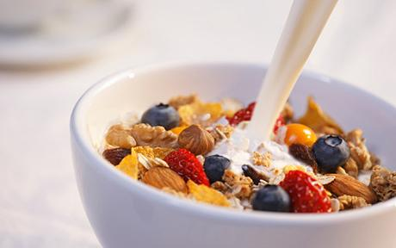
American’s LOVE to Drink!
FOR FUN | FOR HEALTH BENEFITS | FOR ‘SNACKS’ & ‘ON-THE-GO’ | FOR FLAVOR / ADDITIONS
Source: https://www.huffpost.com/entry/americans-soda-beer_n_885340

Slide 3


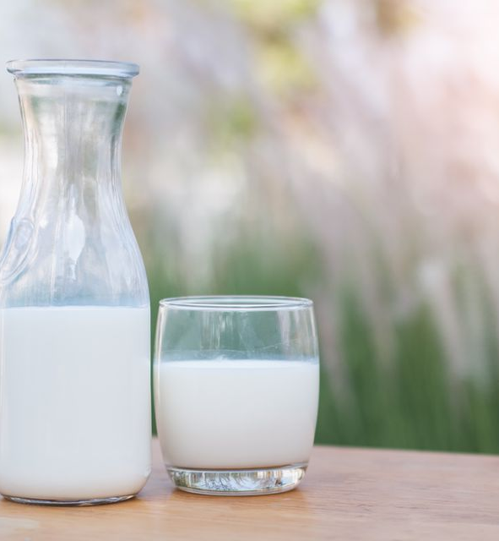



Dairy and Dairy Alternatives are a HUGE and IMPORTANT Category
Milk is the #4 Gallons per capita category
High HHP and Appeals to the Whole Family
>90% HHP with 28 annual Trips per HH
+42% in HH with children/teens, appeal across Income Levels
Dairy & Dairy Alts are Valuable for Retailers
>$15B Category
>$70 Basket per Trip!
Source: https://www.huffpost.com/entry/americans-soda-beer_n_885340

Slide 4



Why Organic?
Organic food & beverages are a source of growth & trust
GROWTH acceleration
Continues thru q3 & q4
a trusted source in times of uncertainty
poised for growth in
2021 and beyond
Organic Growth contribution from New & Existing Buyers
Top 3 Attributes that Organic Shoppers Desire more today
Established & Emerging Organic Segments are driving Growth
#1
Priced Fairly
+$1.9B
#2
In Stock
#3
Carry Brands I Trust
15%
6%
Lowest Importance:
Product on Sale
Product priced lowest
79%

Slide 5

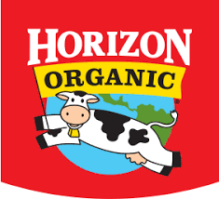
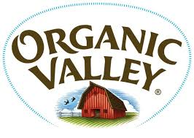
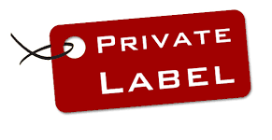

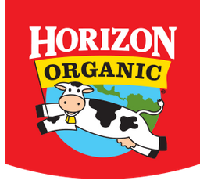
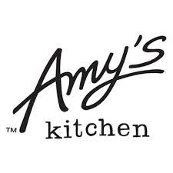
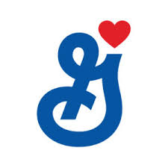

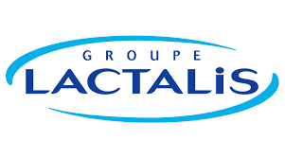
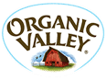

Why Danone?
Danone is the right partner to take organic to the Next Frontier
Danone is the #1 Organic
CPG in the Store (ex PL)
Danone captures more Organic Buyers than any other CPG in the Store (ex PL)
$3.6B
70%
of Horizon Organic Buyers have Repeated over the last year (#1 ex PL)
>
Horizon has nearly 3X more Buyers than the leading Branded Competitor in Dairy
Source 1: IRI Scan, Total MULO+C , L52 We 9/27/20
Source 2: IRI Panel, Total Outlets

Slide 6
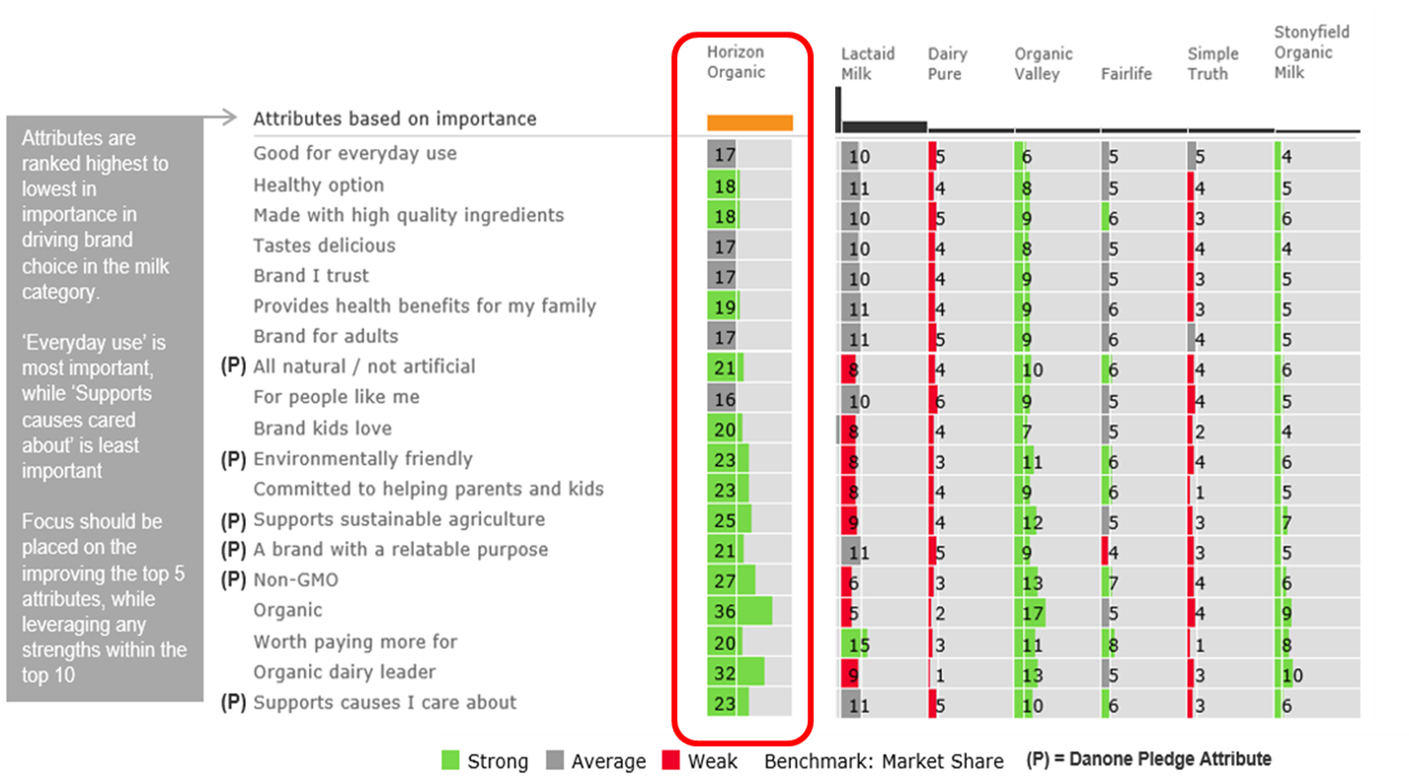
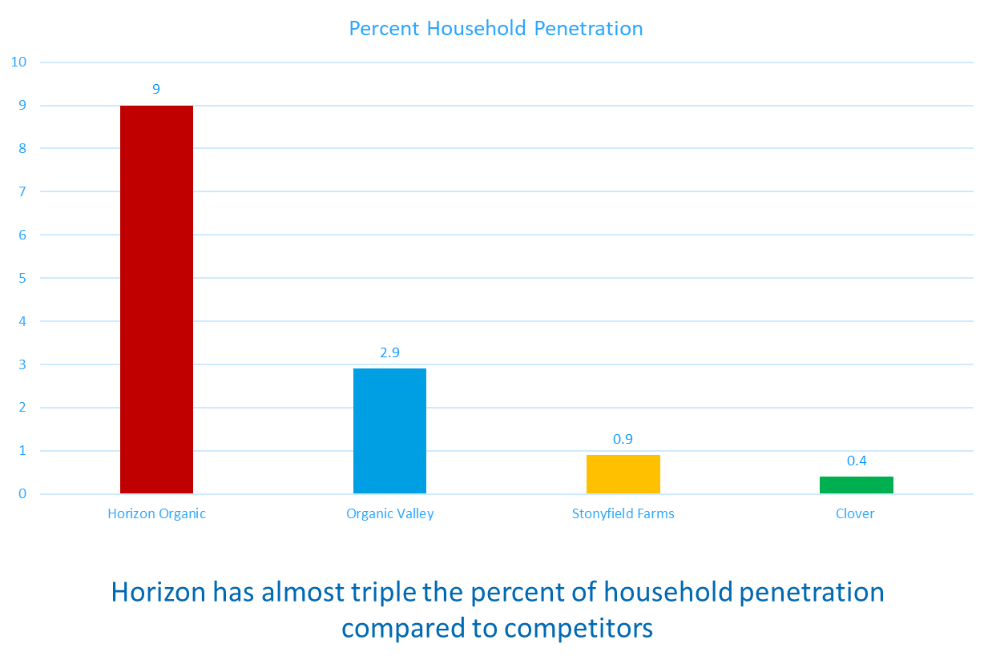
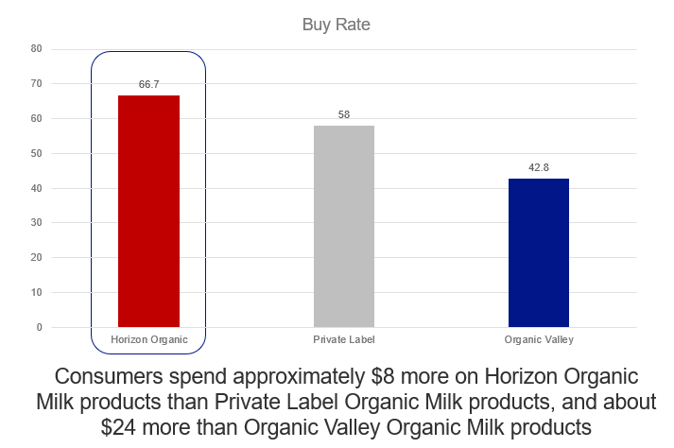
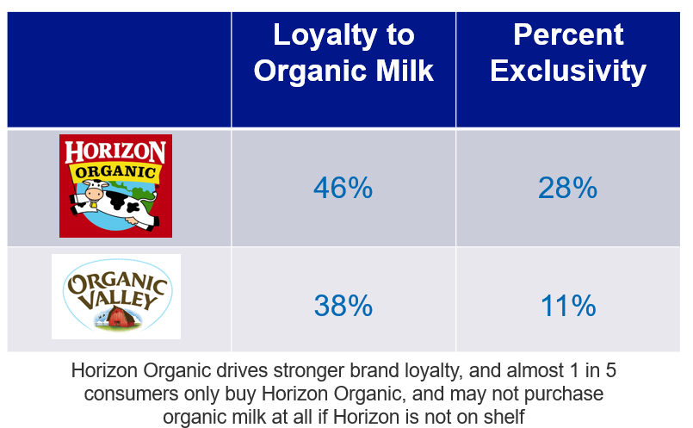
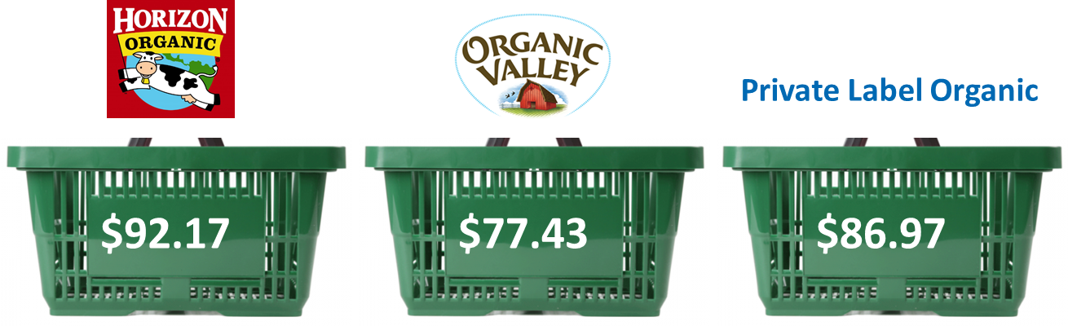
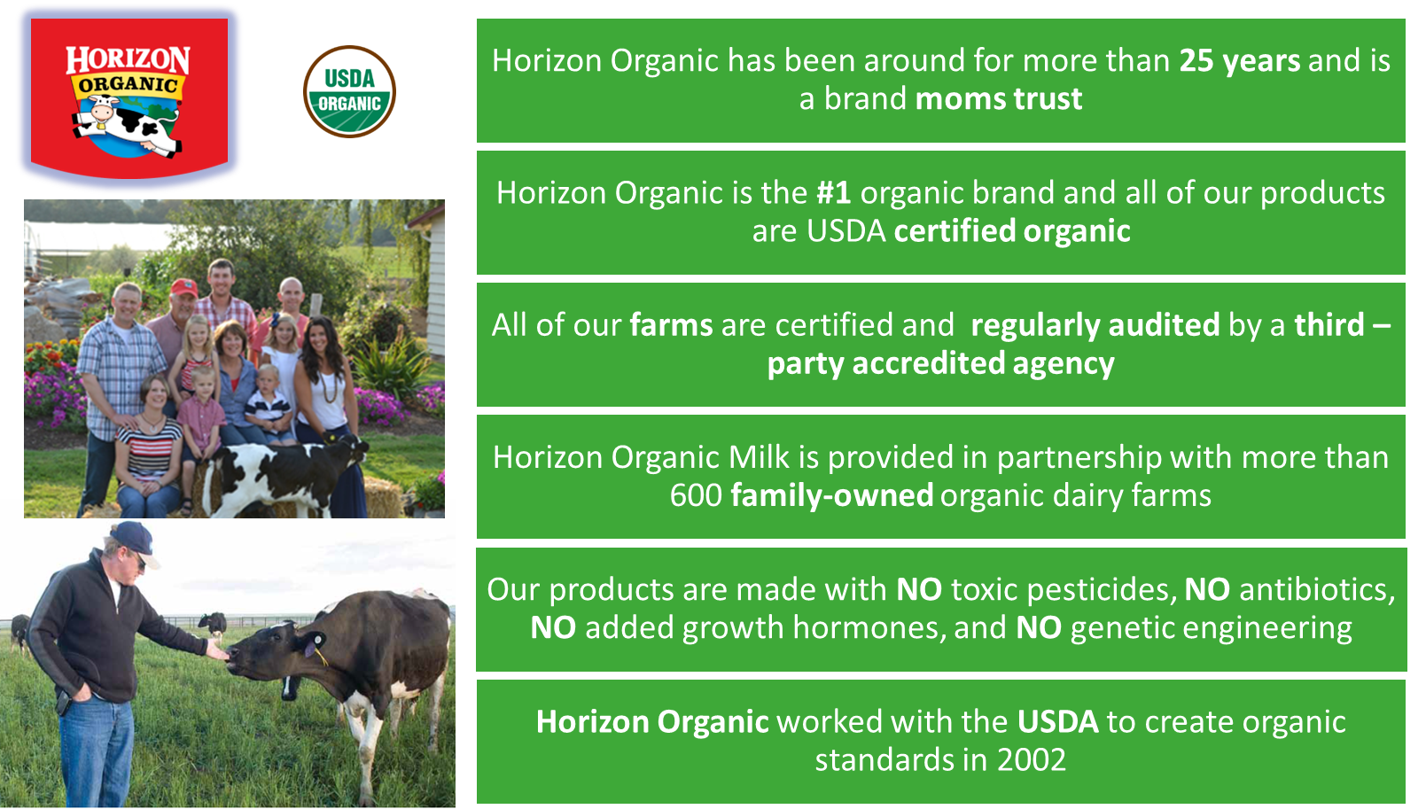
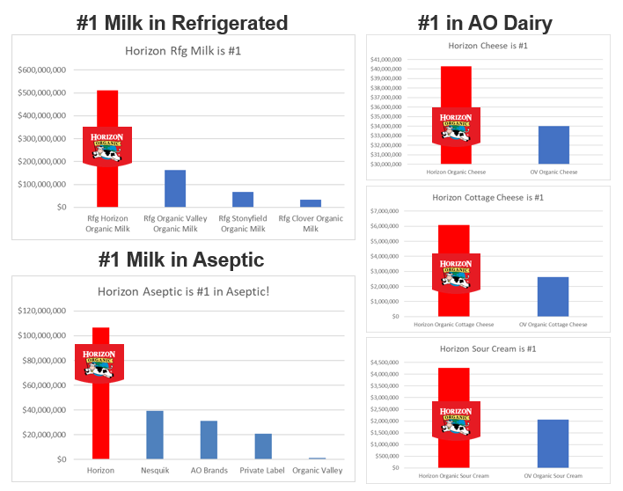
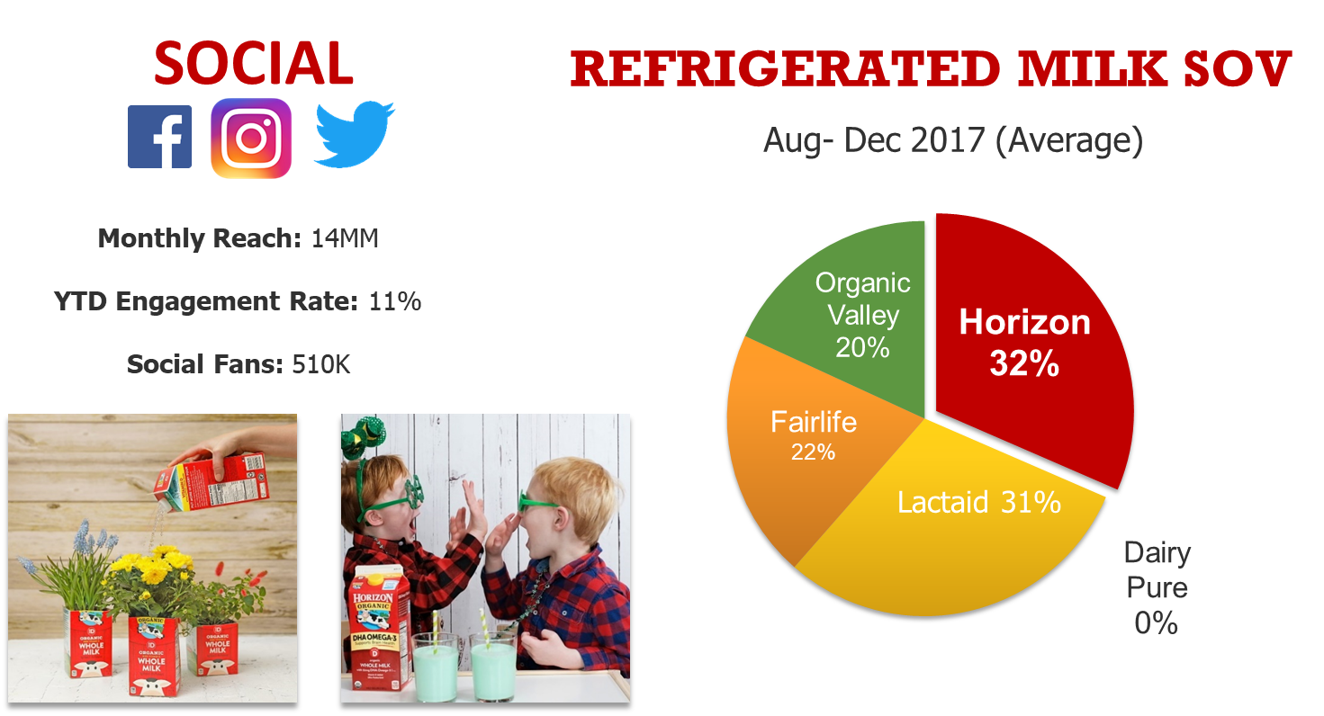
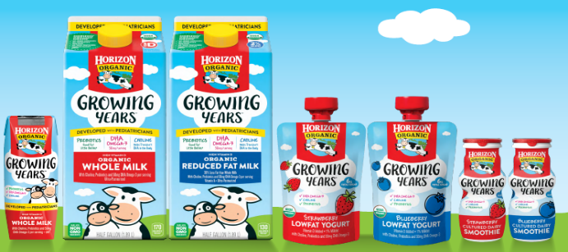
Horizon is the Organic Dairy Partner that can help lead Category Growth
Why Horizon?
1
2
3
4
5
STRONGEST EQUITY SCORES in Value Added Milk | HIGHEST HHP in the Organic Milk Category 3X higher than next brand | LARGEST BASKET SIZE in the Organic Milk Category >$6 more per trip | HIGHEST BUY RATE in the Organic Milk Category >15% higher | MOST LOYAL Organic Milk Shopper 2X higher than OV
HIGHEST SHARE OF VOICE (online, Digital) and a large digital following | INNOVATION LEADER in Organic Milk | #1 BRAND across Organic RFG + SS Milk & Cheese | Horizon PIONEERED Organic Dairy Standards …and we’re not done yet
6
7
8
9
Source: IRI Panel All Outlets Latest 52W W/E 02/23/2020
Source: DataRank Social Analytics
Source: Nielsen GroC+SC, week ending 4/8/17 through 3/31/18

Slide 7
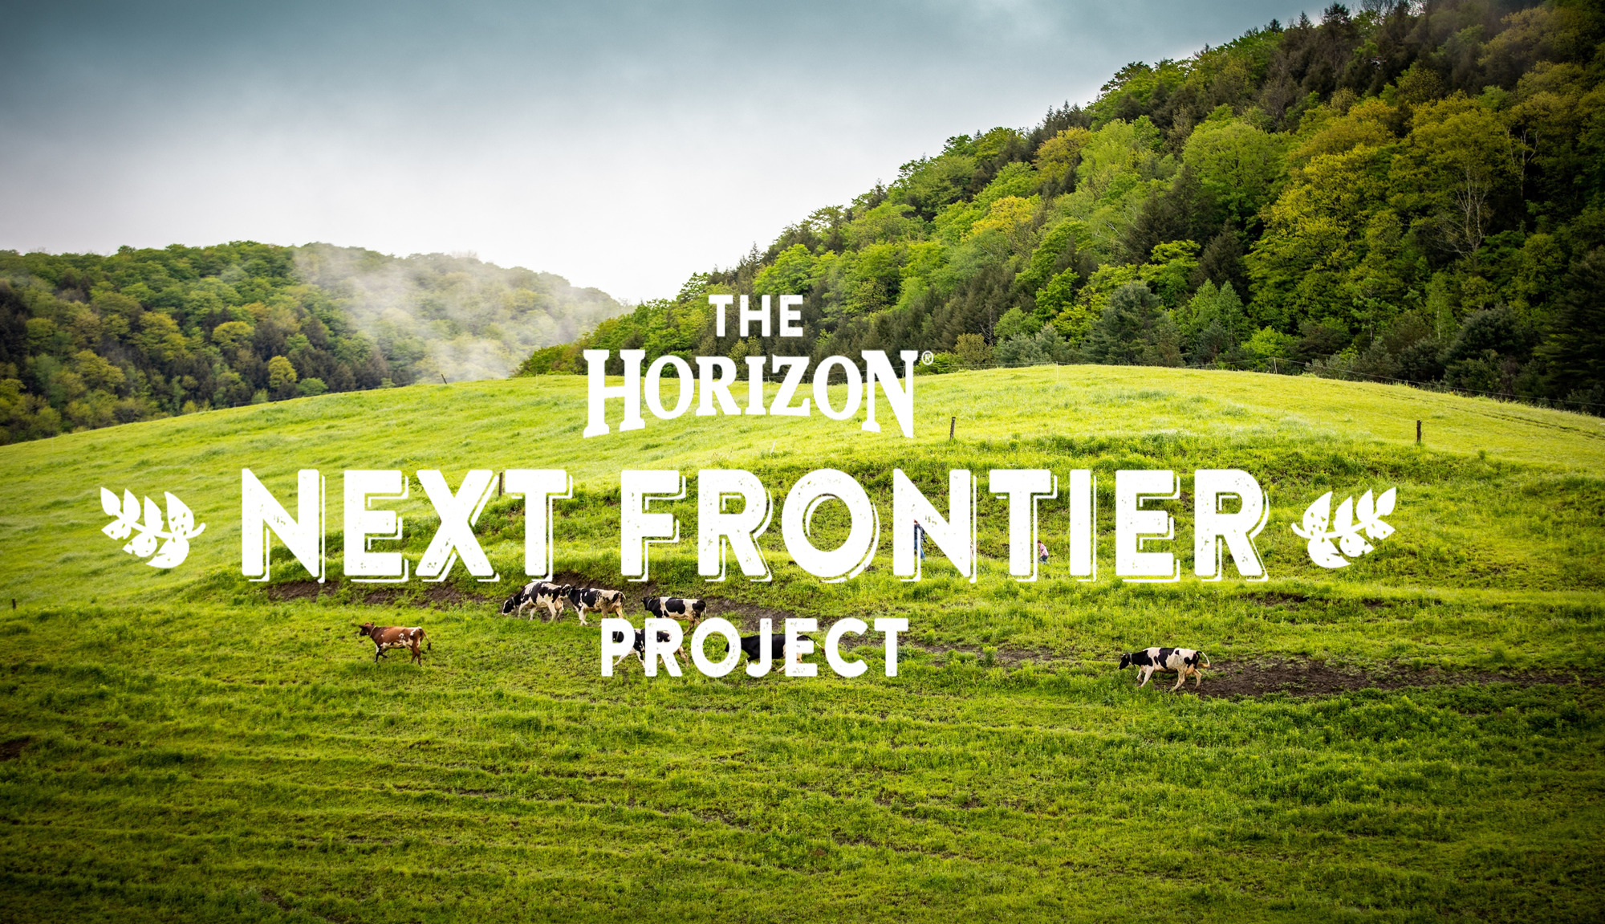
And Horizon is committed to making milk better… for the whole world
Why Horizon?
10
And Horizon CONTINUES TO PIONEER Organic Dairy Standards

Slide 8
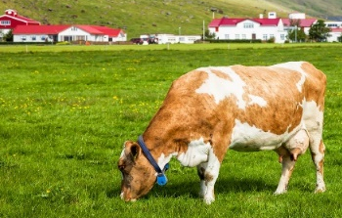
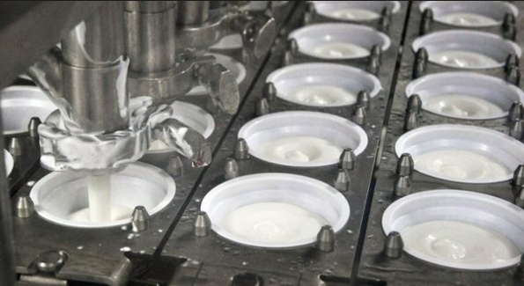
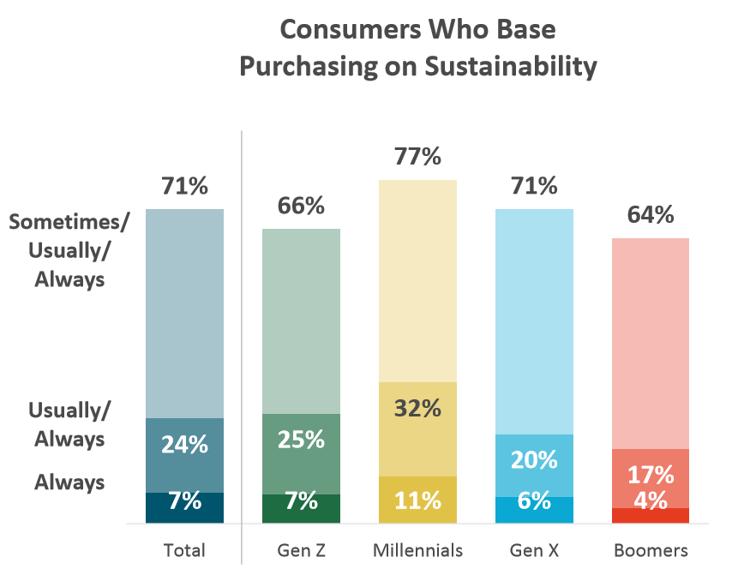
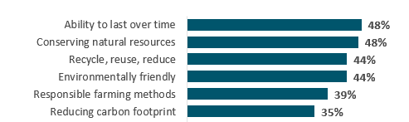

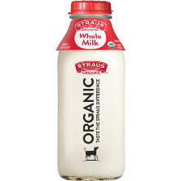
Consumers are increasingly focused on the Environmental Impact of their Food Choices, Including Dairy
Why Sustainability?
Majority of consumers base purchasing decisions on sustainability
Sustainability is closely tied to responsible farming and land management, up from 2013
Consumers seek dairy that has been naturally raised and authentically processed
Consumer Definitions of Sustainability
How is it raised?
How is it processed?
+7 pp
+11 pp
+8 pp
Who made it?
How is it packaged?
The Hartman Group, Sustainability 2019

Slide 9
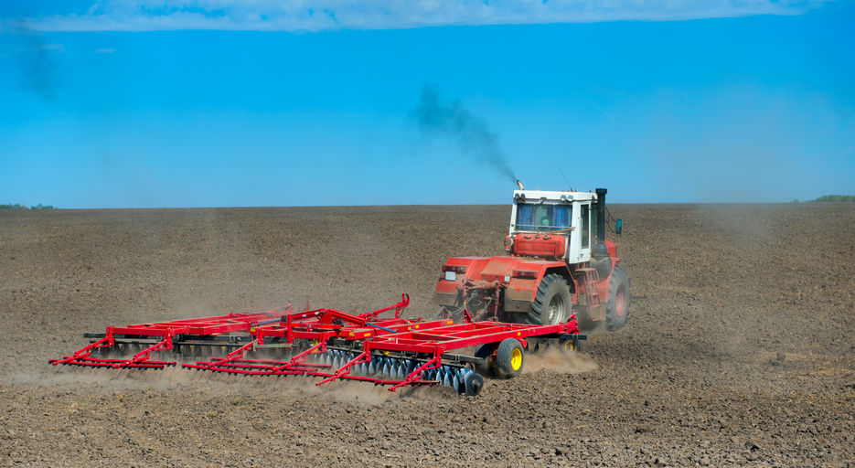
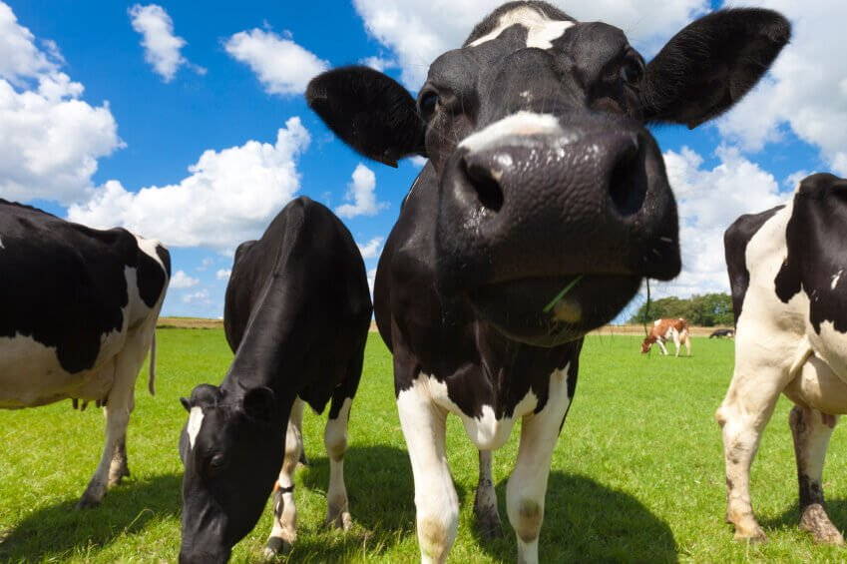
Agriculture’s Contribution to Carbon Emissions creates an opportunity for HORIZON - as the #1 Organic Milk Brand - to Lead the Moment for Change
Why Sustainability?
Agriculture is responsible for up to 10% of the US Greenhouse Gas Emissions
4% from the Dairy Industry
The Hartman Group, Sustainability 2019
https://www.epa.gov/ghgemissions/sources-greenhouse-gas-emissions

Slide 10
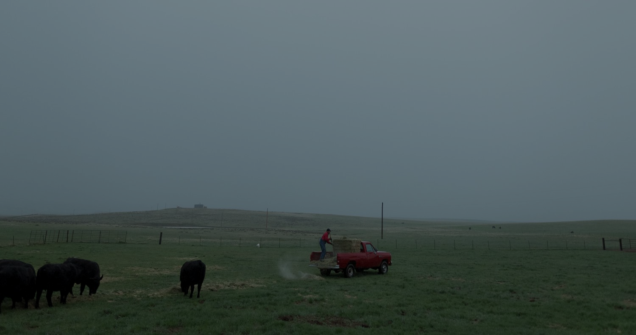
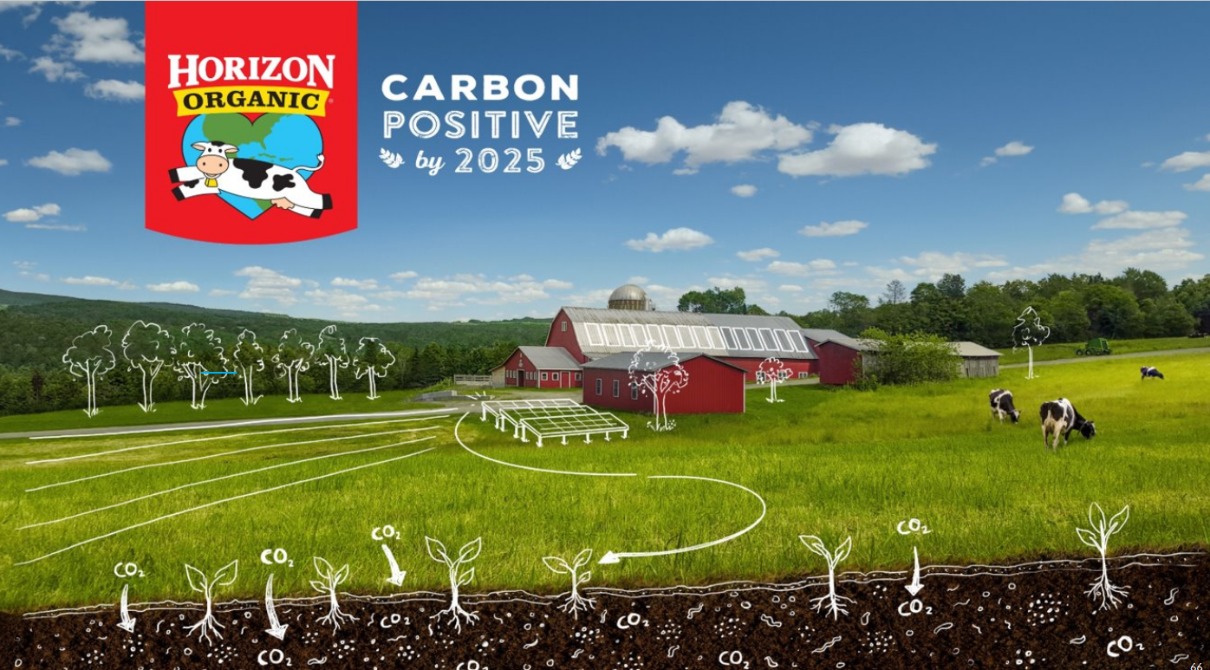
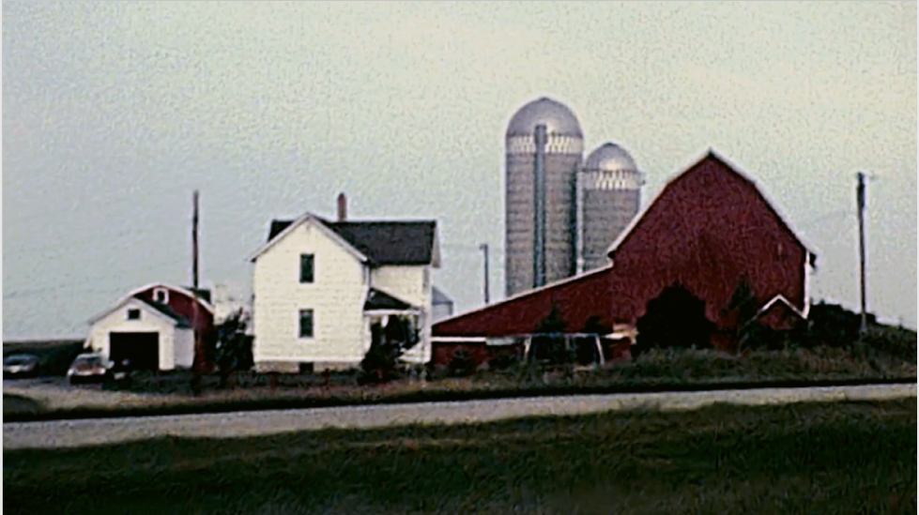
Horizon’s Promise:
The Horizon Commitment
The Creative Idea
ONE HORIZON
Video coming soon
Notes:
Horizon Organic is the first major dairy brand to commit to carbon positivity across the full supply chain: From seed through the consumer usage
The campaign idea is one shared horizon. We have milk that is good for today, but not necessarily good for tomorrow. Good for today, good for tomorrow.
We can make a change one glass at a time
This idea has been tested with consumers, and it tested overwhelmingly positive. We’re so excited to bring this to life.

Slide 11
THANK YOU!

