Slide 1

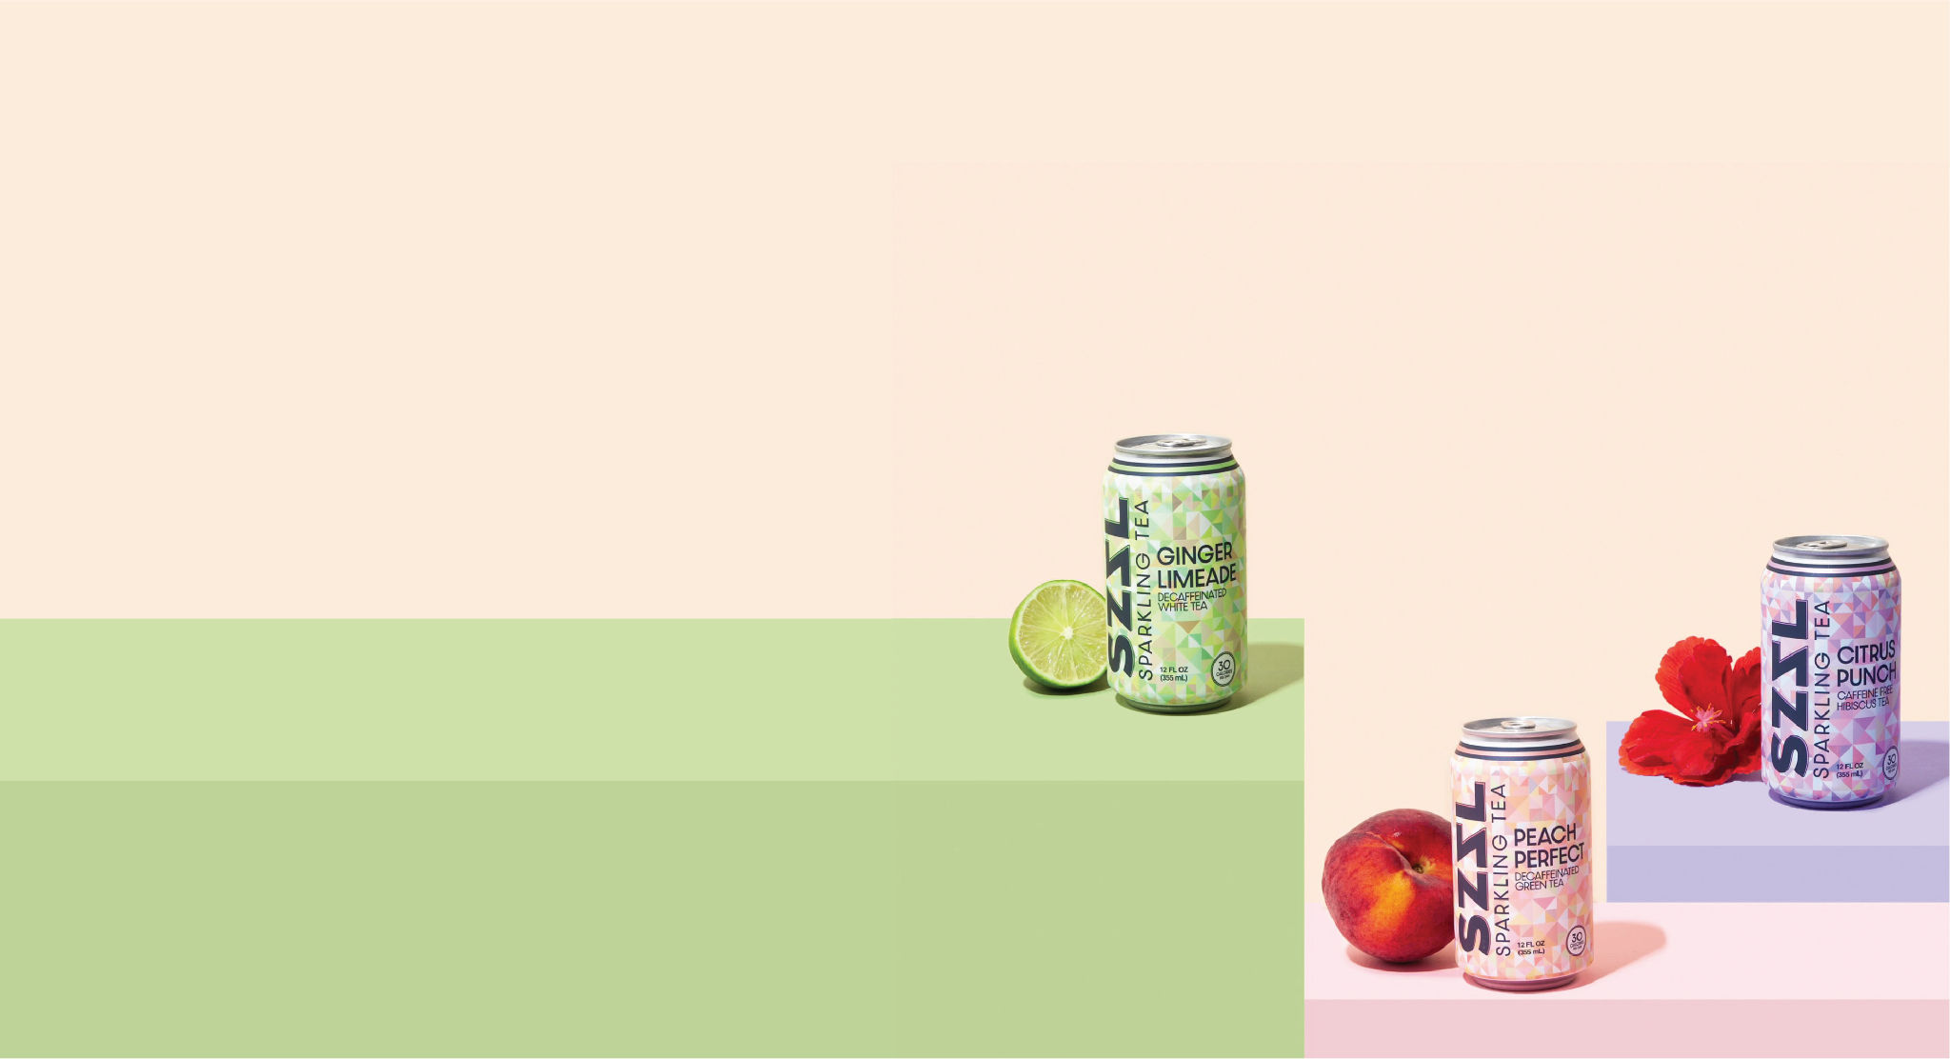

PRESENTED BY: SZZL BRANDS, INC.

Slide 2
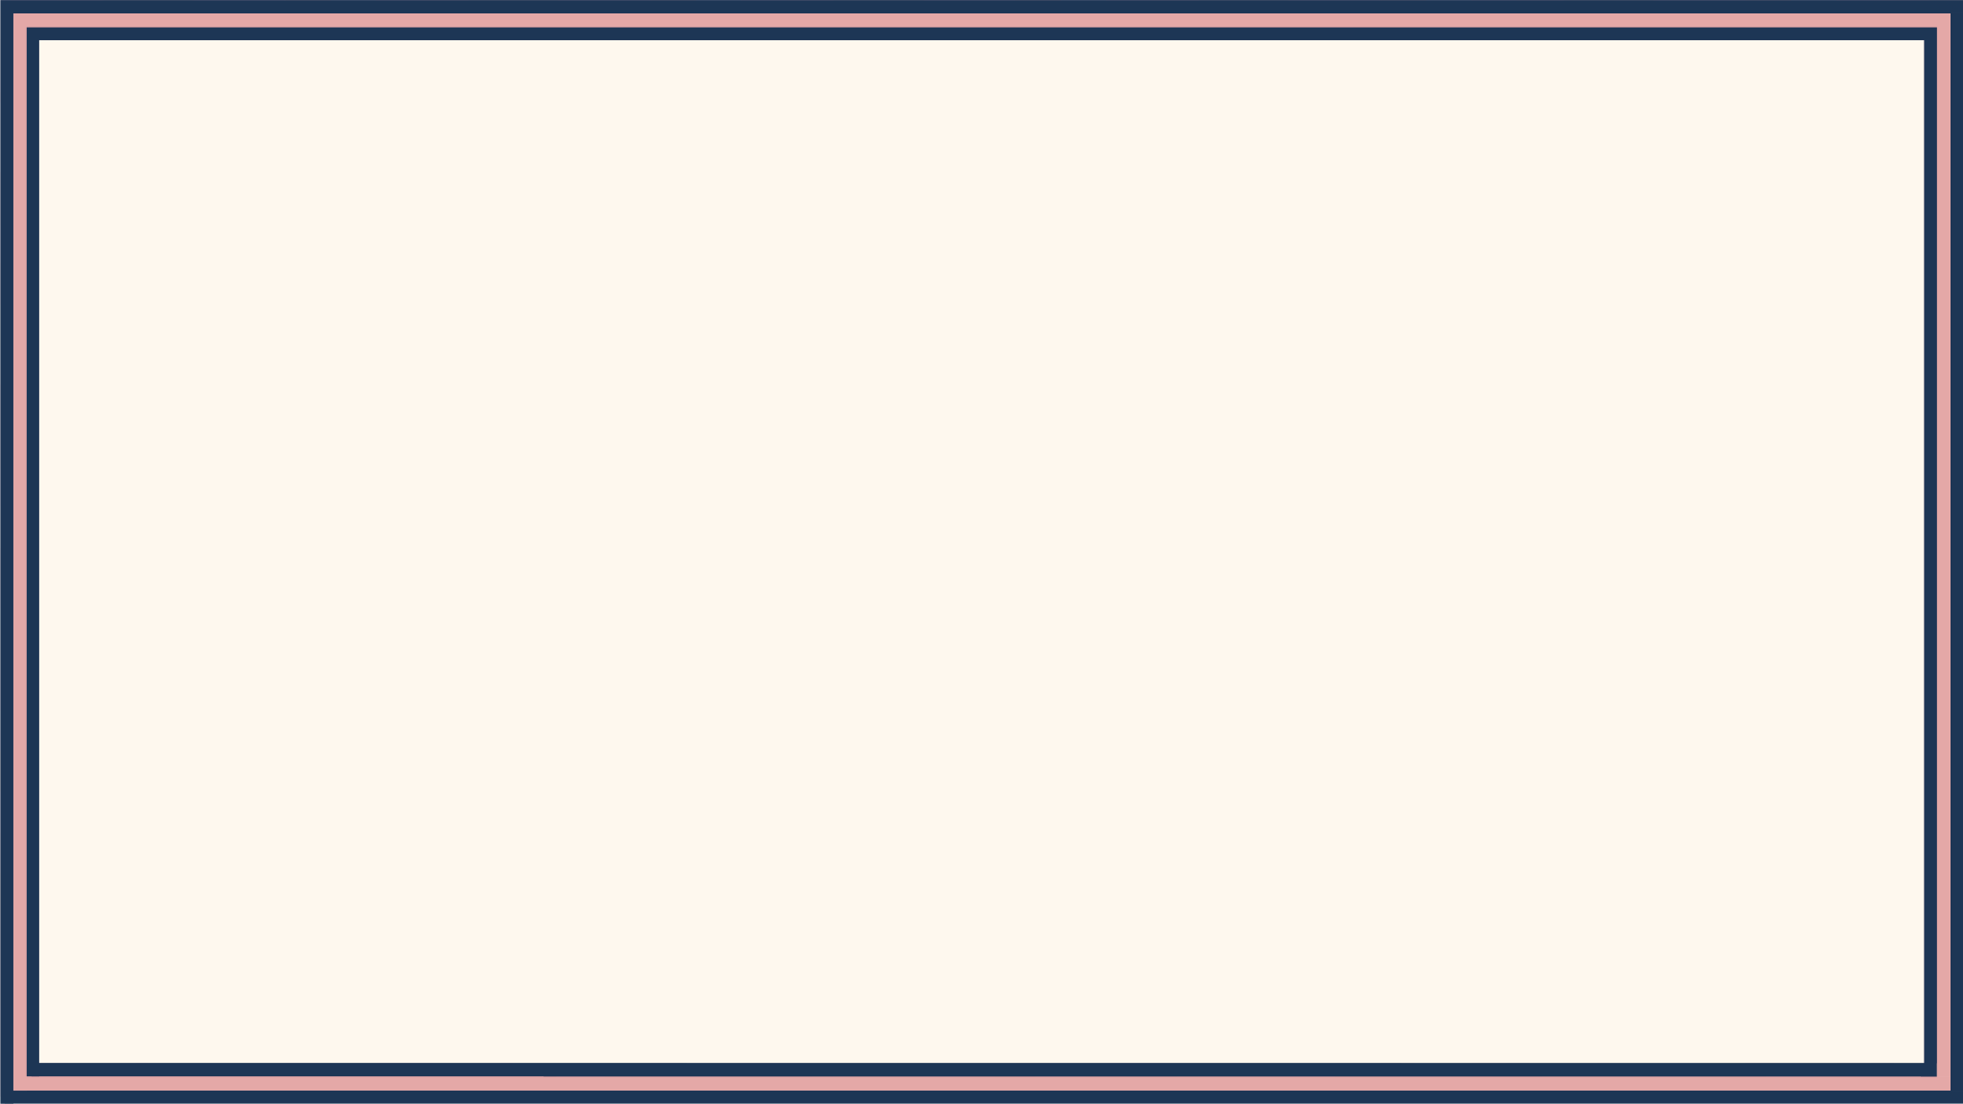

Natural beverage brands are making too many
functional products and not enough tasty ones.
“THIS DRINK SEEMED GREAT, BUT IT SURE DOESN’T TASTE GREAT.
ALL I WANT IS A HEALTHY OPTION THAT TASTES AS GOOD AS IT LOOKS.”

Slide 3
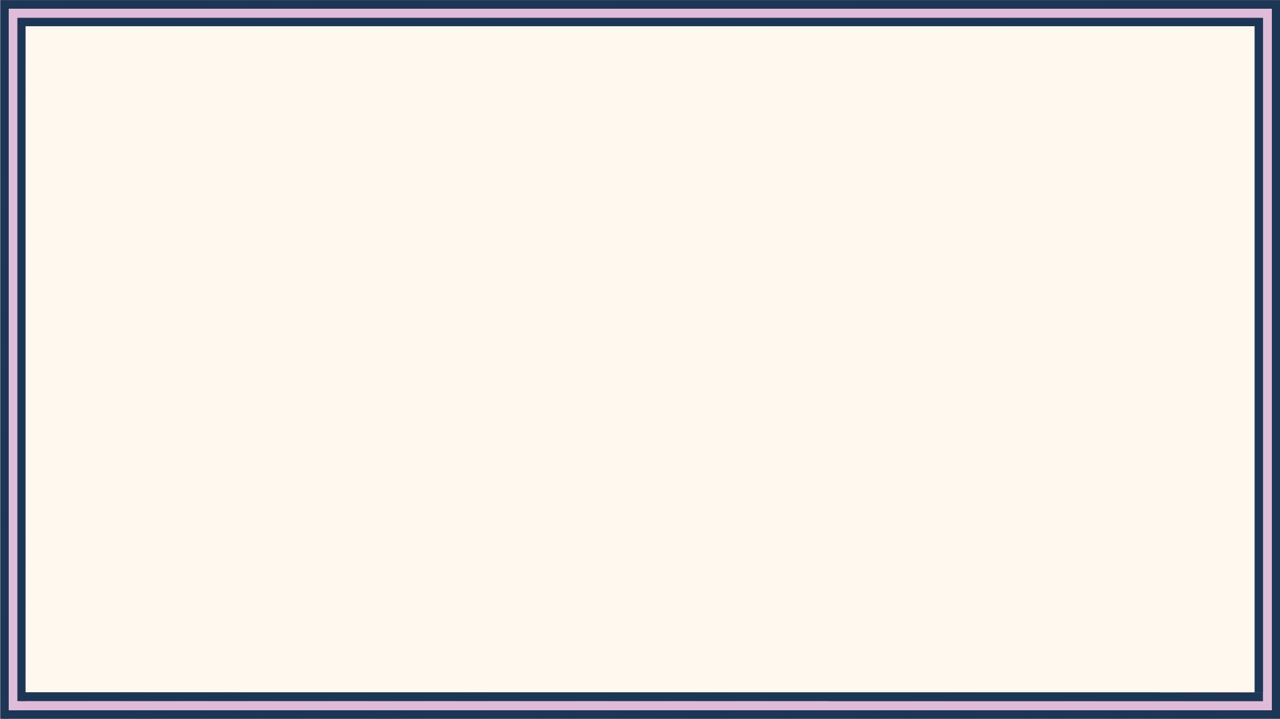

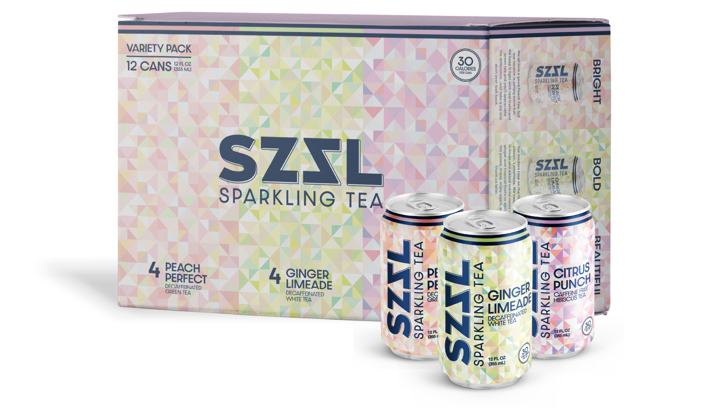
“CHAMPIONING HEALTH, THROUGH FLAVOR.”
The People are thirsty for a healthy option that does not complicate itself.
A product that does not over-promise and under-deliver.
A product that candidly relies on the simple things:
Taste, design, few calories, and even fewer ingredients.
What more do we really need in a soft drink?

Slide 4
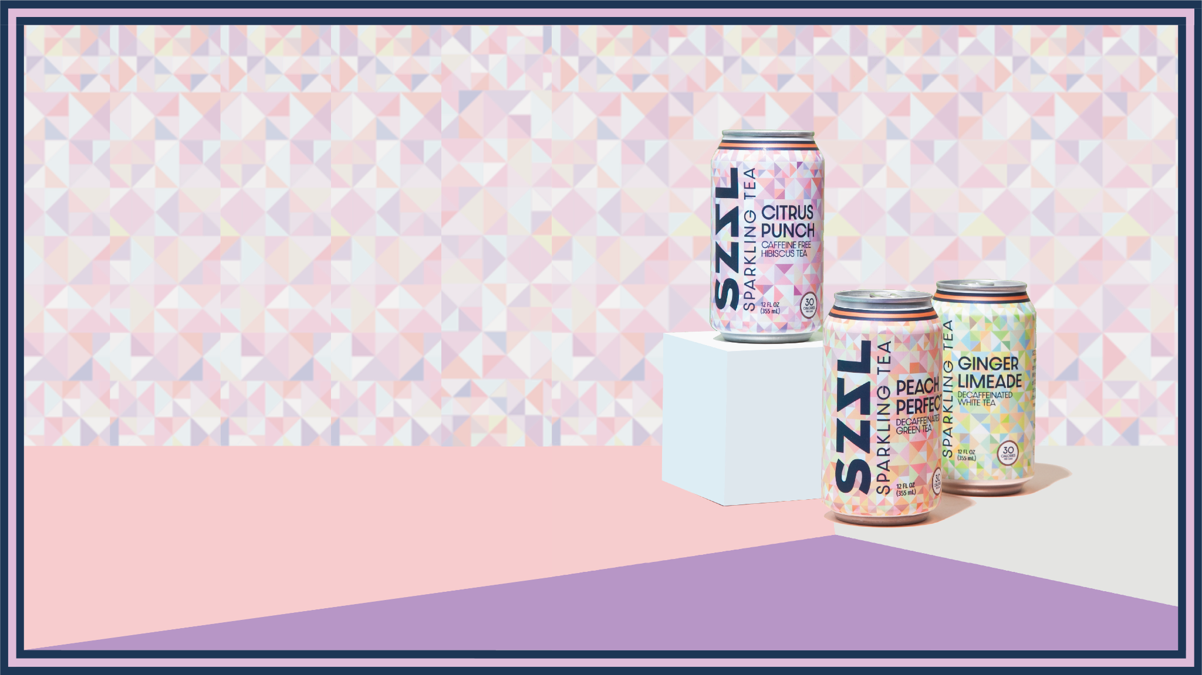
SZZL Sparkling Tea is a reimagination of the classic drinks we used to love -- Fruit Punch, Peach Tea, Ginger Ale & Lemonade -- we make them better and better for you. With only 30 calories and just a few all natural ingredients, this ancient brew has never been so bright & bubbly.
This is tea, revived.
Ingredients:
Tea, Ginger/Hibiscus, Fruit Juice, Cane Sugar, Citric Acid, Natural Flavors.

Slide 5



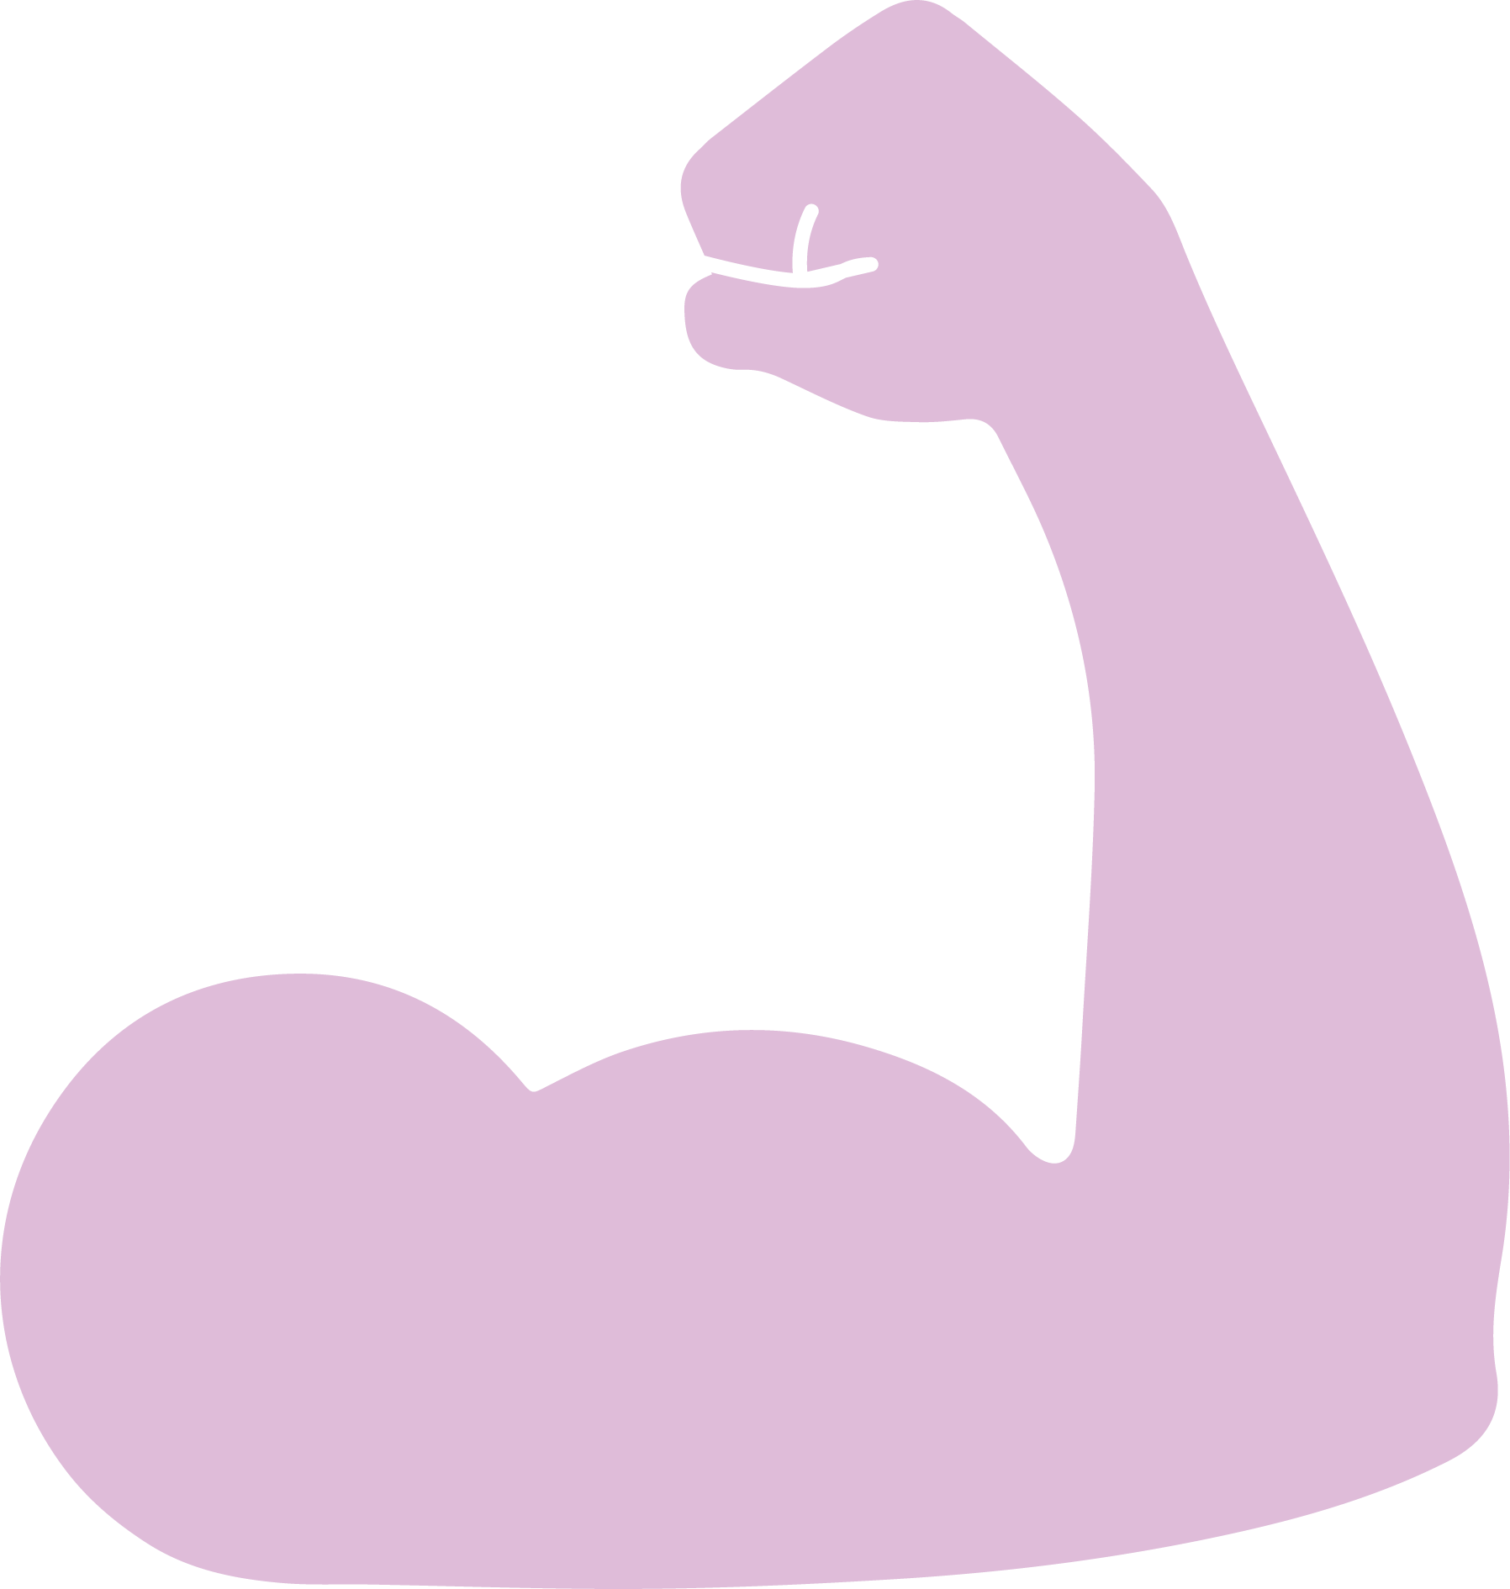

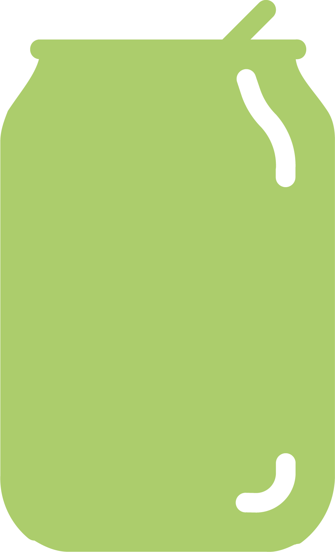
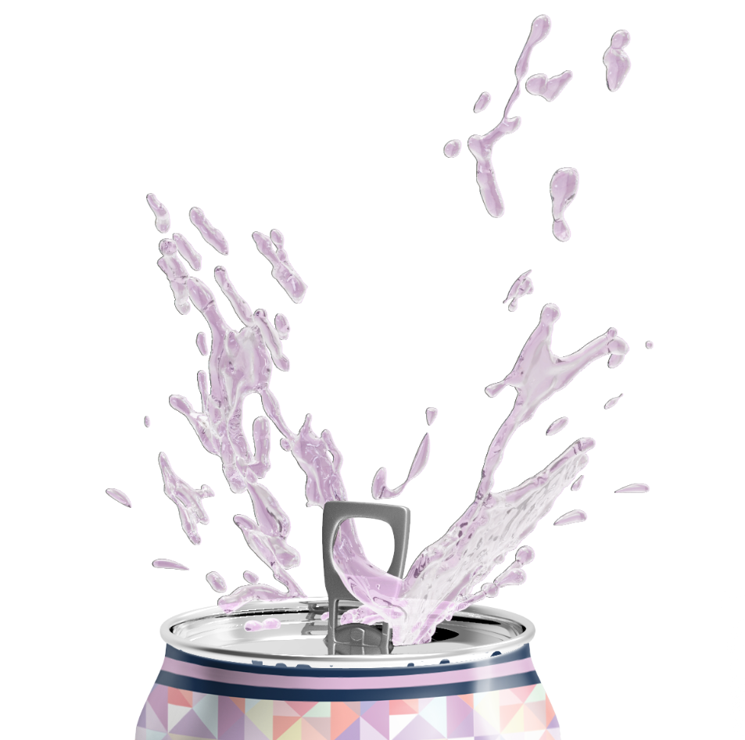
INTEGRITY
COMPASSION
TOUGHNESS
Integrity is core to who we are. Through candid words and actions, we will build trust with partners, consumers, and each other.
We challenge ourselves to embrace genuine empathy for ourselves, our customers, and our partners in every decision we make.
This world ain’t easy; we all need tenacity, resilience and thick skin to ensure we can meet our goals and drive group results.
SKEPTICISM
FLAVOR
PREVISIONS
We are unafraid of and inspired by new ideas; we approach them with healthy skepticism of convention and genuine curiosity.
We don’t take ourselves too seriously; we make space for joy and brightness in everything we do and recognize that there is always room for celebration.
We are at our best when we can be ourselves. We choose to hold ourselves accountable instead of relying on the opinions of others. When you are accountable to yourself, your ethics, self awareness, honesty, criticism, and reaction are even more important.

Slide 6
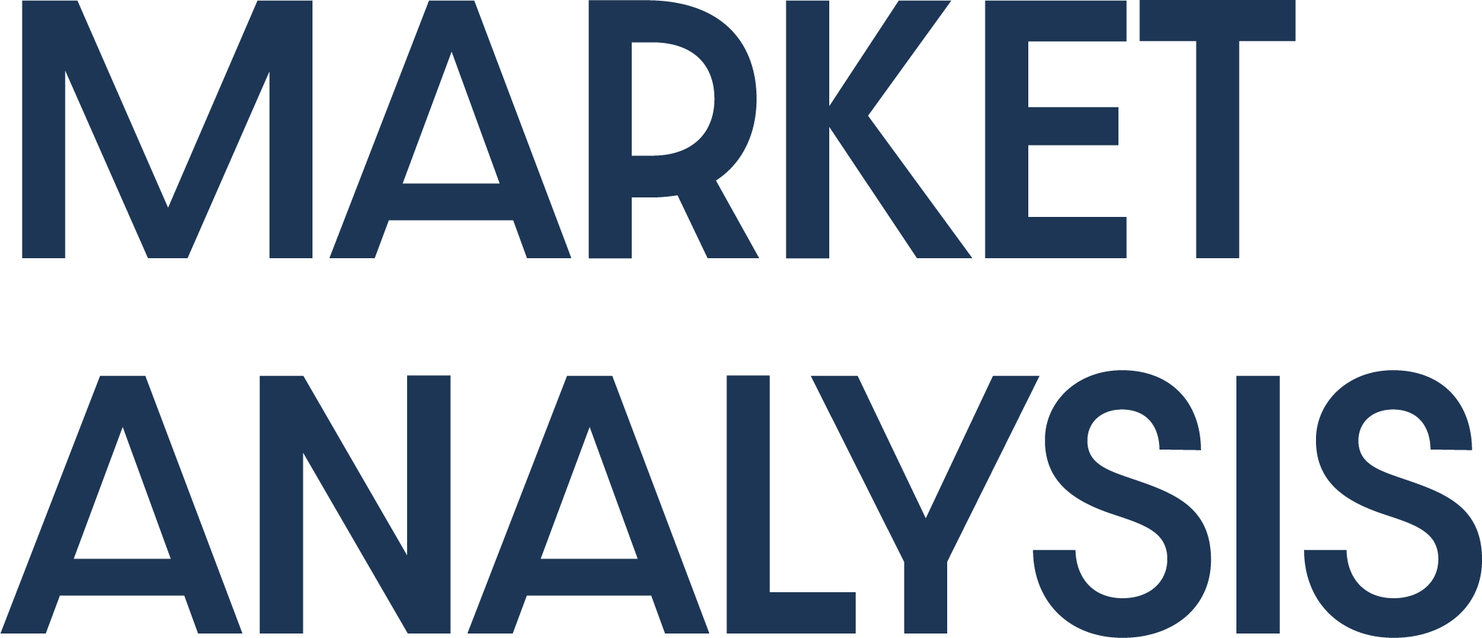
INDUSTRY OVERVIEW,
PRODUCT POSITIONING,
COMPETITIVE LANDSCAPE
& SUMMARY STATISTICS

Slide 7

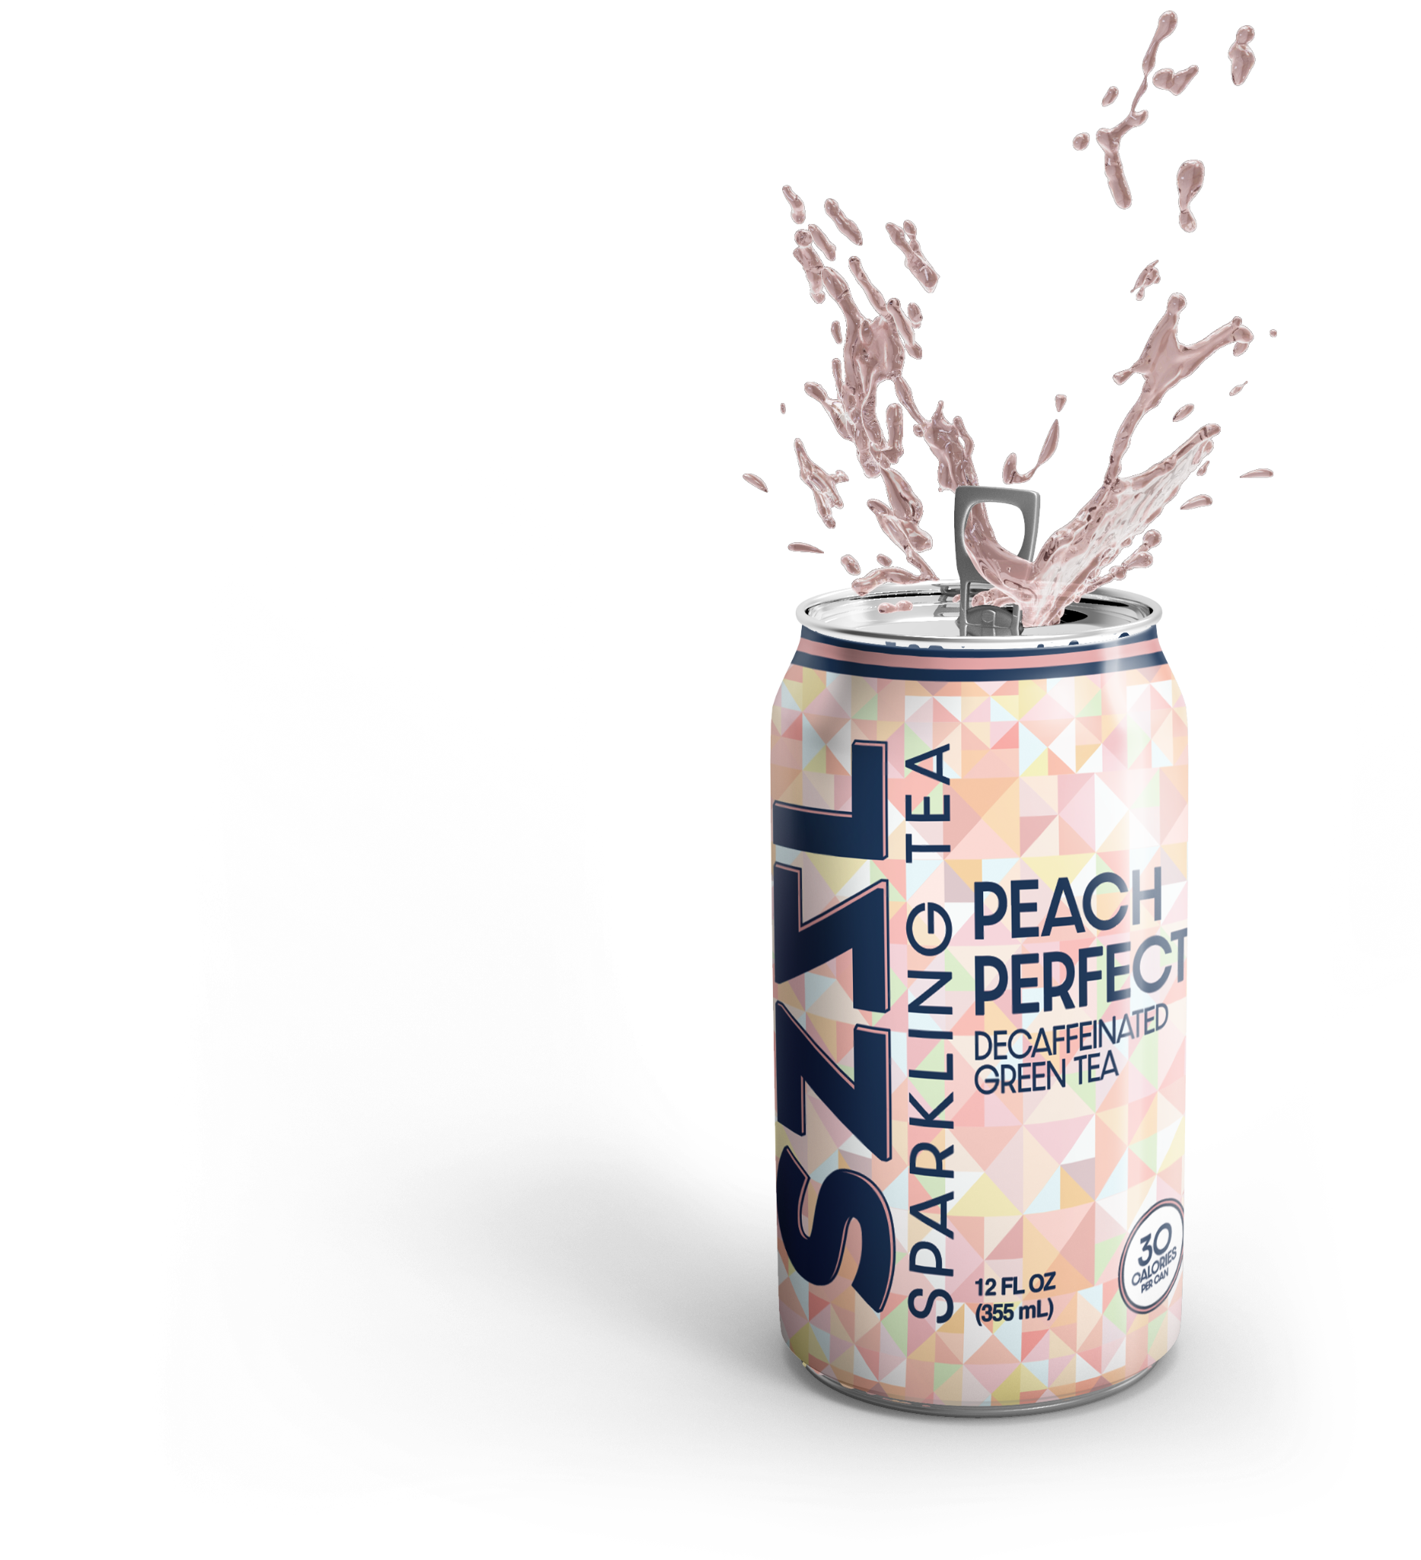
Key Metrics
$183B
21%
19%
12%
North American beverage sales annually.
Market share for CSDs, the highest of any product category, (though YoY sales are declining).
YoY sales growth for Sparkling Waters, the highest of any product category.
YoY sales growth for smaller tea brands, relative to 4% for the category overall.
Takeaway
Dominant legacy brands are struggling to keep up with new health & wellness standards. Health conscious consumers continue to look to smaller brands and low calorie options to satisfy their cravings.
Notes:
Colors/bolded metrics - make the stats/numbers pop out

Slide 8
 | CONVENTIONAL BRANDS | NATURAL BRANDS
CONVENTIONAL CHANNEL GROWTH | 12.7% | 16.8%
NATURAL CHANNEL GROWTH | 26.5% | 9.8%
Key Metrics
Takeaway
Lines between conventional and natural brands are being blurred. While many natural beverages are still marketing products towards their most health conscious customers, there is real growth opportunity with conventional shoppers who are seeking healthier alternatives that don’t remove them from their comfort zones.

Slide 9

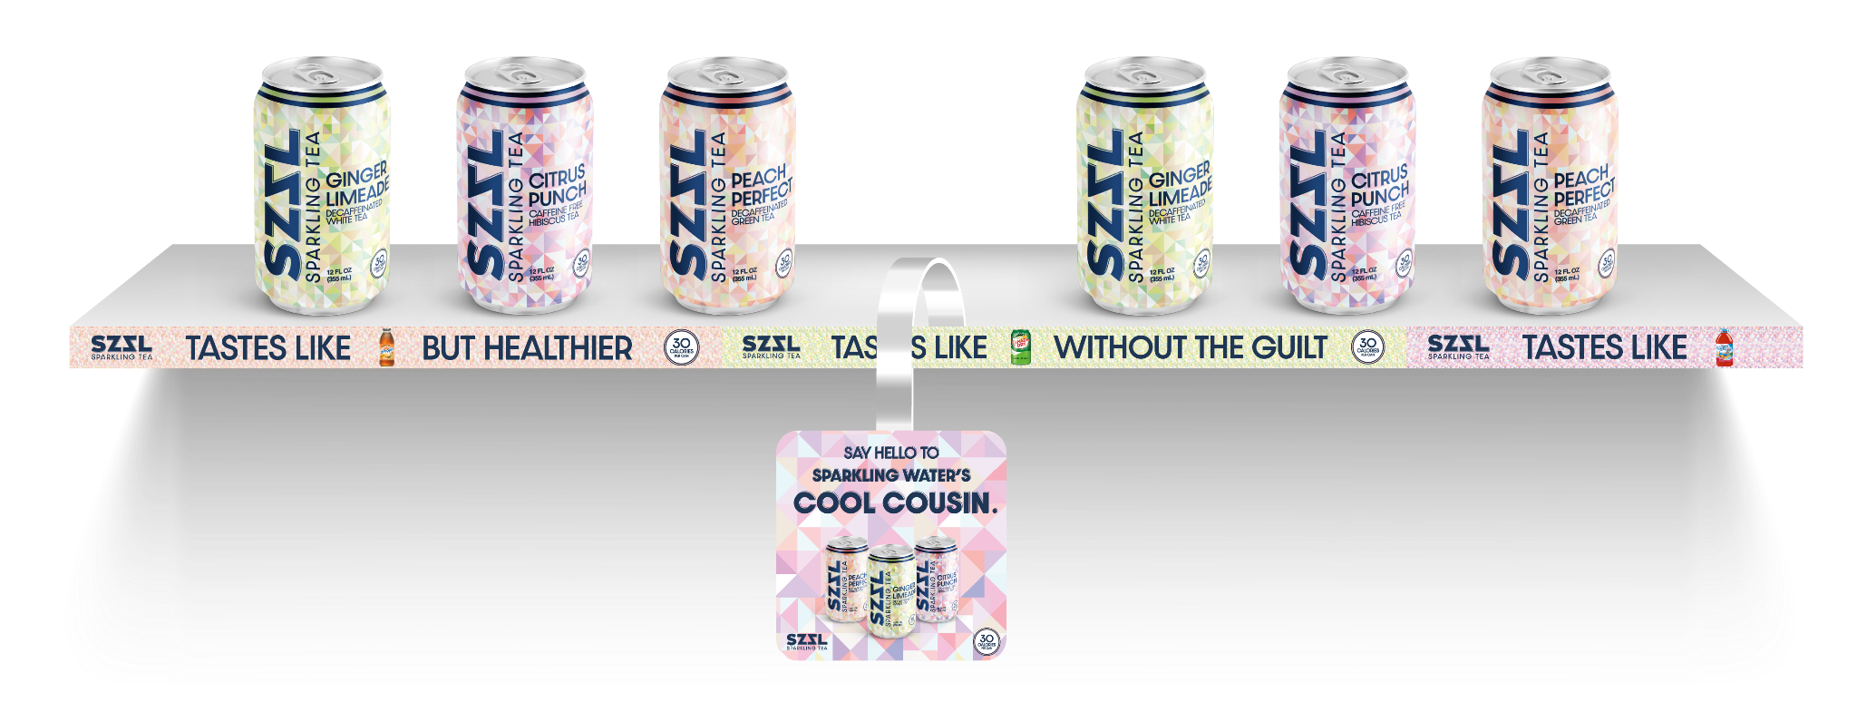
Past + Present = Future
Enter SZZL Sparkling Tea: a Natural brand that continues to blur the lines between Conventional and Natural, combining the familiar flavors from legacy brands of the
past within the framework of present day’s health & wellness standards.
SZZL Sparkling Tea combines the momentum of a Sparkling Water
with the potential upside of a traditional Soft Drink.
Notes:
Create shelf rendering, wobbler rendering

Slide 10

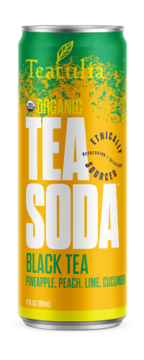
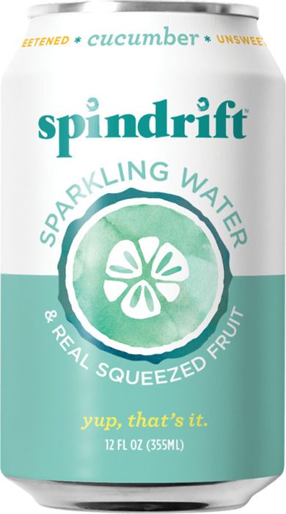
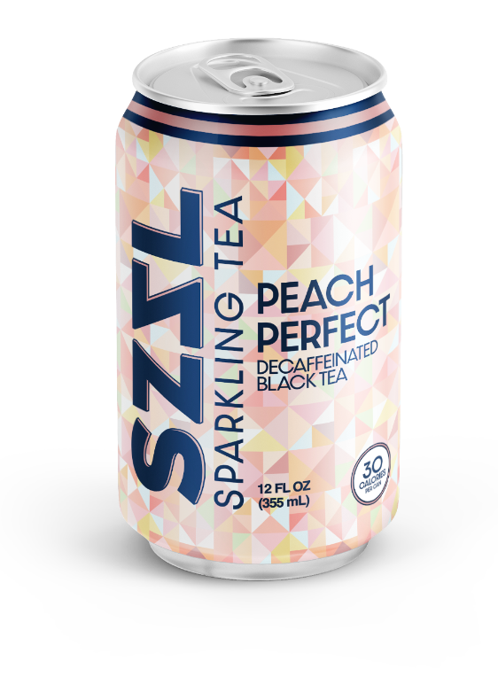
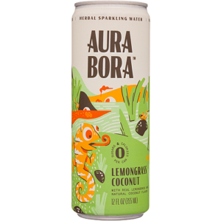
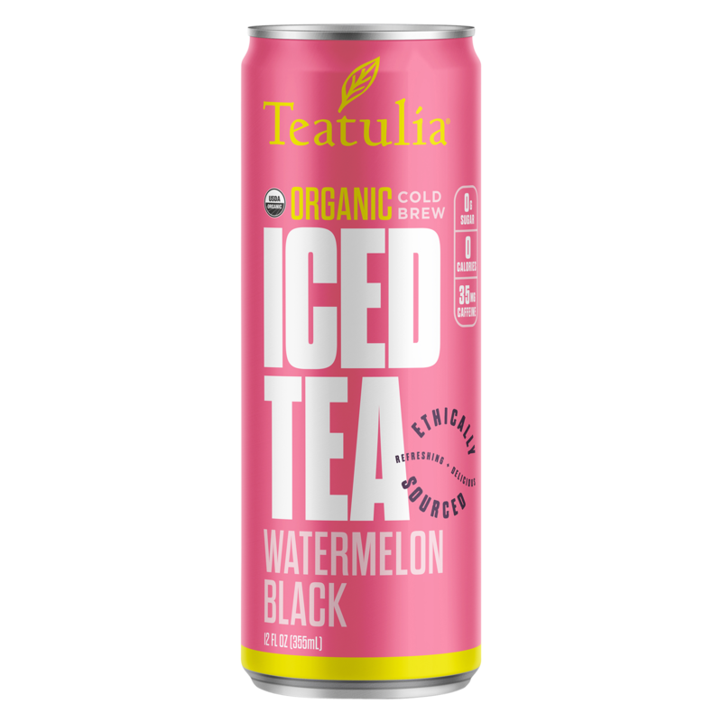
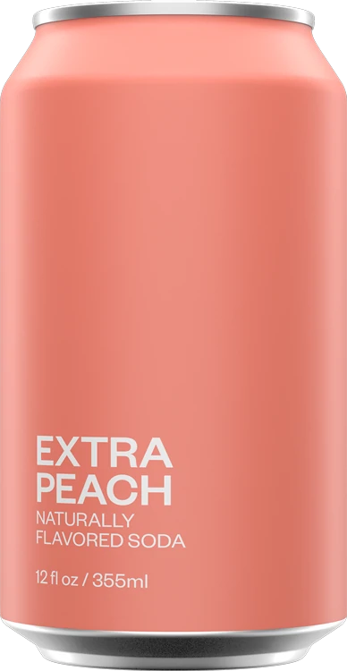
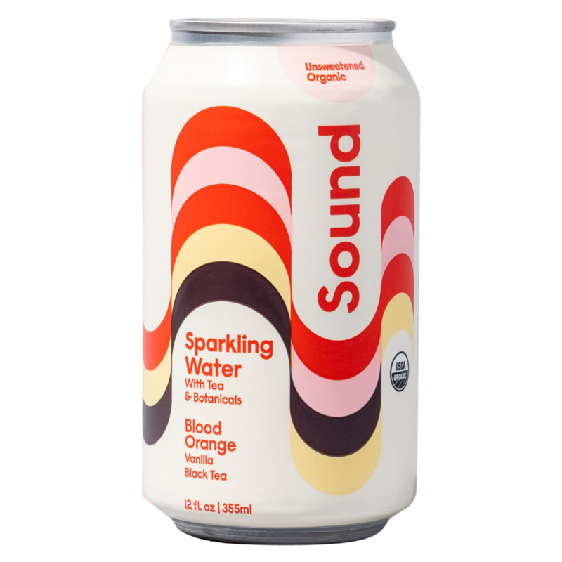
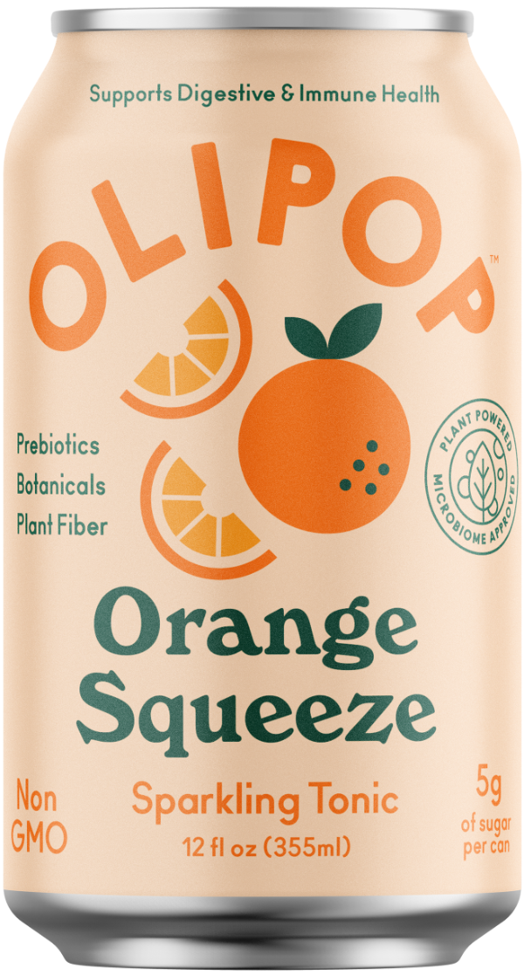
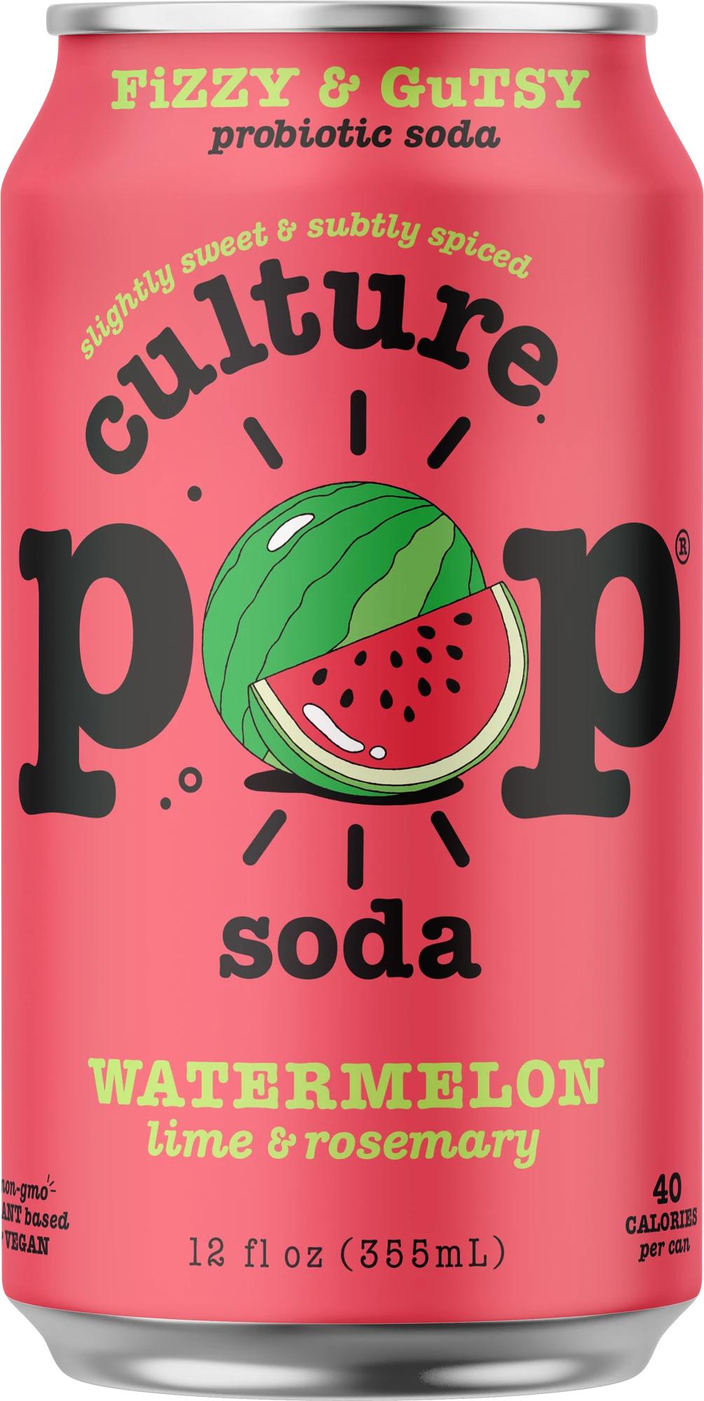
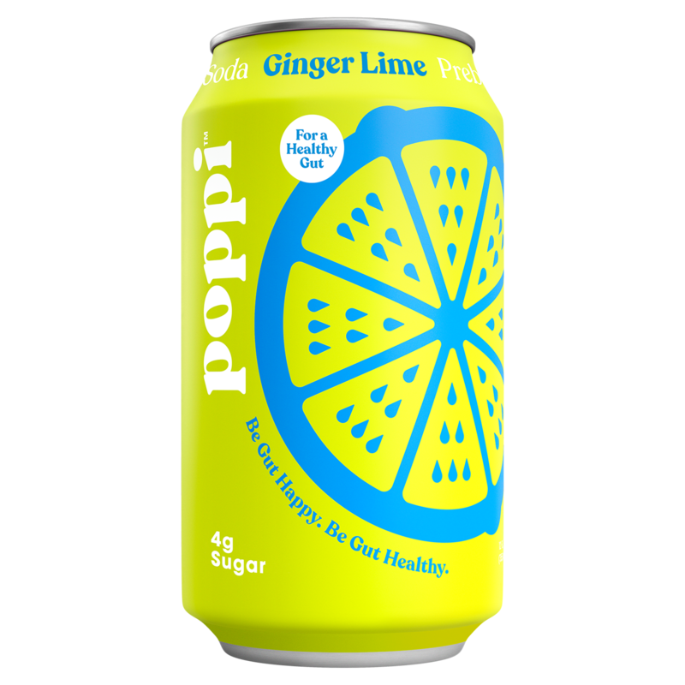
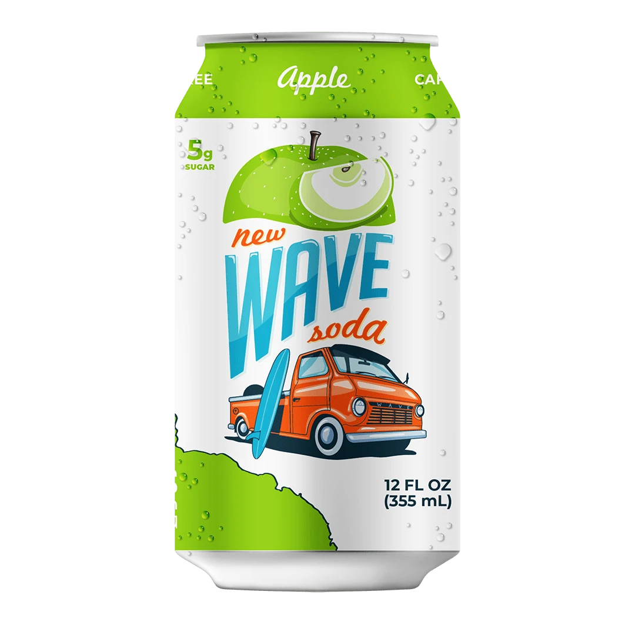
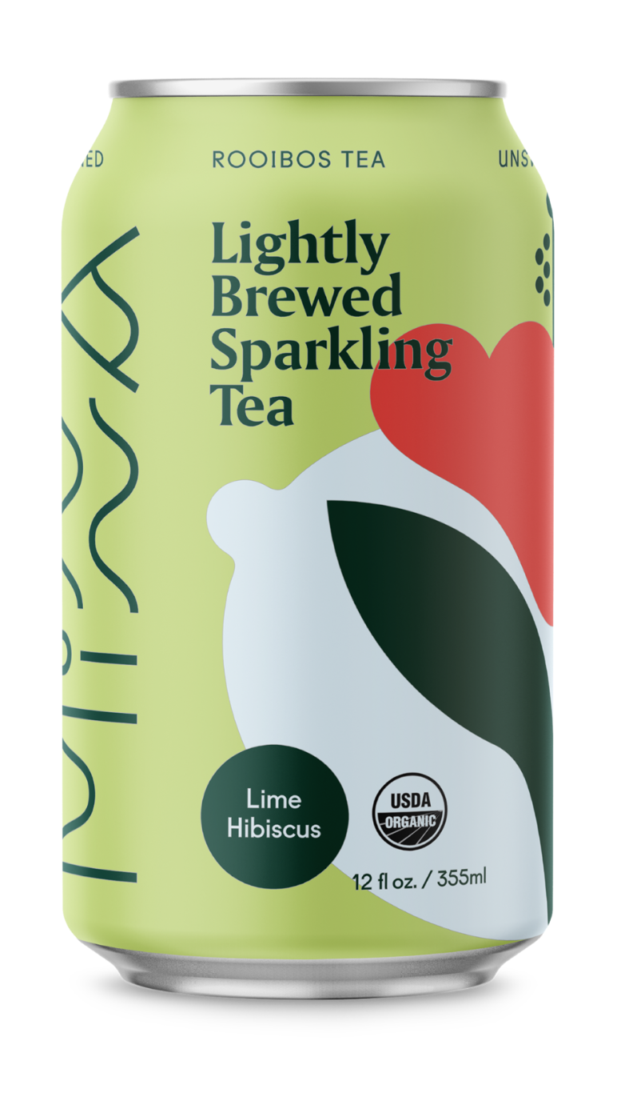
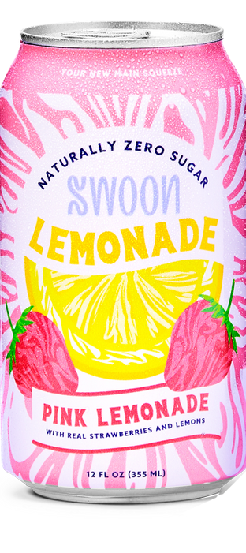
CRUSHABILITY*
*CRUSHABILITY (ADJ.) DEF; THE CAPABILITY OF BEING FREQUENTLY CONSUMED, OR “CRUSHED”
GREAT
DESIGN
GREAT
TASTE
Notes:
Add Ugly Can

Slide 11

Why Sparkling Tea?
PREBIOTIC SODA
SPARKLING WATER
SPARKLING TEA
A nascent market with emerging key players such as Poppi, Olipop, Culture Pop, etc. The term “soda” conveys sweetness and is limiting .
A bonafide and high growth category that is also highly competitive. Nationally established brands include Hint, Bubly, Polar, LaCroix, Hal’s, and many more.
Another nascest market but with no household brands. Many of the current retail products such as. Minna, Sound, Sunwink, and Rishi are unsweetened and medicinal.
This is where SZZL separates itself.

Slide 12
Summary Statistics
Takeaway:
Strong signs of market validation in tastemaker and key accounts such as Snackmagic, Zabar’s, and Grace’s Marketplace.
Competitive unit cost may will allow us to go lower on price as we scale up.
#1
295
35%
SNACKMAGIC RANKING
for brand & product among all Seltzers, Sparkling Waters, Soft Drinks, and Sodas for 2021.
OPEN DOORS
since first distribution date of 12 June 2021.
TRADE SPEND
projected for 2022.
$1.07
$1.43
$2.49
DISTRIBUTOR PRICE
WHOLESALE PRICE
SUGGESTED RETAIL PRICE
Notes:
Similar layout to Values page

Slide 13

GILEAD INGBER, FOUNDER
TEL: 917.626.2516
EMAIL: GILEAD@SZZLTEA.COM
INSTA: @SZZLTEA

