Slide 1





2023 Grovara Brand Deck

Slide 2
About us Kaizen Food Company

Slide 3

About us
We started Kaizen Food Company during our own weight loss journey.
Our cofounder, Arash, leads a community of 300k+ on Instagram where he shares lower carb versions of his favorite foods with his community of followers on @Shredhappens.
We believe pasta should be enjoyed by everyone, anywhere.
Using a delicious superfood (lupin beans), we created the world’s first high protein, lowcarb and keto friendly pasta.

Slide 4
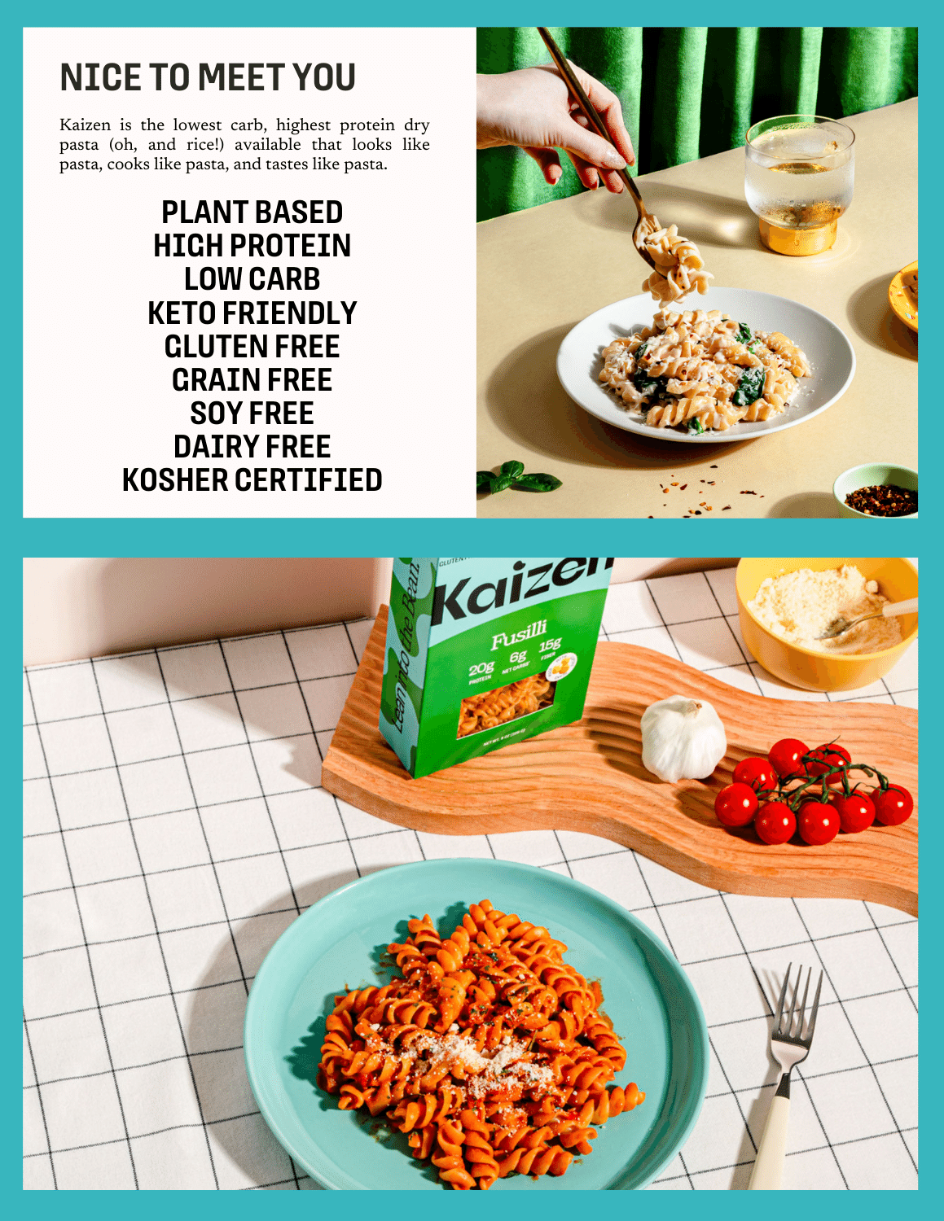


Slide 5
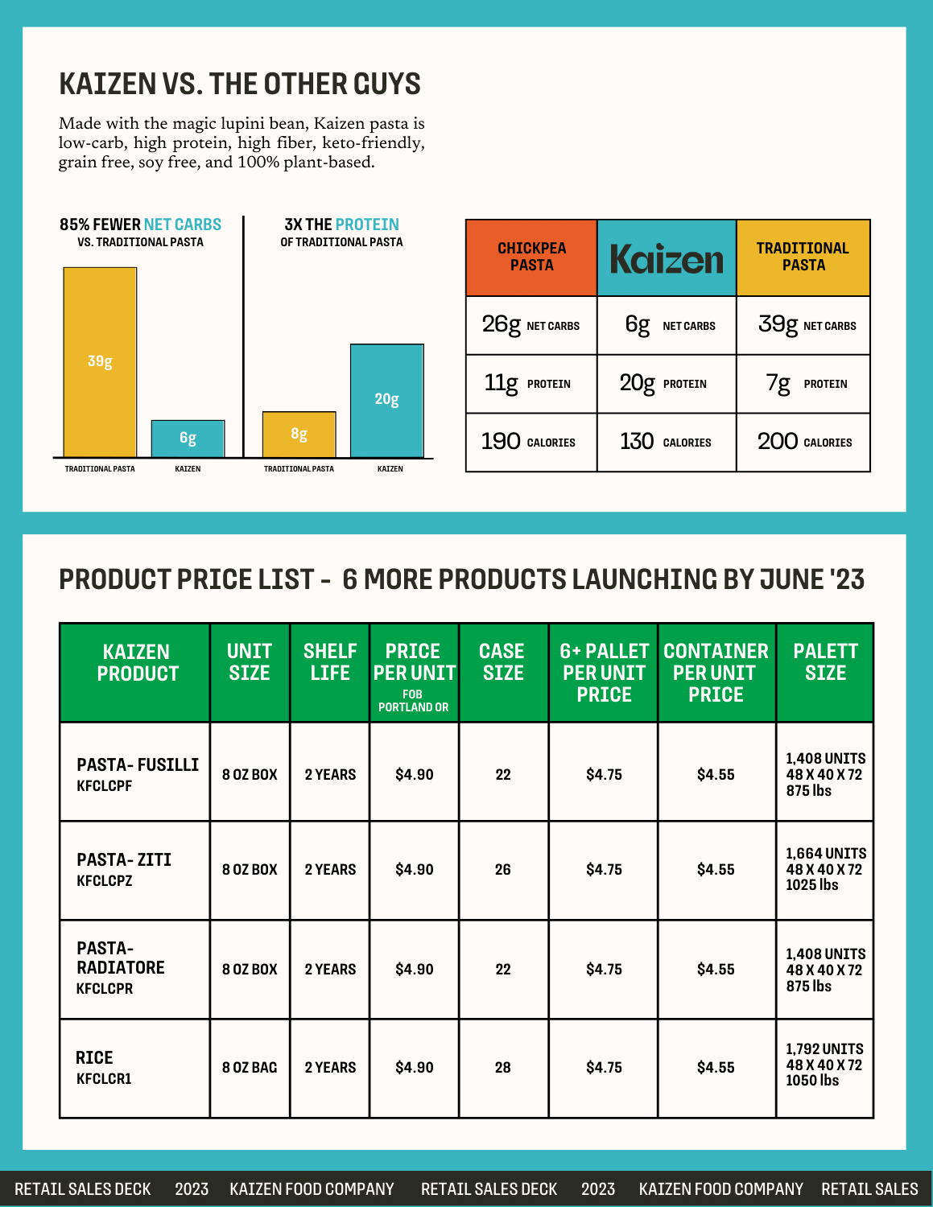

Slide 6
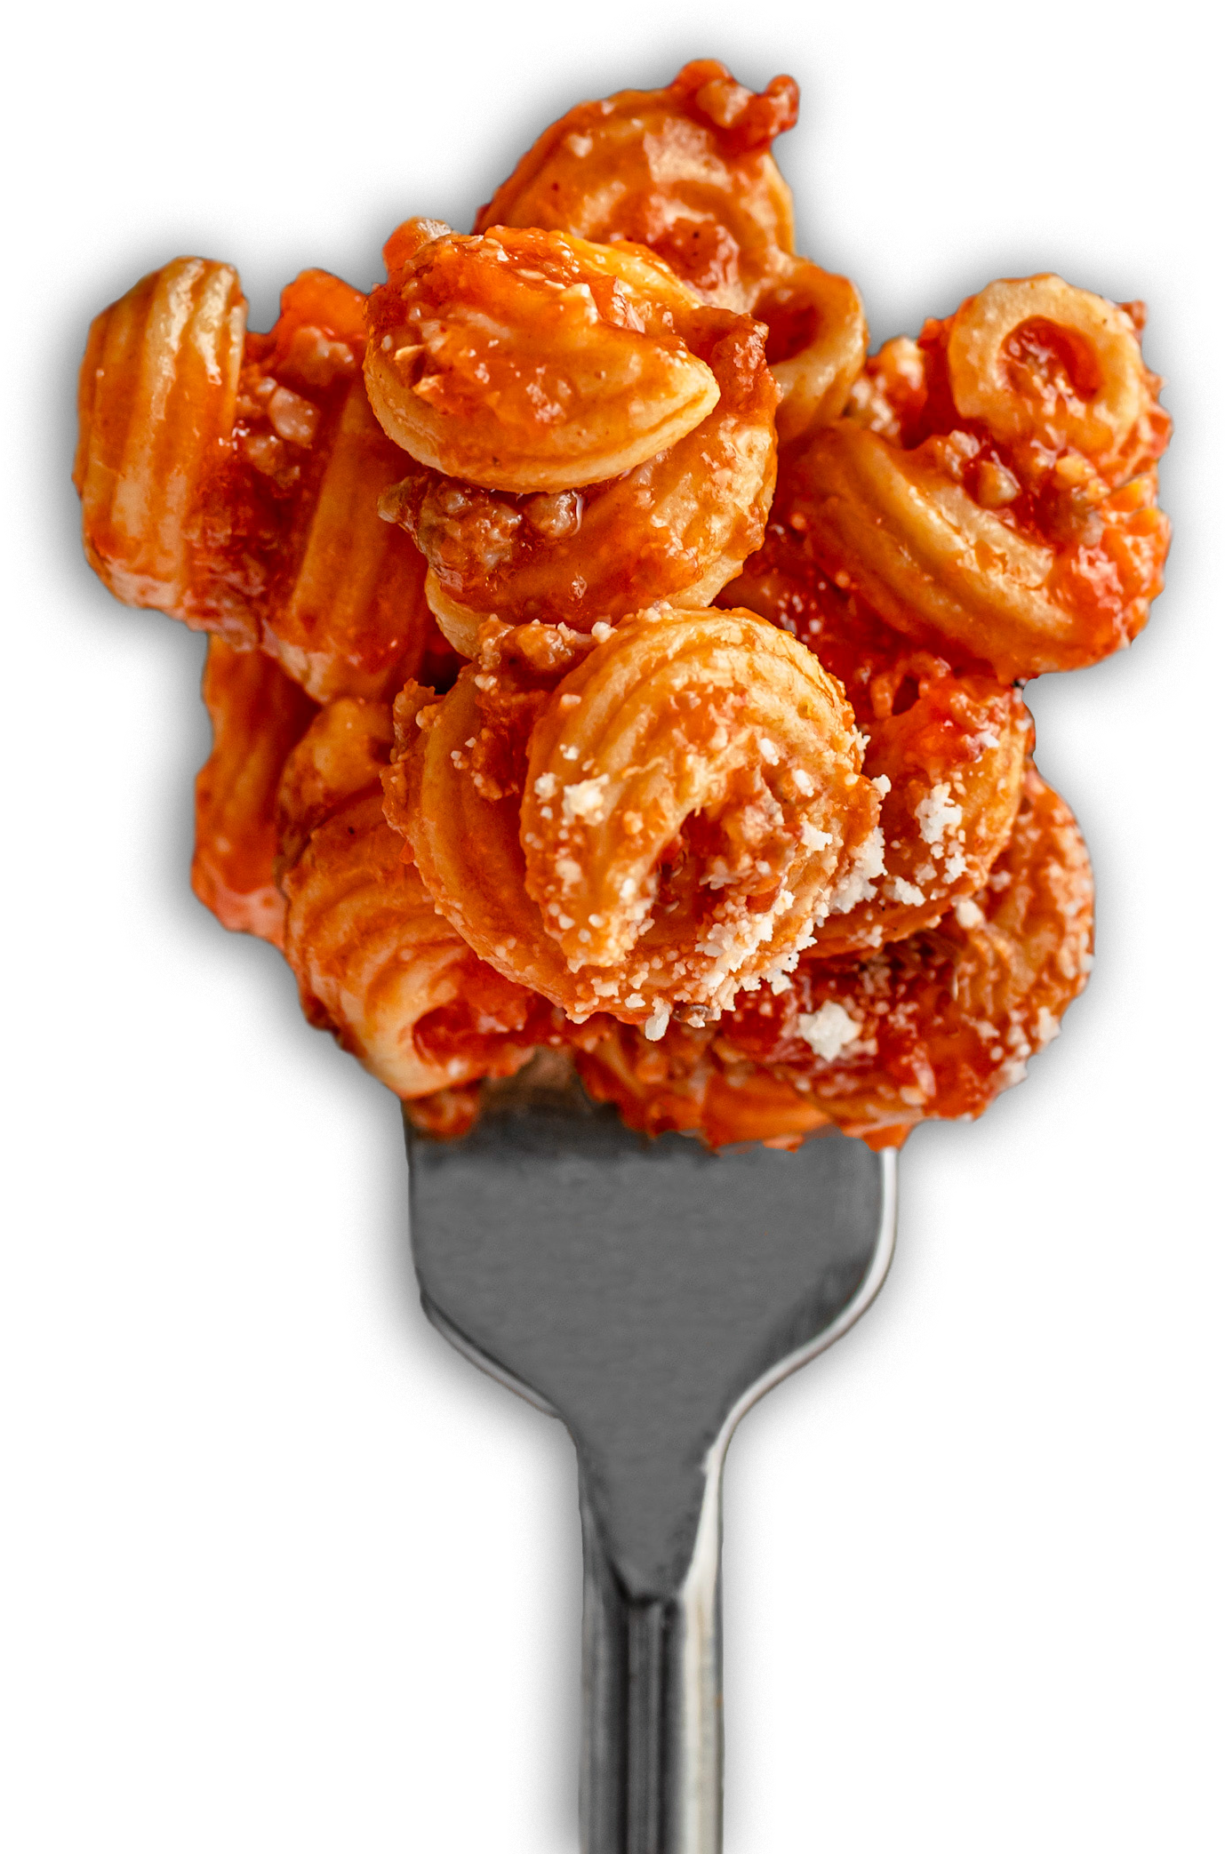
Introducing the world’s first plant based, lowcarb, keto friendly and high protein pasta.
Made from LUPIN BEANS.
20g 6g 130
PROTEIN* NET CARBS* CALORIES*
85%
FEWER CARBS
3x
THE PROTEIN
OF REGULAR PASTA
30%
FEWER CALORIES
* PER 2 OZ SERVING, COMPARED TO TRADITIONAL PASTA

Slide 7
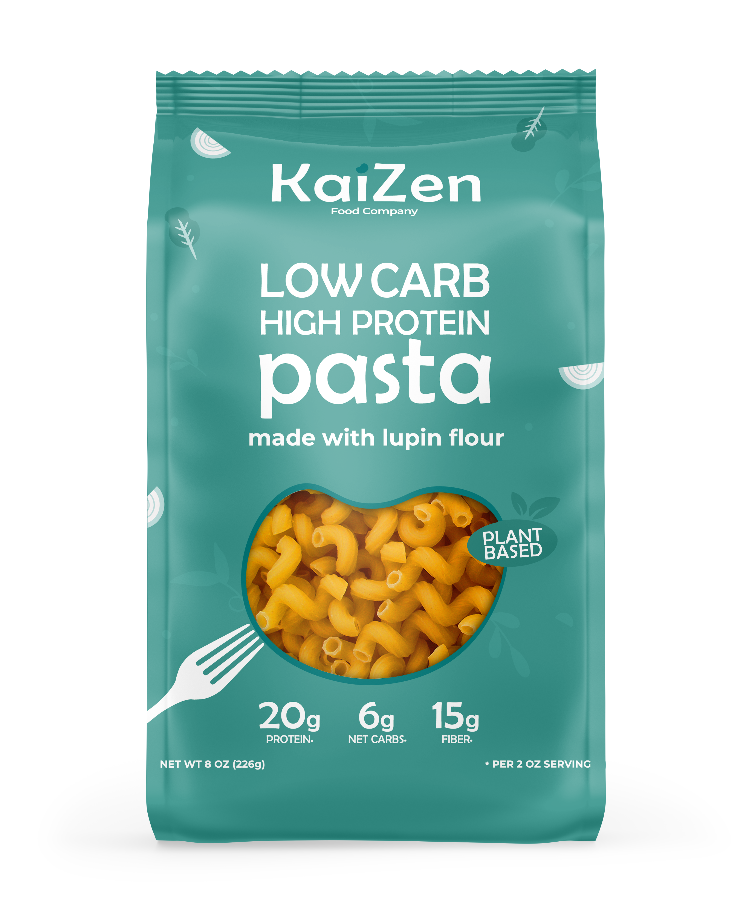

Ingredients
Lupin Flour, Fava Protein, Tapioca Starch, Xanthan Gum.
Key Attributes
Plant based, lowcarb, keto friendly,
high fiber, grain free, gluten free ingredients.
Shelf Life
12 months.
Individual
8 oz bags / 8 x 6 x 2,1
Case
30 x 8 oz bags per case 17 x 11 x 11 / 17 lbs
Pallet
1890 x 8 oz bags per pallet 40 x 46 x 82 / 1.050 lbs

Slide 8
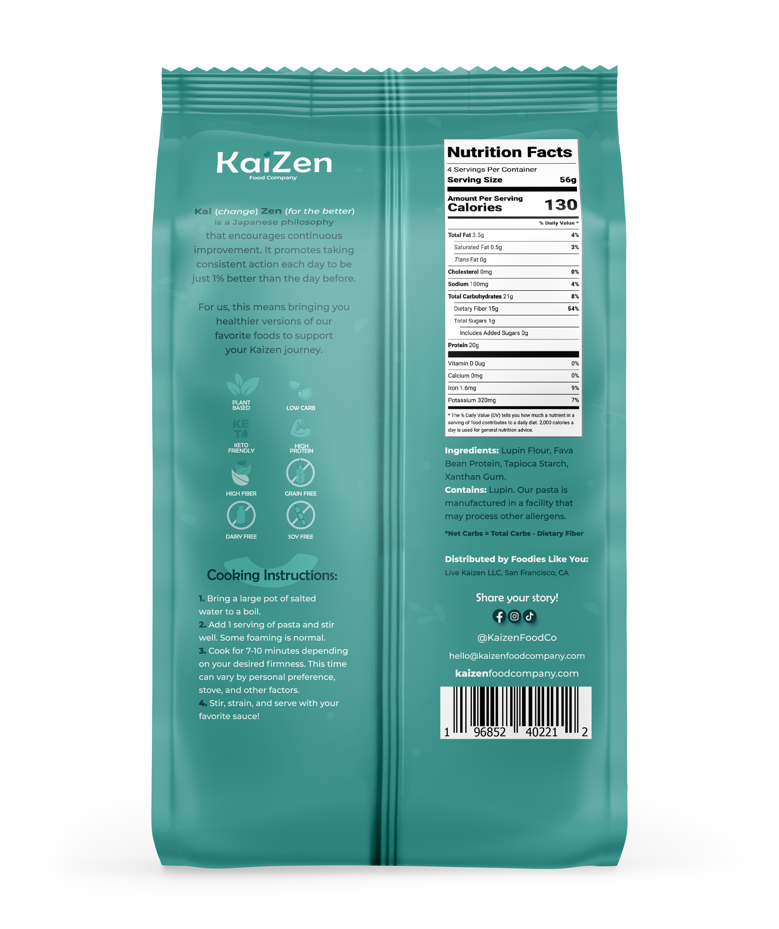
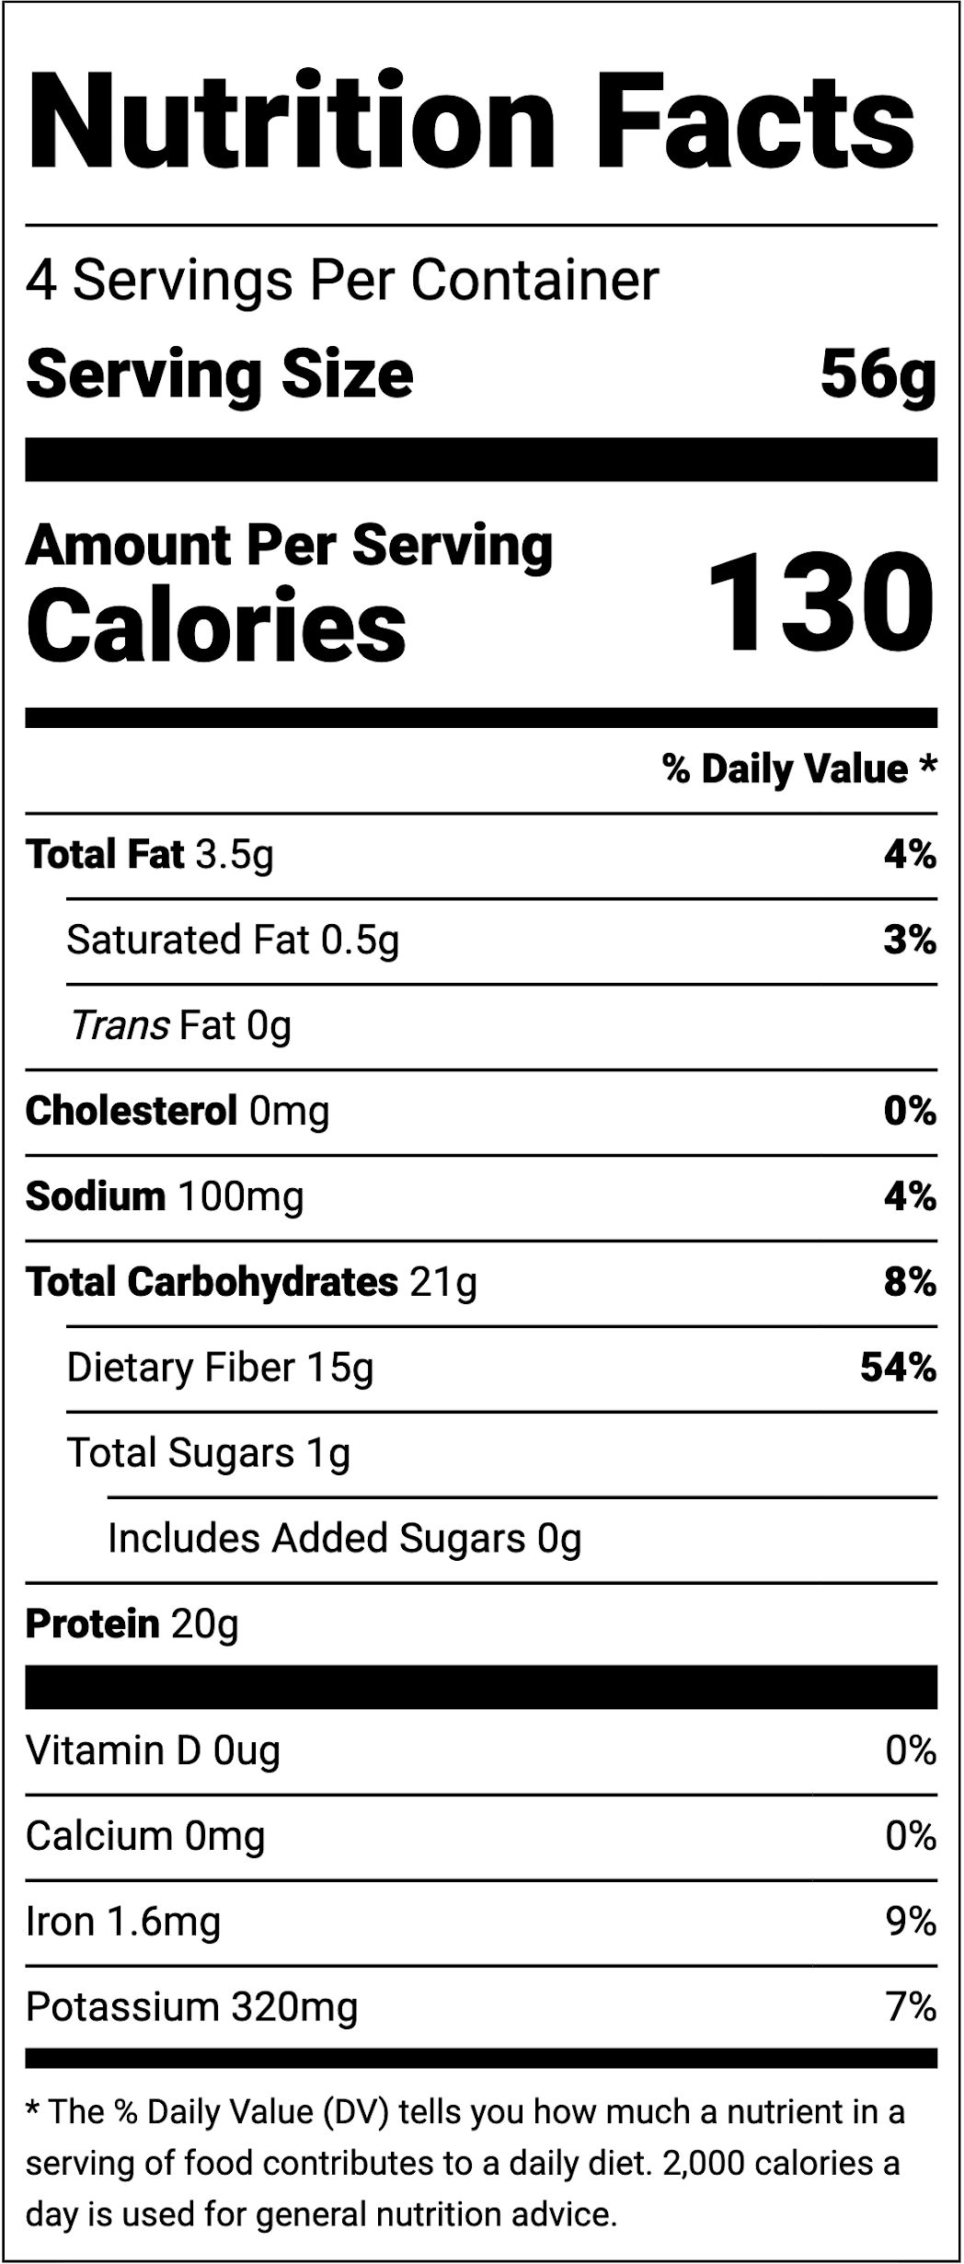

Slide 9
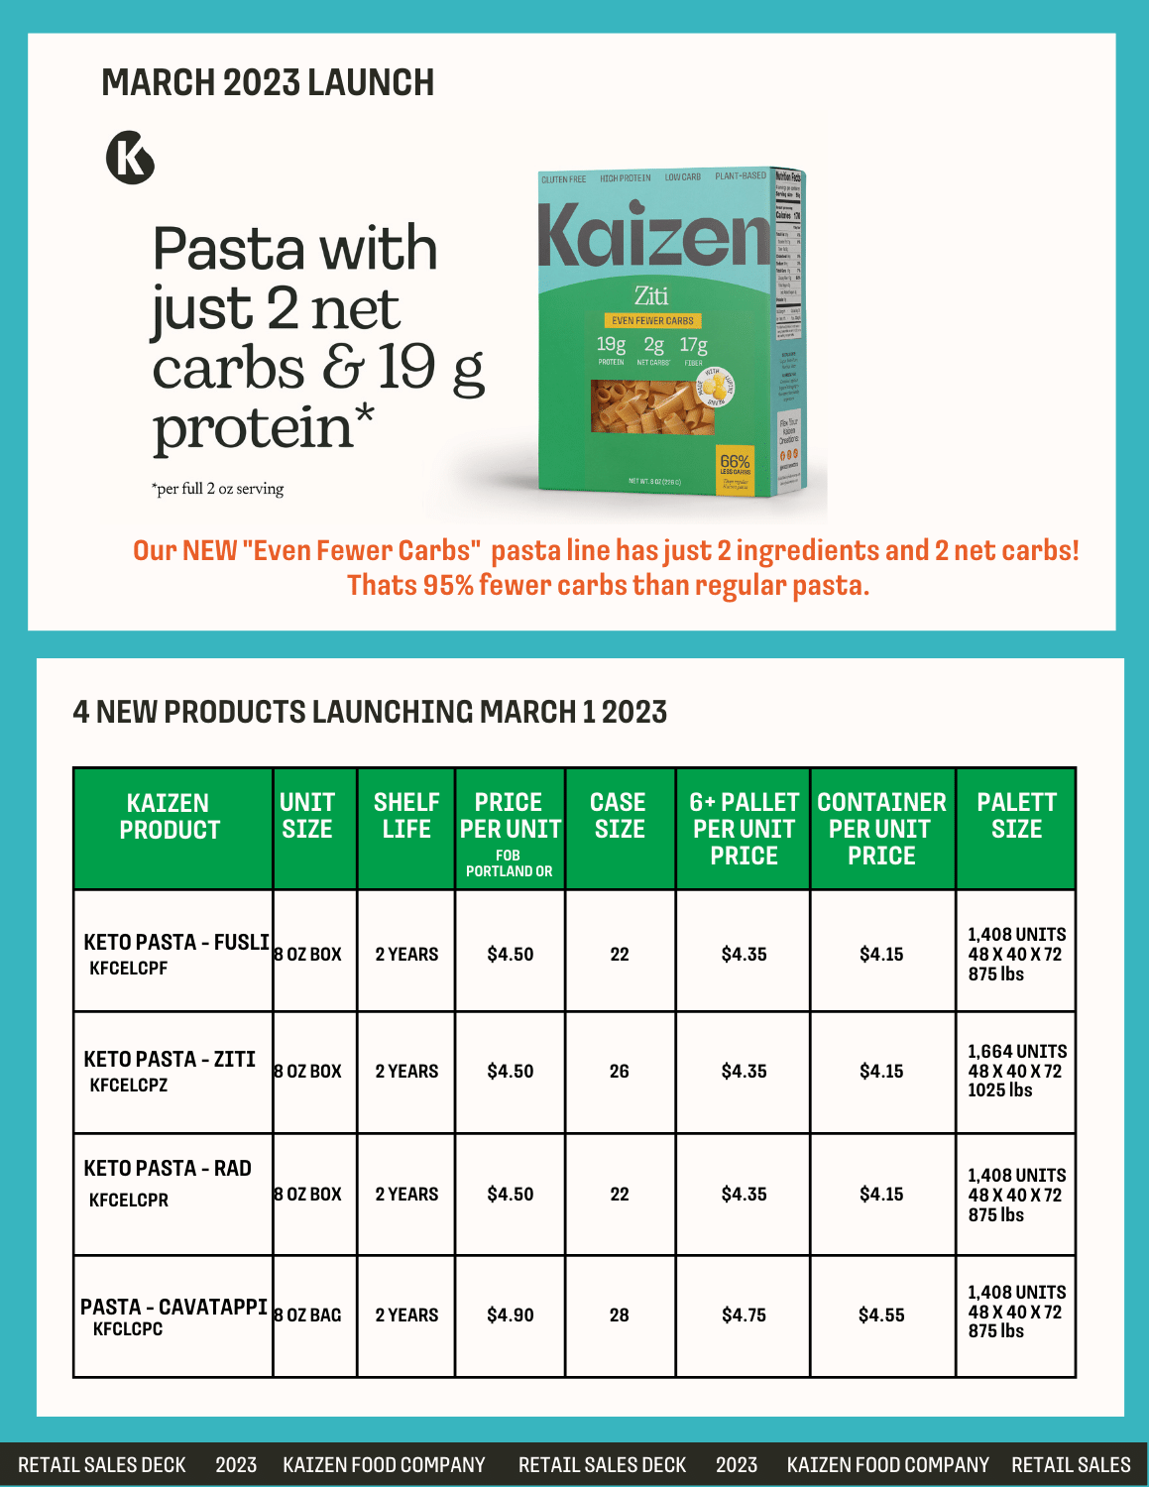

Slide 10
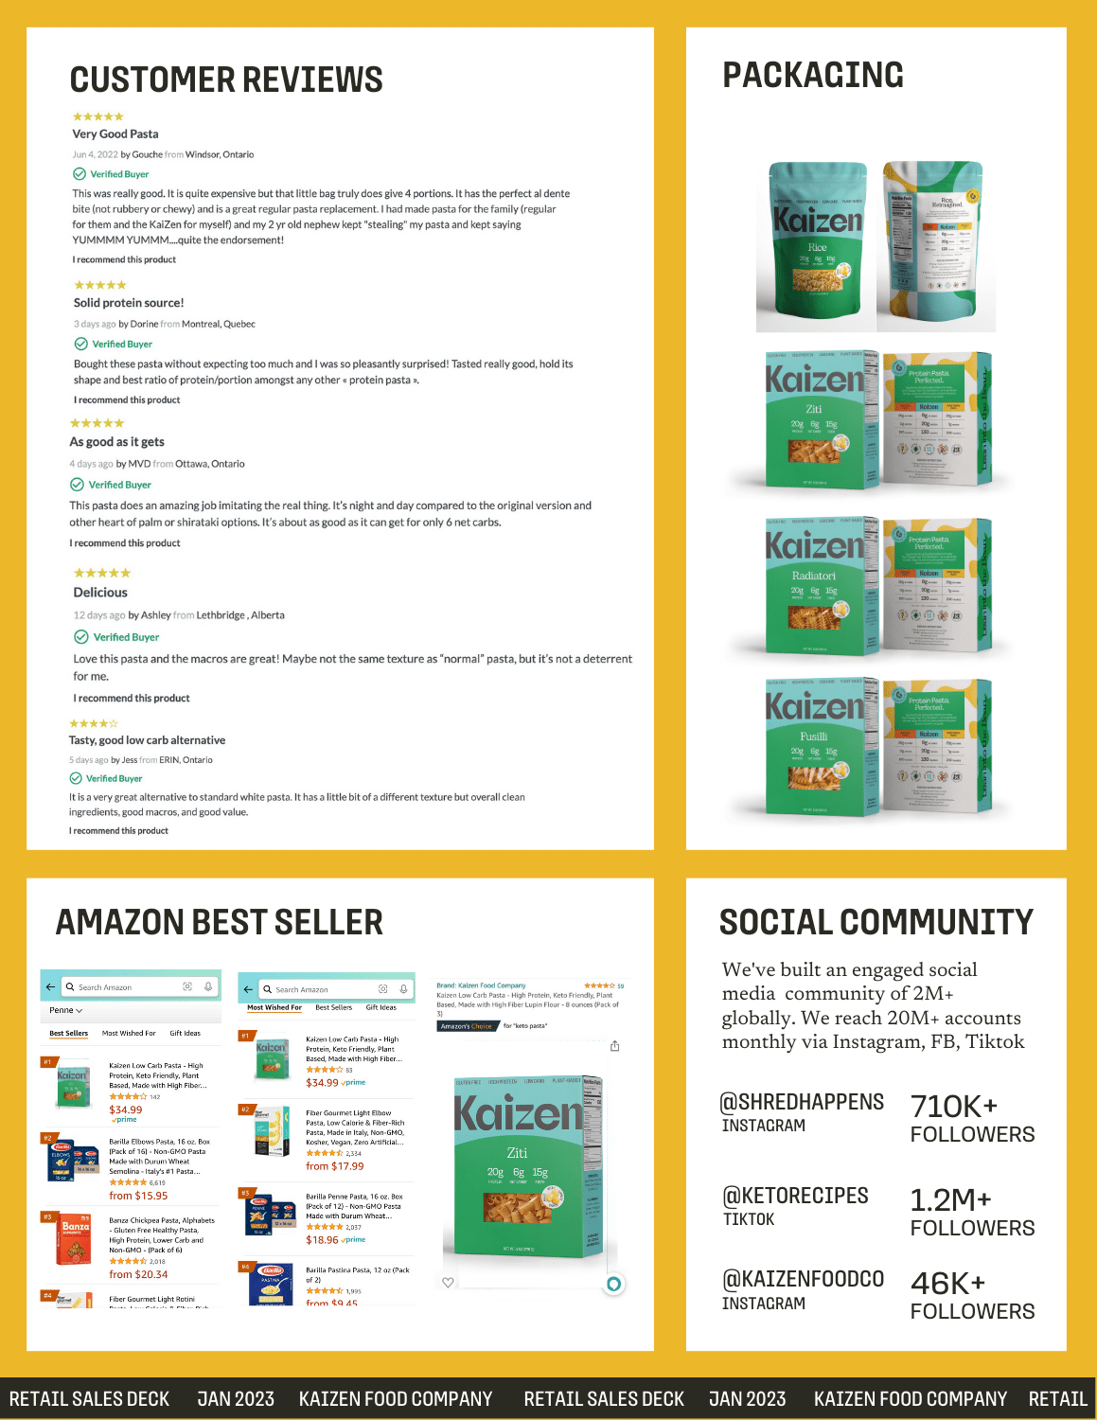

Slide 11

Thank you!

