Slide 1

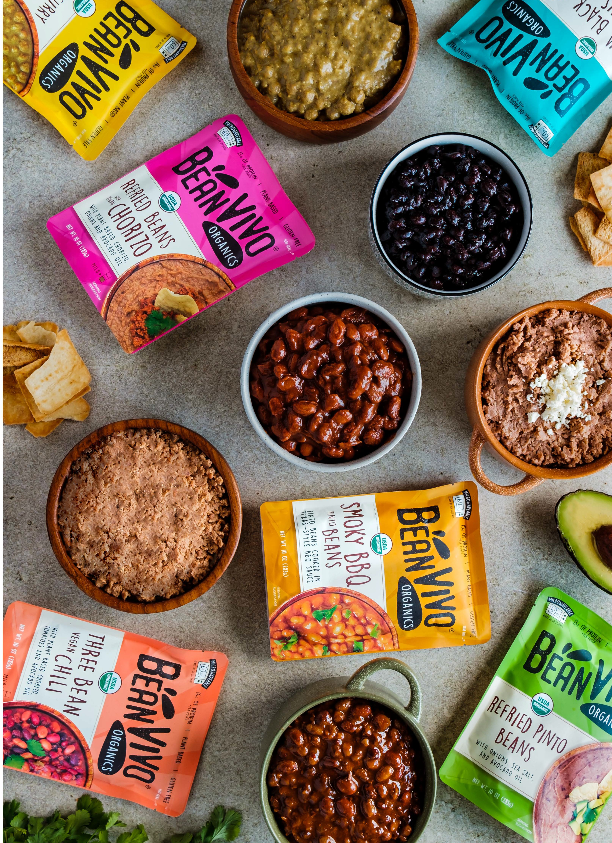

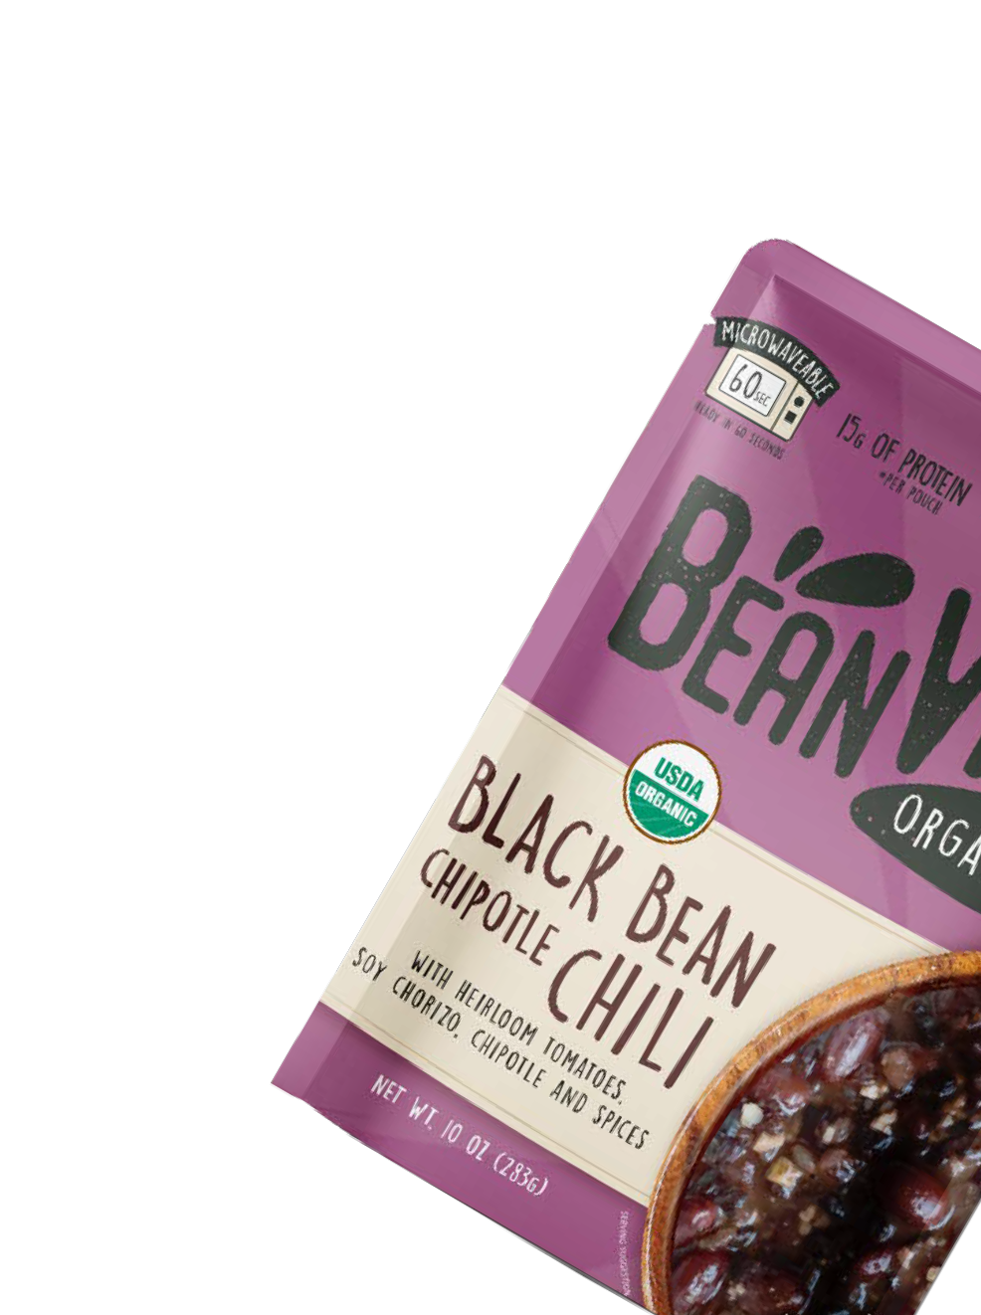
®

Slide 2



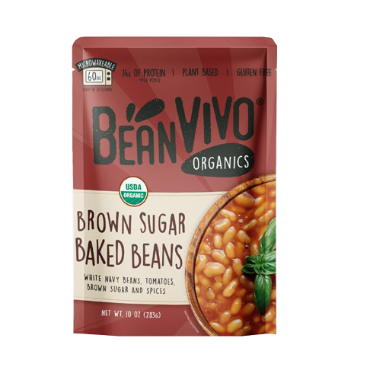
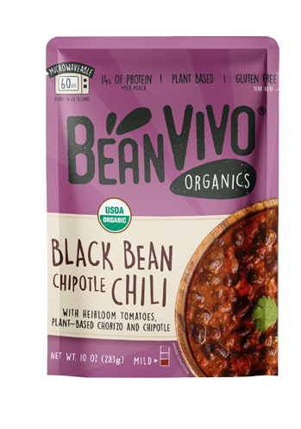
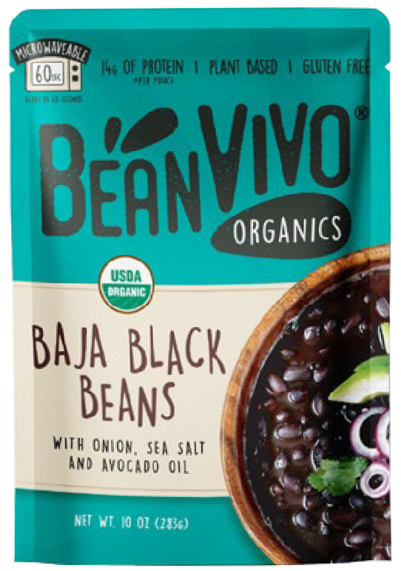

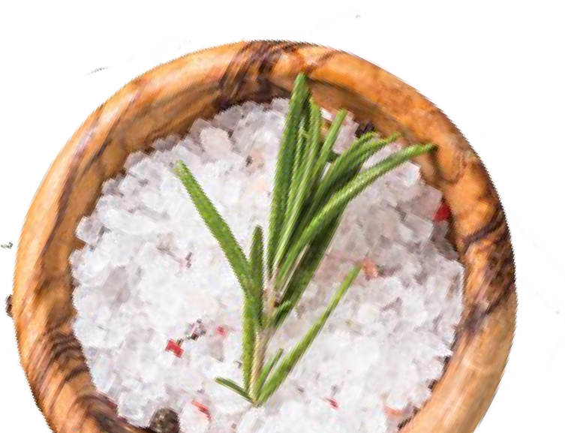


ORGANIC SEASONED BEANS in POUCHES!
1st and Only line of
organic seasoned legumes with specialty ingredients

Slide 3








7,000 Grocery Stores in 1st Year
13

Slide 4



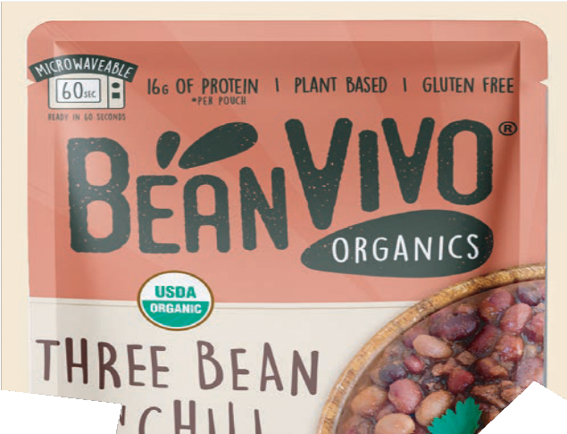





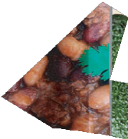


















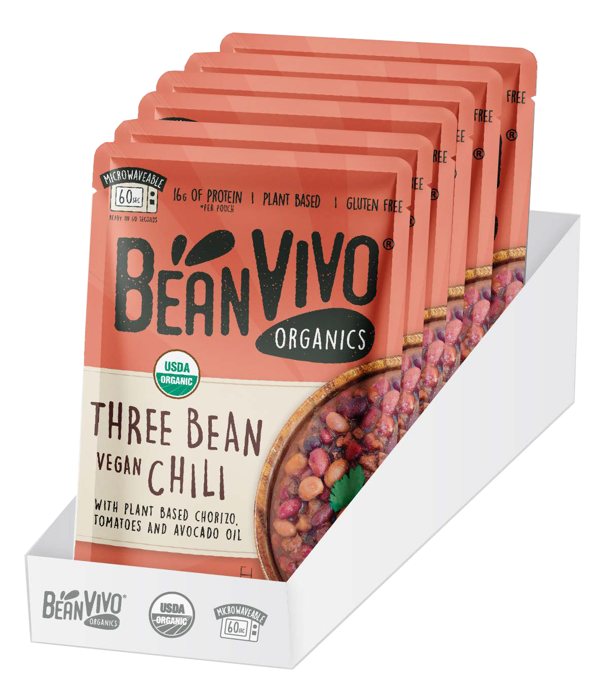

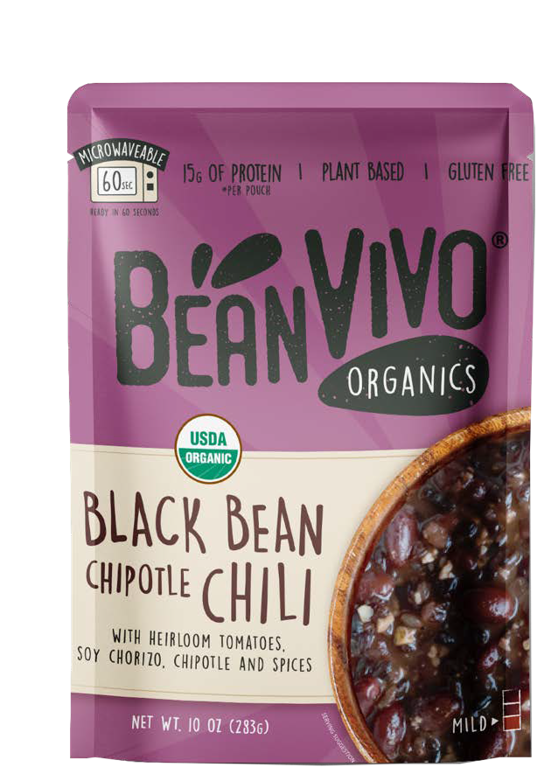
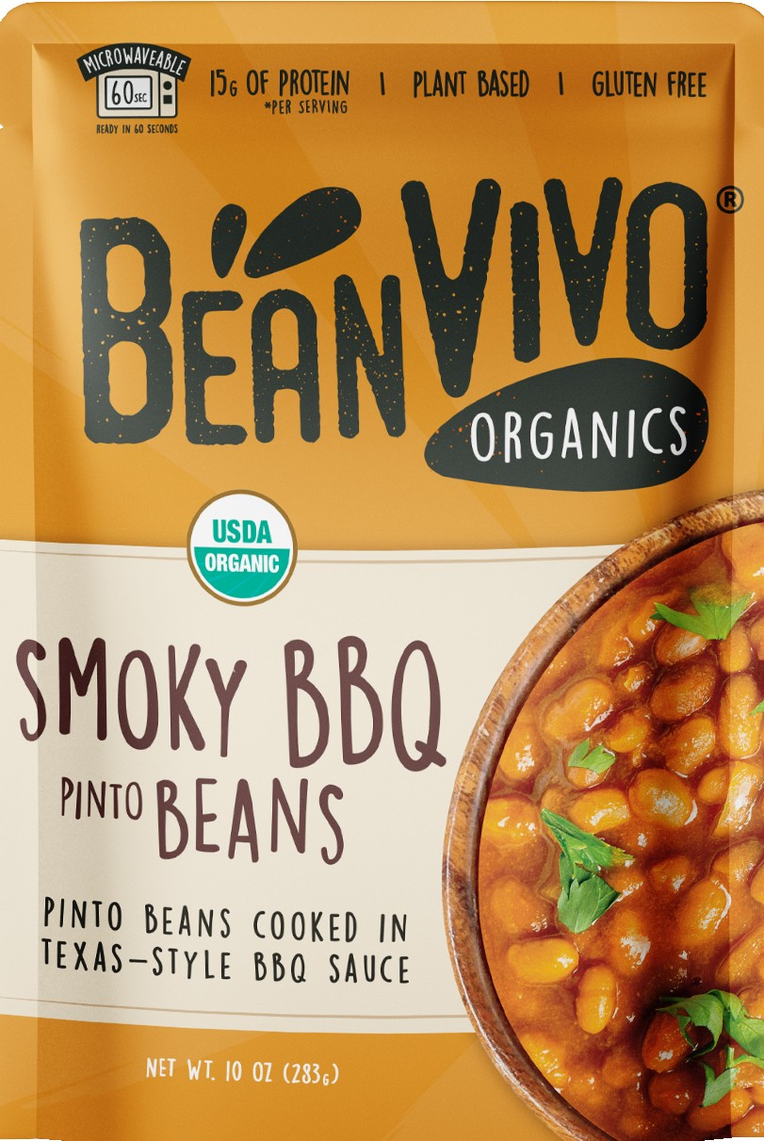
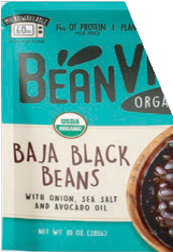






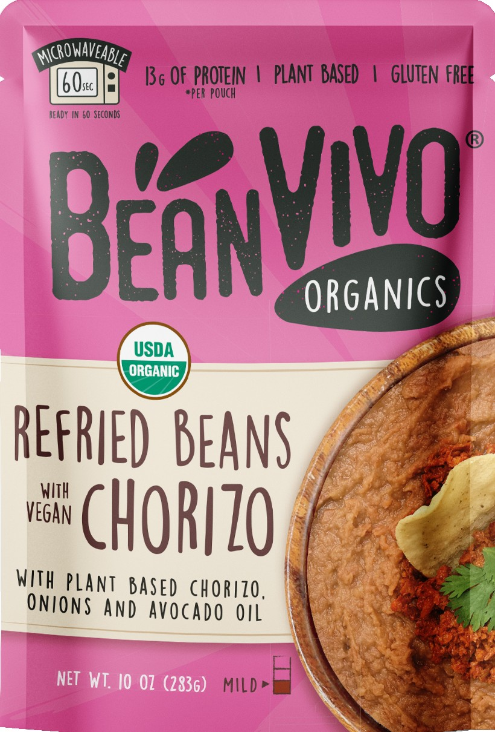

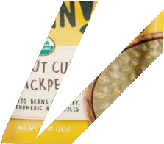




1st and Only ORGANIC SEASONED BEANS in POUCHES
w
o
a
r
v
e
c
a
i
b
m
l
Full Traceability - From Farm to Fork BeanVIVO sources organic beans and legumes as local as possible. QR Codes found on back of pouches, with regions of bean ﬁelds in the United States.
Product Attributes
Instant Meals
Microwaveable
High in Protein & Fiber
All Plant Based
Organic & Gluten Free
Made in USA
Premium Ingredients
e
ready in 60 seconds
Product Information
Net Wt : 10oz per pouch (6 pack)
Specifications
Shelf Life : 12 months guaranteed
Pouch Dimensions : 5.10 x 7.25 x 1.25
Case Dimensions : 5.10 x 7.50 x 6.75
Pallet Conﬁguration : 343 cases (49 Ti x 7 Hi)
Notes:
This includes main information we use for our sales pitch, we are the 1st and only Organic Seasoned beans in microwavable pouches, we are the fastest grower brand in the segment, we reached 7k stores in the first year, and you can find competitor’s comparison on the file as well.
We are going to introduce 2 new items this summer 2023 that are: Organic Black Bean Chipotle Chili & Organic Brown Sugar Baked Beans.

Slide 5



























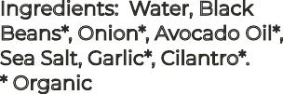


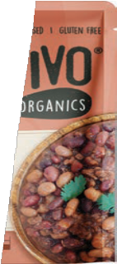
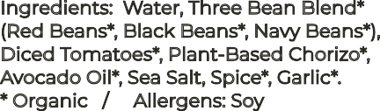






































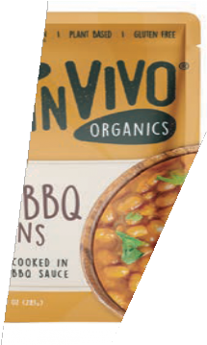

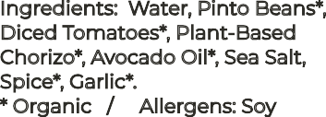
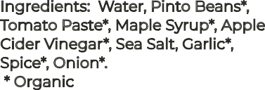






















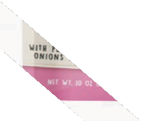





























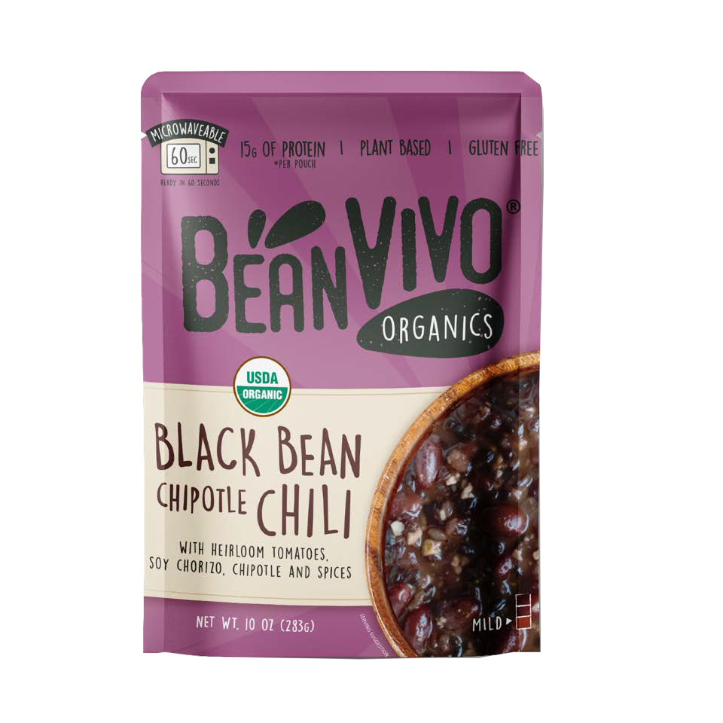











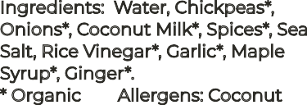














organic I plant based I gluten free I ready to eat
ORGANIC SEASONED LEGUMES WITH SPECIALTY INGREDIENTS
The first and only line of organic seasoned legumes in a variety of unique flavors. Reimagining what bean-centric cooking can look like.
Ingredients: Water, Black Beans*, Onion*, Avocado Oil*, Sea Salt, Garlic*, Cilantro*.
* Organic
Ingredients: Water, Three Bean Blend* (Red Beans*, Black Beans*, Navy Beans*), Diced Tomatoes*, Plant-Based Chorizo*, Avocado Oil*, Sea Salt, Spice*, Garlic*.
* Organic / Allergens: Soy
INDIVIDUAL UNIT
INDIVIDUAL UNIT
CASE
CASE
BAJA BLACK
THREE BEAN
BEANS
VEGAN CHILI
Ingredients: Water, Pinto Beans*, Diced Tomatoes*, Plant-Based Chorizo*, Avocado Oil*, Sea Salt, Spice*, Garlic*.
* Organic / Allergens: Soy
Ingredients: Water, Pinto Beans*, Tomato Paste*, Maple Syrup*, Apple Cider Vinegar*, Sea Salt, Garlic*, Spice*, Onion*.
* Organic
INDIVIDUAL UNIT
INDIVIDUAL UNIT
CASE
CASE
REFRIED BEANS
SMOKY BBQ
w/ VEG CHORIZO
BEANS
Ingredients: Water, Black beans*, Chopped Tomatoes*, Plant-based chorizo*,Onions*, Chipotle Puree*, Maple Syrup, Apple cider vinegar*, Chipotle Chili Pepper*, Garlic*, Sea Salt, Crushed tomatoes*.
* Organic / Allergens: Soy
Ingredients: Water, Chickpeas*, Onions*, Coconut Milk*, Spices*, Sea Salt, Rice Vinegar*, Garlic*, Maple Syrup*, Ginger*.
* Organic Allergens: Coconut
INDIVIDUAL UNIT
CASE
BLACK BEAN CHIPOTLE CHILI
COCONUT CURRY
CHICKPEAS

Slide 6





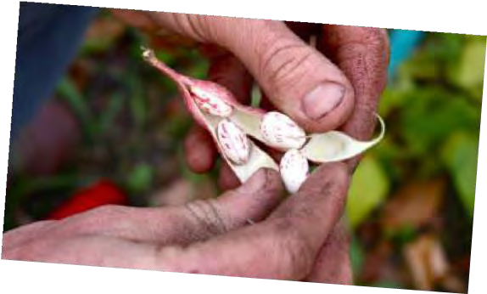


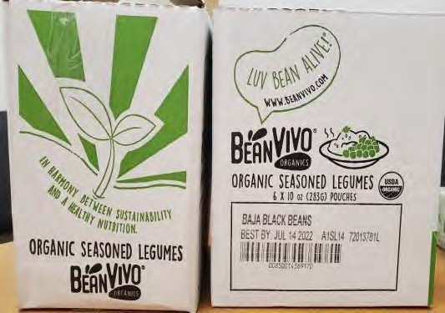
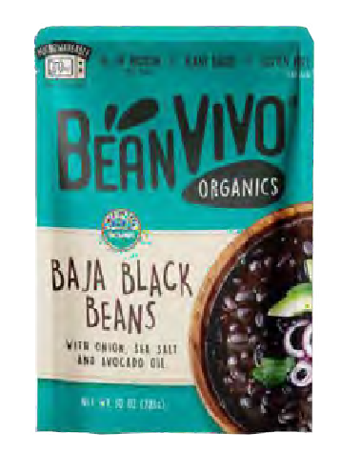
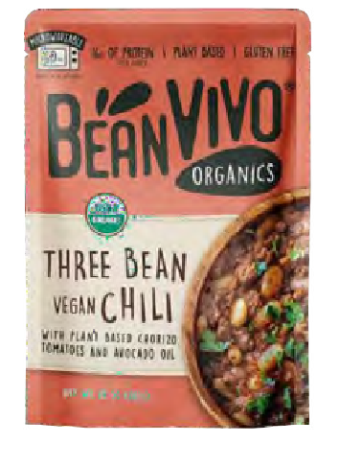
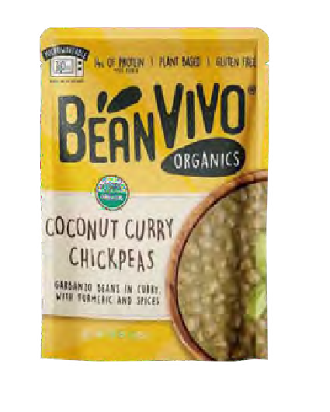
WHY ARE WE FASTEST GROWING BRAND?
ORGANIC
PLANT BASED
60 SECOND MICROWAVE
GREAT VALUE
TRACEABILITY
BeanVIVO® is at the crossroads of Convenience, Digestive Health, and Sustainability. Crafting meals which are all Organic, Vegan and Gluten Free and High in Protein & Fiber.
Made from organic beans grown locally in the United States and paired with delicious flavors from around the world!

Slide 7
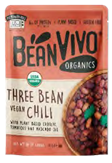

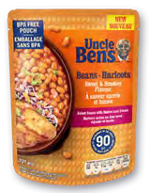
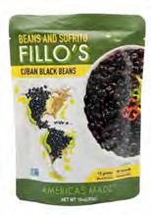
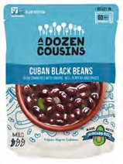
BeanVIVO is the 1st and Only Organic line in the Segment!
COMPETITIVE LANDSCAPE
POINTS OF DIFFERENTIATION | BeanVIVO | UNCLE BEN’S | FILLO’S | DOZEN COUSINS
USDA ORGANIC | YES | NO | NO | NO
MINORITY OWNED | YES | NO | NO | YES
NON-GMO | YES | NO | YES | YES
TRACEABILITY (on pack) TO US BEAN FARMS | YES | NO | NO | NO
USES PLANT BASED MEATS | YES | NO | NO | NO

Slide 8

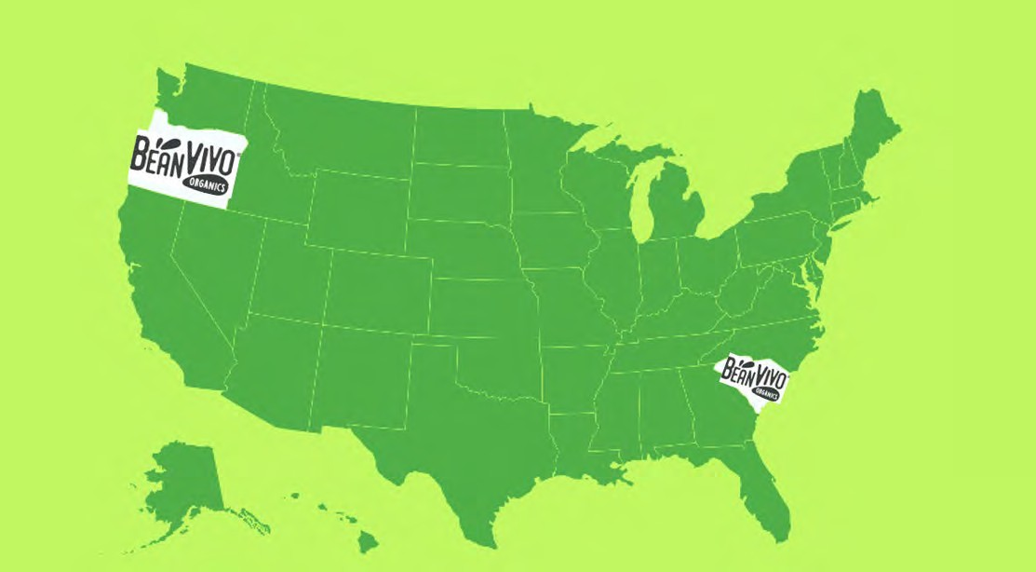
PRODUCTION FLEXIBILITY
Duplicate Production Facilities—Oregon and So Carolina—to effectively and reliably service.

Slide 9
ORGANIC SEASONED BEANS in POUCHES!
1st and Only line of
organic seasoned legumes with specialty ingredients

