Slide 1




JANUARY 2023

Slide 2

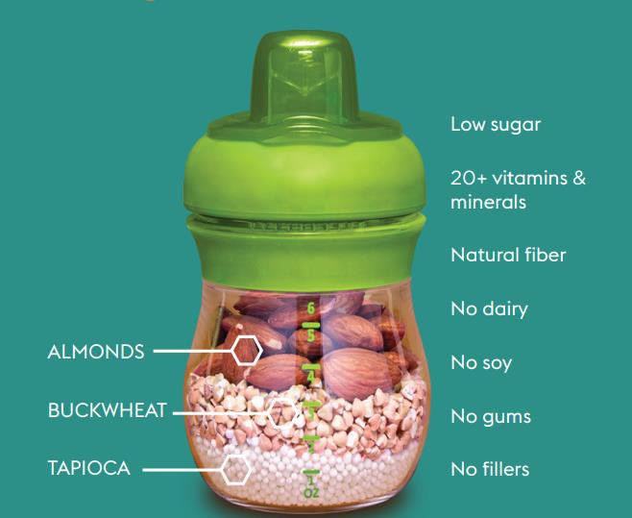
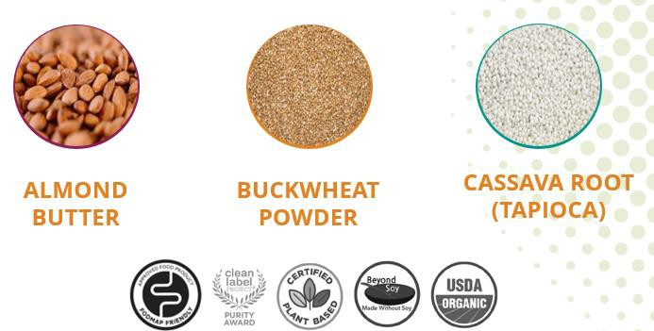

Who is
NEW INNOVATION TO GROW YOUR BABY CATEGORY
It’s more than nutrition. It’s truly something else.
3

Slide 3
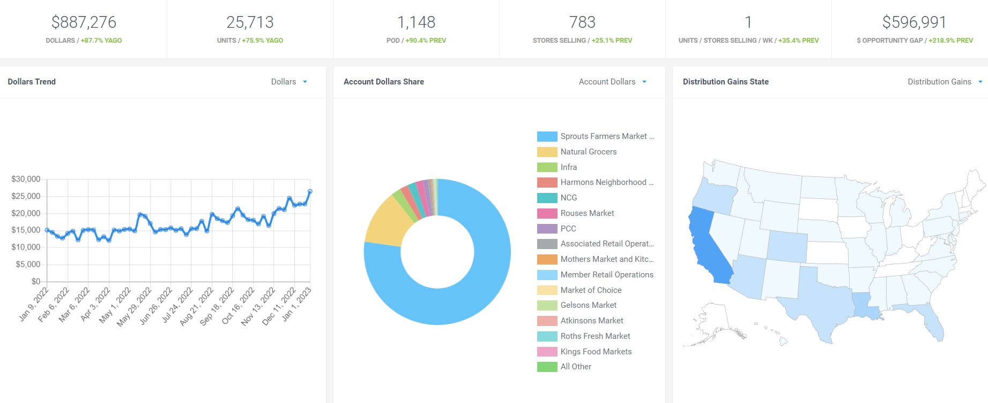


RETAILER SALES L52 WEEKS +8%
*week ending 1.1.23
4

Slide 4
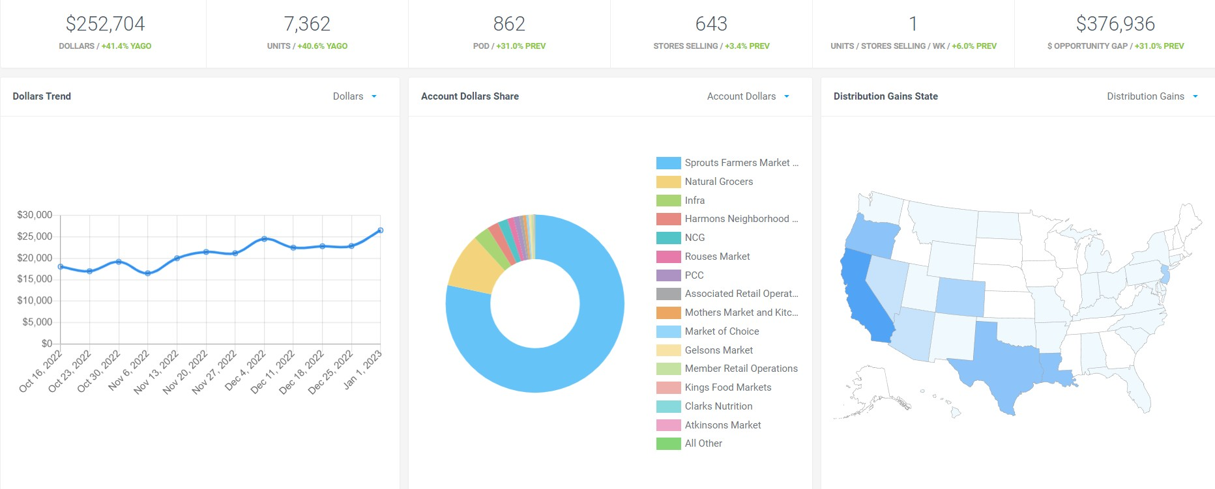
RETAILER SALES L12 WEEKS +41%
*week ending 1.1.23
5

Slide 5
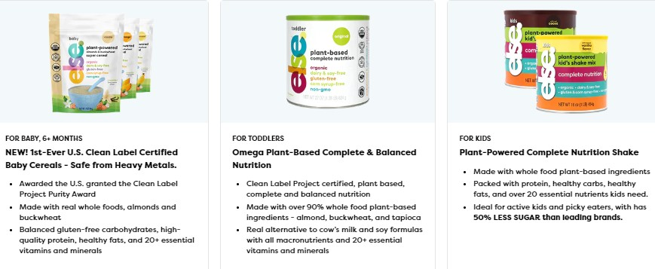




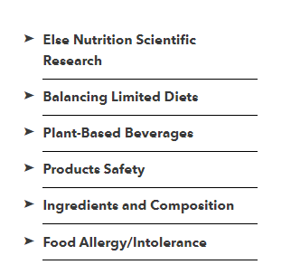



RETAIL & MEDICAL SUPPORT
https://elsenutrition.com/
https://hcp.elsenutrition.com/
6

Slide 6
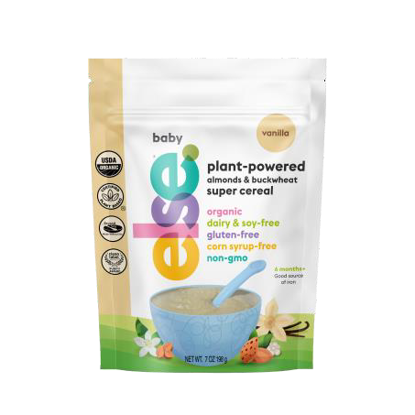

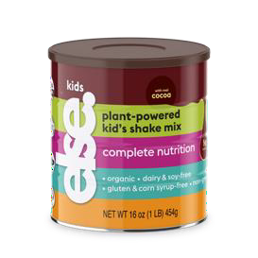
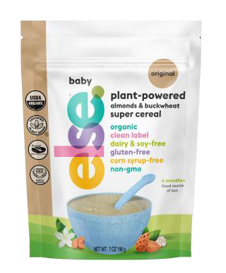



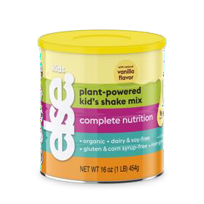




PORTFOLIO
For ALL babies
6 months and up
For Toddlers who are
allergic, sensitive, vegan
For Kids
(2yr+) for who need additional nutrition growth
7

Slide 7
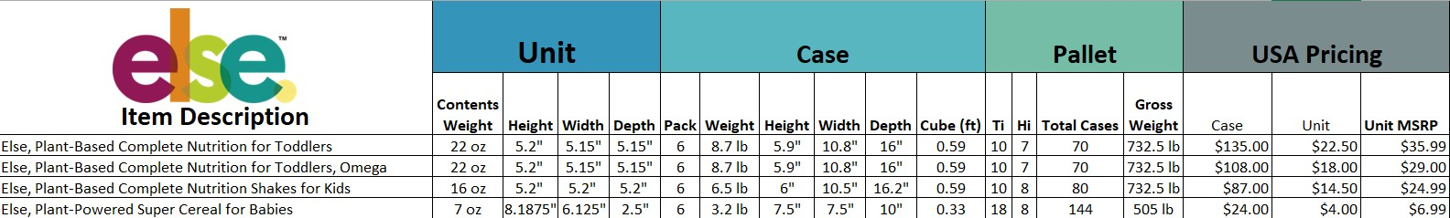

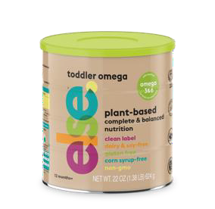
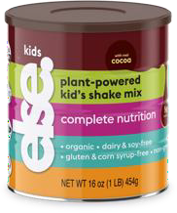
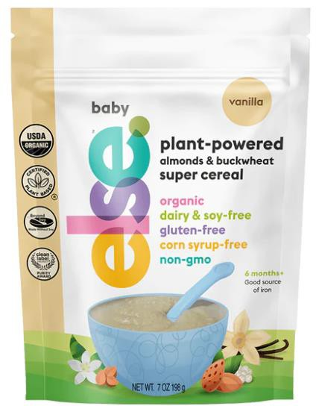
PRODUCT SPECS
Shelf life - Days
Dry
365
8

Slide 8
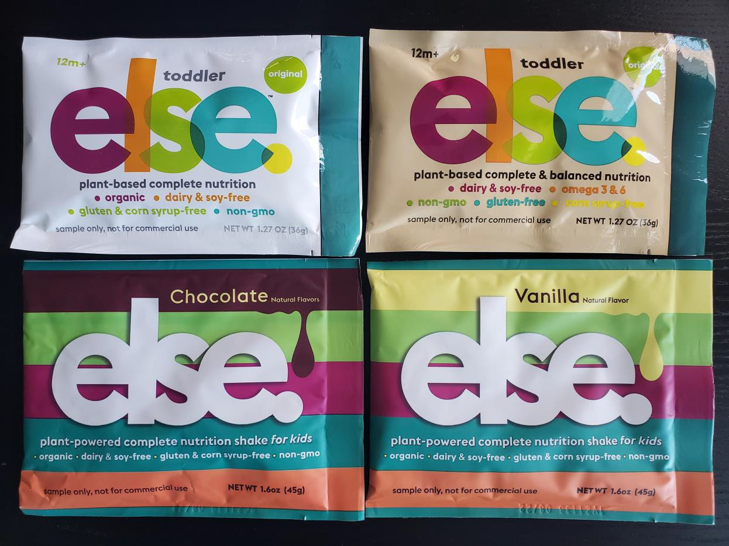
SAMPLES
9

Slide 9


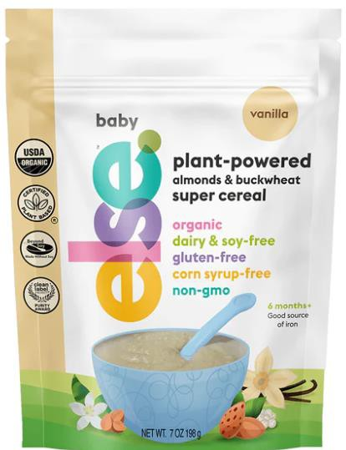
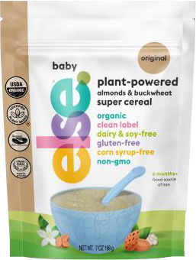

ELSE PLANT-POWERED, SUPER NUTRITION ALMOND
& BUCKWHEAT CEREAL (6 months +)
The 1st and Only Clean Label Project Purity Award Certified Baby Cereal in
the U.S. Introducing
4 nutritious & delicious flavors
Clean Label Purity Award Certified
Else Super Cereal was awarded the Clean Label Purity Award, which tests products for over 400 impurities like Arsenic, Lead, Cadmium and others. That's because we use the cleanest ingredients and process available to ensure this highest level of purity for your baby!
Whole Food Ingredients
Made with >80% almonds, buckwheat and tapioca.
Super nutrition for growing babies’ needs
All 9 essential amino acids
Healthy unsaturated fats
Gluten-free carbohydrates
20+ essential vitamins and minerals
mango
original
organic ● dairy & soy-free ● gluten-free
corn syrup-free ● non-gmo
banana
vanilla

Slide 10





ELSE CEREAL IS BETTER THAN OTHER OPTIONS
 | Else Super Cereal | Gerber Organic Rice Cereal | Earth’s Best Organic Rice Cereal | Beech-nut Organic Oatmeal Cereal | Happy Baby Oats & Quinoa
Size | 7oz | 8oz | 8oz | 8oz | 7oz
Calories | 60 | 60 | 50 | 60 | 50
Protein (g) | 2 | 1 | 1 | 2 | 2
Healthy Fat (g) | 2 | 0.5 | 0 | 1 | 1
Carbs (g) | 10 | 12 | 11 | 10 | 9
Fiber (g) | <1 | 0 | 0 | 2 | 1
Sugars (g) | <1 | 2 | 0 | 1 | 1
Number of Vitamins | 11 | 8 | 1 | 9 | 1
Number of Minerals | 8 | 5 | 1 | 4 | 2
Clean Label
Whole Plant |  | ? | ? | ? | ?
9 Essential Amino Acids |  |  |  |  | Yes
Gluten Free
11

Slide 11


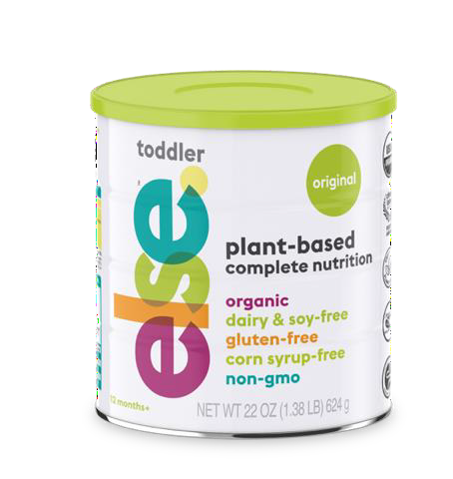
ELSE PLANT-BASED COMPLETE NUTRITION FOR
TODDLER (12 months +) - the game changer
Introducing our Clean Label, Plant-Based formula packed with protein, vitamins, and key minerals to help your little one grow big and strong.
Composition, process and taste
Made from 3 core whole food ingredients:
Almonds, Buckwheat and Tapioca.
Pediatrician & nutritionist endorsed
Minimally processed ingredients with the cleanest
production we can use
Toddler-approved taste, with 50% less sugar than leading brands
Early Adopters are
Vegan, Vegetarian & Flexitarian
Progressive Health Seekers
Allergic & Sensitive
Product SKU Info
22 oz can (case of 6)
17 servings
organic ● dairy & soy-free ● gluten-free
corn syrup-free ● non-gmo

Slide 12

ELSE TODDLER IS BETTER THAN OTHER OPTIONS
Per Serving | Else™ Toddler | Silk® Organic Original Almond Milk | Organic Whole Milk | Enfagrow PREMIUM™ Toddler Natural Milk Flavor
Serving Size | 8 oz | 8 oz | 8 oz | 8 oz
Calories | 180 | 50 | 149 | 160
Protein (g) | 5 | <1 | 8 | 6
Fat (g) | 9 | 3.5 | 8 | 6
Carbohydrate (g) | 19 | 8 | 13 | 20
Sugar (g) | 2 | 7 | 12 | 11
Added sugar (g) | 2 | 7 | 0 | 2
Fiber (g) | 2 | <1 | 0 | <1
20+ Vitamins & Minerals
Plant-based
Organic
Clean Label Certified
*For comparison purpose only: Enfagrow standard dilution yields ~7 oz per manufacturer; values noted reflect standard serving nutritional values
13

Slide 13



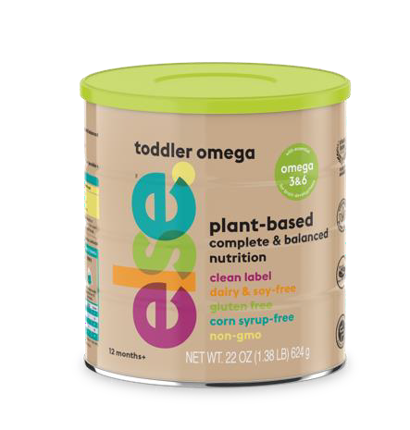
NEW ELSE NUTRITION TODDLER OMEGA PRODUCT
(12 months +) - driving more access to our products
Introducing our Clean Label, Plant-Based formula including Omega 3 & 6
Plant-based made from 3 plants
Almonds, Buckwheat and Tapioca
Clean-Label Certified, all natural and minimally processed
Driven by Pediatricians and Consumer demand
Moms wanted less expensive option, willing to forego Organic Peds wanted something more suitable
This is the evolution of our award-winning Toddler Organic, with a better price point and stronger initial sales online.
clean label ● dairy & soy-free ● gluten-free
corn syrup-free ● non-gmo

Slide 14
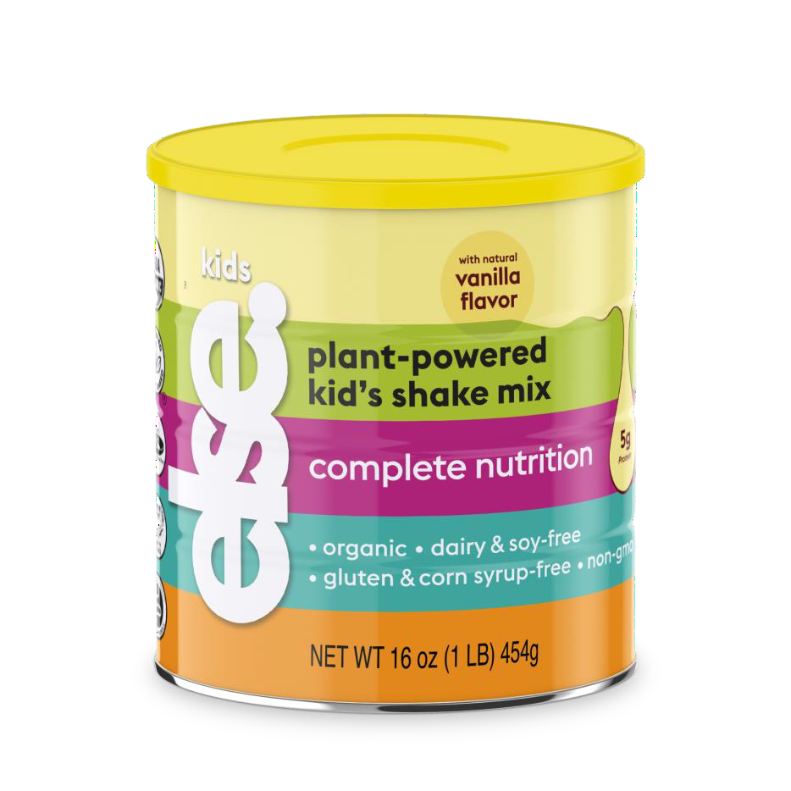
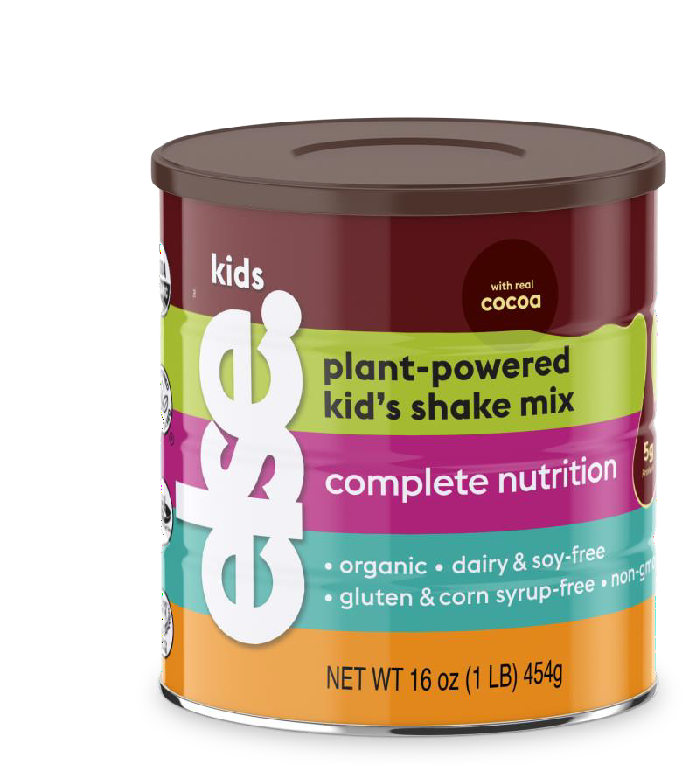
ELSE PLANT-BASED COMPLETE NUTRITION SHAKES
FOR FOR KIDS (3 years +)
Introducing clean, Plant-Based complete nutrition for kiddos that tastes like
a treat!
Organic, Vegan, non-GMO, Gluten-free, Soy-free
Plant-based made from 3 plants – Almonds, Buckwheat and Tapioca
Clean-Label Certified, all natural and minimally processed
Sustainable with minimal ecological footprint
Packed with proteins, healthy fats, over 20 Essential Nutrients that kids deserve.
50% less sugar than the leading brand
organic ● dairy & soy-free ● gluten-free
corn syrup-free ● non-gmo

Slide 15
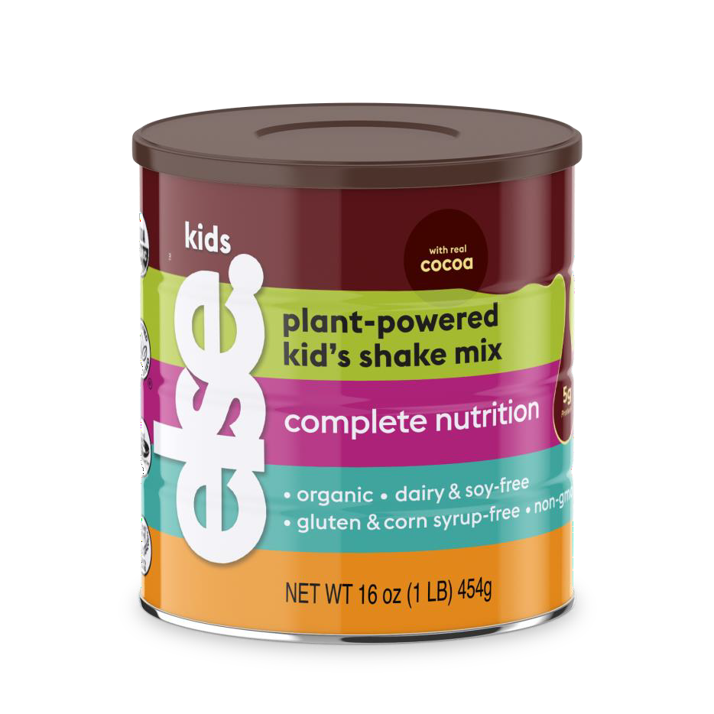
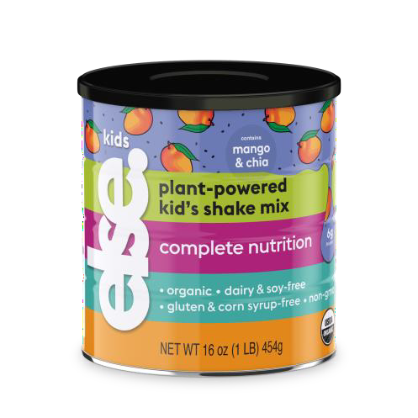
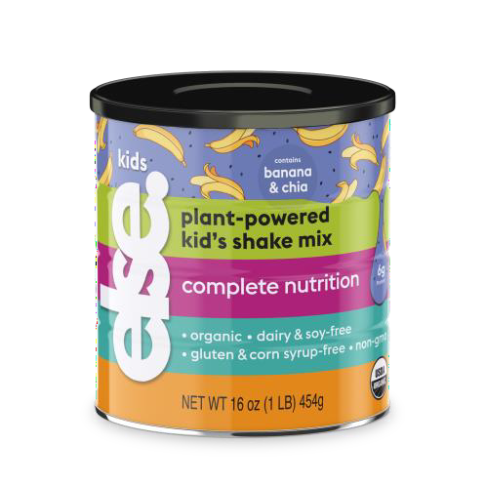
ELSE PLANT-BASED COMPLETE NUTRITION SHAKES
FOR FOR KIDS – 4 flavors (3 years +)
Introducing clean, Plant-Based complete nutrition for kiddos that tastes like
a treat!
Organic, Vegan, non-GMO, Gluten-free, Soy-free
Plant-based made from 3 plants – Almonds, Buckwheat and
Tapioca
Clean-Label Certified, all natural and minimally processed
Sustainable with minimal ecological footprint
Packed with proteins, healthy fats, over 20 Essential Nutrients
that kids deserve.
50% less sugar than the leading brand
organic ● dairy & soy-free ● gluten-free
corn syrup-free ● non-gmo

Slide 16

ELSE KIDS IS BETTER THAN OTHER OPTIONS
Per Serving | Else™ Kids | Pediasure® Grow & Gain Powder | Pediasure® Grow & Gain Liquid | BOOST® Kids Essentials™
Serving Size | 8 oz | 8 oz | 8 oz | 8 oz
Calories | 210 | 220 | 220 | 240
Protein (g) | 5 | 6 | 6 | 7
Fat (g) | 8 | 9 | 9 | 9
Carbohydrate (g) | 29 | 29 | 29 | 32
Sugar (g) | 4 | 12 | 12 | 9
Added sugar (g) | 4 | 12 | 12 | 9
Fiber (g) | 2 | <1 | <1 | 0
20+ Vitamins & Minerals | YES | YES | YES | YES
Plant-based
Organic
Clean Label Certified
17

Slide 17
DRIVING TRIAL
18

Slide 18
























DISTRIBUTION
DOT
COM
BRICK &
MORTAR
19

Slide 19
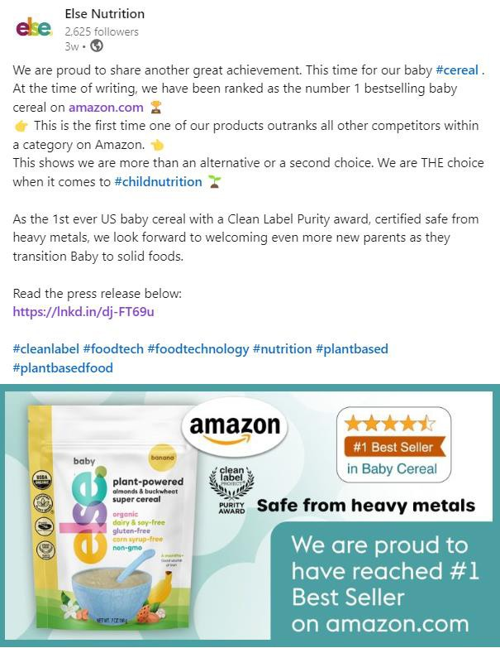





DRIVING PARENTS TO PURCHASE
Social Facebook, Instagram, YouTube, LinkedIn
Influencers
Shawn Johnson, Ashley Tisdale, Alicia Silverstone, Tori Spelling
Media
Parenting magazines, TV test, Parenting events
HCP-Dedicated Website
20

Slide 20








TRADE SHOWS
21

Slide 21
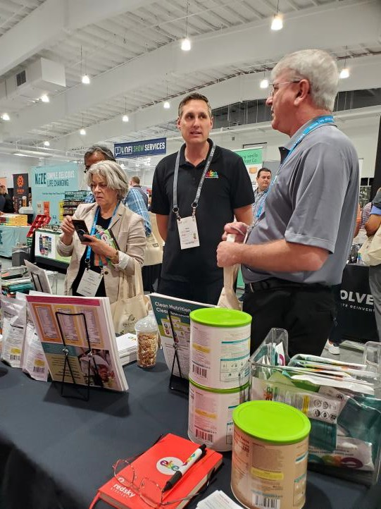
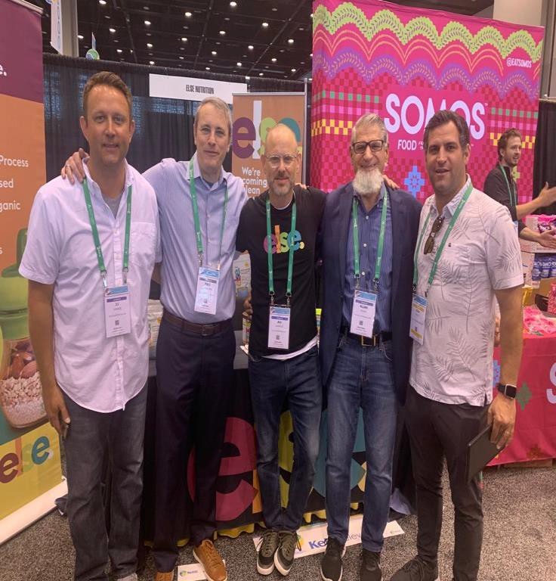

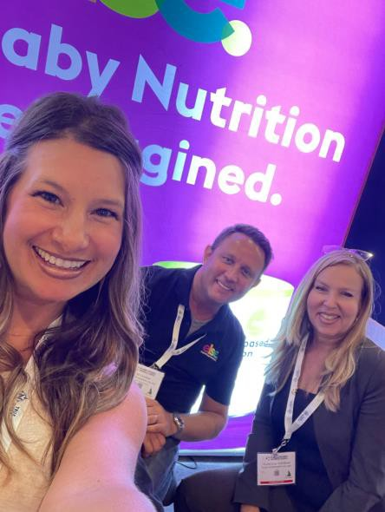
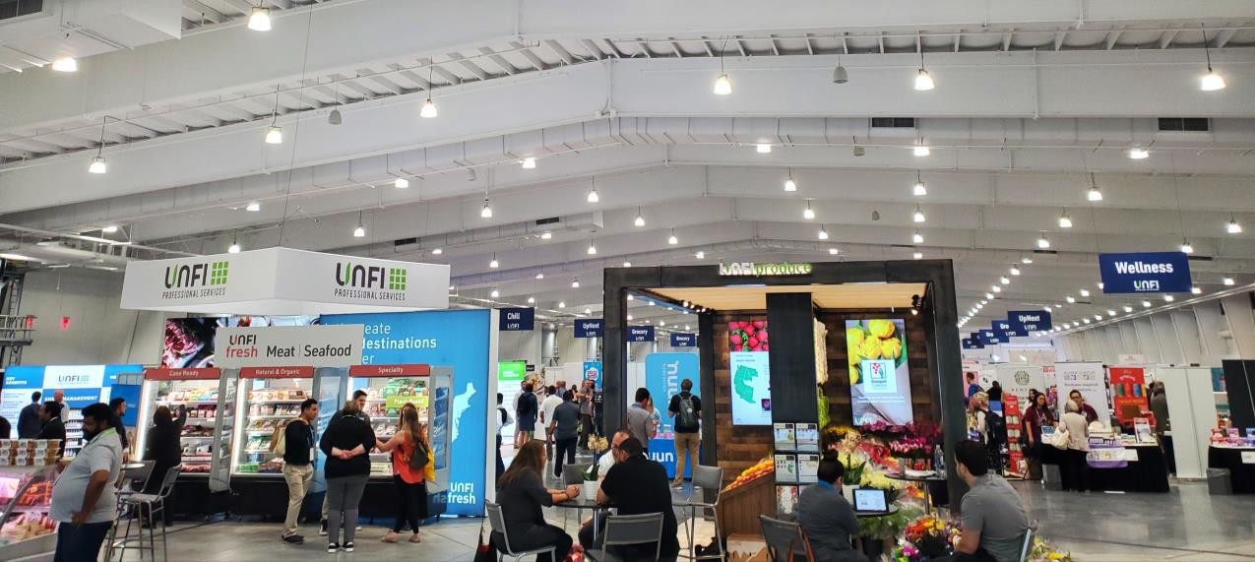
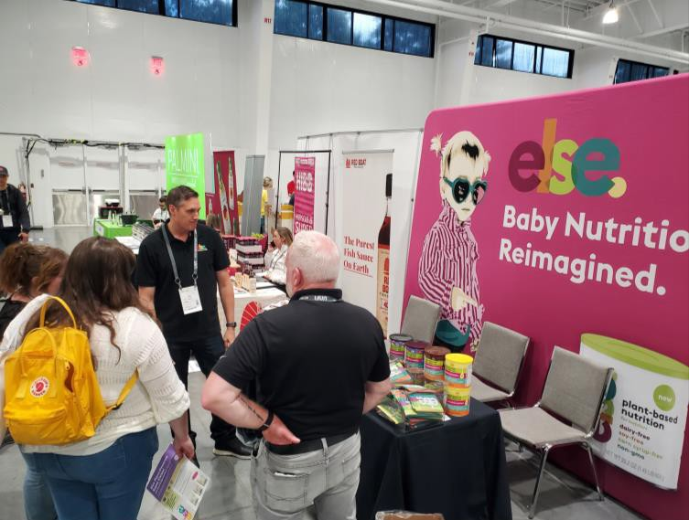
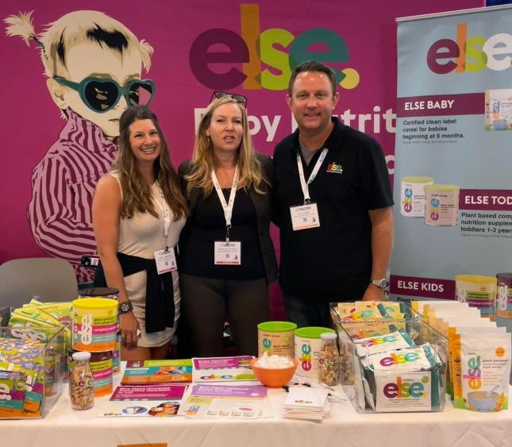
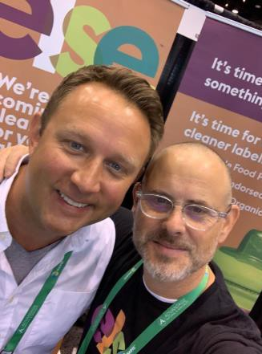
PASSION
22

Slide 22

Contact Details:
D.J. Tanner
Vice President, US Retail
djt@elsenutrition.com
📞 (614) 208-1576
Else Nutrition USA, Inc. retailsales@elsenutrition.com www.elsenutrition.com

