Slide 1
Grovara
2023 Assortment

Slide 2

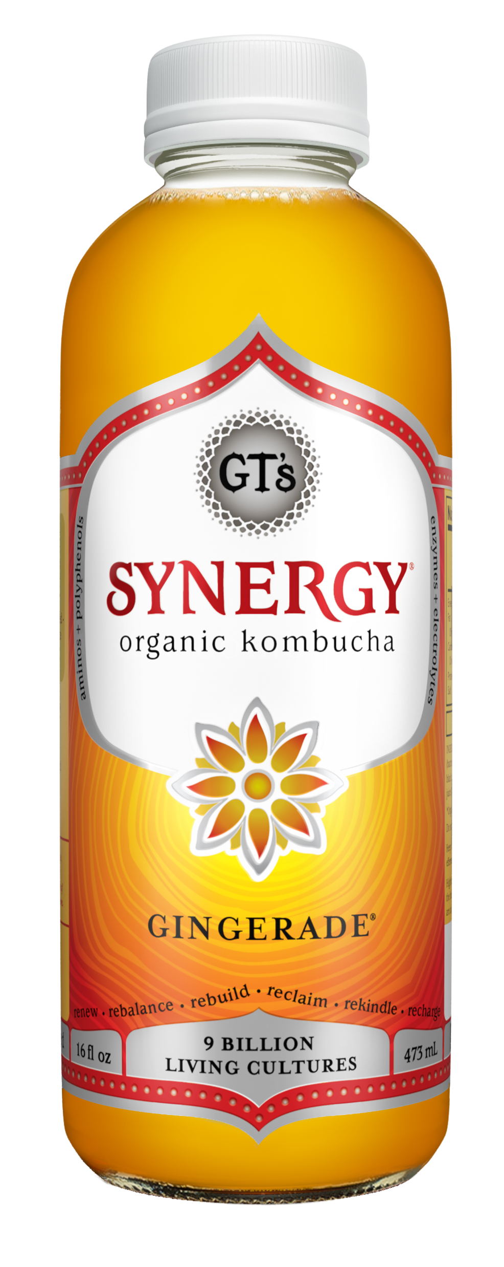
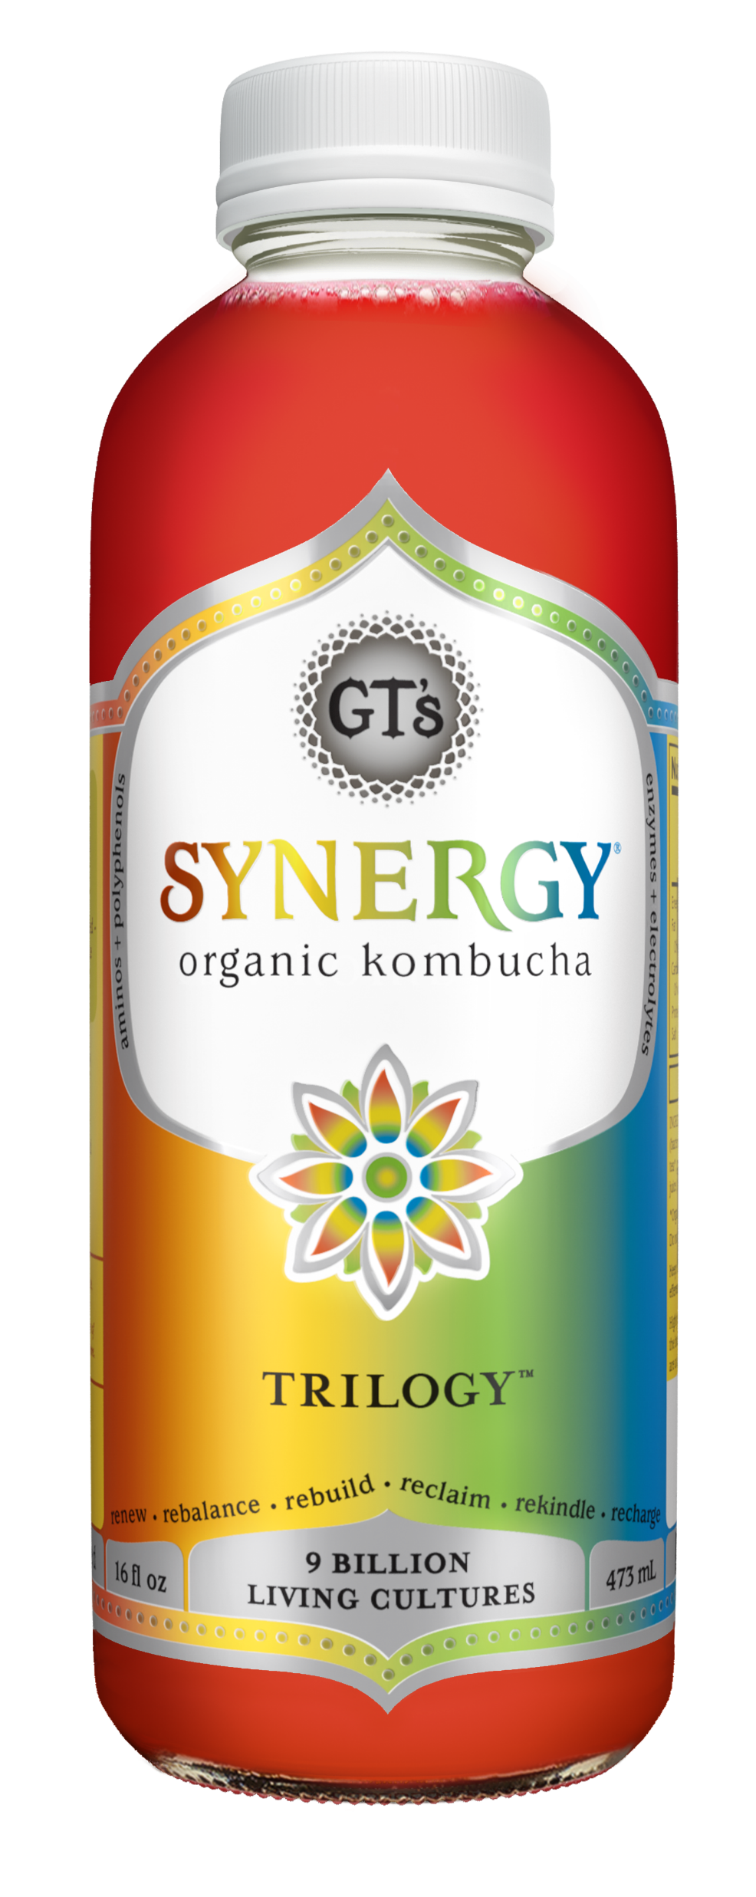
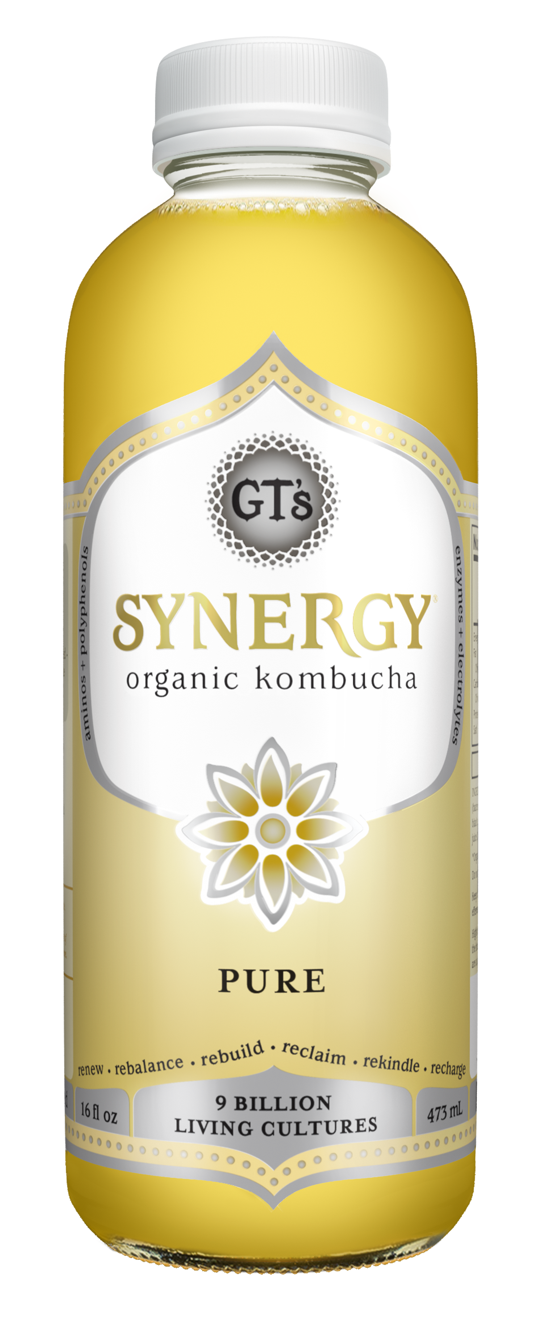
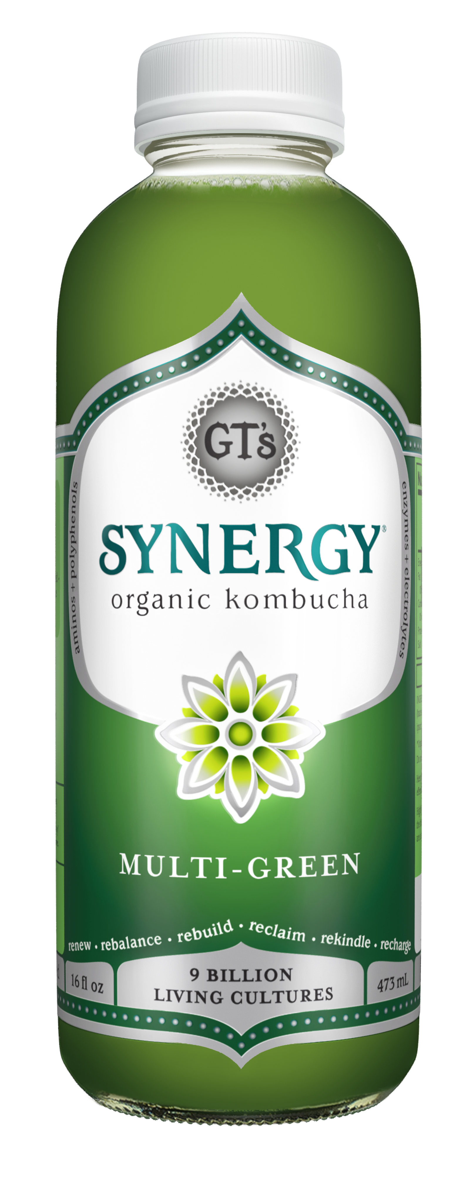
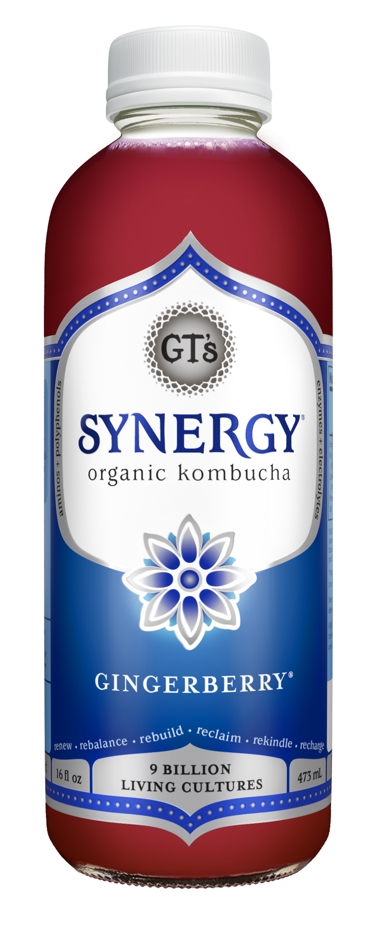
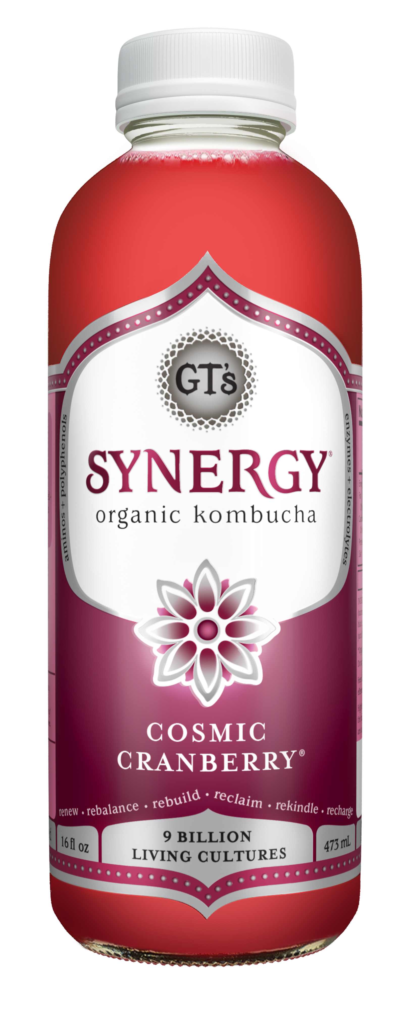
Grovara – 2023 Assortment
2023 Assortment
Description | Item UPC | Case Pack
GT's Synergy Kombucha Cosmic Cranberry 12 units per case 16.0 fl | 722430300122 | 12/16oz
GT's Synergy Kombucha Gingerade 12 units per case 16.0 fl | 722430200125 | 12/16oz
GT's Synergy Kombucha Gingerberry 12 units per case 16.0 fl | 722430600123 | 12/16oz
GT's Synergy Kombucha Multi-Green 12 units per case 16.0 fl | 722430140124 | 12/16oz
GT's Synergy Kombucha Pure 12 units per case 16.0 fl | 722430000121 | 12/16oz
GT's Synergy Kombucha Trilogy 12 units per case 16.0 fl | 722430110127 | 12/16oz
2023 Launches
Description | Item UPC | Case Pack | Market | Listing Status
GT's Synergy Kombucha Gingerade 12 units per case 10.0 fl | 722430200200 | 12/10oz | UK | Q2 (Mid-May); remove from listing for now
GT's Synergy Kombucha Trilogy 12 units per case 10.0 fl | 722430110202 | 12/10oz | UK | Q2 (Mid-May); remove from listing for now
GT's Synergy Kombucha Guava Goddess 12 units per case 16.0 fl | 722430900124 | 12/16oz | UK | Q2 (Mid-May); remove from listing for now
GT's Synergy Kombucha Lemon Berry 12 units per case 16.0 fl | 722430710129 | 12/16oz | UK | Q2 (Mid-May); remove from listing for now
GT's Synergy Kombucha Gingerade 12 units per case 10.0 fl | TBD | 12/10oz | Mexico | TBD
GT's Synergy Kombucha Trilogy 12 units per case 10.0 fl | TBD | 12/10oz | Mexico | TBD
GT's Synergy Kombucha Guava Goddess 12 units per case 10.0 fl | TBD | 12/10oz | Mexico | TBD
GT's Synergy Kombucha Lemon Berry 12 units per case 10.0 fl | TBD | 12/10oz | Mexico | TBD

Slide 3
Grovara - Discos
Discos
Description | Item UPC | Case Pack | Listing Status
GT's Aqua Kefir Pomegranate 12 units per case 16.0 fl | 722430581187 | 12/16oz | Remove
GT's Aqua Kefir Coconut Lime 12 units per case 16.0 fl | 722430591186 | 12/16oz | Remove
GT's Aqua Kefir Peach Pineapple 12 units per case 16.0 fl | 722430571188 | 12/16oz | Remove
GT's Classic Kombucha Gingerade 12 units per case 16.0 fl | 850057003024 | 12/16oz | Remove
GT's Classic Kombucha Trilogy 12 units per case 16.0 fl | 850057003116 | 12/16oz | Remove
GT's Synergy Kombucha Pink Lady Apple 12 units per case 16.0 fl | 722430360126 | 12/16oz | Remove
GT's Synergy Kombucha Gingerade 6 units per case 48.0 fl | 722430200521 | 6/48oz | Remove
GT's Synergy Kombucha Gingerberry 6 units per case 48.0 fl | 722430600482 | 6/48oz | Remove
GT's Synergy Kombucha Guava Goddess 6 units per case 48.0 fl | 722430900483 | 6/48oz | Remove
GT's Synergy Kombucha Hibiscus Ginger 6 units per case 48.0 fl | 722430170480 | 6/48oz | Remove
GT's Synergy Kombucha Trilogy 6 units per case 48.0 fl | 722430110523 | 6/48oz | Remove
GT's Synergy Kombucha Watermelon Wonder 6 units per case 48.0 fl | 722430340487 | 6/48oz | Remove
GT's Synergy Kombucha Carrot Turmeric 6 units per case 48.0 fl | 722430320489 | 6/48oz | Remove

Slide 4
Grovara – Listing Page
Item | Item UPC | Listing Description
GT's Synergy Kombucha Cosmic Cranberry 12 units per case 16.0 fl | 722430300122 | Pure unsweetened cranberry with a tang.
 |  | SYNERGY is an authentic, raw Kombucha fermented for 30 days. Perfect for new and experienced Kombucha drinkers alike, brewed with kiwi juice to cultivate 9 billion living probiotics.
GT's Synergy Kombucha Gingerade 12 units per case 16.0 fl | 722430200125
 |  | Fresh-pressed ginger with a bold finish.
 |  | SYNERGY is an authentic, raw Kombucha fermented for 30 days. Perfect for new and experienced Kombucha drinkers alike, brewed with kiwi juice to cultivate 9 billion living probiotics.
GT's Synergy Kombucha Gingerberry 12 units per case 16.0 fl | 722430600123
 |  | Delicious waves of ripe blueberry finished with a fresh gingery bite.
 |  | SYNERGY is an authentic, raw Kombucha fermented for 30 days. Perfect for new and experienced Kombucha drinkers alike, brewed with kiwi juice to cultivate 9 billion living probiotics.
GT's Synergy Kombucha Multi-Green 12 units per case 16.0 fl | 722430140124
 |  | A powerful blend of three super greens.
 |  | SYNERGY is an authentic, raw Kombucha fermented for 30 days. Perfect for new and experienced Kombucha drinkers alike, brewed with kiwi juice to cultivate 9 billion living probiotics.
GT's Synergy Kombucha Pure 12 units per case 16.0 fl | 722430000121
 |  | Bright fresh Kombucha—pure, simple, and uncompromised.
 |  | SYNERGY is an authentic, raw Kombucha fermented for 30 days. Perfect for new and experienced Kombucha drinkers alike, brewed with kiwi juice to cultivate 9 billion living probiotics.
GT's Synergy Kombucha Trilogy 12 units per case 16.0 fl | 722430110127
 |  | Delicious bursts of tart raspberry combine with bright squeezes of lemon and a bite of fresh-pressed ginger for a flavor as unique as you.
 |  | SYNERGY is an authentic, raw Kombucha fermented for 30 days. Perfect for new and experienced Kombucha drinkers alike, brewed with kiwi juice to cultivate 9 billion living probiotics.

Slide 5
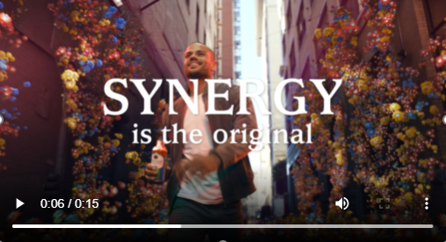
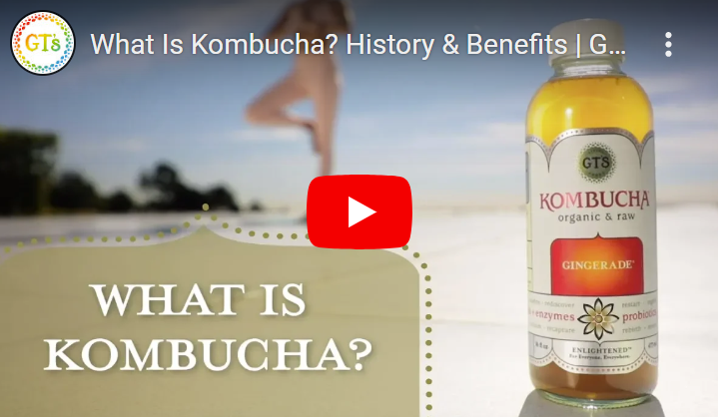
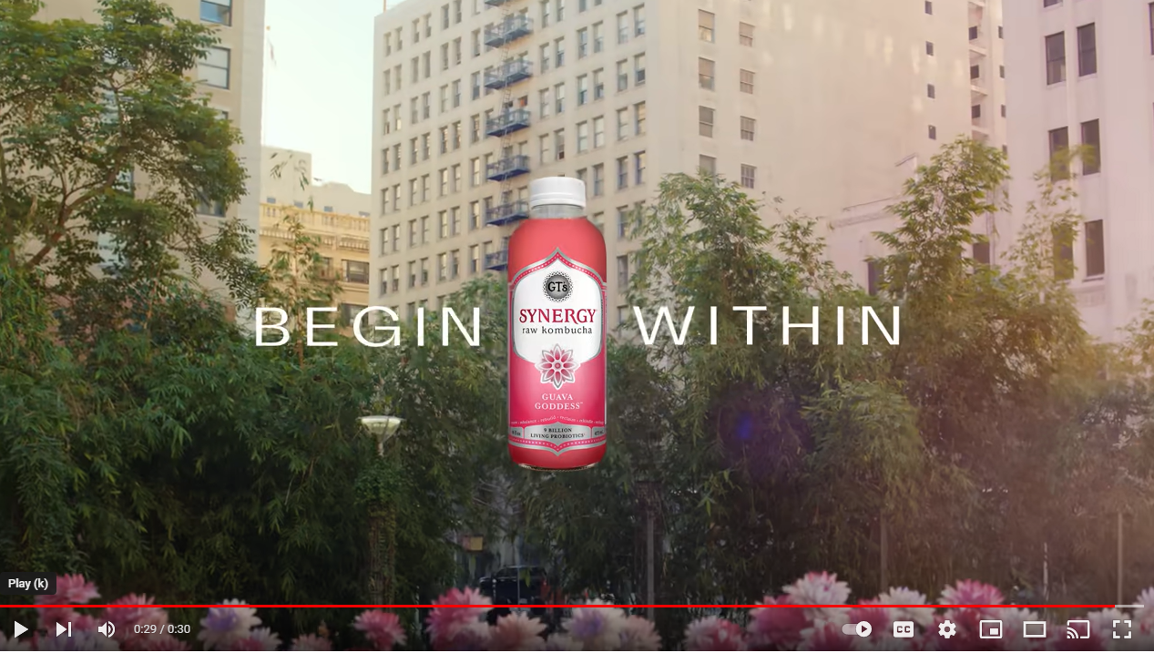
Grovara – Listing Page
Replace landing videos to SYNERGY “Begin Within”

