Slide 1


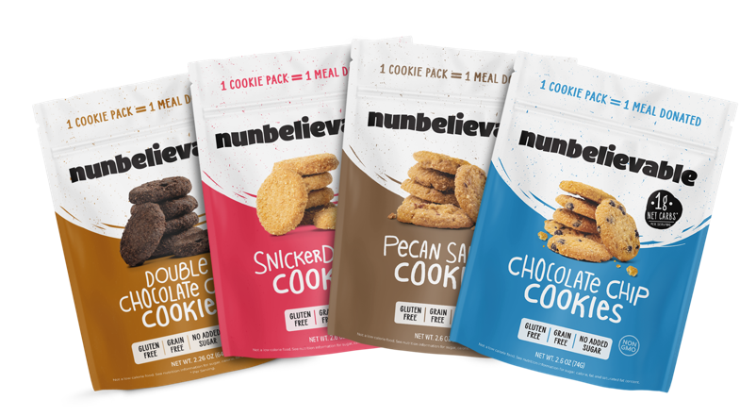

Low-carb/Gluten-free Product Overview
October 20, 2022

Slide 2




The mission-driven baked goods company founded by two cookie lovers who wanted to make a difference.
We bake delicious,
better-for-you products while tackling food insecurity with our BUY 1, GIVE 1 model.

Slide 3

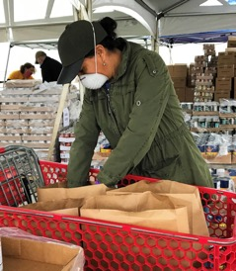

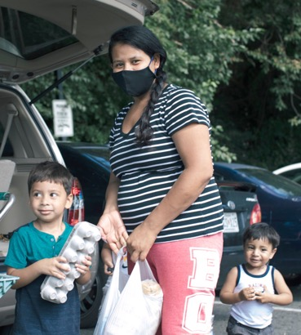





Our Mission
To date, we’ve donated proceeds to provide over 1,000,000 meals to those in need.
Nunbelievable’s mission is to help solve the hunger crisis. 42 million people in the U.S. are food insecure — 11 million of whom are children.
With our buy one, give one model, we partner with organizations that provide meals to those in need.

Slide 4












Our Retail Presence Today
Independents
Door Count: >2,000
*Includes retail outlets + Instant delivery hubs
‹#›

Slide 5








Our Cookies Are Delicious!
We’re getting amazing 5-star reviews from customers.
Great Cookies
They’re Unbelievable!
So Yummy
These cookies taste great, my favorite flavor is the double chocolate chip...and I love the mission as well.
— Jessica L.
These cookies are incredibly delicious, all of them! You wouldn't know the double chocolate are gluten-free if the packaging didn't tell you.
— Andersen S.
Love these cookies and so do my girls! So soft, so delish and very large!
— Danielle G.
‹#›

Slide 6


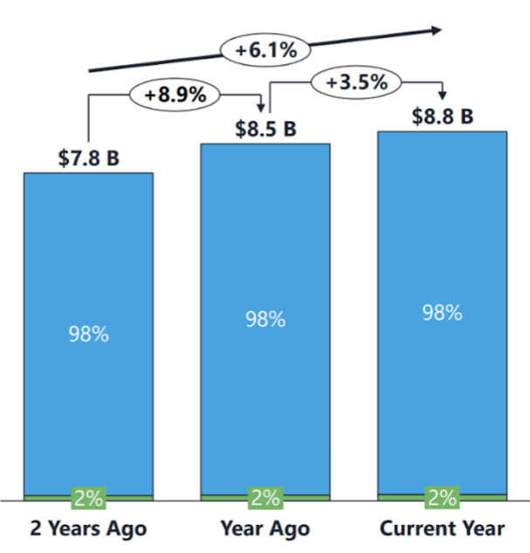
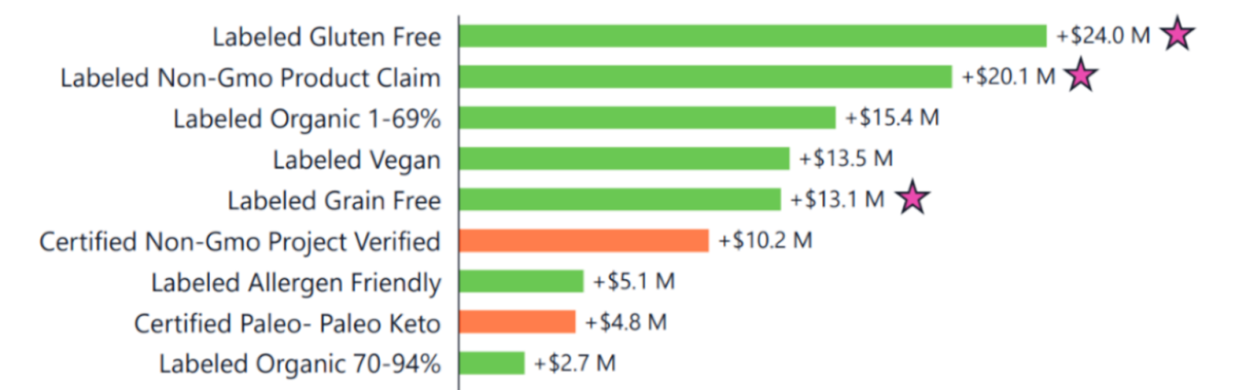

3 Reasons We’re Growing
We address growing consumer trends:
Gluten/Grain Free, Non-GMO & Low Sugar
The category is
growing: a 6.1% CAGR
1
2
3
Our mission is authentic!
87% of Americans will purchase a product that supports a cause they care about.
“Instead of donating money directly to causes they care about, shoppers under the age of 40 prefer to give back through where they shop.”

Slide 7

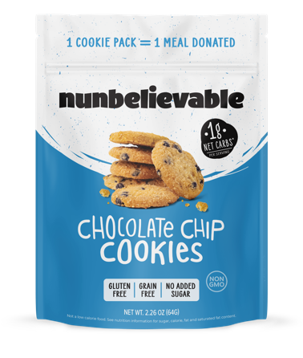
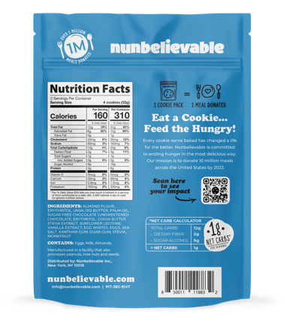
Low Carb Chocolate Chip Cookies
Product Description | Unit UPC | Unit Cost | Unit Size | Units Per Case | Cases Per Pallet | Shelf Life | SRP | Case Cost
Chocolate Chip | 850011118832 | $2.99 | 2.26 oz | 6 | 240 | 365 | $4.99 | $17.94
‹#›

Slide 8
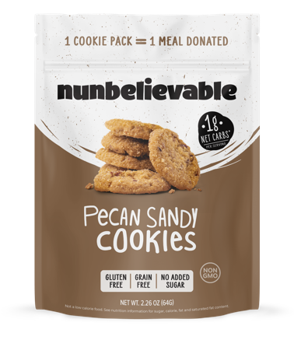
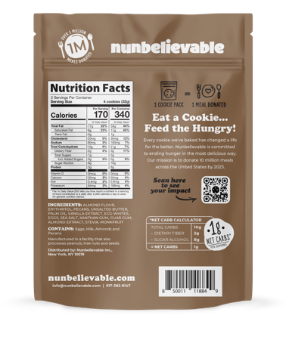
Low Carb Pecan Sandy Cookies
Product Description | Unit UPC | Unit Cost | Unit Size | Units Per Case | Cases Per Pallet | Shelf Life | SRP | Case Cost
Pecan Sandy | 850011118849 | $2.99 | 2.26 oz | 6 | 240 | 365 | $4.99 | $17.94
‹#›

Slide 9
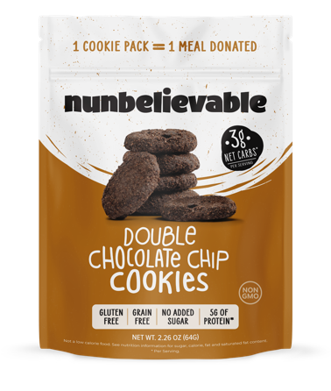
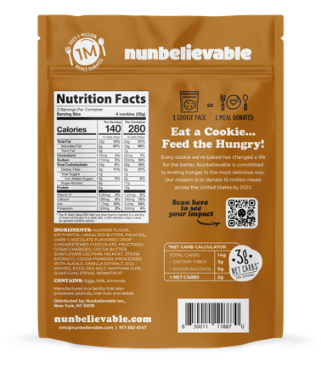
Low Carb Double Chocolate Cookies
Product Description | Unit UPC | Unit Cost | Unit Size | Units Per Case | Cases Per Pallet | Shelf Life | SRP | Case Cost
Double Chocolate | 850011118870 | $2.99 | 2.26 oz | 6 | 240 | 365 | $4.99 | $17.94
‹#›

Slide 10
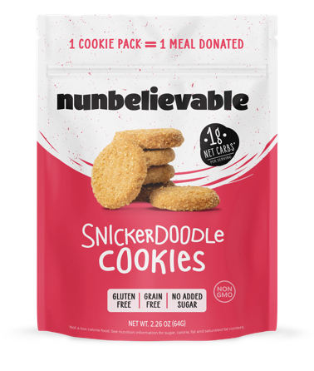
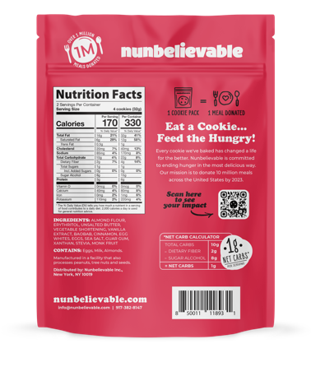
Low Carb Snickerdoodle Cookies
Product Description | Unit UPC | Unit Cost | Unit Size | Units Per Case | Cases Per Pallet | Shelf Life | SRP | Case Cost
Snickerdoodle | 850011118931 | $2.99 | 2.26 oz | 6 | 240 | 365 | $4.99 | $17.94
‹#›

Slide 11
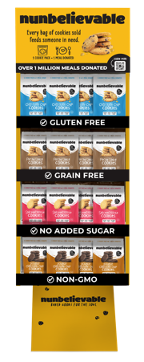
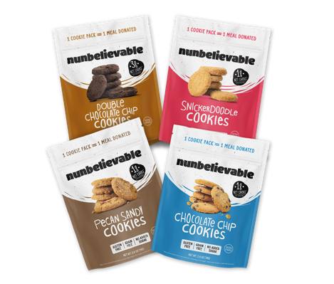
Low Carb Stand Up Display
(12 of Each Flavor Variety)
Product Description | Unit UPC | Unit Cost | Unit Size | Units Per Case | Cases Per Pallet | Shelf Life | SRP | Case Cost
Stand Up Display | 850011119143 | $3.10 | 2.26 oz | 56 | 16 | 365 | $4.99 | $173.60
‹#›

Slide 12
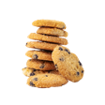

CONTACT OUR TEAM
Neal Lyons, VP of Strategic Accounts
neal@loeb.nyc
(714-815-5083)
Claudia Hernandez, Wholesale Account Manager
claudia@nunbelievable.com
(312-613-8716)
‹#›

