Slide 1
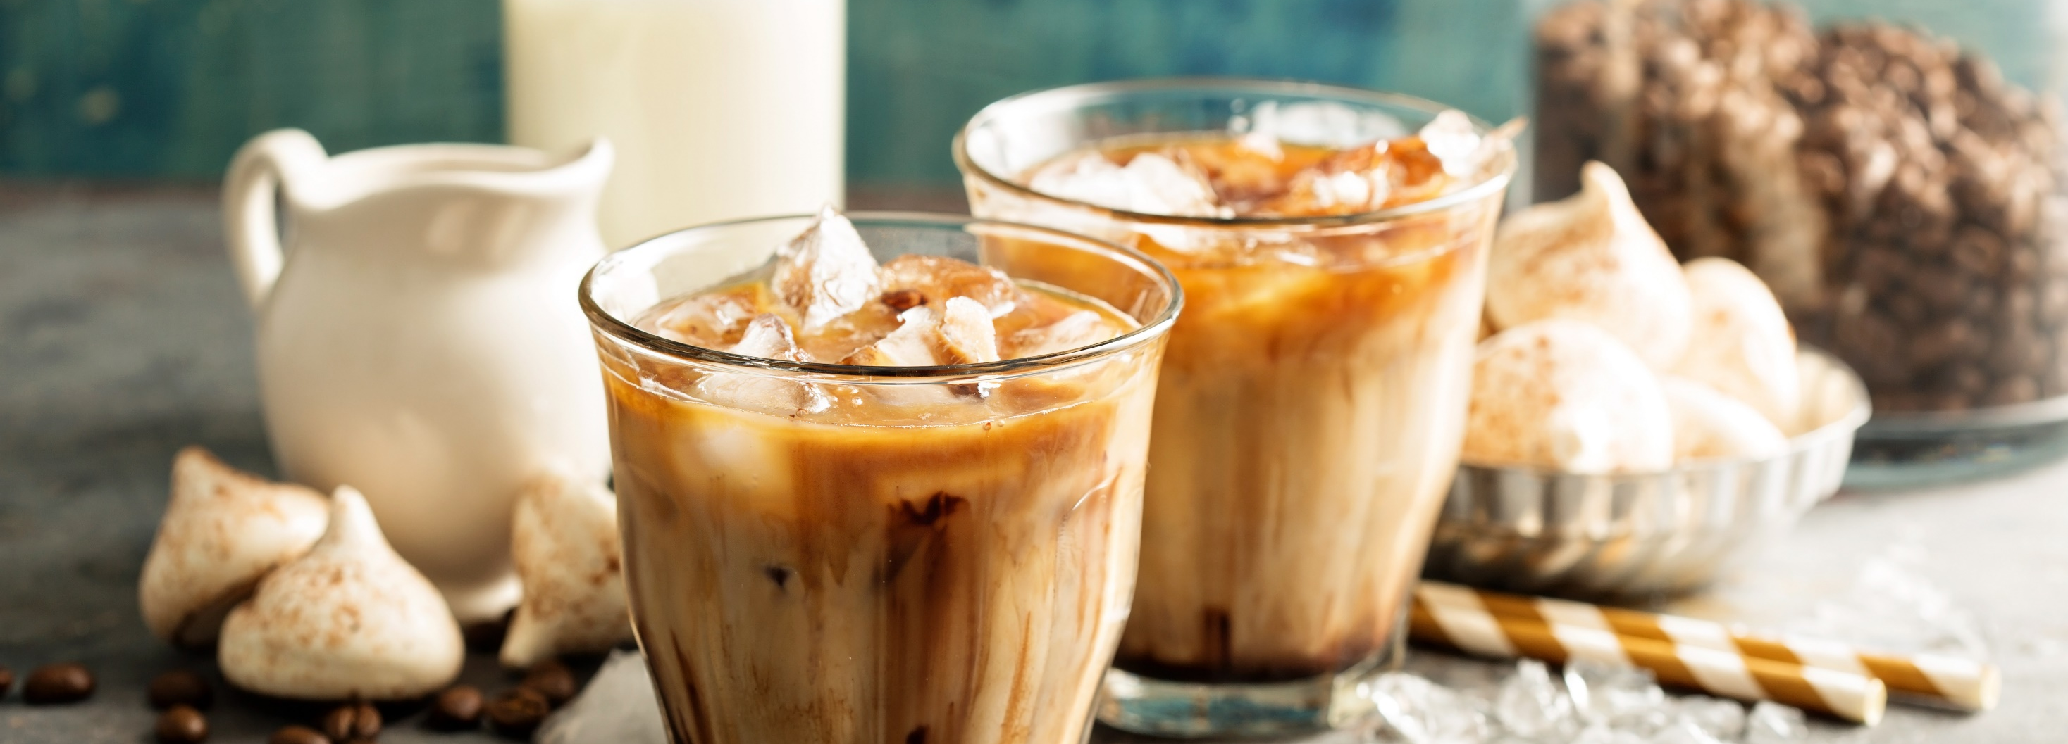

COFFEE INTRODUCTION

Slide 2

Mintel projects coffee to reach $15.6B in 2020, +5% vs. 2019, and to continue growth for the near and long term
COVID-19 has benefitted & will continue to benefit retail coffee
Shelter-in-place boosted coffee at home
Both unemployment & increase in WFH will have a lasting impact
Working and learning at home means more coffee consumption at home
Total US retail sales ($MM) and forecast of coffee and RTD coffee, at current prices, 2015-25
Source: based on IRI InfoScan® Reviews; US Census Bureau, Economic Census/Mintel
Source: Mintel US Coffee including covid-19 impact – July 2020

Slide 3
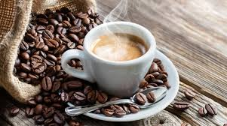
Retail coffee has a history of thriving during recessions and had a 10% 4-year cagr during the great Recession
Coffee is a habitually consumed beverage and very few will leave the market entirely
2009 Great Recession
Consumers reduced their coffee shop purchases during the Great Recession, however coffee sales still rose
Consumers wanted premium coffee drinks
Foodservice branded products have since showed strong performance & will continue through potential upcoming recession
Source: based on IRI InfoScan® Reviews; US Census Bureau, Economic Census/Mintel
Source: Mintel US Coffee including covid-19 impact – July 2020

Slide 4


Coffee continues to be the #1 consumed beverage with consumers entering earlier
Coffee is still the most consumed beverage, with 62% having past-day consumption (vs. 54% for bottled water and 47% for tap water)
81% of all households drink coffee today (HHP is 80.5%), which is up 1.4 points vs. YA
Coffee buyers spend $133/year on the category at retail
Consumers are entering earlier, driving category growth, and trying more types of coffee than older generations
Sources: National Coffee Association Data Trends Report 2020; IRI Panel Data, Total U.S. All Outlet; L52WE 6 Sept 2020

Slide 5


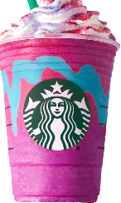
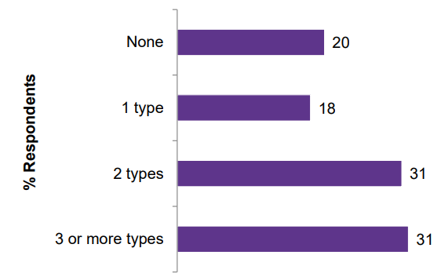
YOUNGER COFFEE CONSUMERS DRIVING THE COFFEE EVOLUTION
Millennials driving growth today; Gen Z is the growth for the future
Consumers entering earlier
Are more engaged & try more types of coffee
Prefer to whiten but also Seek additional benefits
Number of Types of Coffee Consumed
Enter on sweet & creamy coffee drinks
84% whiten their coffee
17.1
Average age Millennials started drinking coffee
IDEAL ATTRIBUTES
48%
Energy Boosting
43%
Helps to Relax
35%
High Protein
14.7
Average age Gen Z started drinking coffee
Consumers drinking 3 or more types:
16% more likely to be Gen Z (36%)
65% more likely to be Millennial (51%)
48% more likely to have children (46%)
PURCHASE INTEREST
32%
Would rather drink functional coffee than take vitamins / supplements
Sources: National Coffee Association‘s 2019 National Coffee Drinking Trends (NCDT) report;
Mintel – Coffee – US – July 2019 report; Base: 2,000 internet users aged 18+

Slide 6
At-home is the top venue for coffee consumption, and is up IN BOTH PRE- AND during COVID
Nearly 60% of coffee drinkers consume solely at home, up 5 pts vs. 2017
Nearly 80% of drinkers consume both at home & AFH, +3 pts
4-in-5 of coffee drinkers prepare coffee at home, up 5 points vs. 2017
More consume coffee at home than out-of-home, and more are planning to do so even post-Covid-19
79% drink coffee at home, +3pts vs. 2017
59% drink at home only
21%
drink away from home only
20%
Both
59% of coffee drinkers consume solely at home, up 5 points from 54% in 2017
20% drink both in-home & away from home
21% drink away from home only, down from 24%
Sources: National Coffee Data Trends, 2020 (NCA – National Coffee Association);
IRI Survey, 4/10-12 among National Consumer Panel representing Total U.S. Primary Grocery Shoppers

Slide 7

77% of consumers are buying more coffee at home are drinking more, and 27% are making coffee at home more often
Only a quarter of consumers say they are not drinking more coffee
COVID-19 SURVEY
27% of consumers are making coffee at home more often, with the majority of these consumers planning to continue this behavior post-Lockdown
77%
of consumers are buying more coffee to drink at home
Sources: Suzy custom survey, August 2020, N=396; IRI Survey, 4/10-12 among National Consumer Panel representing Total U.S. Primary Grocery Shoppers

Slide 8




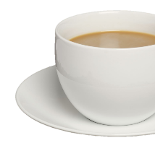
Coffee consumers overwhelmingly drink more coffee at home & have increased the amount consumed per day
Coffee consumers drink significantly more coffee at home, which increased during COVID, and away from home consumption decreased
The amount of coffee consumed at home during COVID has increased
How often do you currently drink coffee…
And how many cups of coffee a day do you drink at home?
AT HOME
35% drink a cup or less (down from 39% pre-COVID)
More than once a day
32% drink about 2 cups
OUTSIDE OF THE HOME
33% drink 3 or more cups (up from 30% pre-COVID)
Once a week or less often
Source: Shopper’s Round Table Custom Survey, Coffee + Creamers COVID, October 2020, n=629

Slide 9

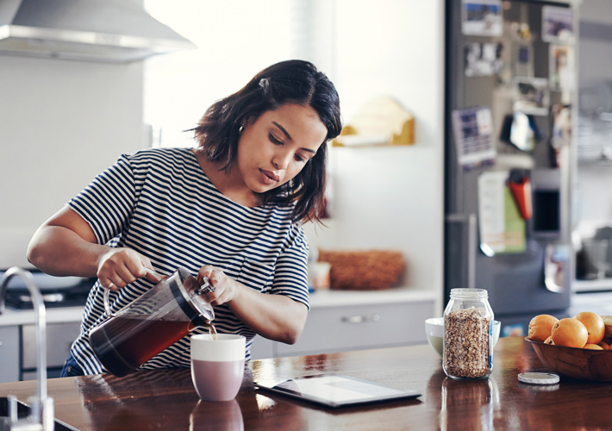
Coffee remains the most popular beverage consumed at home even during covid
Consumers are replacing AFH coffee occasions with at-home consumption
  COVID-19 has disrupted daily commutes and AFH routines
Source: Technomic, Beverages Report, August 2020; Base: Varies among those who are consuming each beverage less often from foodservice. No base sizes are under 30.

Slide 10
Since covid, Coffee shop users have been making more coffee at home, and most expect to continue post-covid
Most coffee shop users expect to continue to buy more coffee & make more coffee, & make coffee more often at home (more usage occasions!)
At least half expect to be more committed to coffee, buying new equipment AND joining a service
Q: Have you made any of the following changes to your at-home beverage behavior because of the coronavirus outbreak? Select all that apply. Base: varies by behavior changes during COVID-19
Q: Which of the following do you expect to continue doing after the coronavirus outbreak has subsided? Select all that apply.
Source: Technomic, Beverages Report, August 2020; Base: 746 consumers who visit these restaurants at least once every 2-3 months

Slide 11

TRADITIONAL CREAMERS

Slide 12
covid is boosting creamer consumption, which is up 15% in the L52 weeks and delivering a +7.7% 5-year Cagr
COVID accelerating growth for all segments
Traditional creamers is nearly 90% of the category growing at +13.8% vs. YA
COVID IMPACT
26% Purchasing MORE RFG coffee creamer since COVID-19
~35% Claiming the reason they are buying more creamers is to indulge/treat themselves
+32.5%
+7.7%
5 YEAR CAGR
+10.8%
Traditional,
$2,388,037,513 87%
+13.8%
Dollars % Chg.. vs. YA
Source: IRI, MULO, L52 WE August 16, 2020; DNA Custom Category & Brand A&U Tracker, Wave 1 (3/31-4/4/20) & Wave 2 (4/16-4/20/20)

Slide 13
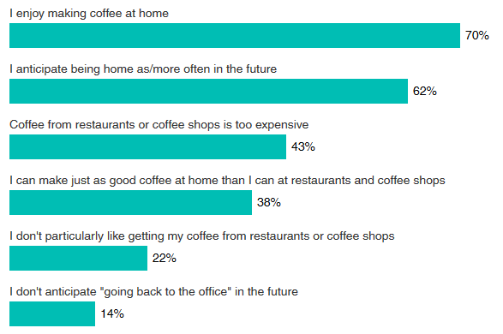
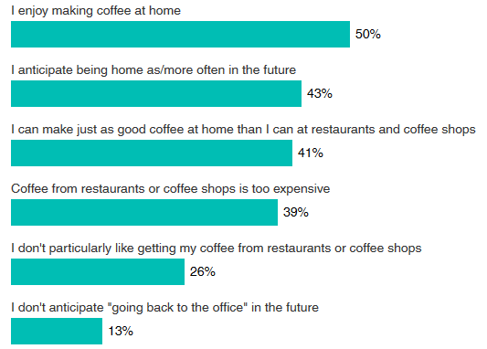
coffee is an emotionally-driven ritual that is expected to grow in importance post-COVID
Making coffee is an important aspect of a consumer’s coffee ritual
Roughly 40% believe they can also make coffee just as good as the restaurants do
You mentioned you think you will drink more coffee at home in the future.
Why is that?
You mentioned you think you will drink less coffee away from the home in the future. Why is that?
N=171
N=varies
Source: Shopper’s Round Table Custom Survey, Coffee + Creamers COVID, October 2020

Slide 14

Coffee drinkers love their coffee, and creamer buyers are more enthusiastic than the average coffee drinker
How would you characterize yourself best when it comes to coffee?
Top 5 Statements
Creamer buyers are more passionate about coffee than the average coffee buyer
Source: Shopper’s Round Table Custom Survey, Coffee + Creamers COVID, October 2020, n=784

Slide 15
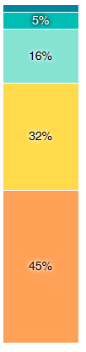


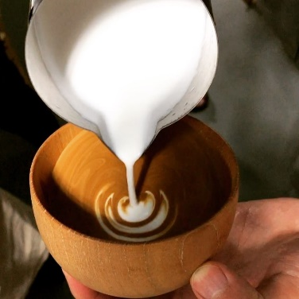
Nearly 80% of coffee drinkers add milk, cream or creamers while roughly only 1-in-5 drink coffee black
How do you take your coffee at home?
Black coffee driven by older consumers
30% of 60+ aged consumers vs. 6% of 18-24 aged consumers
Creamed coffee driven by 18-24 year olds
Nearly 60% more likely to whiten vs. 25+ year olds
More than 2X likely as 60+ year olds
Sources: Shopper’s Round Table Custom Survey, Coffee + Creamers COVID, October 2020, n=629; National Coffee Association Data Trends Report 2020

Slide 16
favorite brand & a variety of flavors drove increased creamer consumption during covid
In the future, consumers will want continued variety
Stocking up is the #1 reason for buying more creamers during COVID while type, brand and variety of flavor are the next top reasons
In the future, coffee consumers will want more indulgence, flavor, texture & variety in their coffee
How have you changed your coffee creamer buying during COVID?
How will you change how you take your coffee in the future?
Source: Shopper’s Round Table Custom Survey, Coffee + Creamers COVID, October 2020, n=392

Slide 17
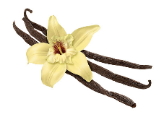
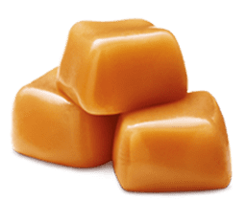
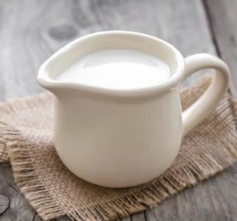
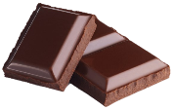
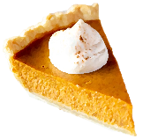


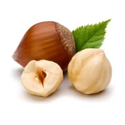
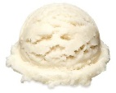

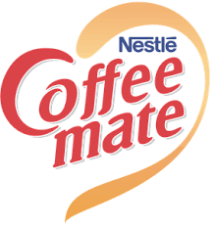


What drives Creamer Consumption? Flavor and brand – these are key purchase drivers among creamer buyers
#1 Decision: Flavor
  Availability
  Variety
  Flavored vs. Unflavored
  Sweetened vs. Unsweetened
  HIGH cross purchase among flavors
Mainstream (85%)
Emerging (70%)
Basic Flavors
(More) Indulgent Flavors
Seasonal & Specialty
PB / All Natural
Functional / CL
H&H / HWC
Unflavored
72%
73%
58%
61%
32%
43%
#2. Brands act as guide posts for shoppers to find their favorite flavors
Coffee-mate reaches 80% of consumers
International Delight reaches 72%
Silk reaches 46%
ID reaches 2X
its fair share of shoppers
(vs. dollar share)!
(#%) = net penetration, meaning % of shoppers that definitely would buy (DWB) at least one variety within a product cluster – a Top Box 9 selected on a 9 point scale i.e.: 85% of category buyers would definitely buy Mainstream creamers (selected 9 out of 9 on purchase interested scale)
Sources: Coffee Creamer CDT – Grocery/Mass channel, March 2020; CDT custom survey, n=500
Notes:
#1: Flavor
The key purchase driver for a coffee creamer buyer is FLAVOR: Availability of flavor, variety of flavor, whether it’s flavored or unflavored, etc.
The consumer views the category as “mainstream” or “emerging”
85% of consumers purchase mainstream creamers vs. 70% of emerging
High percentages indicate high cross purchase
And in terms of how the consumer engages by flavor is from unflavored to basic flavors to more indulgent flavors. This continues into specialty items and “value-added” items which includes PB, CL, H&H/HWC
#2: Brand
Brands act as guide posts for shoppers to find their favorite flavors; through their strong reach, they drive awareness, trial and conversion for the retailer
Coffee-mate reaches 80% of consumers
International Delight reaches 72%
Silk reaches 46%
THINK ABOUT THE ICE CREAM AISLE: Think about when you’re considering buying ice cream, and about you approaching the aisle as you begin to make your decision. Do you think, “chocolate” or “vanilla”, or do you think,
“Breyers, or Ben & Jerry’s”? Chances are you think about flavor or type first, yet, it is organized by brand, and that’s because consumers relate certain flavors to certain brands. Coffee creamer aisle is the same way, consumers do think in terms of flavor first but look to brand to help them navigate the flavors.

Slide 18
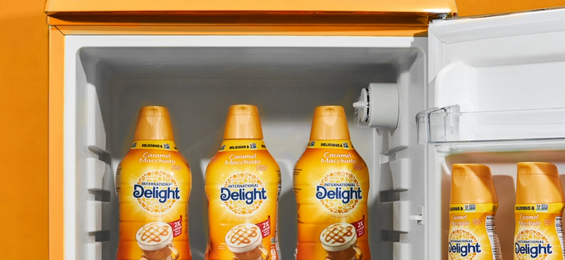
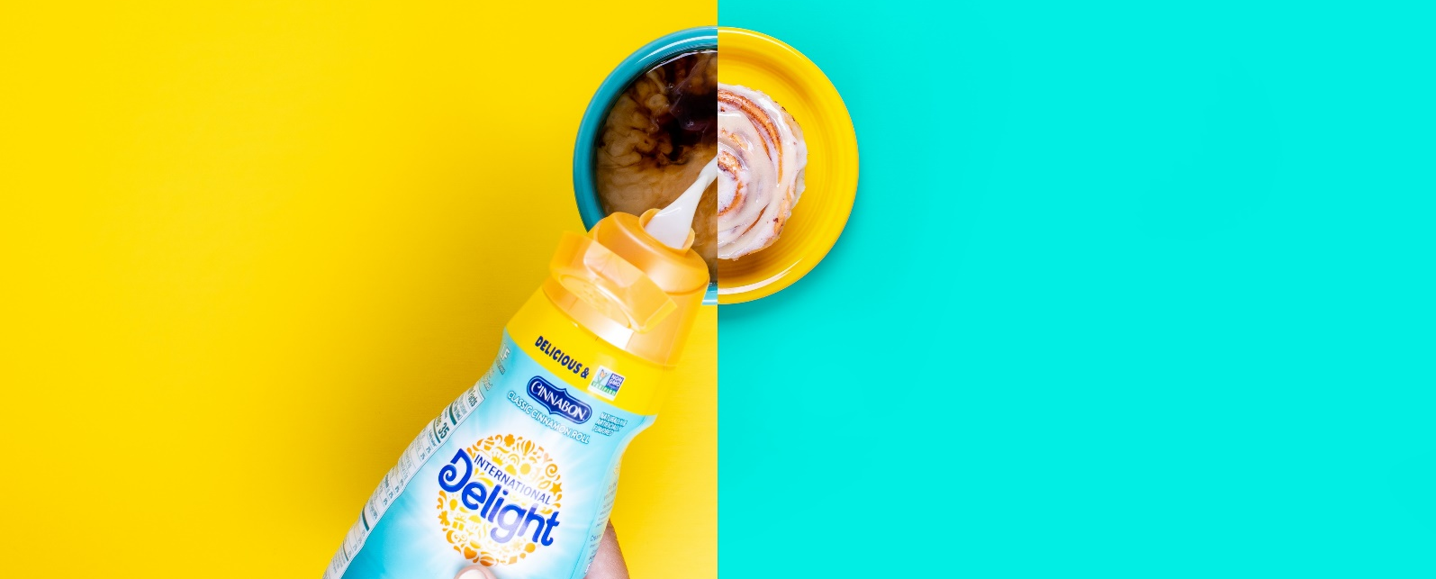
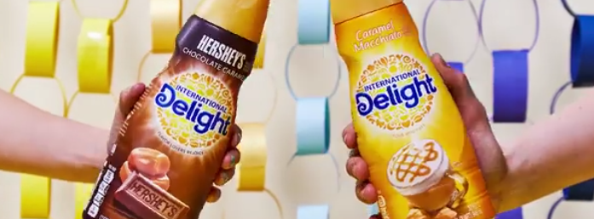
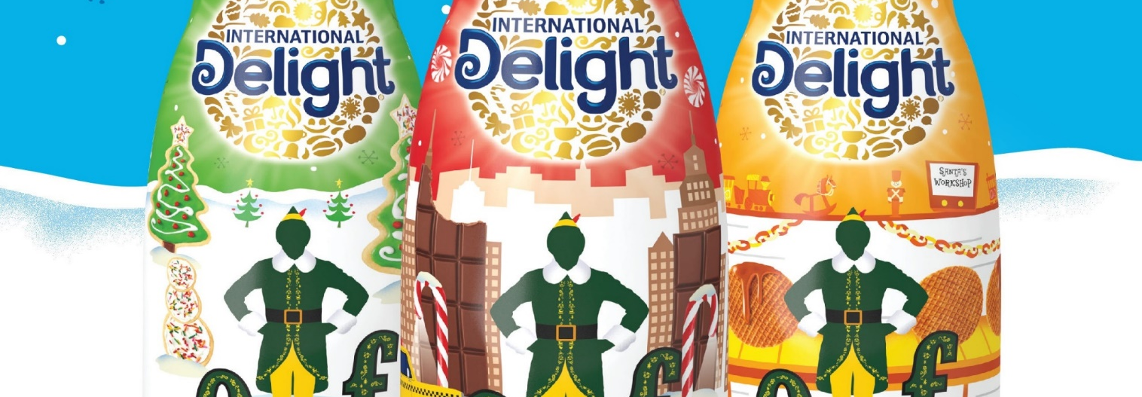
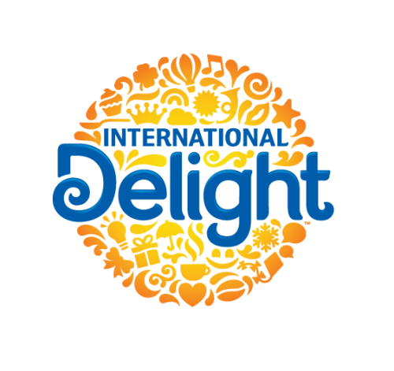

International Delight Creamers
Brand Updates

Slide 19




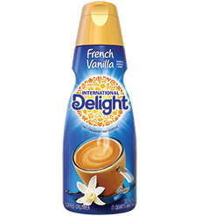
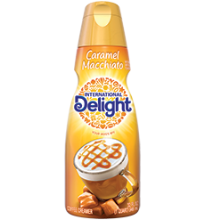
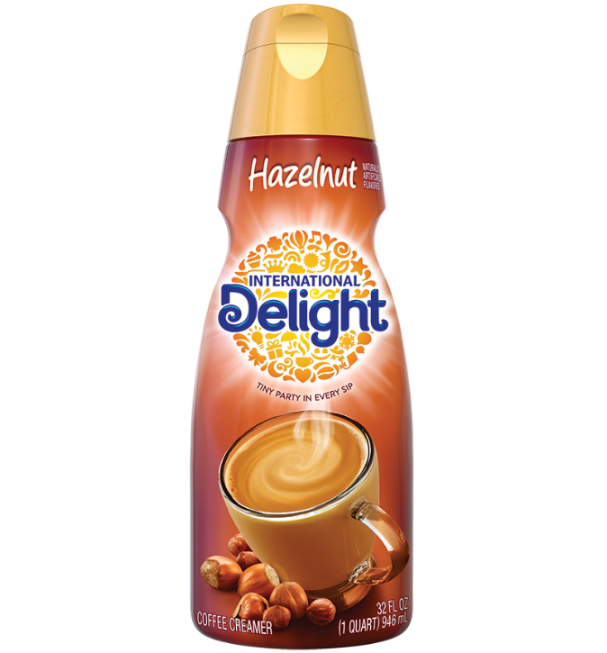
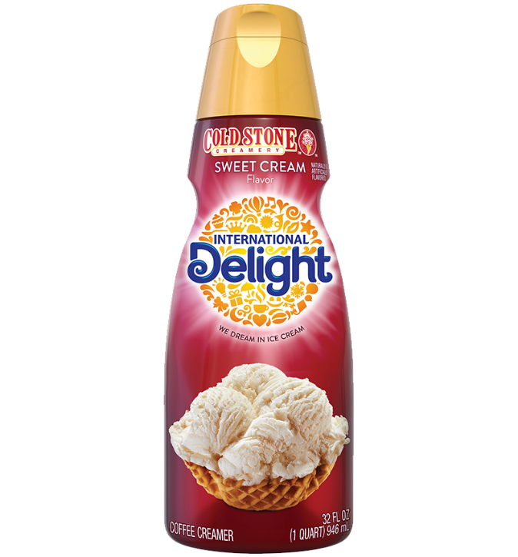
Core 4 flavors deliver 60% of category volume:
Leverage ID product superiority to reach 90 acv!
$26MM Opportunity
French Vanilla | Caramel Macchiato | Hazelnut | Cold Stone Sweet Cream
85 | 82 | 76 | 76
89 | 43 | 88 | 86
Product Score v. CM¹
Superior*
Slight Adv.
Superior
Superior
Market Rank²
#2
#1
#2
#2
#1 Caramel SKU by $s & Velocity
Biggest flavor in category:
ID unlocking NEW “best-ever Vanilla” (more to come!)
Goal:
90 ACV
ID ACV
CM ACV
Gap closure based $/TDP and reaching 90 ACV on each item
¹Conducted in SF & Chicago, June 2020 Blinded seq. monadic CLT, N=153 Traditional Hazelnut creamer users (P6M consumption) ²Source: IRI, MULO, L26W ending 9/6/2020 (excl CM Italian Sweet Crème due to recent service issues – data from Q2 2020) – branded flavor (ID and CM)
Internal Only

Slide 20
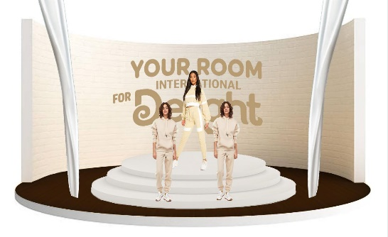







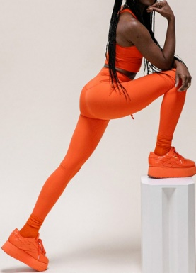

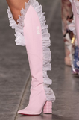
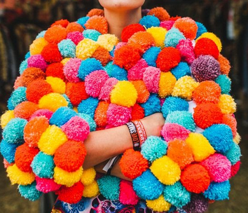



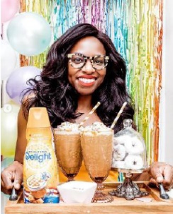
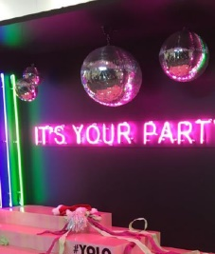

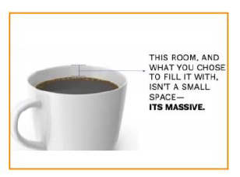
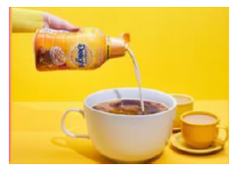
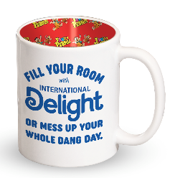
We will bring Campaign to life in a way that excites, engages and recruits the Next Gen of consumers
Video: Engage through the power of dance and music; own room through celebration of flavors
Invite participation through Social with natural extension into new channel (TikTok)
Social Extension
Shopper Marketing
PR & Influencer
Video
Shopper Marketing bring campaign In-Store

Slide 21
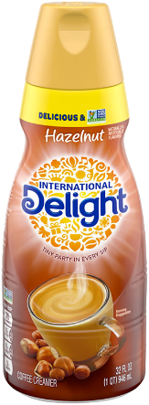
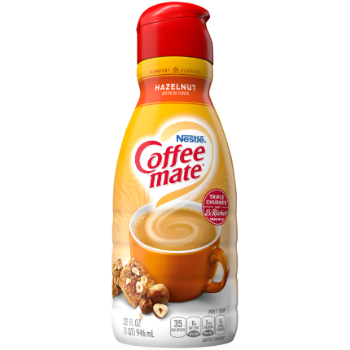
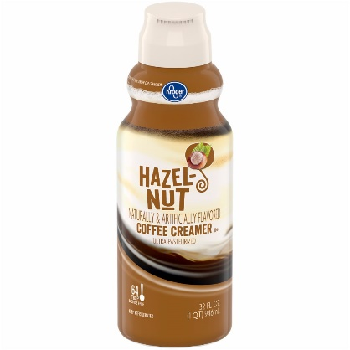
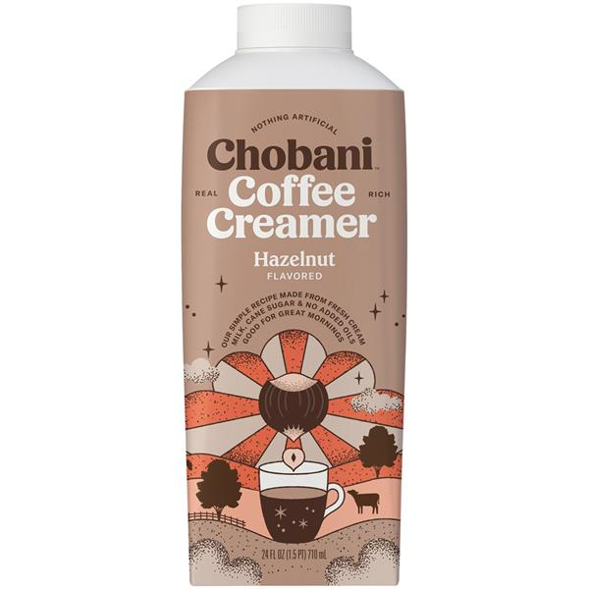
ID Hazelnut formula and velocities outperform competition
ID Hazelnut outperforms three key competitors on Overall Liking and is more often described with positive terms of flavorful and rich
Sig. Higher vs. competitors
Overall Opinion of Hazelnut Creamer in Coffee
ID vs CM Hazelnut Velocities
($/TDP % chg. vs YA, w/e 9/27/20)
Hazelnut 32oz | L5W | L13W | L52W
ID 76 TDPs | +8% | +10% | +17%
CM 88 TDPs | +9% | +7% | +0.1%
Conducted in SF & Chicago, June 2020
Blinded seq. monadic CLT, N=153 Traditional Hazelnut creamer users (P6M consumption)
Lg. letter following mean indicates sig. difference from the product listed at 95% CI

Slide 22
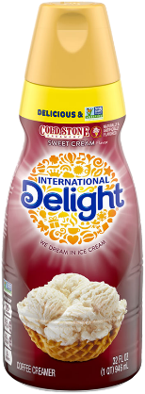
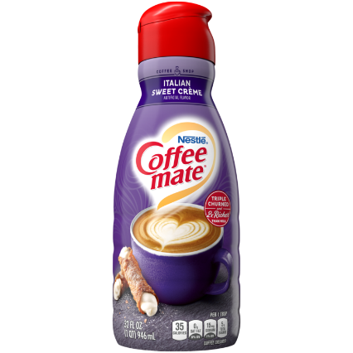
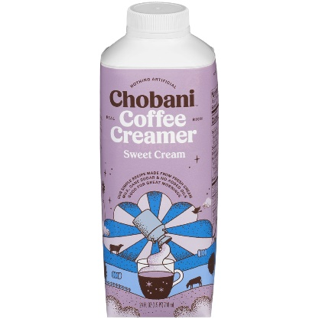
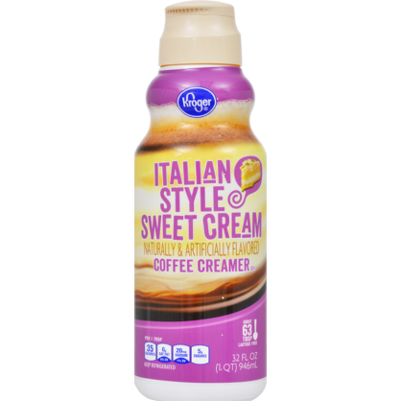
ID Sweet Cream formula and velocities outperform Coffee Mate
ID Cold Stone Sweet Cream outperforms Coffee Mate on Overall Liking and is more often described with positive terms of smooth, flavorful, indulgent, and balanced
Sig. Higher vs.
Coffee Mate
Overall Opinion of Sweet Cream Creamer in Coffee
ID vs CM Sweet Cream Velocities
($/TDP % chg. vs YA, w/e 9/27/20)
BD
D
D
Sweet Cream 32oz | L5W | L13W | L52W
ID 76 TDPs | +26% | +17% | +19%
CM* 86 TDPs | (60%) | (14%) | (0.1%)
  1-9 Liking Scale
  International Delight (A)
  Coffee Mate (B)
  Chobani (C)
  Kroger (D)
*impacted by recent service issues
Conducted in SF & Chicago, June 2020
Blinded seq. monadic CLT, N=153 Traditional Hazelnut creamer users (P6M consumption)
Lg. letter following mean indicates sig. difference from the product listed at 95% CI

Slide 23
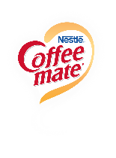
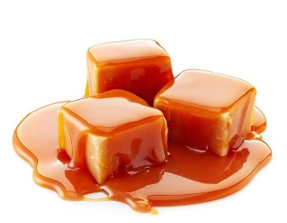
ID Caramel Macchiato is #1 in $230MM Caramel space within trad creamers
Share of Caramel Rfg Trad Creamers Sales by Brand
All Sizes, L52W
  Private Label
  AO
#1 Caramel SKU by $s & Velocity
  CM Caramel Latte
  0.9%
  Starbucks
  ID Caramel Macchiato
+29% $ sales vs YA!
$68MM in sales L52W
  ID Caramel+
Source: IRI, MULO, L52W ending 9/27/20 – Trad Creamer UPCs, all sizes, “CARAMEL” flavor

Slide 24
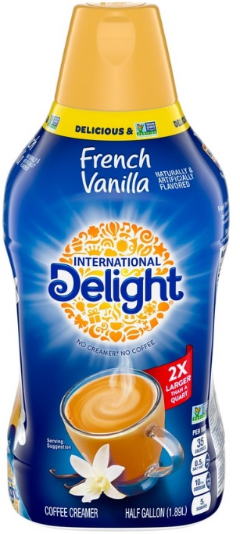
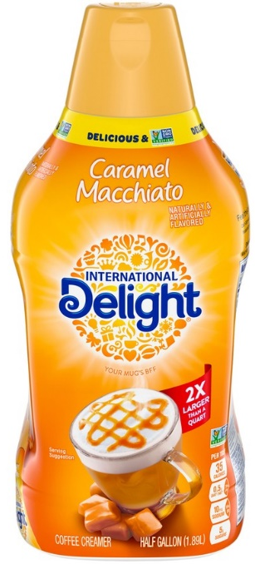
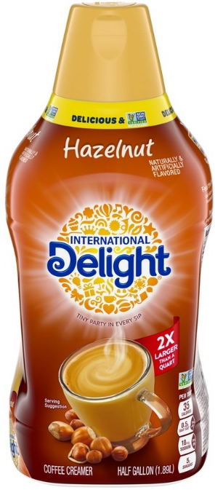
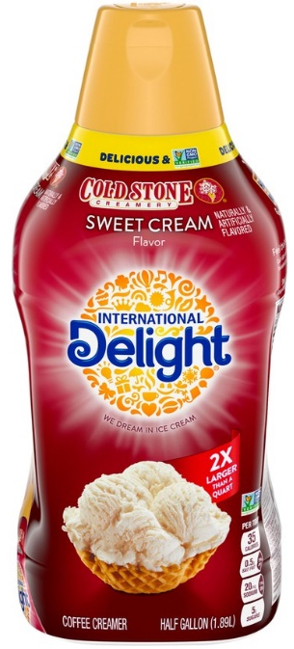
large size is driving 45% of growth & nearly 2X its fair share in contribution: Close ID distro gap
$90MM Opportunity
French Vanilla | Caramel Macchiato | Hazelnut | Cold Stone Sweet Cream
46 | 33 | 2 | 24
84 | NA | 81 | 71
Only Caramel 64oz!
ID ACV
CM ACV
Source: IRI, MULO, LW ending 9/6/2020 (excl CM Italian Sweet Crème due to recent service issues – data from Q2 2020) – branded flavor (ID and CM)
Gap closure based $/TDP and reaching 60 ACV on each item
Internal Only

Slide 25
Retailers that carry ID 64oz are 43% more productive than mulo on average, with ID driving growth
64oz is up 16.7% Nationally, while Retailers specifically carrying ID 64oz are up 45.5%, With ID 64oz driving growth
Retailers that carry ID 64oz are 43% more productive than MULO
Source: IRI, MULO, L52 WE August 16, 2020

Slide 26
In retailers that swapped ID 48 to ID 64oz, ID 64OZ driving 2.3X its fair share of 64oz growth
Growth: +$297MM
Takeaways
ID is roughly 13% of 64oz dollars in MULO but 23% of growth, driving 1.8X its fair share
However, in retailers that swapped ID up from 48oz to 64oz, ID has a 15% share of 64oz and is driving 35% of growth, or 2.3X its fair share
Growth: +$71MM
Source: IRI, MULO, L52 WE August 16, 2020

Slide 27
Retailers benefit from carrying large size creamers, which capture valuable heavy buyers & its growth is driven by ID
Large size creamers capture the most heavy buyers – 44%! – and nearly 80% of dollar sales
Large size creamers driving category growth
ID 48oz & 64oz are fastest growing sizes*
Retailers that carry ID 64oz are more productive, with growth driven by ID
*AO Size is primarily Starbucks, which entered the market July 2019
Sources: IRI POS, MULO, L52 WE August 16, 2020; IRI Panel, Total U.S. All Outlet, L52WE Oct 4, 2020

Slide 28






Shelf Stable
2021 H2 Brand Updates
The Dunkin’ Donuts trademarks, logos and trade dress are owned by DD IP Holder LLC. used under license

Slide 29







Danone is the #1 Manufacturer of shelf stable liquid creamers
Win with the #1 brands and flavors in shelf stable liquid
Traditional
Dairy
Unsweet Dairy
Sweetened Dairy
New Dunkin’ PC
Newest ID flavor
ID Flavor vs. CM Flavor (like-for-like Dollar Sales)
#1
#1
#1
#1
#2
#1
#1
Biggest flavor in entire shelf stable creamer (powder + liquid) category
newest item in the ID shelf stable portfolio, available in 48ct
IRI MULO: Latest 26w Pd ending 09-06-20
The Dunkin’ Donuts trademarks, logos and trade dress are owned by DD IP Holder LLC.
Used under license

Slide 30




New Items Draw on different Strengths to meet consumer needs
#1 Dunkin’ flavor
#1 Flavor in shelf stable
#1 Caramel in liquid shelf stable
Winning Proposition
Winning Proposition
Winning Proposition
#1 Dunkin’ Flavor – Best performing Dunkin’ flavor in refrigerated creamers and #5 quart in the Danone portfolio
#1 Flavor in both liquid shelf stable and in shelf stable creamer category
ID Caramel Macchiato is #1 Caramel SKU in refrigerated creamers
Extra Extra 32oz is a top 15 turning SKU in grocery
First time International Delight Original flavor has been offered in retail
Top performing ID flavor - #2 ID flavor in both refrigerated and shelf stable creamers
A taste consumers already know and love
Only non-GMO project verified PC on the market
A taste consumers already know and love!
IRI MULO: Latest 26w Pd ending 09-06-20
The Dunkin’ Donuts trademarks, logos and trade dress are owned by DD IP Holder LLC.
Used under license

Slide 31


24ct and 48ct pack sizes Bring in different consumers and Should coexist on shelf
24ct & 48ct have a limited buyer overlap
Most consumers are loyal to a specific pack size with only 5.3% of consumers buying both 24ct and 48ct
ID 24ct Consumers
ID 48ct Consumers
94% Exclusively purchase 24ct
46% Exclusively purchase 48ct
Consumers who purchase
24ct
ID creamer singles
Only
5% purchase both sizes
Consumers who purchase
48ct
ID creamer singles
Source: IRI, buyer overlap, L26W ending 9/6/20, 24-50ct size
Notes:
We are going to be supporting ID in a big way, haloing to total portfolio

Slide 32

WHITENERS

Slide 33





Whiteners have excelled during the pandemic, danone is uniquely positioned to capitalize
Very Strong Categories Supported by New Routines
Change in Daily Routines Due to Covid-19
Substantial HHP Growth
H&H Category
66% of consumers cooking more at home!
54.4MM
$1.1B
+6.8% vs. YA
# of Households:
50.0MM
48.0MM
HWC Category
46.2MM
$928MM
+20.0% vs. YA
Source: IRI Total MULO L52W ending 9-27-20
Source: IRI POS, Total U.S. MULO, L52WE 23 Aug 2020; Panel, Total U.S. All Outlet, L52WE 6 Oct 2020
Source: The Hartman Group, Inc. Functional Food & Beverage and Supplements 2020 Report
The LAND O LAKES Brand name is used under license from Land O’Lakes, Inc.
Notes:
Incrementality of coffeehouse

Slide 34




Danone is the #1 branded whitener nationally¹
L13W Results
Sales
Danone +9.3% $ Sales
  Category +7.0%
  2019 grew +1.5%
Share
Danone +0.4 pts
~20% share of H&H
Sales
Danone +36.2% $ Sales
  Category +25.0%
  2019 grew +11.2%
Share
Danone +1.0 pts
~11% share of HWC
¹Source: IRI Total MULO L13W ending 9-27-20
The LAND O LAKES Brand name is used under license from Land O’Lakes, Inc.
Notes:
Incrementality of coffeehouse

Slide 35











2021 Whiteners Priorities
Secure
Core Four
Deliver Early & Accurate Forecast
Ensure Right Pricing
Support Trial on Unique SKU’s
These core four SKU’s represent $156M in $ sales
On average we want the below slope to PL
$.80
Premium
$1.00
Premium
LOL is the 2nd largest business in CHC
$229M L52W
30%
more cream!
0.2 Trial
52.9 Repeat!
Internal Only
Source: IRI Total MULO L52W ending 9-27-20
The LAND O LAKES Brand name is used under license from Land O’Lakes, Inc.
Notes:
Incrementality of coffeehouse

Slide 36





Land O’Lakes Traditional Whiteners
2021 H2 Brand Updates
The LAND O LAKES Brand name is used under license from Land O’Lakes, Inc.

Slide 37

Land O’Lakes shoppers continue to have high value
They have the highest basket spend vs. all other conventional H&H and HWC shoppers
LOL H&H shoppers spend 27% more in total basket than any other H&H shopper
LOL HWC shoppers spend 24% more in total basket than any other HWC shopper
Source: IRI Panel, Total U.S. All Outlet, L52WE 9/6/20
The LAND O LAKES Brand name is used under license from Land O’Lakes, Inc.

Slide 38







Core 4 Velocities are over +70% higher than category
$50M Opportunity to expand Top 4 SKUs and 2 Incremental SKUs
1
2
3
4
5
6
Current ACV
66
37
22
37
12
22
Target ACV
80
55
40
55
30
35
Size of Prize
$13M
$10M
$12M
$8M
$5M
$2M
Source: IRI ending 9.27.2020
The LAND O LAKES Brand name is used under license from Land O’Lakes, Inc.
Internal Only

Slide 39






Land o’lakes packaging change
Summary of Key Changes:
Removal of Maiden
New font type for brand mark
Updated coffee plume
Removal of Standard of Identity on top of pack
Greater callout of “Real Milk and Cream”
On 192ct two-way orientation
Current
New
Current
New
Current
New
Subtle by Design!
Shipping 12/21
Shipping 1/29
Source: IRI Total MULO L52W ending 9-27-20
The LAND O LAKES Brand name is used under license from Land O’Lakes, Inc.

Slide 40











LOL 2021 key marketing drive periods
Q1
Q2
Q3
Q4
CAMPAIGN
FARMER OWNED, TRUSTED FOR OVER 100 YEARS
GROWTH EVENT
New Year/Distribution Support
Easter
Always On
Holiday
INNOVATION /
PRODUCT PROOF POINT
COMMS
CP + Influencer + Instacart + CRM
CP + Influencer
Branded Search
CRM + CP + Influencer
ACTIVATION / LICENSING
1H will be key drive period, shopper support for distribution and national CP/influencer in partnership with master brand
SALES FOCUS AND SUPPORT
Targeted Shopper Support based upon increased distribution
Inclusion in Easter recipes and retailer specific shopper initiatives
Branded Search
Seasonal recipes and craft beverages for the holidays
The LAND O LAKES Brand name is used under license from Land O’Lakes, Inc.

Slide 41



Land o lakes packaging change First Ship Dates
New
Shipping 12/21
Shipping 1/29
Source: IRI Total MULO L52W ending 9-27-20

Slide 42

Horizon Organic Whiteners
2021 H2 Brand Updates

Slide 43











We are doing everything we can to service Horizon Organic Whiteners in 2H 2021
Standard 2H HO farm production cannot support 2H demand
Service 1H demand with standard production
Freeze 1H surplus butter
Thaw butter to support 2H demand
Accurate HO forecast = correct amount of frozen butter
Frozen butter can only be thawed and used as butter
Start HERE

Slide 44

READY TO DRINK COFFEE

Slide 45




RTD Coffee is poised for growth as Younger consumers driving major shifts in the category
Mintel projects within coffee, RTD Coffee will see strongest gains through 2025, a +5.8% 5-year CAGR
$4B today, category is projected to grow to $5.3B in 2025
‘20-’25
5 Year CAGR
RTD growth driven by younger consumers
46% of Gen Z and Millennials drink RTD Coffee vs. just 6% of Baby Boomers or older
Total: +3.3%
RTD: +5.8%
Single Cup: +3.8%
Roasted: +1.5%
Source: Mintel US Coffee including covid-19 impact – July 2020

Slide 46

RTD Coffee is the fastest growing category in the dairy aisle
RTD coffee has a three-year CAGR of 21.2%, or almost 2X faster than the next fastest category
and nearly 5X faster than total Dairy
Source: IRI POS, Total U.S. MULO, L52WE 23 Aug 2020; IRI Panel, Total All Outlets, L52WE 6 Sept 2020
Notes:
Retailers should re-evaluate categories of declining demand. Categories that are unable to jump on emerging trends and meet the needs of future shoppers are ripe for re-evaluation. Keep in mind that there are categories that are declining overall, however, their segments within still driving growth. Specific category recommendations are retailer-specific, and from a national POV, are on the next slide.

Slide 47

RTD Coffee is $3.6B with an 8.5% 4-yr CAGR; MS leading growth with a +25% 4 year cagr, contributing 3x its fair share
MS bringing new and more valuable households
MS, 15% of dollars, is contributing 45% of growth
 | HHP | Chg vs. YA
Total RTD Coffee | 30.1 HHP | -3.6pts
Single Serve | 26.1 HHP | -5.2 pts
Multi Serve | 10.4 HHP | +1.2 pts
4 Year CAGR (2016-2020)
Total | +8.5%
SINGLE | +6.5%
MULTI | +24.9%
Multi-Serve consumers are more valuable:
They spend 19% more in in-basket dollars, $94 vs. $76 for single serve buyers
Source: IRI POS, Total U.S. MULO + Conv; L52WE 9/27/20; IRI Panel, Total U.S. All Outlet, L52WE 9/27/20

Slide 48



When selecting a RTD coffee, A consumer’s first decision falls into three main segments
total rtd coffee consumer decision tree
Sweet & Creamy
Reaches 80% of consumers
Coffee Forward
Reaches 56%
Beyond Coffee
Reaches 66%
CONSUMER SEGEMENT
Sweet & Creamy
Black Coffee
(45%)
Sweetened / Creamed /
Flavored (46%)
Energy
Healthy Attributes
Mainstream Basics (66%)
Starbucks (77%)
Starbucks
Less Sweet
Starbucks
Plant-Based
Milk Equity
Int’l Delight (53%)
Premium Brands
Creamed
Monster
Protein
Dunkin’ Donuts/ McCafé (59%)
Flavored
Danone meets the needs of each of these segments
#1 Brand in Loyalty
#1 Brand in Exclusivity
#2 Brand in HHP (HHP growth)
Highest HHP growth
#2 Brand in Buy Rate, Repeat, Abs Dollar Growth & Velocity
#3 Brand in Loyalty& Exclusivity
NEW!
#1 Brand in In-Basket Dollars
Higher loyalty than Califia
RTD Coffee CDT – Grocery/Mass channel
(#%) = net penetration, meaning % of shoppers that definitely would buy (DWB) at least one variety within a product cluster – a Top Box 9 selected on a 9 point scale

Slide 49


In multi-serve RTD coffee, creamed and black are each important segments but require different approaches
In 2020, for the first time, consumers will spend more on black, multi-serve RTD coffee than on creamed multi-serve coffee
STōK and IDIC are exceedingly incremental to each other—they have completely different shoppers
Black MS RTD $ Growth, P4Y
Creamed MS RTD $ Growth, P4Y
Buyer Overlap – STōK vs IDIC
  300
  285
  300
  269
39%
57%
  250
  250
  +14.5%
  +50.9%
  211
  200
  183
  200
  178
  157
  153
4%
  150
  139
  150
  100
  94
  100
  55
  50
  50
  0
  0
  2016
  2017
  2018
  2019
  2020e
  2016
  2017
  2018
  2019
  2020e
CYTD’20: $202MM (+28%)
Only 4.4% of shoppers who buy either STōK or IDIC buy both
CYTD’20: $214MM +53%)
Source: IRI MULO w/e 9.27.20 | IRI Panel w/e 8.9.20

Slide 50









Your ready-to-drink coffee sales priorities for BH’21
Create the STōK core on your retailer’s shelf
Expand IDIC core lineup
Rock solid launches for BH’21
$22MM*
opportunity
$10MM**
opportunity
STōK Pumpkin
Start of Ship:
Jul/Aug’21
International Delight Iced Coffee
Reese’s Peanut Butter Cup
Start of Ship:
Sep’21
Expand distribution or sell in new items to ensure all 4 of STōK core are on shelf
Expand distribution or sell in new items to ensure IDIC core, top performers are on shelf
* Assumes TDPs on Extra Bold, Bright & Mellow match Not Too Sweet
** Assumes +15 MULO TDPs on Vanilla, Caramel Macchiato
Internal Only

Slide 51





STōK Ready to Drink Coffee
2021 H2 Brand Updates

Slide 52










The black segment is blowing up, and The stōk black skus are top performers
BLACK SEGMENT EXCEEDS CREAMED IN SIZE WITH 2X GROWTH¹
BLACK SKUS DOMINATE THE TOP TERTILE²
+24.8%
+47.7%
#1 | #2 | #3 | #4 | #5 | #7 | #10 | #11 | #14
255MM
257MM
204MM
174MM
SToK Unsweet #1 nationally in velocity ($/TDP)
SToK Extra Bold in top tertile only 7 months after launch with rapidly accelerating velocities
Starbucks success shows potential of roast level strategy with all 3 roasts consistently in the top tertile
Creamed
Black
$ Sales, YA
$ Sales
¹ IRI MULO L52 w/e 9.27.20 | ² IRI MULO L5 w/e 9.27.20

Slide 53






close the GAP
Secure placements for Extra Bold and Bright & Mellow in 2021
PRIORITY
2021 ACV
GOAL
  78
  78
  70
  30
2020 ACV¹
78
33
70
ACV Upside 2021
¹ IRI MULO L5 w/e 9.27.20
Internal Only

Slide 54





In 2021, stōk’s innovation & communication strategies will ladder directly to one thing: stōk is a core lineup
We’ll launch Bright & Mellow, rounding out our varieties of black, un-sweet coffee to three
ALL Core items will get refreshed artwork, creating a proper, core family of products
STōK’s key marketing message will be product-focused and rooted in the irreverence of cold brew culture

Slide 55







55
In 2021, stōk cold brew coffee will launch a new campaign that takes on the way every other coffee brand acts
MOST OF THE COFFEE CATEGORY, BOTH HOT AND COLD, LOOKS A LOT LIKE THIS.
“ARTISANAL” PICTURE-PERFECT
VIGNETTES OF THE MORNING ROUTINE

Slide 56

BUT THERE'S A DEEPLY IRREVERENT SUBCULTURE AROUND COLD BREW WAITING TO BE TAPPED INTO…
ONE THAT ONLY STōK CAN OWN.
The internet has assigned cold coffee and the people who drink it with an over-the-top, even dark personality, one that bridges well into the irreverent tone STōK has worked to build for the brand.
Instead of being irreverent for irreverent’s sake, we’ll use it to own cold brew’s equally dark yet energetic role in culture.

Slide 57




























THIS
COLD BREW
IS
the “hard stuff” people can’t
get enough of, especially
at their worst.
Internal Only

Slide 58


In 2021, stōk cold brew coffee will launch a new campaign that takes on the way every other coffee brand acts

Slide 59




WITH 2020 VELOCITIES FAR EXCEEDING EXPECTATIONS, stōk pumpkin should be on par with starbucks
Velocities ramped quickly, making Pumpkin a top tertile product at a major national retailer¹
U/S/W at Major National Retailer²
ACV¹
  9
31
2021 Goal: Match Starbucks distribution at ~30 ACV
  Starbucks
  8
18
  7
  SToK
  6
12
  5
  Califia
  4
  Chameleon
5
  3
  2
  1
  30-Aug
  6-Sep
  13-Sep
  20-Sep
  27-Sep
  4-Oct
  11-Oct
Source: ¹ L5 w/e 9.27.20 | ² IRI MULO 8.30.20 – 10.11.20
Internal Only
Notes:
Your Retailer needs SToK Pumpkin
Updates:
Title massage of go-get - Ensure point is heard EVERYONE should be taking pumpkin – add comment driving home opp for pumpkin TDP gain in 2021
Show ACV in competitive items if story holds
U/S/W
Target – 7.0
Delhaize – 6.7
Kroger HT – 6.4

Slide 60












stōk pumpkin’s launch campaign hit big
1080 tumblers – designed by comedian Tom Segura – sold out in less than 3 minutes
Product coverage and Tom Segura partnership led to 230MM+ earned media impressions
10 influencer partners created 33 posts leading to 5.7MM+ total impressions and 538K+ TikTok video views

Slide 61


WE literally can’t even: stōk Pumpkin cold bREW
Returning Seasonal
Consumer Insight/Category Need
Pumpkin is the #1 fall flavor trend in coffee, and consumers want a coffee-forward flavor option
Benefit to Retailer
SToK Cold Brew is driving category growth, and a delicious seasonal item with unique messaging will incentivize incremental purchase
WINNING PROPOSITION
Pumpkin is the #1 fall flavor in the RTD Coffee Category
SToK Pumpkin
6/48oz
SRP: $4.99 – Line priced with SToK
Shelving: RTD Coffee
UPC # 00013663207476
The only #antibasic Pumpkin Cold Brew on the market
Bring excitement to the RTD category with an edgy seasonal item
Top tertile at 3 major retailers¹
August 2021
Anticipated volume from most top retailers
Source: ¹$/TDP IRI MULO L4 w/e 10.4.20

Slide 62






















stōk 2021 MARKETING ACTIVATION PLAN
$0 - $5MM
Jan-March
April-August
Aug- November
November-December
CAMPAIGN
HAVE NO CHILL
GROWTH EVENT
BRIGHT AND MELLOW LAUNCH
OWN COLD BREW COFFEE SZN
PUMPKIN AF
BE BIGGER THAN COFFEE
INNOVATION /
PRODUCT PROOF POINT
COMMS
Influencer
League of Boldness Ambassador Program
Influencer / Celeb Partnership
Influencer
Influencer /
Celeb Partnership
Movember Partnership Activation
National Cold Brew
Coffee Day Activation
Campaign Activation
Pumpkin Activation
Digital / Instore Coupons and Shelftalk
Ecomm Support
Digital / Instore Coupons and Shelftalk
Ecomm Support
Ecomm Support
Ecomm Support
CP Support

Slide 63







The stōk lineup
The STōK Core
Extra 3
These 4 items are essential to a successful STōK shelf at any retailer
Notes:
Updates:
Add a slide or two that better drives home the point the biggest priority and gap is close the gap on TDP – get those placements
TDP and $ Up

Slide 64





International Delight
Ready to Drink Coffee
2021 H2 Brand Updates

Slide 65
Creamed Multi-serve coffee is a crucially Important segment, and International Delight leads the way
Creamed MS RTD $ Growth, P3Y
Creamed MS RTD HHP Growth, P3Y
Creamed MS Market Share, P3Y
  300
  +22.9%
  269
  IDIC
  250
  Sbux
  211
  200
  178
  150
  All Other
  100
  50
  Califia
  0
  2018
  2019
  2020e
  2018
  2019
  2020
  2018
  2019
  2020
CYTD’20: $202MM (+28%)
Black may be leading RTD growth, but Creamed is no slouch
In each year since 2018, more than 1MM new households have started buying Creamed, Multi-Serve Coffee
IDIC is the consistent market share leader for Creamed, MS RTD Coffee
Source: IRI MULO w/e 9.27.20 | IRI Panel w/e 8.9.20

Slide 66

















CO-BRANDS AND news-worthy FLAVORS GENERATE STRONG VELOCITIES AND BUZZ AT LAUNCH, BUT THESE DIMINISH OVER TIME
MAX¹
U/S/W 2 Years Post Launch²
Cobrand/Flavor
Benchmark
1HY1 | 2HY1 | 1HY2 | 2HY2
vs.
vs.
vs.
Source: ¹Max weekly U/S/W at national retailer during period of analysis (2 years post-launch), ²Average U/S/W at national retailer as % of best-selling product
Notes:
Notes:
Benchmarks selected because they are the everyday item top performer in the manufacturer’s set for the time period
Chips Ahoy Chocolate Banana was a summertime LTO in 2015; comparison product is the 9.5 oz (same size) of the original flavor (13oz is shown)

Slide 67







Introducing: the 2-year IDIC tag-in strategy
2018 | 2019 | 2020 | 2021 | 2022 | 2023
Oreo!
Hershey’s Chocolate Caramel!
Reese’s!
Something Fun!

Slide 68


















IDIC Consumers love cobrands, and Reese’s is the Perfect match
Reese’s Creamer Launch Hugely Successful
ID Reese’s Creamer Drove Major Buzz for Both Brands
Top Tertile item during first 6 months on shelf¹
130MM Earned Impressions²
Cobrands are Highly Relevant for RTD Coffee Consumers
Reese’s is the #1 Confections Brand in the US³
Top Tertile item during first 6 months on shelf,² 108MM earned impressions at launch
Source: ¹IRI MULO L13 w/e12.27.17; ² U/S/W IRI MULO L4 w/e 8.26.18, ³IRI MULO+C-Store 52wks ending 6.17.18

Slide 69







The International delight iced coffee lineup
The Core
Extra 4
Notes:
Updates:
Add a slide or two that better drives home the point the biggest priority and gap is close the gap on TDP – get those placements
TDP and $ Up

Slide 70
THANK YOU!

