Slide 1




www.MrTortilla.com @MrTortilla

Slide 2
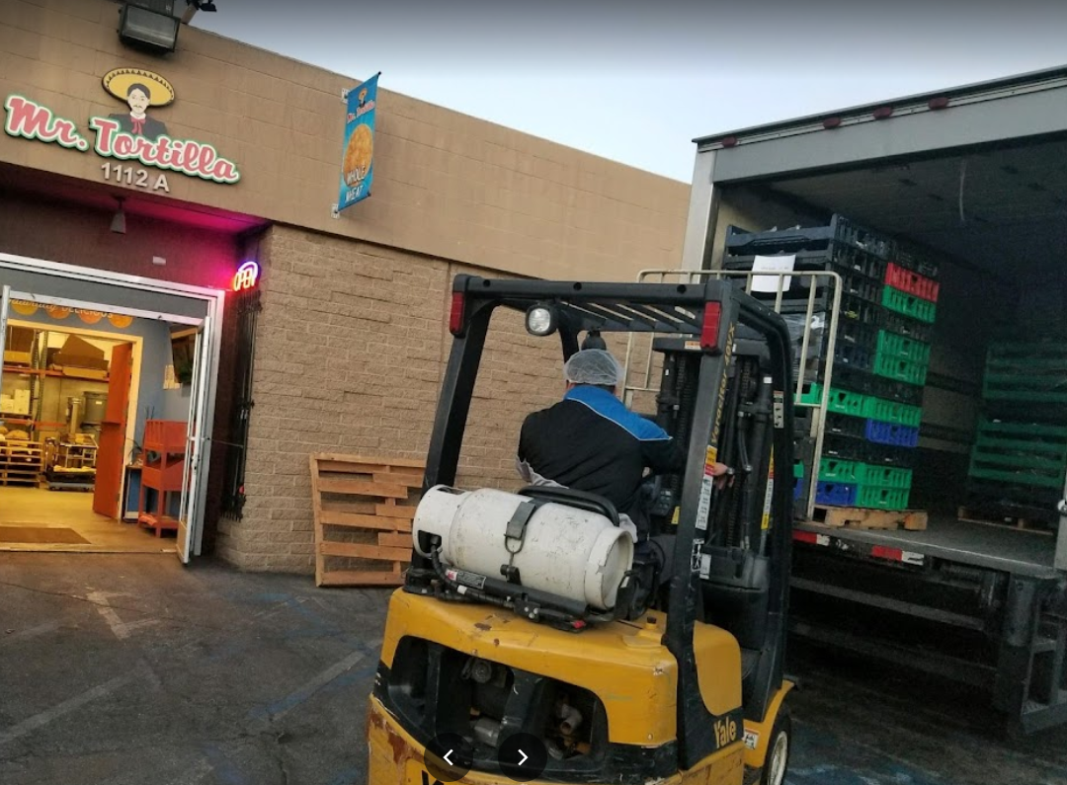

About Us
Mr. Tortilla is a family owned manufacturing business that started in 2010 as an Artisan Flour tortilla producer
Our Mission Statement: To make the World’s best tasting low calorie tortilla using the freshest ingredients and help every household in the world eat better without sacrificing flavor
Idea started one night when Ron and Anthony (Co Owner Brothers) indulged, as many people do, on fan favorite tacos. The guilt associated with this drove the idea to find a better way to enjoy tacos with out the guilt!
In 2019, after years of research, we launched the first Low Carb tortilla and changed the shape of the way tortillas are seen – launching us to great online success!
Currently, we make the World’s best tasting low calorie (15 Calorie) low carb (1 Net Carb) tortilla helping millions achieve a better diet with little sacrifice
We are a leading Omni Channel business that has recently started to spill into the Retail space
We are a minority owned business supporting all communities

Slide 3


Our Brand
We have cultivated amazing National and International Brand Recognition
Marketing support: We invest 7 figures quarterly in online ad / sales support
Willing to invest in Ads / Promotions / Slotting
#1 Selling Tortilla on Shopify
# 1 Tortilla brand on Amazon US, Canada & UK
  $7M sold via Amazon L12 Months
High Customer Satisfaction – 60% repeat buy
Strong international Sales – and Growing!
  Currently in: Hong Kong, Switzerland, Ireland, England, France, Central America, Dominican Republic, Aruba, Israel,
  Future Markets: Australia, UAE, South America
10% profit sharing with employees
We employ workers with Learning Differences
We donate and give back to our local communities
World’s only 15 Calorie Low Carb Tortilla with FLAVOR!
Innovative company that diversifies its offerings in the Better for you Category (11 skus and growing)
  Future products include Keto Friendly baked goods and Salsas / dips
Large follower base on Social media and growing
  106k followers on Instagram
  207K visits to DTC Annually
Very trendy online and leverage our Digital Marketing strategies to connect with our followers
Featured on:

Slide 4
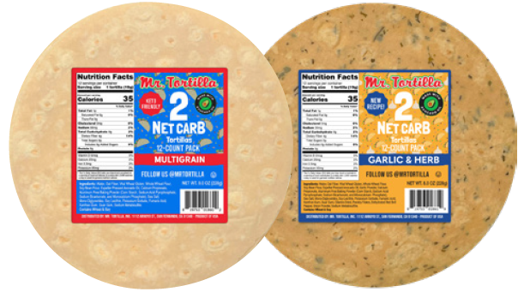
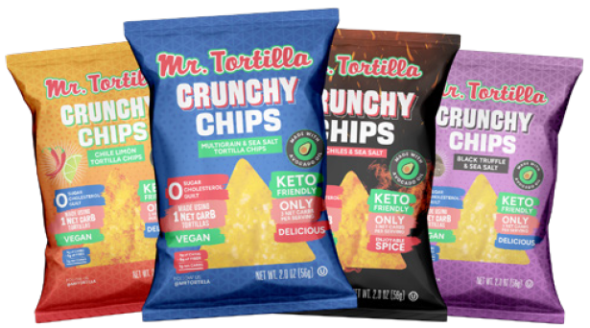
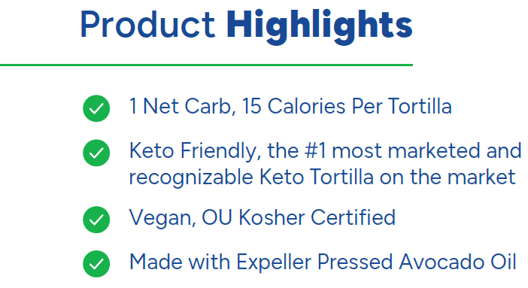
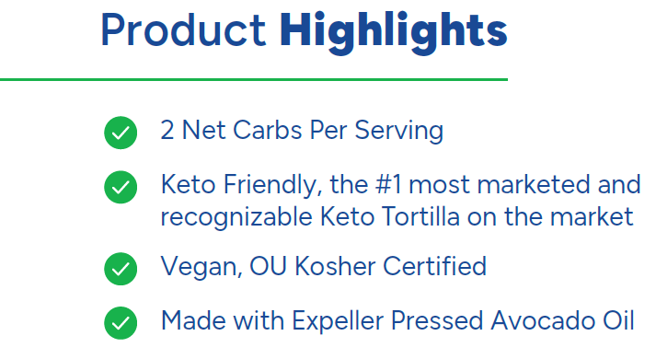
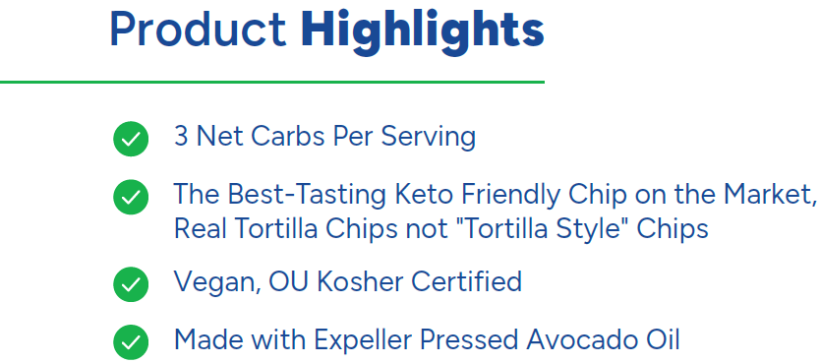
Our Products
1 Net Carb Toritlla Line 2 Net Carb Tortilla Line 3 Net Carb Chip Line

Slide 5
Key Insights
The Soft-Shell Tortilla category has grown by 15.7% online and 31.8% on Amazon in the last year. Mr. Tortilla has grown 2995% online and 2933% on Amazon in the same time period.
2. Mr. Tortilla is currently capturing 13.2% of the Amazon market in this category. The next closest low-carb competitor is Guerrero (Mission) with 4.3%.
3. Mr. Tortilla has significantly outpaced Guerrero in sales, specifically since the beginning of 2022.
4. Mr. Tortilla is currently growing exponentially faster than the closest competitor in the online space.
5. Mr. Tortilla products are most likely to be purchased by those white individuals ages 45-54, with an annual income between 100-150K.
- Neilson IQ report April ‘22

Slide 6
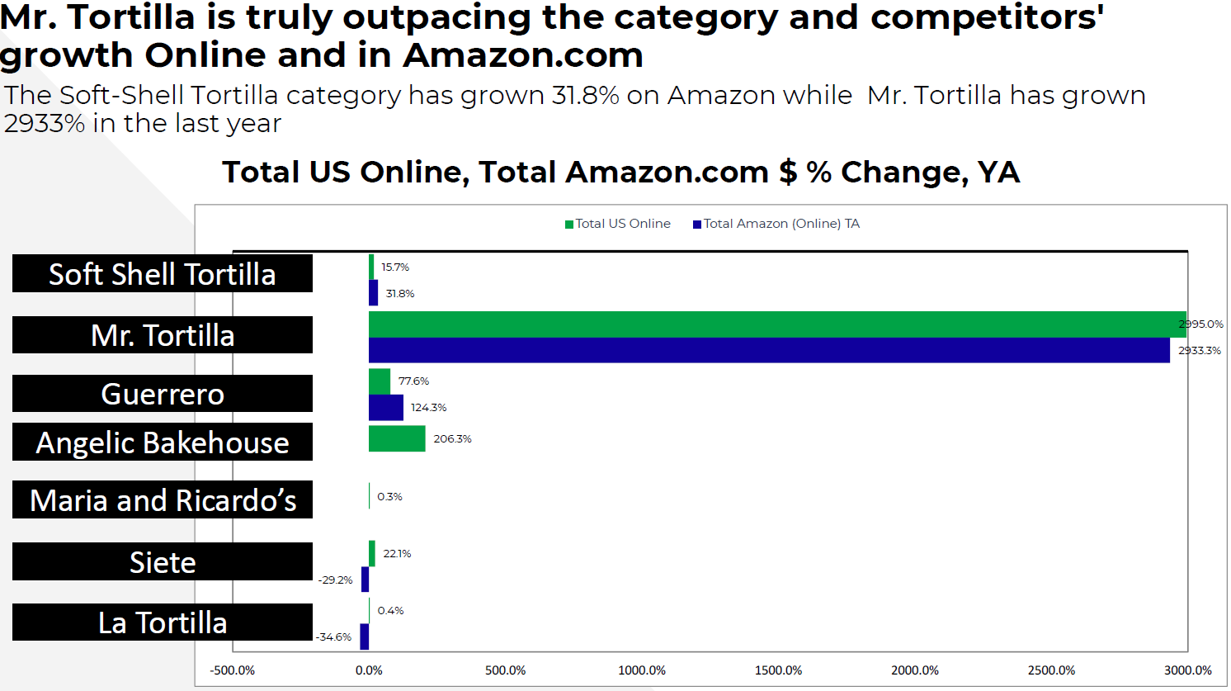
Key Insights (Cont’d)
- Neilson IQ report April ‘22

Slide 7
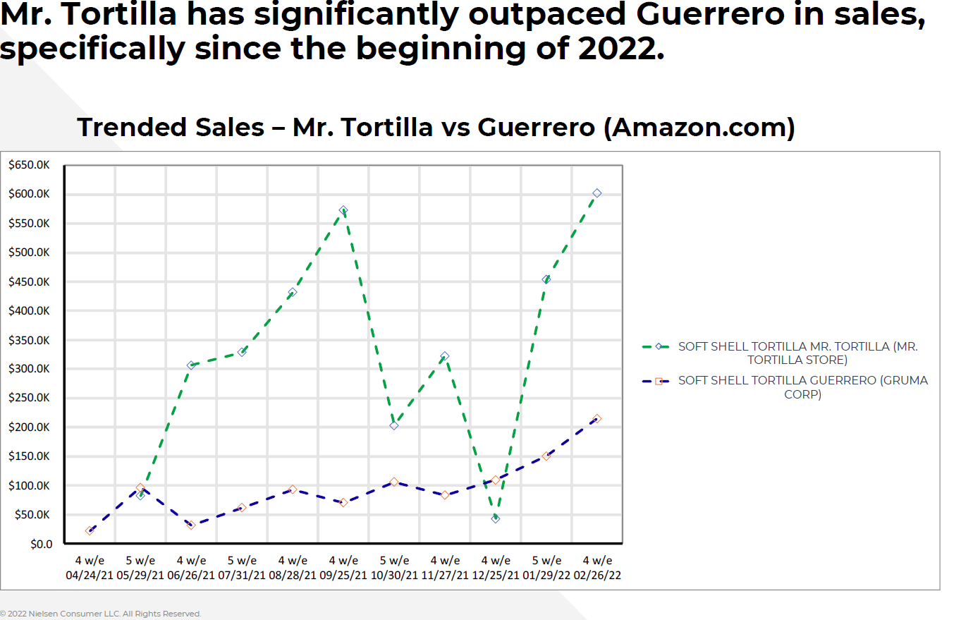
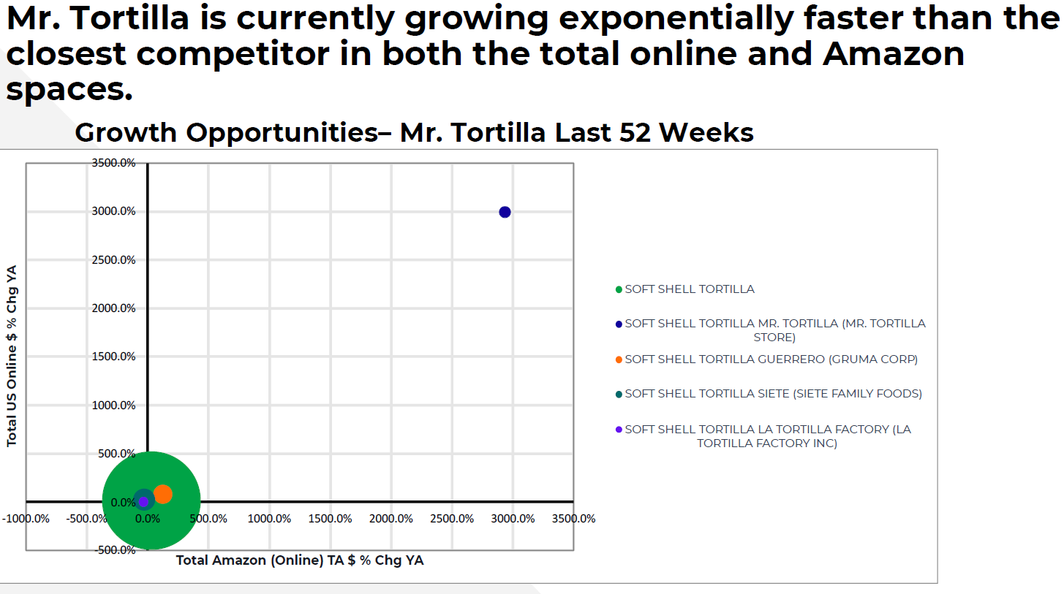
Key Insights
- Neilson IQ report April ‘22

Slide 8
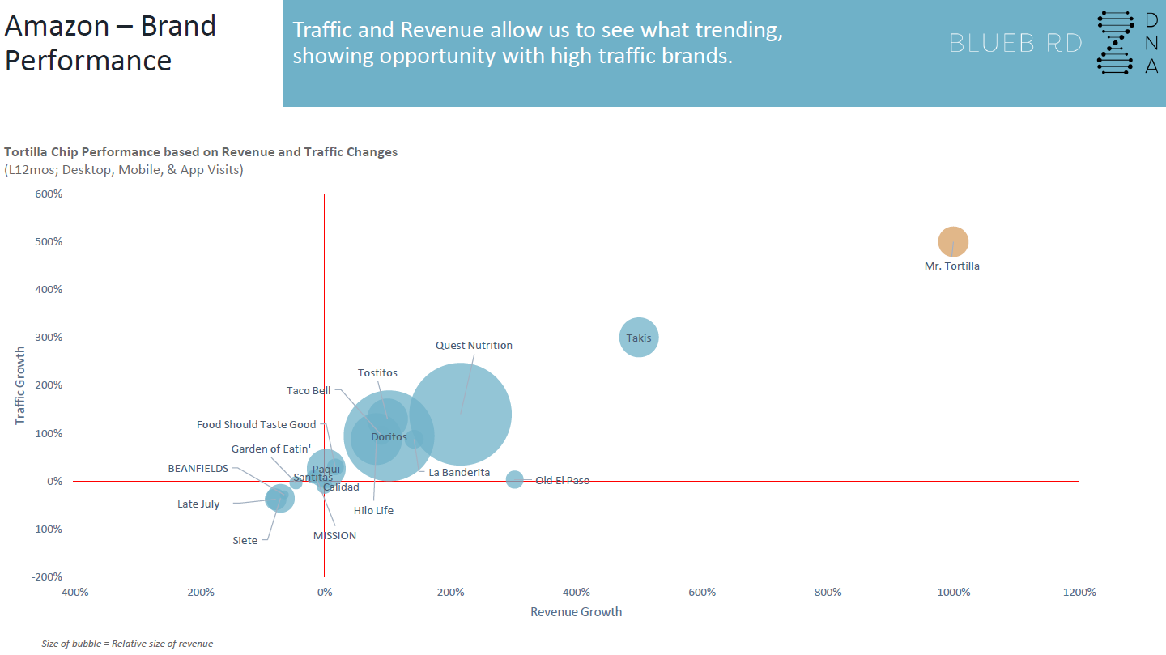
Key Insights
BlueBird Group Reporting Data

Slide 9
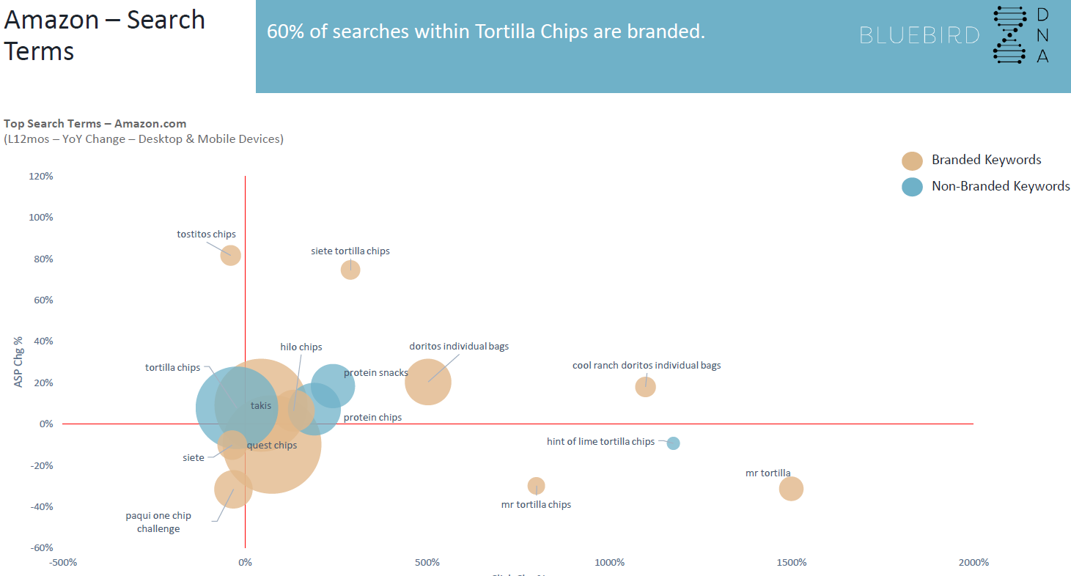
Key Insights
BlueBird Group Reporting Data

Slide 10
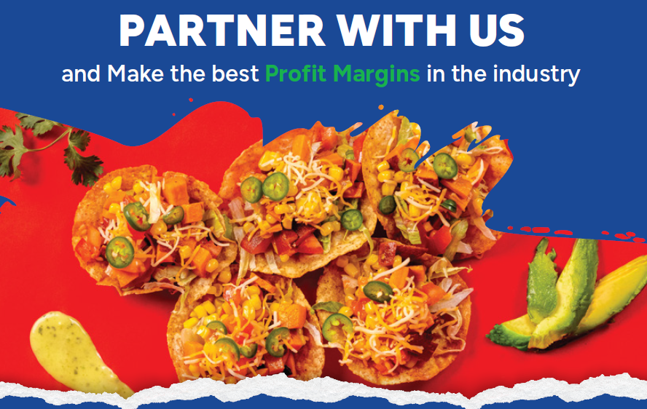
Thank You!!!

