Slide 1

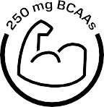

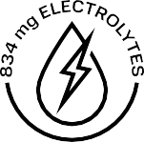
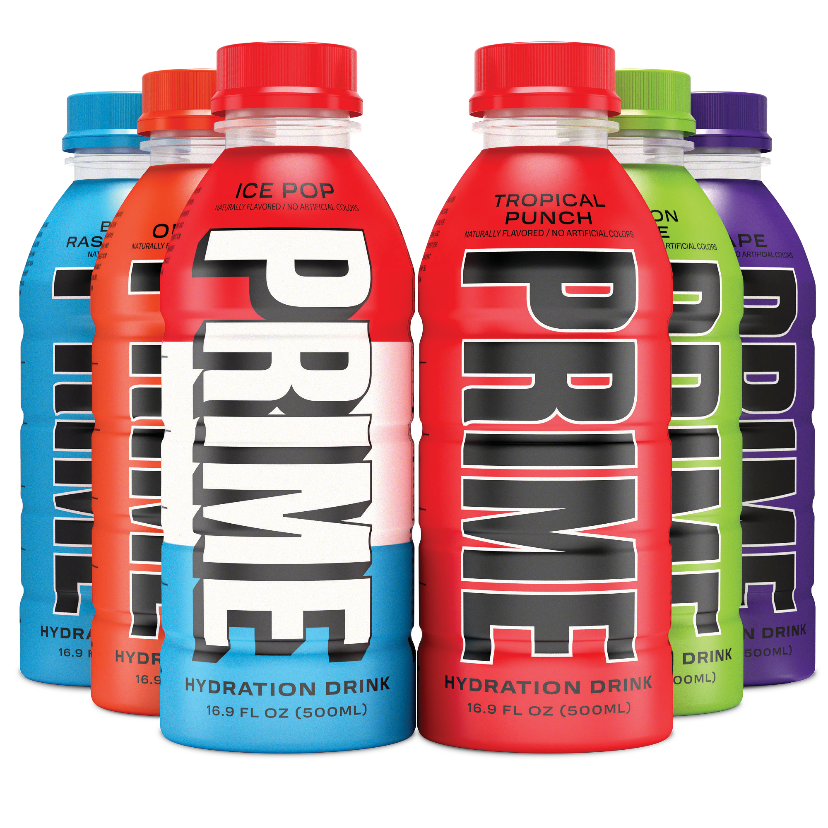
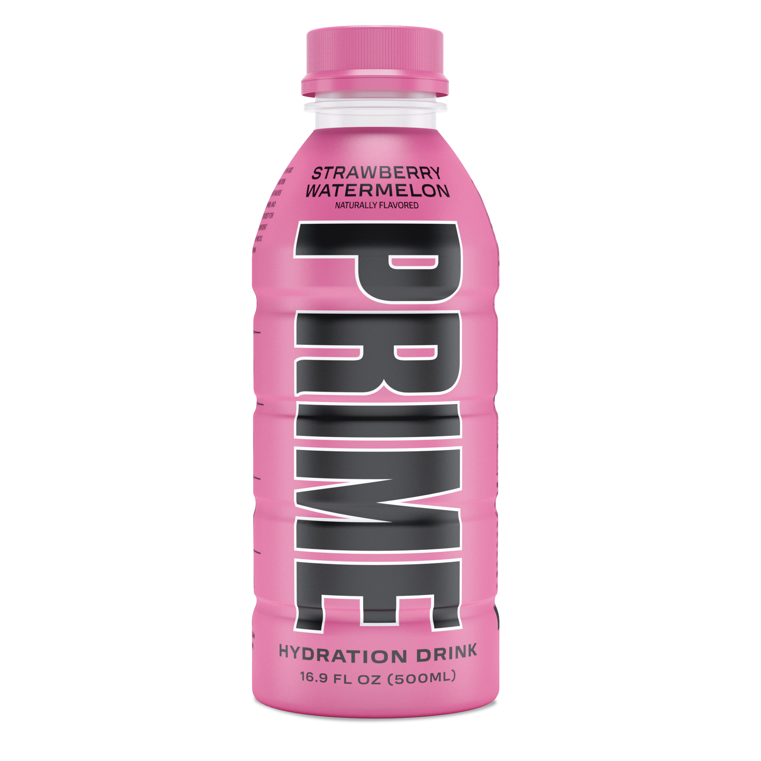
WELCOME TO YOUR PRIME
ZERO ADDED SUGAR
ZERO ARTIFICIAL COLOR

Slide 2
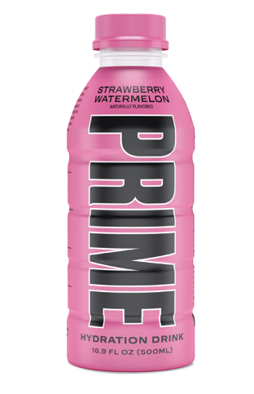
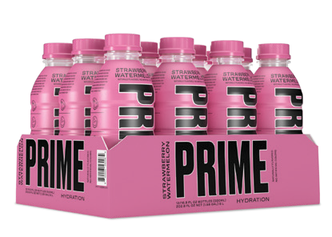
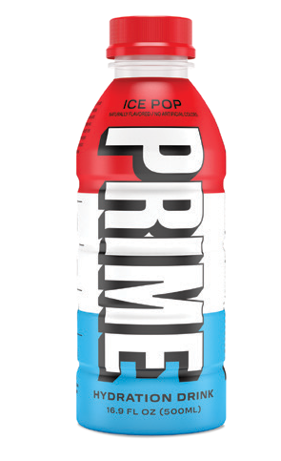
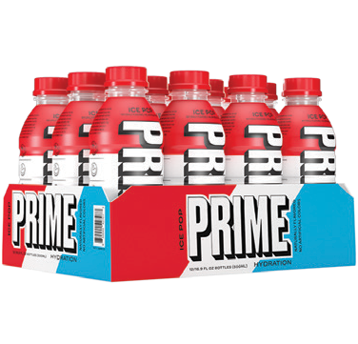
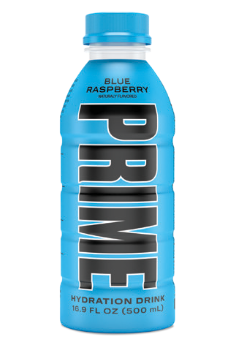
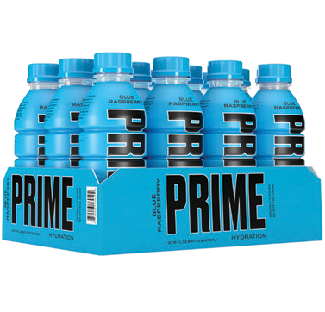




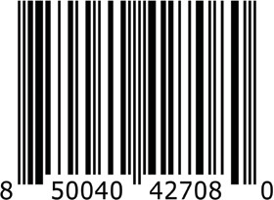

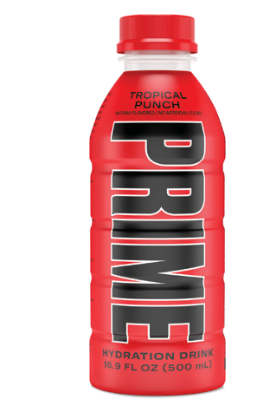
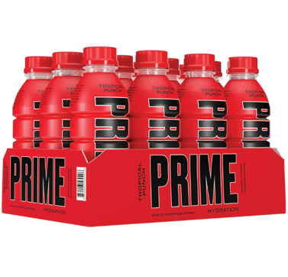
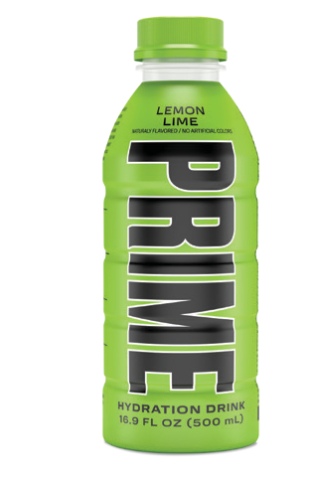
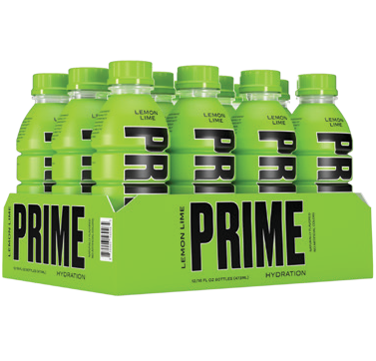
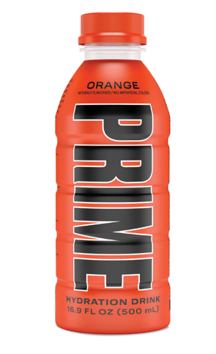
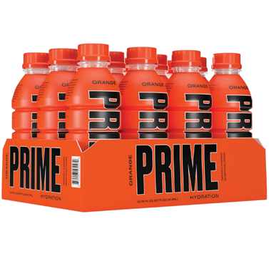






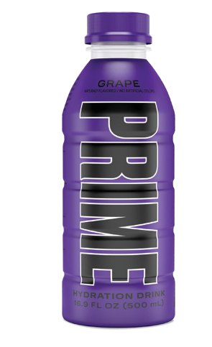
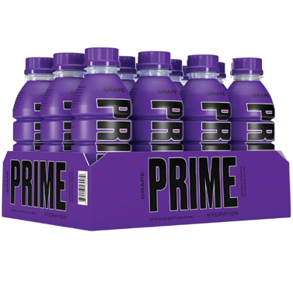
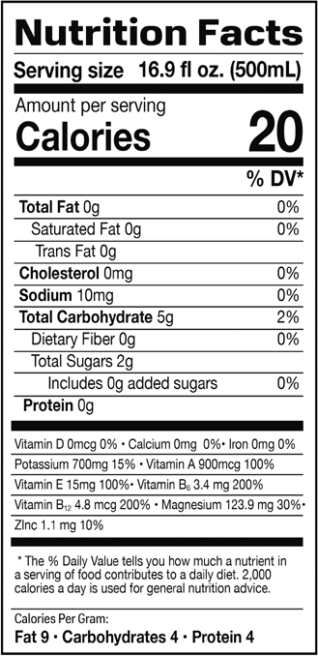
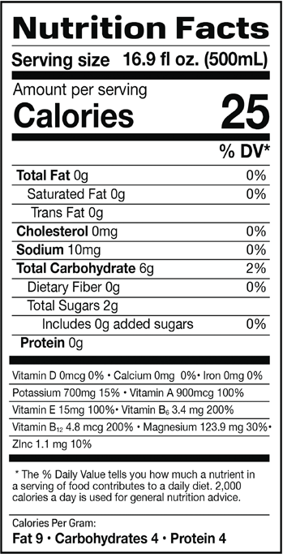


STRAWBERRY WATERMELON
ICE POP
BLUE RASPBERRY
INGREDIENTS: Filtered Water, Coconut Water from Concentrate, Citric Acid, Dipotassium Phosphate, Trimagnesium Citrate, Natural Flavor, Fruit and Vegetable Juice for Color, Sucralose,
L-Isoleucine, L-Leucine, L-Valine, d-Alpha Tocopheryl Acetate (Vitamin E), Acesulfame Potassium, Retinyl Palmitate (Vitamin A), Pyridoxine Hydrochloride (Vitamin B6), Cyanocobalamin (Vitamin B12).
Contains Allergen: Tree Nuts (Coconut)
INGREDIENTS: Filtered Water, Coconut Water from Concentrate, Citric Acid, Dipotassium Phosphate, Trimagnesium Citrate, Natural Flavor, Sucralose, L-Isoleucine, L-Leucine,
L-Valine, d-Alpha Tocopheryl Acetate (Vitamin E), Acesulfame Potassium, Retinyl Palmitate (Vitamin A), Pyridoxine Hydrochloride (Vitamin B-6), Cyanocobalamin (Vitamin B-12).
Contains Allergen: Tree Nuts (coconut)
INGREDIENTS: Filtered Water, Coconut Water from Concentrate, Citric Acid, Dipotassium Phosphate, Natural Flavor, Trimagnesium Citrate, Sucralose, L-Isoleucine, L-Valine, L-Leucine,
d-Alpha Tocopheryl Acetate (Vitamin E), Gum Acacia, Acesulfame Potassium, Retinyl Palmitate (Vitamin A), Zinc Aspartate, Pyridoxine Hydro- chloride (Vitamin B-6), Cyanocobalamin (Vitamin B-12). Contains Tree Nuts (coconut).
TROPICAL PUNCH
LEMON LIME
ORANGE
INGREDIENTS: Filtered Water, Citric Acid, Coconut Water from Concentrate, Dipotassium Phosphate, TrimagnesiumCitrate, Natural Flavor, Vegetable Juice for Color, Sucralose, L-Isoleucine, L-Leucine, L-Valine, Beta Carotene for Color, d-Al- pha Tocopheryl Acetate (Vitamin E), Acesulfame Potassium, Retinyl Palmitate (Vitamin A), Zinc Aspartate, Pyridoxine Hydrochloride (Vitamin
B-6), Cyanocobalamin (Vitamin B-12). Contains Allergen: Tree Nuts (coconut)
INGREDIENTS: Filtered Water, Coconut Water from Concentrate, Citric Acid, Dipotassium Phosphate, Trimagnesium Citrate, Natural Flavor, Sucralose, L-Isoleucine, L-Leucine, L-Valine,
d-Alpha Tocopheryl Acetate (Vitamin E), Acesul- fame Potassium, Beta Carotene for Color, Retinyl Palmitate (Vitamin A), Zinc Aspartate, Pyridoxine Hydrochloride (Vitamin B-6), Cyanocobalamin (Vitamin B-12). Contains Allergen: Tree Nuts (coconut)
INGREDIENTS: Filtered Water, Coconut Water from Concentrate, Citric Acid, Dipotassium Phosphate, Trimagnesium Citrate, Natural Flavor, Sucralose, L-Isoleucine, L-Leucine, L-Valine,
d-Alpha Tocopheryl Acetate (Vitamin E), Acesul- fame Potassium, Beta Carotene for Color, Retinyl Palmitate (Vitamin A), Zinc Aspartate, Pyridoxine Hydrochloride (Vitamin B-6), Cyanocobalamin (Vitamin B-12). Contains Allergen: Tree Nuts (coconut)
GRAPE
DISPLAY SHIPPER EXAMPLE
INGREDIENTS: Filtered Water, Citric Acid, Coconut Water from Concentrate, Dipotassium Phosphate, Trimagnesium Citrate, Natural Flavor, Fruit and Vegetable Juice for Color, Malic Acid, Sucralose, L-Isoleucine, L-Leucine, L-Valine, d-Al- pha Tocopheryl Acetate (Vitamin E), Acesulfame Potassium, Retinyl Palmitate (Vitamin A), Zinc Aspartate, Pyridoxine Hydrochloride (Vitamin B6), Cyanocobalamin (Vitamin B-12). Contains Allergen: Tree Nuts (coconut)
ORANGE
BLUE RASPBERRY
LEMON LIME
TROPICAL PUNCH
ICE POP
GRAPE
STRAWBERRY WATERMELON
12 PACK

