Slide 1
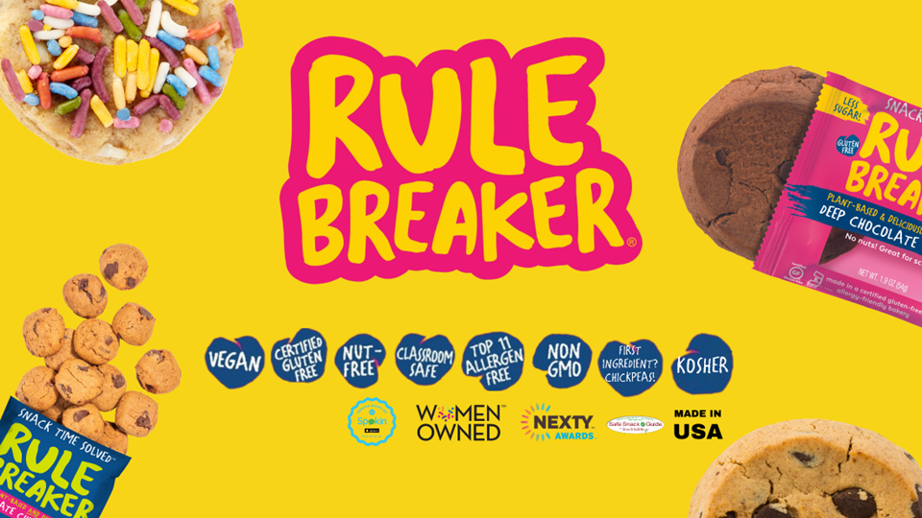




Slide 2

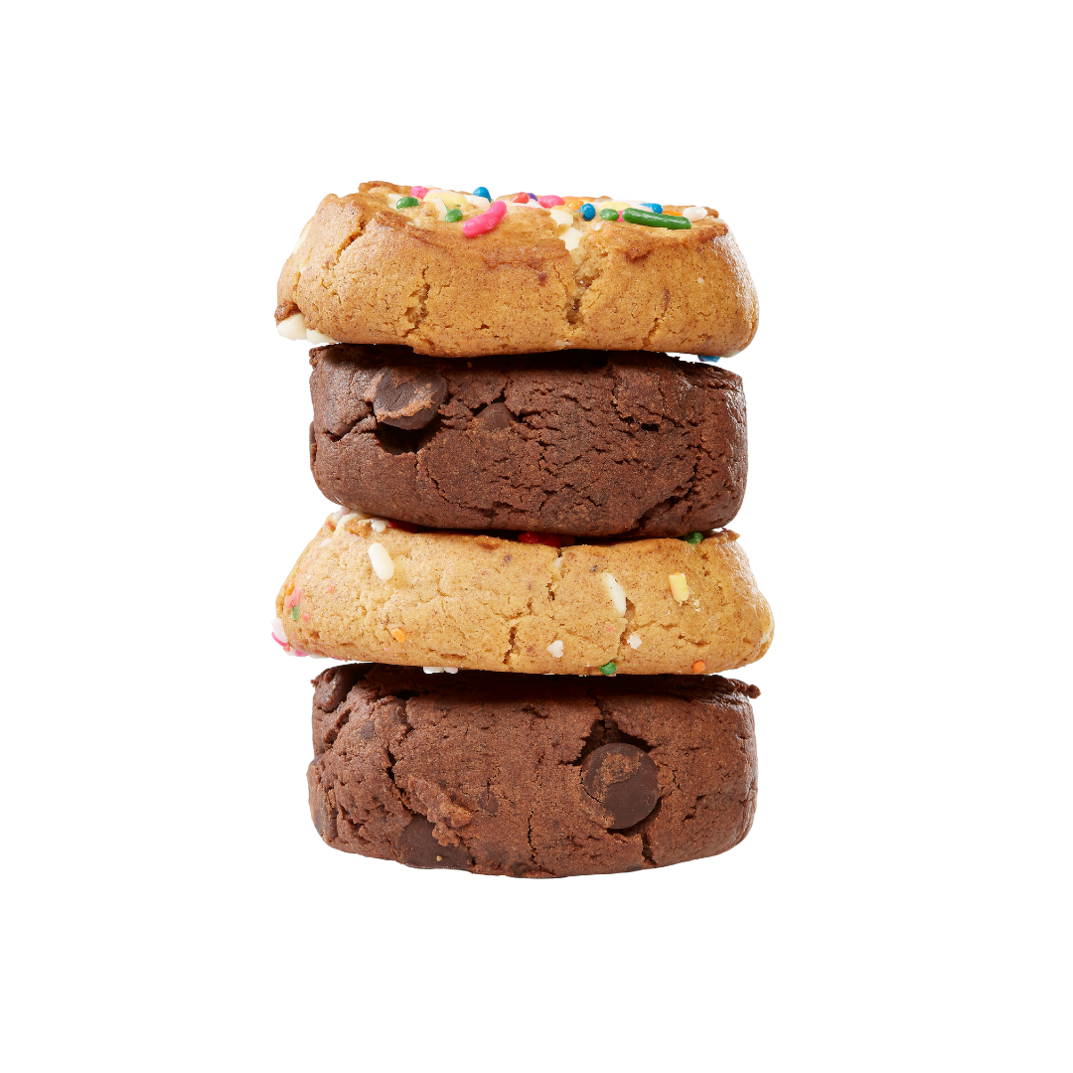
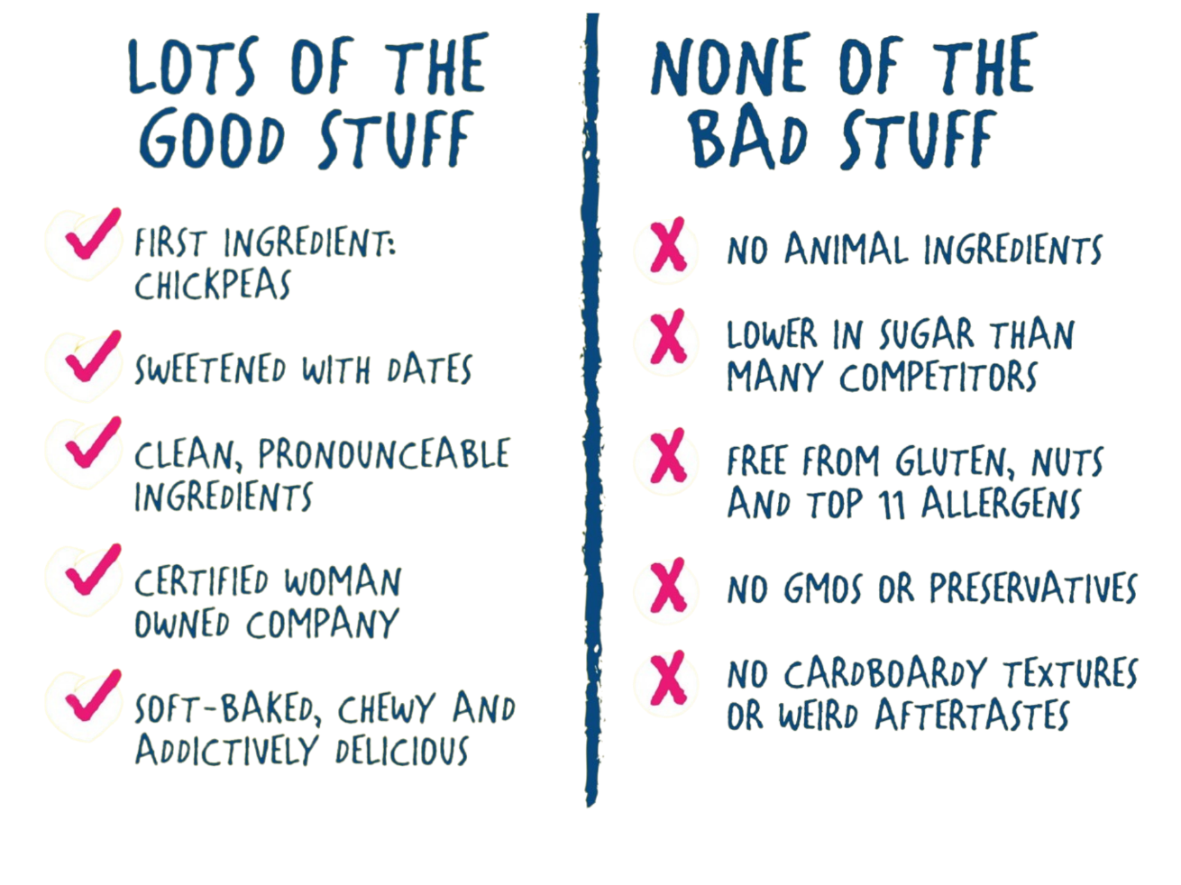


SNACK TIME SOLVED!
Notes:
Snacks are a high repeat consumption category, and US sales are $100 billion and growing. Almost half of consumers eat 3+ snacks per day.
Also growing is the number of Americans with food allergies or other dietary concerns, such as wanting to eat less sugar or more plant-based foods.
If you’re one of these consumers, you know that you often have to choose between satisfying your dietary needs OR your sweet tooth. But no longer. Rule Breaker to the rescue!

Slide 3
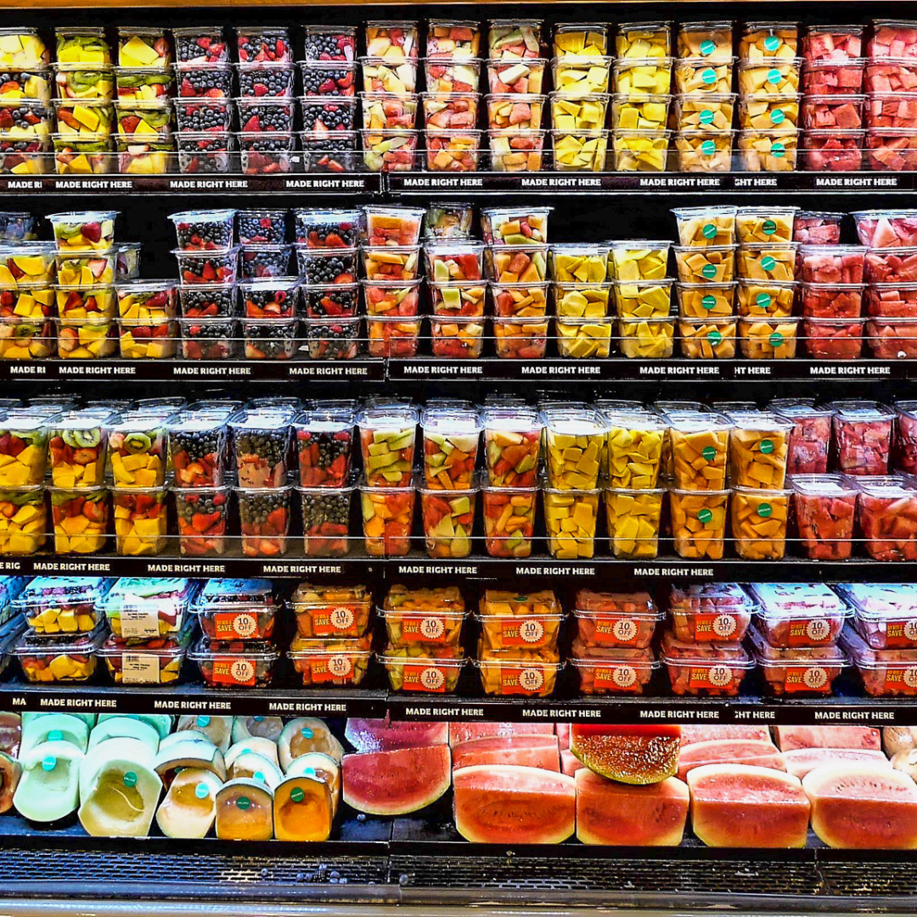


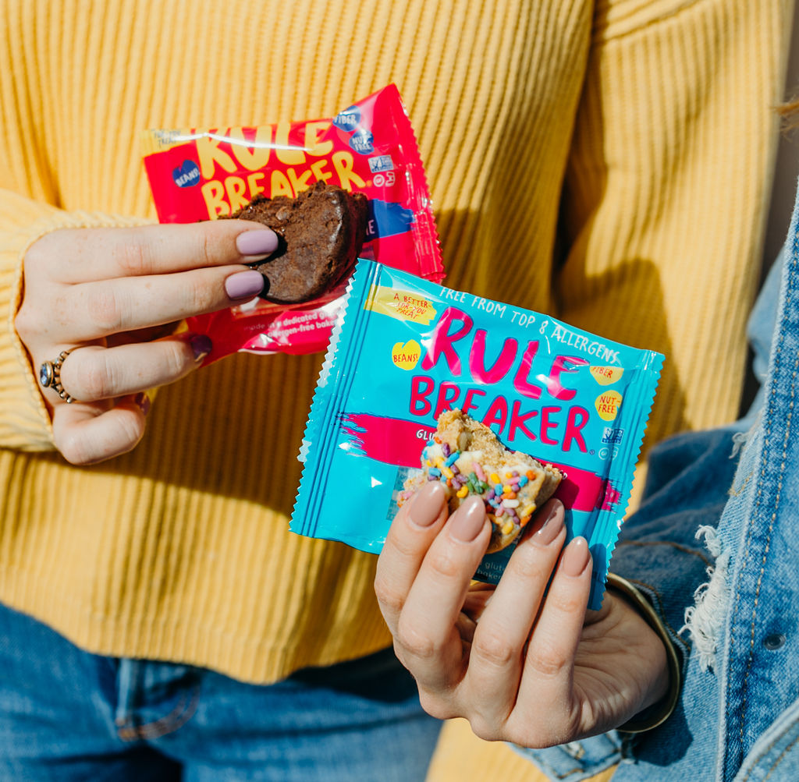
VALIDATION
The Rise and Rise of the Healthy Snack Market
Global HEALTHY Snack Market:
Current Market Size: $90.6B
Projected yearly growth through 2030: 6.6%^{1,} outpacing
conventional snack market (2.7%) by almost 3X.²
Global PLANT-BASED Snack Market:
Current Market Size: $44B³
Projected yearly growth through 2030: 6.9%³
U.S. ALLERGEN-FREE Foods Market:
Current Market Size: $19B.⁴
Projected global yearly growth through 2030: 8.6%⁵
Rule Breaker Snacks:
Continuous Growth YOY for last 4 years
Uses Sustainable ingredients including chickpeas and dates
*Sources on slide 17
Notes:
Snacks are a high repeat consumption category, and US sales are $100 billion and growing. Almost half of consumers eat 3+ snacks per day.
Also growing is the number of Americans with food allergies or other dietary concerns, such as wanting to eat less sugar or more plant-based foods.
If you’re one of these consumers, you know that you often have to choose between satisfying your dietary needs OR your sweet tooth. But no longer. Rule Breaker to the rescue!

Slide 4
Food Allergy Facts
The Rise and Rise of the Healthy Snack Market
US Allergen Market:
10% or 32 million Americans have food allergies, including 5.6 million children under age 18. That’s one in 13 children, or two in every classroom. That’s 11% of Adults and 8% of Children.
US Allergen Market
The Centers for Disease Control & Prevention reports that the prevalence of food
allergy in children increased by 50 percent between 1997 and 2011.
Typical nut and seafood allergies are generally lifelong.
U.S. ALLERGEN-FREE Foods Market:
There are many people who are gluten insensitive, who also rely on these
products being counted as part of those considered with allergies.
Rule Breaker Snacks:
61% of surveyed people indicated that they are willing to pay more
for allergen free food products
*Sources on slide 17
Notes:
Snacks are a high repeat consumption category, and US sales are $100 billion and growing. Almost half of consumers eat 3+ snacks per day.
Also growing is the number of Americans with food allergies or other dietary concerns, such as wanting to eat less sugar or more plant-based foods.
If you’re one of these consumers, you know that you often have to choose between satisfying your dietary needs OR your sweet tooth. But no longer. Rule Breaker to the rescue!

Slide 5
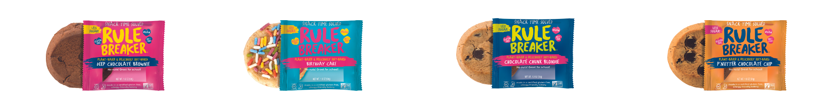
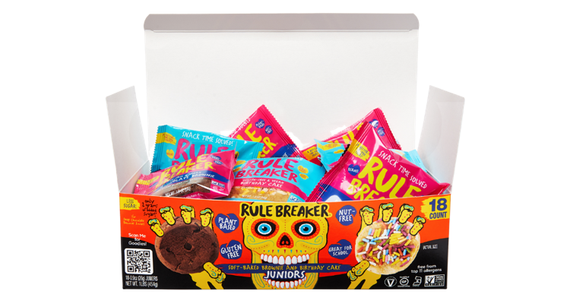
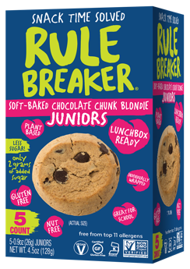
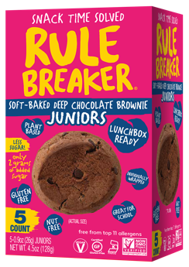
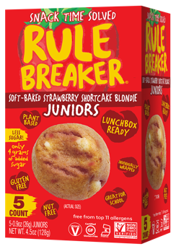
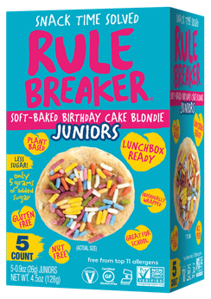

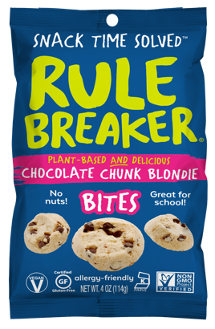
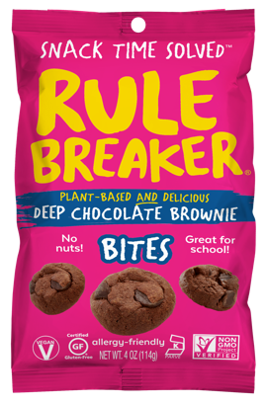
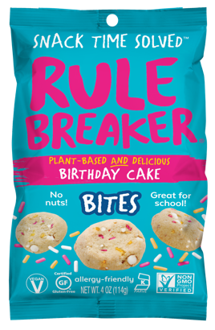
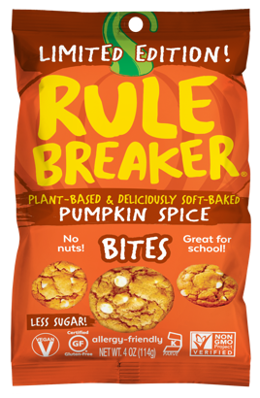
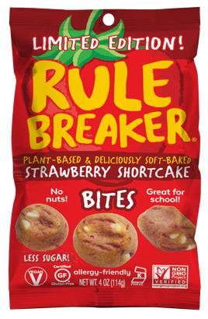
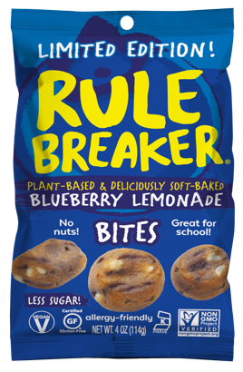
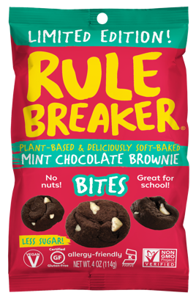
A BETTER-FOR-YOU BRAND
Built For The Mainstream Consumer
Notes:
Snacks are a high repeat consumption category, and US sales are $100 billion and growing. Almost half of consumers eat 3+ snacks per day.
Also growing is the number of Americans with food allergies or other dietary concerns, such as wanting to eat less sugar or more plant-based foods.
If you’re one of these consumers, you know that you often have to choose between satisfying your dietary needs OR your sweet tooth. But no longer. Rule Breaker to the rescue!

Slide 6

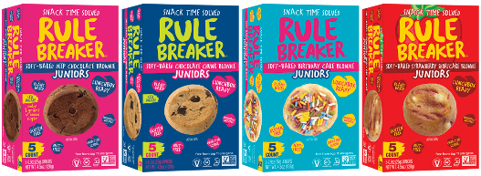





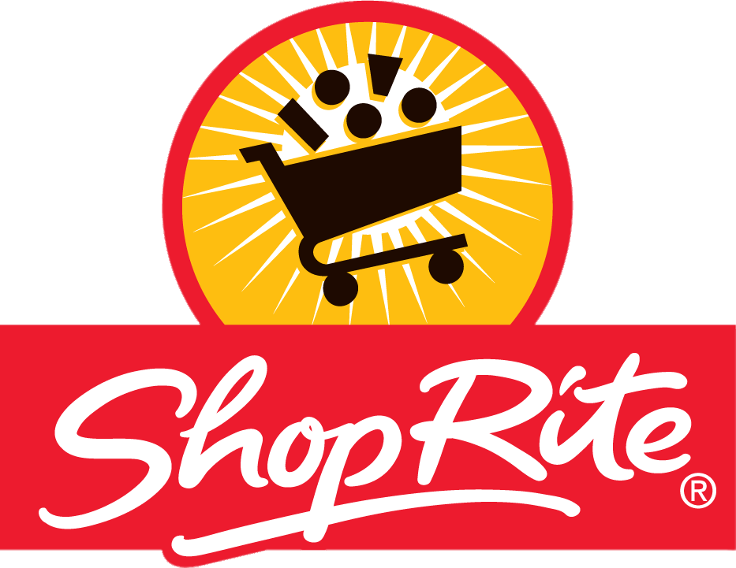





NEW OFFERINGS
Lunchbox Ready
Snack Time Solved
Pantry Pack
1 POUNDER OF BITES
Great value for holiday – limited edition flavors
Srp: $12.99
Big Box of Bites
Great for lunchboxes, the office and snacking on-the-go
100-110 calories
SRP: $5.99
Juniors 5-count boxes
Great for lunchboxes, the office and snacking on-the-go
100-110 calories
SRP: $4.99-$5.99

Slide 7
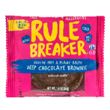



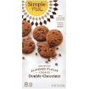




HOW THE OTHER COOKIES CRUMBLE
A Look At Our Direct Competitors
 | Rule Breaker | Enjoy Life | Pamela’s | Home Free | Simple Mills | Partake | Nature’s Bakery
Added Sugar grams* | 4 | 13.5 | 23 | 17 | 13 | 12 | 16
Main Sweetener | Dates | Brown Sugar | Sugar | Sugar | Coconut Sugar | Sugar | Cane Sugar Syrup
Total Sugar grams* | 11 | 23 | 23 | 19 | 15 | 14 | 19
First Ingredient | Chickpeas | Flour Blend (Brown Rice, Sorghum, Buckwheat) | Organic cane sugar | GF Whole Oat Flour | Almonds | Flour Blend | Whole wheat Flour
Nut-free and school safe |  |  | X |  | X |  | X
* Per 54 gram serving

Slide 8

OUR CORE CONSUMERS
Health- and sugar-conscious
Cookie consumption increased 25% during the pandemic.¹
At the same time, 42% of consumers want to reduce sugar intake.²
Allergy-concerned
85 million Americans have food allergies or buy for someone with food allergies.³ Nuts are banned at schools.
68% of those allergy-concerned consumers trust smaller and allergen-friendly brands (68%) more than large brands.⁴
Plant Based/Vegetarian/Next Gen
Next Gen adults purchasing brands that meet their needs, different brands from parents
Looking to explore plant based foods while not being vegan
More adults entering this space each year
Notes:
Our primary target is the allergy-concerned consumer. 1 in 10 adults and 1 in 13 kids have food allergies (that’s 2 per classroom), and their needs drive purchases for families, schools, and all sorts of occasions.
We also appeal to the consumer who’s interested in eating more plant-based foods because they believe it’s better for their health, the animals, and the planet. And it is.
Then there’s the health-conscious consumer looking for less sugar and clean ingredients that she can feel good about giving her family—and that her kids will love. Rule Breaker’s hidden nutritious beans are a bonus.

Slide 9

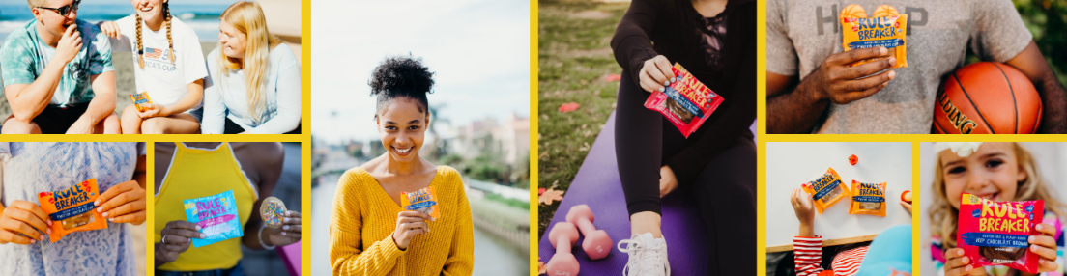
MARKET OPPORTUNITY
Health- and sugar-conscious
Better-For-You products have grown double digits YOY (20%+) and expect to continue to grow
11.3% of US population is diagnosed and 23% of US population undiagnosed w diabetes – looking to purchase items lower in sugar
Allergy-concerned
Free From Foods continue to grow at 21%+ rate YOY and expect to continue thru the next several years
Nuts are banned at most U.S. schools.
Plant-curious
In 2020, 57 percent of all U.S. households purchased plant-based foods. The vast majority were not vegan or even vegetarian. Drivers: taste (52%), health (39%), environmental impact (13%), animal welfare (11%).⁵
Notes:
Our primary target is the allergy-concerned consumer. 1 in 10 adults and 1 in 13 kids have food allergies (that’s 2 per classroom), and their needs drive purchases for families, schools, and all sorts of occasions.
We also appeal to the consumer who’s interested in eating more plant-based foods because they believe it’s better for their health, the animals, and the planet. And it is.
Then there’s the health-conscious consumer looking for less sugar and clean ingredients that she can feel good about giving her family—and that her kids will love. Rule Breaker’s hidden nutritious beans are a bonus.

Slide 10


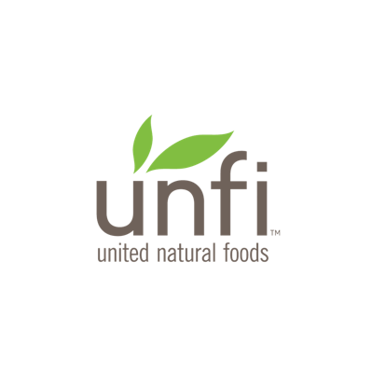




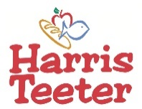
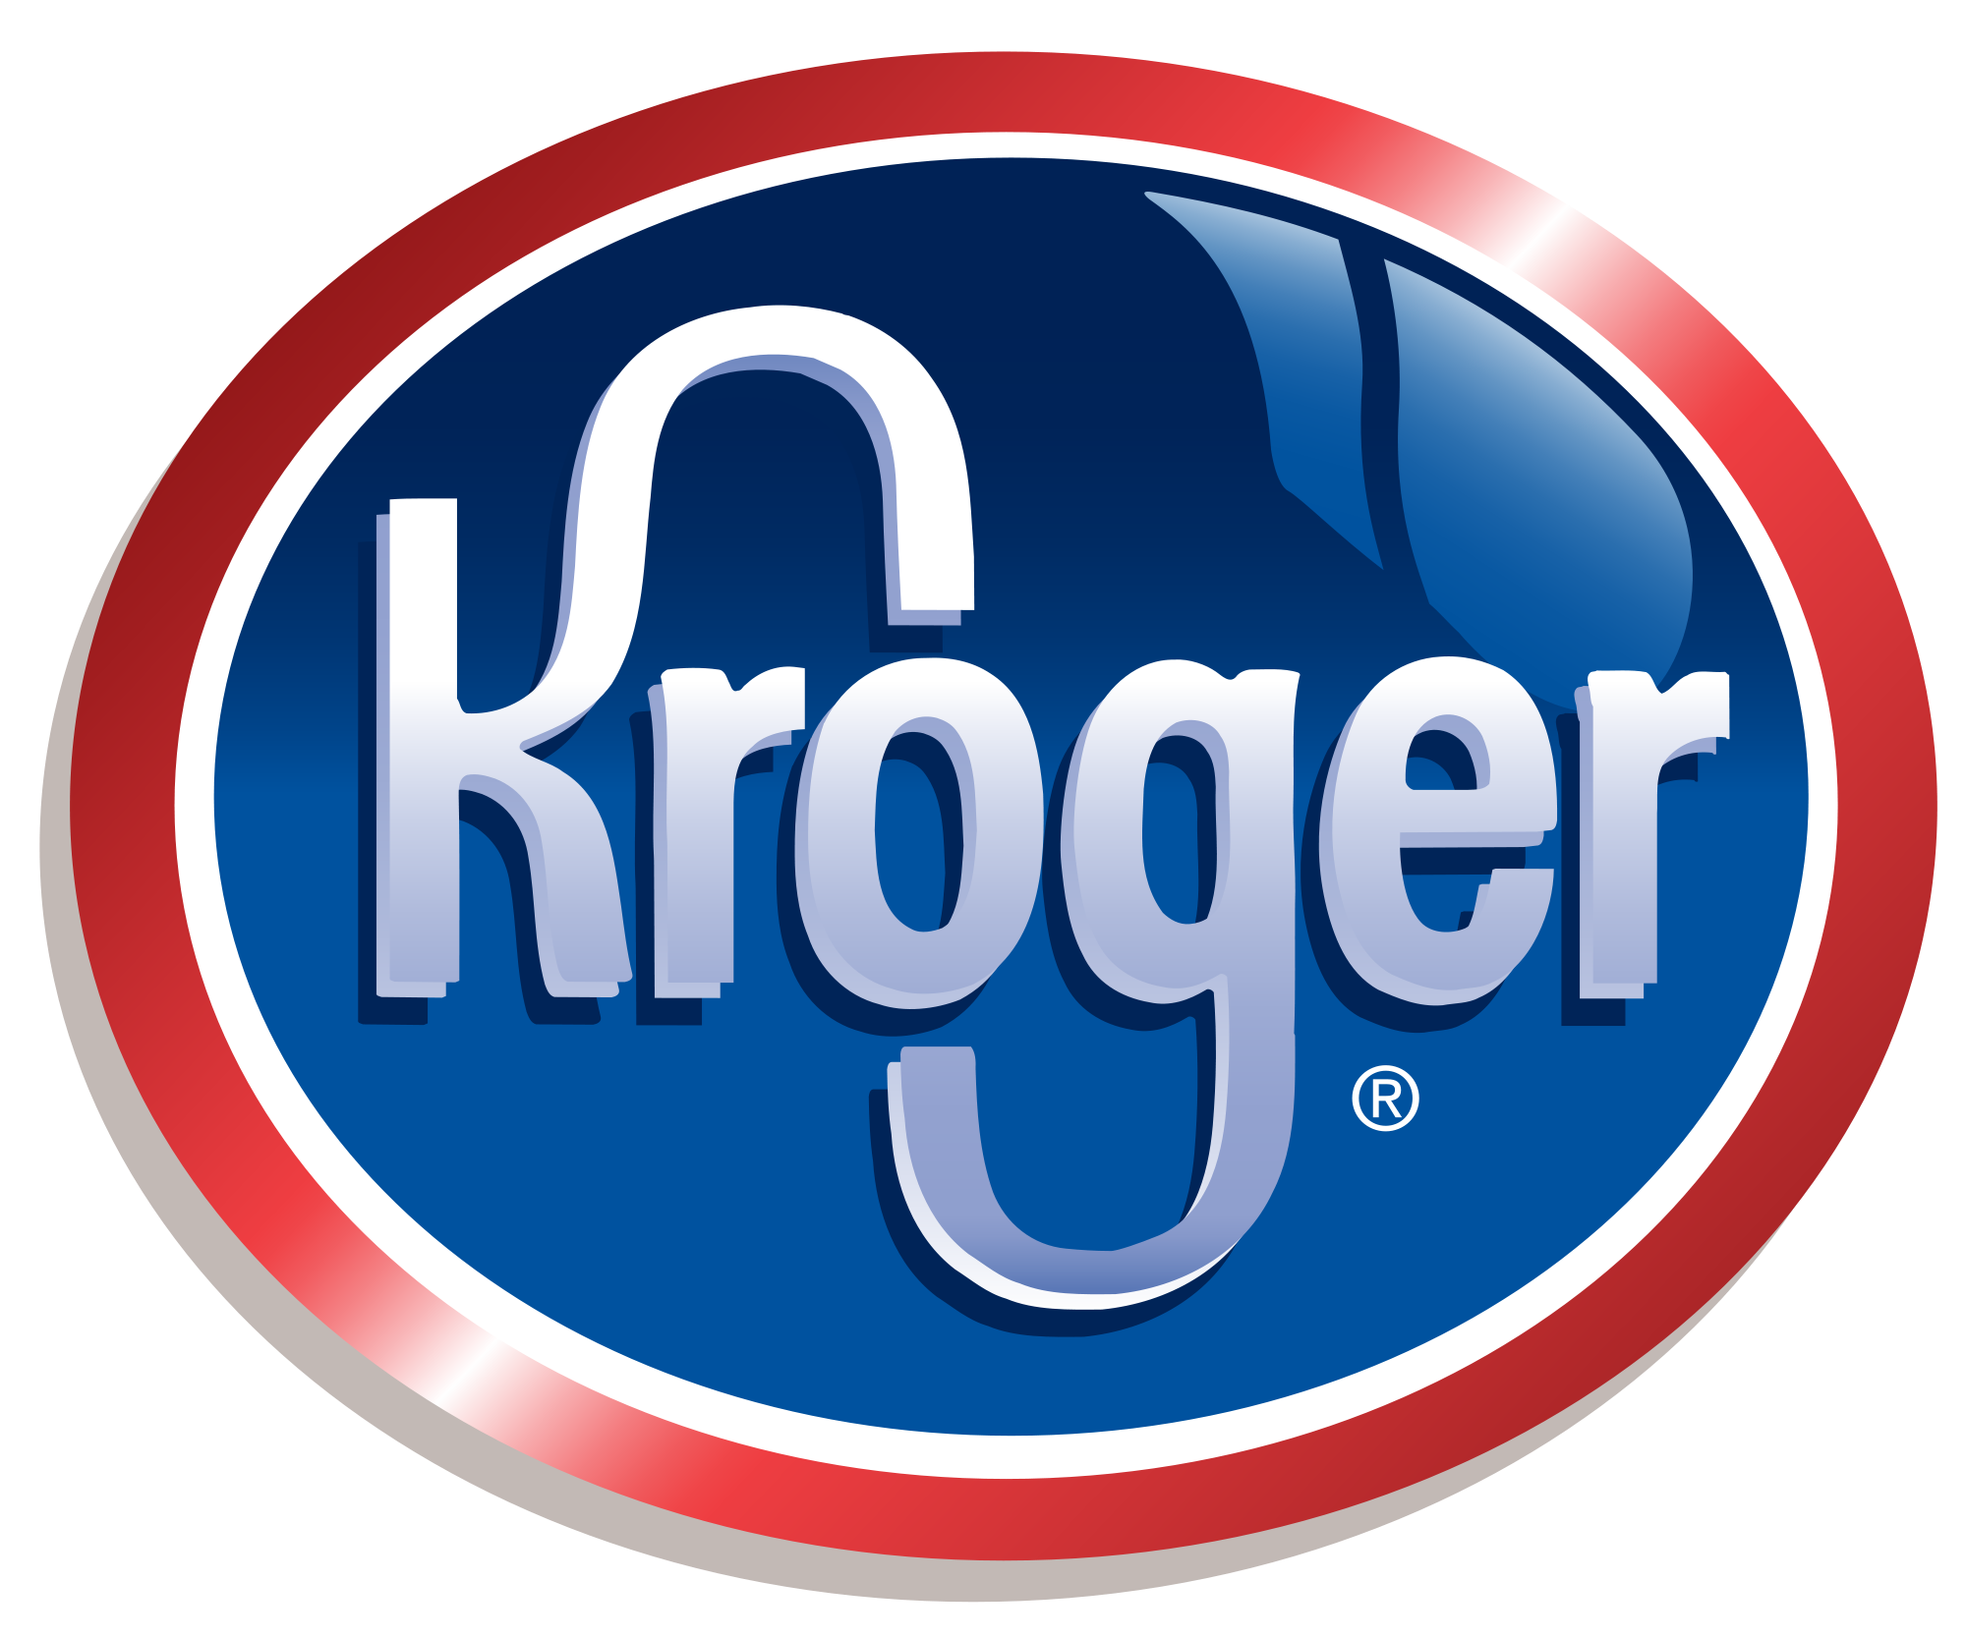



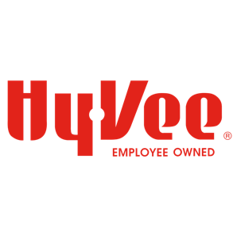









OUR OMNICHANNEL APPROACH
RETAIL
ONLINE RETAILERS
SNACK BOXES
MEAL KITS
TRAVEL &
CONVENIENCE
RULE BREAKER
SNACKS.COM
#1 Selling Item in Bakery
MIAMI INTERNATIONAL AIRPORT
30TH STREET STATION
PHILADELPHIA
UNION STATION
CHICAGO
PENN STATION
BALTIMORE
Notes:
Rule Breaker Snacks are sold in about 1400 major supermarket locations, including Kroger, Wegmans, Schnucks, Bueller’s, and Cosentino’s, and100 natural and specialty food locations.
We’re supported by several regional broker networks and distributors, plus UNFI and KeHE. At Kroger, Rule Breaker has a velocity of just under 3 units per store per week per SKU across 267 locations.

Slide 11

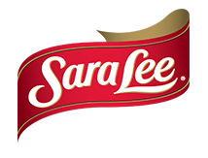

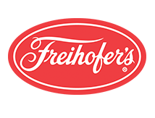
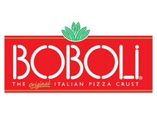


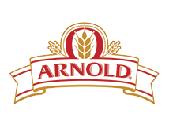
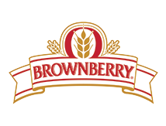
INTRODUCING
Our New Partner
BBU is the largest baked goods company
in the U.S. As active partners, they assist with:
Growth strategy in all channels
Equipment needs for new product lines
Connections with suppliers to lower COGS
And more!

Slide 12

THANK YOU!
Jeff Canner, COO
Jeff@rulebreakersnacks.com
978-884-0771
Michael Fox, Director of Sales
Michaelf@rulebreakersnacks.com
973-380-8654
Notes:
The need for delicious, allergen-free snacks is universal. Rule Breaker can replace the less healthy options, and leave families, especially kids, happier and healthier. That’s what I’d like to see, and I hope you would too.
Now, who wants to come break some rules with me?
Now, who wants to come and break some rules with me?

