Slide 1

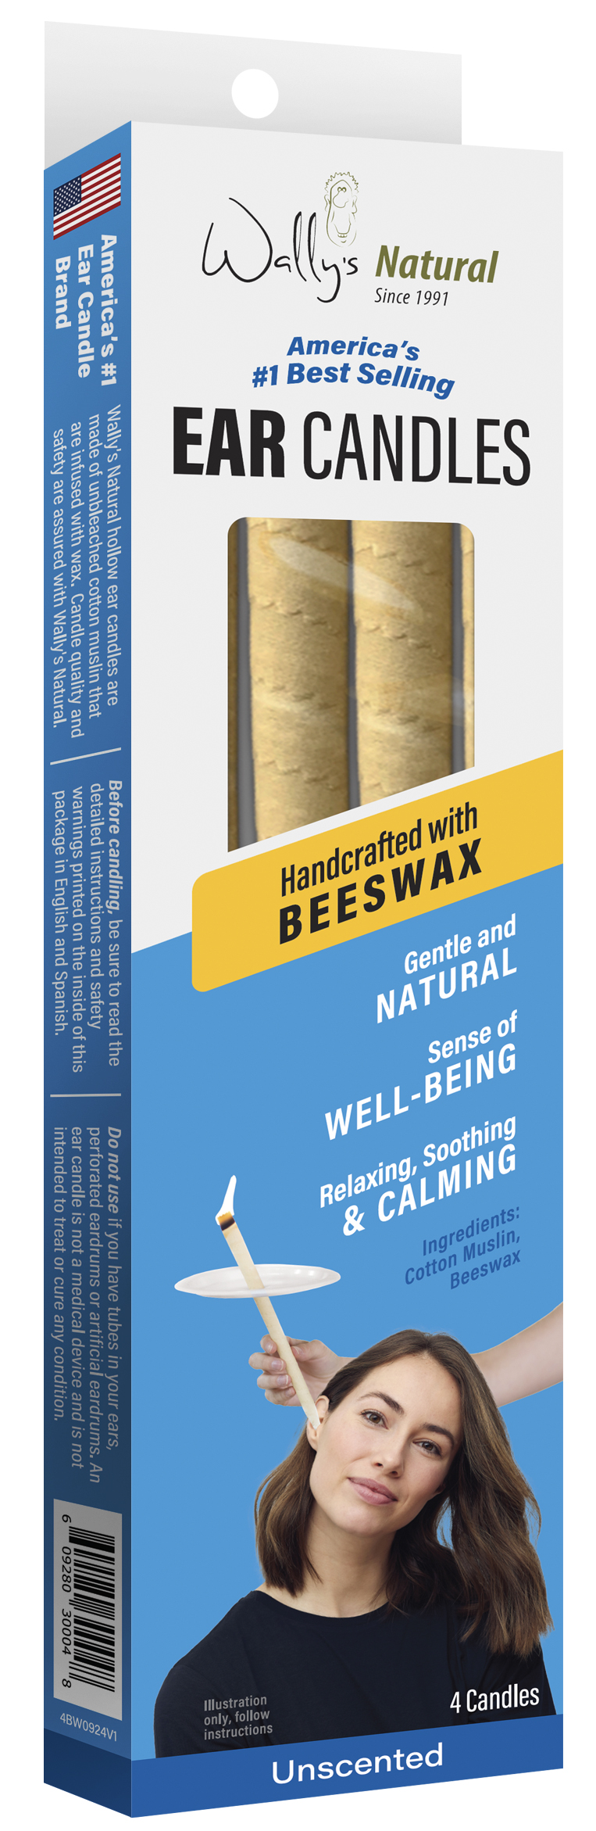
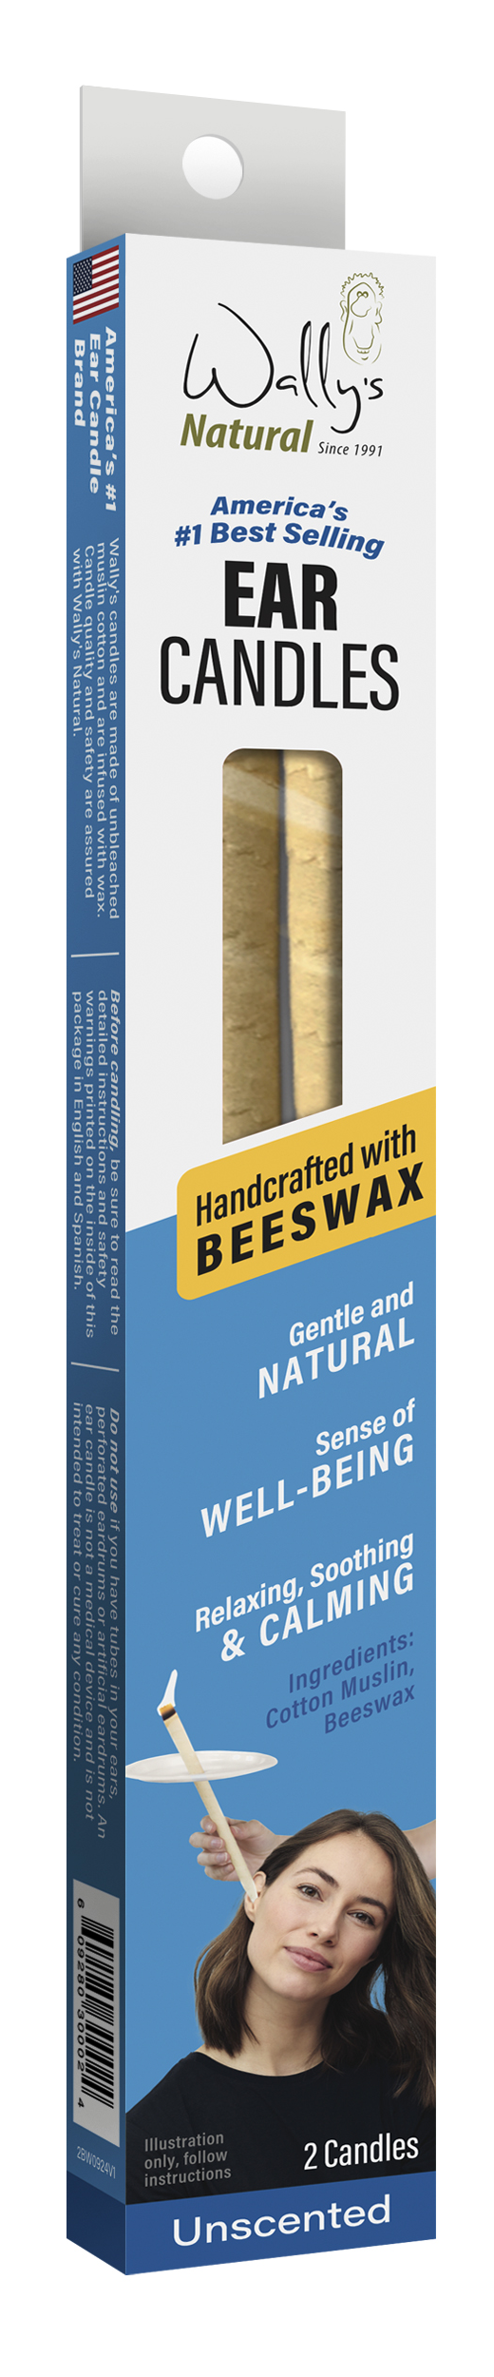









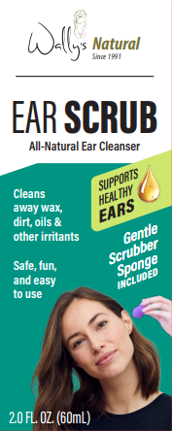
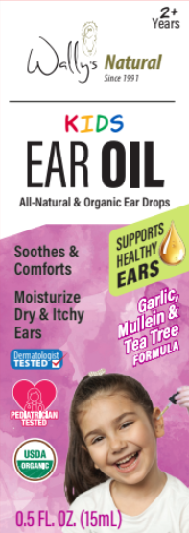
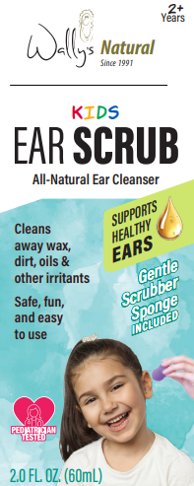
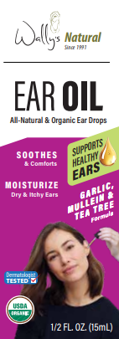
WE’RE ALL EARS!
A leader in natural ear care since 1991,
with a portfolio of Candles, Oils, and Scrubs.
ABOUT WALLY’S NATURAL EAR CANDLES
Ear Candling is a traditional method trusted by generations to promote ear comfort and enhance overall health and well-being
Experience of warm sensations and soothing crackling sounds is calming and revitalizing
No-drip safety filter
America’s #1 Ear Candle, made in USA with safety and quality you can trust
Beeswax, Paraffin and Soy wax options and all-natural scents Herbal, Lavender or Unscented
Hollow candles are simply made of unbleached cotton muslin and infused with wax.
Sold nationwide in Walmart, Target, CVS, Sprouts, and thousands of other stores!
ALSO FROM WALLY’S NATURAL:
Earwax Removal
Ear Scrub
Organic Ear Oil
First launched under the Fearless Naturals brand, this first-of-its- kind ear scrub has rebranded to Wally’s Natural, with options for both Kids and Adults!
The only ear drop that is USDA-Certified Organic. Tested by dermatologists and pediatricians,
our popular ear oil is now available in a Kids version.

