Slide 1

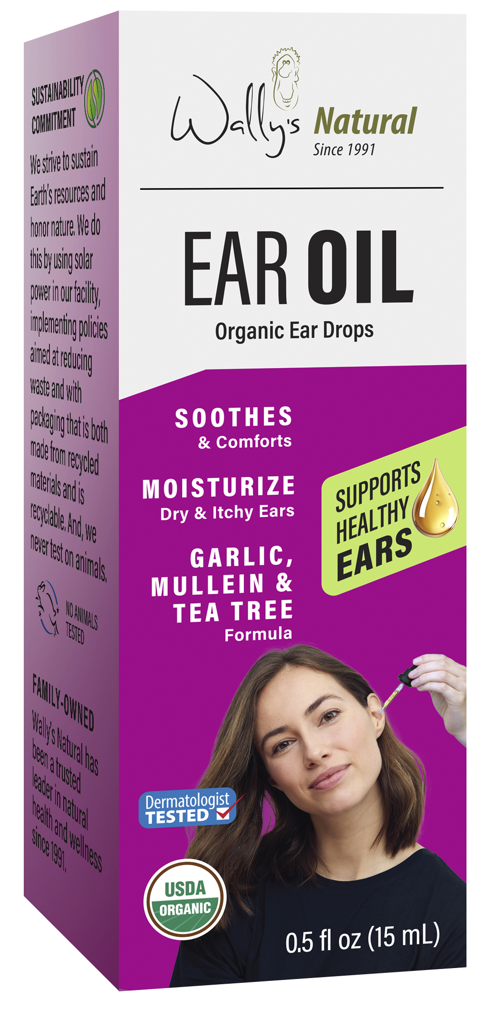
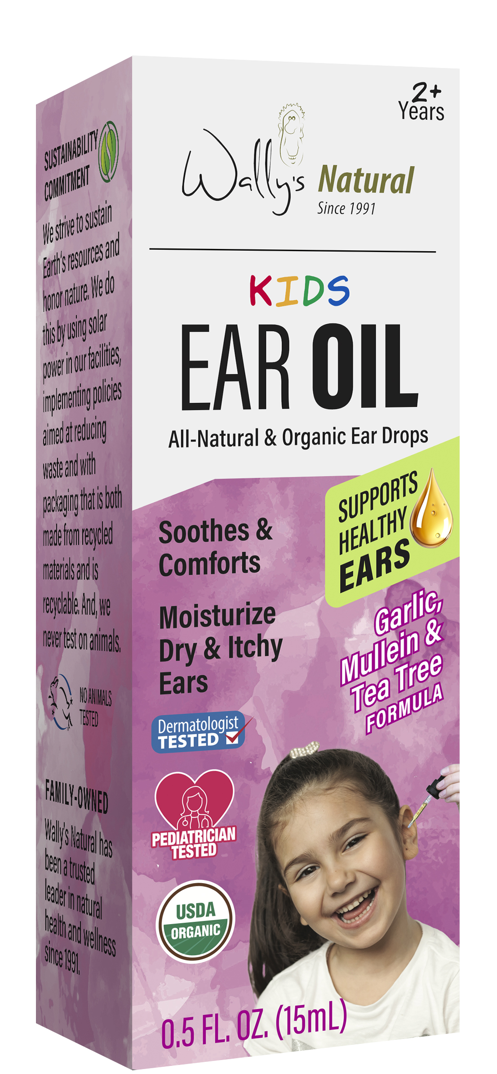












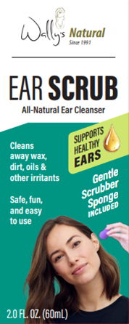

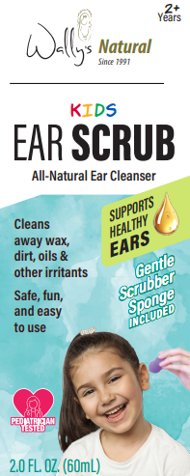
WE’RE ALL EARS!
Celebrating 30+ years of natural ear care,
with a portfolio of Candles, Oils, and Scrubs.
ABOUT WALLY’S NATURAL EAR OIL
Certified USDA Organic
Powerful botanicals loved for holistic healing
Naturally soothes sensitivity, providing calm and comfort to irritated or itchy ears
Use 1-3 drops twice a day or as needed
Safe for kids, formulated with natural ingredients
Made in USA
ALL ORGANIC INGREDIENTS: Lavender, Mullein, Tea Tree, Echinacea and Garlic in an Olive Oil base
Sold in 1000s of stores (Natural/MULO), including Fresh Thyme, Sprouts and Albertsons
ALSO FROM WALLY’S NATURAL:
Earwax Removal Ear Scrub
America’s #1 Ear Candle
First launched under the Fearless Naturals brand, this first-of-its- kind ear scrub has rebranded to Wally’s Natural, with options for both Kids and Adults
Ear Candles have made Wally’s Natural the #1 brand in Home Health Care in the Natural channel. Choose beeswax, paraffin, or soy—scented or unscented—all with a no-drip tip.

