Slide 1

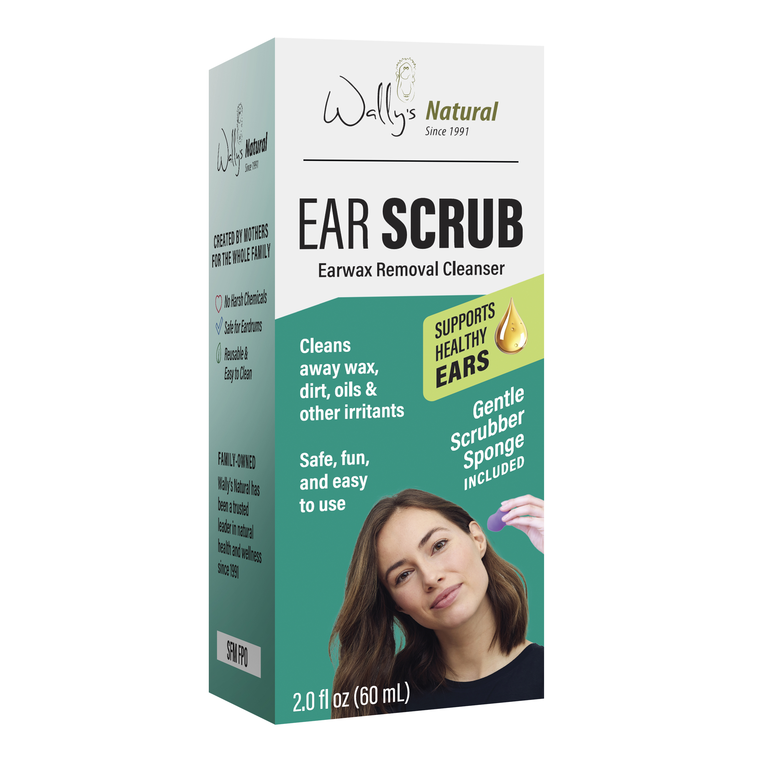
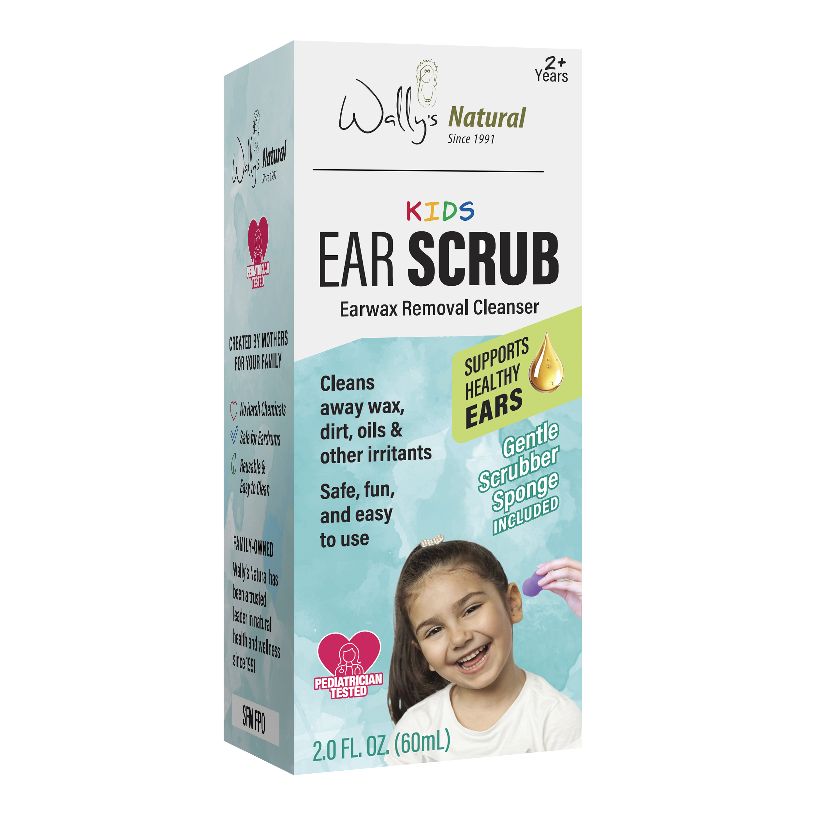








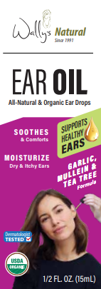

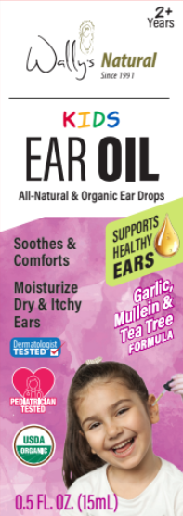
WE’RE ALL EARS!
A leader in natural ear care since 1991
with a portfolio of Candles, Oils and Scrubs.
WALLY’S EARWAX REMOVAL EAR SCRUB
Specialty soap formulated
with aloe barbadensis leaf juice, coconut oil and other natural ingredients
Powerful botanicals beloved since ancient times for natural cleansing and skin care
Includes scrubber sponge
Safely cleans away earwax, dirt and irritants
Made in USA
This innovative ear scrub will be rebranded to Wally’s Natural in 2024 with Kids and Adult SKUs!
Wally’s Natural Ear Care is sold nationwide at Walmart, Target, CVS, Sprouts, and thousands of other stores!
ALSO FROM WALLY’S NATURAL:
Organic Ear Oil
America’s #1 Ear Candle
The only ear drop that is USDA-Certified Organic. Tested by dermatologists and pediatricians,
our popular ear oil now available in a Kids version.
Ear Candles have made Wally’s Natural the #1 brand in Home Health Care in the Natural channel. Choose beeswax, paraffin, or soy—scented or unscented—all with a no-drip tip.

