Slide 1
Performance Update
Nielsen Data for Period Ending 03/25/23

Slide 2
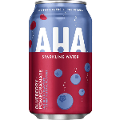
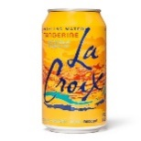
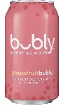
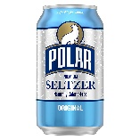

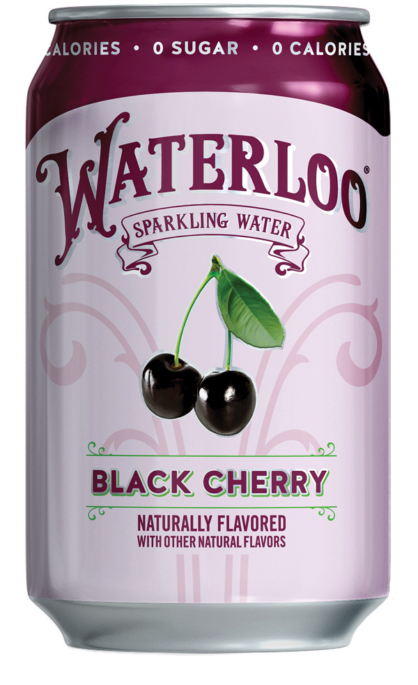
Waterloo Continues to Deliver Category Leading Growth and Velocity Through Latest Nielsen Reporting Period Ending 03/25/23 (Latest 13 Weeks)
$ % Change Year Ago – Latest 13 Weeks
Velocity % Change Year Ago – Latest 13 Weeks
Category Growth: 6.0%
Category Growth: 1.4%
$ velocity - Latest 13 Weeks
$32.3
$48.6
$20.3
$34.8
$47.9
$44.5
Source: Nielsen RMS Data, Total US xAOC, Period Ending 03/25/23
Note: Velocity represents $ / $MM ACV / Item. Bubly data uses Bubly Core.

Slide 3
Waterloo Continues to Deliver Category Leading TDP Growth Through
Latest Nielsen Reporting Period Ending 03/25/23 (Latest 13 Weeks)
TDP % Change Year Ago – Latest 13 Weeks
ACV % Pt Change Year Ago – Latest 13 Weeks
Category Growth: 3.3%
Category Growth: (0.3%)
TDPs - Latest 13 Weeks
311
874
695
686
275
244
Source: Nielsen RMS Data, Total US xAOC, Period Ending 03/25/23
Note: Bubly data uses Bubly Core.

Slide 4
$ Sales % Chg. vs YA, Latest Nielsen Reporting Period Ending 03/25/23
TTL Category
Waterloo
La Croix
Bubly
$4.4B L52
$127.8M L52
$580.4M L52
$310.9M L52
Polar
Spindrift
AHA
$296.2M L52
$170.4M L52
$107.4M L52
Source: Nielsen RMS Data, Total US xAOC, Period Ending 03/25/23
Note: Bubly data uses Bubly Core.

Slide 5

Waterloo vs. Category Across Key Nielsen Metrics (L13 & L4)
Waterloo’s growth is dominant vs. the category across all metrics, and remains the fastest growing brand in the competitive set
$ Sales % Change
Unit Sales % Change
$ Velocity % Change
TDP % Change
ACV % Pt. Change
$ Share Pt. Change
= Category
= Waterloo
Source: Nielsen RMS Data, Total US xAOC, Period Ending 03/25/23
Note: Velocity represents $ / $MM ACV / Item.

