Slide 1

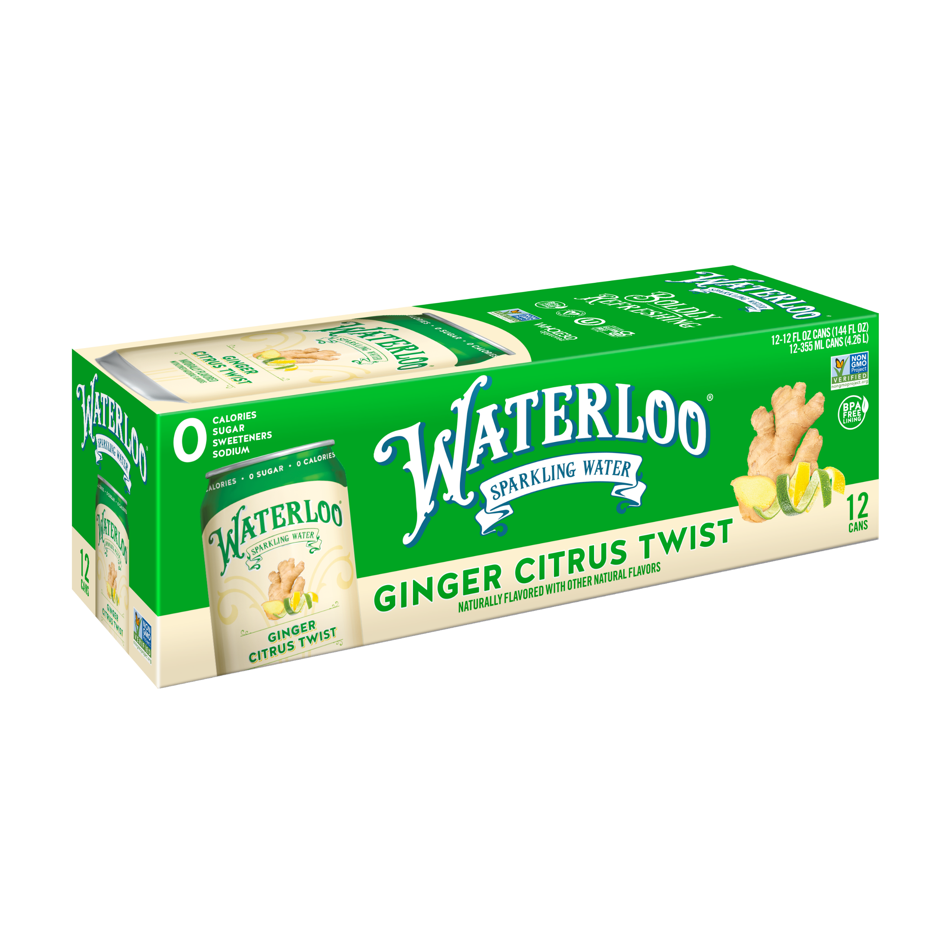
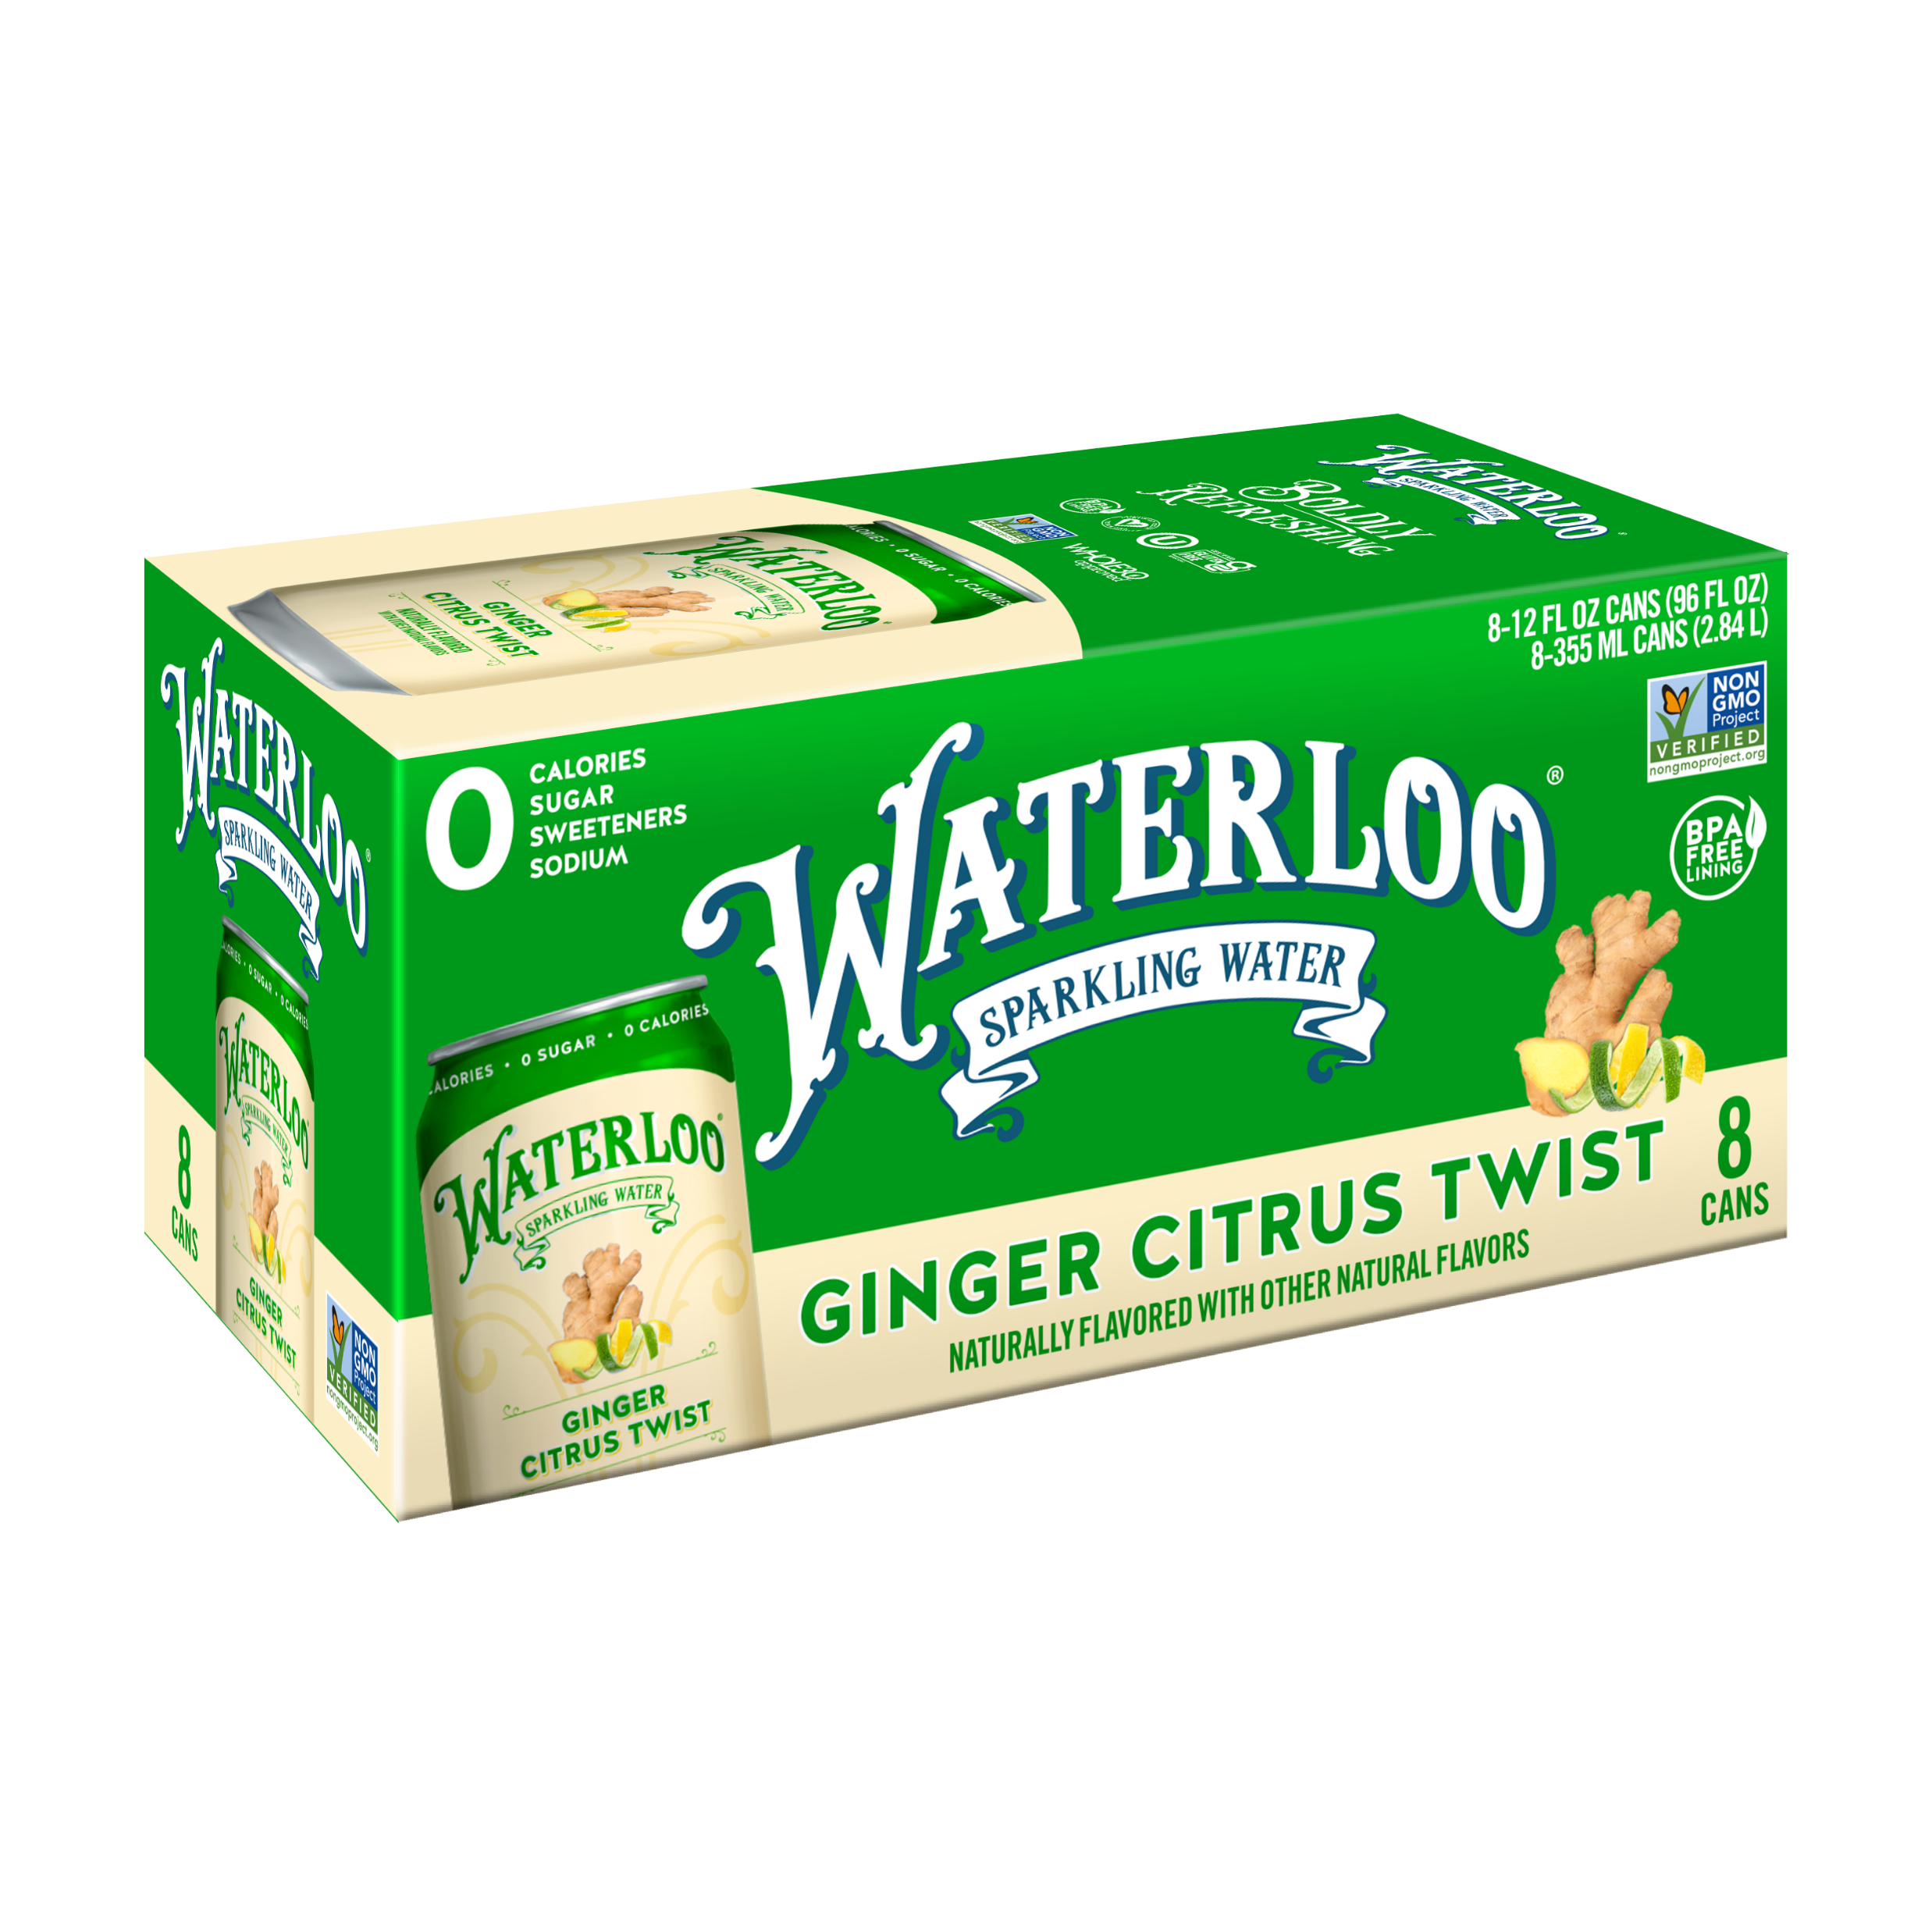
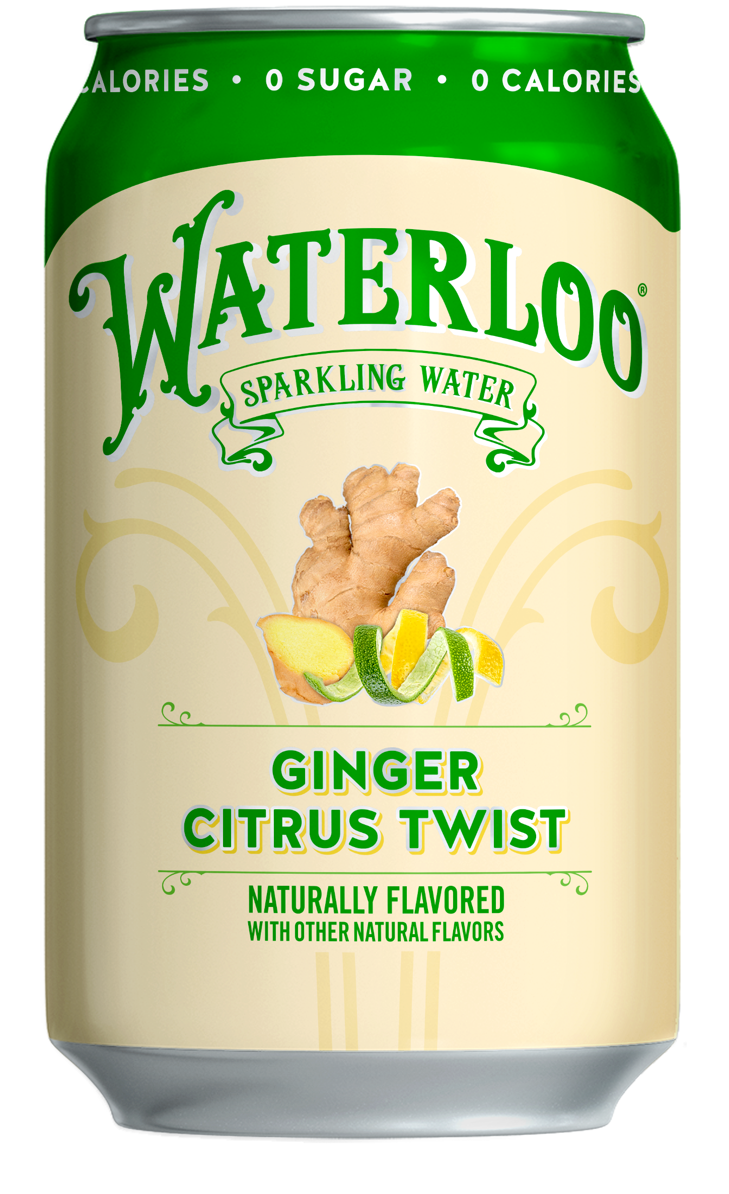



New in 2023
GINGER CITRUS TWIST
1st Ship Availability: 12/15/22*
Perfectly balanced and soothing. A classic combination of earthy ginger and zesty citrus notes.
Ginger is a top emerging flavor in sparkling water category³
Strong reach & uniqueness with 110% index amongst Life Tasters vs overall panel for interest¹.
Ginger Citrus Twist
8pk UPC
Ginger Citrus Twist
12pk UPC
Ginger Citrus Twist
12oz Can UPC
*1st ship availability is contingent on volume commitment submission date with timing subject to deferred shipping.
1. MarketView Research Waterloo Sparkling Water Flavor TURF Study. N=1,309. March 2021; 2. Mintel Still & Sparkling Water- US- March; 3. Sawtoothgroup research – focus groups, 5/21
Source: 1. 2022 Waterloo TURF Analysis; 2. Nielsen AOD W/E 3.26.22 3. Mintel Still & Sparkling Water 2022 Report

Slide 2
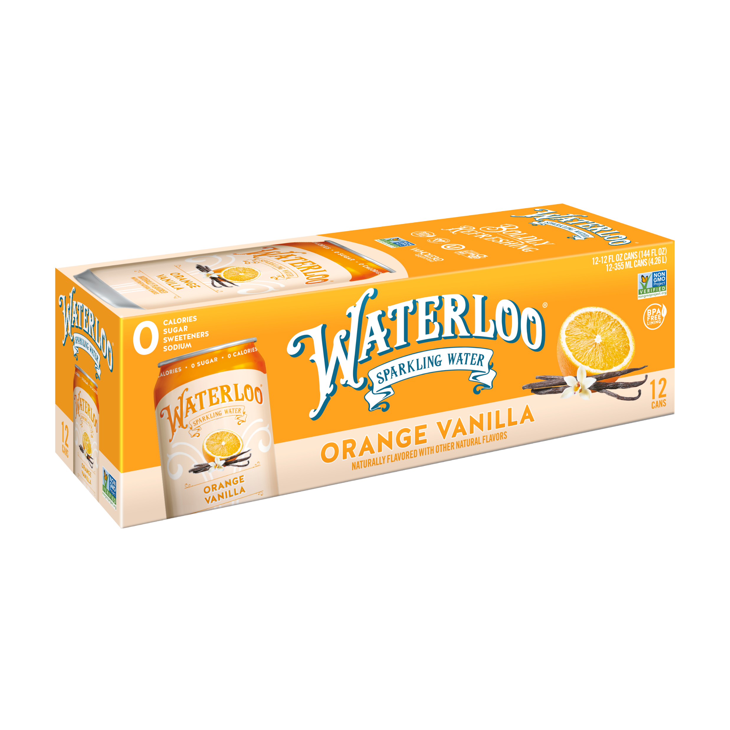
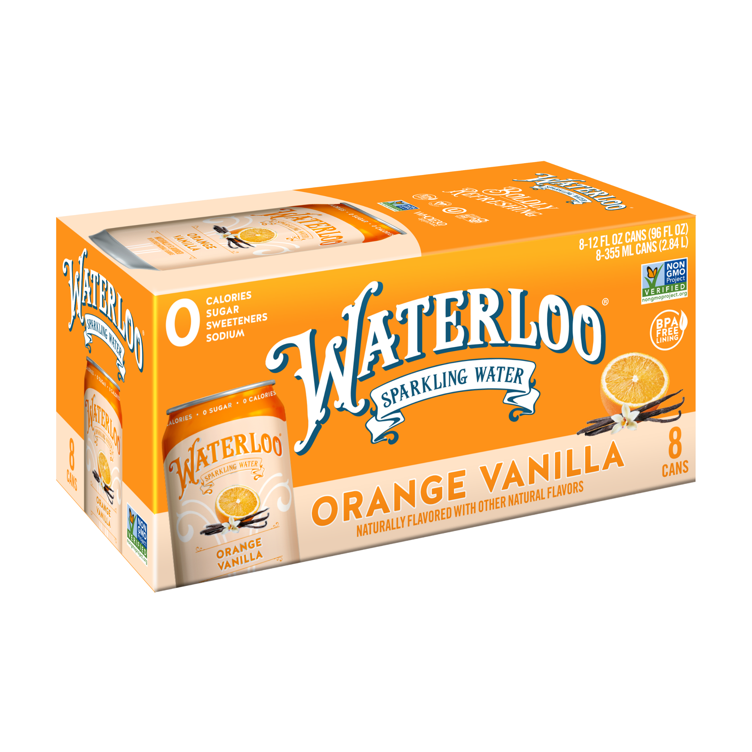
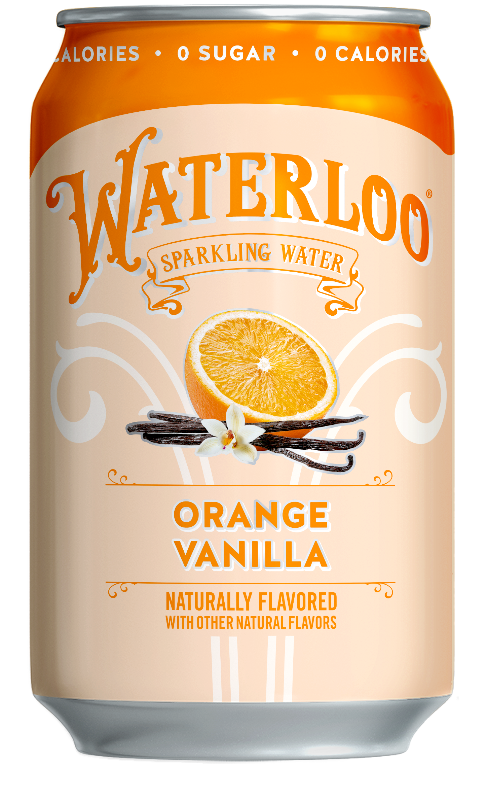



New in 2023
ORANGE VANILLA
1st Ship Availability: 12/15/22*
Refreshingly smooth. Juicy orange notes meet vanilla cream in this playful, nostalgic combination.
Highest uniqueness score of all flavors tested¹
Orange Vanilla
8pk UPC
Orange Vanilla 12pk UPC
Orange Vanilla 12oz Can UPC
Orange Vanilla flavored sparkling water growing +19% vs PY in latest 52W²
*1st ship availability is contingent on volume commitment submission date with timing subject to deferred shipping.
1. MarketView Research Waterloo Sparkling Water Flavor TURF Study. N=1,309. March 2021; 2. Mintel Still & Sparkling Water- US- March; 3. Sawtoothgroup research – focus groups, 5/21
Source: 1. 2022 Waterloo TURF Analysis; 2. Nielsen AOD W/E 3.26.22 3. Mintel Still & Sparkling Water 2022 Report

Slide 3
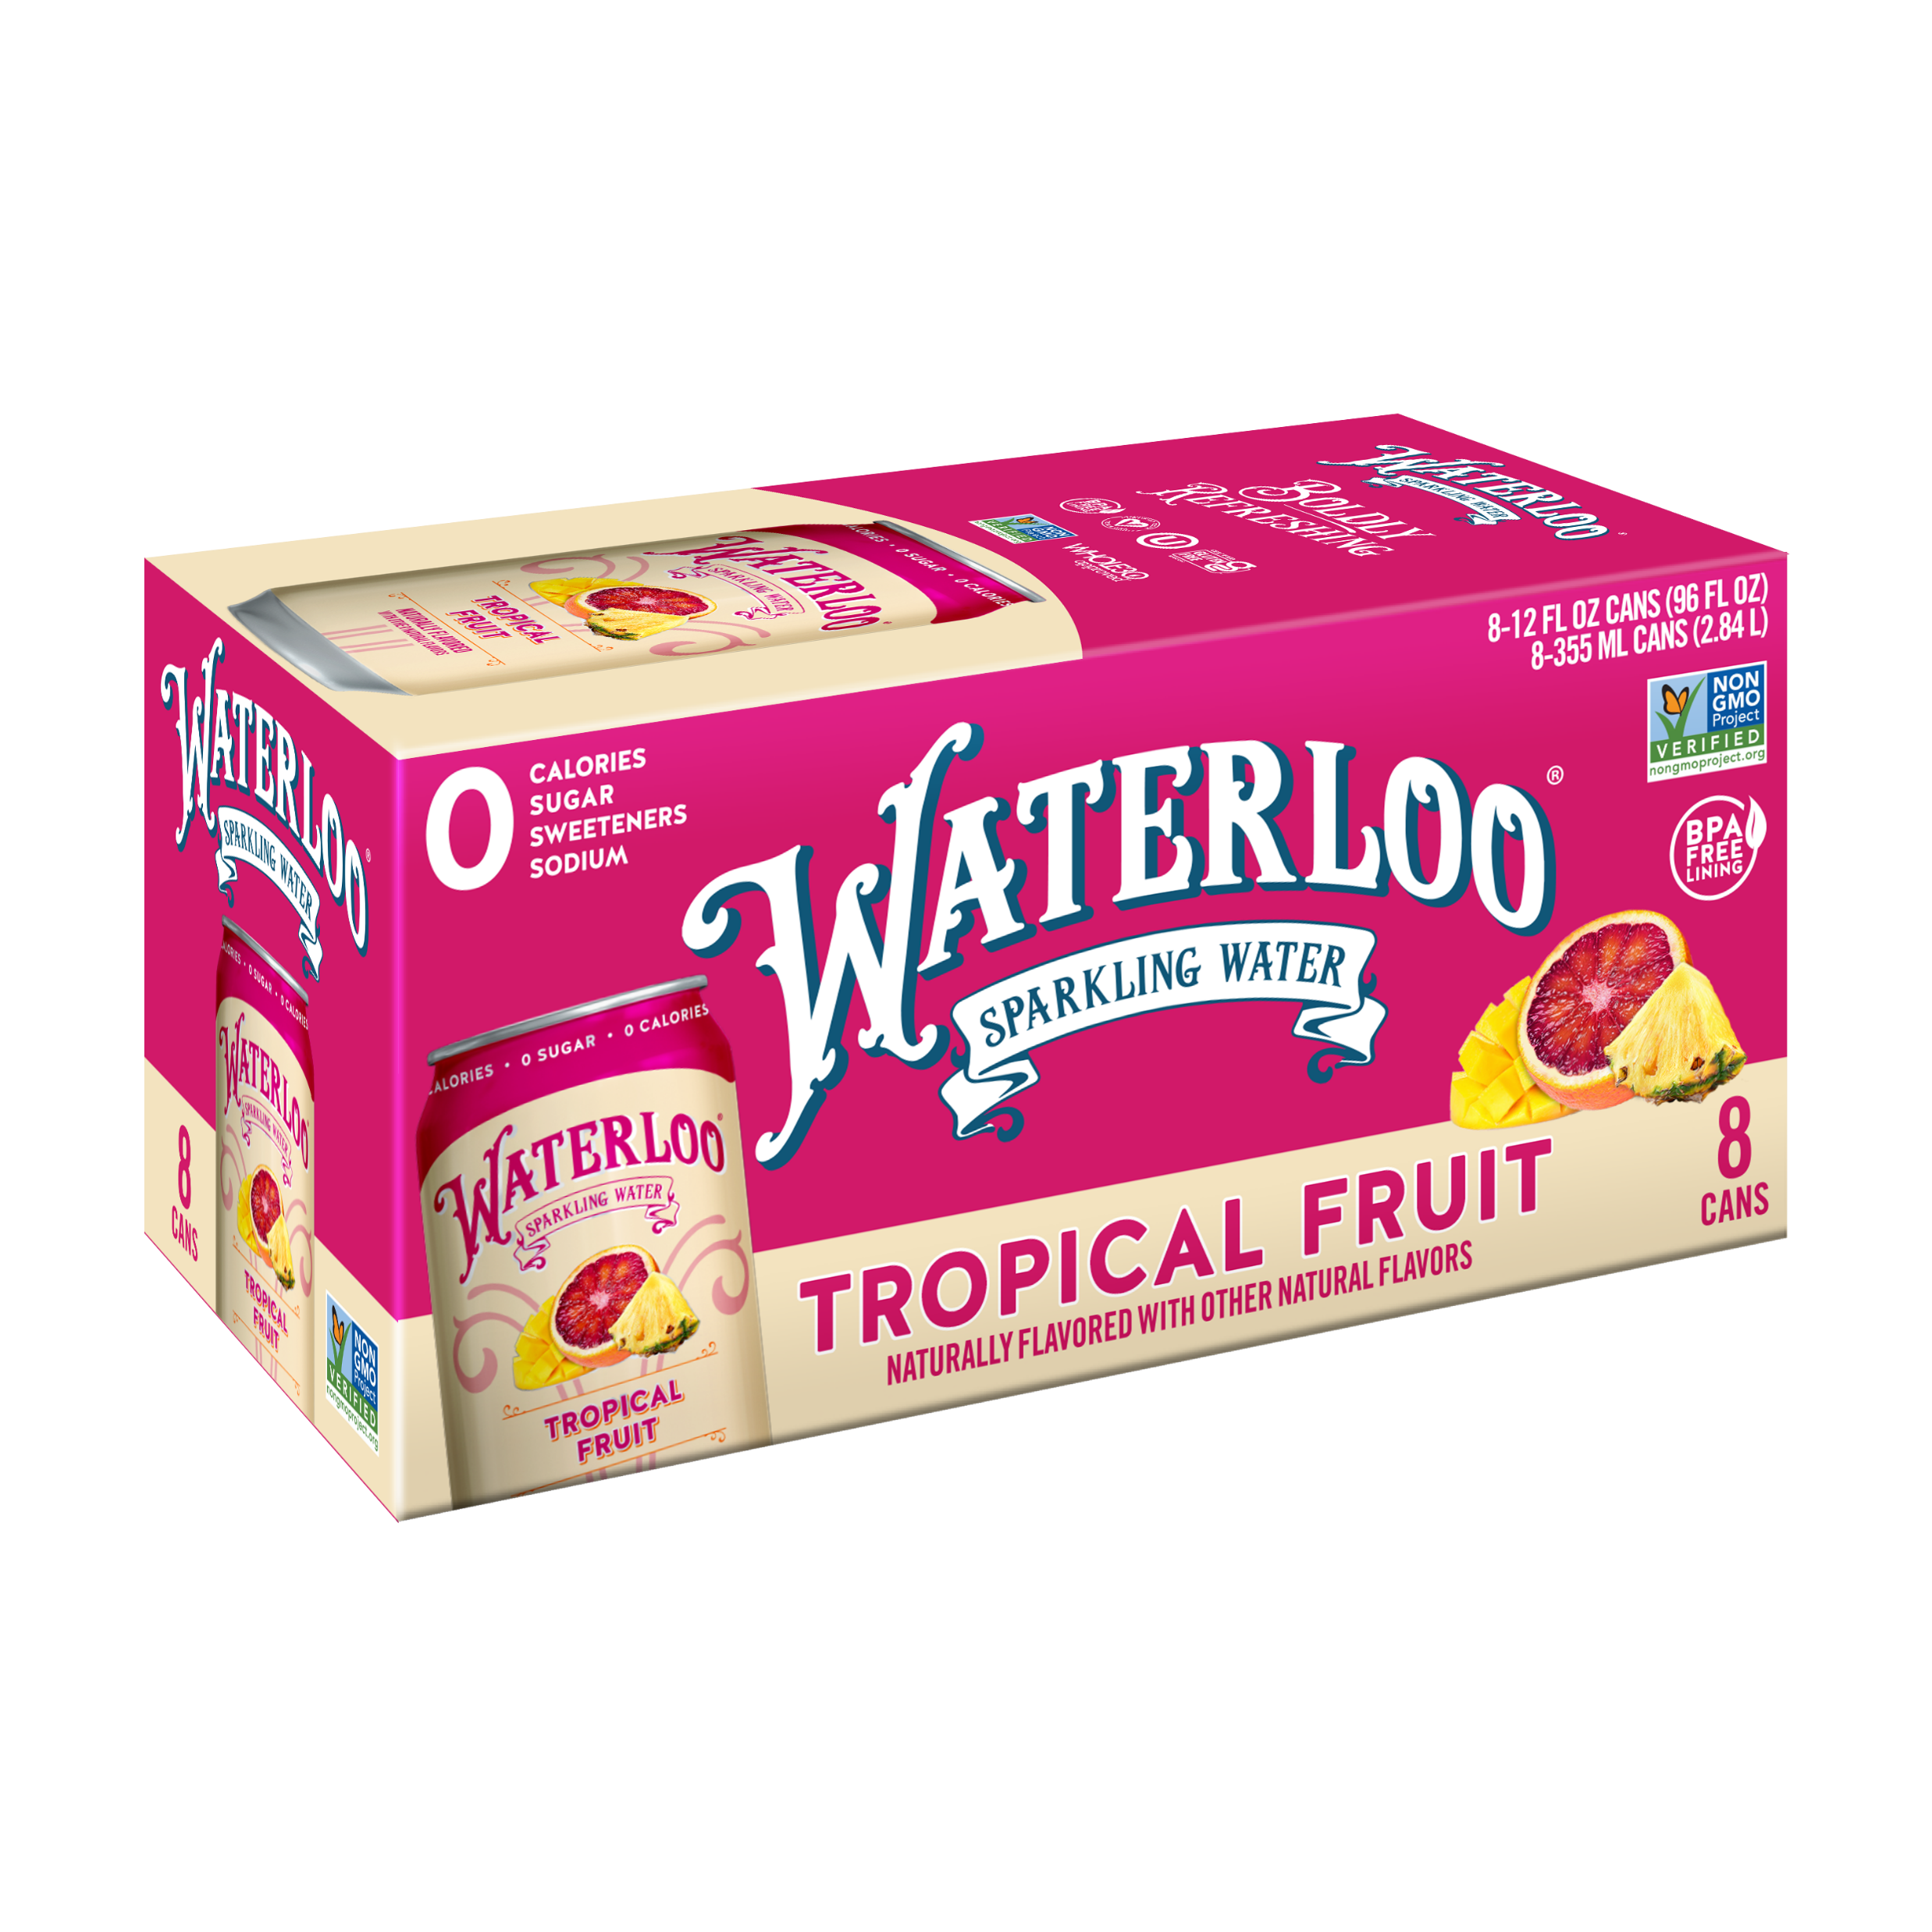
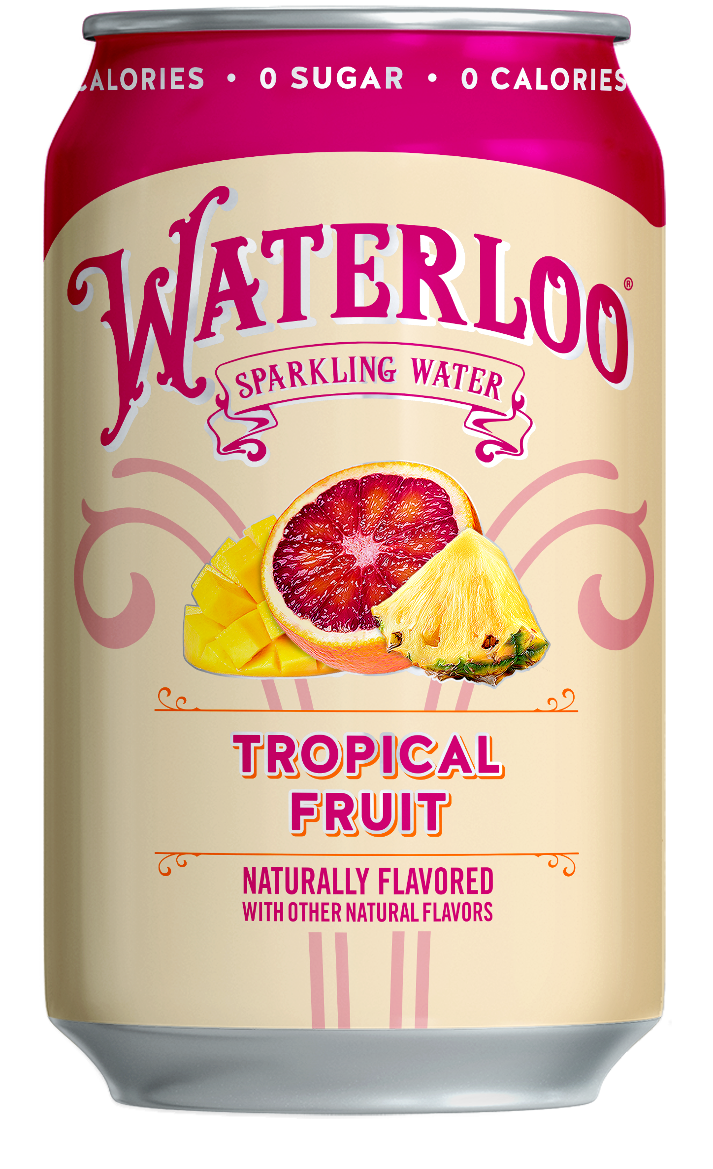
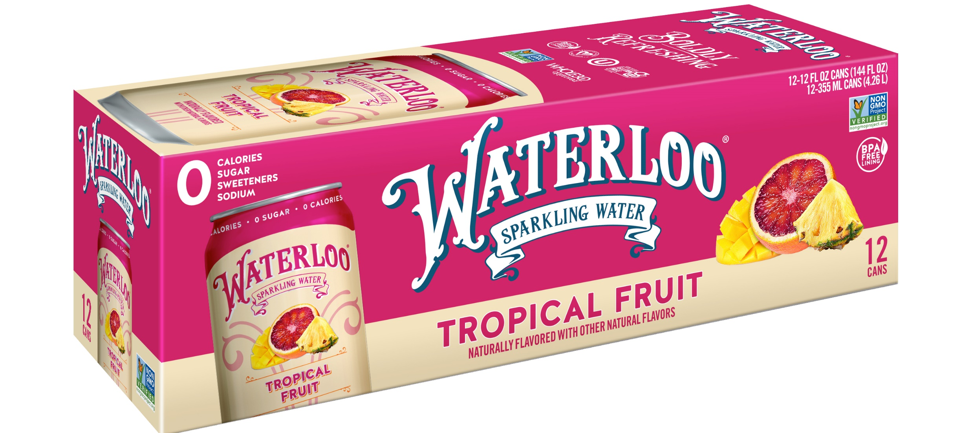



New Summer 2023 LTO
TROPICAL FRUIT
Volume commitment available through 1/20/23
1st Ship Availability: 4/17/23*
Uniquely bright and tropical. A nostalgic blend of smooth guava layered with pineapple and citrus notes.
Top overall ranked new flavor in 2022 TURF study¹
Tropical Fruit
8pk UPC
Tropical Fruit
12pk UPC
Tropical Fruit
12oz Can UPC
Tied with Cherry Limeade and Blackberry Lemonade in both interest and reach¹
*1st ship availability is contingent on volume commitment submission date with timing subject to deferred shipping.
1. MarketView Research Waterloo Sparkling Water Flavor TURF Study. N=1,309. March 2021; 2. Mintel Still & Sparkling Water- US- March; 3. Sawtoothgroup research – focus groups, 5/21
Source: 1. 2022 Waterloo TURF Analysis; 2. Nielsen AOD W/E 3.26.22 3. Mintel Still & Sparkling Water 2022 Report

Slide 4
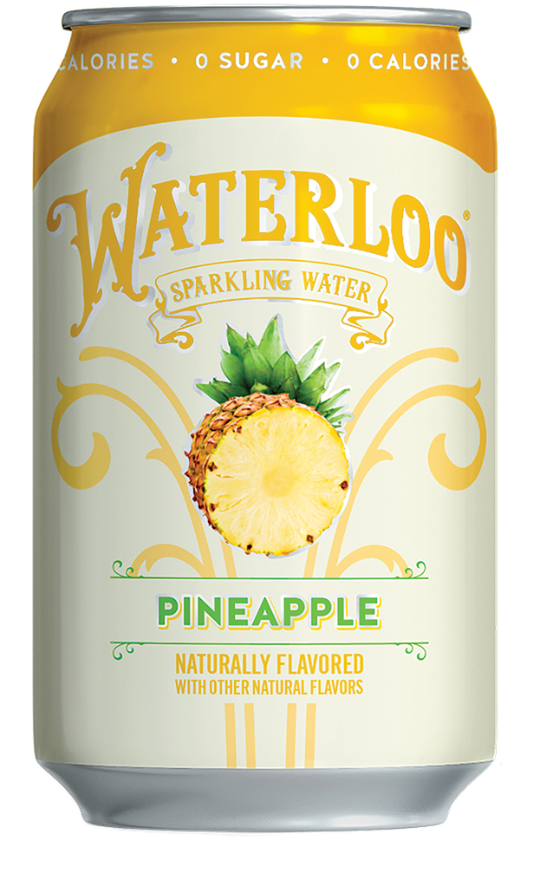
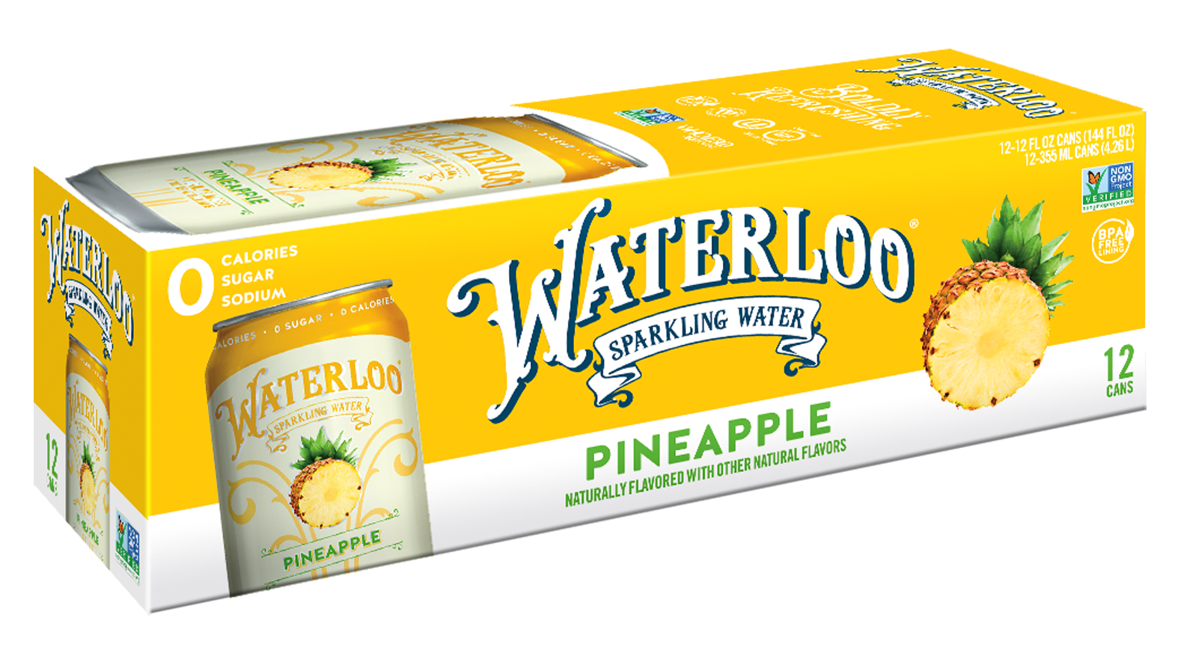
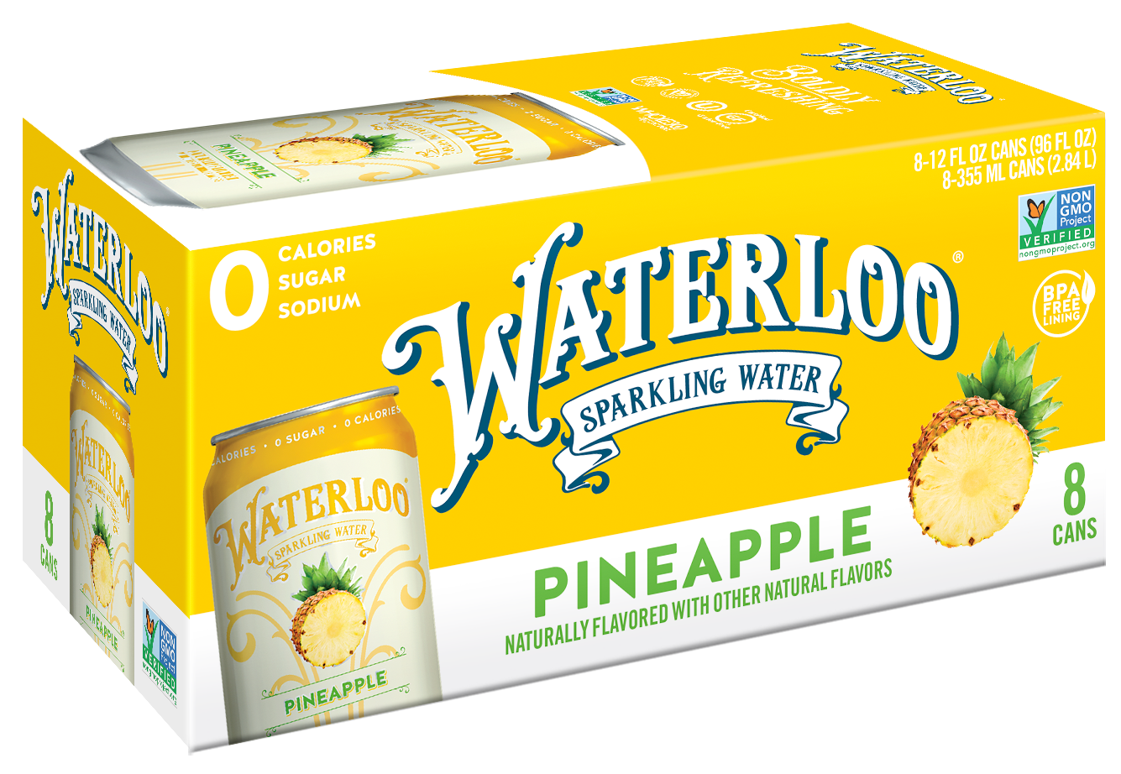



Now Available Everyday
Pineapple
The perfect tropical balance of tangy, tart and sweet. With a distinct upfront Pineapple aroma and authentic flavor that leaves you craving more.
TOP
PERFORMER Amongst all flavors in 2022 TURF Analysis across reach and fit with brand¹
#2
Pineapple
12pk UPC
Pineapple
12oz Can UPC
Pineapple
8pk UPC
In total $ sales at Retailer A over latest 13 weeks vs YA²
Source: 1. 2022 Waterloo TURF Analysis; 2. Nielsen AOD W/E 3.26.22 3. Mintel Still & Sparkling Water 2022 Report

Slide 5
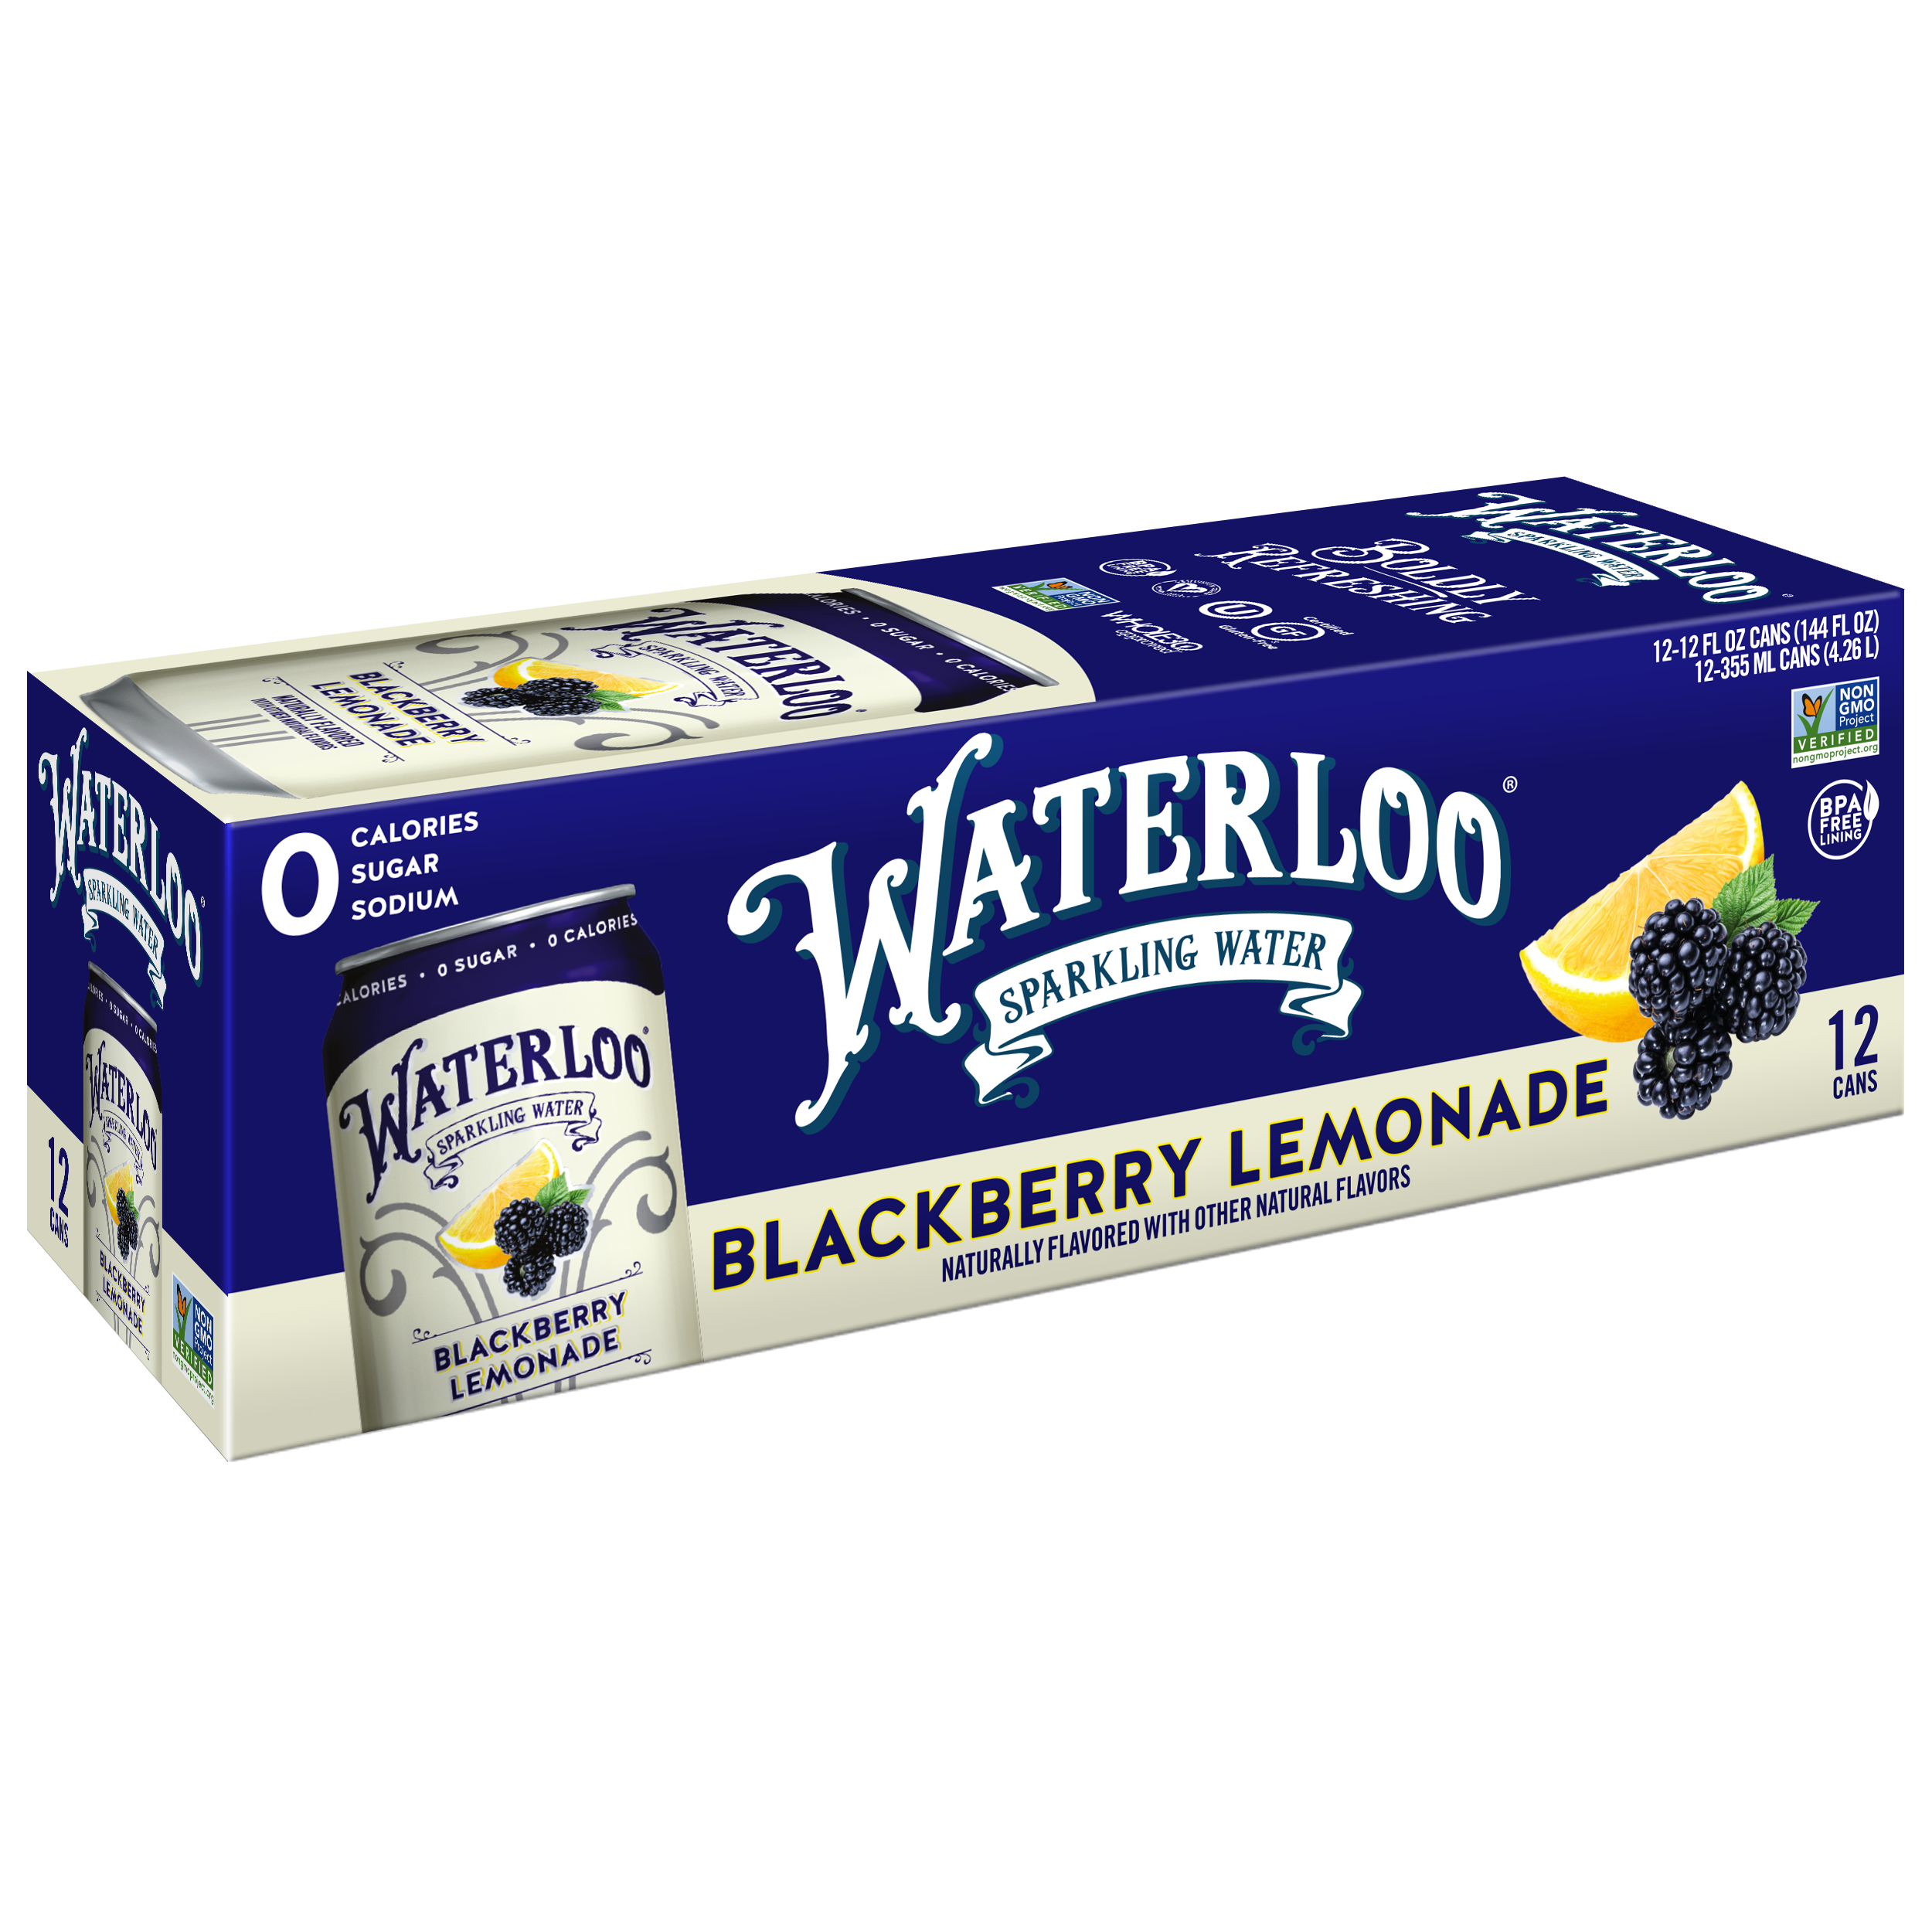
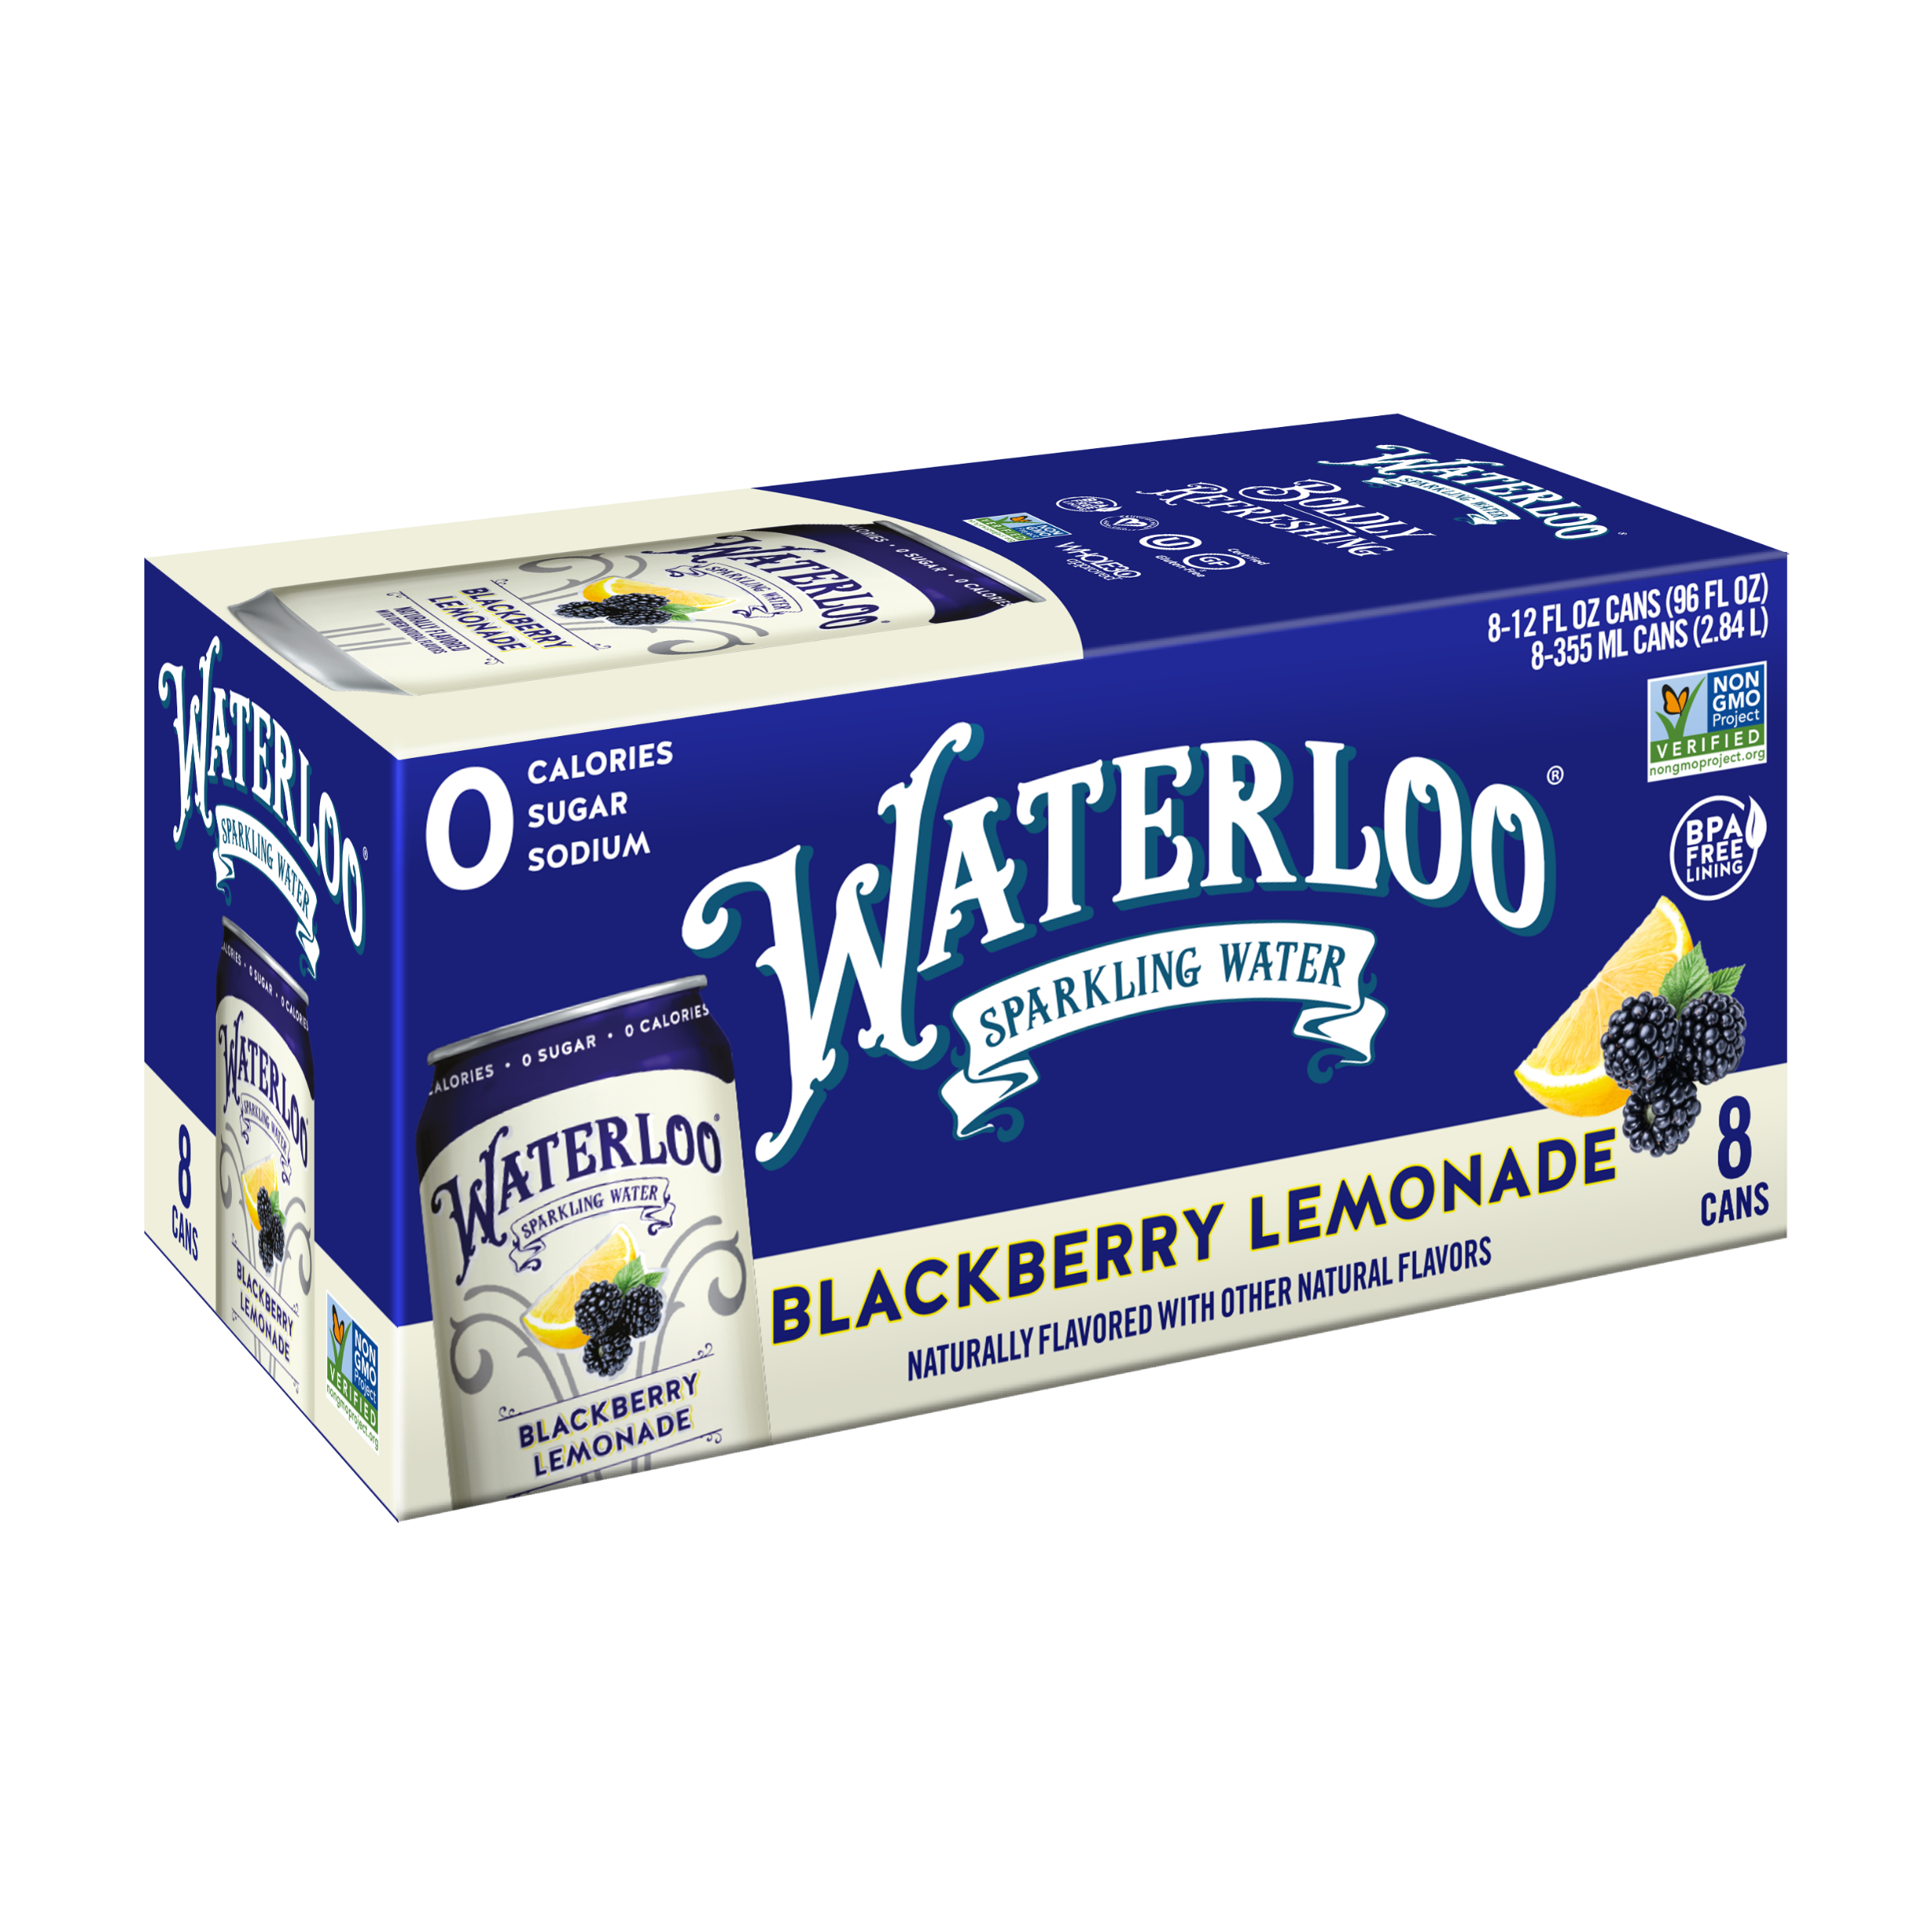
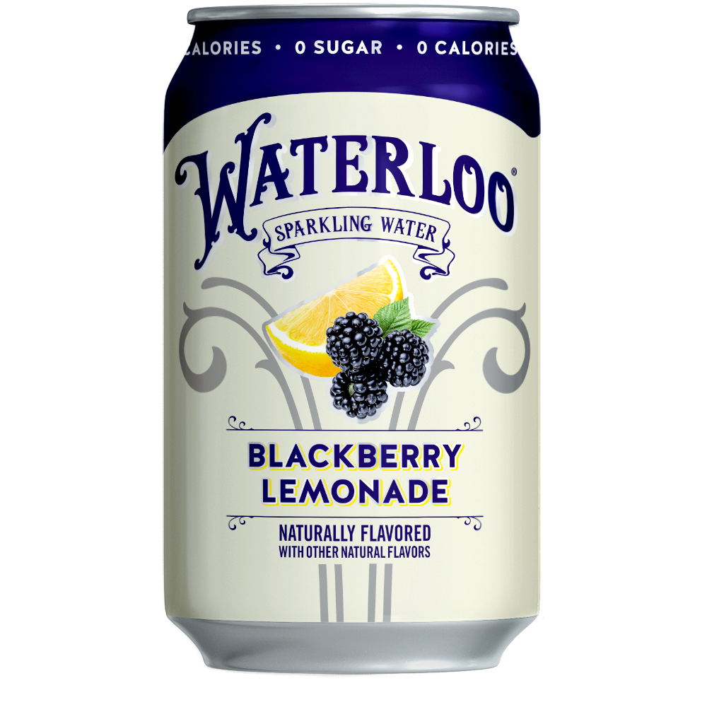



Now Available Everyday
Blackberry Lemonade
A dynamic twist on classic country lemonade. With complex, ripe and juicy blackberry notes layered into what you’d expect from a fresh lemonade stand.
#2
In absolute $ velocity at Retailer B since launch in March ‘22²
2nd
Blackberry Lemonade
8pk UPC
Blackberry Lemonade
12pk UPC
Blackberry Lemonade
12oz Can UPC
Overall flavor in latest TURF ‘22 Analysis with strong reach and uniqueness¹
Source: 1. 2022 Waterloo TURF Analysis; 2. Nielsen AOD W/E 3.26.22 3. Mintel Still & Sparkling Water 2022 Report

Slide 6
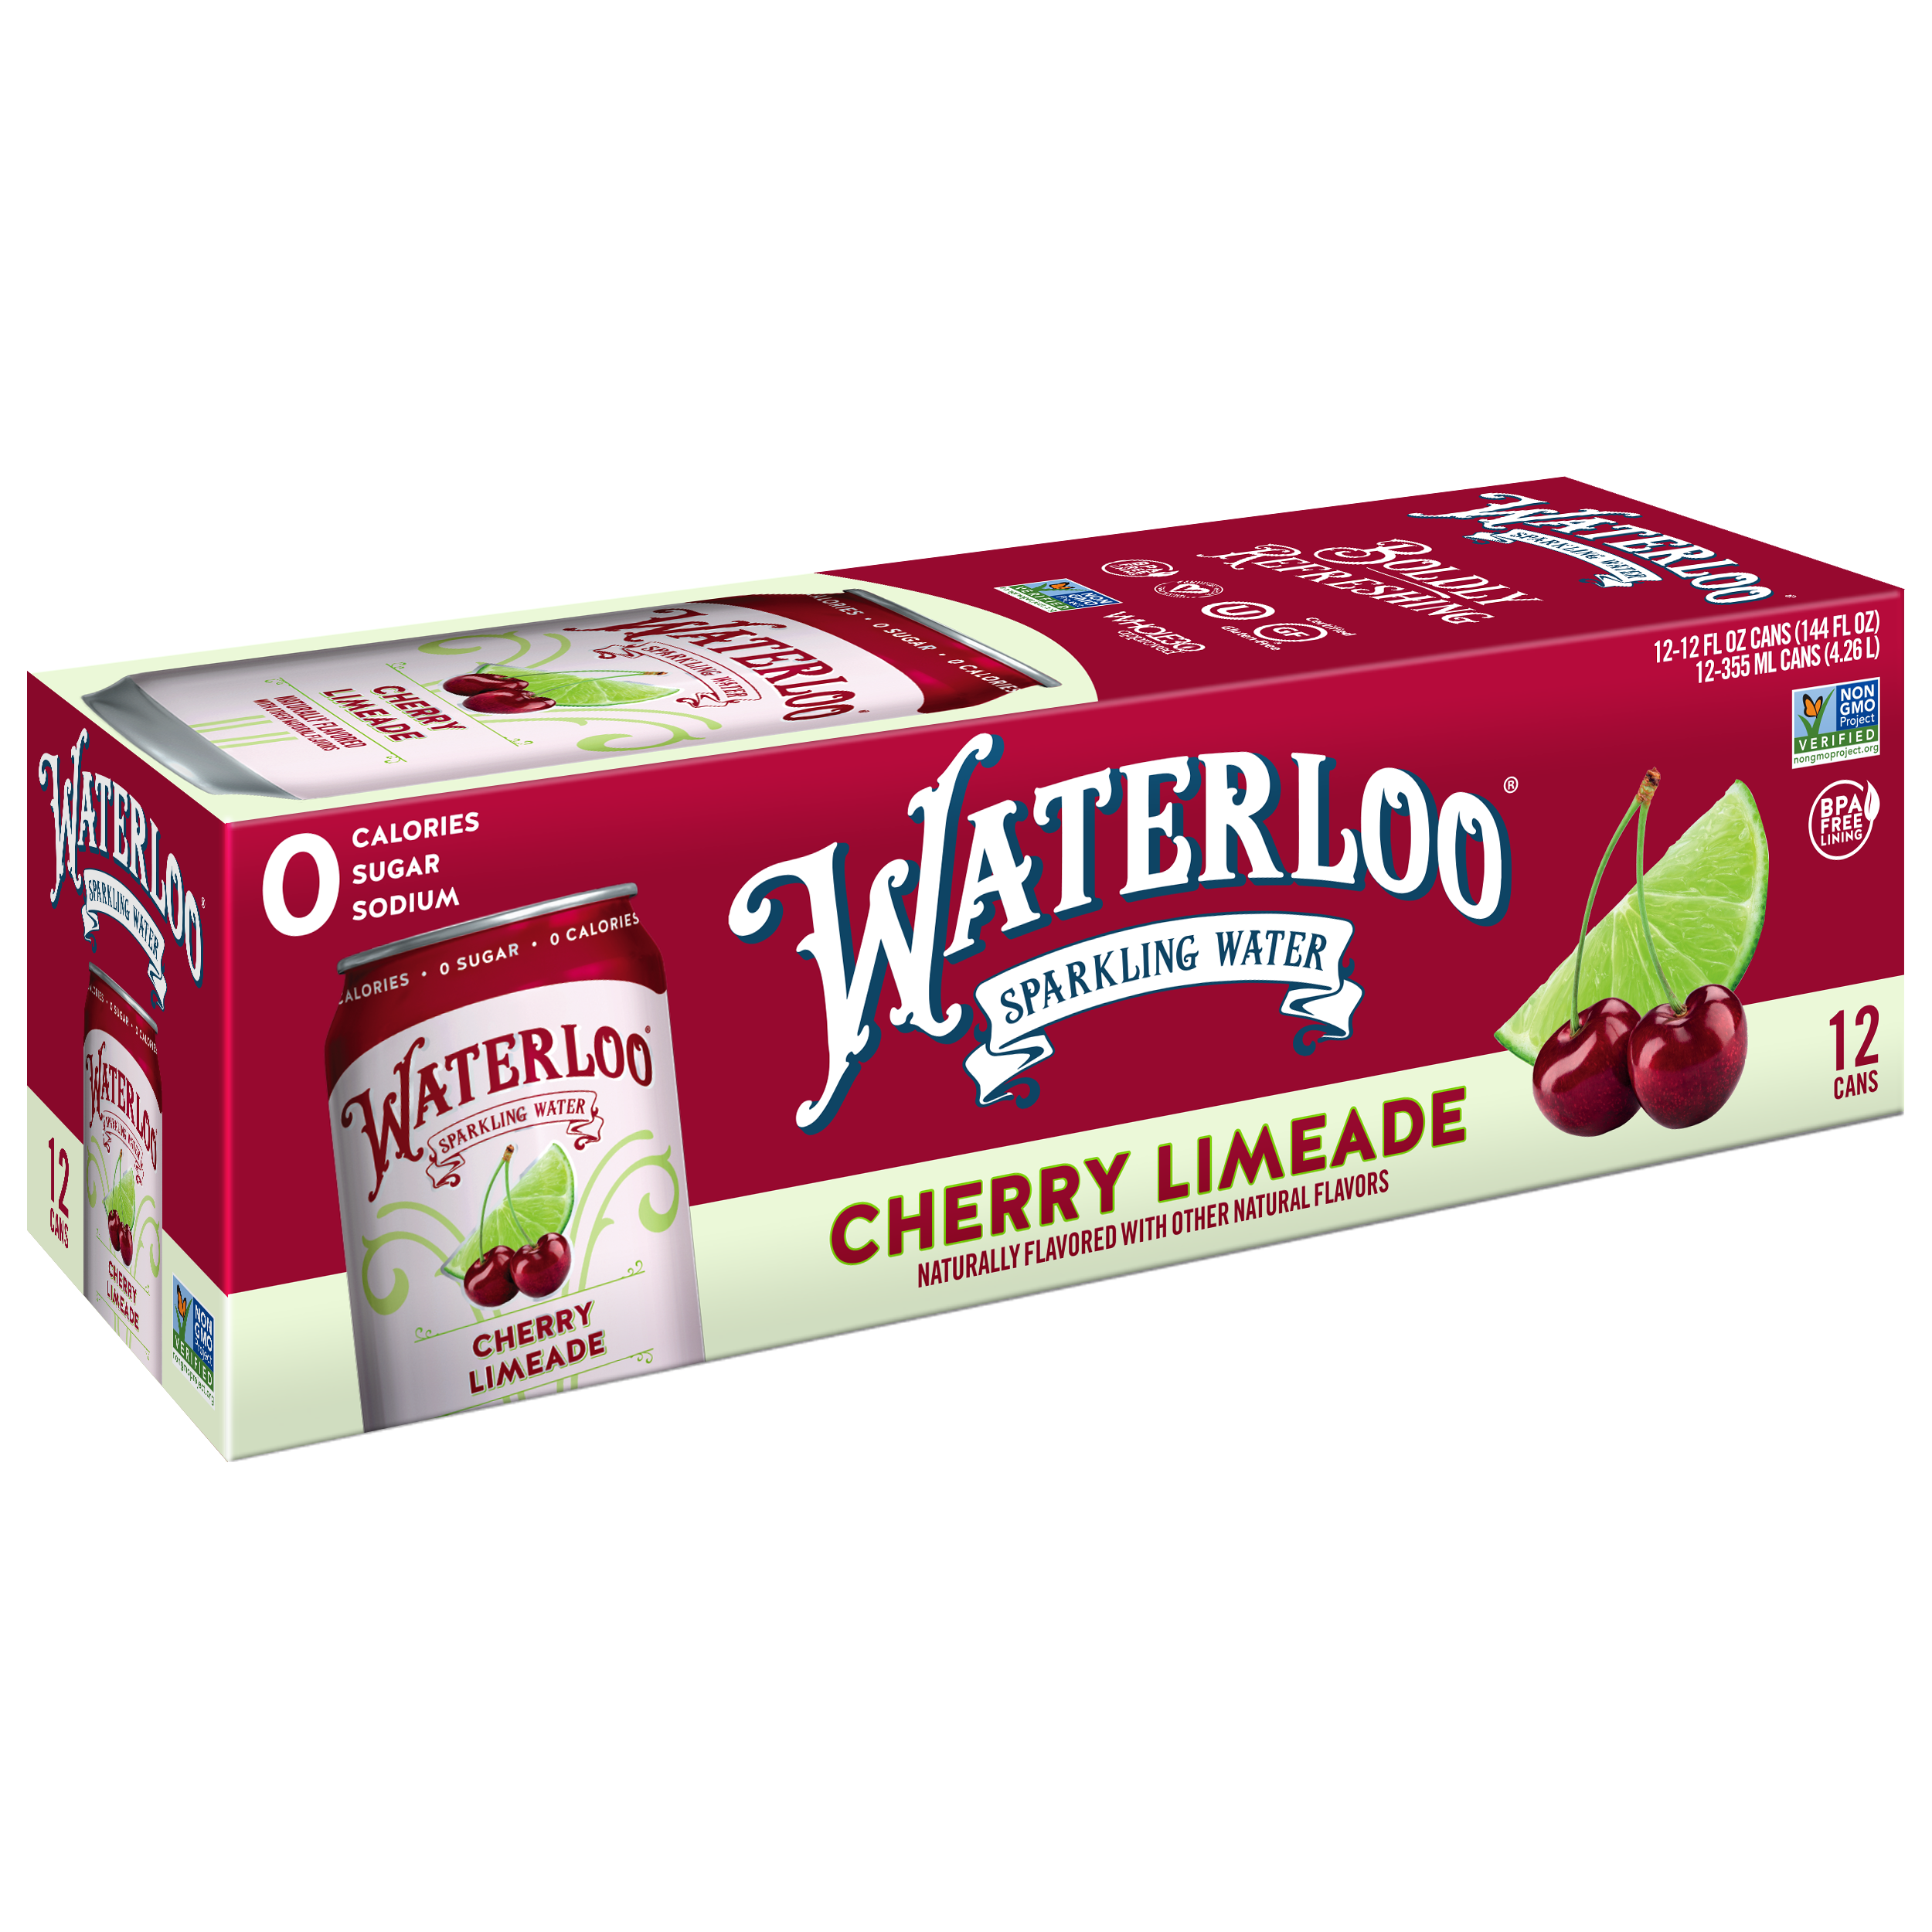
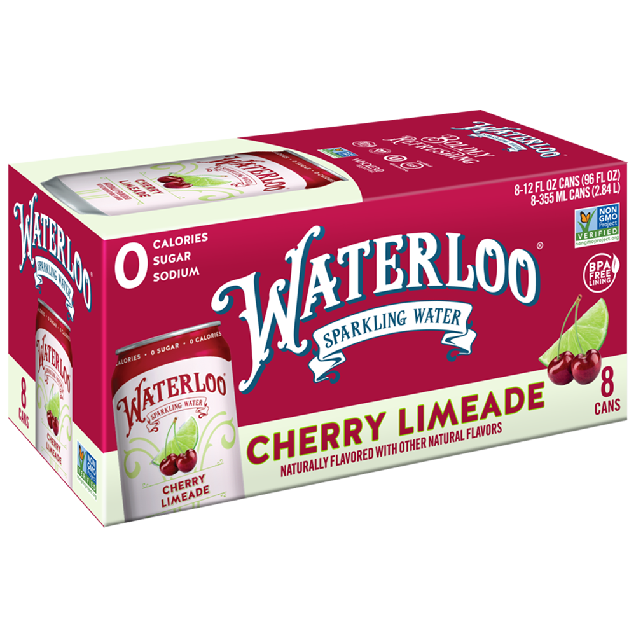
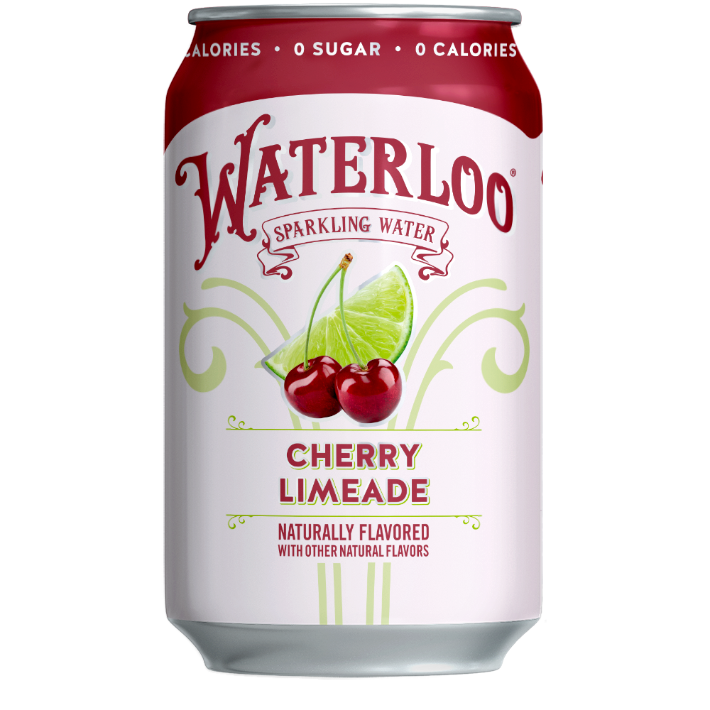



Now Available Everyday
Cherry Limeade
The perfect mash-up of lime citrus and bright red cherries. A nostalgic combination that transports you back to a carefree, hot summer day – all year long.
3rd
Overall flavor in latest TURF ‘22 Analysis with strong reach and fit with brand¹
#4
Cherry Limeade
12oz Can UPC
Cherry Limeade
8pk UPC
Cherry Limeade
12pk UPC
Flavor in absolute $ velocity across all channels since launch in March ’22²
Source: 1. 2022 Waterloo TURF Analysis; 2. Nielsen AOD W/E 3.26.22 3. Mintel Still & Sparkling Water 2022 Report

