Slide 1
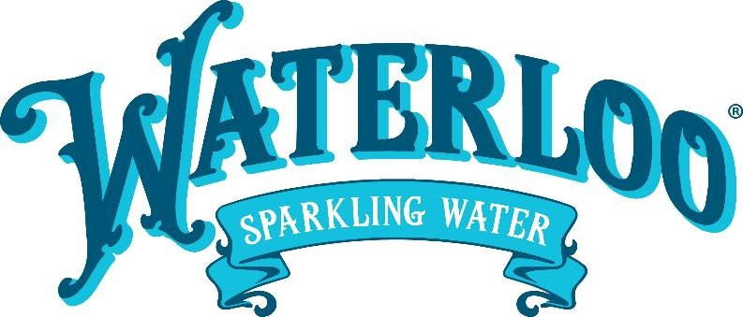
Waterloo Sparkling Water Overview
July 2022

Slide 2
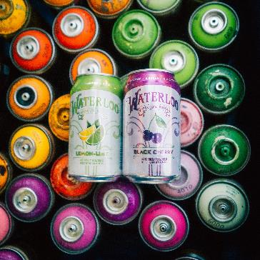
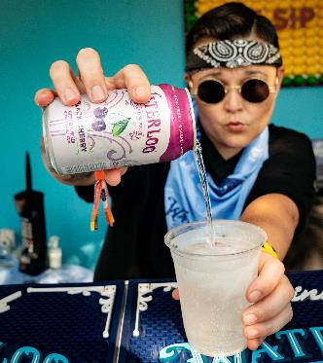
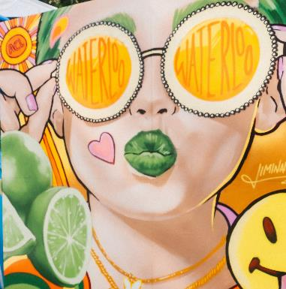
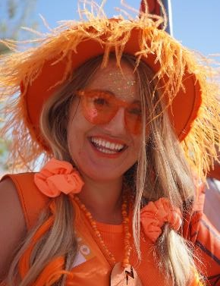

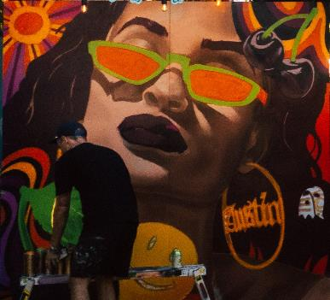
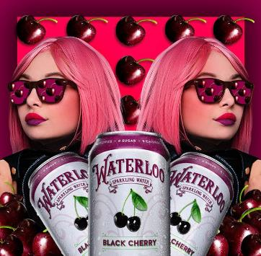
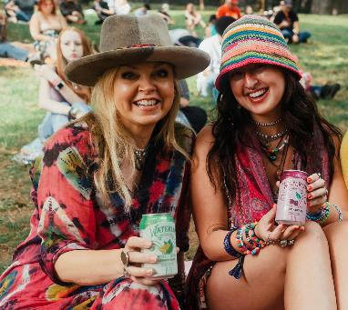
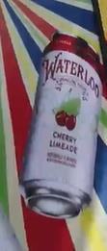
We are the sparkling water that goes all in on living life at full flavor.
We’re for telling it like it is, with an unapologetically single-minded focus of making it better than you thought it could be.
Our commitment to doing things our way, is focused on living better, doing better, and tasting better. We are for elevating everyone and everything around us.
We WATER DOWN NOTHING,
that’s how we sip different
.

Slide 3

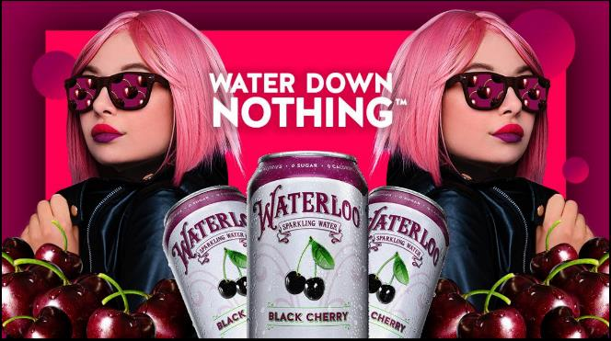
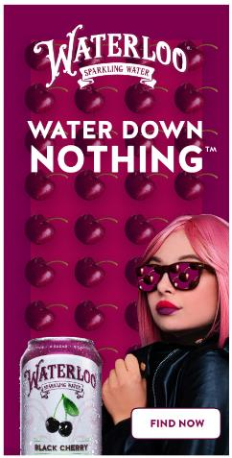
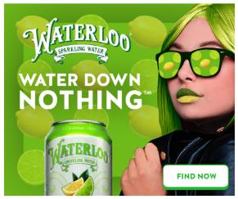

New Campaign Launching Q2
PRIVILEGED AND CONFIDENTIAL
^ Billboard example
Banner examples (final slide of animated ads) >

Slide 4





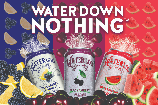


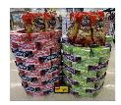

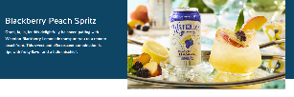

Our 2022 Marketing Plan has a Multi-Tier Approach
PRIVILEGED AND CONFIDENTIAL
Generate brand awareness among life tasters within core DMAs
Increase buyer count by being present across multiple touch points for life tasters
Continue to build loyalty among the loo lovers through ongoing engagement and usage
Paid Social Media, Programmatic Display, Billboards, Etc.
Shopper Marketing Ads / Sponsors Ads, Events, Cans In Hands, Shipper, Innovation
Social Media, Email, Recipe Development, Innovation

Slide 5
Strong Results Across Awareness, Buyers, Loyalty and Sales
PRIVILEGED AND CONFIDENTIAL
Customer Acquisition Progression
Growing Aided Awareness
+65%
43% in March 22 vs.
26% in October 20 ¹
Rapidly Increasing
Customer Base
Fastest Growing in the comp set
+22%, Latest 52 Wks.
+37%, Latest 26 Wks.
% change in # of buyers of Waterloo²
Strong Repeat & Loyalty:
Fastest growing in the comp set
+21%, Latest 52 Wks.
+14%, Latest 26 Wks.
$ Share of Requirements vs YA²
Explosive Growth
Waterloo Growth Significantly Out-Pacing the Category
7x Category Growth
YTD ’22 (thru H1)
(Nielsen xAOC $ Sales Waterloo & Category³)
+
+
=
Absolute # of Buyers % Change
L52 & L26 vs. LY (Ending 3/26/22)
Loyalty ($ Share of Requirements) % Change
L52 & L26 (Ending 3/26/22)
1. Source; Marketingview Research Study, March ‘22 (National N –1,000) vs. Hanover Research Study Oct ‘20 (National = 408); 2. Nielsen HH PanelData -Total US Latest 52 W/E 3/26/22 and Latest 26 WE 3/26/22; 3, Nielsen, $ Sales Growth xAOC L26 ending 6/18/22

Slide 6
$ Share growth driven by ACV, TDPs, and Velocity!

Slide 7
Waterloo Continues Strong Period Over Period Growth
(Waterloo $ Sales xAOC)
P1
P2
P3
($ in millions)
($ in millions)
($ in millions)
P4
P5
P6
($ in millions)
($ in millions)
($ in millions)
Source: Nielsen RMS Data, Total US xAOC

Slide 8
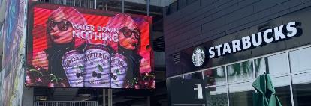
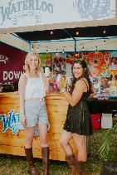

The 2023 Marketing Plan Will Take Spend to New Levels!
PRIVILEGED AND CONFIDENTIAL
2023E Initial Marketing Spend % Break Down
Creative Campaigns to Evolve With Celebrity
~$35M
Marketing Spend
Majority of the spend is allocated towards Awareness driving tactics
8
Source: Company information

Slide 9

PERFORMANCE $658,273 for last 52 weeks through 7/16/22
TOTAL SALES
SALES BY WEEK FOR PROMO IMPACT
$658.3k
+471.1%
$476.5k
+313.5%
$346.3k
+256.2%
$211.7k
+266%
$112.1k
+256.2%
May promotion generated 67.7% lift in unit sales vs previous 5 weeks.
Base unit sales post promotion showing 14.5% lift vs pre-promotion rate of sale. Average 5,500 total units per week.
July promo 36.0% lift on increased base units
Watermelon sales at reduced retail removed from data
March Reset-Three flavors with distribution increased to over 4k stores
Swap Pineapple for Watermelon-New flavor has scanned in 90.5% of subscribed stores. Overall, 4 flavors, with increased distribution have scanned in 95.1% of subscribed stores in last 18 weeks.
RSI through 7/16/22

Slide 10

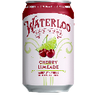
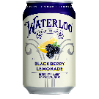



STRONG Innovation CALENDAR for 2022
PRIVILEGED AND CONFIDENTIAL
Core/everyday skus
Summer Berry
Now offered as a core SKU given consistently strong consumer insights, messages and sales (Currently core item at HEB, Amazon, and Walmart.com).
Top performing flavor in both TURF analysis and absolute velocity on shelf during summer ‘21 and ‘22.
Blackberry Lemonade/Cherry Limeade
Both flavors within top 3 in absolute velocity at Retailer A since launching in March ‘22.
Tied for highest interest and reach amongst all flavors in latest TURF ‘22 study.
Summer lto
Passion Fruit
One of the top performing flavors in latest TURF ‘22 study with strong purchase interest, reach, and fit with brand among sparkling water category users.
Over indexes with target consumer for purchase interest vs total sparkling water consumers.
According to recent Nielsen scan, Passion Fruit sparkling water flavored products are growing +9% vs YA in the latest 52 weeks.
Fall/winter lto
Cranberry (Relaunch)
2nd highest absolute velocity amongst all flavors in Q4 ‘21 at select retailers.
Spiced Apple
Ranked highly for uniqueness in latest TURF ‘22 flavor study.
Spice/fruit flavor combinations considered an emerging, trending category according to Mintel 2022 Sparkling Water report.
Confidential
*Marketview Research, 3/22 - Flavor TURF research; Nielsen AOD Market Scan w/e 3.26.22; Mintel Still and Sparkling Water, US - 2022

Slide 11






Our New Product Pipeline Will Continue To Deliver
Category-Leading Innovation…
PRIVILEGED AND CONFIDENTIAL
2022 Innovation Consumer Quotes
2023 Flavor Innovation Pipeline
“
Everyday Items
I love your Cherry Limeade and always recommend…As someone who’s been a loyal customer for years, I just want to say you’re doing great work!
Tropical Fruit
Top ranked new flavor in 2022 TURF study¹
Ginger Citrus Twist
Strong reach and uniqueness with 110% index amongst Life Tasters vs overall panel for interest¹
“
That Blackberry Lemonade will be in my full rotation!
“
Every flavor that I have tried has been phenomenal and I was super stoked when you introduced Blackberry Lemonade and Cherry Limeade
Summer LTO
Orange Vanilla
3rd ranked new flavor in 2022 study¹
Orange Vanilla flavored sparkling water growing +19% vs PY in latest 52W²
Cucumber Jalapeno
Strong uniqueness score vs the set¹
111% index in interest amongst target consumer vs overall sample¹
“
OMG Passion Fruit, yes please!! I need it! My family is obsessed with all your different flavors
“
I recently switched to your water, after being a loyal Polar Seltzer drinker. Passion Fruit! The best flavors of all flavors in the history of flavors!
Fall / Winter LTO
Spiced Apple
Ranked highly for uniqueness; Strong Fall ‘22 buy-in
Spice/fruit flavor combinations considered an emerging, trending category to Mintel ‘22 Sparkling Water report³
Pomegranate Plum
2nd overall ranked new flavor in 2022 study¹
“
For the love of God, please keep (Cherry Limeade) all year round
¹Marketview Research Mar ‘22- Flavor TURF research. ²Nielsen AOD L52W xAOC Sparking Water Category (minimum 5% ACV + $5MM $ volume); Market Scan w/e 5.21.22; ³Mintel Still and Sparkling Water, US – 2022.

Slide 12
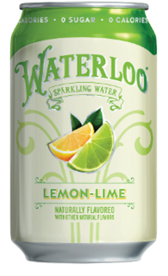
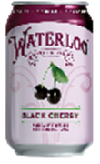
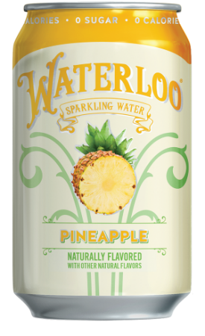
Waterloo recommendation for 2023 POg
PRIVILEGED AND CONFIDENTIAL
Expand Top 2 skus to 6,000+ stores
Lemon-Lime
#1 Waterloo item at Walgreens and a top item for Waterloo nationally
Velocity has been accelerating and is approaching .7 units/store/week on promo
Black Cherry
#2 Waterloo item at Walgreens and a top item for Waterloo nationally
Velocity accelerating and over .5 unit/store/week in most recent week
Add 2 Newest SKU’s to 6,000+ Stores
Blackberry Lemonade
One of our two newest flavors and is now Waterloo’s #1 seller at numerous major retailers
#1, or #2 at our largest customer depending on the week
Cherry Limeade
Our other newest flavor and also #1, or #2 at numerous major retailers
Both of these flavors have quickly surpassed the velocity of most of our legacy flavors
Maintain Pineapple in 4,000+ Stores
Pineapple
Solid #3 item at Walgreens and strong national performer
Would be the #5 ranked item in the recommended assortment, but still moving about .4 units/store week
We could consider a swap into one of our brand new flavors for 2023 like Orange Vanilla
Confidential
*Marketview Research, 3/22 - Flavor TURF research; Nielsen AOD Market Scan w/e 3.26.22; Mintel Still and Sparkling Water, US - 2022

Slide 13
Appendix

Slide 14
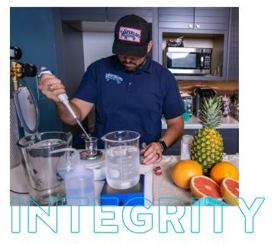
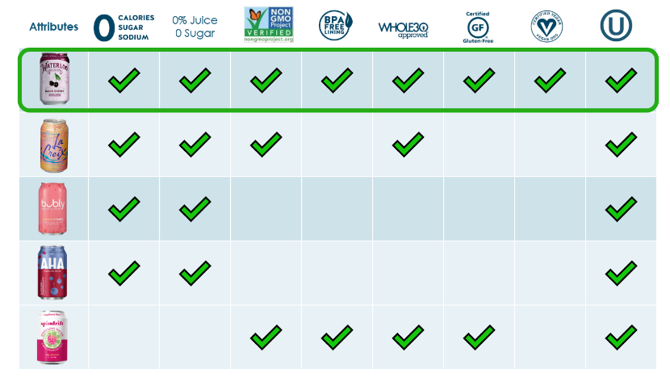
Waterloo Delivers on product integrity
PRIVILEGED AND CONFIDENTIAL
Fruit-inspired flavor and aroma
Zero calories, zero sugars, zero sodium
No added sweeteners
Lively amount of carbonation
Non-GMO Project Verified flavors
Whole30 Approved
Produced in aluminum cans made with BPA-free liners
Confidential

Slide 15





Life Tasters have an appealing demographic profile, that appears to align with Key Retailers
PRIVILEGED AND CONFIDENTIAL
They are relatively evenly distributed through out the US vs. the Sparkling Water/Health-Conscious Consumer
Demographically, they span across ages (with Millennials the largest group and over-indexing), over-index on Household Income, college education, and never married
Additionally, ~19M are already Sparkling Water Consumers, with the remaining Health-Conscious consumers
Northeast
18% | 94
WEST
27% | 107
Midwest
21% | 104
South
34.4% | 96
[124]
[146]
[123]
[130]
[126]
[95]
[98]
[94]
[85]
[90]
[71]
[113]
2.8M
2.9M
4.4M
5.3M
4.5M
3.5M
2.8M
4.1M
3.4M
3.7M
7.2M
[130]
[102]
[113]
[102]
60%
[95]
Median HHI: $103K
Aver HHI: $132K
55%
45%
43%
31%
29%
[83]
female
male
education
married
never married
kids
[78]
[100]
[101]
[119]
[96]
[116]
[110]
[ SOURCE ] SIMMONS – Summer 2020 NHCS ADULT STUDY 12-MONTH; Index against Sparkling Water and Health Conscious Consumers (N=167M)
Confidential

Slide 16
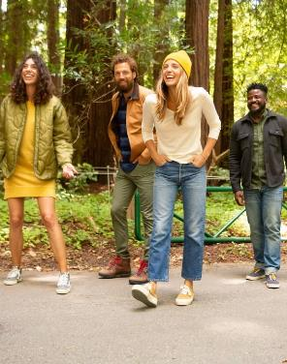
Waterloo’s Consumer Is Unique to the category
PRIVILEGED AND CONFIDENTIAL
Life Tasters over-index among category users* on discovery, being health conscious, focused on quality and more environmentally savvy, with stronger spending power bringing uniqueness to the category
Meet the
Life Tasters
(Waterloo’s New Target Consumer)
Life Tasters –Demographics
Approx. 44M Adults in the US
~50% already in the category
~50% health conscious – not in the category yet
College Degree+
Index* of 119 on total base
Age: 30-39
(Largest segment)
Index* 128 on total base
Average HHI of $134K
Index* of 113 on total Base
LIFE TASTERS AGREE A LOT | % of Life Tasters Agree | INDEX
I like to try out new food products | 38% | 164
I like to try new recipes | 45% | 146
I actively seek information about nutrition and healthy diet | 32% | 157
I always try to eat healthy and maintain a balanced diet | 41% | 140
I make sure I exercise regularly | 34% | 138
I usually look for the freshest ingredients when I cook | 44% | 134
It is worth paying extra for quality goods | 34% | 150
It is important to me that others see me as being environmentally conscious | 33% | 153
People are often surprised by the things I know | 37% | 168
I like to share my knowledge with others | 47% | 170
*Life Tasters were indexed vs. Sparkling Water and/or Health-Conscious Consumers in the U.S. (~167M), to highlight uniqueness to the Life Taster vs. Overall Category Consumers
[ SOURCE ] SIMMONS – Summer 2020 NHCS ADULT STUDY 12-MONTH; Index against Sparkling Water and Health Conscious Consumers (N=167M)
Confidential

