Slide 1
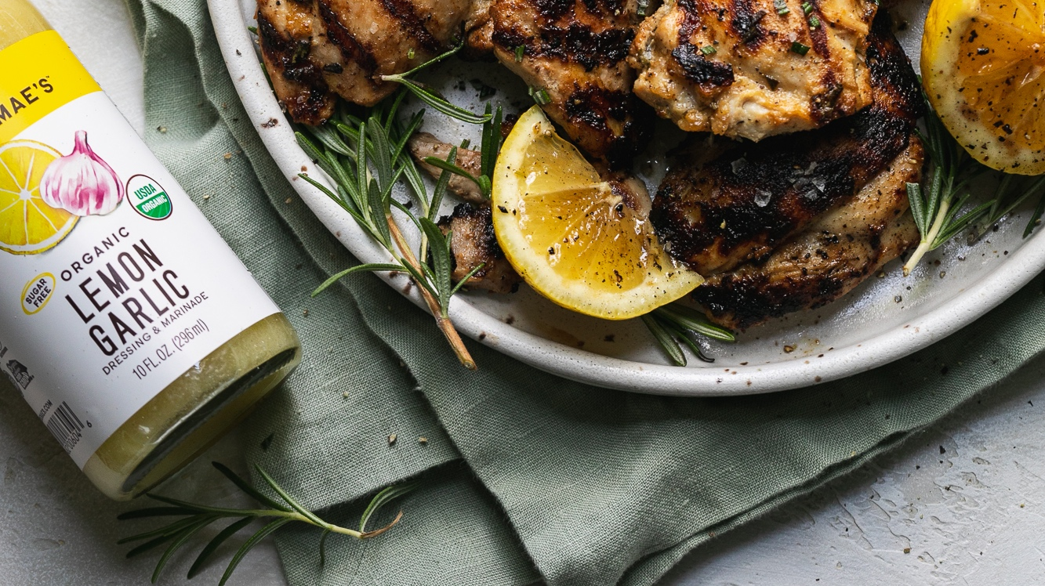


Slide 2
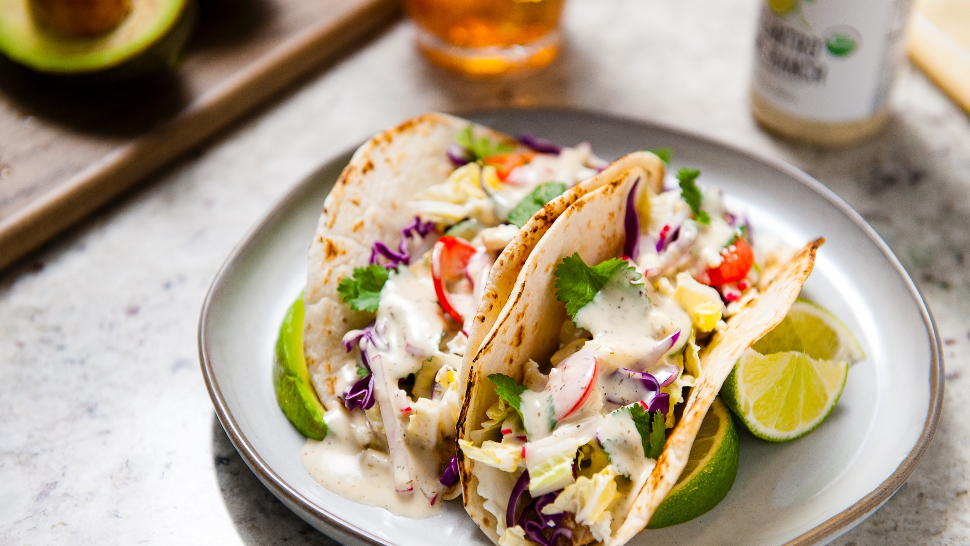

Slide 3
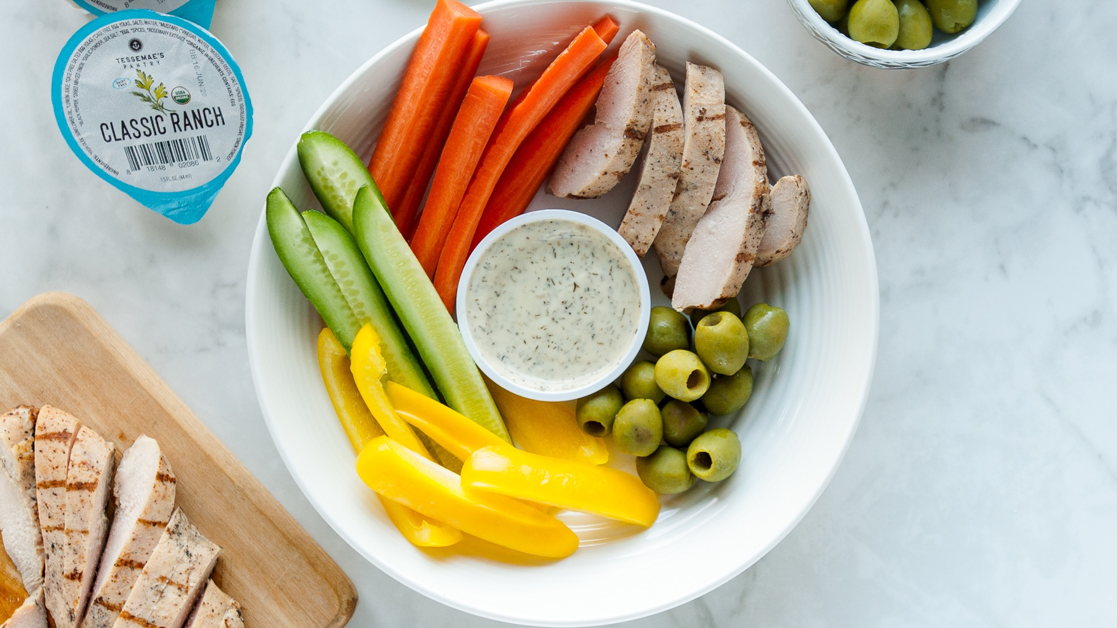

Slide 4
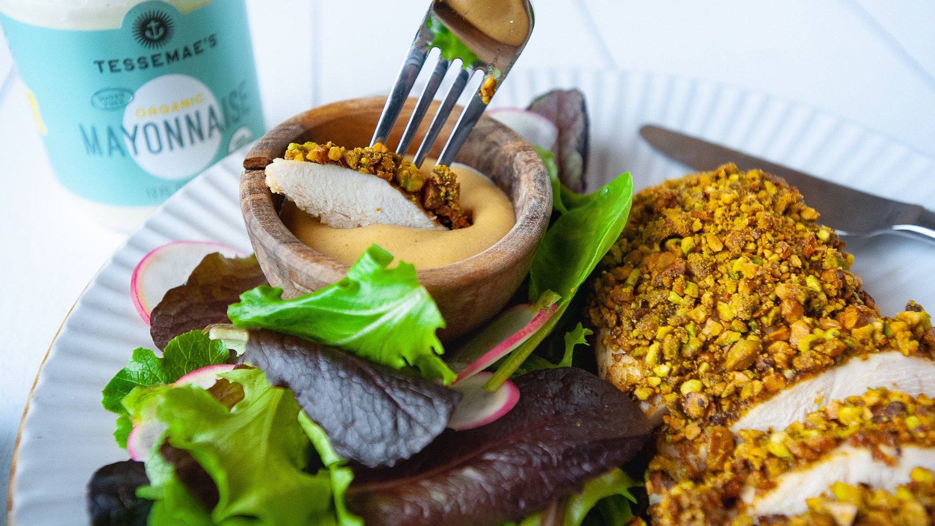
AGENDA
TK
TK
TK
TK
TK

Slide 5
GOALS
Earn a 5 share through brand awareness campaigns that gain us new households
1
Goal #1 TK
2
Goal #2 TK
3
Goal #3 TK
4
Goal #4 TK

Slide 6
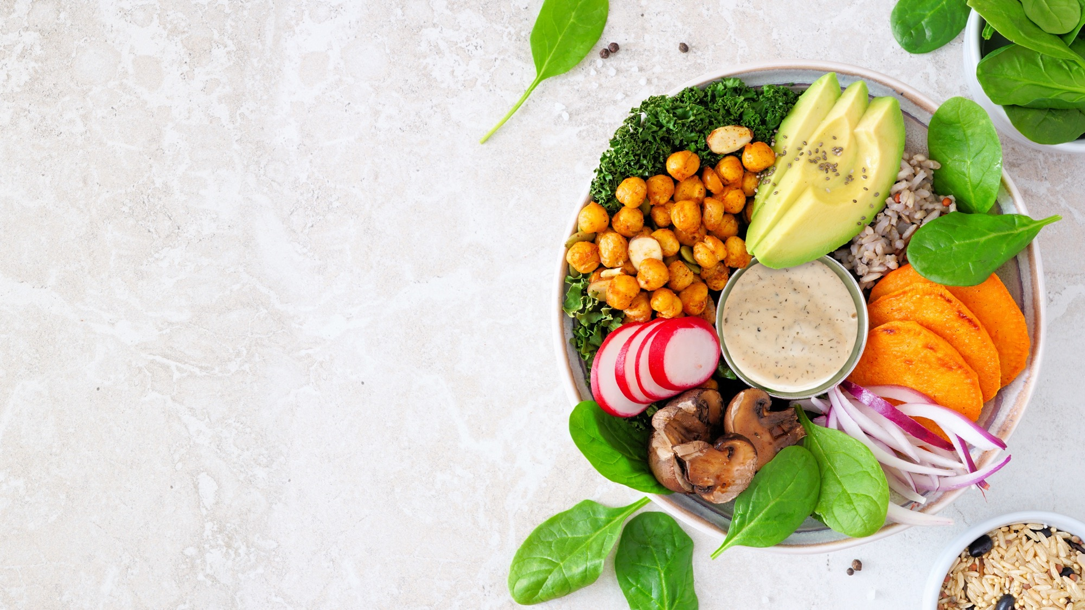
OUR VALUES
VISION
Simplify Food. Amplify Life.
MISSION
Make the most delicious, innovative, and clean dressings, sauces and products available

Slide 7
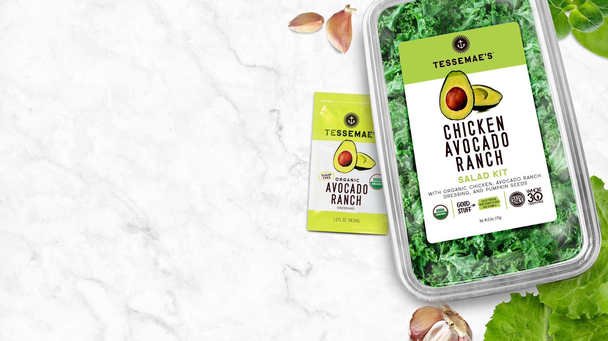
OUR VALUES
VISION
Simplify Food. Amplify Life.
MISSION
Make the most delicious, innovative, and clean dressings, sauces and products available.

Slide 8
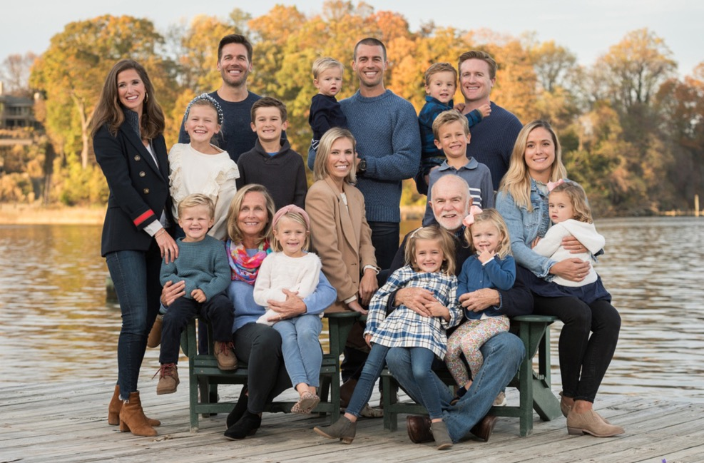
SIMPLIFY FOOD. AMPLIFY LIFE.
As the mother of three athletic boys, Tesse had to figure out a wat to get them to eat their veggies while staying healthy.
Because serving a salad dressing full of artificial ingredients was not an option, she created and perfect her own recipe made from only real ingredients.
Eating foods full of artificial ingredients does not nee to be the only option for our consumers either. We are committed to making the most delicious, innovative, and clean products available.
of consumers want transparency
of consumers want all-natural
of consumers want certified organic

Slide 9

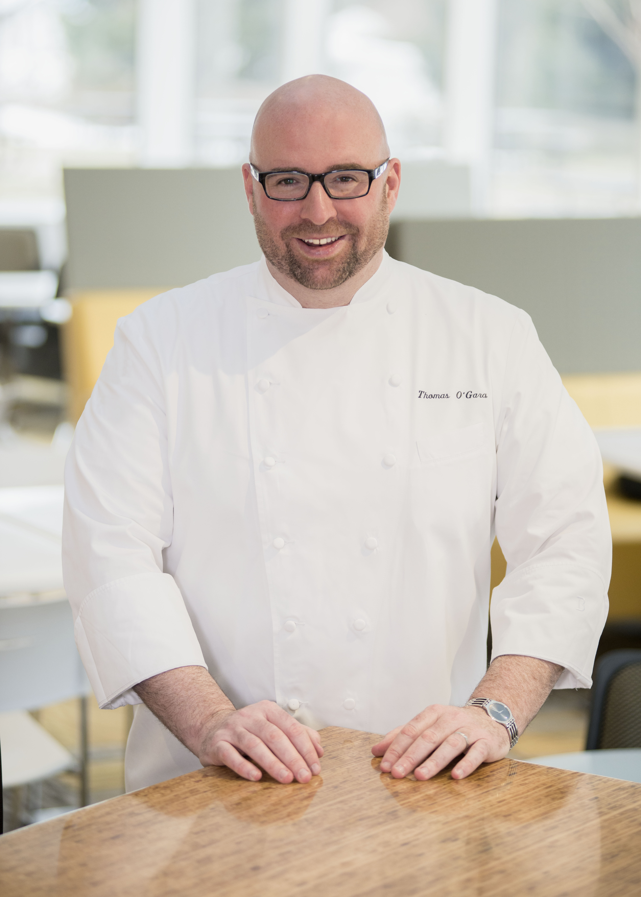
MEET THE CHEFS BEHIND THE BRAND
Chef Kristen Dittami
CHIEF PRODUCT OFFICER
Chef Tom O’Gara
VP, CULINARY
Chef Kristen leads the Culinary team, overseeing research & development, the innovation pipeline, new packaging, and regulatory compliance, as well as lending her expertise to develop original recipes for Tessemaes.com.
Prior to joining Tessemae’s in 2013, Kristen earned her degree from the French Culinary Institute in New York. From there she began working in editorial test kitchens, including Martha Stewart Living, Real Simple, and Food Network. Kristen moved to Maryland in 2009 to work with Marriott International’s Global Culinary Development team. There she worked on recipe development and documentation across all Marriott hotel brands.
Chef Tom plays a pivotal role in research and development for Tessemae's innovation pipeline, including new products, optimizing current items, and developing brand extensions. Additionally, he is responsible for regulatory compliance, and contributing culinary content for Tessemae’s sales and marketing.
Before joining Tessemae's Culinary team in 2020, Tom had massed 20+ years of experience, leading and rolling out culinary programs for large, dynamic organizations, while contributing time and talent to educational and charitable efforts.

Slide 10
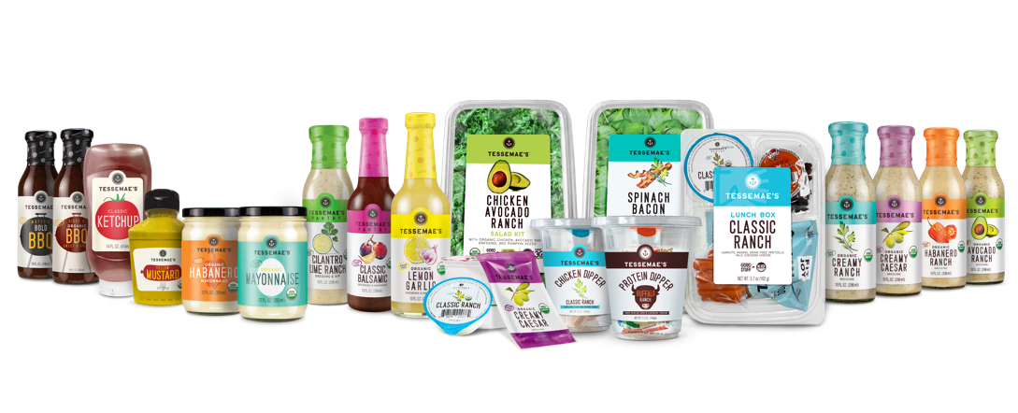
WHO WE ARE
#1
organic dressing in the country
FROM
TO
Family owned & operated—inspired by Mom’s recipe
First organic, clean label dressing on the market
Distribution in Whole Foods, natural channel and some conventional retailers
Located in fresh produce
12+ years in business! Remains family owned & operated
Transition into broad based clean-label food company
Launching shelf stable dressings, condiments, salad kits, OTG items, and salty snacks
National Distribution:
    Distribution in 10,000 stores, 600 Club Stores and multiple online platforms
    Walmart, Target, Kroger, Whole Foods, Shop Rite, Ahold, Safeway, HEB, Albertson’s, Raley’s, Sprouts, and Sam’s Club

Slide 11
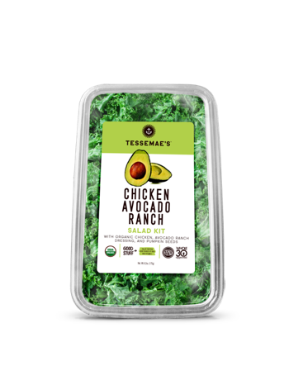



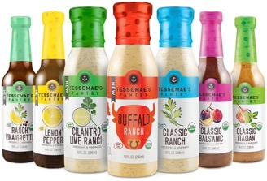



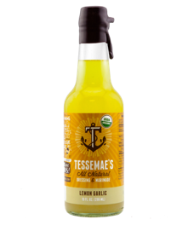

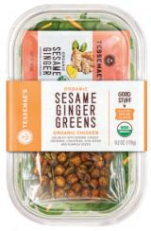
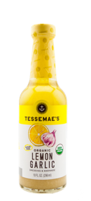
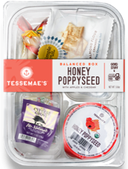
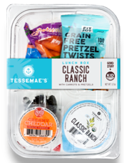



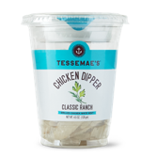
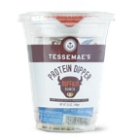
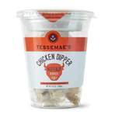
THE TESSEMAE’S JOURNEY
Introduced premium natural condiments
Became certified organic, new creamy recipes
Launched full line of shelf stable dressings and condiments
Family Size Salad Kits & Pantry Staples
2009
2013
2015
2016
2017
2019
2020
2022+
One item in local natural food store
Expanded from natural to conventional grocery
Launched new brand identity, category expansion with salad kits
Launched fresh food expansion line with Balanced Boxes & Dippers

Slide 12









THE TESSEMAE’S TRIFECTA
Make prettier
ORGANIC | CLEAN LABEL | DELICIOUS
Same high-quality ingredients chef’s use to cook at home
Tessemae’s is Gluten Free, Sugar Free, Dairy Free, Keto, Paleo, and Whole30 organically—not by design
Taste is Tessemae’s key driver of R&D—not cost

Slide 13
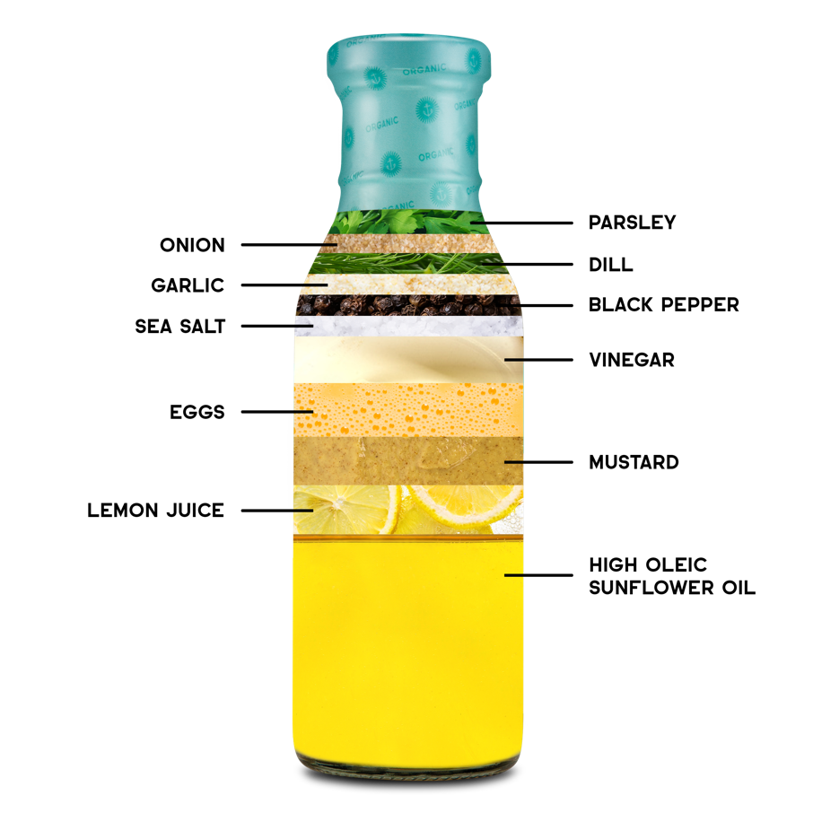
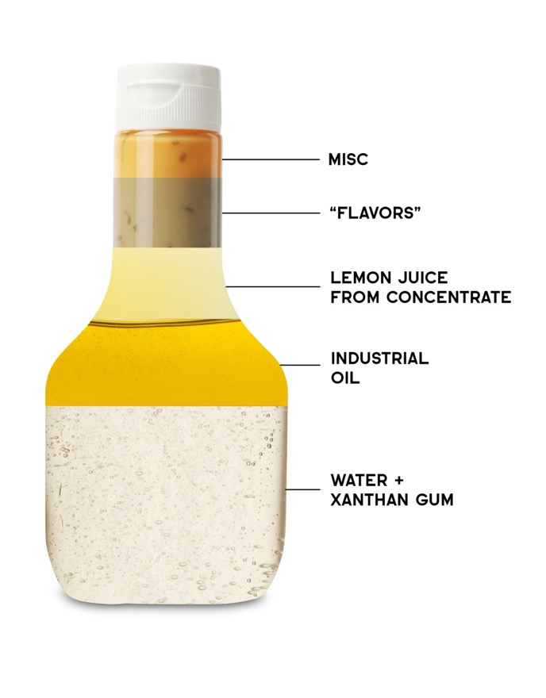
TESSEMAE’S VS. THE COMPETITION
Xanthan gum can have negative side effects on consumers
Dressings can contain between 25-40% xanthan gum by volume
100% clean label product using only organic ingredients
Competitors use fillers like xanthan gum or maltodextrin

Slide 14
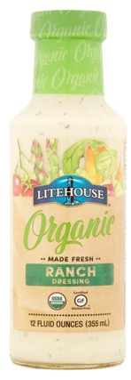
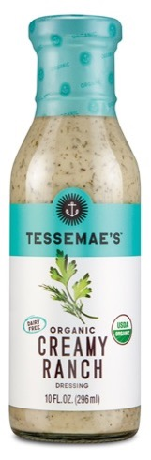
INGREDIENT TRANSPARENCY
Buttermilk (Cultured Nonfat Milk, Milk, Sodium Citrate, Vitamin A Palmitate), Water, Yogurt (Cultured Pasteurized Grade A Milk, Cream, Nonfat Milk, Pectin, Carrageenan), Soybean Oil, Reduced Acid Pineapple Juice Concentrate, Whey Protein Concentrate, Distilled Vinegar, Salt, Egg Yolk, Spice (Parsley, Mustard Seed), Xanthan Gum, Maltodextrin, Onion Powder, Yeast Extract, Garlic Powder, Citric Acid, Natural Flavor, Disodium Inosinate, Disodium Guanylate, Guar Gum, Carrageenan
ORGANIC SOYBEAN OIL, ORGANIC BUTTERMILK, WATER, ORGANIC CIDER VINEGAR, ORGANIC EGG YOLK, ORGANIC SUGAR, SALT, ORGANIC DISTILLED VINEGAR, ORGANIC ONION, ORGANIC MODIFIED CORN STARCH, MALTODEXTRIN, CULTURED DEXTROSE, ORGANIC MILK POWDER, ORGANIC SPICE, LACTIC ACID, XANTHAN GUM, ORGANIC GUAR GUM, CITRIC ACID, ORGANIC EXTRACT.
*HIGH OLEIC SUNFLOWER OIL, WATER,*LEMON JUICE, *MUSTARD (*VINEGAR, WATER, *MUSTARD SEEDS, SALT, * SPICES), *CAGE FREE SALTED EGG YOLKS (*CAGE FREE EGG YOLKS, SALT), * DISTILLED VINEGAR, SEA SALT, *BLACK PEPPER, *ONION POWDER, *SPICES, *GARLIC POWDER, *WHOLE EGG
*ORGANIC INGREDIENTS
CONVENTIONAL
ORGANIC
CLEAN LABEL

Slide 15
COMPETITIVE OVERVIEW
 | Taste | Organic | Clean Label | Healthy (perceived) | Accessible | Whole30 | Keto | Paleo
Tessemae’s
Annie’s
Bolthouse
Briannas
Cindy’s Kitchen
Litehouse
Marie’s
Marzetti
OPA by Litehouse
Organic Girl
Primal Kitchen
Sir Kensington
The New Primal
Whole30
365 Everyday Value

Slide 16
WHY TESSEMAE’S?
Our R&D/Culinary team have deep and broad experience in the industry and have worked for Marriot, Avendra, and Martha Stewart Living. They are the architects behind our #1 organic dressings and have created a best-in-class innovation pipeline for the next 5 years.
We have a seasoned sales and marketing team that understand how to differentiate ourselves in the market and to build long-term programs and partnerships that accelerate our growth plan.
R&D
KITCHEN
ABILITY
TO
CREATE
We currently source over 100+ raw ingredients and components from the best suppliers around the world with one purpose—to provide the best quality products and a remarkable consumer experience.
With over 200,000 followers across our social media platforms and 50K through our email, we’re able to have one-on-one conversations with our dedicated consumers on a daily basis.
OUR
CONSUMER
SOURCING
We’ve pioneered clean manufacturing in dressings and condiments. There is no one else in the dressings/condiments categories manufacturing to national scale with a 100% clean label product.
MANUFACTURING

Slide 17
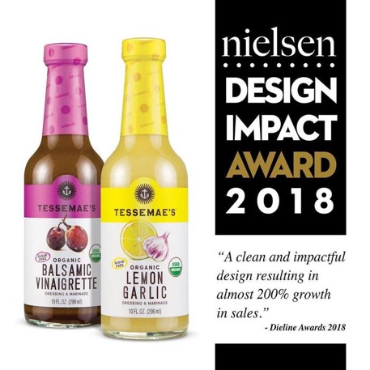










WE DON’T MEAN TO BRAG
We are now the #1 organic dressing in the category – larger than the next 5 competitors combined
Successfully established premium tier dressings/condiments within conventional and natural grocery channels
Tessemae’s continues to drive 50-70% of category growth with Kroger and other key retailers
National distribution footprint
Won Nielsen award for best packaging in 2017
Extended Tessemae’s brand into fresh produce space with launch at Sam’s Club and Whole Foods
Now have over 190K+ followers through social media….all were gained organically
Established best in class ecommerce platforms that ships nationally and provides valuable access to loyal consumers

Slide 18






































OUR RETAIL PARTNERS

Slide 19






















EXPANSION & GROWTH (AS OF 2021)
+6,500 NEW STORES
PENDING
East/Seattle
Shelf Stable
Additional Items

Slide 20
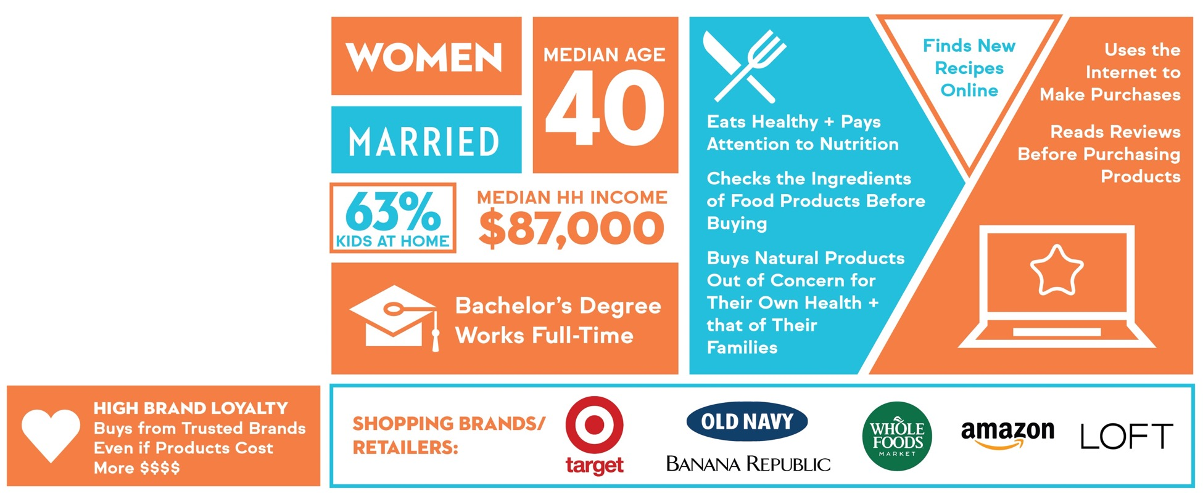
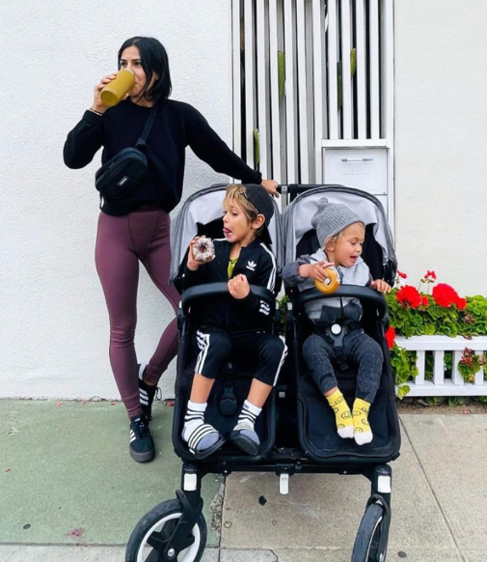
CORE CONSUMER | FOOD & FITNESS TRIBES

Slide 21


TARGET CONSUMER | FORWARD THINKERS

Slide 22
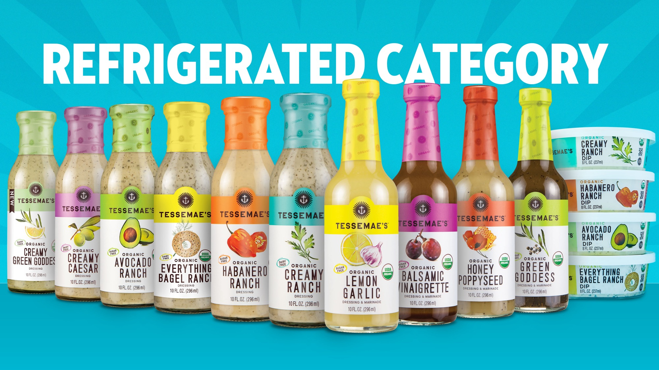

Slide 23
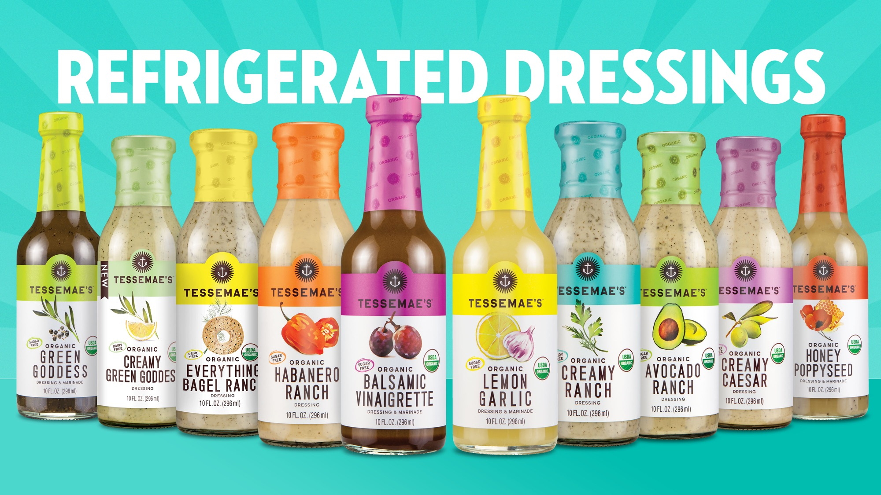

Slide 24
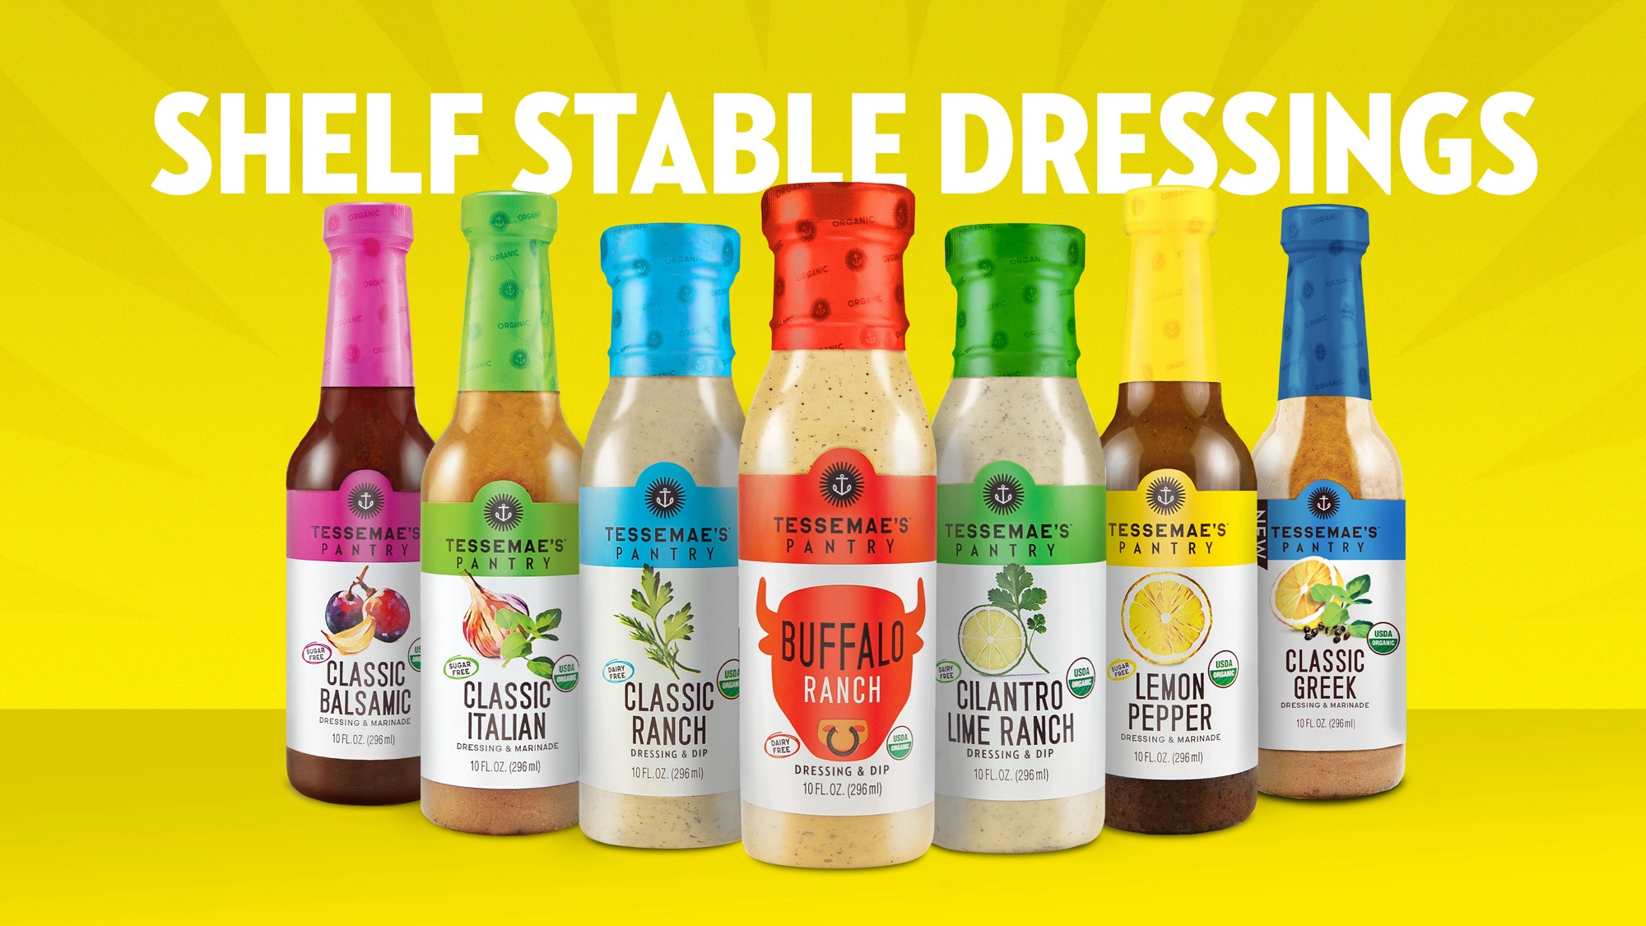

Slide 25
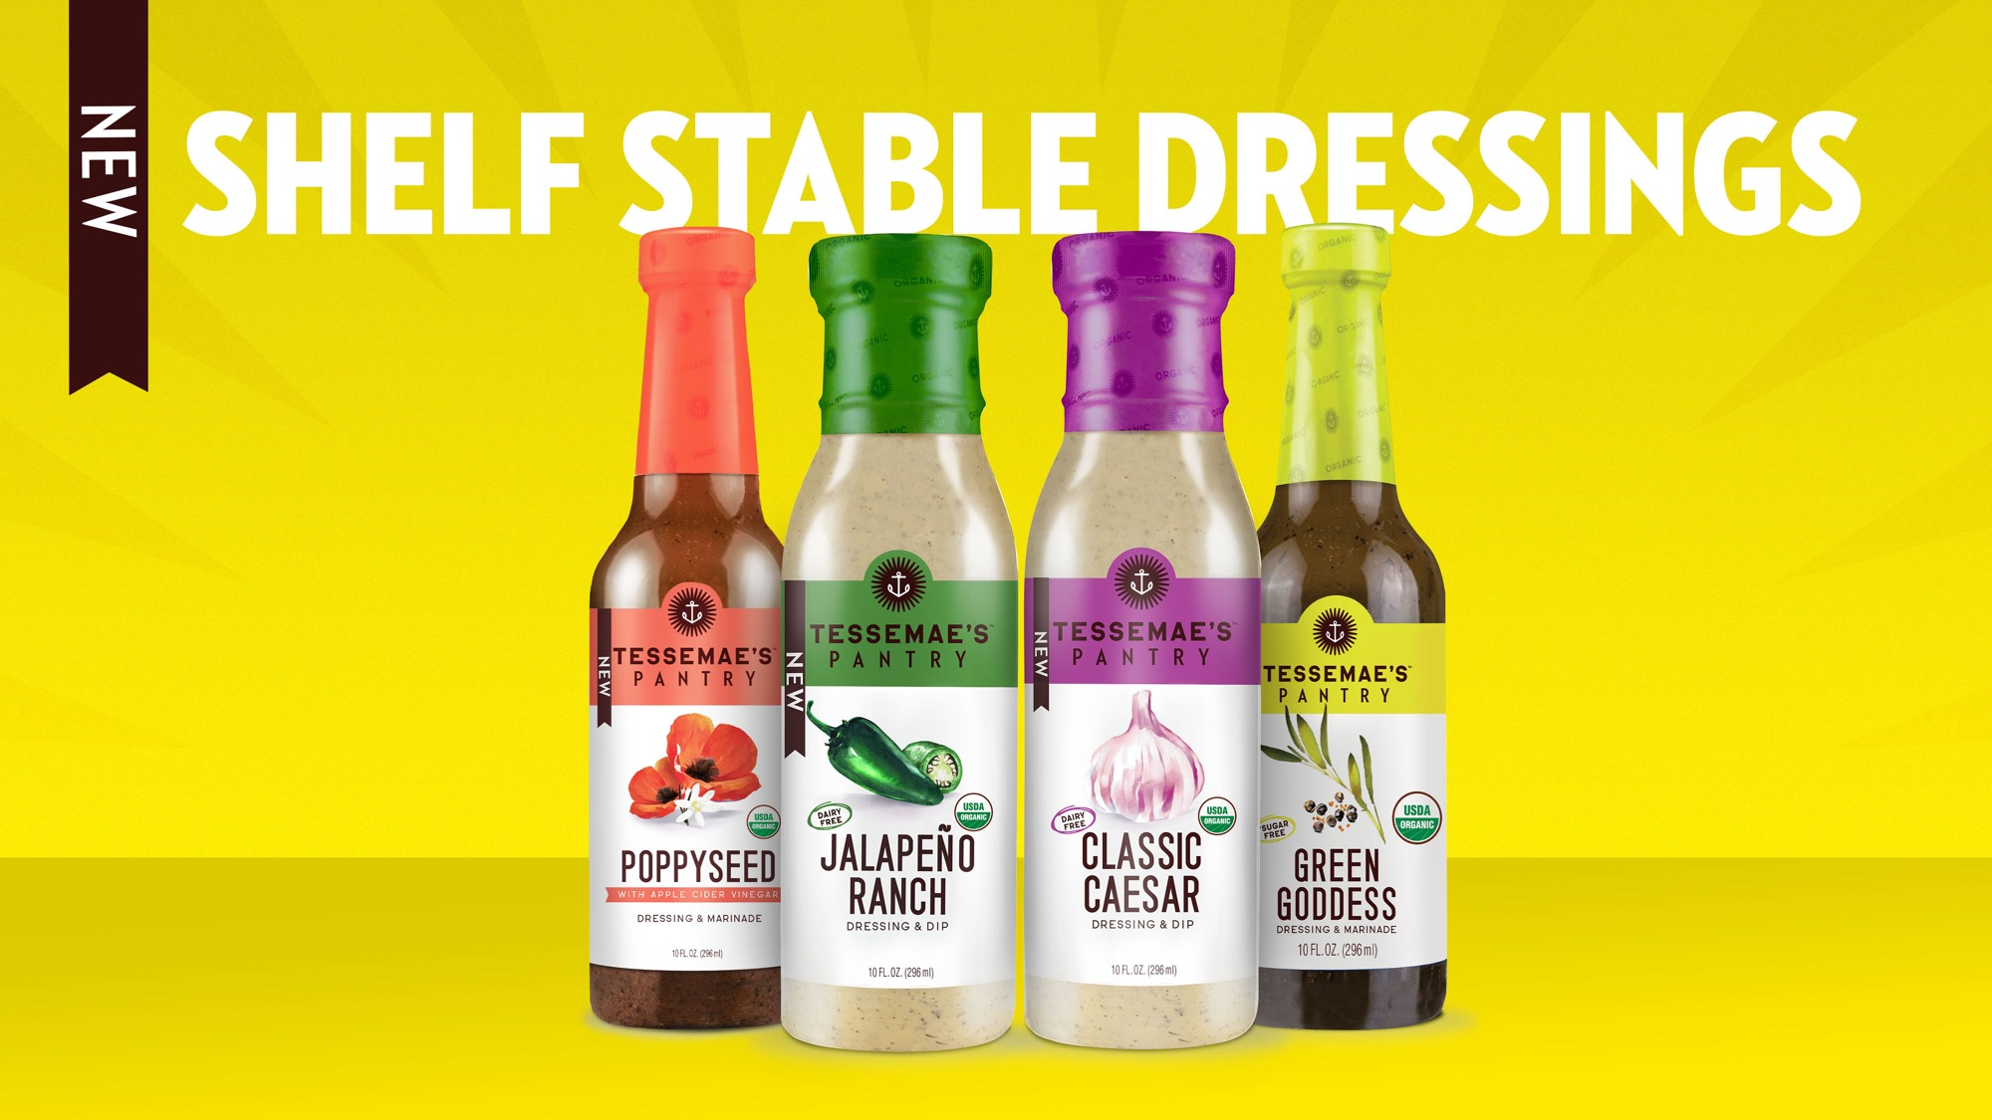

Slide 26
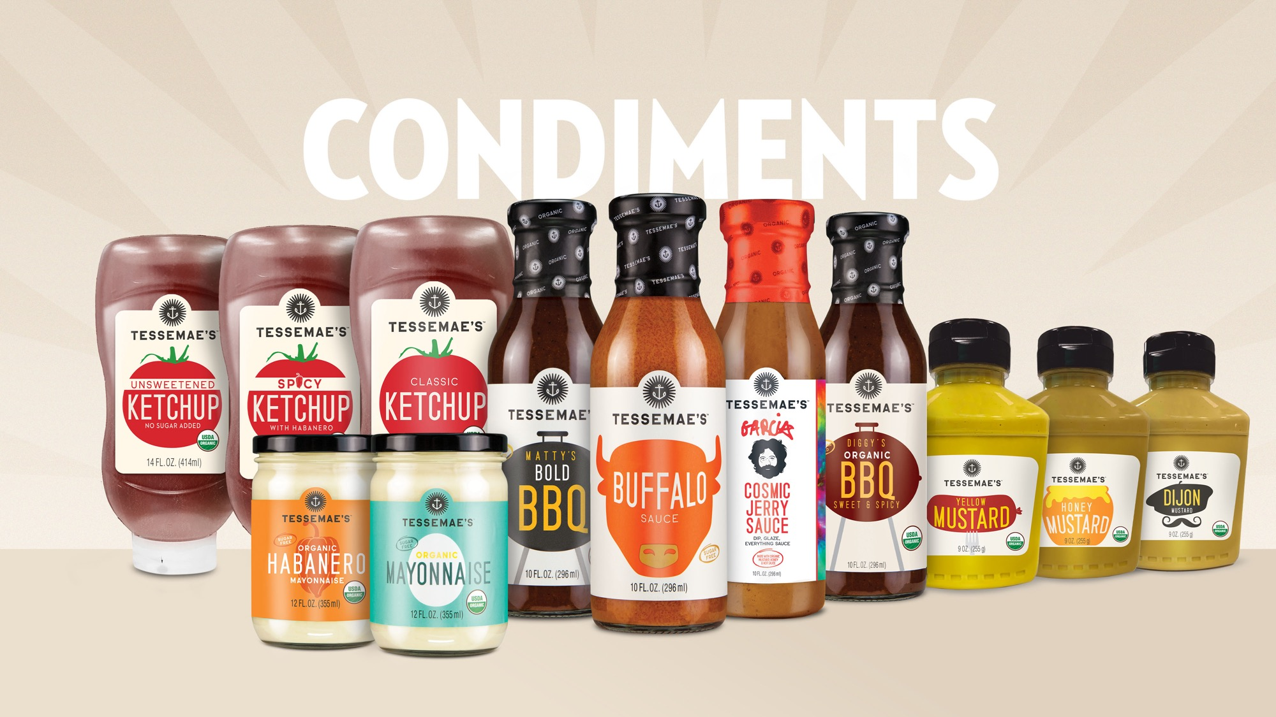

Slide 27
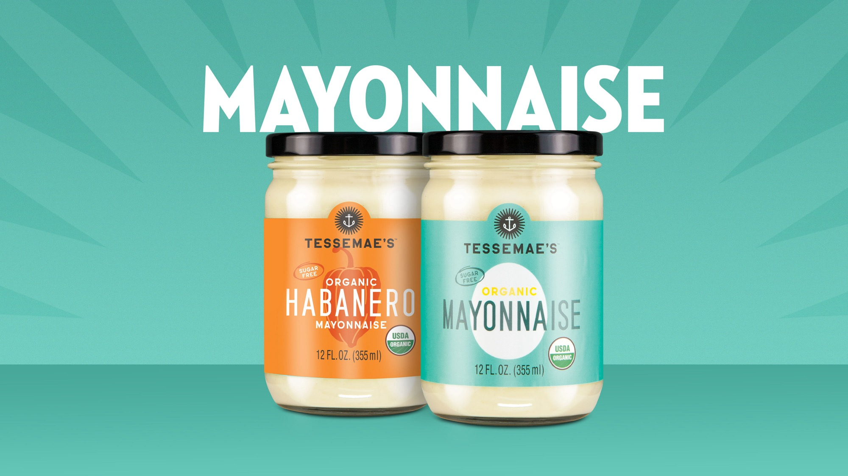

Slide 28
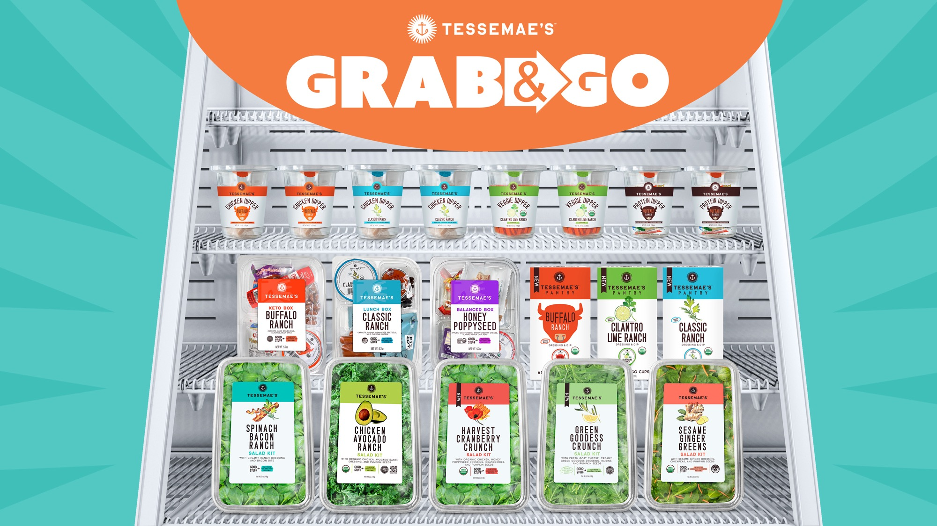

Slide 29
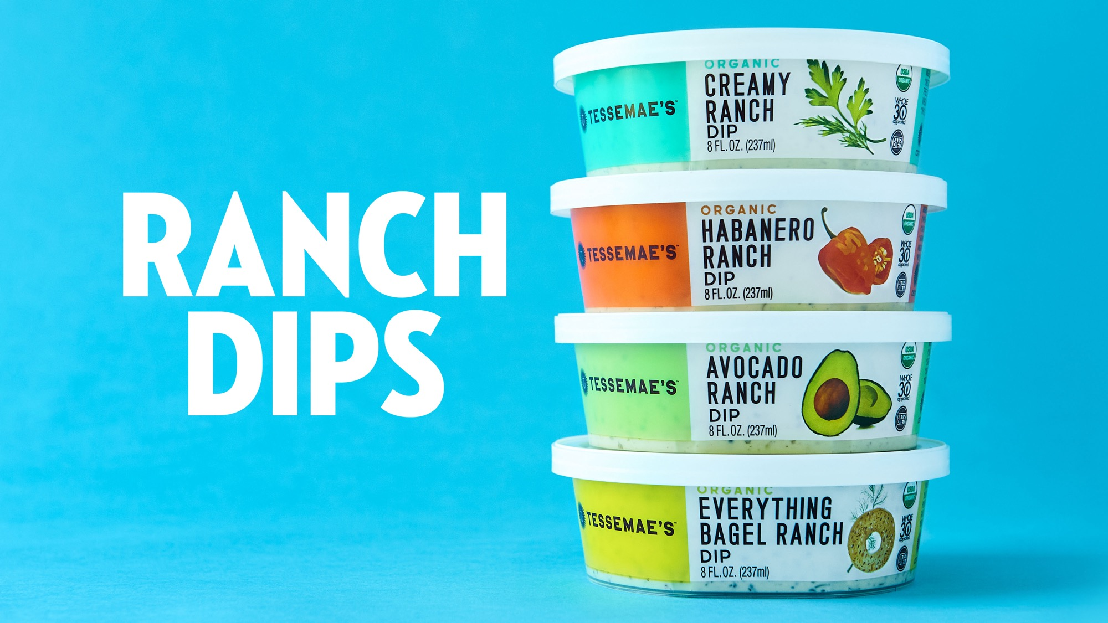

Slide 30






TOTAL ORGANIC SALAD DRESSING | SALES & SHARE (REFRIGERATED + SHELF STABLE; ALL BRANDS WITH CERTIFIED ORGANIC STAMP)
TOTAL ORGANIC DRESSINGS:
$42.9MM
TESSEMAE’S IS, BY FAR,
THE #1 BRAND IN THE COUNTRY!
ALMOST 3X LARGER THAN THE NEXT
LARGEST COMPETITOR!
*All brands with certified organic stamp
Source: SPINS; Total US MULO, 52 Weeks Ending 3/21/21

Slide 31
ORGANIC SEGMENT BREAKDOWN | SALES & SHARE
Refrigerated Salad Dressings: $22.1MM
Shelf Stable Salad Dressings: $29.6MM
95% - 99% Organic = 91% of TTL Organic Sales
95% - 99% Organic = 55% of TTL Organic Sales*
Among products labeled with 95% - 99% Organic ingredients, Tessemae’s is by far the largest brand in Total US MULO generating over $16MM in sales
In the Refrigerated Category, Tessemae’s represents over 57% of overall sales – larger than all other brands combined
When combining both Refrigerated and Shelf Stable 95% - 99% Organic sales, Tessemae's has the largest share by far (32% share)
* 1% - 69% = 41.6% of Organic sales in Shelf Stable Dressings
Source: SPINS; Total US MULO, 52 Weeks Ending 3/21/21

Slide 32


IMPORTANCE OF SEARCH TRENDS
With the increase usage of digital platforms such as online grocery pickup & delivery and last mile delivery services (Instacart, Shipt), analyzing increases or declines in search volume allows us to recognize consumer shopping trends and desires.
81%
of consumers reported using online research prior to an in-store purchase.¹
59%
of US shoppers expect to use digital shopping more in the future.³
Q1 2020 |  | Q2 2020 |  | Q3 2020
Amazon.com | Grocery | Amazon.com | Grocery | Amazon.com | Grocery
256 | 17 | 473 | 72 | 353 | 34
273 | 5 | 601 | 5 | 448 | 2
1,447 | 268 | 10,018 | 373 | 5,643 | 425
37%
of product searches are non-branded exceeding branded search in ecommerce.²
63%
of shoppers who visit Amazon or Walmart.com visit these sites for initial product research.²
Amazon Search Frequency Rankings
Q3 2020 |  | Q4 2020 |  | Q1 2021 |  | Q2 2021
Amazon.com | Grocery | Amazon.com | Grocery | Amazon.com | Grocery | Amazon.com | Grocery
353 | 34 | 781 | 161 | 273 | 55 | 340 | 30
448 | 2 | 1,219 | 13 | 332 | 7 | 787 | 20
5,643 | 425 | 5,354 | 1,247 | 1,564 | 828 | 2,098 | 1,281
Q3 2020 |  | Q4 2020 |  | Q1 2021 |  | Q2 2021
Amazon.com | Grocery | Amazon.com | Grocery | Amazon.com | Grocery | Amazon.com | Grocery
1,603 | 627 | 1,791 | 689 | 1,281 | 29 | 1,872 | 14
9,024 | 531 | 11,759 | 736 | 6,917 | 546 | 9,014 | 530
39,652 | 1,512 | 31,305 | 2,071 | 23,591 | 2,031 | 45,213 | 2,669
Keto
Keto snacks
Keto food
Vegan
Vegan snacks
Vegan food
This is a sampling of keto and vegan keywords and their search frequency rankings across all of Amazon.com and the grocery category on Amazon.com
¹ GE Capital Retail Bank Study
² The State of Ecommerce 2021, A landmark study by Catalyst and Kantar
³ The future Shopper Report 2020, Wunderman Thompson Commerce

Slide 33
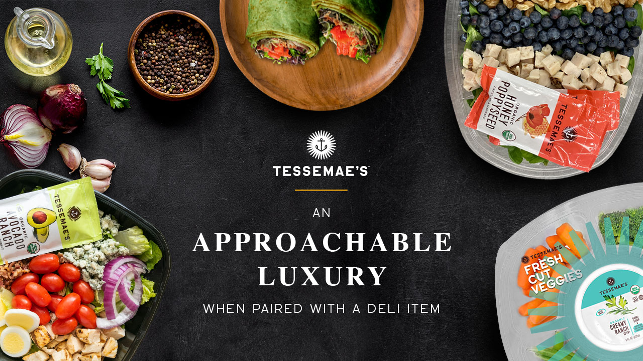
33

Slide 34

34

Slide 35
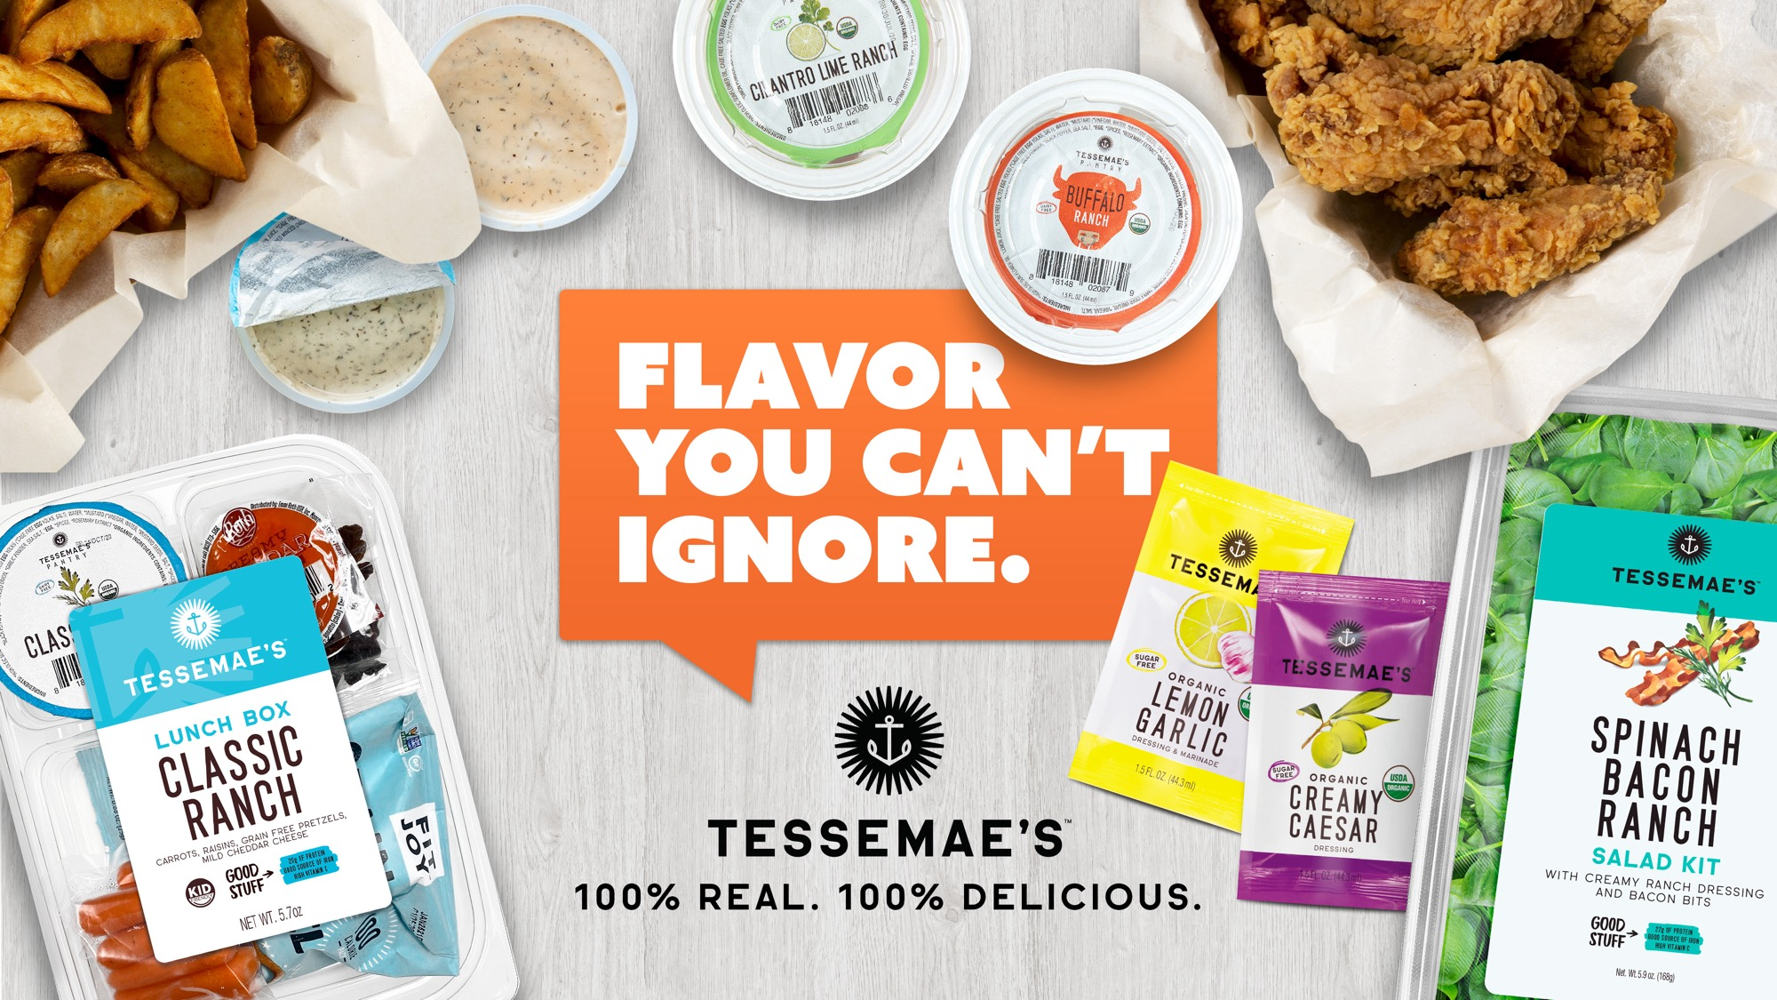
35

Slide 36
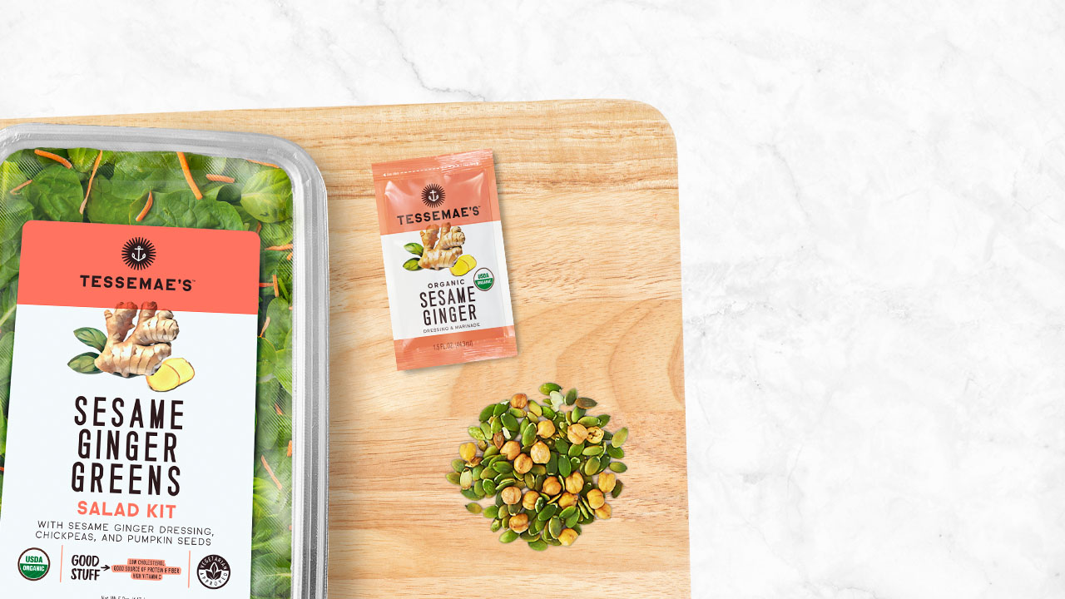

Organic Sesame Ginger Greens Salad Kit
Baby kale, crunchy carrots, and fresh spinach make the perfect bed for a nutrient dense topping—pumpkin seeds and chickpeas! Drizzle with our Sesame Ginger dressing for the perfect pop of flavor. This individual salad kit is a great grab-and-go option for work or a day on the run!
36

Slide 37
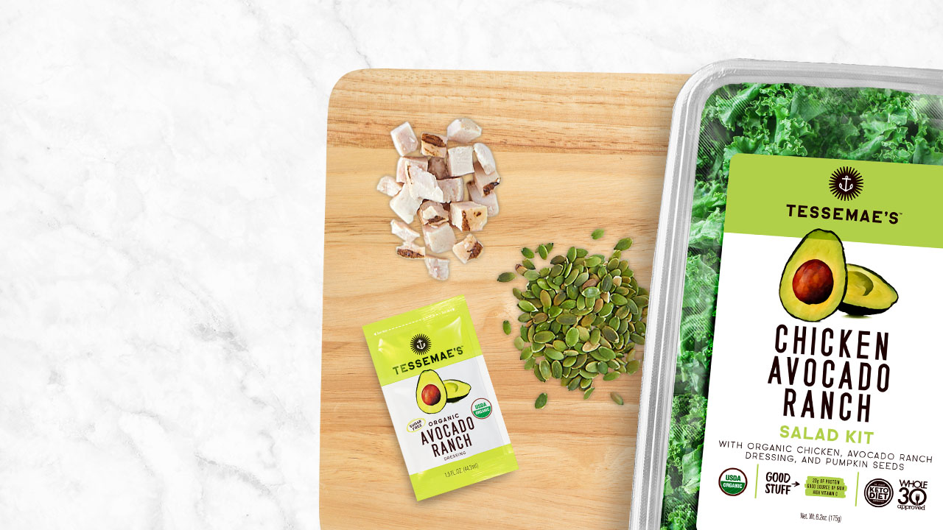
Organic Chicken Avocado Ranch Salad Kit
A superfood blend of chopped green kale, shredded broccoli and radicchio topped with organic grilled white meat chicken, rich and creamy Avocado Ranch dressing, and nutrient dense pumpkin seeds. This salad kit is the perfect to-go salad for all avocado lovers out there looking for the dream combination of protein, health, and deliciousness.

Slide 38
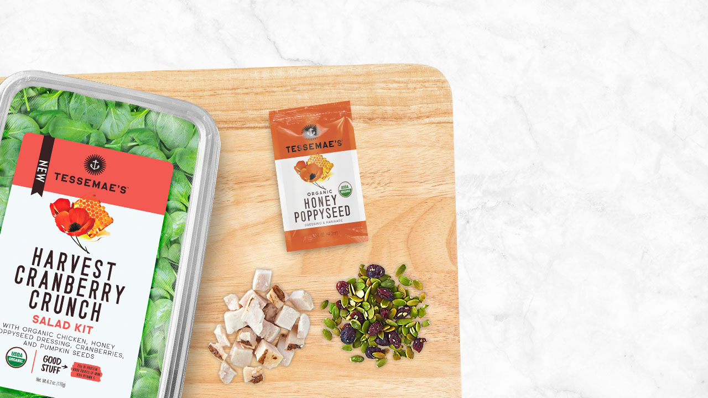
Organic Harvest Cranberry Crunch Salad Kit
The Harvest Cranberry Crunch salad packs a crunch and it's bursting with flavor. A bed of crispy spinach topped with organic chicken, pumpkin seeds, cranberries, and our Honey Poppyseed dressing. The vinaigrette gives you the perfect tang combined with sweet honey. Get to drizzlin'!

Slide 39
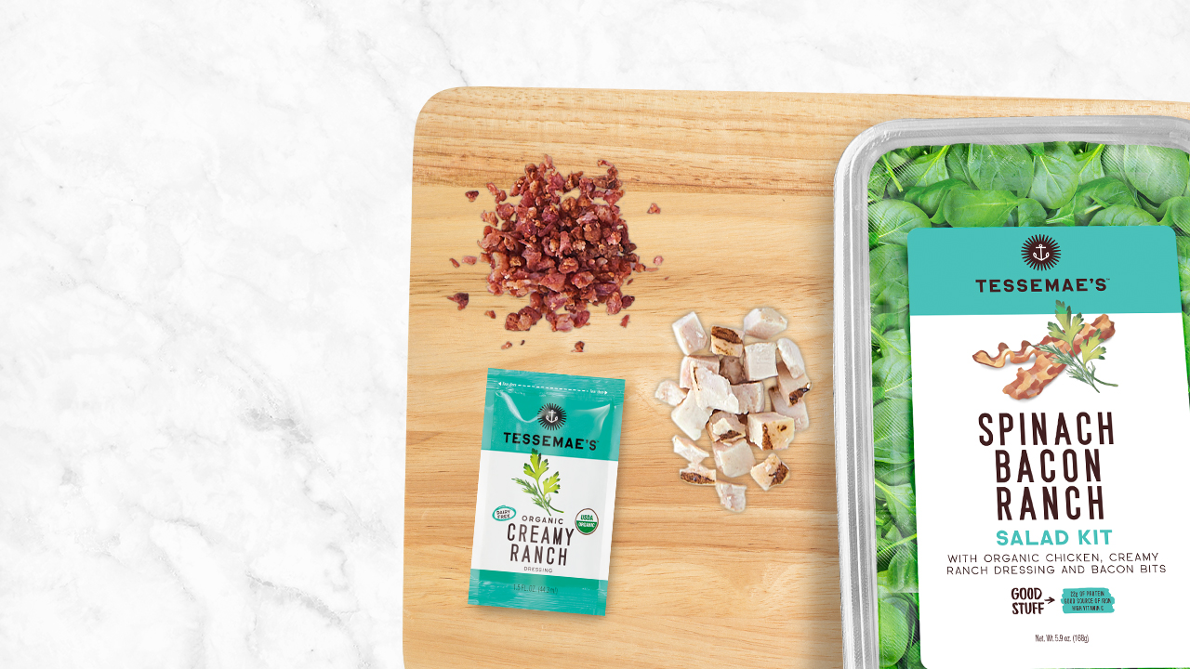
Spinach Bacon Ranch Salad Kit
Sonny and Cher. Beyonce and Jay-Z. Bacon and Ranch. We love power couples. That's why we took our Creamy Ranch dressing and our Bacon Salad Topper to create the perfect marriage AND lunch! Organic chicken and crisp spinach make the perfect home for these two.

Slide 40
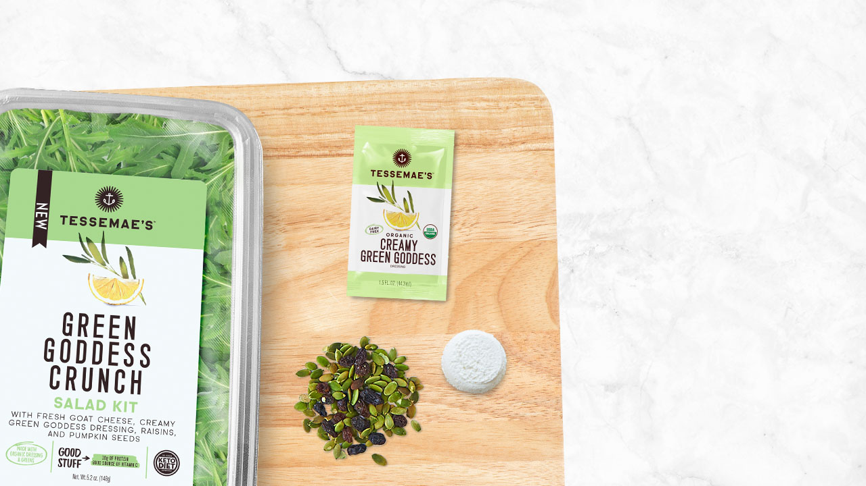
Green Goddess Crunch Salad Kit
Baby rocket arugula topped with a gourmet fresh goat cheese medallion, our savory Green Goddess vinaigrette, and a nutrient dense topper filled with pumpkin seeds and raisins. This healthy, tasty, and flavor filled to-go option will make all of your co-workers jealous!

Slide 41
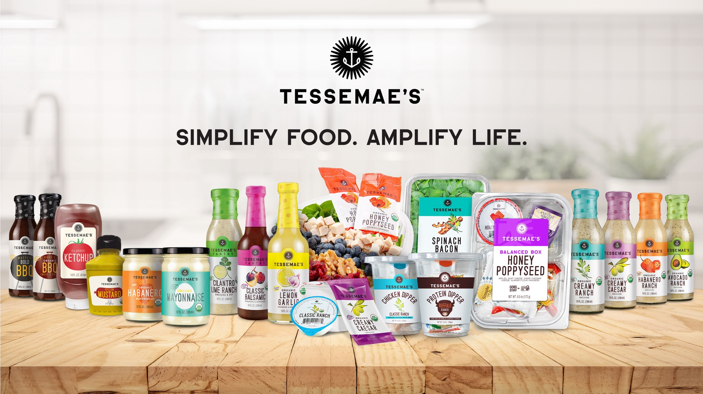

Slide 42
APPENDIX

Slide 43

SPINS – ‘LABELED ORGANIC’ DESIGNATIONS
The LABELED ORGANIC attribute field is used for the organic coding based on USDA guidelines.
LABELED ORGANIC 100%: All ingredients, except for water and salt, are certified organic. The company usually, but not always, puts a USDA or other certifying body’s Organic logo on the label, or it may be deduced from the ingredient panel that 100% of the ingredients are certified organic.
LABELED ORGANIC 95-99%: Products with 95-99% 3rd party certified organic ingredients, excluding water and salt.
LABELED ORGANIC 70-94%: Products with 70-94% 3rd party certified organic ingredients, as declared by the company, website, or label.
LABELED ORGANIC 1-69%: This value is used when there is a claim made by company, website, or label stating between 1-69% of ingredients are certified organic.

Slide 44
SLIDE HEADER [ALL CAPS; ARIAL 34]
PARAGRAPH HEADER
Paragraph body copy
Bullets
Bullets
Bullets

