Slide 1

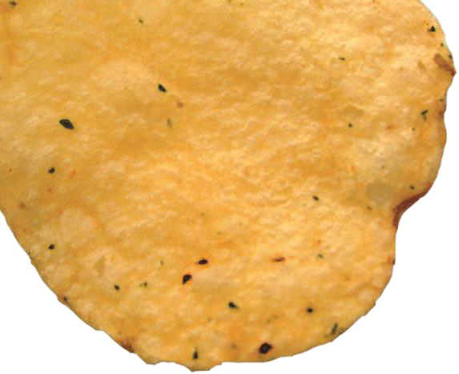



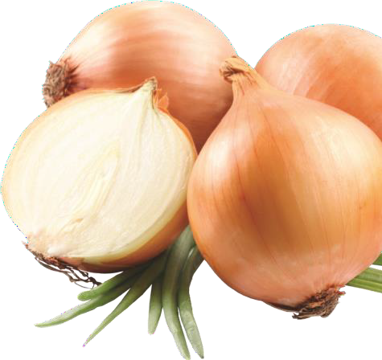





Slide 2


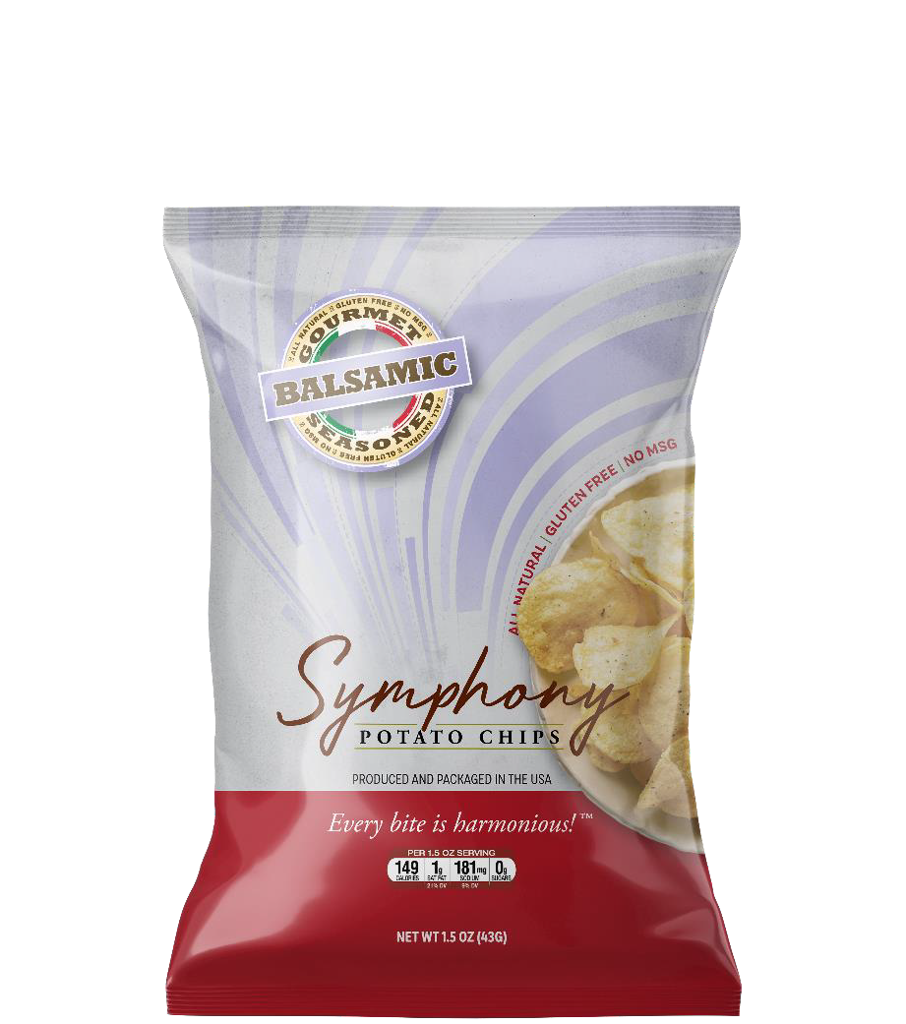
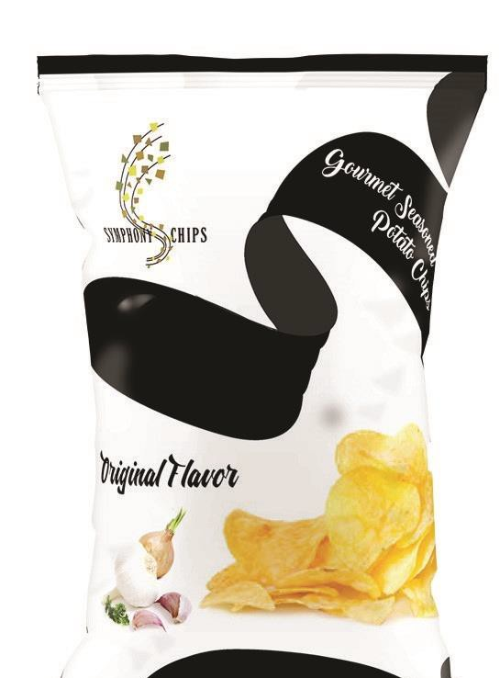


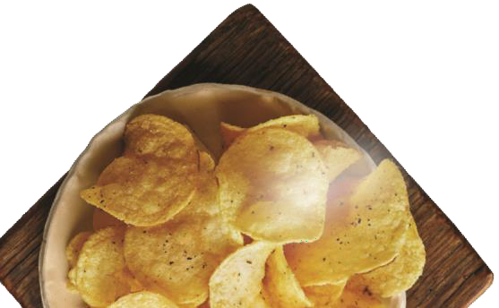
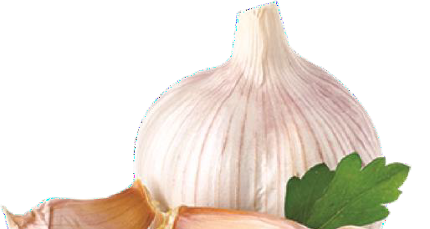
Welcome to
Symphony Chips
Food is much deeper than just a quick meal or snack. Food brings families together and connects people by sharing experience, knowledge, and appreciation. Family recipes are passed down from generation to generation, preserving tradition and bonds. Symphony
Chips was born out a family’s connections with food that goes back over 40 years. Having
originally started as a spice company, Dondre Anderson used potato chips as a way to let people sample his family’s various spice blends. An idea was born when a customer told him “you should make chips out of this!” Thus, Symphony Chips was born. Today, Symphony Chips are sold across Atlanta, GA and customers from all over the country are ordering online to get a taste of these simple yet masterfully flavored snacks.
We greatly appreciate your interest in partnering with Symphony Chips. Our chips have ignited a plethora of support and demand around the country that continues to grow as more locations carry these delicious snacks. As demand grows we are doing our best to provide our customers with chips through our online store, however nothing beats being able to grab a bag of chips at your closest grocery store or cafe. This is where you come in.
This presentation will walk you through the Symphony Chips brand and wholesale opportunities that we can offer your business. You’ll learn about the history of Symphony Chips and the Anderson family as we introduce you to one of the few black-owned potato chip companies in America. We’ll also present you with wholesale pricing options, tell you our family plans for additional products and provide some insight on the responses that we’ve received from our customers. Thanks again for your interest and we look forward to adding you to our family!

Slide 3


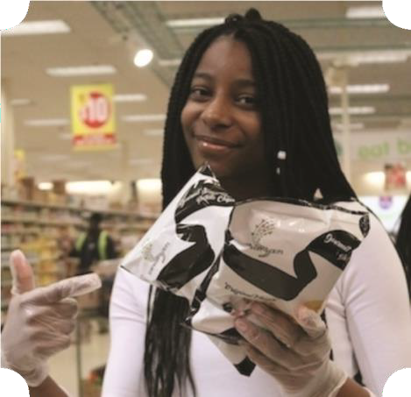




Meet the Andersons
Dondre Anderson is the son of retired chef Andre Anderson who spent 40-years creating and refining the spices behind Symphony Chips. Before there was Symphony Chips, Dondre and his dad Andre were selling his family’s spices through his company “All A’s Spices” in Atlanta, letting people sample the spices on raw vegetables and chips. Once people got a taste of his spices on chips, they started asking him where they could find these chips, which lead him to create “Symphony Chips.” Ran by Dondre and his two daughters, Amina (18) and Amari (17), this family business has grown to new heights.
Having the same entrepreneurial drive and business savvy mindset as their dad, Amina and Amari are creating their own Symphony lines as well. Using a spice blend based off of the family’s sweet potato line, Amari is creating her own line of Symphony Pastries. Meanwhile, Amina is busy starting her own line of Symphony Mills that offers both a gluten-free and low carb fry-mix batter, which provides a healthy yet flavorful meal option.

Slide 4



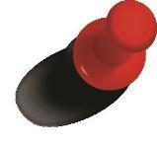
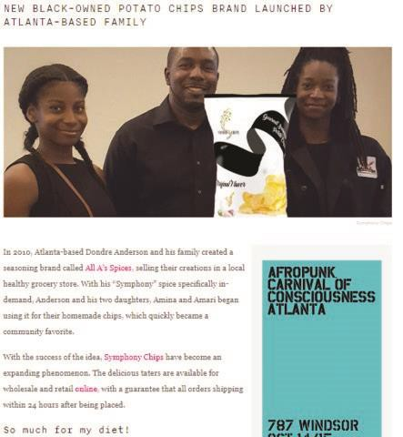






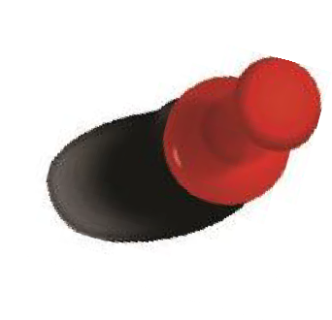




Slide 5
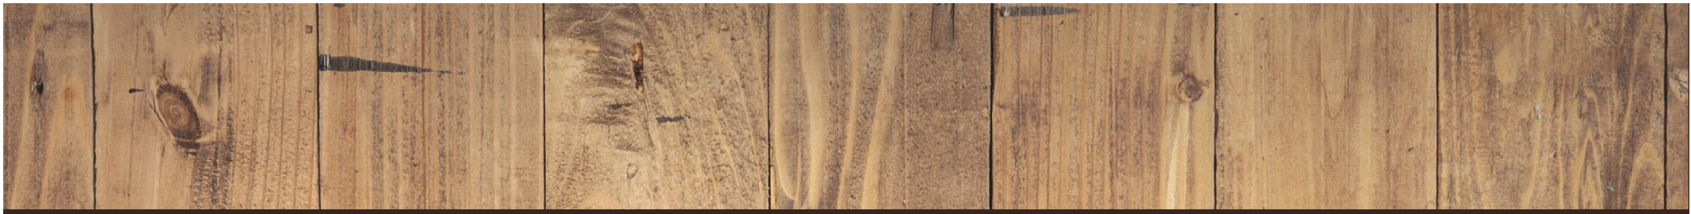



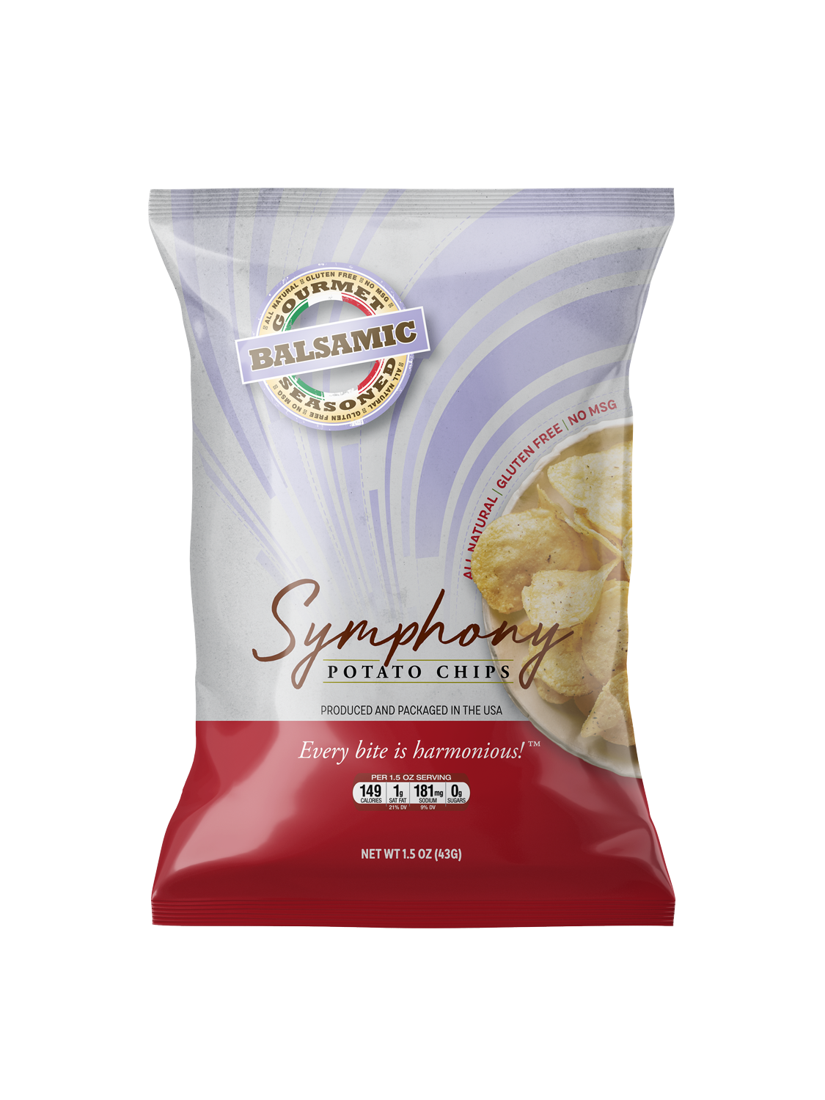
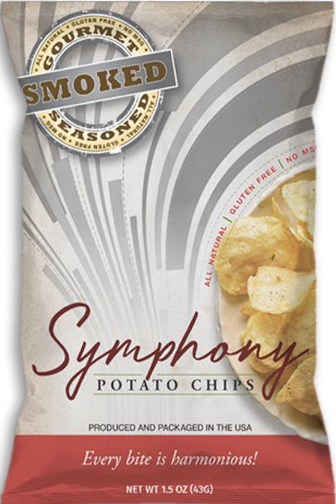

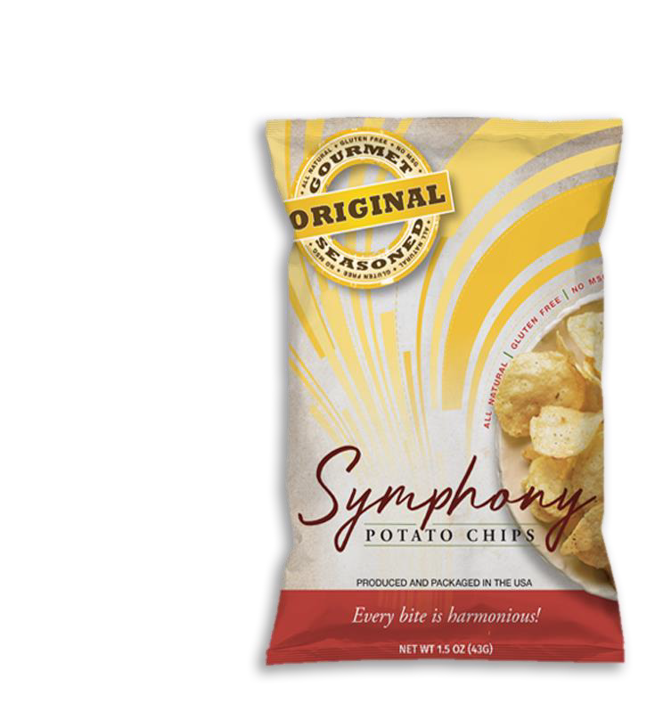







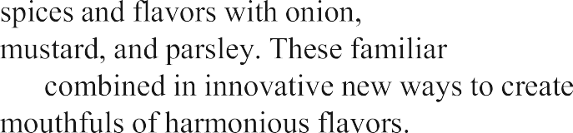



MSG or gluten, making them the ideal snack for
picnic, paired with a meal or part of a charcuterie
oil and seasoned with a masterful blend of natural
NET WT 7.0OZ

Slide 6
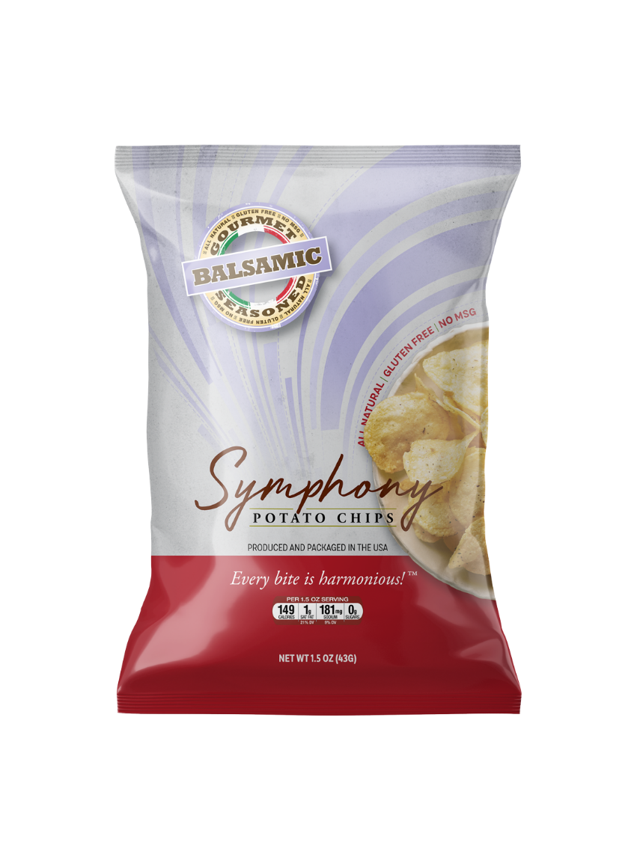

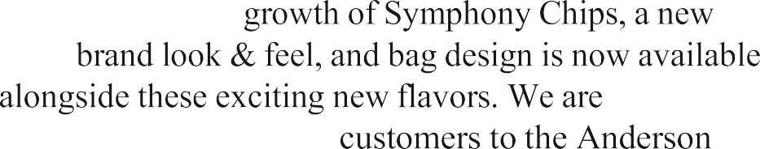


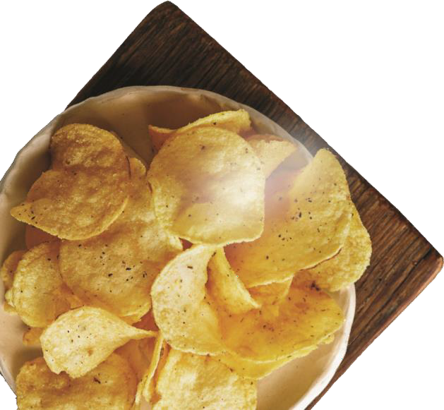







launch soon are:
Chipotle Aioli
Soufflé (Sweet Potato)
Bouillon
Lemon Pepper Aioli

Slide 7

MANUFACTURING
We have taken great care in selecting a manufacturer that is able to keep up with the growing demand for Symphony Chips so that there is never a shortage. We hold our manufacturer up to the same high standards that we hold our flavors, which is why we picked a manufacturer that is the
4th largest in the country. Being in operation since 1951, our manufacturer is able to produce 1,000 bags of our 1.5oz chips in under 12 minutes. That breaks down to 85 bags a minute, or about 2 bags a second, which means there will never be a shortage of snacks
12 min. 1 min. 1 sec.
1,000 bags
85 bags
2 bags

Slide 8
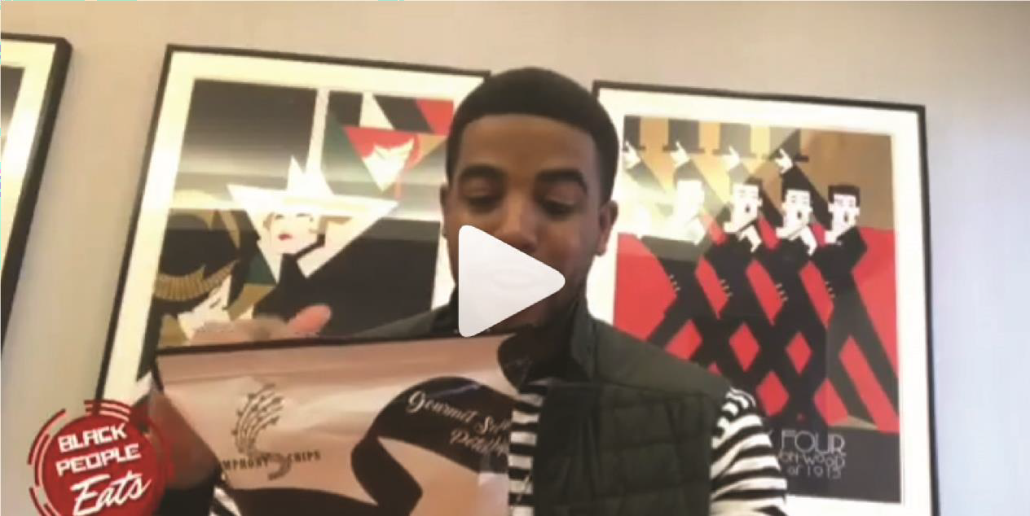

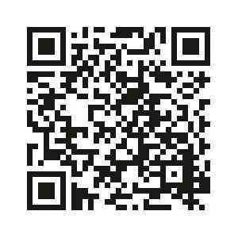








What People are saying
Shop Symphony Chip
s

Slide 9
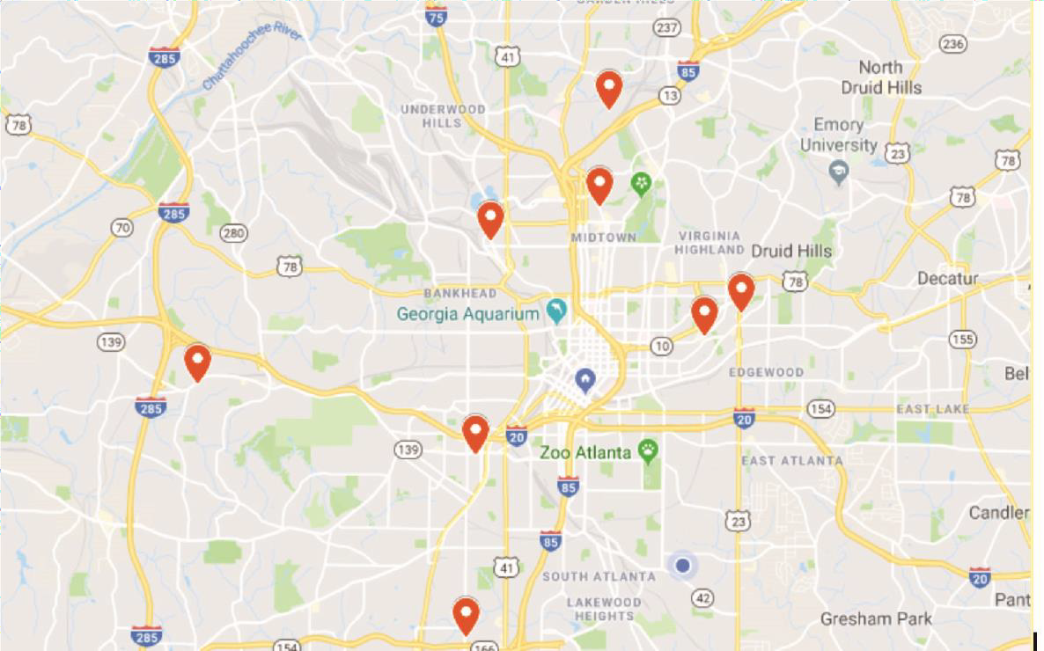
Shop Symphony Chips
Symphony Chips have spread across various grocery stores, specialty markets, and hotels in Atlanta. We are proud to be partnered with so many wonderful retailers who are as excited as we are to have people try our delicious chips. We are currently located throughout metro Atlanta, including:
Target Stores
Omni Hotels Atlanta
Hyatt Hotels Atlanta
Urban City Market
Multiple Wholesale Locations

Slide 10


CONTACT PAGE
Dondre Anderson CEO/Co-Founder
585-310-1970
danderson@symphonychips.com or ajackson@symphonychips.com

Slide 11
We are excited that you are considering a wholesale opportunity with Symphony Chips.
If you have any further questions you can contact us directly or visit our website at
www.symphonychips.com

