Slide 1
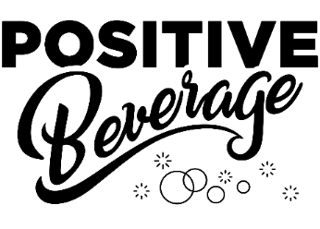
2021 Brand Overview

Slide 2
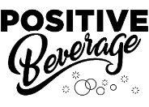
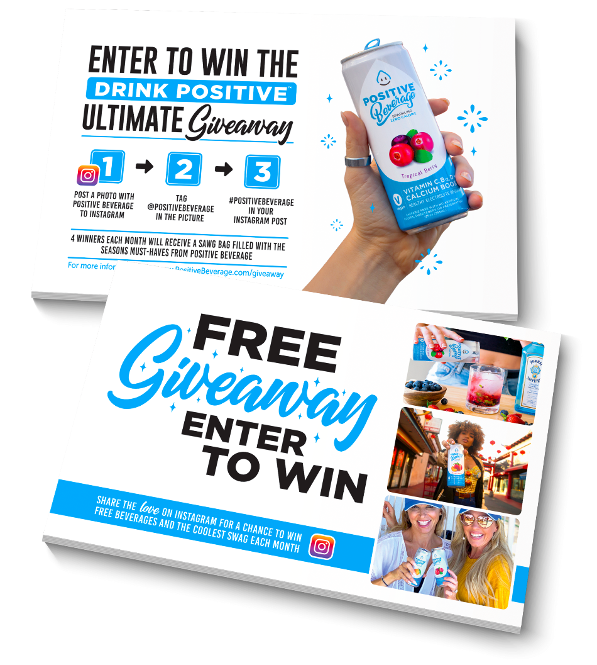
HOW WE SEE THINGS
In a world of trends, we understand that great flavor, quality ingredients and honest brand values never go out of style.
With a mission to bring health back to hydration, we’ve created the first simply beneficial portfolio that’s great for all ages and perfect for one's daily routine.
Both are reasonably priced and perfect for all ages. We reinforce our core values by enriching lives and empowering whatever big day people have in store!
Giving back is vital to positively support organizations that are making a difference in peoples lives.
POSITIVE BEVERAGE CHARITIES

Slide 3
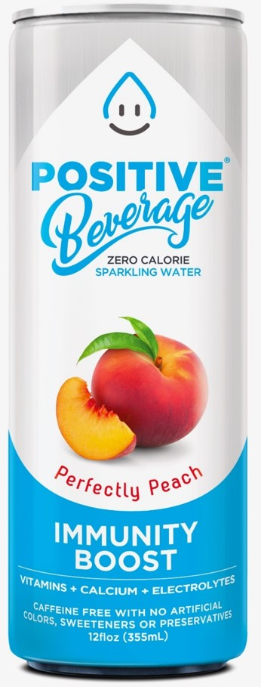
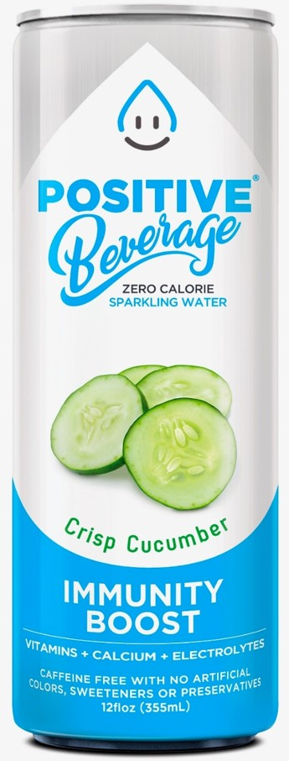

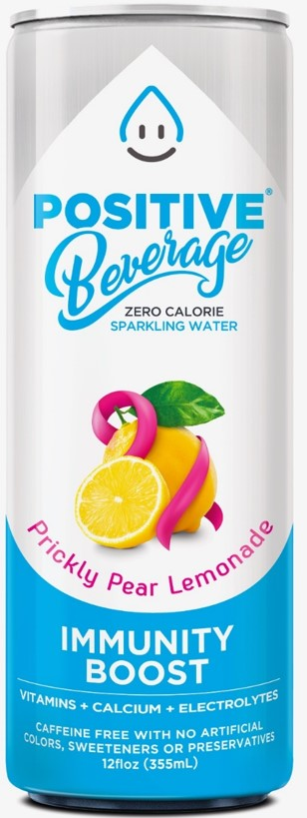
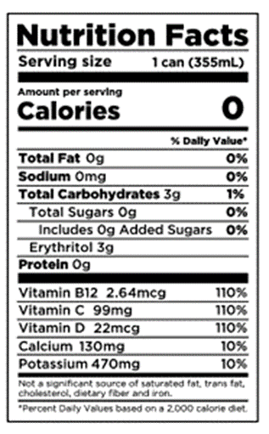
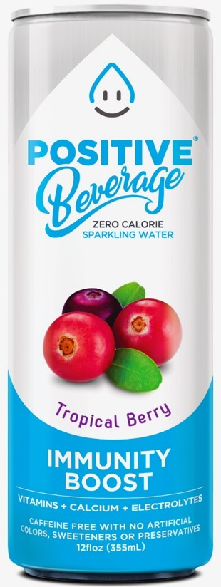
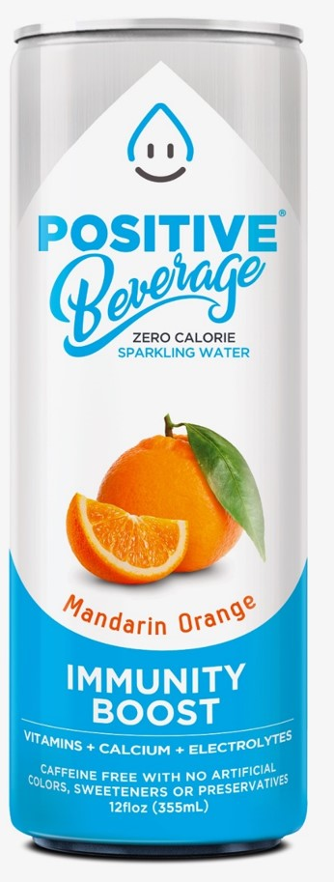
BETTER HEALTH & IMMUNITY TO SPARKLING HYDRATION
Experience the ONLY simply beneficial beverage to deliver strength-building Calcium, hydrating Potassium electrolytes and 110% of all added vitamins in a zero calorie, lightly carbonated, thirst-quenching experience great for all ages!
Vibrant, Clear & Simple “Attribute Messaging”
Vegan, Gluten Free, NON-GMO Project Verified, Low Glycemic, Keto Friendly
ZERO CALORIES, ZERO SUGAR!
Natural Flavors taken from the most concentrated part of the fruit such as the rind, deliver a bold flavor without the sugar from traditionally found if juiced.
The subconscious acceptance of the word POSITIVE builds immediate trust
Zero Calorie
The number one desired attribute from consumers
Vitamin C, B12 & D
Immunity Boost, Natural Energy, Happiness
Calcium
Most important nutrient lacking within the American diet
Plus, Electrolytes!
Caffeine Free
No Artificial Colors, Sweeteners or Preservatives & No Sugar
3
©2021 POSITIVE BEVERAGE, LLC ALL RIGHTS RESERVED

Slide 4
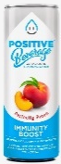

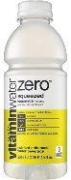
POSITIVELY FOCUSED ON DIFFERENCIATION
We offer a no-compromise solution with desired attributes that satisfies consumers appetite for functionality that tastes great in an elevated experience
Positive has consistent “Good for You” functional attributes that are beneficial for everyone!
Serving Size | Calories | Vitamin C | Vitamin B12 | Vitamin D | Calcium | Caffeine Free | Non-GMO Project Verified | Certified Vegan | Gluten Free on Label | Low Glycemic on Label
12oz | 0 | 110% | 110% | 110% | 25% | Yes | Yes | Yes | Yes | Yes
12oz | 25 | 0 | 0 | 0 | 2% | Yes | No | No | Yes | No
11.5oz | 5 | 15% | 0 | 0 | 0 | No, 35-45 mg of caffeine | No | No | Yes | Yes
12oz | 0 | 0 | 0 | 0 | 0 | No, 75mg of Caffeine | Yes | Yes | Yes | No
20oz | 0 | 50% - 150% Depending on flavor | 100% | 0 | 0 | Yes | No | No | No | No

Slide 5

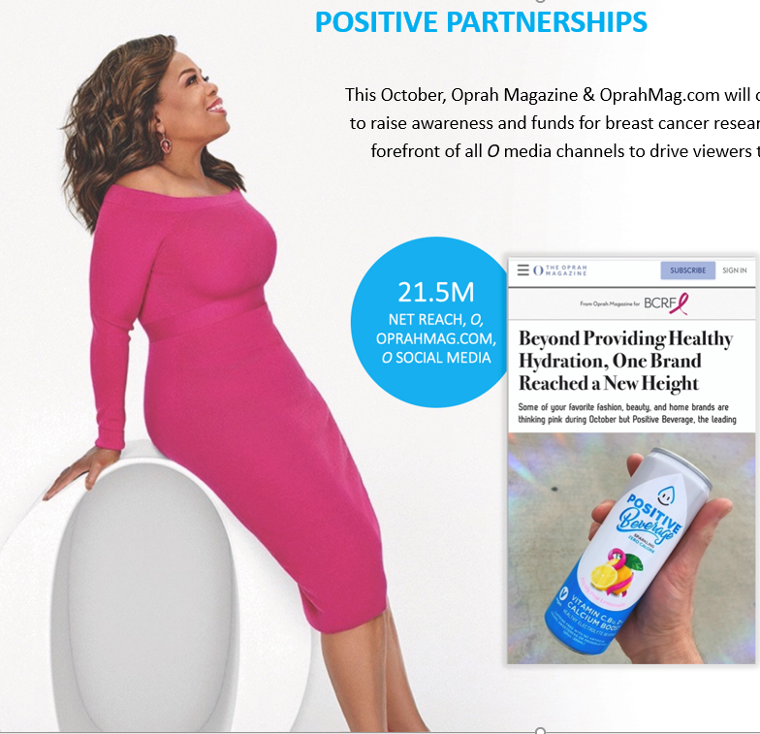
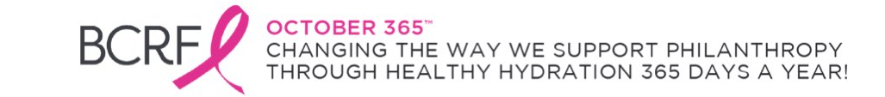
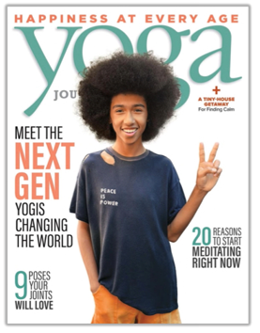
POSITIVE PHILANTHROPY
Positive Beverage launched October 365, a philanthropic division to change the way we view philanthropy and support those in need.
Cementing our commitment to the cause, Positive Beverage made an initial $20,000 donation to The Breast Cancer Research Foundation last year and will continue to donate proceeds from each Prickly Pear Lemonade sold 365 days a year at $0.05 for every can sold.
Due to the success of October 365, Positive Beverage has become the first company to receive a multi-year partnership with the Breast Cancer Research Foundation which we now showcase on all packaging with the logo and statement
POSITIVE PARTNERSHIPS
This October, Oprah Magazine & OprahMag.com will once again work with BCRF partners to raise awareness and funds for breast cancer research, placing partner products at the forefront of all O media channels to drive viewers to act and shop featured brands.
Tabay Atkins, became an America’s youngest certified yoga teacher and a vegan chef, all while he helped his Mom fight & beat cancer! Loves our product that has provided balance, passion, positive energy in his life. He will be part of our social media and messaging, reaching a broader audience.
We’re open to other charitable partnerships as well.
5
©2021 POSITIVE BEVERAGE, LLC ALL RIGHTS RESERVED

Slide 6
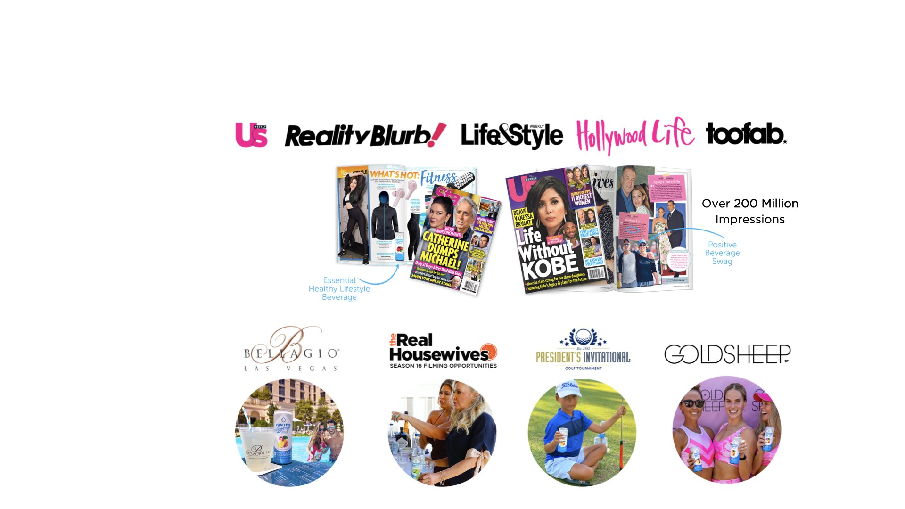
CROSS-CHANNEL MARKETING
Our strategy seamlessly communicates across multiple touch-points through a perfect combination of event-based, social media, influencer-based and traditional media which drives and strengthens our retail partnerships which we reinforce through GEO specific stores and customers. We have a dedicated Social Leader managing our Instagram, Facebook and other Social Media sites
Demographics
55% Female / 45% Male
  Millennials (23-38)
  Gen X (39-54)
Available pool side
& in rooms
Charity fund
raising Event
Vibrant One-of-a-Kind
Fitness Legging Wear
6
©2021 POSITIVE BEVERAGE, LLC ALL RIGHTS RESERVED

Slide 7
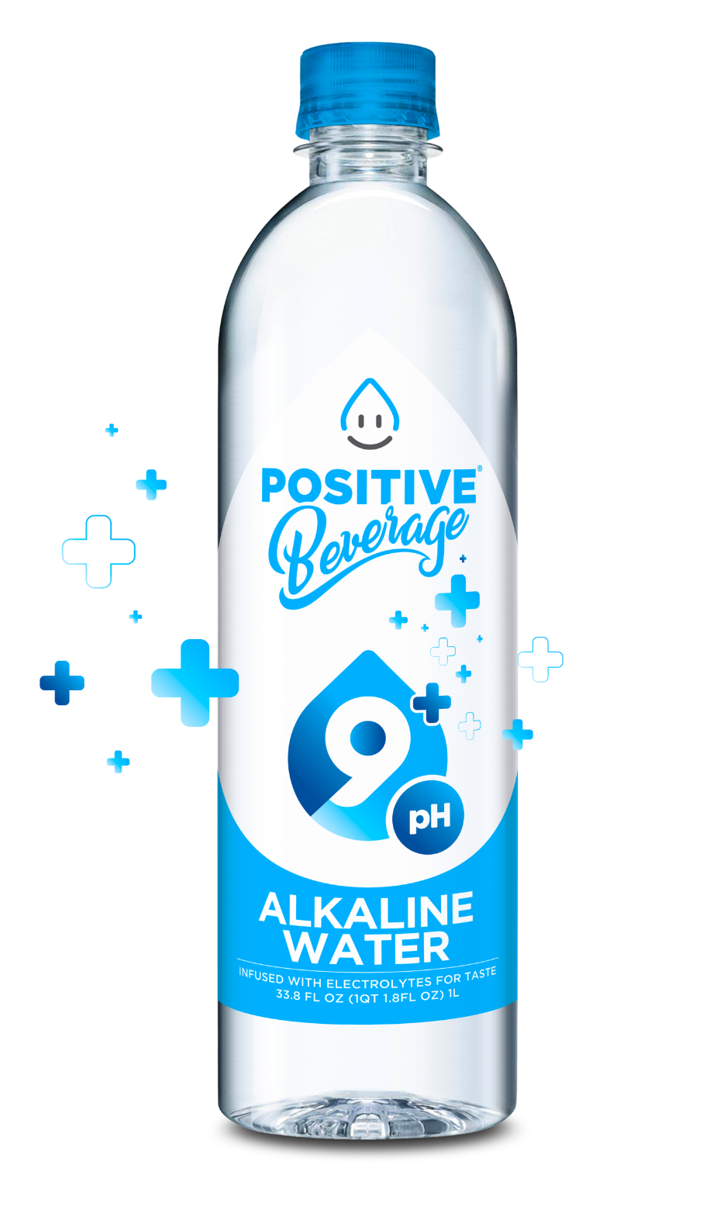
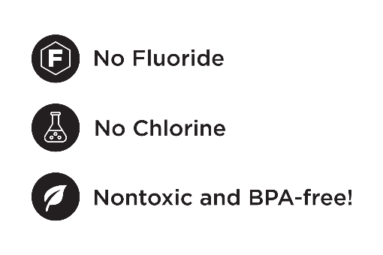
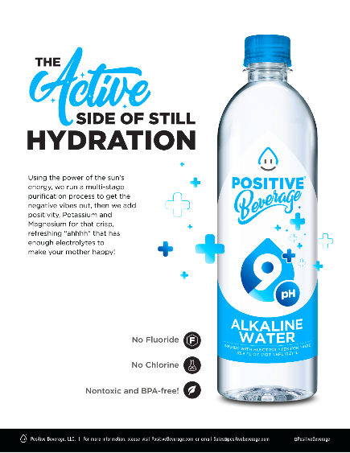
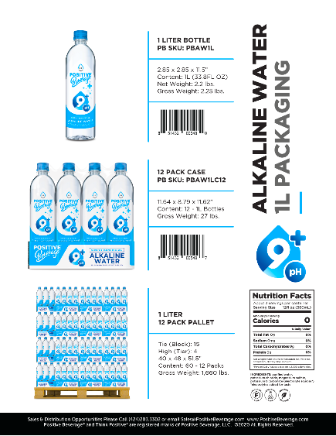
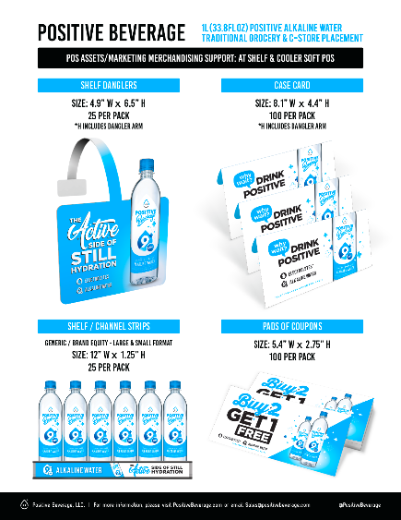
NEW! - 1-LITER POSITIVE 9+pH – AVAILABLE NOW!
Compliments our 12oz. Sparkling Line Up…transparent packaging, simple ingredients.
Trustworthy line extension for consumers looking for non-flavored still hydration
Using the power of the sun’s energy, we run a multi-stage purification process to get the negative vibes out before adding a little positivity – Potassium and Magnesium for that crisp, refreshing “ahhh” that has enough electrolytes to make even your mother happy!
Healthy Potassium Electrolytes vs. Sodium
Higher pH neutralizes body acid for better wellness and more oxygen
Subconscious Acceptance of ”Positive”

Slide 8
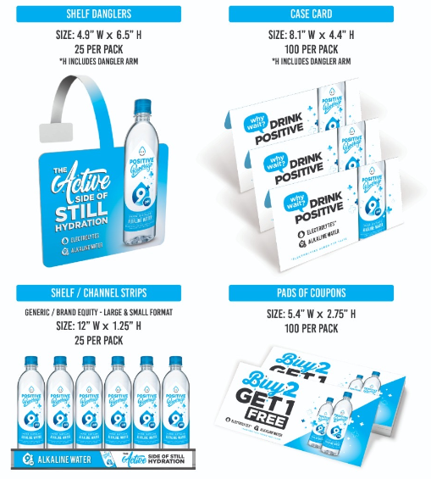
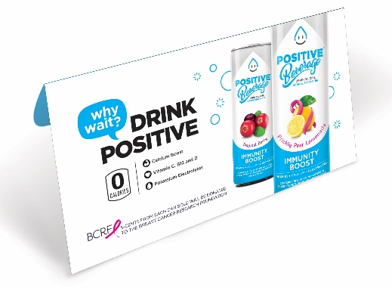
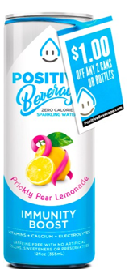
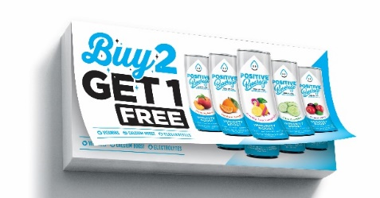
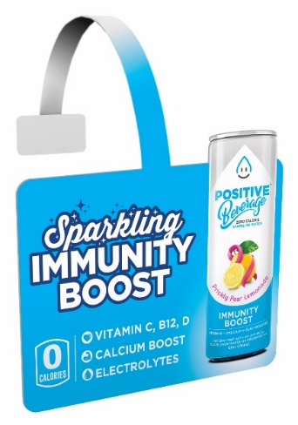
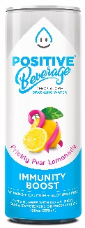
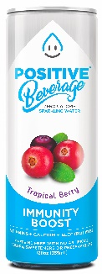
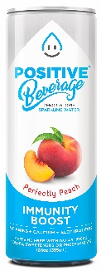
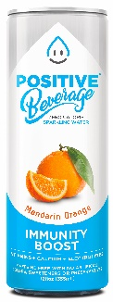
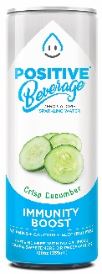

2021 POSITIVE - POS
COUPON PADS – IRC’s
CAN BAND COUPONS & PADS COUPONS
CASE CARDS
SIZE: 6” x 8”
25 PER PACK
SIZE: 2.5” x 5.5”
25 COUPONS PER PAD
SHELF WOBBLER
SIZE: 4.9” x 6.5”
25 PER PACK
*H INCLUDES DANGLER ARM
SHELF / CHANNEL STRIPS
GENERIC / BRAND EQUITY
LARGE & SMALL FORMAT 12” W x 1.25” H
25 PER PACK

Slide 9
Pricing Slide…

Slide 10
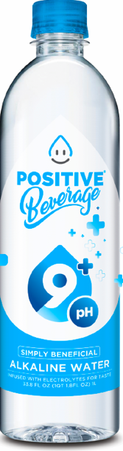
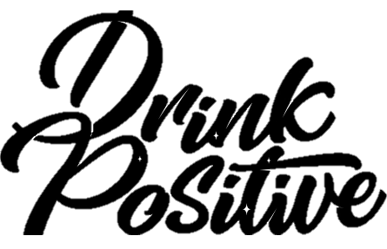
Thank you for the Opportunity!

Slide 11


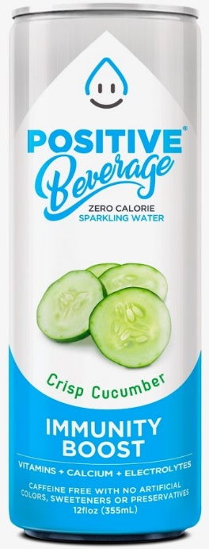












APPENDIX - Positive Beverage UPC Codes – Unit Specs
Unit UPC
Unit UPC
Unit UPC
Unit UPC
Unit UPC
Unit
UPC
Case UPC
Case UPC
Case UPC
Case UPC
Case UPC
Case
UPC

