Slide 1

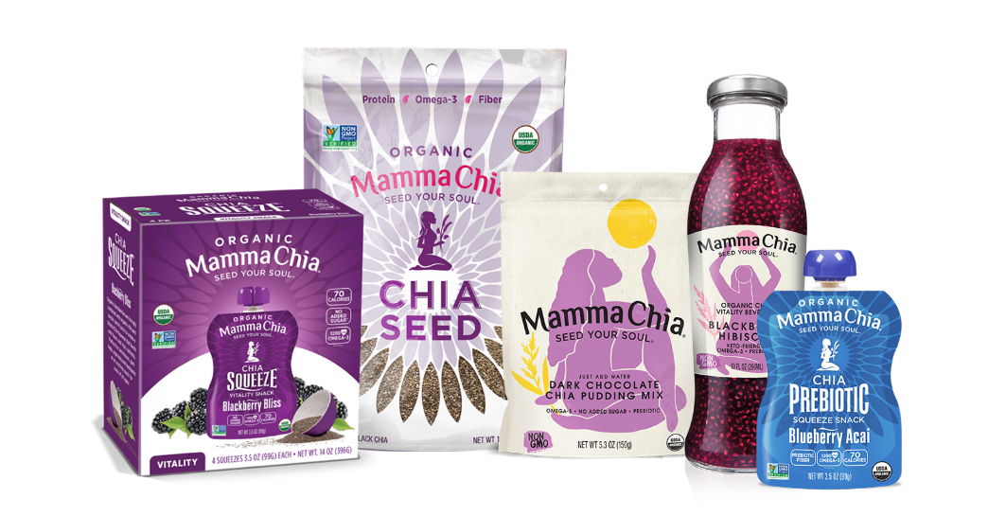


Slide 2


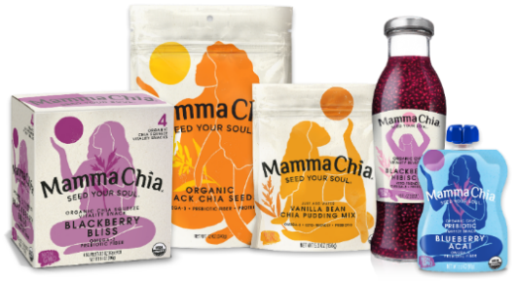
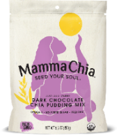
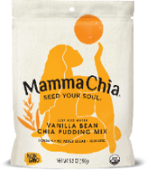
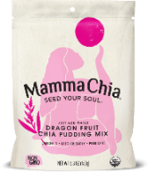

What’s New at Mamma Chia in 2023?
Modern and Fresh new look!
NO UPC
CHANGES
Mamma Chia reveals new branding that is a complete revolution of the beloved, iconic brand in January 2022.
Created by an award-winning branding agency, the new design will modernize the brand, inspire energy and freshness while supporting diversity, inclusivity and body positivity, as well as highlight the brand being a certified women-owned company.
The branding will welcome new Gen-Z consumers who specifically seek out brands that reflect their personal values and are choosing relevant, healthier, sustainable and delicious options.
Unique Mamma Chia Goddess for each product line
Mamma Chia logo lockup for continuity
Important key callouts on front of pack
  Omega-3
  Prebiotic
  Keto-Friendly
New Product Line: Chia Pudding Mixes
Mamma Chia is introducing a first of its kind line of “ready to make” Chia Pudding Mixes that is incredibly flavorful, without added sugar and packed with essential Omega-3.
Chia Pudding Mix is delightfully easy to prepare! Just add water or your favorite non-dairy milk, whisk together, refrigerate and enjoy.
Our Chia Pudding is a low-calorie snack that can be enjoyed any time of day. Just add fresh fruit and it becomes a nourishing breakfast, satisfying lunch or delicious dessert.

Slide 3


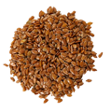


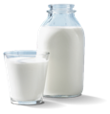





The Magic of Chia®
10x More
Omega-3
Than Salmon
25% More
Fiber
Than Flax Seed
3x More
Antioxidants
Than Blueberries
50% More
Protein
Than Soybeans
5x More
Calcium
Than Milk
15x More
Magnesium
Than Broccoli
*Based on a gram-for-gram comparison with chia³
The Benefits of Omega-3 and Prebiotic Fiber in Chia are Profound!
Boosts Immunity
Heart Health
Cognitive Health
Gut Health

Slide 4
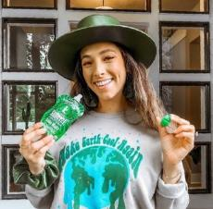




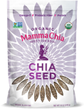





Mamma Chia’s Loyal Consumers
Eco-conscious Gen Z
Trendy Millennials
Healthy Moms
Active Souls
Why? Because our products are delicious, nutrient-dense, convenient, clean label snacking for the whole family
Values Driven ✔
Convenient Format ✔
Clean Label ✔
Nutrient Dense ✔
Omega-3
Prebiotic Fiber
Plant Protein
Keto-Friendly

Slide 5
Mamma Chia Squeeze has double digit growth in both Natural and MULO and significantly outpaces the category
Brand ranked
#6 in category
Brand ranked
#3 in category
NO UPC
CHANGES
SPINS- SS Fruits – MULO/Natural Enhanced - Dollar Sales Diff YAGO 52 Weeks Ending 10/2/2022

Slide 6
Mamma Chia Organic Chia Squeezes are seeing double digit growth in all channels
Mamma Chia Organic Chia Squeezes 4pks MULO⁽¹⁾
Mamma Chia Organic Chia Squeeze Singles Natural⁽²⁾
SPINS- SS Fruits – MULO - 52 Weeks Dollar Sales Ending 10/2/2022
SPINS- SS Fruits – Enhanced Natural - 52 Weeks % change YAO Dollar Sales Ending 10/2/2022

Slide 7


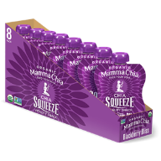
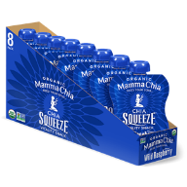
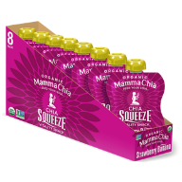
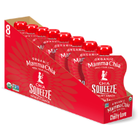
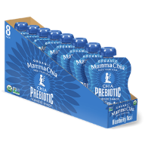
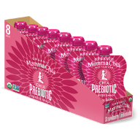
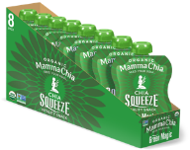
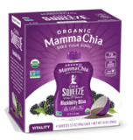
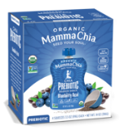
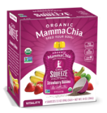
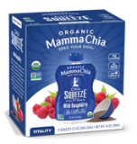
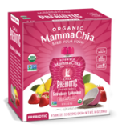
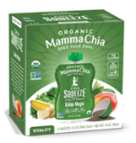
Category: fruit/applesauce
Single Formats:
  SRP: $1.99
  Case pack: 2/8/3.5oz
Multipacks (4pks):
  4pks SRP: $6.99
  Case Pack: 6/4/3.5oz
Shelf stable
Shelf Life from Manufacturing: 360 days
Chia Squeeze Single (8-Pack) Flavors
#1
#2
#3
#4
#5
NEW
NEW
Blackberry Bliss
Wild Raspberry
Strawberry
Banana
Green Magic
Cherry
Love
Prebiotic Blueberry Acai
Prebiotic Strawberry Lemonade
Key Health Attributes
No added Sugar
1200mg Omega-3
70 Calories per pouch
2g Plant-Based Protein
4g Fiber (6g Fiber for Prebiotics)
USDA Certified Organic
Non-GMO
Gluten Free & Kosher
Chia Squeeze 4-Pack Flavors
#1
#2
#3
#4
#5
#6
Blackberry Bliss
Prebiotic Blueberry Acai
Strawberry
Banana
Wild Raspberry
Prebiotic Strawberry Lemonade
Green Magic
7
Guaranteed Shelf Life at Delivery: 90 Days | Shelf Stable

Slide 8



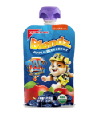




Mamma Chia delivers what consumers are looking for today!
Per Pouch | Mamma Chia | GoGo squeeZ | Organic Slammers | Mott’s | NOKA | Crunch Pak | Santa Cruz Organic
Calories | 70 | 60 | 70 | 40 | 120 | 80 | 45
Omega-3 | 1200 mg | None | None | None | 600mg | None | None
Fiber | 4g & 6g | 3g | 1g | 1g | 5g | 1g | 2g
Sugar | 5g | 13g | 13g | 8g | 14g | 14g | 10g
Protein | 2g | og | 1g | 0g | 5g | <1g | og
Organic | Yes | No | Yes | No | Yes | Yes | Yes
Non-GMO | Yes | No | No | No | Yes | No | Yes
Family Friendly | Yes | Kids Only | Kids Only | Kids Only | Adults Only | Kids Only | Kids Only

Slide 9
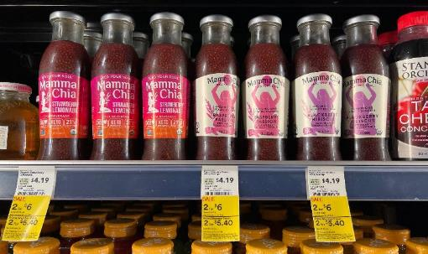
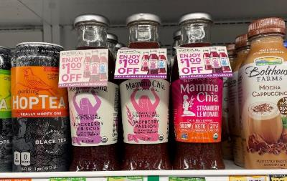
Mamma Chia Prebiotic Chia Beverages are also seeing double digit growth in sales
SPINS – Refrigerated Functional Beverage –Natural Enhanced - 52 Week Period Ending 10/02/2022

Slide 10


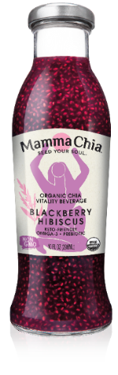
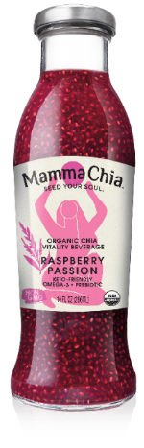
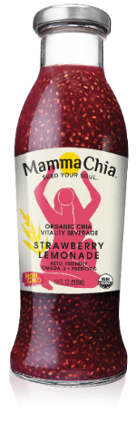
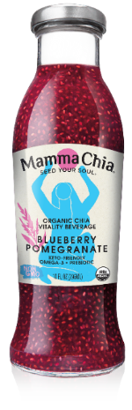
Prebiotic & Keto-Friendly Organic Chia Beverages
Category: refrigerated juice
Suggested Retail Price: $3.49
Case Pack: 12/10oz
Shelf Life from Manufacturing: 300 days
5 Key Attributes:
Keto-Friendly, only 4g sugar and filled with powerful antioxidants
Unique offering in this space for its revitalizing and hydrating properties and containing functional health benefits such as 3400mg Omega-3 , 4g plant-based protein and 6g fiber.
Packaged in glass, our beverages are sustainable, organic and Kosher certified.
3 key callouts: ► Keto-Friendly ► Omega-3 ► Prebiotic
#1
#2
#3
#4

Slide 11



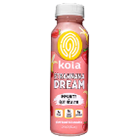


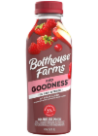

Per Bottle | Mamma Chia | Harmless Harvest | POM Wonderful | Koia Smoothie | Naked | GT’s Synergy | Bolthouse Goodness | Health-Ade
Calories | 120 | 70 | 150 | 120 | 250 | 50 | 240 | 70
Omega-3 | 3400mg | 0g | 0g | 0g | 0g | 0g | 0g | 0g
Fiber | 6g | 0g | 0g | 4g | 0g | 0g | 2g | 0g
Sugar | 4g | 15g | 32g | 9g | 44g | 12g | 49g | 16g
Protein | 3g | 0g | <1g | 5g | 1g | 0g | 1g | 0g
Organic | ✔ | ✔ | ✘ | ✘ | ✘ | ✔ | ✘ | ✘
Keto-Friendly | ✔ | ✘ | ✘ | ✘ | ✘ | ✘ | ✘ | ✘
Mamma Chia Prebiotic Chia Beverage Leads Nutrition
Only Brand with Heart/Brain Healthy Omega-3
Mamma Chia delivers what consumers are looking for today!
  Omega-3
  Less Sugar
  More Fiber
  More Protein

Slide 12
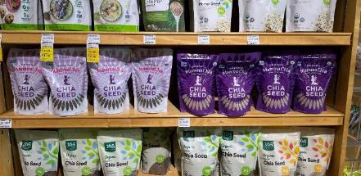
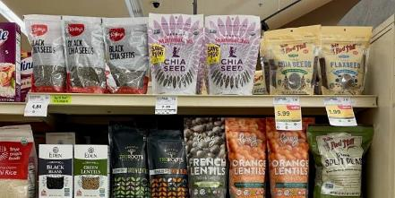
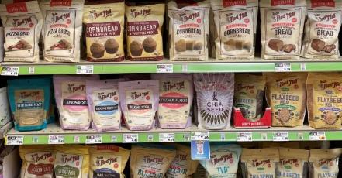
Mamma Chia Organic Chia Seeds are growing in all channels
Chia Seed $ Dollar Change vs YAGO
SPINS 52 – SS Seeds – MULO, US FOODS, Natural Enhanced $ Sales % Diff YAGO, 52 Week Period Ending 10/02/2022

Slide 13

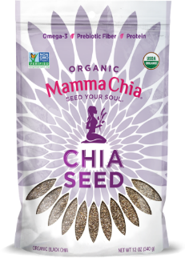
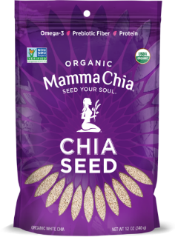
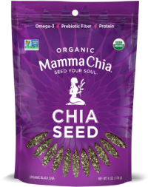
Organic Black & White Chia Seeds 12oz
Category: baking seeds, functional foods
Suggested Retail Price 12oz: $6.99
Suggested Retail price 6oz: $4.99
Case Pack: 4/12oz
Shelf Life from Manufacturing
Key Attributes:
2430mg Omega-3 (ALA) , 3g plant-based protein and 4g prebiotic fiber.
As a chia centric and consumer trusted brand, we know chia best and select high quality organic chia seeds priced competitively (avg 20% less than competitor*).
As of Q4 2022, our chia seeds bags is fully recyclable, making it the first brand in that space to offer such sustainable option.
Keto-Friendly and filled with powerful antioxidants
USDA Certified Organic, Non-GMO
Gluten Free, Vegan & Kosher
(*) $/oz compared to competitors found in 8-12oz bags

Slide 14
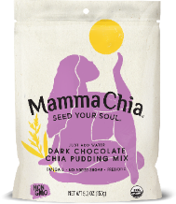

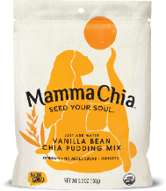
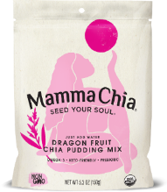


Organic Chia Pudding Mixes
Category: Baking Mixes/Breakfast Cereals
Suggested Retail Price: $7.99
Case Pack: 6/5.3 oz.
Shelf Life from Manufacturing: 300 days
3 key callouts: ► No added sugar ► Omega-3 ► Prebiotic
Mamma Chia is introducing a first of its kind line of “ready to make” Chia Pudding Mixes that is incredibly flavorful, without added sugar and packed with essential Omega-3.
Chia Pudding Mix is delightfully easy to prepare! Just add water or your favorite non-dairy milk, whisk together, refrigerate and enjoy.
Our Chia Pudding is a low-calorie snack that can be enjoyed any time of day. Just add fresh fruit and it becomes a nourishing breakfast, satisfying lunch or delicious desert.
The new bag’s material (launching in Q2 2023) is approved for store drop-off program offered by the How2Recycle® and the Sustainable Packaging Coalition (SPC). The How2Recycle® label clearly and concisely communicates to consumers how and where to recycle the pouch.
This exciting launch will coincide with the new Mamma Chia’s re-branding that inspires inclusivity, female empowerment and body-positivity.
Dark Chocolate
Vanilla Bean
Dragon Fruit

Slide 15
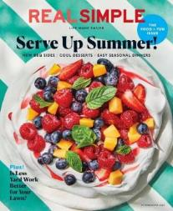
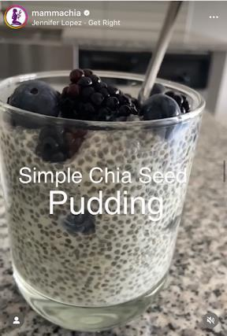
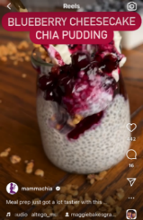

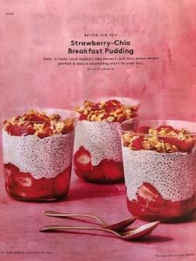
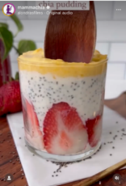


Chia Pudding is buzzing!
Kim Kardashian’s Chia Pudding recipe goes viral.
#chiapudding is our second highest engaged hashtag on Instagram this year
Our most popular reels feature Chia Pudding!
#chiapudding TikTok videos have over 204.7M views
Strawberry Chia Pudding featured in July/August 2022

Slide 16

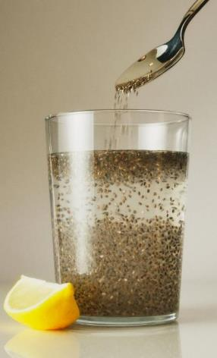

New York Times Names Chia as the #1 Nutrition Tip for 2023!
10 Quick Nutrition Tips for 2023. – New York Times, Dec. 28, 2022
By Dani Blum
As 2022 comes to a close, Well is taking a look at our coverage of food and nutrition over the past year and reflecting on what we have learned about eating (and drinking). Here are some of our favorite nuggets of healthy wisdom.
Chia seeds deserve a place in your diet.
The superpowered seeds found their way into puddings, pretzels, jams and TikTok trends in 2022 as chia — once again — rose to popularity. Experts say chia seeds have earned their hype: They’re packed with fiber and rich in antioxidants. You can add a tablespoon of seeds to a smoothie or soak them in plant milk to make a snack.
Read More: https://www.nytimes.com/2022/12/28/well/food-nutrition-advice.html

Slide 17

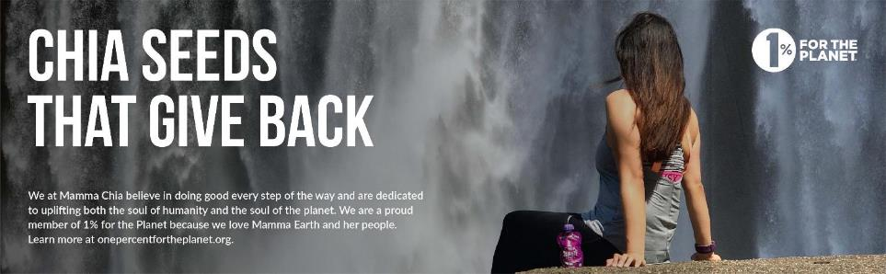
Socially Conscious and Values Driven
We at Mamma Chia believe in doing good every step of the way and are dedicated to uplifting both the soul of humanity and the soul of the planet. We are proud to be a Certified B Corp, a Certified Women-Owned Business and 1% for the Planet member because we love Mamma Earth and her people.

Slide 18
Thank you!

