Slide 1








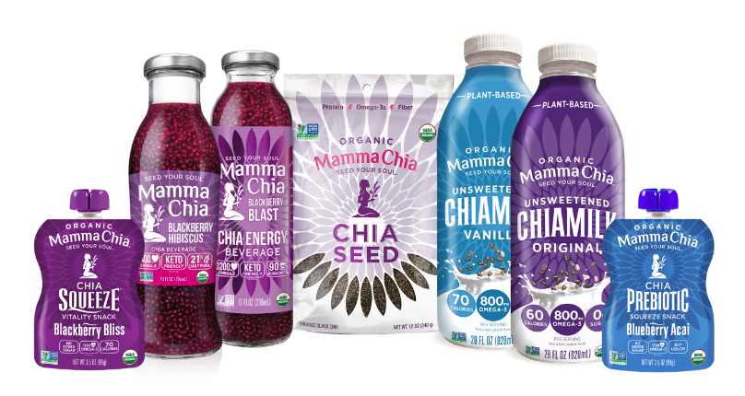
2021 Mamma Chia Brand Review

Slide 2

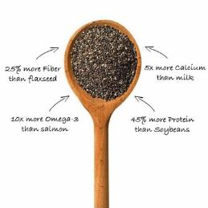
Know your Chia
  Chia seed is the edible seed of Salvia Hispanica, a flowering plant in the mint family famously used by the Tarahumara People for their hydrating and nutrient dense properties.
Sourced mostly from tropical and subtropical climates such as Paraguay, Bolivia, Mexico, Argentina and Nicaragua, Mamma Chia organic chia seeds is a community seed. Thanks to our long-standing relationships with our organic grower partners, we only select the highest quality yields.
For that matter, our growers primarily use rainwater, rather than irrigation systems. Chia seed crops are harvested once a year, typically before winter. During off-season, the farmers plant other organic crops for rotation that promotes healthy and robust soil.
We have a very strict quality protocol and go through each harvest thoroughly, before choosing the highest quality organic chia seeds.

Slide 3

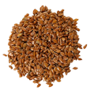


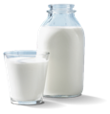

The Magic of Chia®
10x More
Omega-3
Than Salmon
26% More
Fiber
Than Flax Seed
3.5x More
Antioxidants
Than Blueberries
47% More
Protein
Than Soybeans
5x More
Calcium
Than Milk
15x More
Magnesium
Than Broccoli
*Based on a gram-for-gram comparison with chia³
Consumer Insights
Chia is a “Superfood”¹
Consumers come to perceive chia as a ‘Superfood’ that can positively impact them due to its wide range of benefits
Chia Boosts Immunity!
Consumers recognize the myriad of benefits chia provides and are motivated to buy chia products
Chia Fills Gaps in Diets¹
Consumers see chia as an important addition to their regimen to fill specific gaps in their/family’s diets
Chia Purchases to Increase²
39% of chia consumers expect their purchases of beverage and food products containing chia to increase
^{1,2} Attitude & Usage / Focus Groups
³https://ndb.nal.usda.gov/ndb/search/list

Slide 4
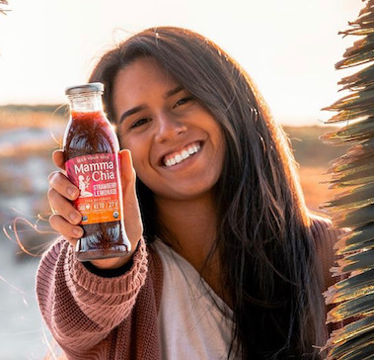


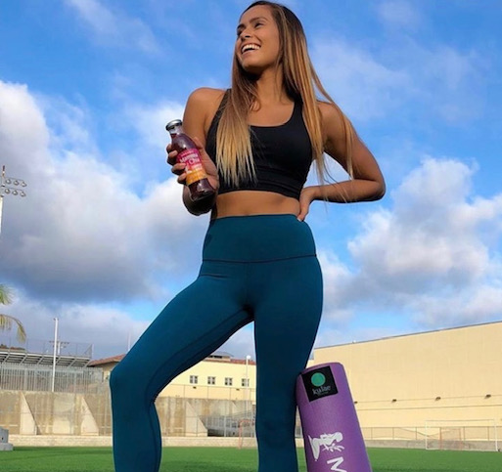


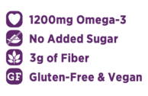






Mamma Chia’s Loyal Consumers
Eco-conscious Gen Z
Trendy Millennials
Healthy Moms
Active Souls
Why? Because our products are delicious, nutrient-dense, convenient, clean label snacking for the whole family
Values Driven ✔
Convenient Format ✔
Clean Label ✔
Nutrient Dense ✔

Slide 5







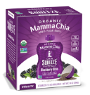
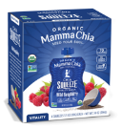
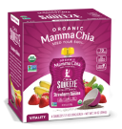
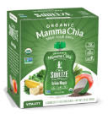
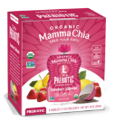
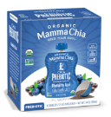
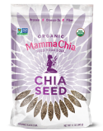
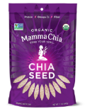









Mamma Chia Product Lines
CHIA VITALITY
BEVERAGES
CHIA ENERGY
BEVERAGES
CHIAMILK
New!
CHIA SQUEEZE 4-PACKS
New
Packaging!
CHIA SEEDS
CHIA SQUEEZE SINGLES

Slide 6








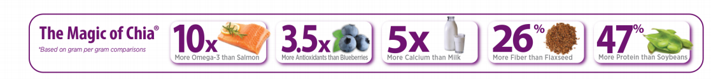
Chia Vitality Beverages NOW Keto-friendly
Refrigerated – juices & functional drinks
SRP $2.99
Case Pack: 12 x 10oz
3400mg Omega-3
4g Plant-Based Protein
6g Fiber
Keto-Friendly – 6g Net Carbs
Powerful Antioxidants
USDA Certified Organic
Non-GMO Verified
Gluten Free, Vegan & Kosher
Blackberry Hibiscus
Blueberry Pomegranate
Raspberry Passion
Strawberry Lemonade

Slide 7



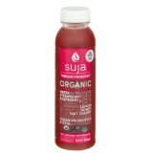


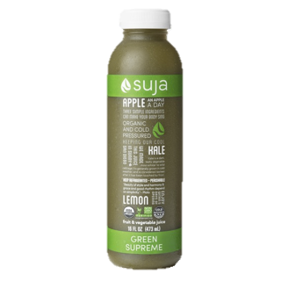
Mamma Chia Organic Chia Beverage Leads in Nutrition
Per Bottle | Mamma Chia | Harmless Harvest | POM Wonderful | ZICO Organic Coconut Water | ZICO Pineapple Mango | WTRMLN WTR | Suja Green Supreme | Suja Vibrant Probiotic | Evolution Fresh Strawberry Lemonade
Calories | 120 | 70 | 150 | 80 | 120 | 60 | 90 | 60 | 210
Omega-3 | 3400mg | 0g | 0g | 0g | 0g | 0g | 0g | 0g | 0g
Fiber | 6g | 0g | 0g | 0g | 0g | 1g | 0g | 1g | 1g
Sugar | 4g | 15g | 32g | 15g | 22g | 12g | 18g | 11g | 46g
Protein | 3g | 0g | <1g | 0g | 0g | 1g | 1g | 1g | 0g
Mamma Chia delivers what consumers are looking for today!
  Omega-3
  Less Sugar
Only Brand with Heart/Brain Healthy Omega-3
  More Fiber
  More Protein

Slide 8
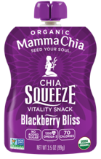
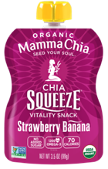
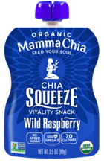
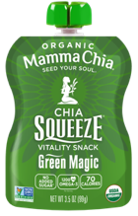
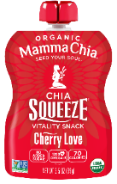
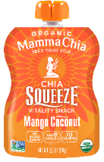
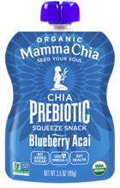
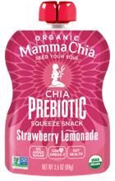

Mamma Chia Organic Chia Squeezes
1200mg Omega-3
70 -80 Calories per pouch
2g Plant-Based Protein
4g Fiber
USDA Certified Organic
Non-GMO Verified
No Added Sugar
Gluten Free & Kosher
Prebiotic Chia Squeezes support gut health for souls of all ages!
  Fiber Rich Prebiotics
  6g Fiber
  1200mg Omega-3
  70 Calories Per Pouch
  2g Plant-Based Protein

Slide 9
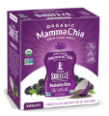
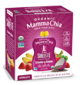
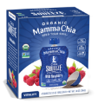
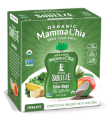
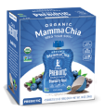
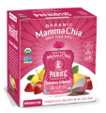






Optimizing Mamma Chia Organic Chia Squeeze Set
Chia Squeeze 4-Pack Flavors
  Infused with delicious fruits and vegetables to create a convenient, fun and tasty snack for active souls of all ages!
  4pks:
    SRP: $5.99
    Pack Size: 6/4/3.5oz
  Singles:
    SRP: $1.79
    Pack Size: 2/8/3.5oz
  Single Squeeze promotes trial and impulse buy.
  4 Pks are great for families!
  Shelf life for all squeezes: 12 months from production.
  Shelf stable
#1
#2
#3
#4
NEW
NEW
Blackberry Bliss
Strawberry
Banana
Wild Raspberry
Green Magic
Prebiotic Blueberry Acai
Prebiotic Strawberry Lemonade
Chia Squeeze Single (8-Pack) Flavors
#1
#2
#3
#4
#5
#6
Blackberry Bliss
Strawberry
Banana
Wild Raspberry
Green Magic
Cherry Love
Coconut Mango
Notes:
After slide #18

Slide 10
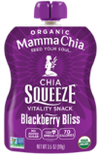


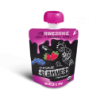
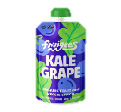
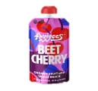
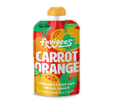
Per Pouch | Mamma Chia Blackberry Bliss | Plum Apple & Broccoli | Plum Purple Carrot & Blueberries | GoGo Squeez Boulder Berry | Shine Organics Calm | Peter Rabbit Strawberry & Banana | Organic Slammers Awesome | Fruigees Kale Grape | Fruigees Beet Cherry | Fruigees Carrot Orange
Calories | 70 | 50 | 60 | 70 | 130 | 70 | 60 | 80 | 70 | 70
Omega-3 | 1200mg | 0g | 0g | 0g | 0g | 0g | 0g | 0g | 0g | 0g
Fiber | 4g | 2g | 3g | 4g | 2g | 2g | 1g | 0g | 0g | 0g
Sugar | 7g | 9g | 7g | 11g | 16g | 15g | 9g | 14g | 13g | 12g
Protein | 2g | 1g | <1g | <1g | 1g | 1g | 1g | 0g | 0g | 0g
Mamma Chia Organic Chia Squeeze Leads in Nutrition
Mamma Chia delivers what consumers are looking for today!
Only Brand with Heart/Brain Healthy Omega-3
  Omega-3
  No Added Sugar
  More Fiber
  More Protein
  For the Whole Family

Slide 11
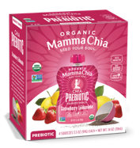


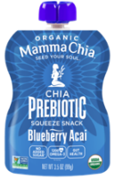
Gut health is now more important than ever!
Prebiotic Chia Squeeze supports gut health for souls of all ages!
  Healthy gut is directly linked to a stronger immune system
  Consumers look at their food to strengthen and protect their health during these unprecedented times
  Mamma Chia Squeeze provides immunity boosting Omega-3 combined with prebiotic fiber in a tasty snack
  Add Prebiotic Chia Squeeze to existing Core Flavor Squeezes to increase functionality to the set
  Key Health Benefits
  Fiber Rich Prebiotics (Organic Jerusalem Artichoke)
  6g Prebiotic Fiber
  1200mg Omega-3
  70 Calories Per Pouch
  2g Plant-Based Protein
  No added sugar

Slide 12
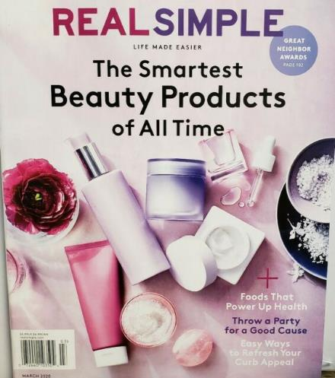
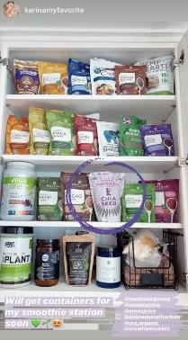
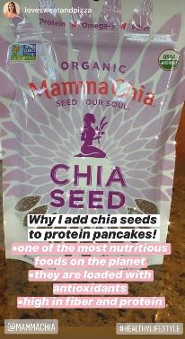
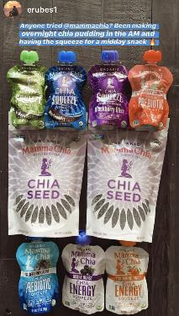
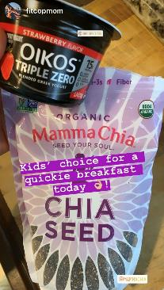
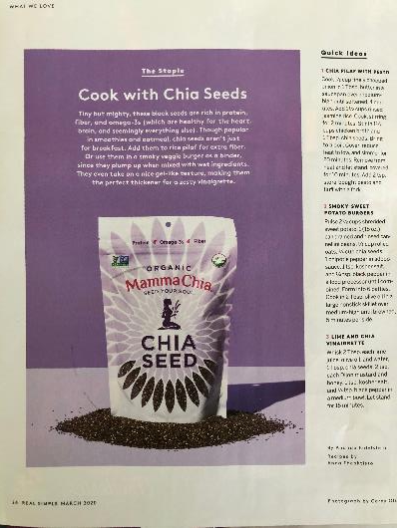
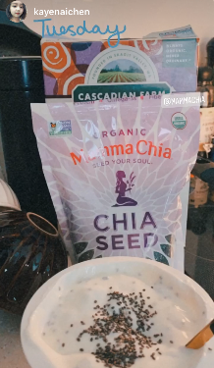
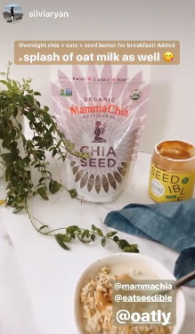
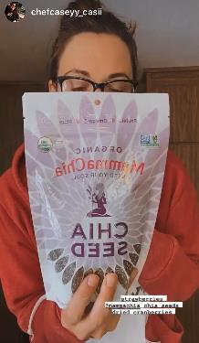
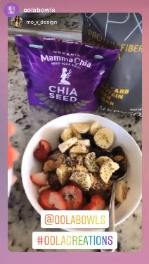
Thanks to its bountiful health benefits and versatility, Chia Seeds is experiencing a growing interests during the pandemic!
Real Simple March 2020

Slide 13
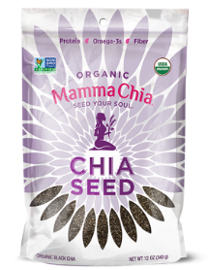










Mamma Chia Organic Chia Seeds: going back to the basics
  Baking or Functional Food Category
  Organic White or Black Chia Seeds (4/12oz): SRP $6.99
  Organic Black Chia Seeds (8/6oz): SRP $3.99
  Because Chia contains 5x Calcium than milk, adding chia seeds into a diet sparse in dairy, is a great way to up naturally Calcium intake!
  With 10 times more Omega-3 than salmon, chia promotes a healthier heart without the fishy taste!
  The high antioxidant content of chia, strengthens the immune system through the prevention of cell damage.
  As a chia centric and consumer trusted brand, we know chia best and select high quality organic chia seeds priced competitively (avg 20% less than competitor).*
Black Chia Seeds 12oz
White Chia Seeds 12oz
Black Chia Seeds 6oz
(*) $/oz compared to competitors found in 8-12oz bags

Slide 14



Jan/Feb 2021 Issue – Plant-Based Milk Roundup
As highlighted in Women’s Health recent issue, Chiamilk contains high amount of calcium in addition to great flavor while remaining organic. Calcium is key for bone strength and for preventing osteoporosis!

Slide 15





NEW Mamma Chia Organic Chiamilk
Plant-based milk (Dairy)
SRP; $4.99
Pack Size: 6/28oz
Changing consumer lifestyles is creating a plant-based milk category that is projected to reach $28B sales by 2021.
Calcium is key to bone health and due to a decrease in dairy conception, consumers are looking for alternative source of calcium such as chia (5 x more than milk) which is easily digested.
Shelf Life: 12 months from production
No Other Plant-Based Milk Measures Up!
Texture: smooth, creamy and delicious
Sustainability: chia requires little to no irrigation and can thrive solely on rainwater in many climates
Flavor: neutral, natural flavor that compliments smoothies, coffee and recipes requiring milk
Nutrition: plant-based, low in sodium, high in Omega-3 and MCT, zero grams of sugar, and an excellent source of calcium
Function: perfect for adding to smoothies, cereal, coffee or enjoying straight from the bottle
Unsweetened Original
Unsweetened Vanilla

Slide 16







Chiamilk provides all the nutrition for a balanced diet
Per Container | Mamma Chia Unsweetened Original Chiamilk | Forager Unsweetened Plain Cashew Milk | Good Karma Unsweetened Flaxmilk | Ripple Unsweetened Original Pea Milk | Oatly Original Oat-Milk | Pacific Foods Unsweetened Coconut Milk | MALK Unsweetened Almondmilk
Serving Size | 8 fl oz (237ml) | 8 fl oz (237ml) | 8 fl oz (240ml) | 8 fl oz (240ml) | 8 fl oz (240ml) | 8 fl oz (240ml) | 8 fl oz (240ml)
Calories | 60 | 50 | 25 | 70 | 120 | 45 | 100
Sugar | 0g | 0g | 0g | 0g | 7g | 0g | <1g
Fat | 5g | 3.5g | 2.5g | 4.5g | 5g | 4g | 9g
Sodium | 10mg | 10mg | 80mg | 110mg | 100mg | 70mg | 75mg
Protein | 2g | 1g | 0g | 8g | 3g | 0g | 4g
Omega-3 | 800mg | N/A | 1200mg | 32mg | N/A | N/A | N/A
Calcium | 390mg | 21mg | 280mg | 465mg | 350mg | 42mg | 38.5mg
Vitamin D | 11mcg | 0mcg | 2.3mcg | 6mcg | 3.6mcg | 2mcg | 0mcg
Organic | ✓ | ✓ | X | X | X | ✓ | ✓
Package Size | 28 fl oz | 48 fl oz | 64 fl oz | 48 fl oz | 64 fl oz | 32 fl oz | 28 fl oz

Slide 17


Socially Conscious and Values Driven
We at Mamma Chia believe in doing good every step of the way and are dedicated to uplifting both the soul of humanity and the soul of the planet. We are proud to be a Certified B Corp, a Certified Women-Owned Business and 1% for the Planet member because we love Mamma Earth and her people.

Slide 18
Thank you!

