Slide 1

Notes:
Founded in 2010, with the first sale occurring in January 2011, Big Spoon Roasters makes handcrafted nut butters and bars from scratch with world-class ingredients sourced directly from local and like-minded producers. We believe that food choices matter, and our mission is to build a healthier relationship with our planet through delicious, nutritious foods made without compromise.

Slide 2
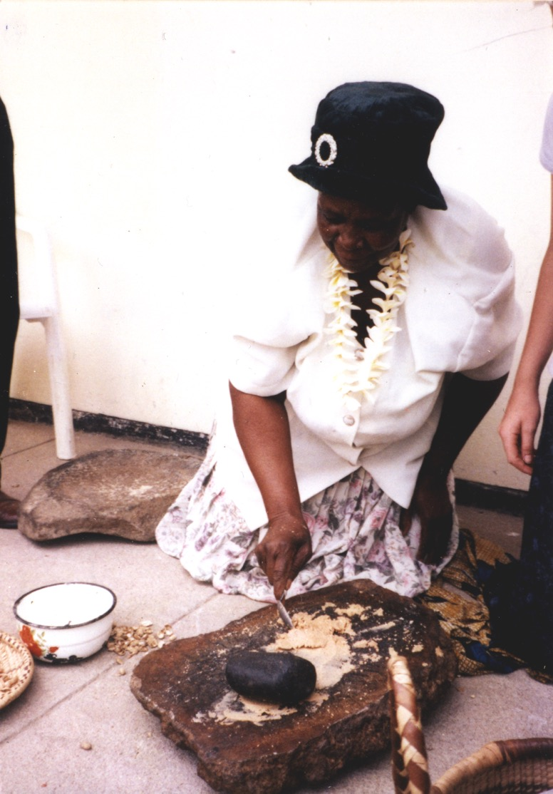
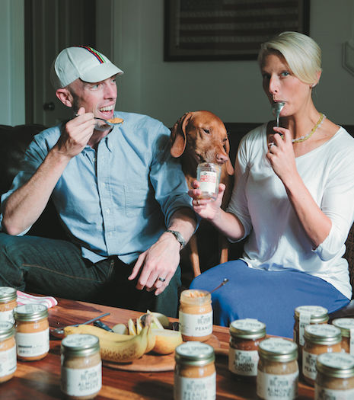
WHO WE ARE
Our Story
Inspiration during Mark's Peace Corps experience
Mark’s career focused on food, nutrition, and culture
Megan’s experience in business, education, and innovation
Opportunity to build a business that is aligned with our passions and good for people and the planet
Core Values
Food matters. We believe that food should be delicious, nutritious, and good for all those involved in producing it.
Engage like-minded partners on both sides of the supply chain.
Strive for environmental, social, and fiscal sustainability.
    Living wage and value-based benefits
    Zero waste and light footprint
    Community impact
Notes:
A couple of years ago, we established some core values that inform every decision we make.

Slide 3
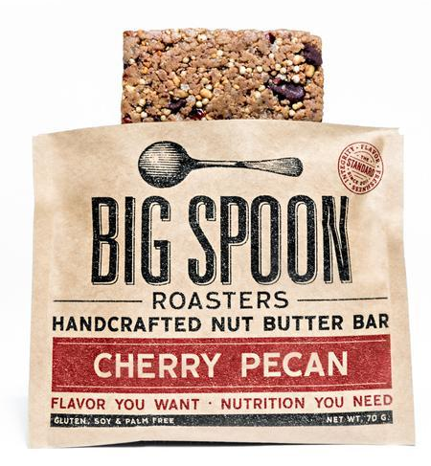
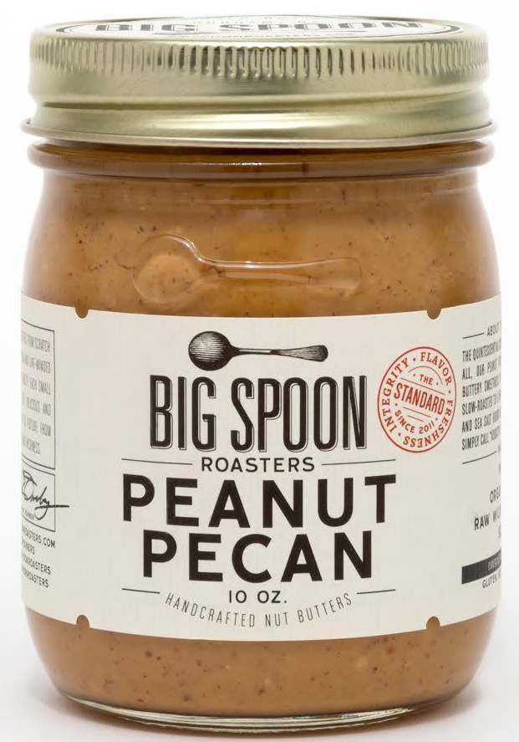
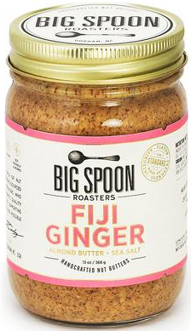
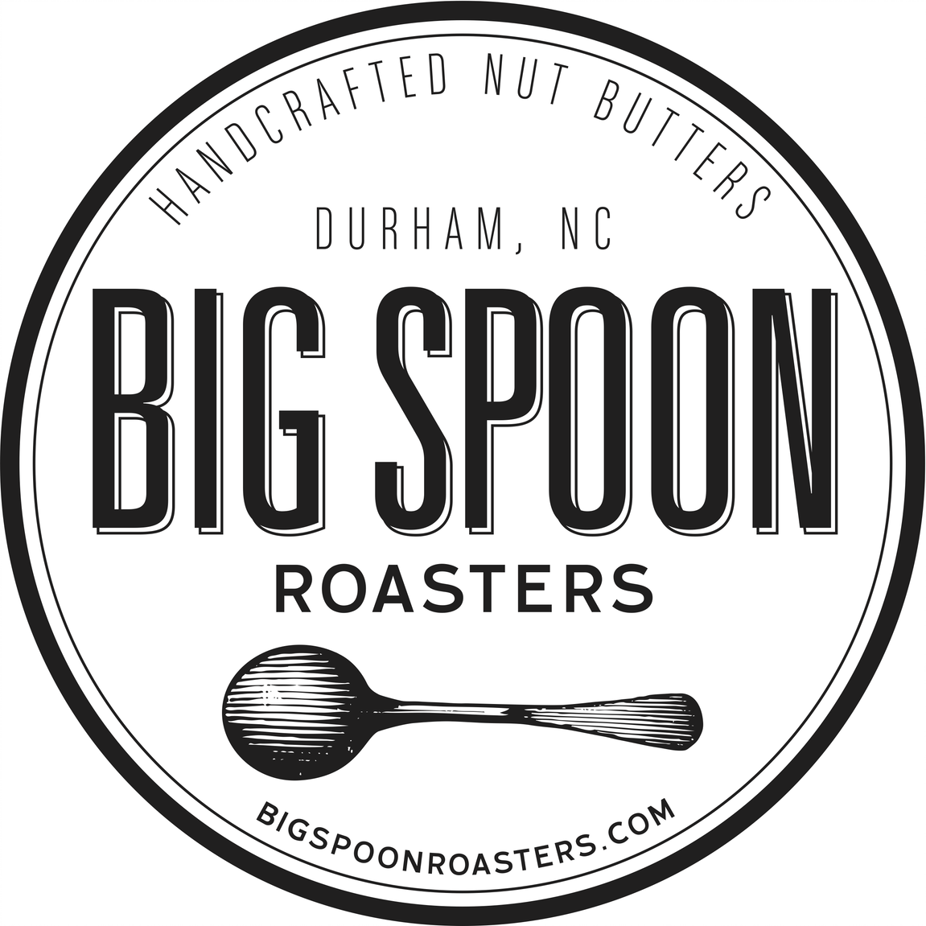
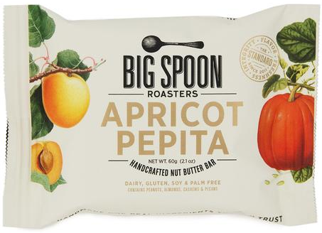
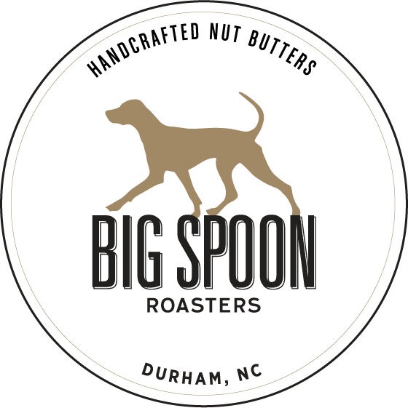
MILESTONES
Introduced 13oz nut butter jars with no price increase
WFM – South planogram featured 5 nut butters
Integrated new bar equipment
Launched botanical bar packaging
2018-19
Whole Foods Market welcomed Big Spoon!
Dedicated production space
Launched wholesale nut butter bars
2013
Nut Butters launch in WFM Florida and Mid-Atlantic Regions
Named 2021 South Region Supplier of the Year!
2021
2010-11
Company founded
Launched at Carrboro (NC) Farmer’s Market
2015-16
Introduce award-winning 10oz nut butter packaging
Almond Butter added to WFM Smoothie Bar
2020
Nut butter bars launched in WF Mid-Atlantic
Creation of Wag Butter Peanut Butter for Dogs
First New Product Collaboration with WFM – Crunchy Peanut Sorghum

Slide 4






Notes:
Within the first year of business, we were clearly hitting on something, because Big Spoon Roasters was featured in many national media publications. Oprah featured our Chai Spice Nut Butter, which I had created as a favor for our wedding in May 2013, and it quickly became our bestseller and still is to this day.

Slide 5

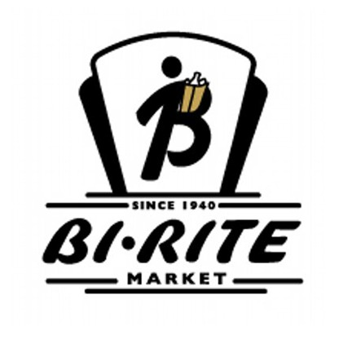


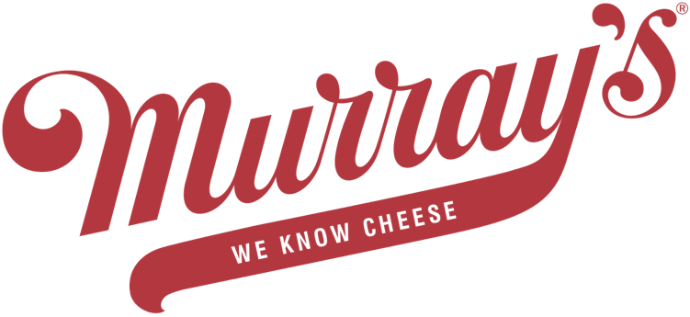

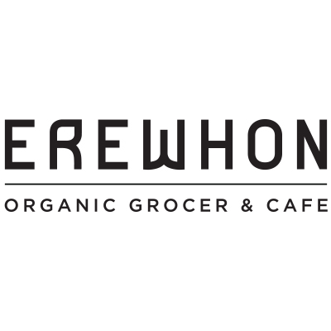

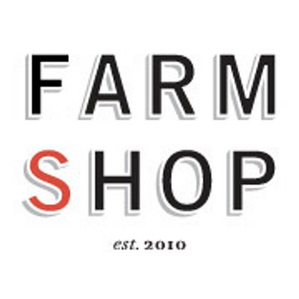
Notes:
A few examples of key wholesale customers in the U.S. We have more than 700 wholesale customers in the U.S. and some direct customers in Japan, Canada, and Europe.

Slide 6


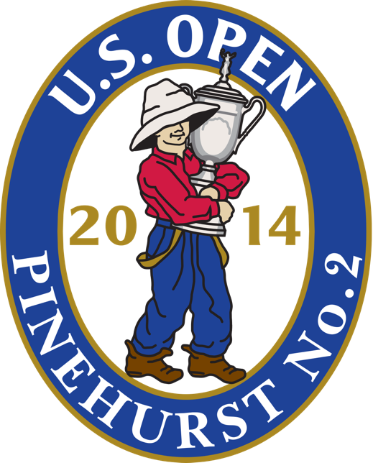



Notes:
Examples of special events and celebrity gifting. Saturday Night Live has featured our bars backstage during three seasons. The Late Show with Stephen Colbert features our Almond Butter in the guest prep rooms. The U.S. Open Gold Championship featured our Peanut Pecan Butter in hospitality tents.

Slide 7
2018-2020 REVENUE GROWTH
Notes:
2018 – Focus on shoring up operations and designing new packaging for both nut butters and bars.
2019 & 2020 – Increased focus on sales and marketing support for natural grocers.

Slide 8
INNOVATION
Named one of the 50 Most Influential Businesses by the WSJ
First to use “Nut Butter” & “Nut Butter Bars”
41 New Recipes over 10 years
Featured Jams: ABJ & PBJ
Coffee Roaster Collaborations
Membership Clubs

Slide 9
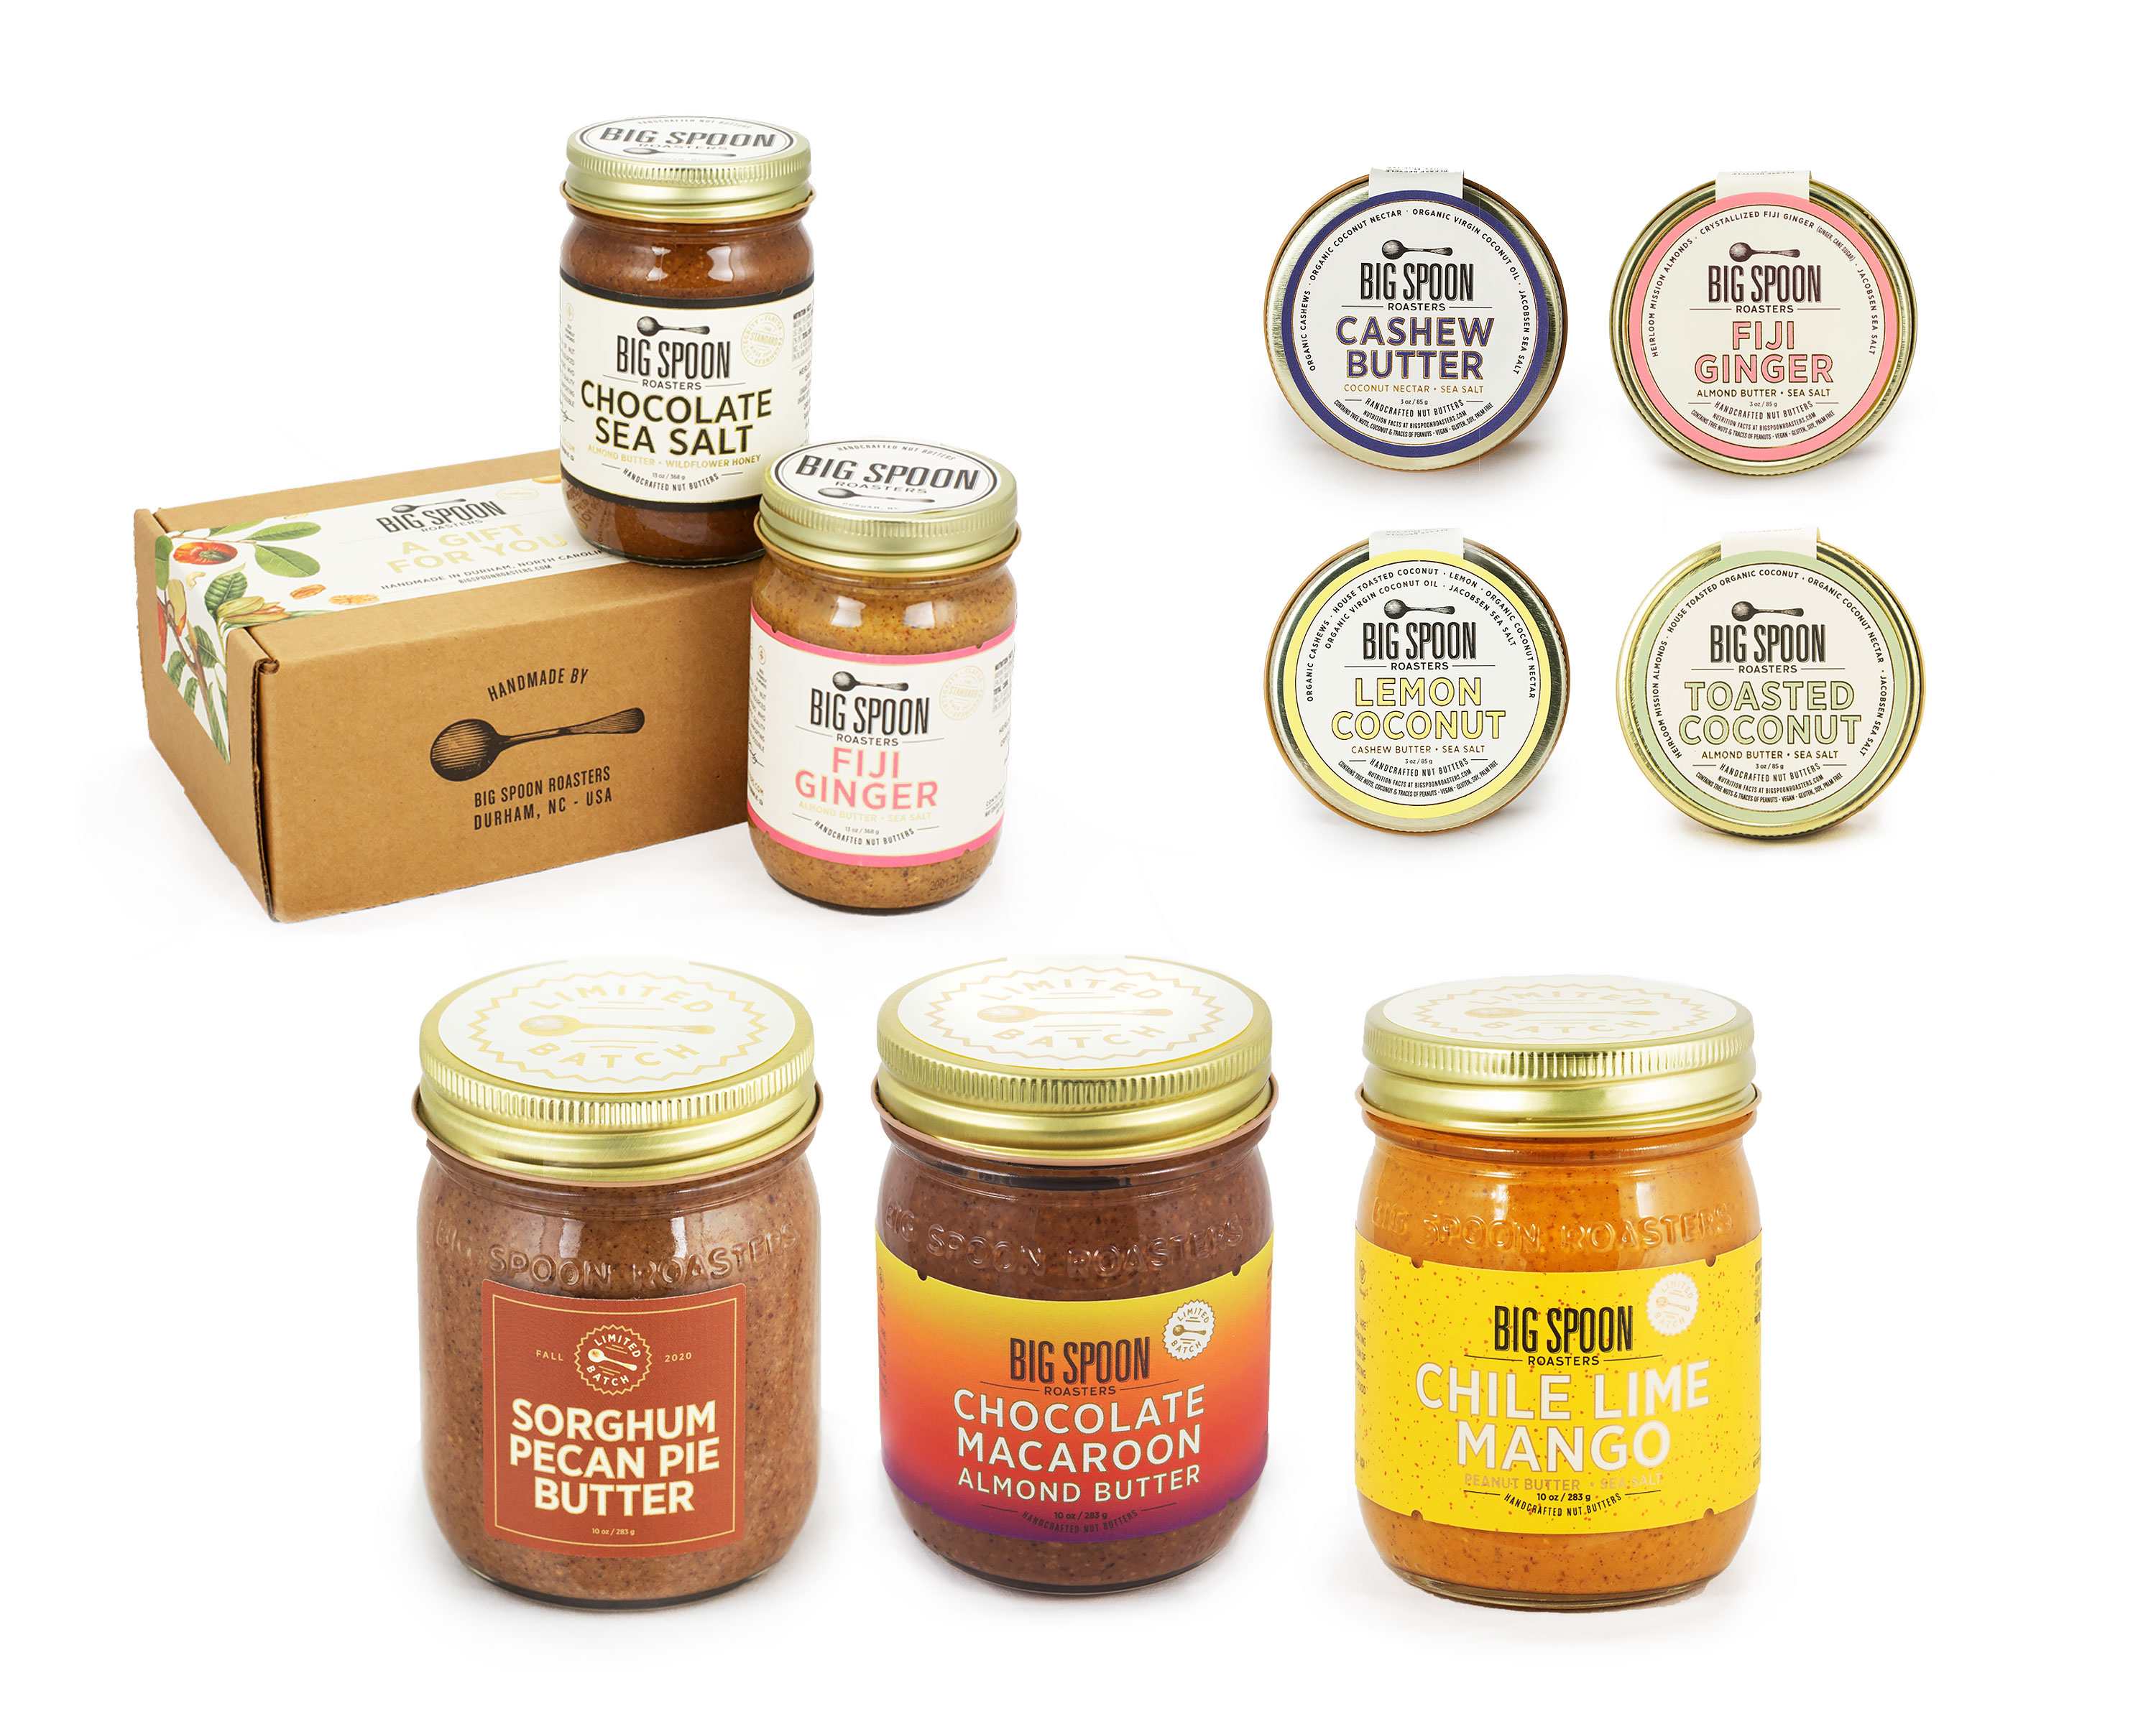
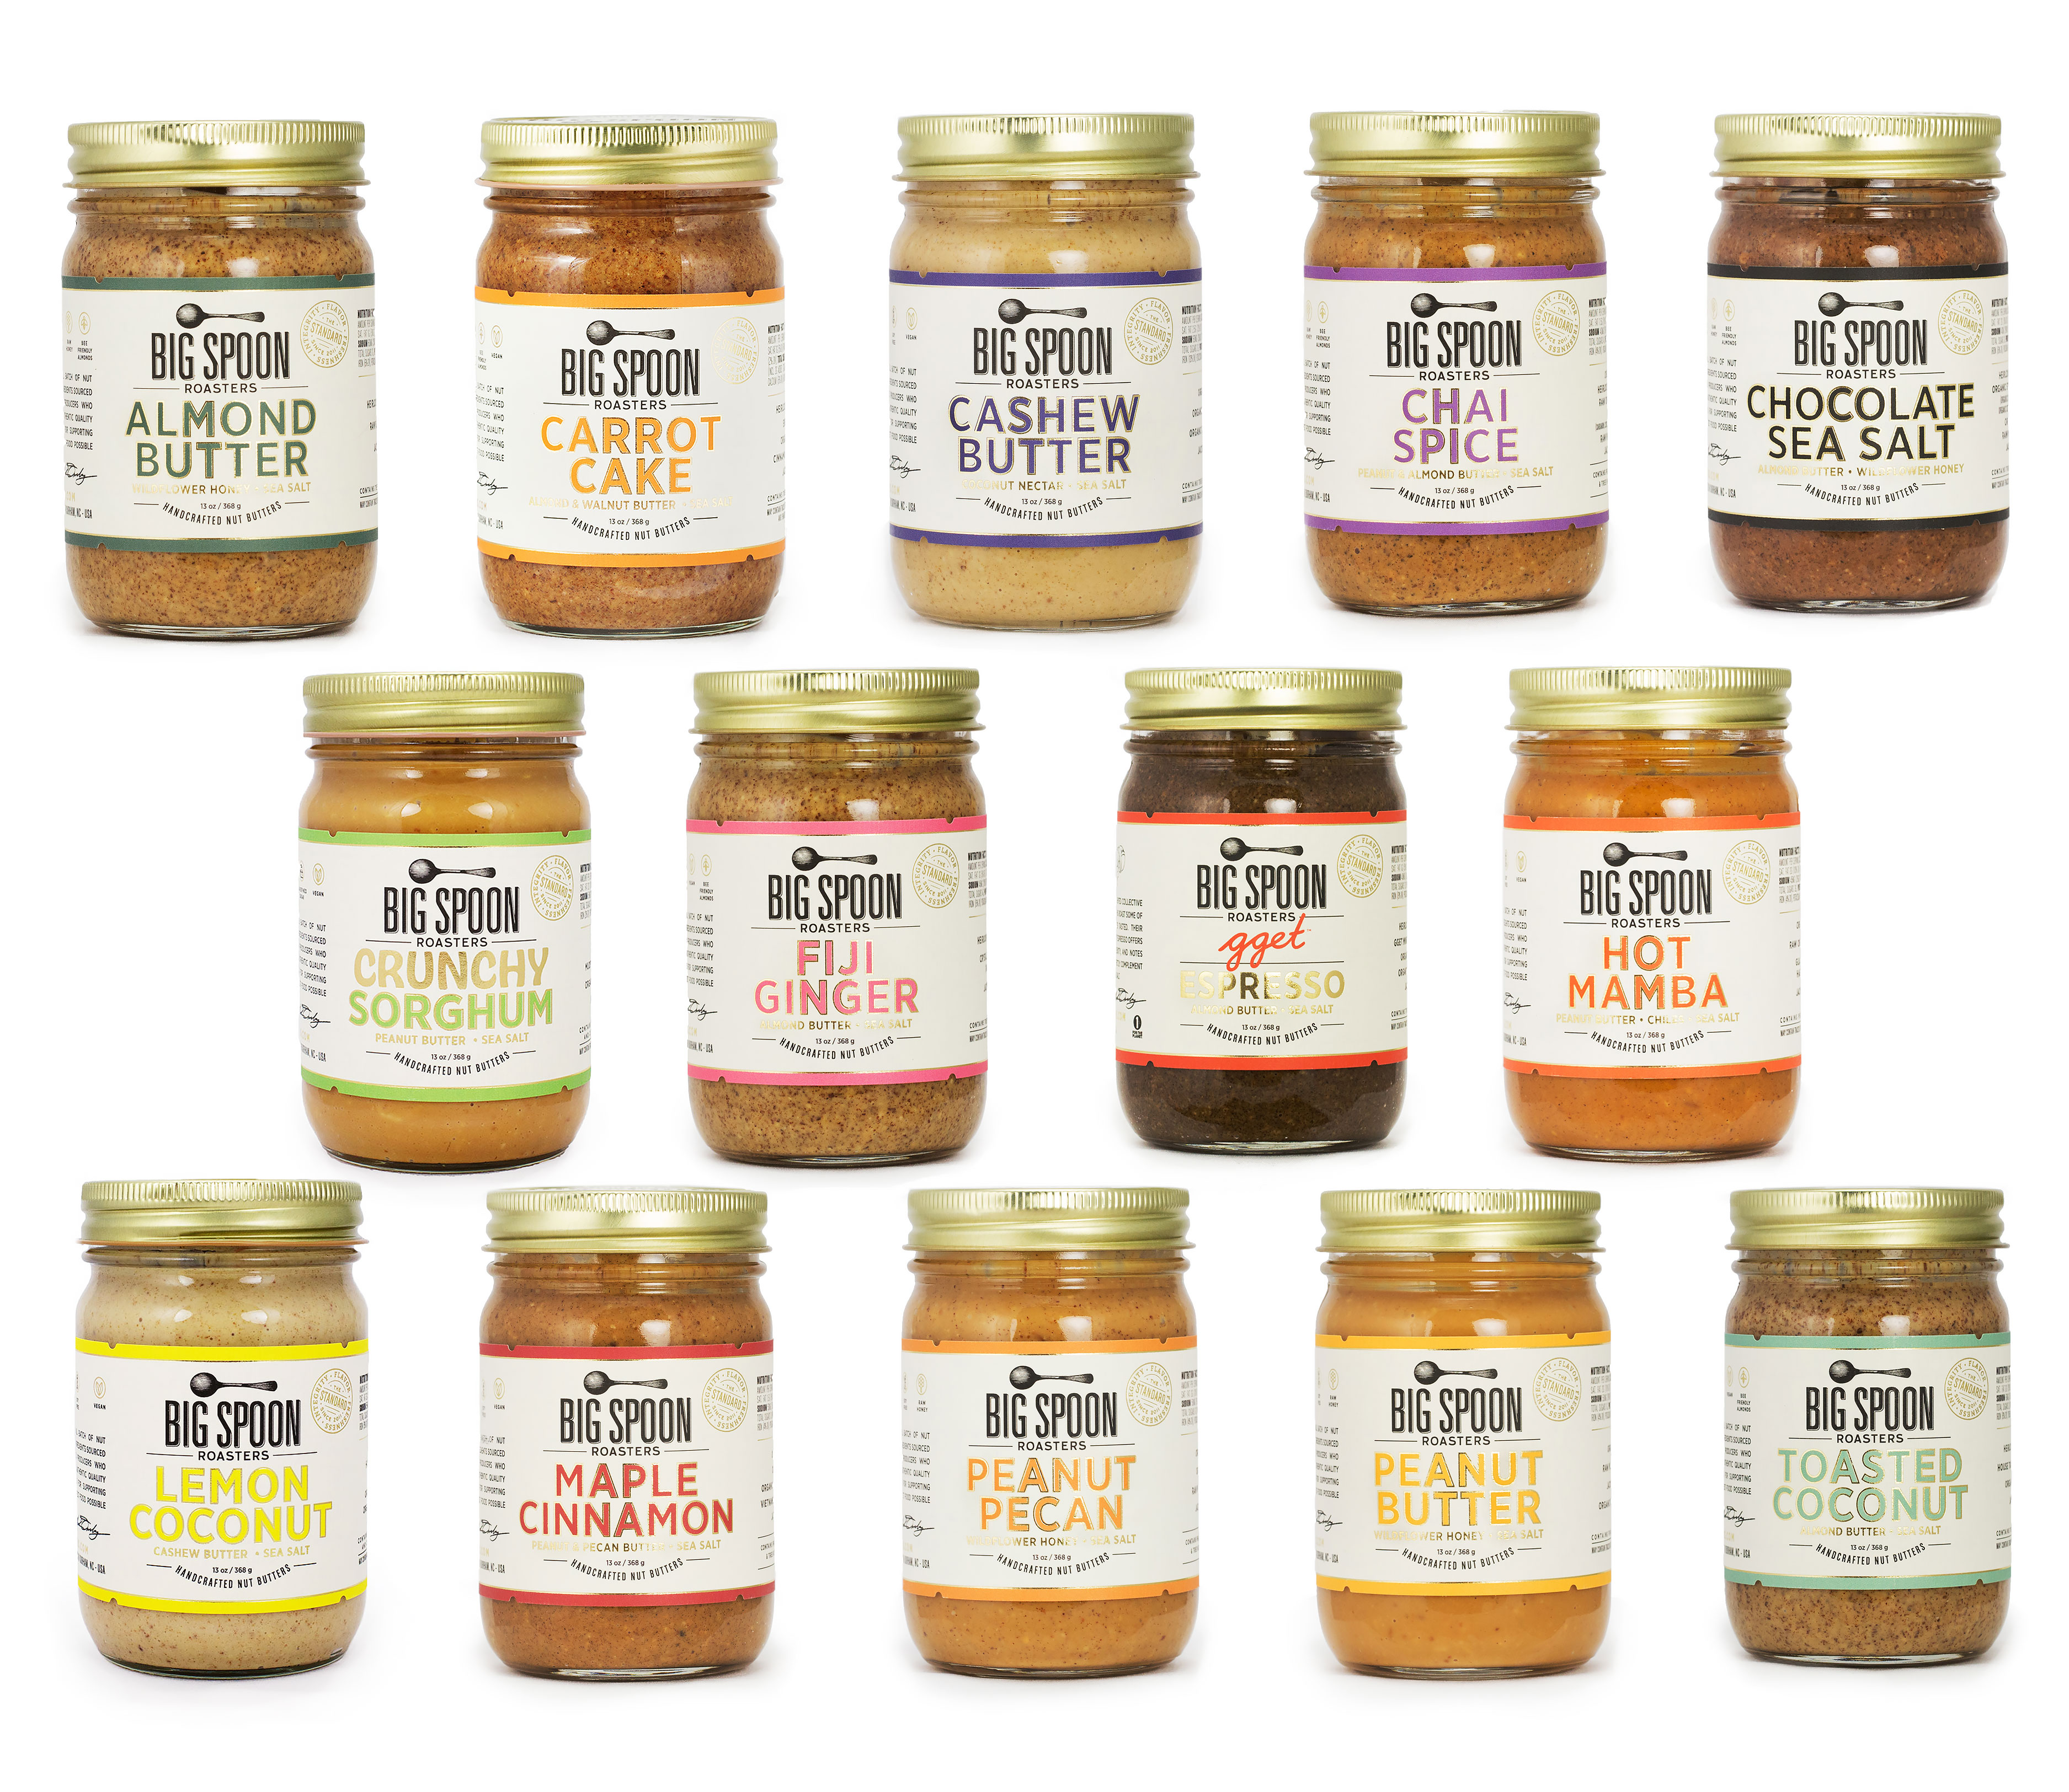
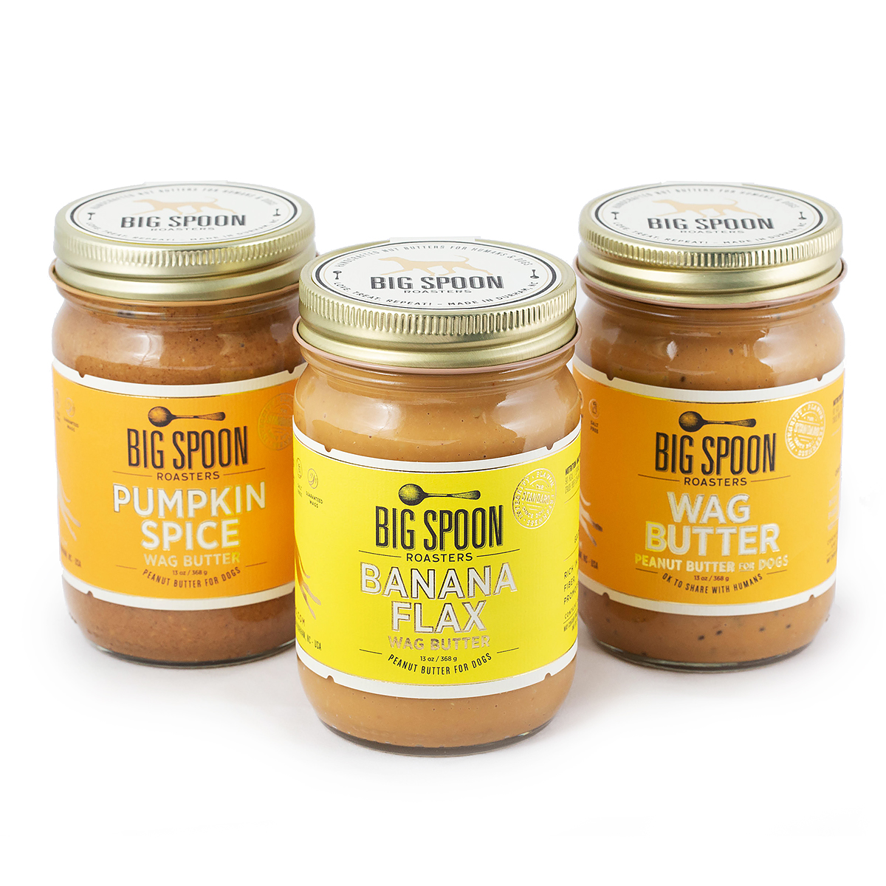
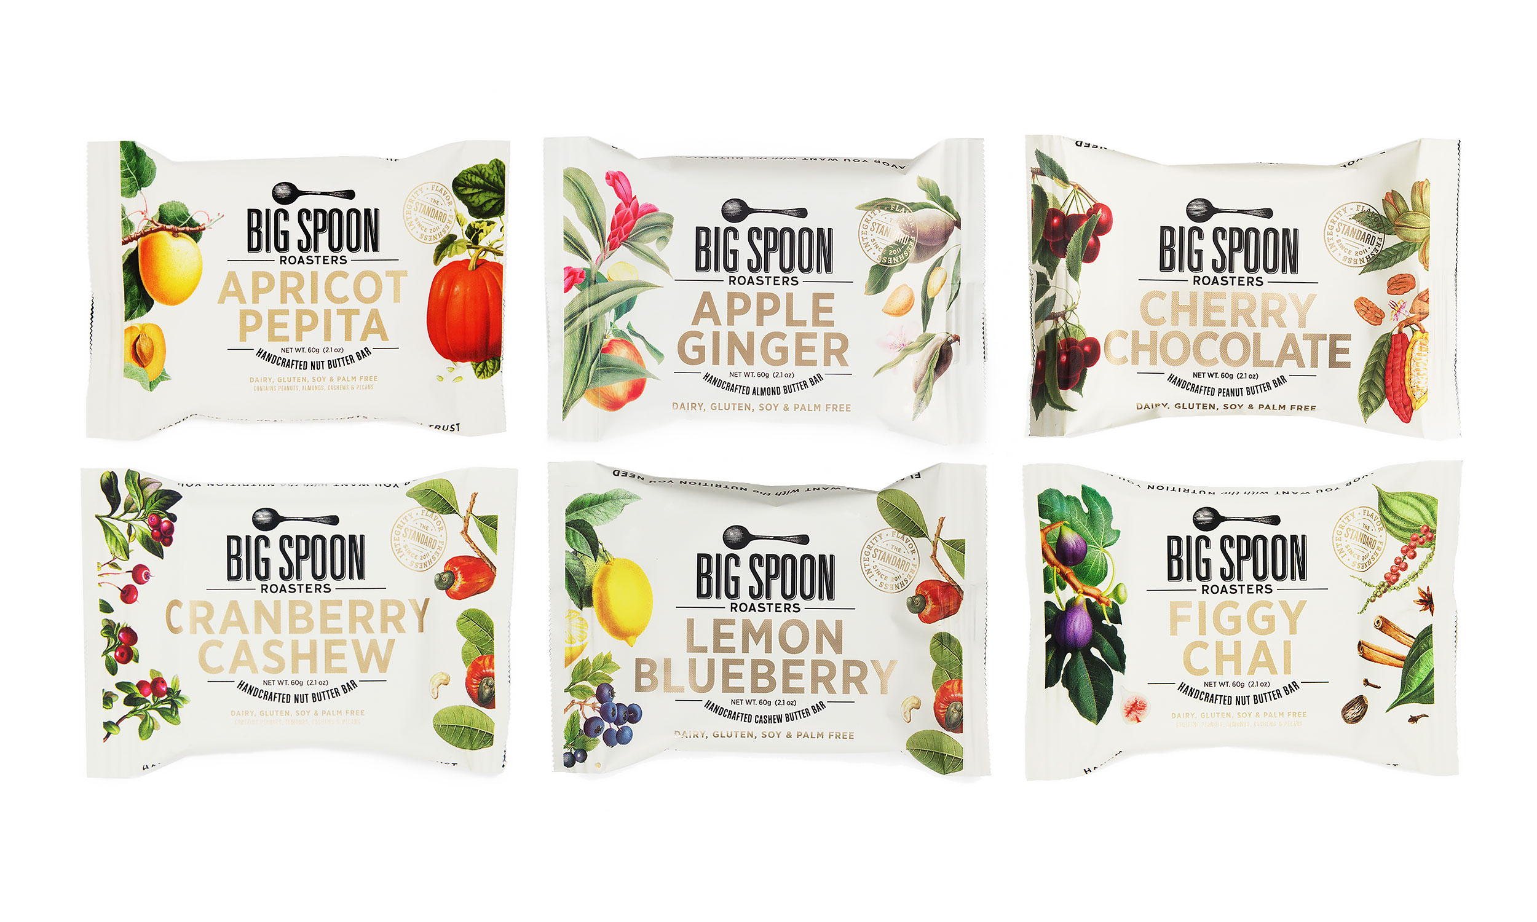
2021
Big Spoon Roasters
Product Line
14 Nut Butters
6 Nut Butter Bars
3 Wag Butters for Dogs
Quarterly Limited Batch
R&D Member Batches
Gift Sets
      3oz
      13oz
      Bar Variety Packs
      Bundles with like-minded companies

Slide 10

{ Thank you }

